Slide 1
AZ-104T00A Module 06: Network Traffic Management

Slide 2
Azure Load Balancer Overview
Azure Load Balancer
Public Load Balancer
Internal Load Balancer
Load Balancer SKUs
Backend Pools
Load Balancer Rules
Session Persistence
Health Probes
Notes:
Lesson overview

Slide 3
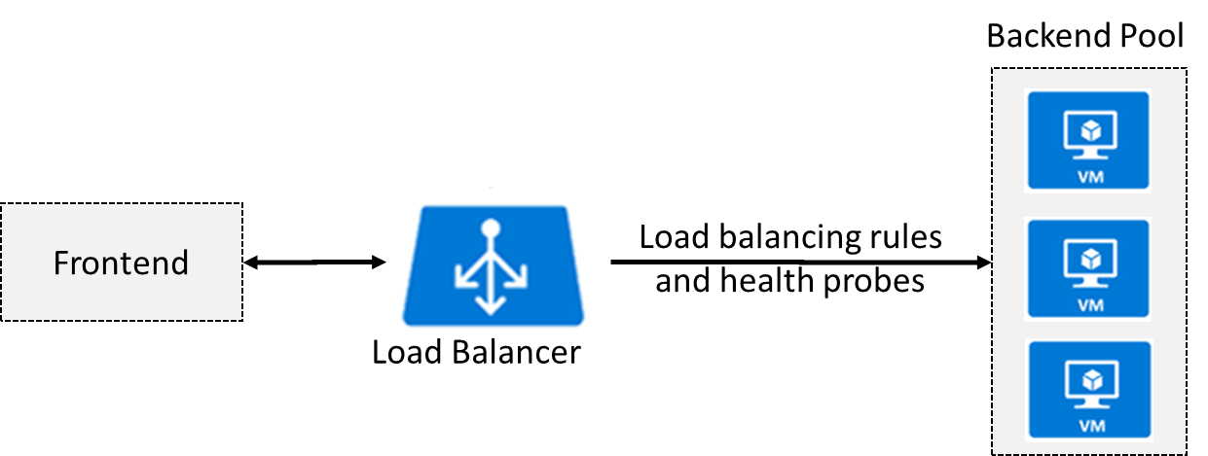
Azure Load Balancer
Distributes inbound traffic to backend resources using load-balancing rules and health probes
Can be used for both inbound/outbound scenarios
Extend Active Directory to the cloud
Two types: Public and Internal
Notes:
✔ Keep this diagram in mind since it covers the four components that must be configured for your load balancer: Frontend IP configuration, Backend pools, Health probes, and Load balancing rules.
Load Balancer documentation - https://docs.microsoft.com/en-us/azure/load-balancer/

Slide 4
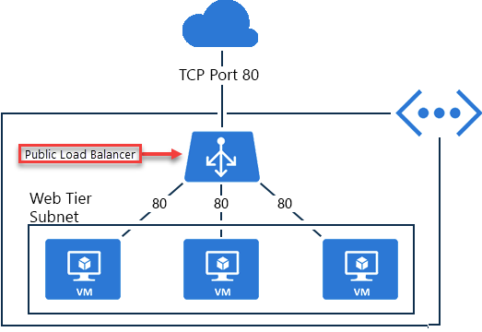
Public Load Balancer
Maps public IP addresses and port number of incoming traffic to the VM’s private IP address and port number, and vice versa.
Apply load balancing rules to distribute traffic across VMs or services.

Slide 5
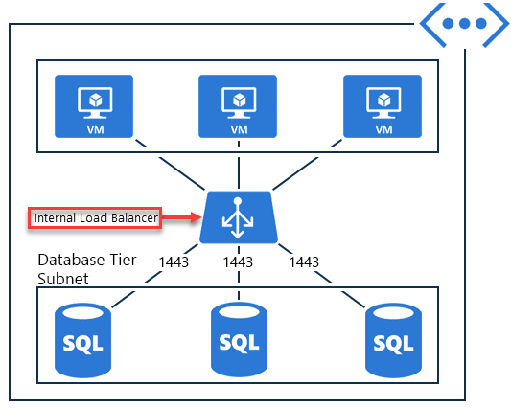
Internal Load Balancer
Directs traffic only to resources inside a virtual network or that use a VPN to access Azure infrastructure.
Frontend IP addresses and virtual networks are never directly exposed to an internet endpoint.
Enables load balancing within a virtual network, for cross-premises virtual networks, for multi-tier applications, and for line-of-business applications.
Notes:
✔ Can you see how a public load balancer could be placed in front of the internal load balancer to create a multi-tier application.

Slide 6
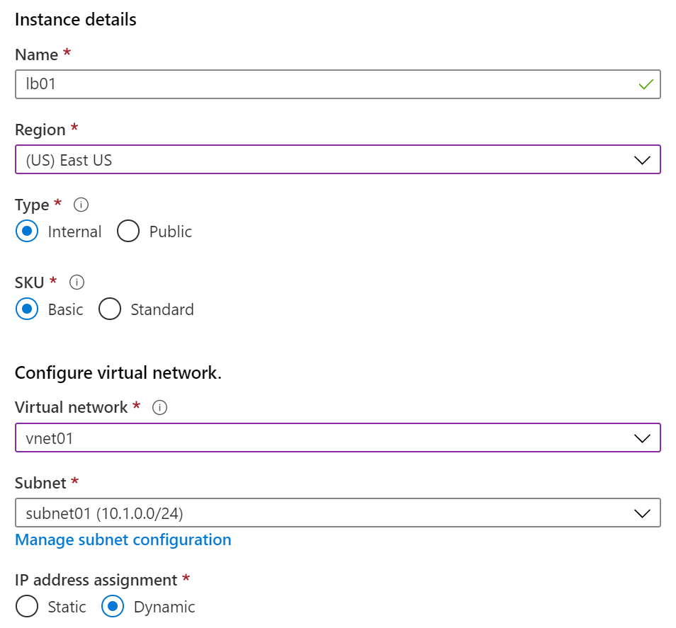
Load Balancer SKUs
Load balancer supports both Basic and Standard (newer) SKUs
SKUs are not mutable
Load Balancer rule cannot span two virtual networks
No charge for the Basic Load Balancer SKU
Load Balancer frontends are not accessible across global virtual network peering

Slide 7
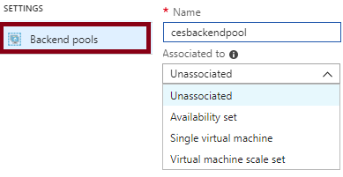
Backend Pools
SKU | Backend pool endpoints
Basic SKU | VMs in a single availability set or VM scale set.
Standard SKU | Any VM in a single virtual network, including a blend of VMs, availability sets, and VM scale sets.
To distribute traffic, a back-end address pool contains the IP addresses of the virtual NICs that are connected to the load balancer
Notes:
✔ In the Standard SKU you can have up to 1000 instances in the backend pool. In the Basic SKU you can have up to 100 instances.

Slide 8
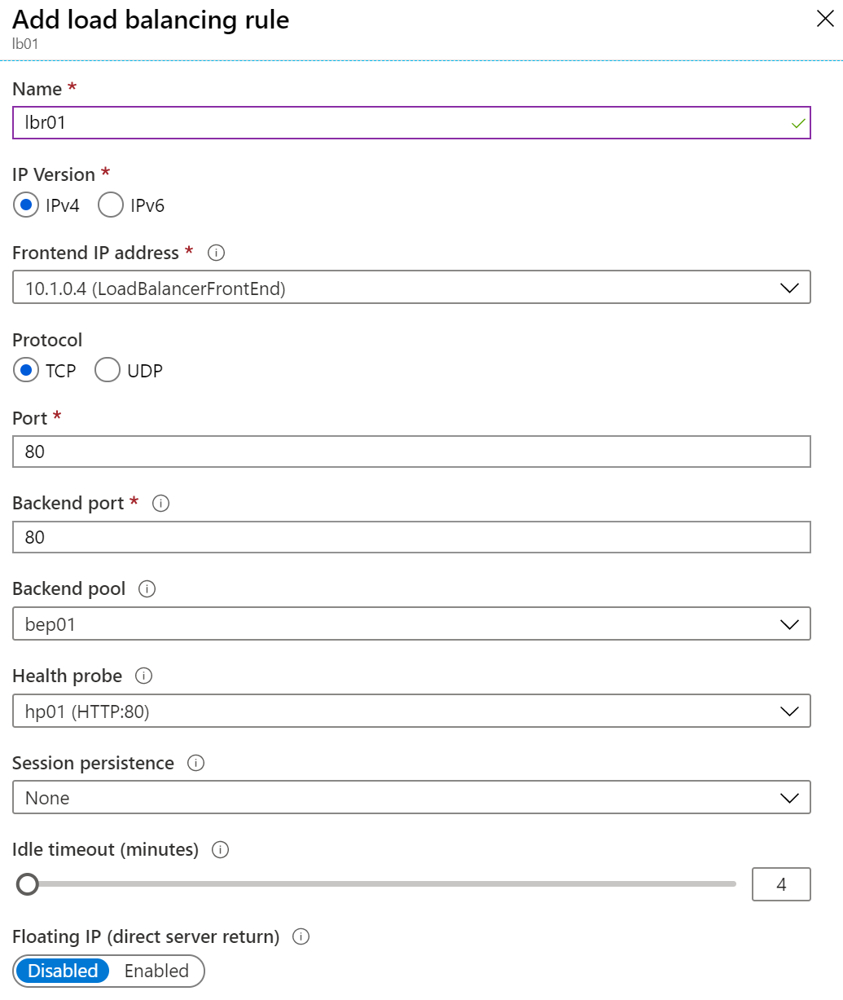
Load Balancer Rules
Maps a frontend IP and port combination to a set of backend IP addresses and port combination
Rules can be used in combination with NAT rules
A NAT rule is explicitly attached to a VM (or network interface) to complete the path to the target
Notes:
✔ Can you see the difference between load balancing rules and NAT rules? Remember, this approach should only be used when you need connectivity from the Internet. Most normal communications would occur from on-premises to Azure connections such as site-to-site VPN and ExpressRoute.

Slide 9
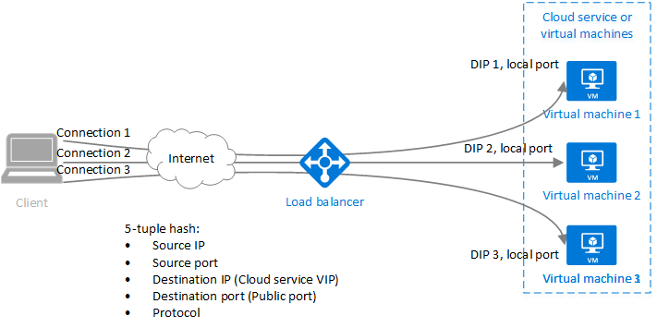
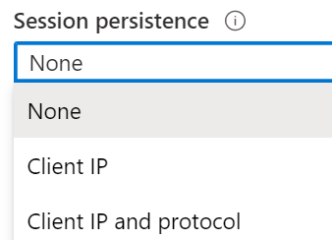
Session Persistence
Session persistence specifies how client traffic is handled
Client IP (default) requests can be handled by any virtual machine
Client IP and protocol specifies that successive requests from the same address and protocol will be handled by the same virtual machine
Notes:
✔Keeping session persistence information is very important in applications that use a shopping cart. Can you think of any other applications?

Slide 10
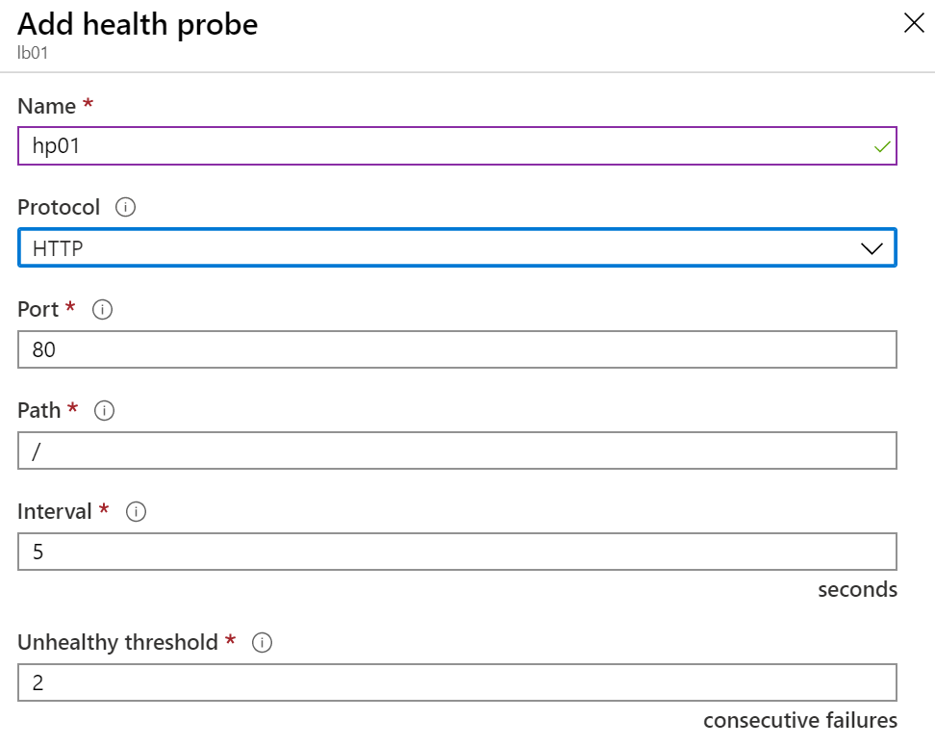
Health Probes
Allows the load balancer to monitor the status of an app
Dynamically adds or removes VMs from the load balancer rotation based on their response to health checks
HTTP custom probe (preferred) pings every 15 seconds
TCP custom probe tries to establish a successful TCP session
Notes:
✔ There is also a guest agent probe. This probe uses the guest agent inside the VM. It is not recommended when HTTP or TCP custom probe configurations are possible. Relate back to the original diagram to ensure all the components are covered.

Slide 11
Lesson 03: Azure Application Gateway

Slide 12
Application Gateway Overview
Application Gateway
Application Gateway Routing
Application Gateway Configuration

Slide 13
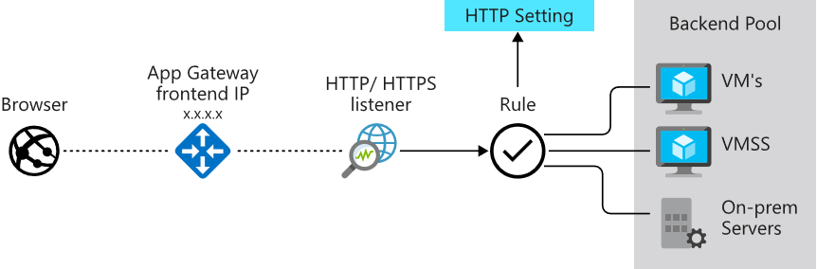
Application Gateway
Manages web app requests
Routes traffic to a pool of web servers based on the URL of a request
The web servers can be Azure virtual machines, Azure virtual machine scale sets, Azure App Service, and even on-premises servers

Slide 14
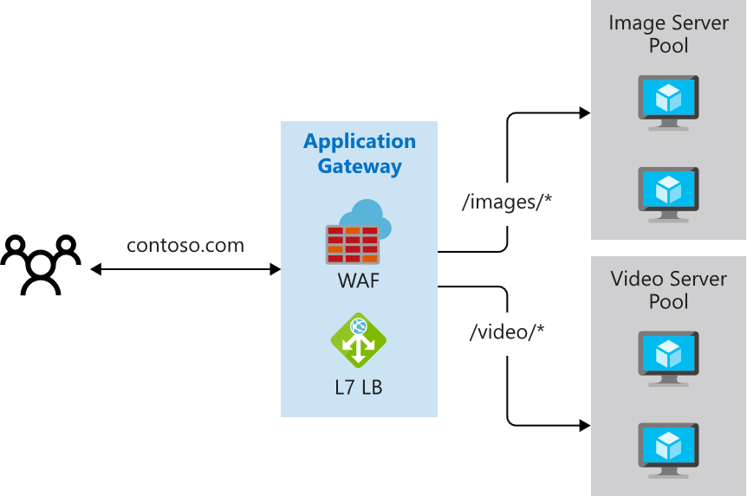
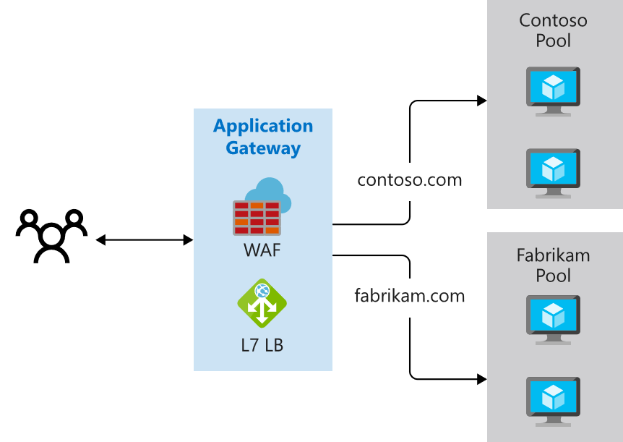
Application Gateway Routing
Path-based routing
Multiple-site routing

Slide 15
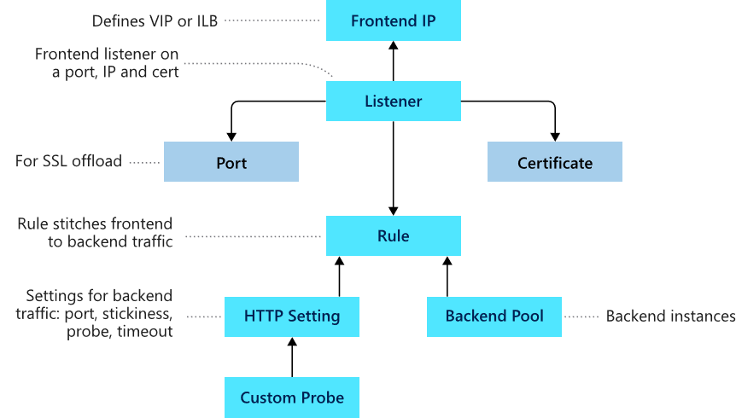
Application Gateway Components
Frontend IP
Listeners
Routing rules
Backend pools
Web application firewall (optional)
Health probes

Slide 16
Lesson 04: Azure Traffic Manager

Slide 17
Traffic Manager Overview
Azure Traffic Manager
Traffic Manager Routing Methods
Distributing Network Traffic

Slide 18
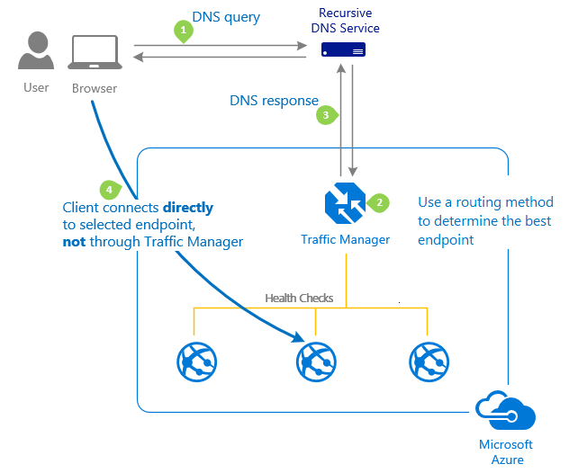
Azure Traffic Manager
Allows you to control distribution of user traffic to service endpoints around the world
Uses DNS to direct end-user requests to the most appropriate endpoint
Selects an endpoint based on the configuring traffic-routing method
Provides endpoint health checks and automatic endpoint failover
Notes:
Traffic Manager - https://azure.microsoft.com/en-us/services/traffic-manager/

Slide 19
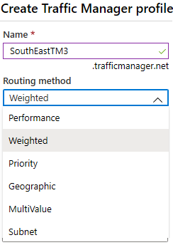
Traffic Manager Routing Methods
Priority routing routes traffic to a prioritized list of service endpoints
Performance routing Routes traffic to the location closest to the user
Geographic routing routes traffic to a set of geographic locations
Weighted routing distributes traffic evenly using a pre-defined weighting
MultiValue routing distributes traffic only to IPv4 and IPv6 endpoints
Subnet routing distributes traffic based on source IP ranges

Slide 20
Distributing Network Traffic
Service | Azure Load Balancer | Application Gateway | Traffic Manager
Technology | Transport Layer (level 4) | Application Layer (level 7) | DNS Resolver
Protocols | Any TCP or UDP Protocol | HTTP, HTTPS, HTTP/2, & WebSockets | DNS Resolution
Backends or Endpoints | Azure Virtual Machines, and Azure Virtual Machine Scale Sets | Azure Virtual Machines, Azure Virtual Machine Scale Sets, Azure App Services, IP Addresses, and Hostnames | Azure Cloud Services, Azure App Services, Azure App Service Slots, and Public IP Addresses
Network Connectivity | External and Internal | External and Internal | External
Azure has several options to distribute network traffic
They can each be used in isolation or in combination

Slide 21
Lesson 05: Module 06 Lab and Review

Slide 22
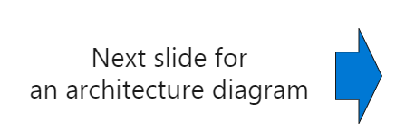
Lab 06 – Implement Traffic Management
Scenario
You are tasked with implementing a hub spoke topology for network traffic. The topology should include an Azure Load Balancer and Azure Application Gateway.
Objectives Task 1: Provision the lab environment Task 2: Configure the hub and spoke network topology Task 3: Test transitivity of virtual network peering Task 4: Configure routing in the hub and spoke topology Task 5: Implement Azure Load Balancer Task 6: Implement Azure Application Gateway

Slide 23
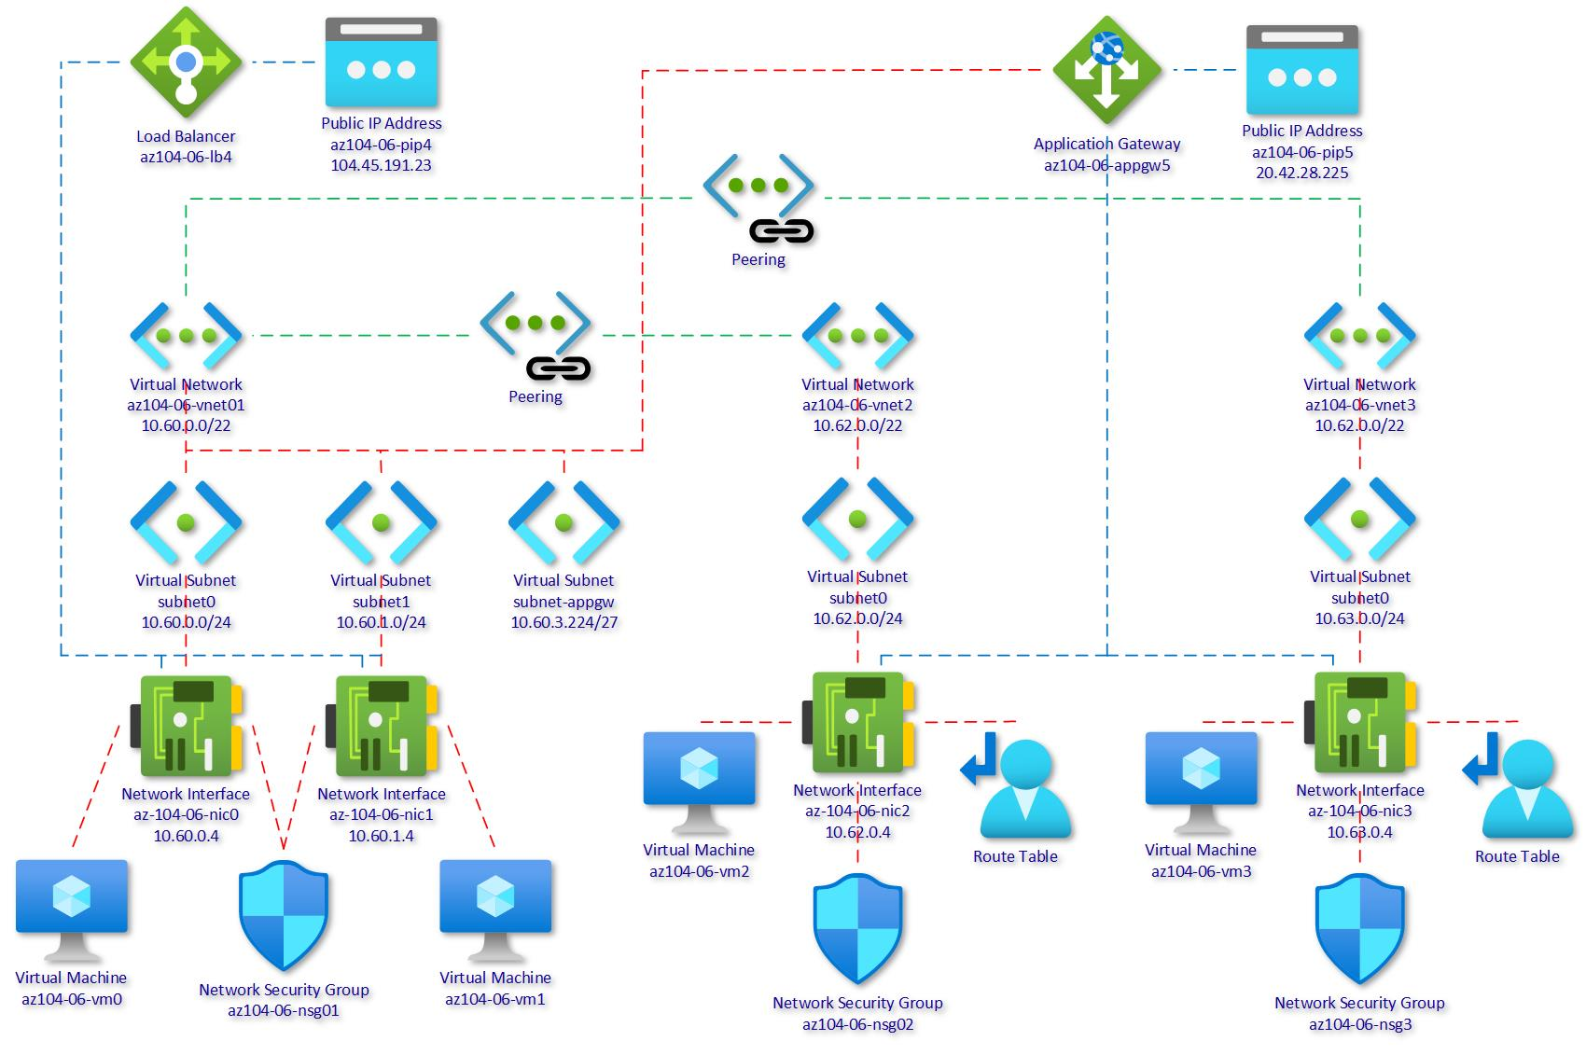
Lab 06 – Architecture Diagram
1
2
3
Notes:
Break down the explanation by reviewing the components in each of the three virtual networks.

Slide 24
Module Review
Module Review Questions
Microsoft Learn Modules (docs.microsoft.com/Learn)
Manage and control traffic flow in your Azure deployment with routes
Improve application scalability and resiliency by using Azure Load Balancer
Load balance your web service traffic with Application Gateway
Enhance your service availability and data locality by using Azure Traffic Manager
Notes:
https://docs.microsoft.com/en-us/learn/modules

