Slide 1
AZ-104T00A Module 07: Azure Storage

Slide 2
Module Overview
Lesson 01: Storage Accounts
Lesson 02: Blob Storage
Lesson 03: Storage Security
Lesson 04: Azure Files and File Sync
Lesson 05: Managing Storage
Lesson 06: Module 07 Lab and Review
Notes:
Module overview

Slide 3
Lesson 01: Storage Accounts

Slide 4
Storage Accounts Overview
Azure Storage
Azure Storage Services
Storage Account Kinds
Replication Strategies
Accessing Storage
Securing Storage Endpoints
Demonstration – Securing a Storage Endpoint
Notes:
Lesson overview

Slide 5
Azure Storage
A service that you can use to store files, messages, tables, and other types of information
Durable, secure, scalable, managed, accessible
Manage data with multiple storage accounts
Three categories of Azure storage:
Storage for virtual machines – Disks and File Shares
Unstructured data – Blobs and Data Lake Store
Structured data - Tables, Cosmos DB, and Azure SQL DB
Standard storage backed by magnetic drives (HDD) is lowest cost
Premium storage backed by solid state drives (SSD)
Notes:
Azure Storage - https://azure.microsoft.com/en-us/services/storage/

Slide 6
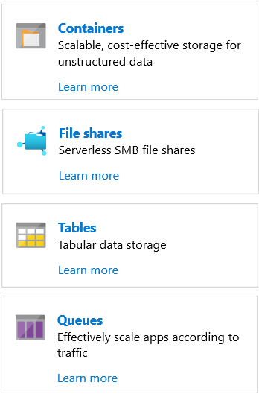
Azure Storage Services
Azure Containers: A massively scalable object store for text and binary data
Azure Files: Managed file shares for cloud or on-premises deployments
Azure Tables: A NoSQL store for schemaless storage of structured data
Azure Queues: A messaging store for reliable messaging between application components
Notes:
Blobs and Files each have a lesson. This is the only time Tables and Queues are discussed.

Slide 7
Storage Account Kinds
Storage account type | Supported services | Supported tiers | Replication options
BlobStorage | Blob (block blobs and append blobs only) | Standard | LRS, GRS, RA-GRS
Storage (general purpose v1) | Blob, File, Queue, Table, and Disk | Standard, Premium | LRS, GRS, RA-GRS
StorageV2 (general purpose v2) | Blob, File, Queue, Table, and Disk | Standard, Premium | LRS, GRS, RA-GRS, ZRS, ZGRS (preview), RA-ZGRS (preview)
Block blob storage | Blob (block blobs and append blobs only) | Premium | LRS, ZRS (limited regions)
File Storage | Files only | Premium | LRS, ZRS (limited regions)
✔️ All storage accounts are encrypted using Storage Service Encryption (SSE) for data at rest

Slide 8
Replication Strategies
Data Replication Options | Description
Locally redundant storage (LRS)​ | Data is replicated three time within a single facility in a single region.​
Zone-redundant storage (ZRS)​ | Data is replicated three times across two to three facilities, either within a single region or across two regions.​
Geo-redundant storage (GRS)​ | Data is replicated three times within the primary region and replicated three times to the regions pair.​
Read access geo-redundant storage (RA-GRS)​ | Data is replicated three times within the primary region and replicated with read-access to the region pair.​
Geo-zone-redundant storage (GZRS)​ | Data is replicated across three Availability Zones and replicated to the region pair.​
Read-access Geo-zone-redundant storage (RA-GZRS)​ | Data is replicated across three Availability Zones and replicated with read-access to the region pair.​

Slide 9
Accessing Storage
CNAME record | Target
blobs.contoso.com | contosoblobs.blob.core.windows.net
Every object has a unique URL address
The storage account name forms the subdomain of that address
The subdomain and domain name forms an endpoint
Container service: http://mystorageaccount.blob.core.windows.net
Table service: http://mystorageaccount.table.core.windows.net
Queue service: http://mystorageaccount.queue.core.windows.net
File service: http://mystorageaccount.file.core.windows.net
If you prefer you can configure a custom domain name
Notes:
✔️A Blob storage account only exposes the Blob service endpoint. And, you can also configure a custom domain name to use with your storage account.

Slide 10
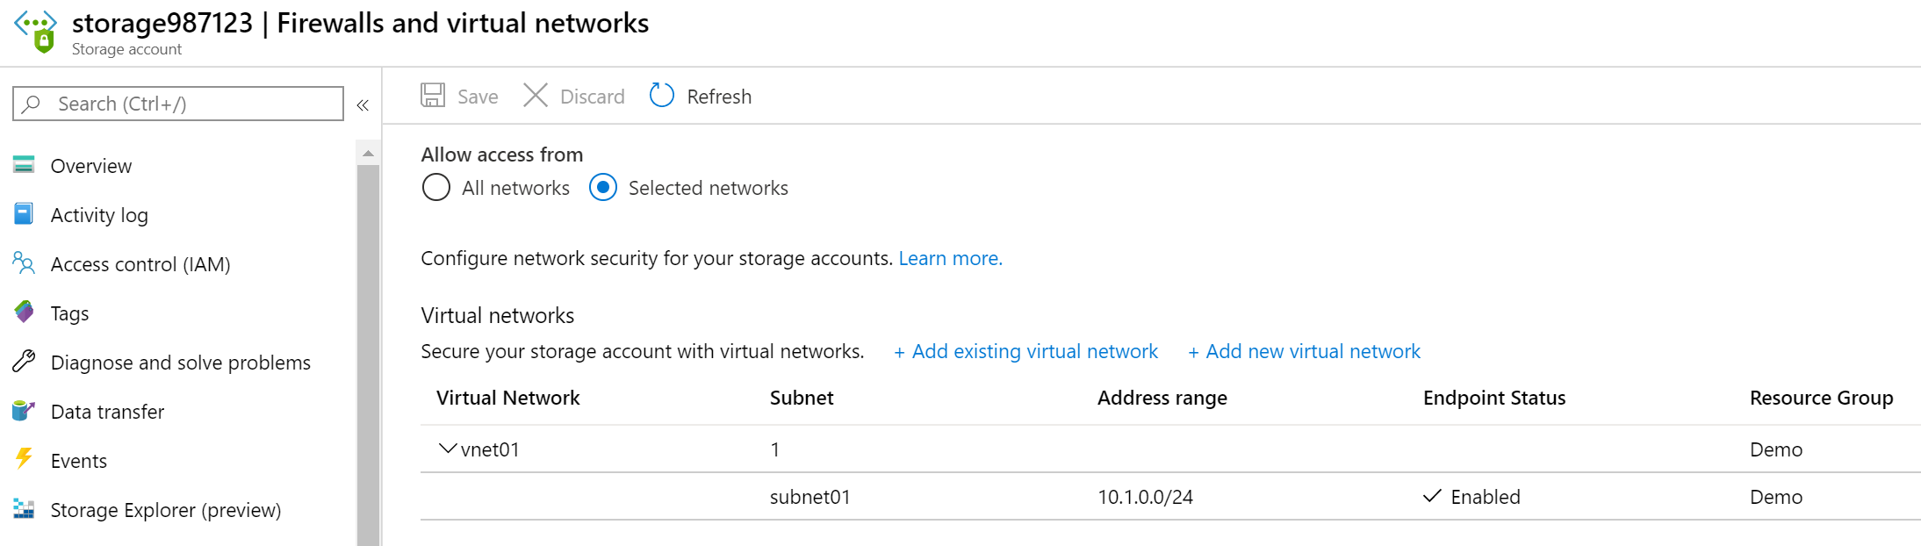
Securing Storage Account Endpoints
Firewalls and Virtual Networks allows for restricting access to the Storage Account from specific Subnets on Virtual Networks
Subnets and Virtual Networks must exist in the same Azure Region or Region Pair as the Storage Account
Notes:
✔️It is important to test and ensure the service endpoint is limiting access as expected.

Slide 11
Demonstration – Securing a Storage Endpoint
Create a storage account
Upload a file to the storage account
Create a subnet service endpoint
Secure the storage to the service endpoint
Test the storage endpoint
Notes:
✔ Always consider having students walk-through the demonstrations themselves. Also, consider the overlap with the formal labs and your best use of time.

Slide 12
Lesson 02: Blob Storage

Slide 13
Blob Storage Overview
Blob Storage
Blob Containers
Blob Access Tiers
Blob Lifecycle Management
Uploading Blobs
Storage Pricing
Demonstration – Blob Storage
Notes:
Lesson overview

Slide 14
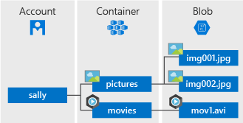
Blob Storage
Stores unstructured data in the cloud
Can store any type of text or binary data
Also referred to as object storage
Common uses:
Serving images or documents directly to a browser
Storing files for distributed access
Streaming video and audio
Storing data for backup and restore, disaster recovery, archiving
Storing data for analysis by an on-premises or Azure-hosted service
Notes:
Azure Blob Storage - https://azure.microsoft.com/en-us/services/storage/blobs/

Slide 15
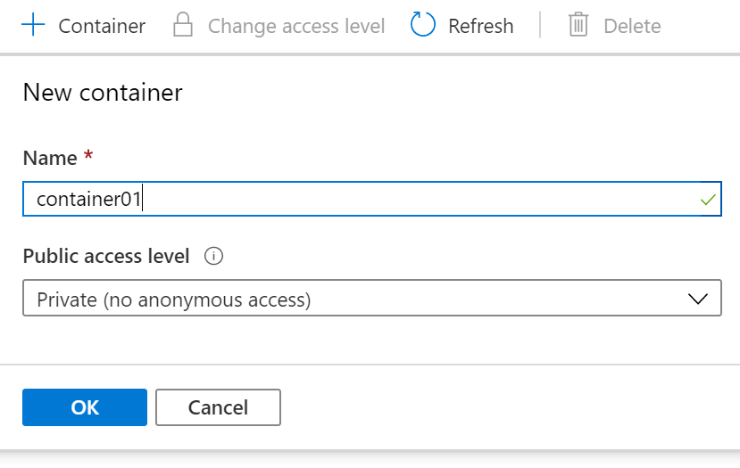
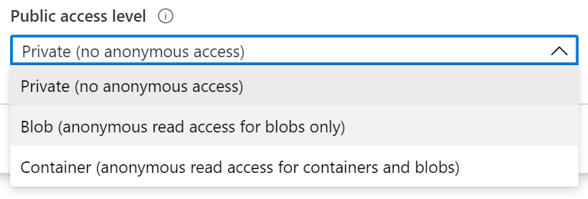
Blob Containers
All blobs must be in a container
Accounts have unlimited containers
Containers can have unlimited blobs
Private blobs - no anonymous access
Blob access - anonymous public read access for blobs only
Container access - anonymous public read and list access to the entire container, including the blobs

Slide 16
Blob Access Tiers
Hot tier - Optimized for frequent access of objects in the storage account
Cool tier - Optimized for storing large amounts of data that is infrequently accessed and stored for at least 30 days
Archive - Optimized for data that can tolerate several hours of retrieval latency and will remain in the Archive tier for at least 180 days
✔️ You can switch between these access tiers at any time.

Slide 17
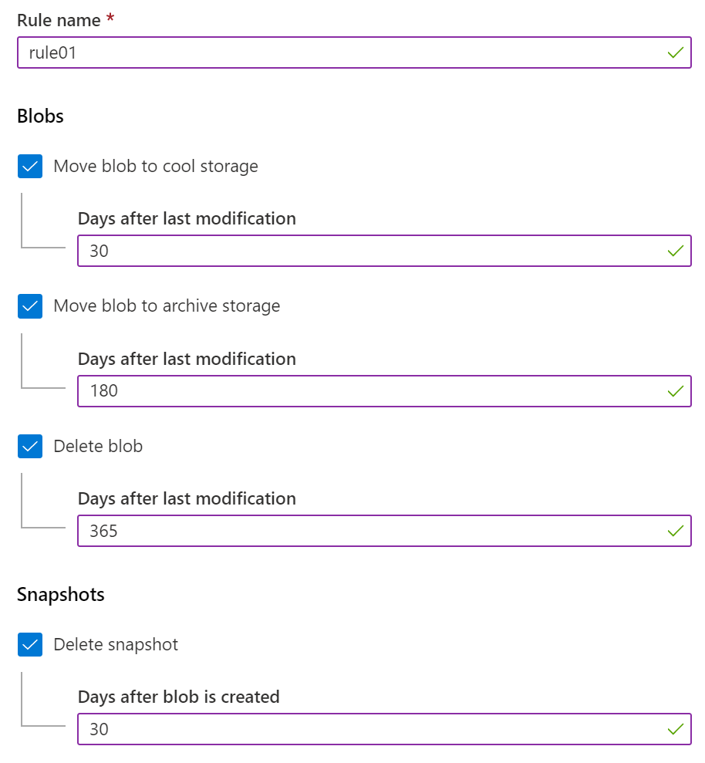
Blob Lifecycle Management
Blob Lifecycle Management allows for:
Transitioning of blobs to a cooler storage tier to optimize for performance and cost
Delete blobs at the end of their lifecycle
Apply rules to filtered paths in the Storage Account

Slide 18
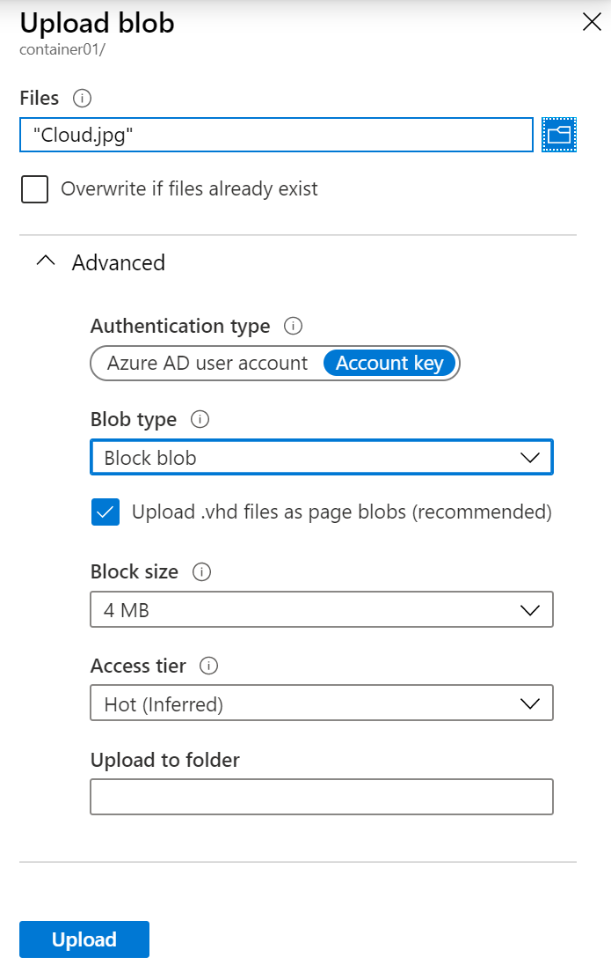
Uploading Blobs
Block blobs (default) - useful for storing text or binary files
Page blobs - More efficient for frequent read/write operations
Append blobs - useful for logging scenarios
Access tier – select either Hot, Cool, or Archive
✔️ You cannot change a blob type once it has been created

Slide 19
Storage Pricing
Storage costs
Blob storage
Data access costs
Transaction costs
Geo-Replication data transfer costs
Outbound data transfer costs
Changing the storage tier

Slide 20
Demonstration – Blob Storage
Create a container
Upload a block blob
Download a block blob
Notes:
✔ Always consider having students walk-through the demonstrations themselves. Also, consider the overlap with the formal labs and your best use of time.

Slide 21
Lesson 03: Storage Security

Slide 22
Storage Security Overview
Storage Security
Shared Access Signatures
URI and SAS Parameters
Demonstration – SAS (Portal)
Storage Service Encryption
Customer Managed Keys
Storage Security Best Practices
Notes:
Lesson overview

Slide 23
Storage Security
Storage Encryption Services
Authentication with Azure AD and RBAC
Client-side encryption, HTTPS, and SMB 3.0 for data in transit
Azure disk encryption
Shared Access Signatures – delegated access
Shared Key – encrypted signature string
Anonymous access to containers and blobs

Slide 24
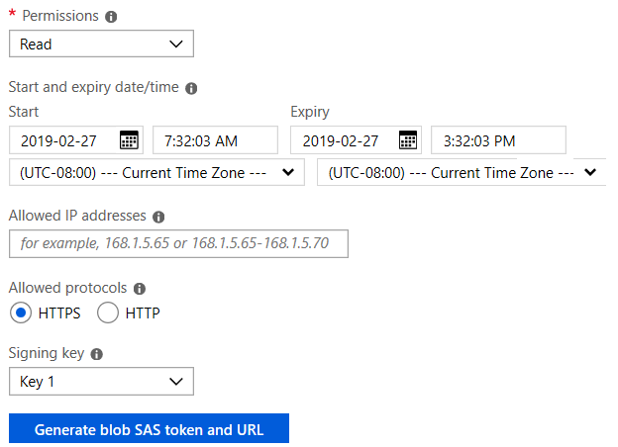
Shared Access Signatures
Provides delegated access to resources
Grants access to clients without sharing your storage account keys
The account SAS delegates access to resources in one or more of the storage services
The service SAS delegates access to a resource in just one of the storage services
Notes:
What is a shared access signature? - https://docs.microsoft.com/en-us/azure/storage/common/storage-dotnet-shared-access-signature-part-1?toc=%2fazure%2fstorage%2fblobs%2ftoc.json#what-is-a-shared-access-signature

Slide 25
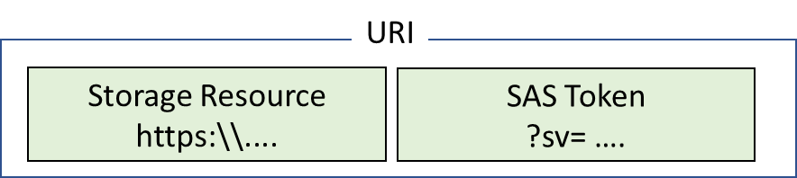
URI and SAS Parameters
A SAS is a signed URI that points to one or more storage resources
Consists of a storage resource URI and the SAS token
https://myaccount.blob.core.windows.net/?restype=service&comp=properties&sv=2015-04-05&ss=bf&srt=s&st=2015-04-29T22%3A18%3A26Z&se=2015-04-30T02%3A23%3A26Z&sr=b&sp=rw&sip=168.1.5.60-168.1.5.70&spr=https &sig=F%6GRVAZ5Cdj2Pw4txxxxx
Includes parameters for resource URI, storage services version, services, resource types, start time, expiry time, resource, permissions, IP range, protocol, signature
Notes:
Shared access signature parameters - https://docs.microsoft.com/en-us/azure/storage/common/storage-dotnet-shared-access-signature-part-1?toc=%2fazure%2fstorage%2fblobs%2ftoc.json#shared-access-signature-parameters

Slide 26
Demonstration – SAS (Portal)
Create a SAS at the service level
Create a SAS at the account level
Notes:
✔ Always consider having students walk-through the demonstrations themselves. Also, consider the overlap with the formal labs and your best use of time.

Slide 27
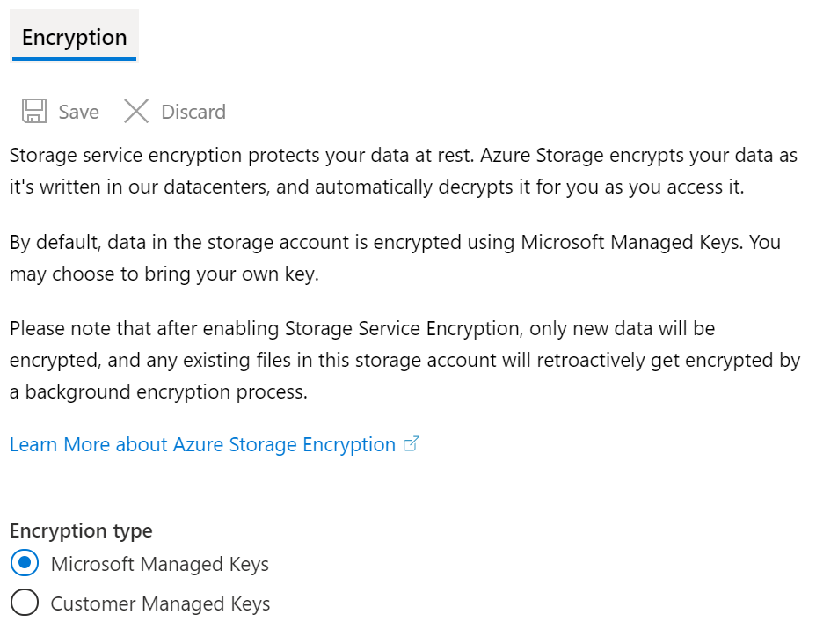
Storage Service Encryption
Protects your data for security and compliance
Automatically encrypts and decrypts your data
Encrypted through 256-bit AES encryption
Is enabled for all new and existing storage accounts and cannot be disabled
Is transparent to users
✔️ You can use your own key (next topic)
Notes:
✔️ SSE is enabled for all new and existing storage accounts and cannot be disabled. Because your data is secured by default, you don't need to modify your code or applications.

Slide 28
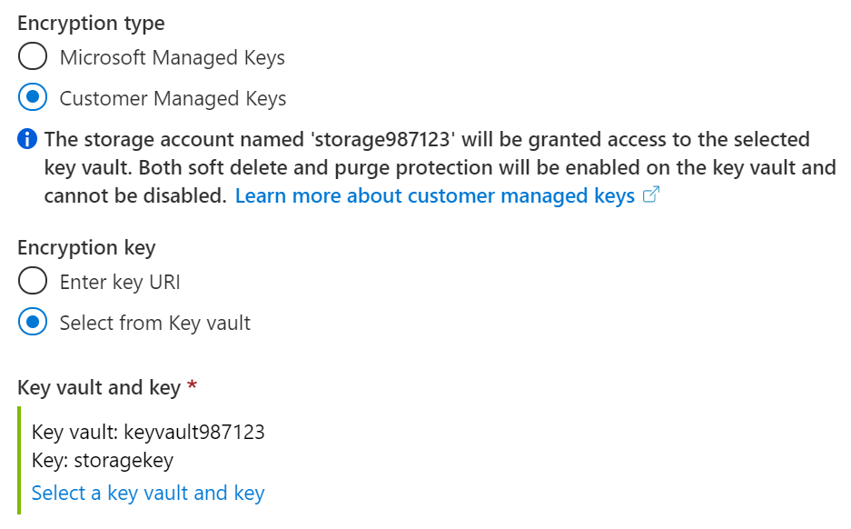
Customer Managed Keys
Use the Azure Key Vault to manage your encryption keys
Create your own encryption keys and store them in a key vault
Use Azure Key Vault's APIs to generate encryption keys
Custom keys give you more flexibility and control
Notes:
✔️ To use customer-managed keys with SSE, you can either create a new key vault and key or you can use an existing key vault and key. The storage account and the key vault must be in the same region, but they can be in different subscriptions.
✔️ The key vault can also be used to store BitLocker keys.

Slide 29
Storage Best Practices
Always use HTTPS to create or distribute an SAS
Reference stored access policies where possible
Use near-term expiration times on an ad hoc SAS
Have clients automatically renew the SAS if necessary
Be careful with SAS start time
Be specific with the resource to be accessed
Understand that your account will be billed for any usage
Validate data written using SAS
Don't assume SAS is always the correct choice
Use Storage Analytics to monitor your application

Slide 30
Lesson 04: Azure Files and File Sync

Slide 31
Azure Files and File Sync Overview
Files vs Blobs
Managing File Shares
File Share Snapshots
Demonstration – File Shares
Azure File Sync
Azure File Sync Components
File Sync Steps
Notes:
Lesson overview

Slide 32
Files vs Blobs
Feature | Description | When to use
Azure Files | SMB interface, client libraries, and a REST interface that allows access from anywhere to stored files. | Lift and shift an application to the cloud. Store shared data across multiple virtual machines. Store development and debugging tools that need to be accessed from many virtual machines.
Azure Blobs | Client libraries and a REST interface that allows unstructured data (flat namespace) to be stored and accessed at a massive scale in block blobs. | Support streaming and random-access scenarios. Access application data from anywhere.
Notes:
✔️ When selecting which storage feature to use, you should also consider pricing.

Slide 33
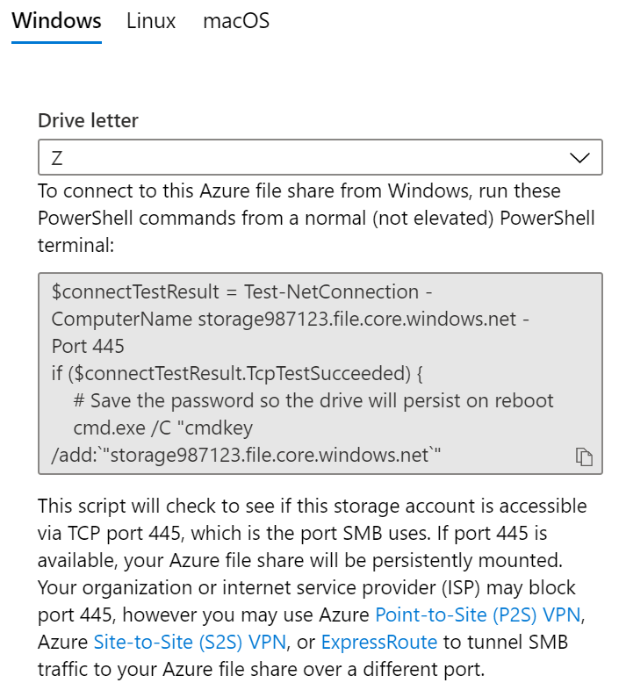
Managing File Shares
File share quotas
Windows – ensure port 445 is open
Linux – mount the drive
MacOS – mount the drive
Secure transfer required - SMB 3.0 encryption
Notes:
Use Azure Files with Linux - https://docs.microsoft.com/en-us/azure/storage/files/storage-how-to-use-files-linux
Create a persistent mount point for the Azure file share with /etc/fstab - https://docs.microsoft.com/en-us/azure/storage/files/storage-how-to-use-files-linux#create-a-persistent-mount-point-for-the-azure-file-share-with-etcfstab
Require secure transfer in Azure Storage - https://docs.microsoft.com/en-us/azure/storage/common/storage-require-secure-transfer

Slide 34
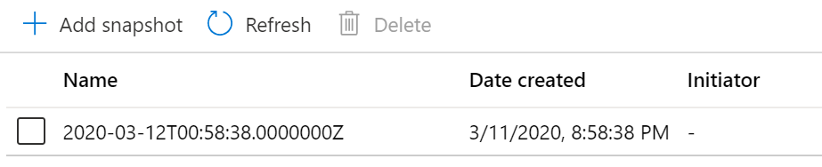
File Share Snapshots
Incremental snapshot that captures the share state at a point in time
Is read-only copy of your data
Snapshot at the file share level, and restore at the file level
Uses:
Protection against application error and data corruption.
Protection against accidental deletions or unintended changes.
General backup purposes.

Slide 35
Demonstration – File Shares
Create a file share and upload a file
Manage snapshots
Create a file share (PowerShell)
Mount a file share (PowerShell)
Notes:
✔ Always consider having students walk-through the demonstrations themselves. Also, consider the overlap with the formal labs and your best use of time.

Slide 36
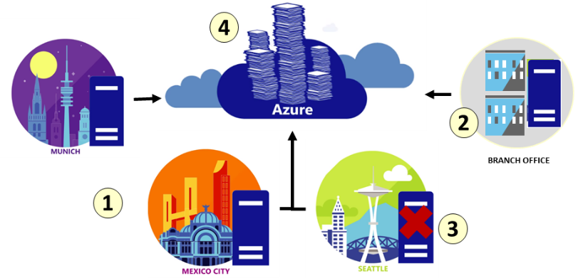
Azure File Sync
Centralize file shares in Azure Files
Lift and shift
Branch Office backups
Backup and Disaster Recovery
File Archiving
Notes:
✔️ Cloud tiering is an optional feature of Azure File Sync in which frequently accessed files are cached locally on the server while all other files are tiered to Azure Files based on policy settings.
Planning for an Azure File Sync deployment - https://docs.microsoft.com/en-us/azure/storage/files/storage-sync-files-planning

Slide 37
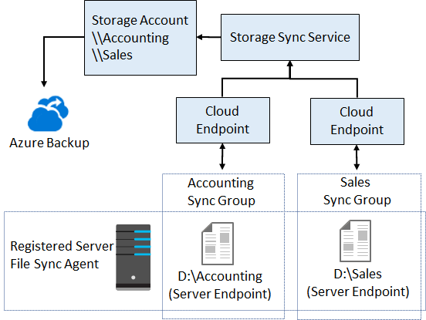
File Sync Components
The Storage Sync Service is the top-level resource.
The registered server object represents a trust relationship between your server (or cluster) and the Storage Sync Service
The Azure File Sync agent is a downloadable package that enables Windows Server to be synced with an Azure file share
A server endpoint represents a specific location on a registered server, such as a folder
A cloud endpoint is an Azure file share
A sync group defines which files are kept in sync

Slide 38
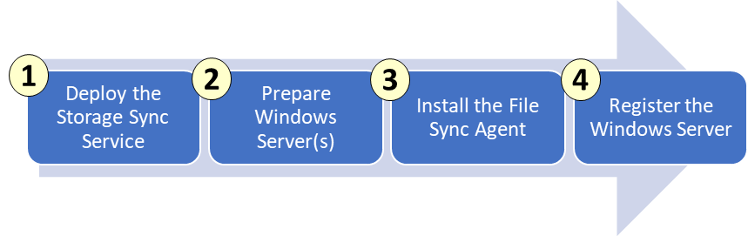
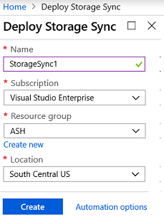
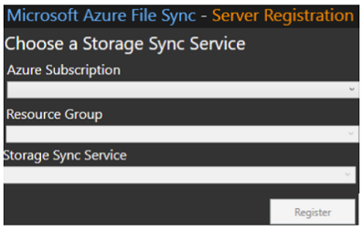
File Sync Steps

Slide 39
Lesson 05: Managing Storage

Slide 40
Managing Storage Overview
Storage Explorer ​
Import and Export Service​
Data Box​
AzCopy​
Data Transfer Tool Selection​
Demonstration – Storage Explorer​
Demonstration - AzCopy
Notes:
Lesson overview

Slide 41
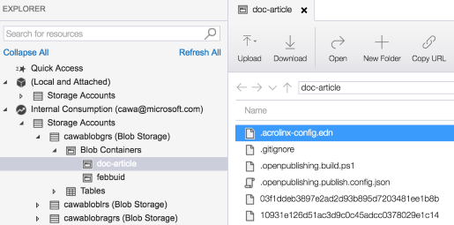
Storage Explorer
Access multiple accounts and subscriptions
Create, delete, view, edit storage resources
View and edit Blob, Queue, Table, File, Cosmos DB storage and Data Lake Storage
Obtain shared access signature (SAS) keys
Available for Windows, Mac, and Linux

Slide 42
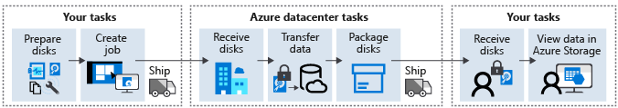
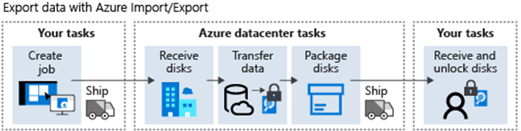
Import and Export Service
Import jobs move large amounts of data to Azure blob storage or files
Export jobs move large amounts of data from Azure storage (not files)

Slide 43


Data Box
Offline
Data Box Disk (8TB SSDs)
Data Box (up to 100TB)
Data Box Heavy (up to 1PB)
Azure Datacenter
Data
Data Box Gateway (virtual appliance)
Data Box Edge (physical appliance)
Azure
Online
Easy, secure, fast large volume data transfer
Offline usage - one-time migration, incremental transfer, periodic updates
Online usage – cloud archival, data aggregation, integration with on-premises workloads, pre-process data (Edge), inference Azure Machine Learning (Edge)
Notes:
Azure Data Box Products - https://azure.microsoft.com/en-us/services/storage/databox/
Azure Data Box - https://docs.microsoft.com/en-us/azure/databox-family/

Slide 44
AzCopy
AzCopy /Source:<source> /Dest:<destination> [Options]
Command-line utility
Available on Windows, Linux, and MacOS
Designed for copying data to and from Azure Blob, File, and Table storage
Authentication options include Active Directory or SAS token
Example 1: Copy a Blob storage account to another account
Example 2: List/Remove files and blobs (wildcard support)
Notes:
Download and install AzCopy on Windows - https://docs.microsoft.com/en-us/azure/storage/common/storage-use-azcopy#download-and-install-azcopy-on-windows

Slide 45
Data Transfer Tool Selection
Dataset | Network bandwidth | Solution to use
Large dataset | Low-bandwidth network or direct connectivity to on-premises storage is limited by organization policies | Azure Import/Export for export; Data Box Disk or Data Box for import where supported; otherwise use Azure Import/Export
Large dataset | High-bandwidth network: 1 gigabit per second (Gbps) - 100 Gbps | AzCopy for online transfers; or to import data, Azure Data Box Edge, or Azure Data Box Gateway
Large dataset | Moderate-bandwidth network: 100 megabits per second (Mbps) - 1 Gbps | Azure Import/Export for export or Azure Data Box family for import where supported
Small dataset: a few GBs to a few TBs | Low to moderate-bandwidth network: up to 1 Gbps | If transferring only a few files, use Azure Storage Explorer, Azure portal, AzCopy, or AZ CLI

Slide 46
Demonstration – Storage Explorer
Download and install Storage Explorer
Connect to an Azure subscription
Attach an Azure storage account
Generate a SAS connection string for the account you want to share
Attach to a storage account by using a SAS Connection string
Notes:
✔ Always consider having students walk-through the demonstrations themselves. Also, consider the overlap with the formal labs and your best use of time.

Slide 47
Demonstration - AzCopy
Install the AzCopy tool
Explore the help
Download a blob from Blob storage to the file system
Upload files to Azure blob storage
Notes:
✔ Always consider having students walk-through the demonstrations themselves. Also, consider the overlap with the formal labs and your best use of time.

Slide 48
Lesson 06: Module 07 Labs and Review

Slide 49
Lab 07 – Manage Azure Storage
Lab scenario
You need to evaluate the use of Azure storage for storing files residing currently in on-premises data stores. While many of these files are not accessed frequently, there are some exceptions. You would like to minimize cost of storage by placing less frequently accessed files in lower-priced storage tiers. You also plan to explore different protection mechanisms that Azure Storage offers, including network access, authentication, authorization, and replication. Finally, you want to determine to what extent Azure Files service might be suitable for hosting your on-premises file shares.
Objectives
Task 1: Provision the lab environment
Task 2: Create and configure Azure Storage accounts
Task 3: Manage blob storage
Task 4: Manage authentication and authorization for Azure Storage
Task 5: Create and configure an Azure Files shares
Task 6: Manage network access for Azure Storage

Slide 50
Module Review
Module Review Questions
Microsoft Learn Modules (docs.microsoft.com/Learn)
Create an Azure Storage account
Secure your Azure Storage
Optimize storage performance and costs using Blob storage tiers
Make your application storage highly available with read-access geo-redundant storage
Copy and move blobs from one container or storage account to another from the command line and in code
Move large amounts of data to the cloud by using Azure Data Box family
Monitor, diagnose, and troubleshoot your Azure storage
Notes:
https://docs.microsoft.com/en-us/learn/modules

