Slide 1
AZ-104T00A Module 11: Monitoring

Slide 2
Module Overview
Lesson 01: Azure Monitor
Lesson 02: Azure Alerts
Lesson 03: Log Analytics
Lesson 04: Network Watcher
Lesson 05: Module 11 Lab and Review
Notes:
Module overview

Slide 3
Lesson 01: Azure Monitor

Slide 4
Azure Monitor Overview
Azure Monitor Service
Key Capabilities
Monitoring Data Platform
Log Data
Data Types
Azure Advisor
Activity Log
Query the Activity Log
Notes:
Lesson overview

Slide 5
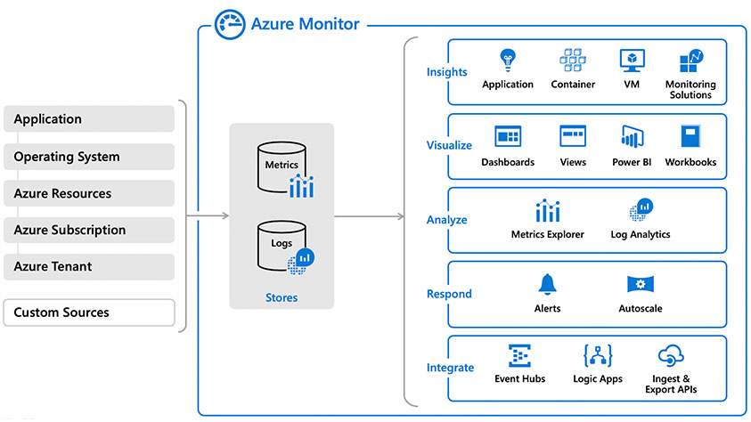
Azure Monitor Service

Slide 6
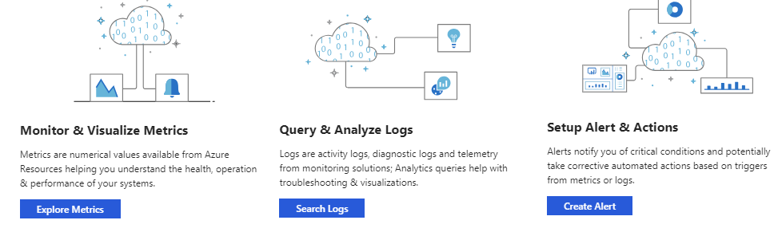
Key Capabilities
Core monitoring for Azure services
Collects metrics, activity logs, and diagnostic logs
Use for time critical alerts and notifications

Slide 7
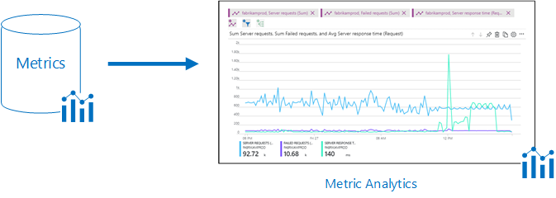
Monitoring Data Platform
Metrics are numerical values that describe some aspect of a system at a point in time. They are lightweight and capable of supporting near real-time scenarios.
Logs contain different kinds of data organized into records with different sets of properties for each type. Telemetry such as events and traces are stored as logs in addition to performance data so that it can all be combined for analysis.

Slide 8
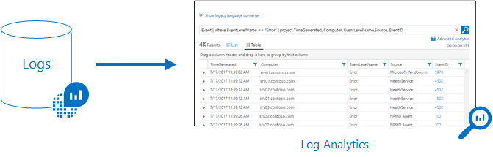
Log Data
Log data is stored in Log Analytics which includes a rich query language to quickly retrieve, consolidate, and analyze collected data
The Data Explorer query language that is suitable for simple log queries but also includes advanced functionality such as aggregations, joins, and smart analytics

Slide 9
Data Types
Application monitoring data - Performance and functionality of the code you have written, regardless of its platform
Guest OS monitoring - Azure, another cloud, or on-premises
Azure resource monitoring
Azure subscription monitoring - Operation and management of an Azure subscription, as well as data about the health and operation of Azure itself
Azure tenant monitoring – Operation of tenant-level Azure services, such as Azure Active Directory

Slide 10
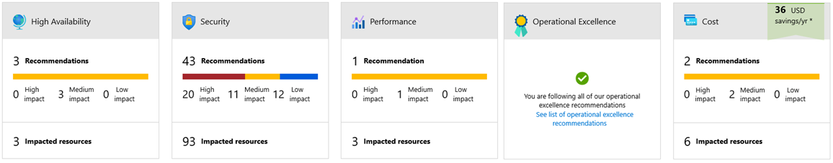
Azure Advisor
Personalized cloud consultant
Analyzes your configuration and recommends solutions
Four areas: High Availability, Security, Performance, Operational Excellence, and Cost

Slide 11
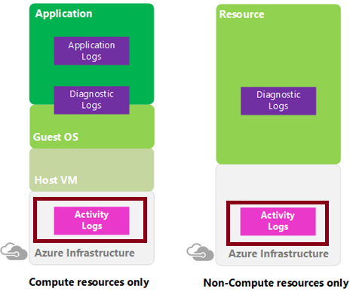
Activity Log
Send data to Log Analytics for advanced search and alerts
Query or manage events in the Portal, PowerShell, CLI, and REST API
Stream information to Event Hub
Archive data to a storage account
Analyze data with Power BI

Slide 12
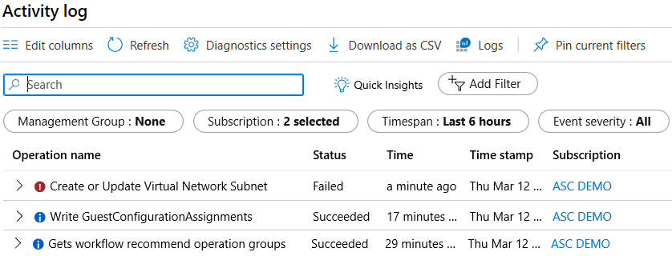
Query the Activity Log
Filter by: Management group, Subscription, Timespan, and Event Severity
Add a filter, like Event Category (Security, Recommendations, Alerts)
Pin current filters and download as CSV
Notes:
For more information, you can see:
Query the Activity Log in the Azure portal - https://docs.microsoft.com/en-us/azure/monitoring-and-diagnostics/monitoring-overview-activity-logs#query-the-activity-log-in-the-azure-portal

Slide 13
Lesson 02: Azure Alerts

Slide 14
Azure Alerts Overview
Azure Monitor Alerts
Creating Alert Rules
Action Groups
Demonstration - Alerts
Notes:
Lesson overview

Slide 15
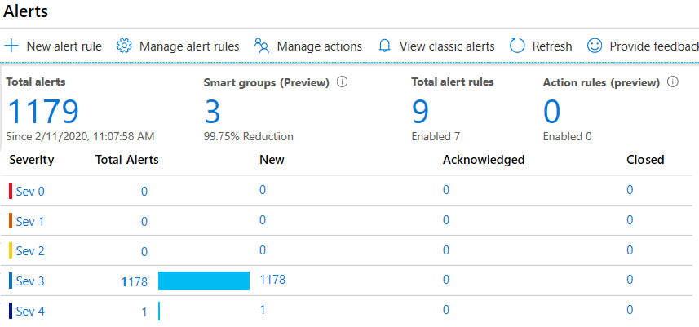
Azure Monitor Alerts
Unified authoring experience
Displayed by severity
Categorized by New, Acknowledged, and Closed
Notes:
The new alerts experience in Azure Monitor - https://docs.microsoft.com/en-us/azure/monitoring-and-diagnostics/monitoring-overview-unified-alerts

Slide 16
Creating Alert Rules
Resource: Target selection, Alert criteria, and Alert logic
Condition: Alert rule name, description, and severity (0 to 4)
Action group: notify your team via email and text messages or automate actions using webhooks and runbooks

Slide 17
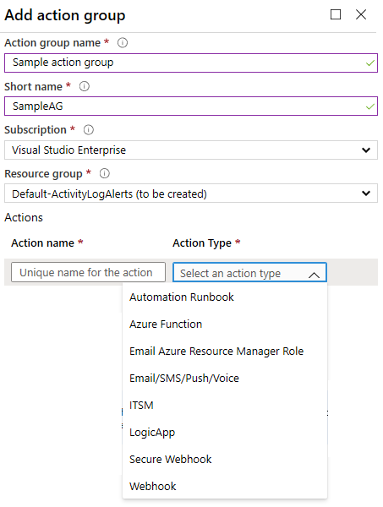
Action Groups
Notifies a group of users that an alert has been triggered
Is a collection of notification preferences

Slide 18
Demonstration - Alerts
Create an alert rule
Explore alert targets
Explore alert conditions
Explore alert details
Notes:
✔ Always consider having students walk-through the demonstrations themselves. Also, consider the overlap with the formal labs and your best use of time.

Slide 19
Lesson 03: Log Analytics

Slide 20
Log Analytics Overview
Log Analytics
Create a Workspace
Connected Sources
Data Sources
Log Analytics Querying
Query Language Syntax
Demonstration – Log Analytics
Notes:
Lesson overview

Slide 21
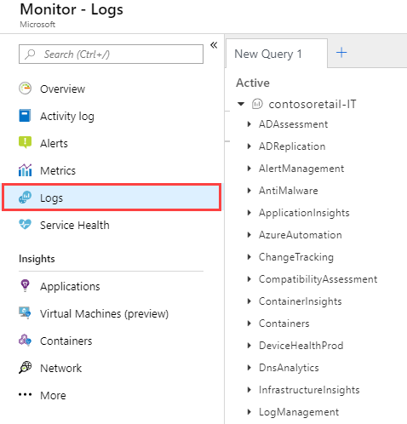
Log Analytics
A service that helps you collect and analyze data generated by resources in your cloud and on-premises environments
Write log queries and interactively analyze their results
Examples include assessing system updates and troubleshooting operational incidents

Slide 22
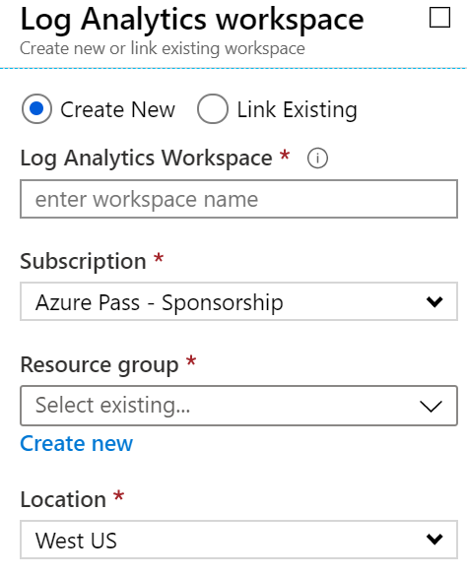
Create a Workspace
A workspace is an Azure resource and is a container where data is collected, aggregated, analyzed, and presented
You can have multiple workspaces per Azure subscription, and you can have access to more than one workspace
A workspace provides a geographic location, data isolation, and scope

Slide 23
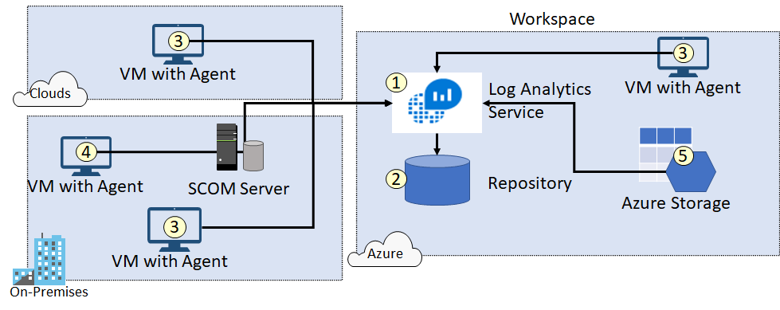
Connected Sources
Connected Sources generate data
Data can be collected from Windows, Linux, SCOM and Azure Storage

Slide 24
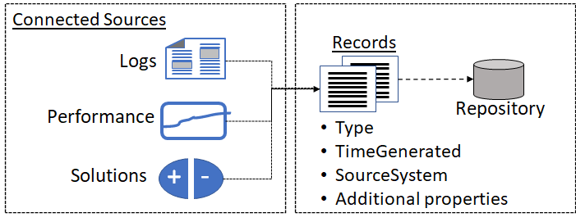
Data Sources
Data sources include: Windows Event Logs, Windows Performance Counters, Linux Performance Counters, IIS Logs, Custom Fields, Custom Logs, and Syslog.
Each data source has additional configuration options.

Slide 25
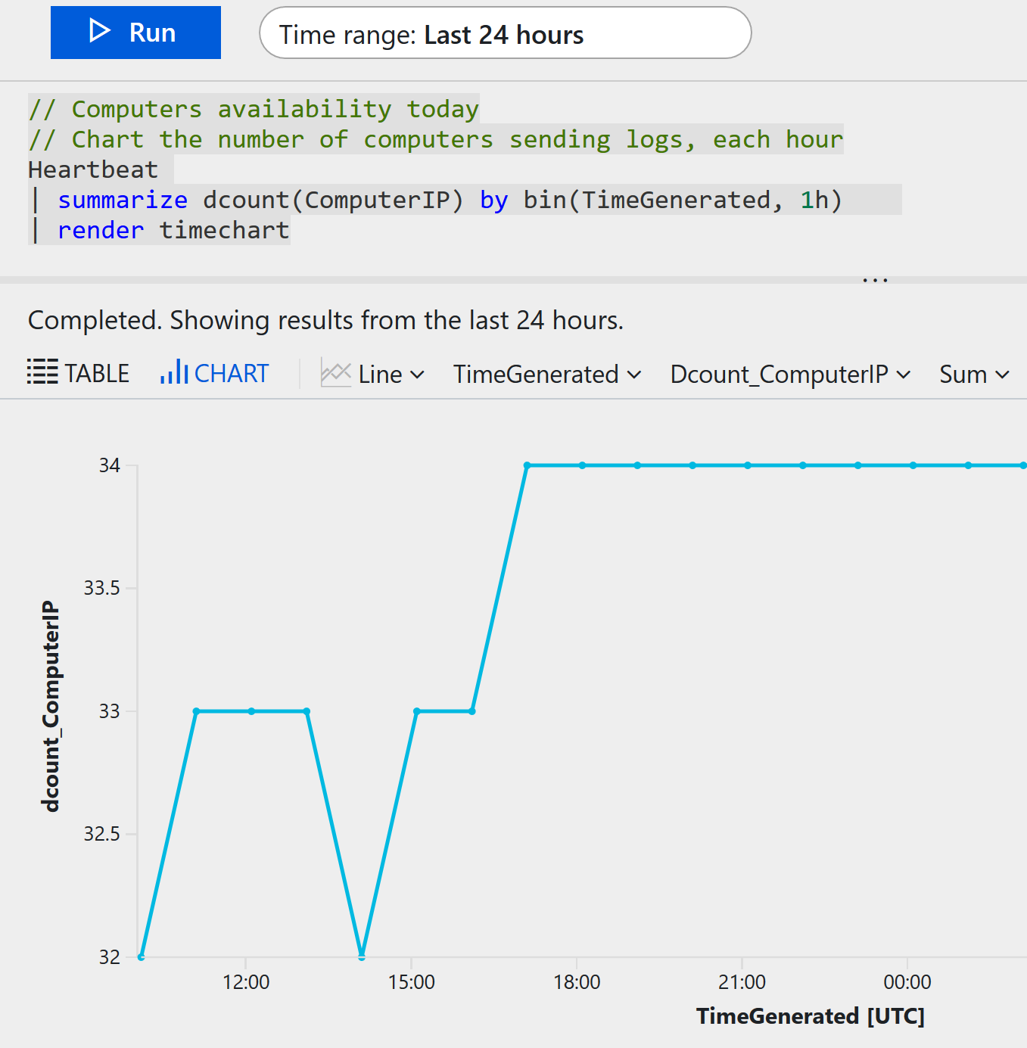
Log Analytics Querying
Log Analytics provides a query syntax
Quickly retrieve and consolidate data in the repository
Save or have log searches run automatically to create an alert
Export the data to Power BI or Excel

Slide 26
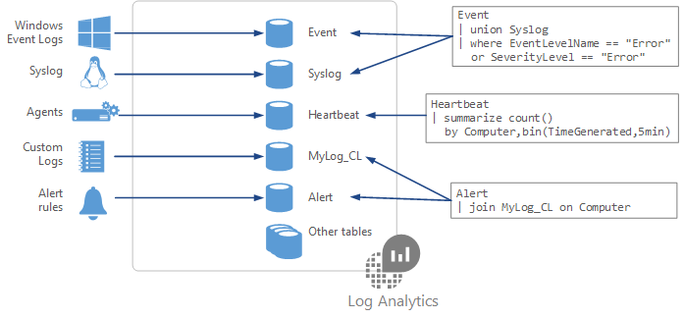
Query Language Syntax
Event
| where (EventLevelName == "Error")
| where (TimeGenerated > ago(1days))
| summarize ErrorCount = count() by Computer
| top 10 by ErrorCount desc
Notes:
Azure Monitor log queries - https://docs.microsoft.com/en-us/azure/azure-monitor/log-query/query-language

Slide 27
Demonstration – Log Analytics
Access the demonstration environment
Use the Query Explorer
Notes:
✔ Always consider having students walk-through the demonstrations themselves. Also, consider the overlap with the formal labs and your best use of time.

Slide 28
Lesson 04: Network Watcher

Slide 29
Network Watcher Overview
Network Watcher
Network Watcher Diagnostics
Diagnostics – IP Flow Verify
Diagnostics – Next Hop
Diagnostics – Effective Security Rules
Diagnostics – VPN Troubleshoot
Diagnostics – Packet Capture
Diagnostics - Connection Troubleshoot
Logs - NSG Flow Logs
Monitoring - Topology
Notes:
Lesson overview

Slide 30
Network Watcher
Is a regional service
Provides tools to monitor, diagnose, view metrics, and enable or disable logs
Provides scenario level monitoring so you can diagnose problems at an end to end network level view
Provides a visual representation of your networking elements
Notes:
Network Watcher - https://azure.microsoft.com/en-us/services/network-watcher/

Slide 31
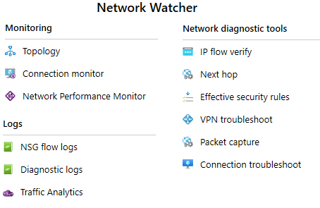
Network Watcher Diagnostics
IP Flow Verify diagnoses connectivity issues
Next Hop determines if traffic is being correctly routed
VPN Diagnostics troubleshoots gateways and connections
NSG Flow Logs maps IP traffic through a network security group
Connection troubleshoot shows connectivity between source VM and destination
Topology generates a visual diagram of resources

Slide 32
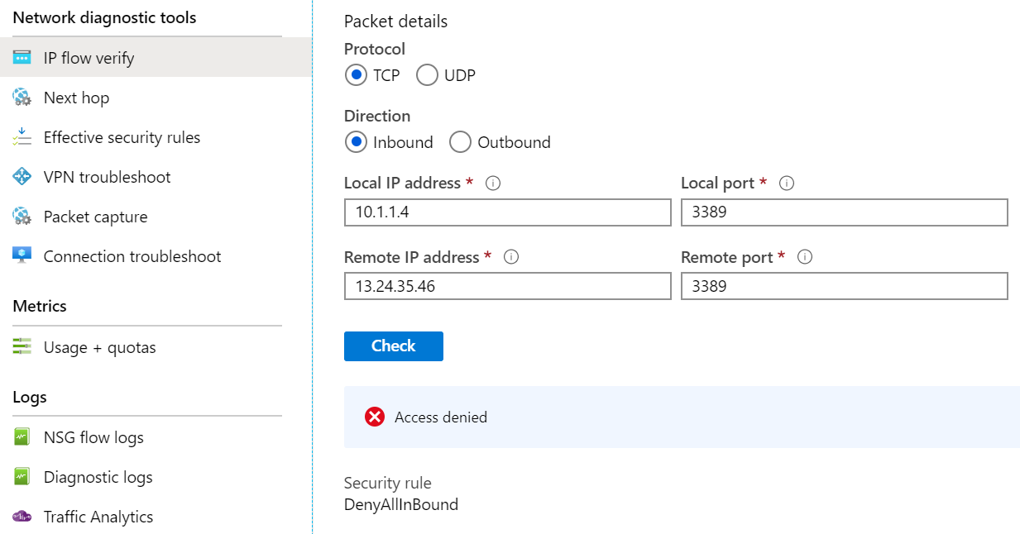
Diagnostics - IP Flow Verify
Diagnose connectivity issues from or to the internet and from or to the on-premises environment. Ideal for ensuring security rules are being correctly applied.

Slide 33
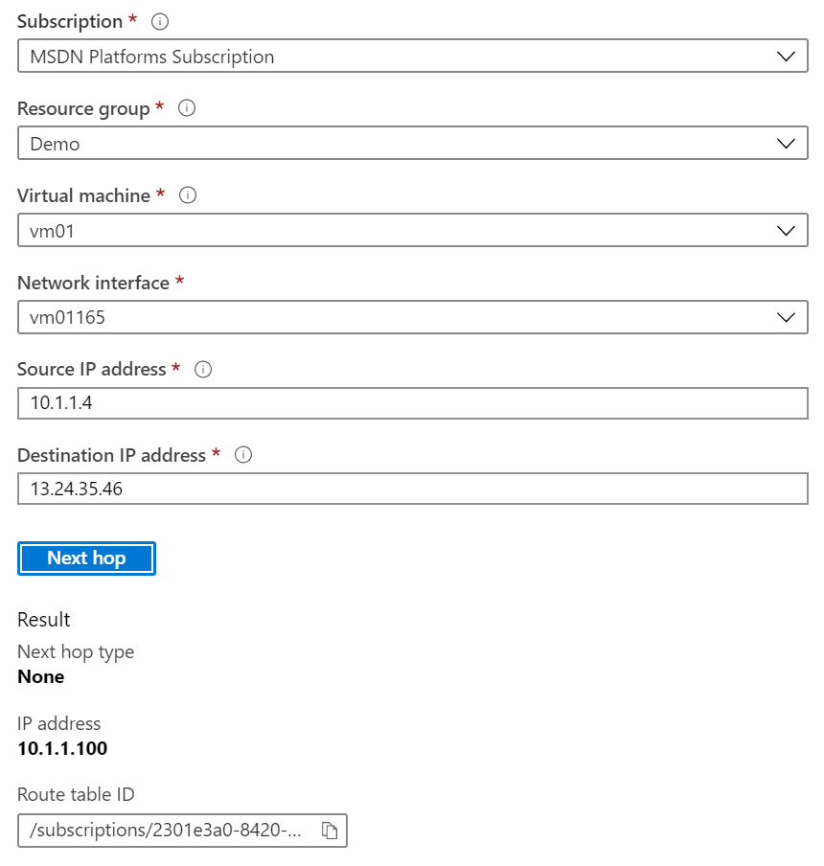
Diagnostics - Next Hop
Helps with determining whether traffic is being directed to the intended destination by showing the next hop

Slide 34
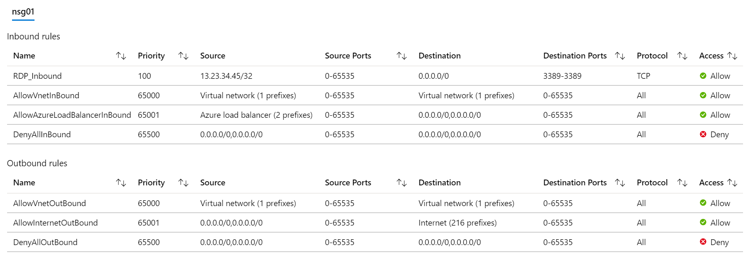
Diagnostics - Effective Security Rules
Details the Effective Security Rules (inbound and outbound) of the Network Interface card of a Virtual Machine.

Slide 35
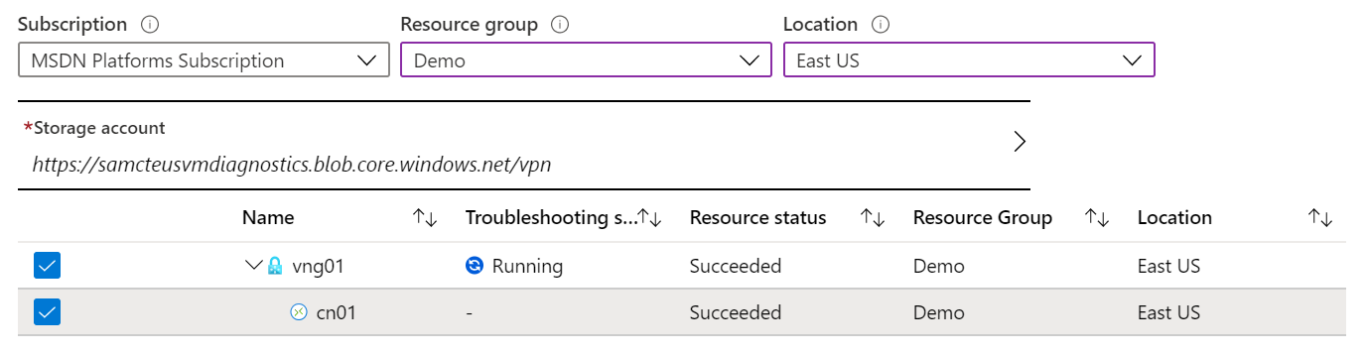
Diagnostics - VPN Troubleshoot
Helps you troubleshoot gateways and connections
Provides summary information and detailed information
Can troubleshoot multiple gateways or connections simultaneously

Slide 36
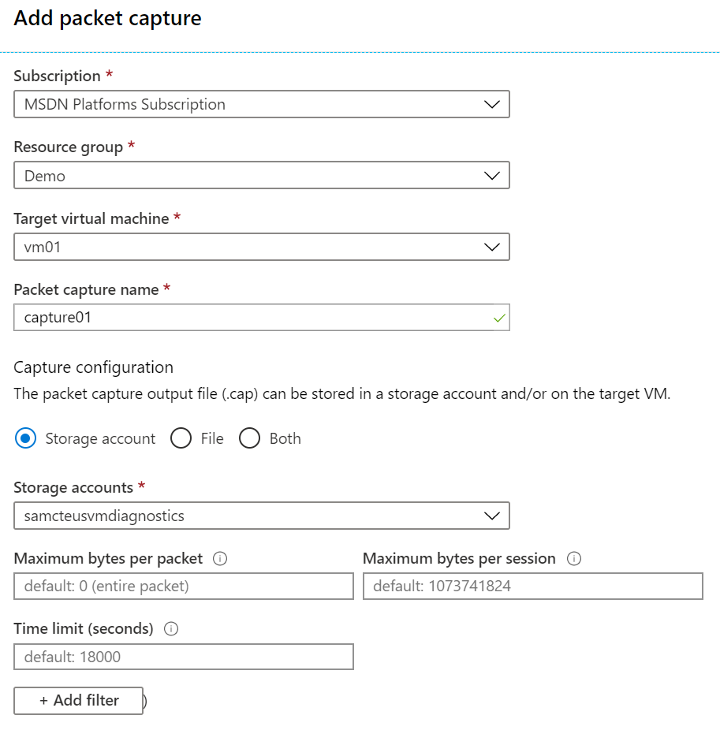
Diagnostics - Packet Capture
Captures inbound and outbound traffic from a Virtual Machine
Saves data to a storage account, a local file, or both.

Slide 37
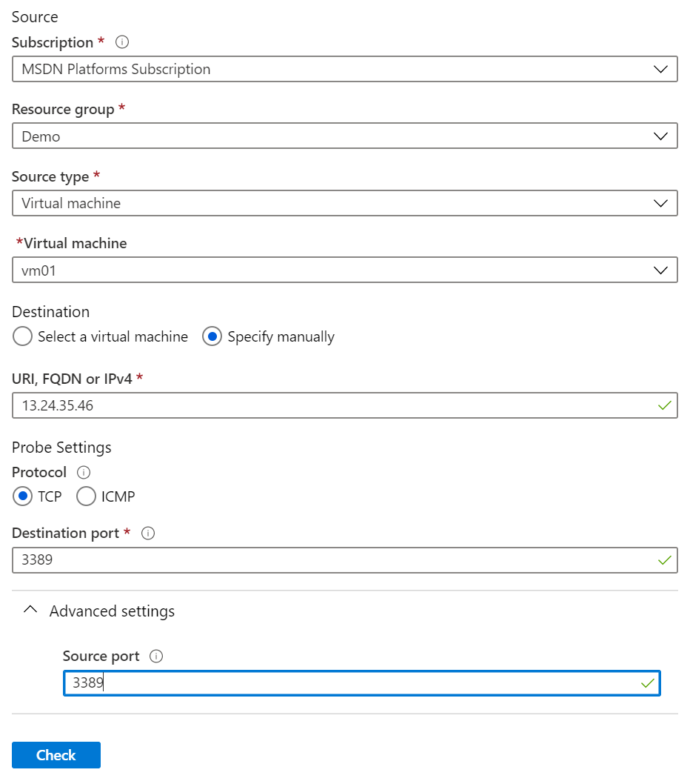
Diagnostics - Connection Troubleshoot
Check connectivity between source VM and destination
Identify configuration issues that are impacting reachability
Provide all possible hop by hop paths from the source to destination
Review hop by hop latency - min, max, and average between source and destination
View a graphical topology from your source to destination
Notes:
Troubleshoot connections with Azure Network Watcher using the Azure portal - https://docs.microsoft.com/en-us/azure/network-watcher/network-watcher-connectivity-portal

Slide 38
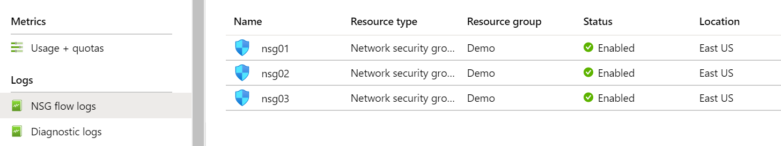
Logs - NSG Flow Logs
View information about ingress and egress IP traffic through an NSG
Flow logs are written in JSON format and show outbound and inbound flows on a per rule basis
The JSON format can be tools like Kibanavisually displayed in Power BI or third-party

Slide 39
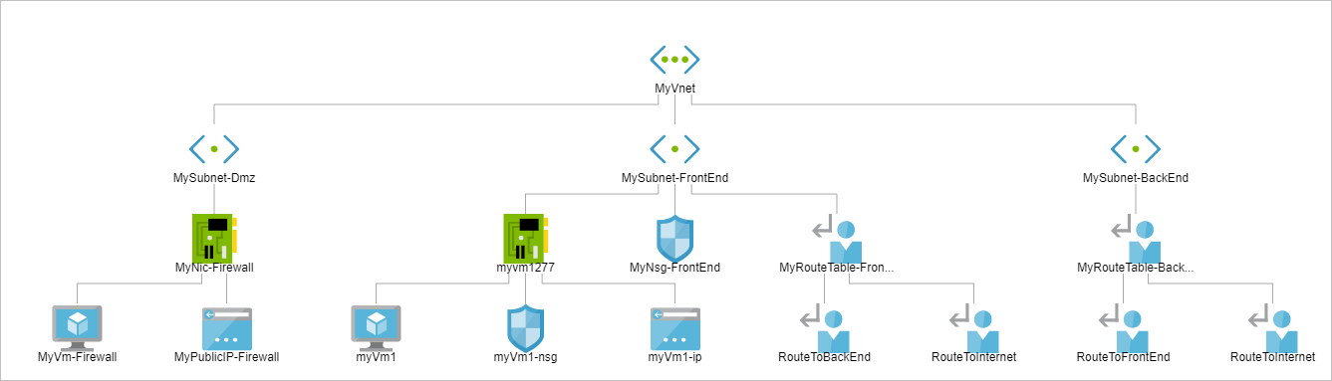
Monitoring - Topology
Provides a visual representation of your networking elements
View all the resources in a virtual network, resource to resource associations, and relationships between the resources
The Network Watcher instance in the same region as the virtual network

Slide 40
Lesson 05: Module 11 Lab and Review

Slide 41
Lab 11 – Implement Monitoring
Lab scenario
You need to evaluate Azure functionality that would provide insight into performance and configuration of Azure resources, focusing on Azure virtual machines. To accomplish this, you intend to examine the capabilities of Azure Monitor, including Log Analytics.
Objectives
Task 1: Provision the lab environment
Task 2: Create and configure an Azure Log Analytics workspace and Azure Automation-based solutions
Task 3: Review default monitoring settings of Azure virtual machines
Task 4: Configure Azure virtual machine diagnostic settings
Task 5: Review Azure Monitor functionality
Task 6: Review Azure Log Analytics functionality

Slide 42
Module Review
Module Review Questions
Microsoft Learn Modules (docs.microsoft.com/Learn)
Analyze your Azure infrastructure by using Azure Monitor logs
Improve incident response with alerting on Azure
Monitor the health of your Azure virtual machine by collecting and analyzing diagnostic data
Monitor, diagnose, and troubleshoot your Azure storage
Notes:
https://docs.microsoft.com/en-us/learn/modules

