Slide 1
AZ-303: Microsoft Azure Architect Technologies

Slide 2
Module 0: Course Introduction
Welcome
Instructor Introduction
Student Introductions
Facilities
Azure Architect Role
About this Course: Prerequisites
Course Outline
AZ-303 Certification
Microsoft Certifications
Hands-on Labs (Optional)
Additional Resources (Optional)
Notes:
Adjust as necessary

Slide 3
Welcome
Thank you for joining us today
We’ve worked together with the Microsoft Partner Network and Microsoft IT Academies to bring you a world-class learning experience. At the end of class, please complete an evaluation of today’s experience. We value your feedback!
Microsoft Certified Trainers + Instructors
Your instructor is a premier technical and instructional expert who meets ongoing certification requirements
Customer Satisfaction Guarantee
Our partners offer a satisfaction guarantee, and we hold them accountable for it
Certification Exam Benefits
After training, consider pursuing a Microsoft Certification to help distinguish your technical expertise and experience. Ask your instructor about available exam promotions and discounts
We wish you a great learning experience and ongoing career success!

Slide 4
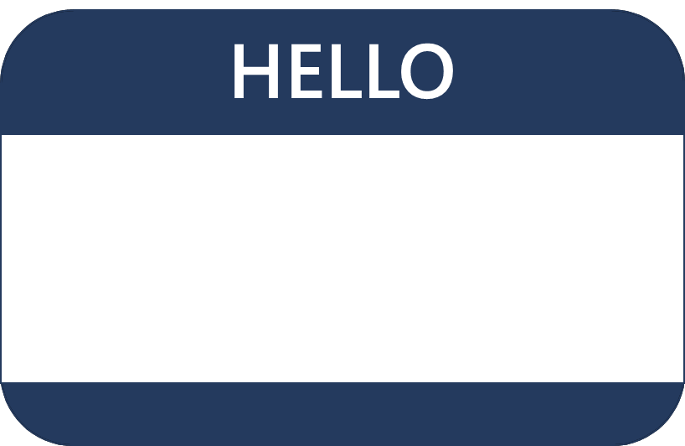
Hello! Instructor Introduction
Instructor: <Name>
<Title or other credentials, e.g., Microsoft Certified Trainer>
<Affiliation/Company>
<A few words about my technical and professional experience

Slide 5
Hello! Student Introductions
Your name
Company affiliation
Title/function
Microsoft Azure experience
Your expectations for the course

Slide 6
Facilities (adjust)
Class hours
Messages
Building or virtual hours
Smoking
Parking
Internet access
Restrooms
Recycling
Meals
Emergency procedures
Phones

Slide 7
Azure Architect Role
Azure Architects translate business requirements into secure and reliable recommendations for infrastructure, governance, high availability, cost optimization, and data integration.
Skills include recommending solutions for logging, multi-factor authentication, SSO, hybrid identity, backup and recovery, containers, microservices, monitoring, automation, networking, and application infrastructure.

Slide 8
About this Course: Prerequisites
Successful Azure Architects start this role with experience on operating systems, virtualization, cloud infrastructure, storage structures, governance, and networking.
Understanding of on-premises virtualization technologies, including: VMs, virtual networking, and virtual hard disks.
Understanding of network configuration, including TCP/IP, Domain Name System (DNS), virtual private networks (VPNs), firewalls, and encryption technologies.
Understanding of Active Directory concepts, including domains, forests, domain controllers, replication, and Kerberos protocol.
Understanding of resilience and disaster recovery, including backup and restore operations.
* Students should have a minimum of 6-12 months of hands-on experience with Azure.

Slide 9
Course Outline
Module 1: Implement Azure Active Directory
Module 2: Implement and Manage Hybrid Identities
Module 3: Implement Virtual Networking
Module 4: Implement VMs for Windows and Linux
Module 5: Implement Load Balancing and Network Security
Module 6: Implement Storage Accounts
Module 7: Implement NoSQL Databases
Module 8: Implement Azure SQL Databases
Module 9: Automate Deployment and Configuration of Resources
Module 10: Implement and Manage Azure Governance Solutions
Module 11: Manage Security for Applications
Module 12: Manage Workloads in Azure
Module 13: Implement Container-Based Applications
Module 14: Implement an Application Infrastructure
Module 15: Implement Cloud Infrastructure Monitoring
* This is a suggested order and aligns with the learning objectives described on the Exam AZ-303: Microsoft Azure Architect Technologies page.
Notes:
AZ-303 Exam Page - https://docs.microsoft.com/en-us/learn/certifications/exams/az-303

Slide 10
AZ-303 Certification
Study Areas | Weights
Implement and monitor an Azure infrastructure | 50-55%
Implement management and security solutions | 25-30%
Implement solutions for apps | 10-15%
Implement and manage data platforms | 10-15%
Percentages indicate the relative weight of each area on the exam
The higher the percentage, the more questions you are likely to see in that area

Slide 11
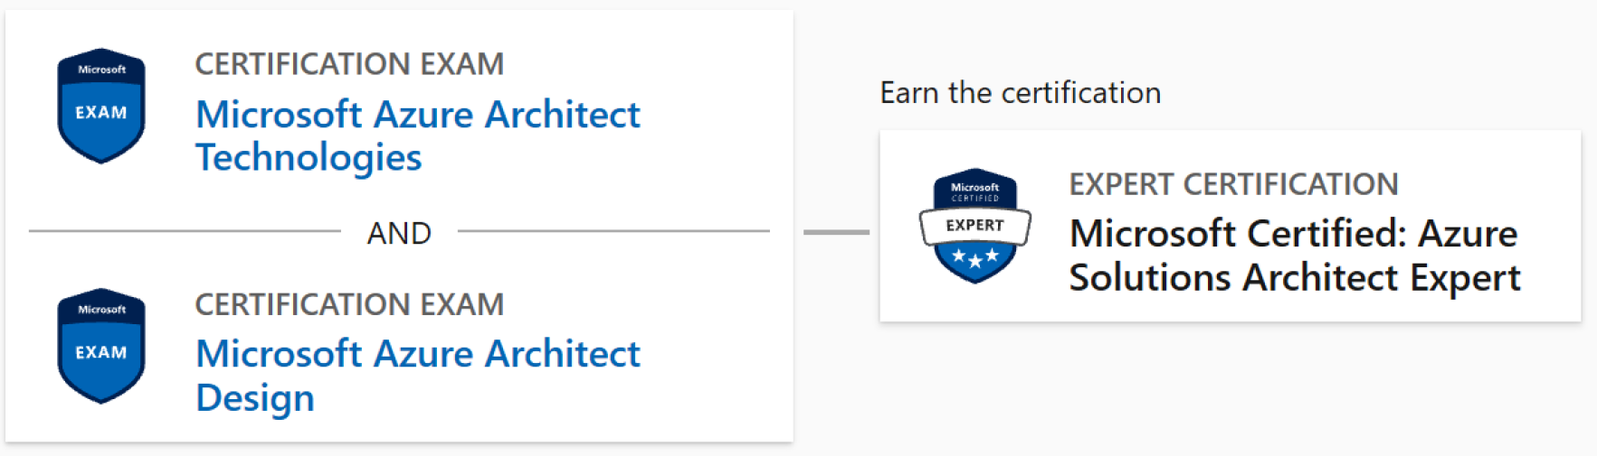
Microsoft Certifications
The AZ-303 Microsoft Azure Architect Technologies certification combined with the AZ-304 Microsoft Azure Architect Design certification result in the Microsoft Certified: Azure Solutions Architect Expert.

Slide 12
Hands-on Labs (optional)
You will use a Microsoft Learning Azure Pass to provide access to Microsoft Azure
Check the dollar balance of you Azure Pass within Microsoft Azure once you have set up your subscription
Be aware of how much you are consuming and do not allow Microsoft Azure components to run overnight or for extended periods
Lab instructions are in a GitHub repository. For this class use the <your region> location
Each lab creates a new resource group. To minimize costs, remove the resource group at the end of the lab
Notes:
If you find something that needs corrected in the labs, submit an Issue on the repository. Also, you may want to review any recent Issues that have been submitted by other instructors.

Slide 13
Additional Resources (optional)
Microsoft Learn
Channel 9
Azure Documentation
Microsoft Azure Blog
Azure Architecture Center
Microsoft Learning Community Blog
Azure Tuesdays with Corey
Azure Fridays with Scott Hanselman
Notes:
Microsoft Learn - https://docs.microsoft.com/en-us/learn/browse/. There is a summary slide at the end of each lesson with applicable online training modules.
Azure Documentation - https://docs.microsoft.com/en-us/azure/. Stay informed on the latest products, tools, and features. Get information on pricing, partners, support, and solutions.
Azure Architecture Center - https://docs.microsoft.com/en-us/azure/architecture/
Azure Fridays - https://channel9.msdn.com/Shows/Azure-Friday. Join Scott Hanselman as he engages one-on-one with the engineers who build the services that power Microsoft Azure, as they demo capabilities, answer Scott's questions, and share their insights.
Channel 9 - https://channel9.msdn.com/. Channel 9 provides a wealth of informational videos, shows, and events.
Microsoft Azure Blog - https://azure.microsoft.com/en-us/blog/. Keep current on what's happening in Azure, including what's now in preview, generally available, news & updates, and more.
Microsoft Learning Community Blog - https://www.microsoft.com/en-us/learning/community-blog.aspx). Get the latest information about the certification tests and exam study groups.

Slide 14
End of presentation

