Slide 1
AZ-303: Microsoft Azure Architect Technologies

Slide 2






Module 01: Implement Azure Active Directory
Lesson 01: Azure Active Directory and Resource Organization
Lesson 02: Users and Groups
Lesson 03: Managing Azure AD Tenants
Lesson 04: Implement Conditional Access
Lesson 05: Configure Multi-Factor Authentication (MFA)
Lesson 06: Azure AD Identity Protection
Notes:
Lesson 01, Overview of Active Directory. was combined with Lesson 02, Management Groups. Lesson 10, Configure Guest Users, was combined with Users and Groups. The Conditional Access lesson includes the Trusted IP lesson. AD Join was removed but the slides are at the end if you would like to include them.
This module had significant changes in the order, but it is the only module that had this level of correction.

Slide 3
Lesson 01: Azure Active Directory and Resource Organization

Slide 4
Azure Active Directory and Resource Organization Overview
Azure Active Directory (Azure AD)
Azure AD Concepts
Management Groups
Subscriptions and Limits (Quotas)
Resource Groups
Resource Group Organization

Slide 5
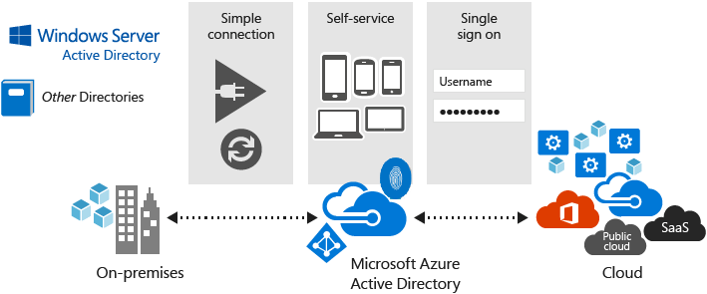
Azure Active Directory (Azure AD)
Multi-tenant cloud-based directory and identity management
Single sign-on access to cloud applications and resources
Facilitates developing apps with a global scope
Offers a full suite of identity management capabilities

Slide 6
Azure AD Concepts
Concept | Description
Identity | An object that can be authenticated
Account | An identity that has data associated with it
Azure AD account | An identity created through Azure AD or another Microsoft cloud service
Azure AD tenant/directory | A dedicated and trusted instance of Azure AD, a Tenant is automatically created when your organization signs up for a Microsoft cloud service subscription​ ​ Additional instances of Azure AD can be created​ Azure AD is the underlying product providing the identity service​ The term Tenant means a single instance of Azure AD representing a single organization​ The terms Tenant and Directory are often used interchangeably​
Azure subscription | Used to pay for Azure cloud services
Notes:
Azure AD Terminology - https://docs.microsoft.com/en-us/azure/active-directory/fundamentals/active-directory-whatis#terminology

Slide 7
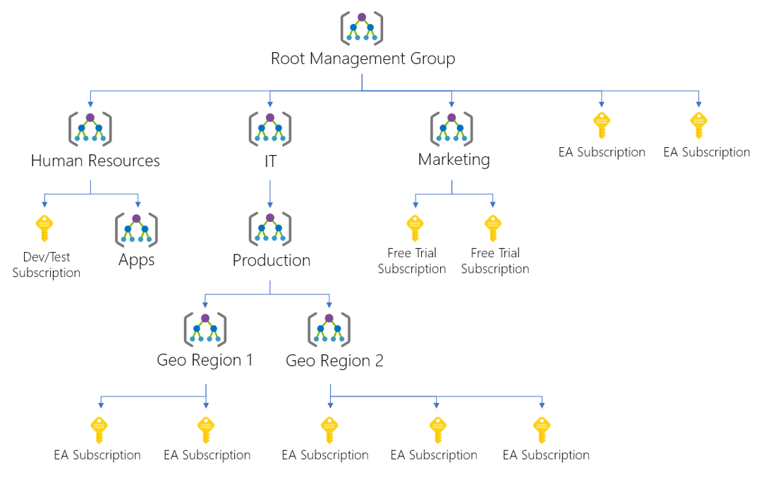
Management Groups
Provides a level of scope above subscriptions
Targeting of policies and spend budgets across subscriptions and inheritance down the hierarchies
Compliance and cost reporting by organization (business/teams)

Slide 8
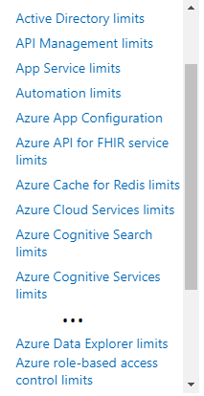
Subscriptions and Limits (Quotas)
Azure subscription and service limits:
Microsoft Azure limits are also called quotas
Some limits apply on the regional level
Most resources have limits
Managing limits:
You can raise soft limits by raising an online customer support request at no charge
Notes:
Instructor - https://docs.microsoft.com/en-us/azure/azure-resource-manager/management/azure-subscription-service-limits

Slide 9
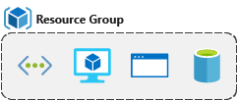
Resource Groups
Serves as a logical grouping of resources
Ties to resource life cycle
Can't be nested
Each resource must belong to a resource group
Most resources can be moved between resource groups
A fundamental concept

Slide 10

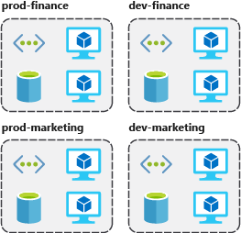


Resource Group Organization
Use a consistent naming convention
Organize by infrastructure
Consider authorization, life cycle, and billing

Slide 11
Lesson 02: Users and Groups

Slide 12
Users and Groups Overview
User Accounts
Create and manage users
Manage guest users
Group accounts
Demonstration: Users and Groups

Slide 13
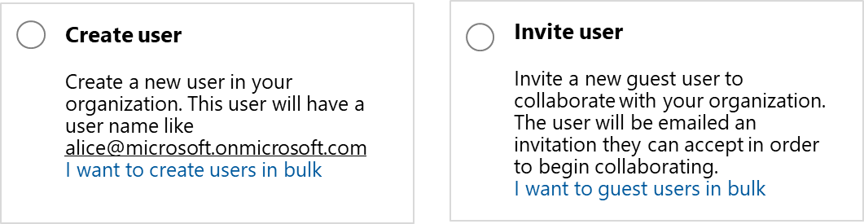
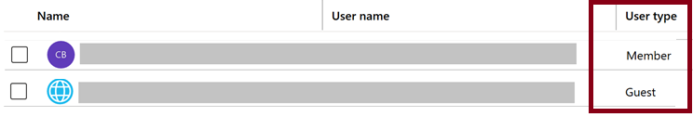
User Accounts
Azure Active Directory users can be Members or Guests

Slide 14
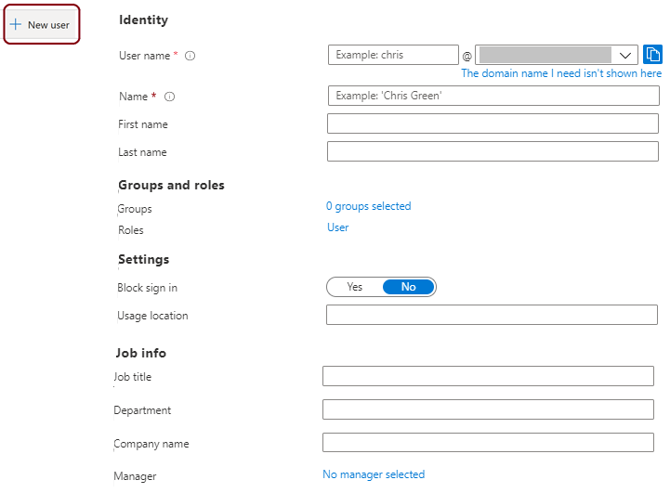
Create and Manage Users
You can manually create users or synchronizing users from Windows Server Active Directory

Slide 15
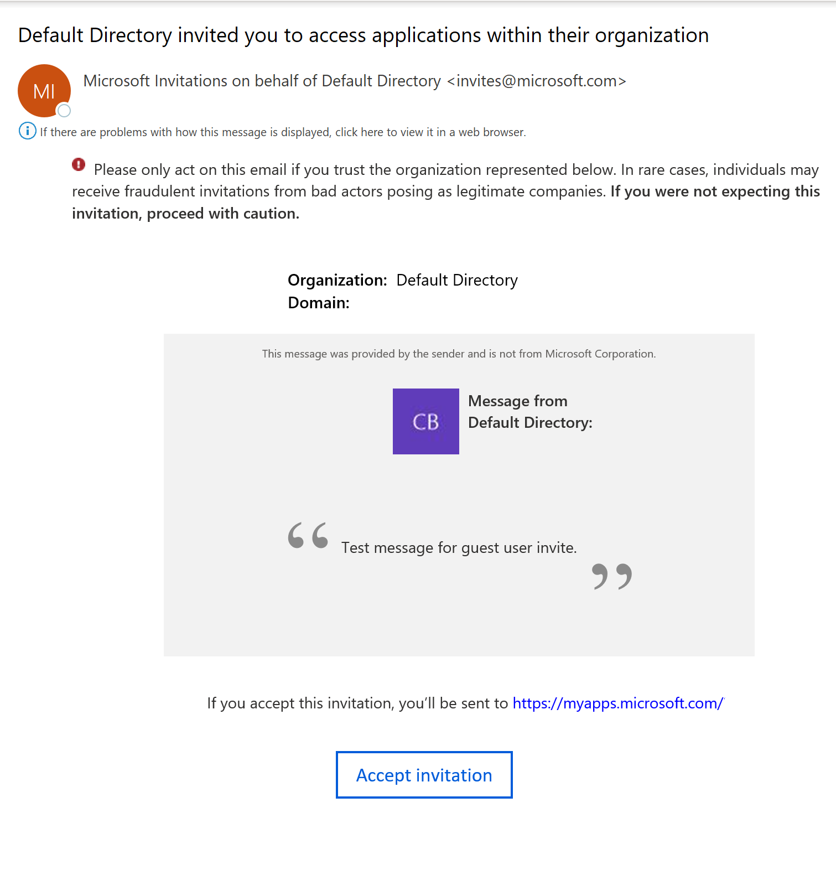
Managing Guest Users
Guest users sign in with their own work, school, or social identities
Guest users must be invited to your directory and accept the invitation
To test guest-related scenarios, you need
An Azure AD user with a role that allows creating user accounts
A valid email account

Slide 16
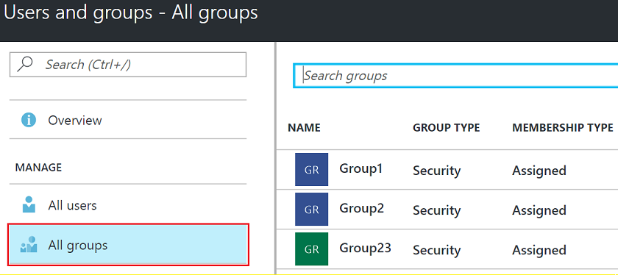
Azure AD Groups
Group Types
Security groups
Microsoft 365 groups
Assignment Types
Assigned
Dynamic User
Dynamic Device (Security groups only)
Notes:
Users, groups, licensing, and roles for large organizations - https://docs.microsoft.com/en-us/azure/active-directory/users-groups-roles/directory-overview-user-model
A group helps organize users to make it easier to manage permissions. Groups can be easily added through the portal. There are two types of groups: security groups and distribution groups.
✔️ Have you given any thought to which groups you need to create? How will you assign users to groups?

Slide 17
Demonstration: Users and Groups
Explore Active Directory users and groups
Explore PowerShell for group management

Slide 18
Lesson 03: Managing Azure AD Tenants

Slide 19
Managing Azure AD Tenants Overview
Managing multiple directories
Azure AD B2B and B2C
Domains and custom domains
Verifying custom domain names

Slide 20
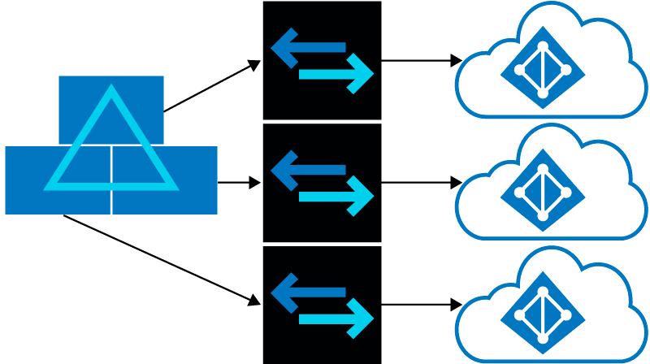
Managing Multiple Directories
You can create multiple Azure AD tenants
Reasons for creating multiple tenants
Resource independence
Administrative independence
Synchronization independence

Slide 21
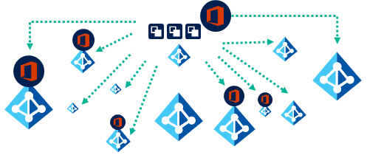
Azure AD B2B (1 of 2)
No external administrative overhead for your organization
Use your own identities and credentials; Azure AD is not required
No need to manage external accounts or passwords
No need to sync accounts or manage account lifecycles

Slide 22
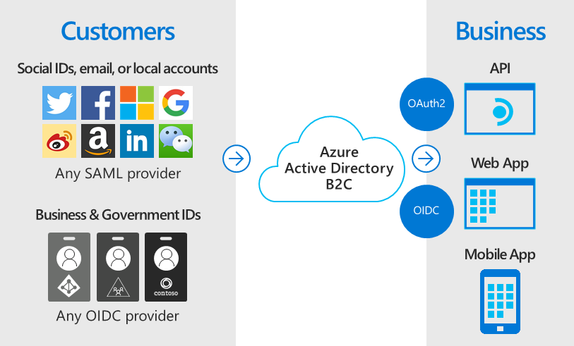
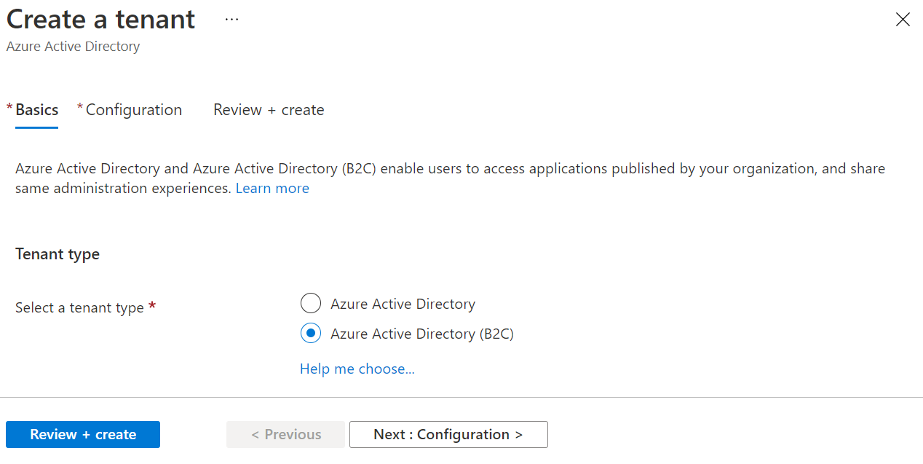
Azure AD B2C (2 of 2)
Provides business-to-customer identity as a service
Customize pages when users sign up, sign in, and modify their profile
Built-in and customizable workflows
Up to 100 custom attributes per user

Slide 23
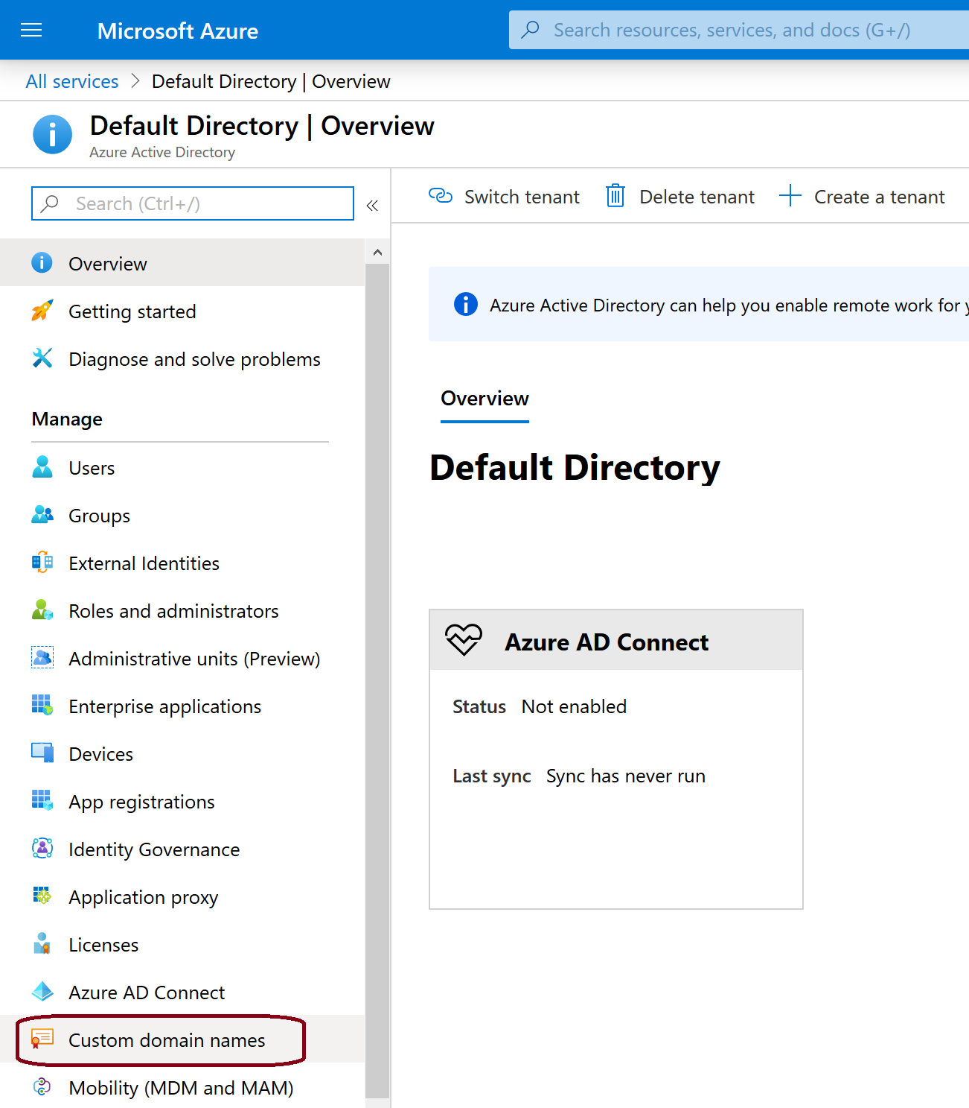
Domains and Custom Domains
Azure AD tenant domain names:
Initial (mandatory) with onmicrosoft.com suffix
Custom (optional)
Domain name management:
Requires global administrator privileges
Domain names are globally unique
Custom domain names require verification

Slide 24
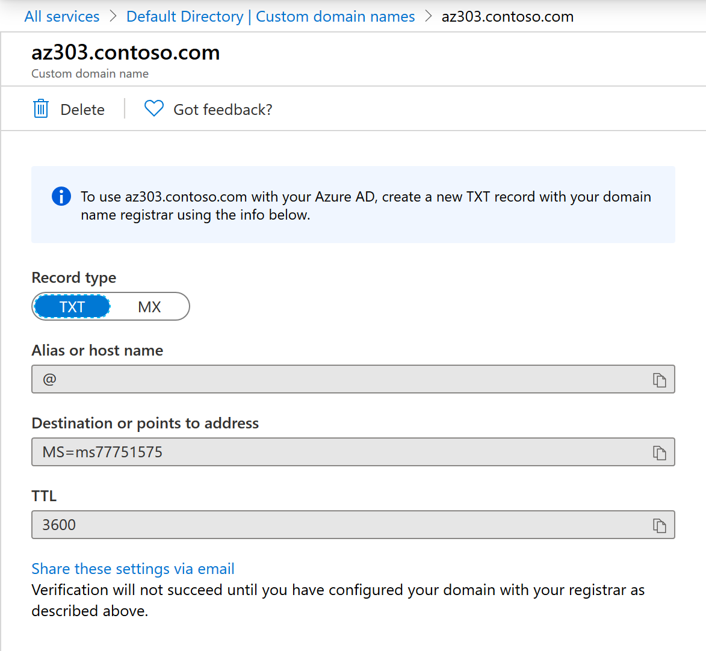
Verifying Custom Domain Names
A custom domain name is initially in an unverified state
To verify a custom domain, create a TXT or MX DNS record in the DNS zone

Slide 25
Lesson 04: Implement Conditional Access

Slide 26
Implement Conditional Access Overview
Azure AD Conditional Access
Azure AD Conditional Access Policies
Example – Named locations
Example – Trusted locations
Demonstration – Conditional access with MFA

Slide 27
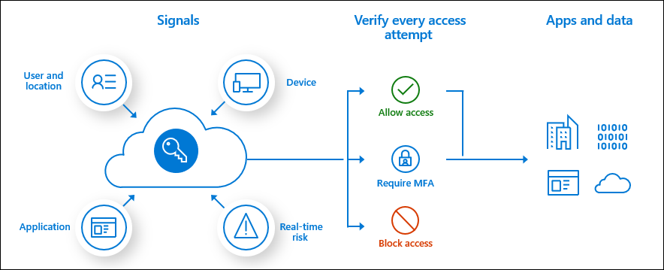
Azure AD Conditional Access
Identity management is the new control plane
Use signals to make an informed decision
Base the decision on organizational policy
Enforce the decision across resources
Notes:
What is Conditional Access? - https://docs.microsoft.com/en-us/azure/active-directory/conditional-access/overview

Slide 28
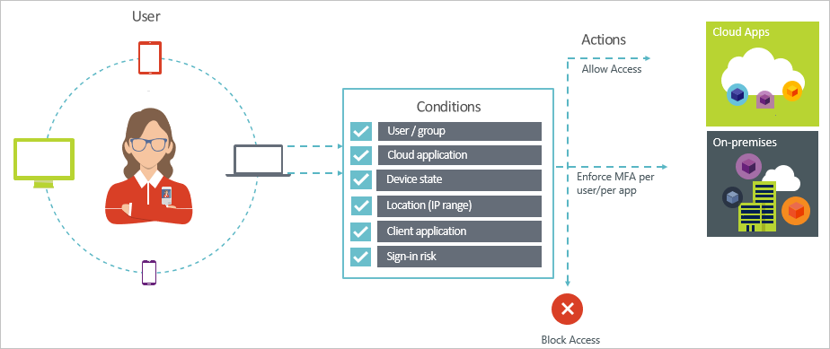
Azure AD Conditional Access Policies
Conditions – “When this happens”
Access controls – “Then do this”
Provides two step authentication verification
Lets you enforce controls on access to apps based on specific conditions
Notes:
Conditional Access: Require MFA for all users - https://docs.microsoft.com/en-us/azure/active-directory/conditional-access/howto-conditional-access-policy-all-users-mfa

Slide 29
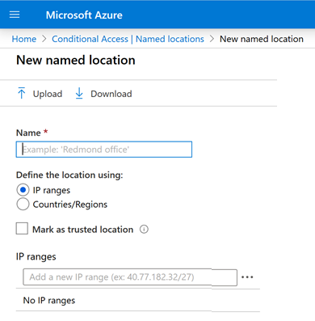
Example – Named Locations
Create logical groupings of IP address ranges or countries and regions
Use groupings in the location condition of Conditional Access policies
A named location has the following components:
Name
IP ranges
Mark as trusted location
Countries/regions
Include unknown areas

Slide 30
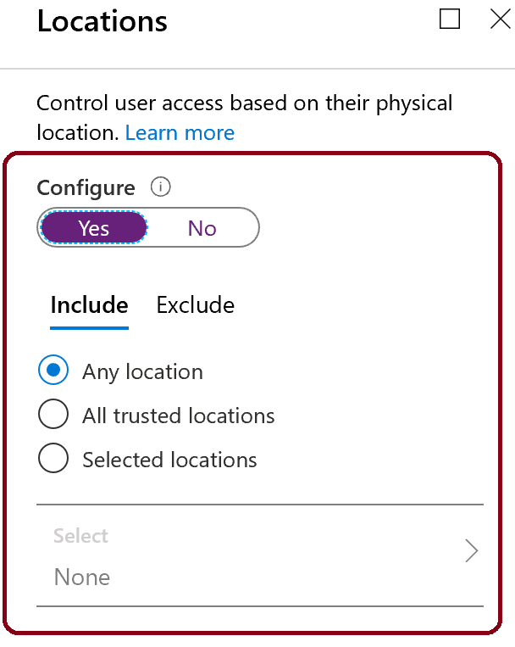
Example - Trusted locations
A location is a label for a network location that either represents a named location or multi-factor authentication Trusted IPs.
Azure AD enables single sign-on to devices, apps, and services from anywhere on the public internet
You can control access to your cloud apps based on the network location of a user
Common uses are:
Requiring multi-factor authentication for users accessing a service when they are off the corporate network.
Blocking access for users accessing a service from specific countries or regions.

Slide 31
Demonstration: Conditional Access
Create a conditional access policy
Configure conditions for multifactor authentication
Test MFA

Slide 32
Lesson 05: Azure Multi-Factor Authentication

Slide 33
Azure Multi-Factor Authentication Overview
Azure Multi-Factor Authentication
Azure MFA Settings
Azure MFA Reports

Slide 34
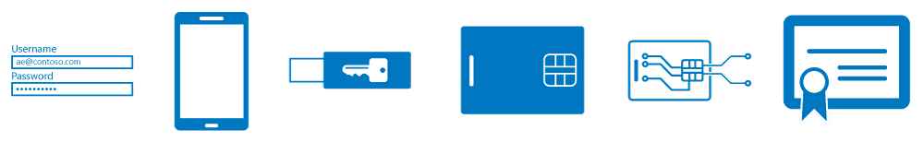
Multi-Factor Authentication (1 of 2)
Something you know, typically a password
Something you have, such as a trusted device that is not easily duplicated, like a phone or hardware key
Something you are - biometrics like a fingerprint or face scan

Slide 35
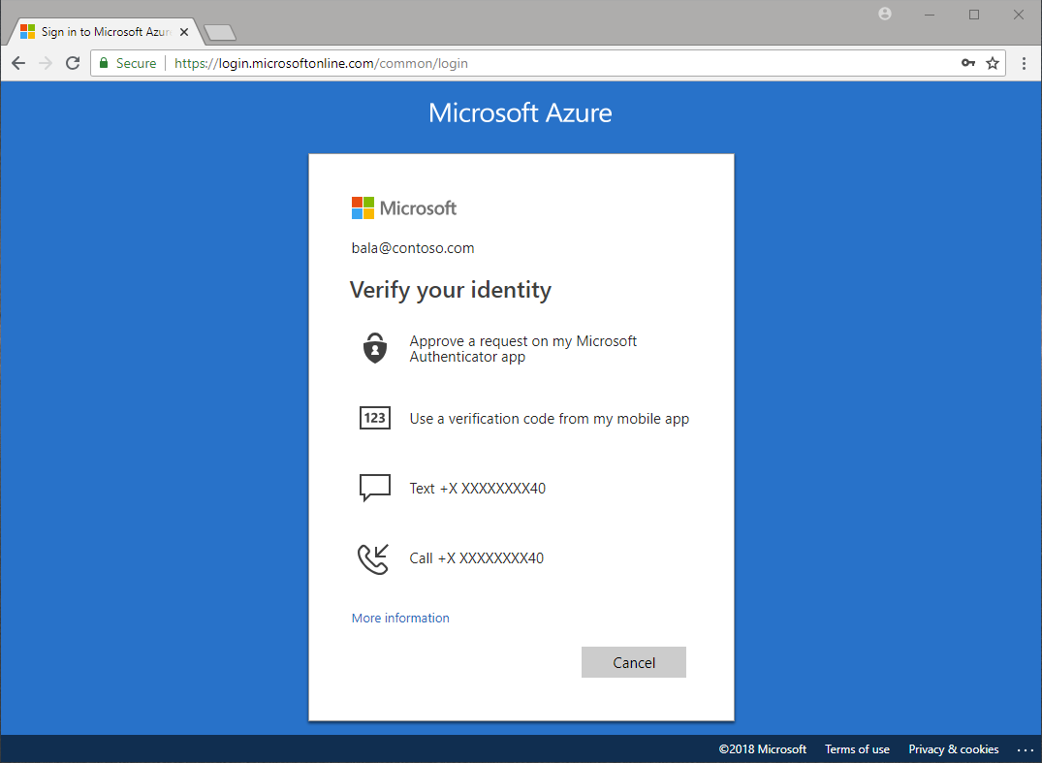
Multi-Factor Authentication (2 of 2)
Verification methods:
Microsoft Authenticator app
OATH hardware token
SMS
Voice call

Slide 36
Azure MFA Settings
Feature | Description
Account lockout | Temporarily lock accounts in the MFA service after too many denied authentication attempts – applies to PIN users
Block/unblock users | Block specific users from receiving MFA requests. Users are blocked for 90 days
Fraud alert | Configure user's ability to report fraudulent verification requests
Notifications | Enable notifications of MFA server events
OATH tokens | For cloud-based Azure MFA environments
Phone call settings | Includes greetings for cloud and on-premises environments
Providers | Shows existing authentication providers associated with your account

Slide 37
Azure MFA Reports
Report | Description
Blocked User History | Shows the history of requests to block or unblock users.
Usage and fraud alerts | Provides information on overall usage, user summary, and user details; as well as a history of fraud alerts submitted during the date range specified.
Usage for on-premises components | Provides information on overall usage for MFA through the NPS extension, ADFS, and MFA server.
Bypassed User History | Provides a history of requests to bypass Multi-Factor Authentication for a user.
Server status | Displays the status of Multi-Factor Authentication Servers associated with your account.

Slide 38
Lesson 06: Azure AD Identity Protection

Slide 39
Azure AD Identity Protection Overview
Azure AD Identity Protection

Slide 40
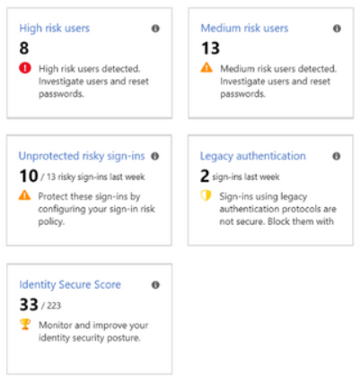
Azure Active Directory Identity Protection (1 of 2)
Automate the detection and remediation of identity-based risks
Investigate risks using data presented in the Azure portal
Export risk detection data to third-party utilities for further analysis

Slide 41
Azure Active Directory Identity Protection (2 of 2)
Risk detection and remediation
Risk investigation - risky users, risky sign-ins, risk detections
Risk detection type | Description
Atypical travel | Sign in from an atypical location based on the user's recent sign-ins.
Anonymous IP address | Sign in from an anonymous IP address (for example: Tor browser, anonymizer VPNs).
Unfamiliar sign-in properties | Sign in with properties we've not seen recently for the given user.
Malware linked IP address | Sign in from a malware linked IP address
Leaked Credentials | This risk detection indicates that the user's valid credentials have been leaked
Azure AD threat intelligence | Microsoft's internal and external threat intelligence sources have identified a known attack pattern

Slide 42
Azure Active Directory - Review
Knowledge Check
Microsoft Learn Modules (docs.microsoft.com/Learn)
Create Azure users and groups in Azure Active Directory
Allow users to reset their password with Azure Active Directory self-service password reset
Strengthen authentication (conditional access) with Azure Active Directory
Secure Azure Active Directory users with Multi-Factor Authentication
Host your domain on Azure DNS
Protect your identities with Azure AD Identity Protection
Notes:
Learn - https://docs.microsoft.com/en-us/learn/browse/

Slide 43
End of presentation

Slide 44
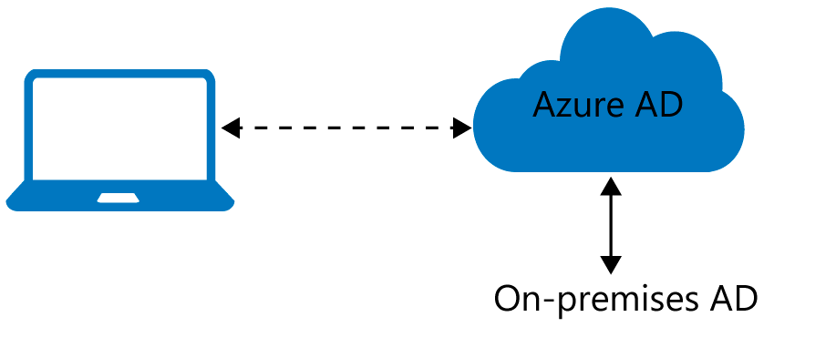
Azure AD Join
Benefits of AD Join:
Single-sign-on (SSO)
Enterprise compliant roaming
Access to Microsoft Store for Business
Windows Hello
Seamless access to on-premises resources
Connection options:
Registering
Joining
Notes:
Old student notes
Azure Active Directory (Azure AD) enables single sign-on to devices, apps, and services from anywhere. The proliferation of devices - including Bring Your Own Device (BYOD) – empowers end users to be productive wherever and whenever. But, IT administrators must ensure corporate assets are protected and that devices meet standards for security and compliance.
Azure AD Join is designed provide access to organizational apps and resources and to simply Windows deployments of work-owned devices. AD Join has these benefits.
Single-Sign-On (SSO) to your Azure managed SaaS apps and services. Your users will not have additional authentication prompts when accessing work resources. The SSO functionality is available even when users are not connected to the domain network.
Enterprise compliant roaming of user settings across joined devices. Users don’t need to connect to a Microsoft account (for example, Hotmail) to observe settings across devices.
Access to Microsoft Store for Business using an Azure AD account. Your users can choose from an inventory of applications pre-selected by the organization.
Windows Hello support for secure and convenient access to work resources.
Restriction of access to apps from only devices that meet compliance policy.
Seamless access to on-premise resources when the device has line of sight to the on-premises domain controller.
Connection options
To get a device under the control of Azure AD, you have two options:
Registering a device to Azure AD enables you to manage a device’s identity. When a device is registered, Azure AD device registration provides the device with an identity that is used to authenticate the device when a user signs-in to Azure AD. You can use the identity to enable or disable a device.
Joining a device is an extension to registering a device. This means, it provides you with all the benefits of registering a device and in addition to this, it also changes the local state of a device. Changing the local state enables your users to sign-in to a device using an organizational work or school account instead of a personal account.
✔️ Registration combined with a mobile device management (MDM) solution such as Microsoft Intune, provides additional device attributes in Azure AD. This allows you to create conditional access rules that enforce access from devices to meet your standards for security and compliance.
✔️ Although AD Join is intended for organizations that do not have on-premises Windows Server Active Directory infrastructure it can be used for other scenarios like branch offices.

Slide 45
Devices in Azure AD
Azure AD registered
Devices that are Azure AD registered are signed in with a personal Microsoft account or another local account.
Windows 10
iOS
Android
MacOS
Azure AD joined
Devices that are Azure AD joined are owned by an organization and are signed in with an Azure AD account belonging to that organization. They exist only in the cloud.
Windows 10
Windows Server 2019 Virtual Machines running in Azure (Server core is not supported)
Hybrid Azure AD joined
Devices that are hybrid Azure AD joined are owned by an organization and are signed in with an Active Directory Domain Services. They exist in the cloud and on-premises.
Windows 7, 8.1, or 10
Windows Server 2008 or newer
Notes:
Old student notes
Azure AD registered
Devices that are Azure AD registered are typically personally owned or mobile devices and are signed in with a personal Microsoft account or another local account.
Windows 10
iOS
Android
MacOS
Azure AD joined
Devices that are Azure AD joined are owned by an organization, and are signed in with an Azure AD account belonging to that organization. They exist only in the cloud.
Windows 10
Windows Server 2019 Virtual Machines running in Azure (Server core is not supported)
Hybrid Azure AD joined
Devices that are hybrid Azure AD joined are owned by an organization and are signed in with an Active Directory Domain Services account belonging to that organization. They exist in the cloud and on-premises.
Windows 7, 8.1, or 10
Windows Server 2008 or newer
Note: A hybrid state refers to more than just the state of a device. For a hybrid state to be valid, a valid Azure AD user also is required.

