Slide 1
AZ-303: Microsoft Azure Architect Technologies

Slide 2



Module 02: Implement and Manage Hybrid Identities
Lesson 01: Azure AD Connect
Lesson 02: Self-Service Password Reset
Lesson 03: Azure AD Connect Health
Notes:
Lesson 01, Install Azure AD Connect, was combined with Azure AD Connect. Lesson 02 now has more about synchronization and less about SSPR. Again, most modules follow Skillpipe more closely.

Slide 3
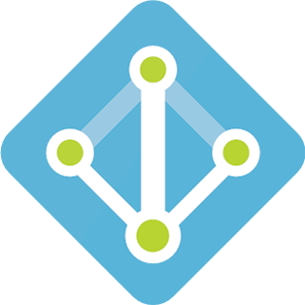
Lesson 01: Azure AD Connect

Slide 4
Azure AD Connect Overview
Azure AD Connect
Azure AD Cloud Sync
Azure AD Connect Installation
Hybrid Identity with Azure Active Directory
Authentication Options
Password Hash Synchronization
Pass-through Authentication
Federation with Azure AD
Single Sign-on
Demonstration: Azure AD Seamless Single Sign-On

Slide 5
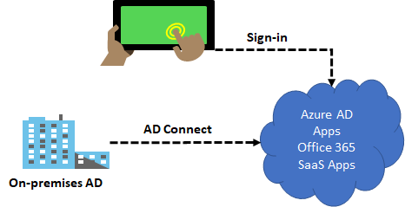
Azure AD Connect
Integrate your on-premises directories with Azure Active Directory
Provides a common identity for your users for Office 365, Azure, and SaaS applications integrated with Azure AD
There are several authentication options to enable hybrid identity
Notes:
What is Azure AD Connect - https://docs.microsoft.com/en-us/azure/active-directory/hybrid/whatis-azure-ad-connect
SaaS = Software as a Service
Azure AD Connect will integrate your on-premises directories with Azure Active Directory. This allows you to provide a common identity for your users for Office 365, Azure, and SaaS applications integrated with Azure AD in a hybrid identity environment. Microsoft Azure Active Directory Connect can be downloaded for free. Integrating your on-premises directories with Azure AD makes your users more productive by providing a common identity for accessing both cloud and on-premises resources.

Slide 6
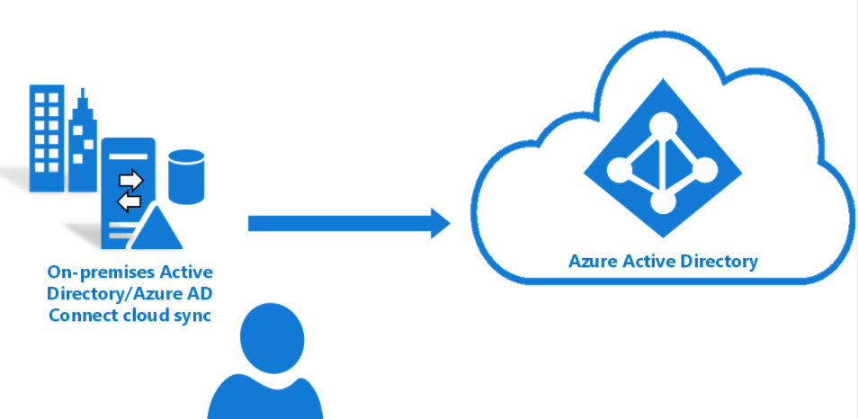
Azure AD Connect Cloud Sync
Alternate method to integrate your on-premises directories with Azure Active Directory
Uses the Azure AD cloud provisioning agent
Runs stand-alone or along-side Azure AD Connect
Notes:
All you need to know about Cloud Sync → Azure AD Connect cloud sync documentation | Microsoft Docs
How is Azure AD Connect cloud sync different from Azure AD Connect sync?
With Azure AD Connect cloud sync, provisioning from AD to Azure AD is orchestrated in Microsoft Online Services. An organization only needs to deploy, in their on-premises and IaaS-hosted environment, a lightweight agent that acts as a bridge between Azure AD and AD. The provisioning configuration is stored in Azure AD and managed as part of the service.
What is Azure AD Connect cloud sync
Azure AD Connect cloud sync is new offering from Microsoft designed to meet and accomplish your hybrid identity goals for synchronization of users, groups and contacts to Azure AD. It accomplishes this by using the Azure AD cloud provisioning agent instead of the Azure AD Connect application. However, it can be used alongside Azure AD Connect sync and it provides the following benefits:
Support for synchronizing to an Azure AD tenant from a multi-forest disconnected Active Directory forest environment: The common scenarios include merger & acquisition, where the acquired company's AD forests are isolated from the parent company's AD forests and companies that have historically had multiple AD forests.
Simplified installation with light-weight provisioning agents: The agents act as a bridge from AD to Azure AD, with all the sync configuration managed in the cloud.
Multiple provisioning agents can be used to simplify high availability deployments, particularly critical for organizations relying upon password hash synchronization from AD to Azure AD.
Support for large groups with up to 50K members. It is recommended to use only the OU scoping filter when synchronizing large groups.

Slide 7
Azure AD Connect Installation
Install Azure AD Connect:
Express settings
Custom settings
Upgrade from DirSync
Upgrade from Azure AD Sync or Azure AD Connect
Configure sync features:
Filtering
Password hash synchronization
Password writeback
Prevent accidental deletes
Automatic upgrade

Slide 8
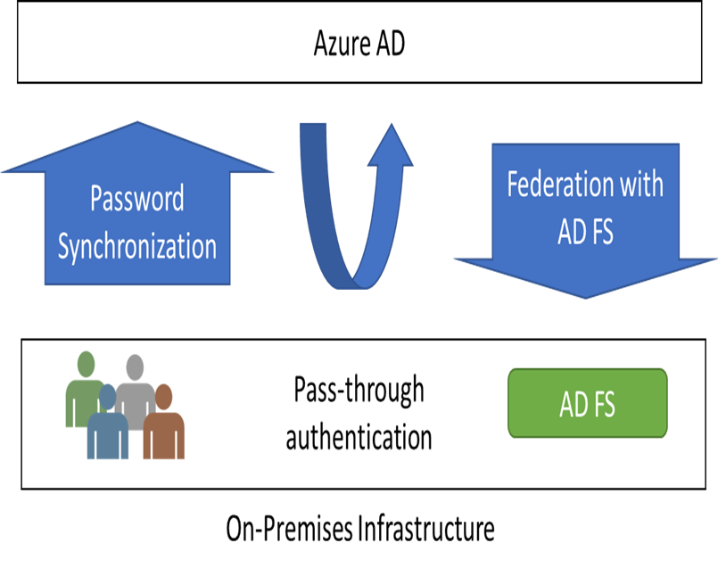
Hybrid Identity with Azure Active Directory (1 of 2)
Password Hash Synchronization (PHS) can synchronize an encrypted version of the password hash for user accounts
Pass-through authentication (PTA) authenticates the username and password with the on-premises domain controllers
AD FS is the Microsoft implementation of an identity federation solution that uses claims-based authentication
Notes:
What is Azure AD Connect - https://docs.microsoft.com/en-us/azure/active-directory/hybrid/whatis-azure-ad-connect
Each of these options is discussed in more detail on the following slides.

Slide 9
Hybrid Identity with Azure Active Directory (2 of 2)
I need to: | PHS and SSO | PTA and SSO | AD FS
Sync new user, contact, and group accounts created in my on-premises Active Directory to the cloud automatically. | X | X | X
Set up my tenant for Office 365 hybrid scenarios. | X | X | X
Enable my users to sign in and access cloud services using their on-premises password. | X | X | X
Implement single sign-on using corporate credentials. | X | X | X
Ensure no password hashes are stored in the cloud. |  | X | X
Enable cloud-based multi-factor authentication solutions. | X | X | X
Enable on-premises multi-factor authentication solutions. |  |  | X
Support smartcard authentication for my users. |  |  | X
Display password expiry notifications in the Office Portal and on the Windows 10 desktop. |  |  | X
Notes:
Also see:
https://github.com/Azure/fta-identity/blob/master/identity-applications/aad-external-identities-decision-tree.md
Azure Active Directory External Identities Decision Tree
There are a number of flavors of Azure Active Directory (Azure AD) that allow you to work with "external identities", i.e. users that are outside of your own organization:
Azure AD (sometimes also referred to as Azure AD B2E - Business to Enterprise) When writing applications for Azure AD, you can target users from a single organization (single tenant), or users from any organization that already has an Azure AD tenant (called multi-tenant applications).
Azure AD B2B (Business to Business) This isn't so much a different directory service, it's an extension on top of Azure AD that allows you to work with external identities, mainly for collaboration scenarios using Microsoft applications (e.g. Office 365, Microsoft Teams, PowerBI, ...). In Azure AD B2B, you invite external users into your own tenant as "guest" users that you can then assign permissions to (for authorization) while still allowing them to keep using their existing credentials (for authentication) inside their own organization.
Azure AD B2C (Business to Consumer, Customer or even Citizen) This is a separate directory service (but still built on top of the global Azure AD infrastructure) which enables you to customize and control how customers sign up, sign in, and manage their profiles when using your applications.
In order to choose the right Azure AD flavor for your project, there are a number of decision factors that come into play. This lesson provides a decision tree and guidance to help you make the right choice.
Here are some additional considerations for a few of these decision points:
Should any user from any and all existing Azure AD tenants be able to sign in? covers the scenario where all three of the following conditions are met: The users will be defined in a regular Azure AD tenant (not in Azure AD B2C) or have a personal Microsoft Account. The Azure AD tenants that contain the users already exist. You accept users to sign in from any existing Azure AD tenant (in practice you can of course still reject users inside the application itself depending on the tenant that they signed in through, e.g. if you only want to allow users from specifically allowed tenants).
Do you prefer to 'see' the users in your own Azure AD tenant (as guests)? This is an important decision factor to check if Azure AD B2B is suitable for your scenario because B2B users are represented as guest users inside your own Azure AD tenant. This has implications around trust and security, e.g. guest users can be browsed in your directory and granted permissions to your resources (e.g. SharePoint documents, Outlook calendars, PowerBI dashboards, even your Azure subscriptions). Guest users are also able to get information about users in your directory (which they are now a guest of), and depending on the permissions you've granted these guest users they can also browse users and groups, see application definitions and more. This may be exactly what you want in a situation where you trust these users to collaborate with your organization (e.g. business partners or vendors); it may also be something you explicitly want to avoid (e.g. to prevent someone from inadvertently or maliciously granting these guest users permissions to corporate resources or your Azure subscriptions). Think of it this way: would you invite these users into your physical office building? If so, then B2B guest user access may be a great choice.
Do you need extensive support for branding/customization? Azure AD (and by extension, Azure AD B2B) allow for branding of the sign-in page, but this is more limited than what Azure AD B2C offers. For now, fully customized user experiences can only be achieved in Azure AD B2C.
Is creating a just-in-time (unmanaged) Azure AD tenant acceptable? This refers to the Azure AD capability where users can perform a self-service signup in Azure AD with their email address and an Azure AD tenant corresponding to their email domain will automatically and transparently be created for them behind the scenes (a so-called unmanaged or just-in-time directory, sometimes also referred to as a viral tenant). Note that customers can still take control of this unmanaged directory, but depending on your user base having this directory created for them may or may not be acceptable.
NOTE: This decision tree is intended as a starting point to understand your options, but there can be others or even combinations of different options. For example, you can use Azure AD B2C and configure it to allow user sign-in for multi-tenant Azure AD tenants - with or without the traditional support for self-service sign up and social identity providers.

Slide 10
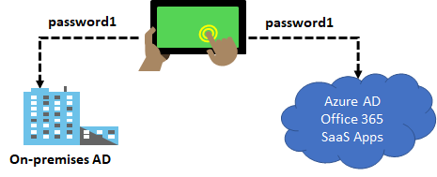
Authentication Options - Password Hash Synchronization
Password hash synchronizes user passwords from on-premises Active Directory to cloud-based Azure AD
Sign into Azure AD services using the on-premises password
Improve the productivity of your users and reduce your helpdesk costs
Notes:
What is password hash synchronization with Azure AD? - https://docs.microsoft.com/en-us/azure/active-directory/hybrid/whatis-phs
Password hash synchronizes user passwords from on-premises Active Directory to cloud-based Azure AD. Sign in to Azure AD services using the on-premises password. Improve the productivity of your users and reduce your helpdesk costs.
How password hash synchronization works
https://docs.microsoft.com/en-us/azure/active-directory/hybrid/how-to-connect-password-hash-synchronization#how-password-hash-synchronization-works
✔️ This is same sign-in, not single sign-on. The user still authenticates against two separate directory services.

Slide 11
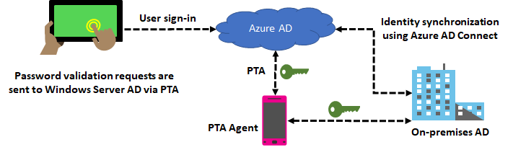
Authentication Options - Pass-through Authentication
Supports user sign-in into all web browser-based applications and into Microsoft Office client applications
Is a free feature and can be enabled via Azure AD Connect
Is not only for user sign-in but allows an organization to use other Azure AD features – MFA and Self-Service Password Reset
Notes:
User sign-in with Azure Active Directory Pass-through Authentication - https://docs.microsoft.com/en-us/azure/active-directory/hybrid/how-to-connect-pta
Azure Active Directory (Azure AD) Pass-through Authentication allows your users to sign in to both on-premises and cloud-based applications using the same passwords. This feature provides your users a better experience - one less password to remember, and reduces IT helpdesk costs because your users are less likely to forget how to sign in. When users sign in using Azure AD, this feature validates users' passwords directly against your on-premises Active Directory.

Slide 12
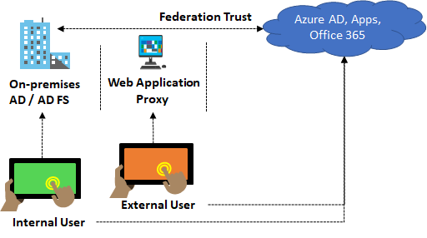
Authentication Options - Federation with Azure AD
Federation is a collection of domains that have established trust
You can federate your on-premises environment with Azure AD and use this federation for authentication and authorization
This sign-in method ensures that all user authentication occurs on-premises
Notes:
Azure AD Connect and federation - https://docs.microsoft.com/en-us/azure/active-directory/hybrid/how-to-connect-fed-whatis

Slide 13
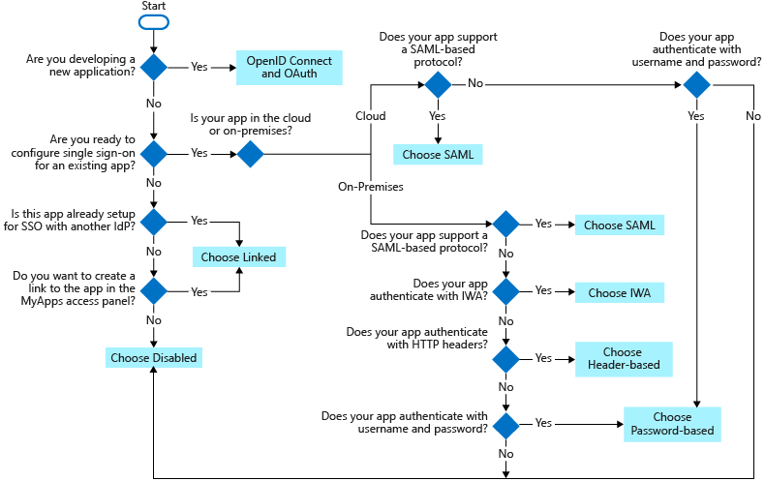
Single Sign-On
Choosing a single sign-on method depends on how the application is configured for authentication.
Cloud applications can use OpenID Connect, OAuth, SAML, password-based, linked, or disabled methods for single sign-on.
On-premises applications can use password-based, Integrated Windows Authentication, header-based, linked, or disabled methods for single sign-on. The on-premises choices work when applications are configured for Application Proxy.

Slide 14
Demonstration: Azure AD Seamless Single Sign-On
Prerequisites
Enable Azure AD Connect
Verify Seamless SSO is enabled

Slide 15
Lesson 02: Self-Service Password Reset

Slide 16
Self-Service Password Reset Overview
Self-Service Password Reset
Password Writeback
Demonstration: SSPR

Slide 17
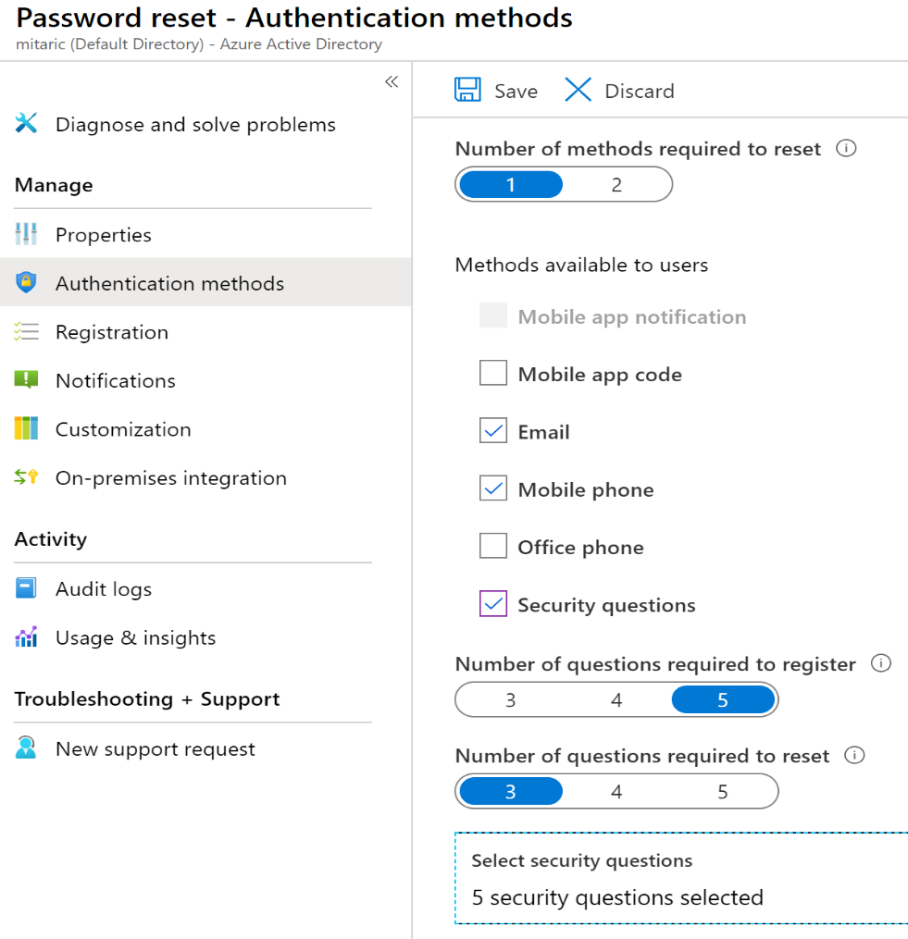
Self-Service Password Reset
Users can bypass the helpdesk and reset their own passwords
Determine who can use self-service password reset
1
2
Choose the number of authentication methods required and the methods available (email, phone, questions)
3
You can require users to register for SSPR (same process as MFA)
Notes:
Plan an Azure Active Directory self-service password reset deployment - https://docs.microsoft.com/en-us/azure/active-directory/authentication/howto-sspr-deployment

Slide 18
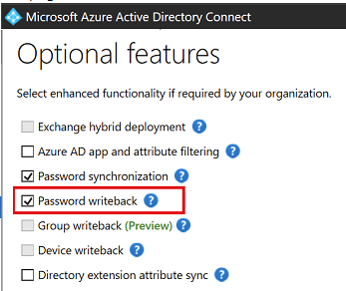
Password Writeback
Use Password Writeback to configure Azure AD to write passwords back to your on-premises Active Directory
A component of Azure AD Connect
Available to subscribers of Premium Azure Active Directory editions
Removes the need to set up and manage an on-premises SSPR solution
Notes:
Tutorial: Enable Azure Active Directory self-service password reset writeback to an on-premises environment - https://docs.microsoft.com/en-us/azure/active-directory/authentication/tutorial-enable-sspr-writeback
Having a cloud-based password reset utility is great but most companies still have an on-premises directory where their users exist. How does Microsoft support keeping traditional on-premises Active Directory (AD) in sync with password changes in the cloud? Password writeback is a feature enabled with Azure AD Connect that allows password changes in the cloud to be written back to an existing on-premises directory in real time.
Password writeback provides:
Enforcement of on-premises Active Directory password policies. When a user resets their password, it is checked to ensure it meets your on-premises Active Directory policy before committing it to that directory. This review includes checking the history, complexity, age, password filters, and any other password restrictions that you have defined in local Active Directory.
Zero-delay feedback. Password writeback is a synchronous operation. Your users are notified immediately if their password did not meet the policy or could not be reset or changed for any reason.
Supports password changes from the access panel and Office 365. When federated or password hash synchronized users come to change their expired or non-expired passwords, those passwords are written back to your local Active Directory environment.
Supports password writeback when an admin resets them from the Azure portal. Whenever an admin resets a user’s password in the Azure portal, if that user is federated or password hash synchronized, the password is written back to on-premises. This functionality is currently not supported in the Office admin portal.
Doesn’t require any inbound firewall rules. Password writeback uses an Azure Service Bus relay as an underlying communication channel. All communication is outbound over port 443.

Slide 19
Demonstration: Self-Service Password Reset
Enable SSPR
Select authentication and registration options
Configure notifications and customizations
Test

Slide 20
Lesson 03: Azure AD Connect Health

Slide 21
Configure Azure AD Connect Health Overview
Azure AD Connect Health Overview
Implement Azure AD Connect Health

Slide 22
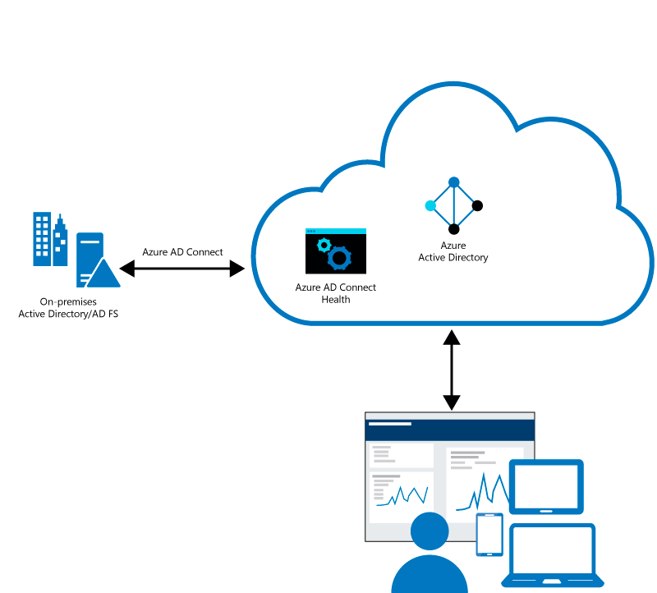
Azure AD Connect Health Overview
Helps monitor on-premises identity infrastructure thus ensuring the reliability of the environment
Key benefits:
Enhanced security
Alerts on all critical AD FS system issues
Simplified deployment and management
Rich usage metrics
Enhanced admin experience

Slide 23
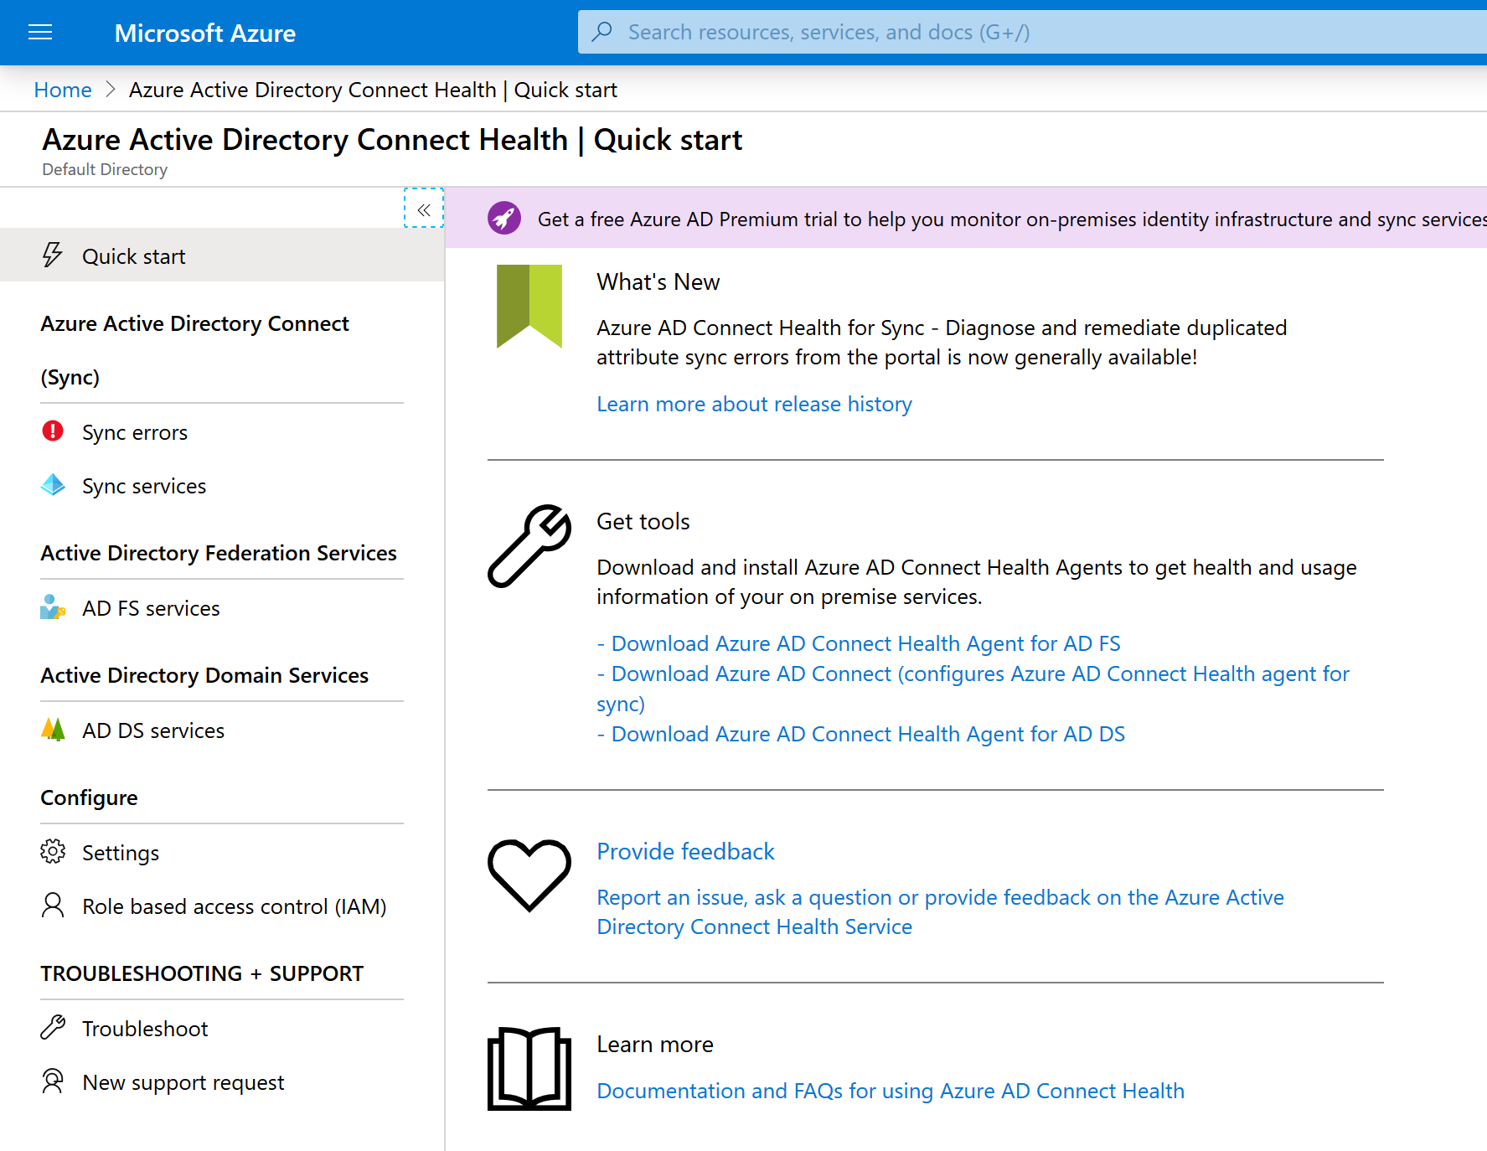
Implement Azure AD Connect Health
Install the Azure AD Connect Health agent
Install the latest version of Azure AD Connect (includes Azure AD Connect Health for sync)
Monitor Azure AD Connect Health portal
Views of alerts
Performance monitoring
Usage analytics

Slide 24
Implement and Manage Hybrid Identities - Review
Knowledge Check
Microsoft Learn Modules (docs.microsoft.com/Learn)
Implement Azure AD Connect
Plan for Azure AD Connect implementation
Strengthen authentication (conditional access) with Azure Active Directory
Secure Azure Active Directory users with Multi-Factor Authentication
Notes:
Learn - https://docs.microsoft.com/en-us/learn/browse/

Slide 25
End of presentation

