Slide 1
AZ-303: Microsoft Azure Architect Technologies

Slide 2



Module 03: Implement Virtual Networking
Lesson 01: Azure Virtual Networks
Lesson 02: Virtual Network Peering
Lesson 03: Extending the Virtual Network
Notes:
Concepts on VPN Gateway have moved toward the end.

Slide 3

Lesson 01: Azure Virtual Networks

Slide 4
Virtual Networks Overview
Azure Virtual Networking
Notes:
Indented topics on the Overview slide indicate those Skillpipe pages are covered/consolidated onto another slide.

Slide 5



Azure Virtual Networking (1 of 3)
Virtual network concepts:
Address space
Subnets
Regions
Subscription
Best practices:
Ensure non-overlapping address spaces
Don’t cover the entire VNet address space
Configure a few larger VNets (rather than many small ones)
Secure VNets by assigning NSGs to subnets
Subnet 1
Subnet 2
Virtual Network
Notes:
https://docs.microsoft.com/en-us/azure/virtual-network/virtual-networks-overview
https://docs.microsoft.com/en-us/azure/virtual-network/concepts-and-best-practices

Slide 6
Azure Virtual Networking (2 of 3)
Internet
Azure
On-premises
To the internet:
Outbound traffic is allowed by default
Inbound traffic through:
A public IP address
A public load balancer
Within Azure:
Virtual network
VNet Peering
Virtual network service endpoint and/or private endpoint
To on-premises resources:
Point-to-site VPN
Site-to-site VPN
Azure ExpressRoute

Slide 7
Azure Virtual Networking (3 of 3)
Filter network traffic:
Network Security Groups
Network virtual appliances
Route network traffic:
Route tables
BGP routes
Virtual network integration for Azure services:
Deploy dedicated instances of the service into a VNet
Use Private Link
Use service endpoints

Slide 8
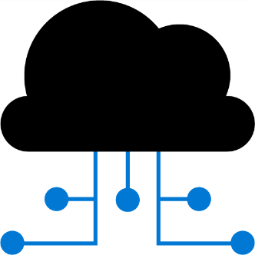
Lesson 02: Virtual Network Peering

Slide 9
Virtual Network Peering Overview
Connect Services with VNet Peering
Configure VNet Peering
VNet Peering Considerations

Slide 10
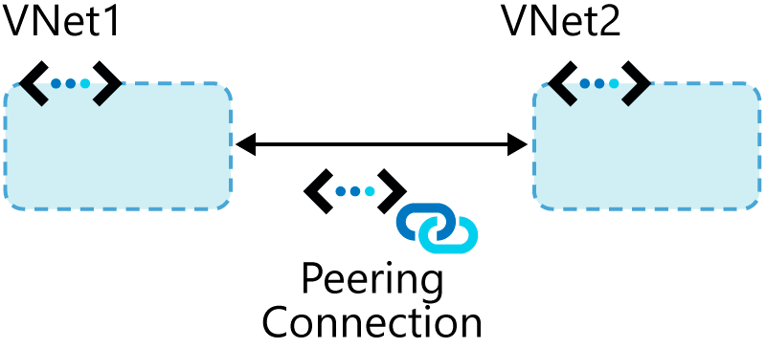
Connect Services with VNet Peering
Types of peering connections:
Virtual network peering
Global virtual network peering
Peering considerations:
Reciprocal connections are required
Cross-subscription peerings are supported

Slide 11
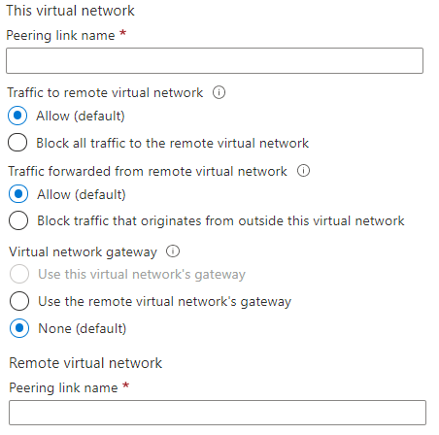
Configure VNet Peering
Create two virtual networks
Peer the virtual networks
Create virtual machines on each network
Test communication between the machines
Notes:
https://docs.microsoft.com/en-us/azure/virtual-network/virtual-network-peering-overview

Slide 12
VNet Peering Considerations
Peering virtual networks in different regions is referred to as Global VNet Peering
To add or remove address ranges, delete the peering, add or remove the address ranges, then re-create the peering.
Global VNet peering costs more than VNet peering within a region
Address ranges can’t be added to or deleted from a virtual network once a virtual network is peered
Notes:
https://docs.microsoft.com/en-us/azure/virtual-network/virtual-network-peering-overview

Slide 13
Extending the Virtual Network

Slide 14
Extending the Virtual Network Overview
Gateway Transit and Connectivity
Service Chaining
VNet Peering vs VPN Gateways
Considerations

Slide 15
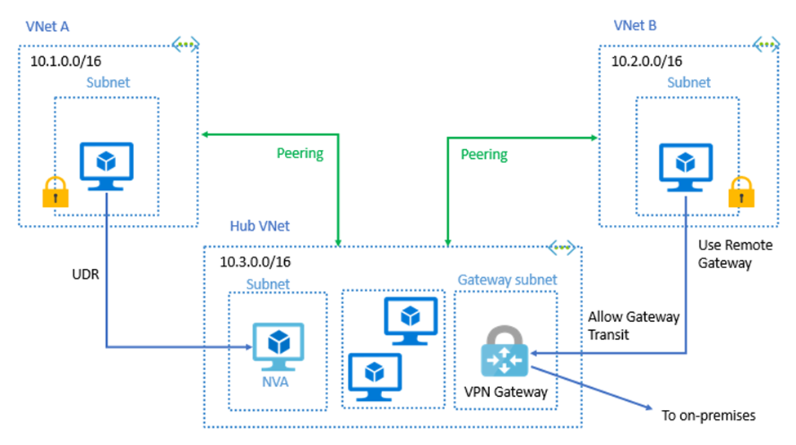

Gateway Transit and Connectivity
Gateway transit allows peered virtual networks to share the gateway and get access to resources
No VPN gateway is required in the peered virtual network
Default VNet peering provides full connectivity
IP address spaces of connected networks can't overlap
Notes:
Azure Virtual Network frequently asked questions (FAQ) VNet Peering - https://docs.microsoft.com/en-us/azure/virtual-network/virtual-networks-faq

Slide 16
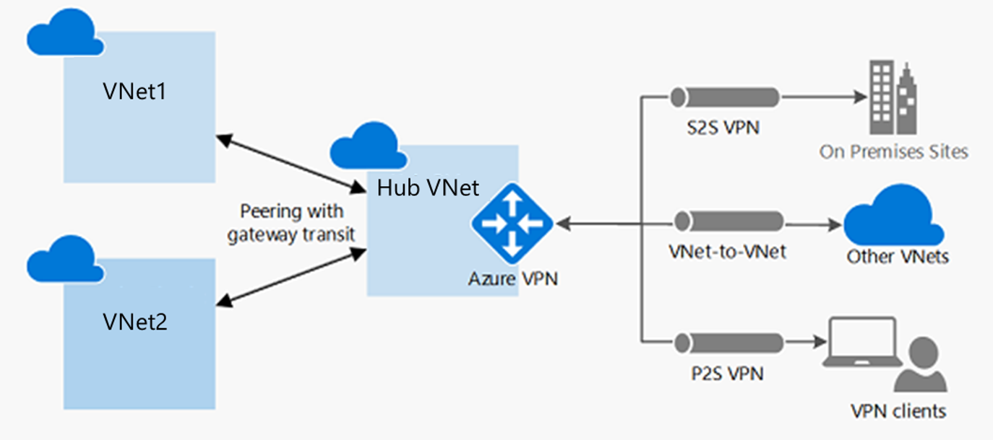
Service Chaining
Leverage user-defined routes and service chaining to implement custom routing
Implement a VNet hub with a network virtual appliance or a VPN gateway
Service chaining enables you to direct traffic from one virtual network to a virtual appliance, or virtual network gateway, in a peered virtual network, through user-defined routes
Notes:
Distribute your services across Azure virtual networks and integrate them by using virtual network peering - https://docs.microsoft.com/learn/modules/integrate-vnets-with-vnet-peering

Slide 17
VNet Peering vs VPN Gateways
Both support networks in different regions, subscriptions, and tenants
Item | VNet Peering | VPN Gateway
Limits | Up to 500 per VNet | One per VNet (SKU-dependent)
Pricing model | Ingress/Egress | Hourly + Egress
Encryption | Not included | IPsec/IKE
Bandwidth | No limits | SKU-dependent
Public endpoints | No | Yes
Transitivity | No | Yes (routing dependent)
Initial setup time | Fast | ~30 minutes
Typical scenarios | Data replication, database failover, and other scenarios needing frequent backups of large data. | Encryption-specific scenarios that are not latency sensitive and do not need high throughout.

Slide 18
Considerations
Virtual Network peering:
Direct (no interconnecting devices)
Low-latency, high-bandwidth
Regional or global
VPN gateways:
Serve as interconnecting devices
Introduce extra latency and limit bandwidth
Gateway transit:
Allows sharing a VPN or ExpressRoute gateway across a peering
Minimizes complexity and centralizes management

Slide 19
Demonstration: VNet Peering
Configure VNet Peering
Configure a VPN Gateway
Allow Gateway Transit
Confirm VNet Peering

Slide 20
Implement Virtual Networking- Review
Knowledge Check
Microsoft Learn Modules (docs.microsoft.com/Learn)
Distribute your services across Azure virtual networks and integrate them by using virtual network peering
Connect your on-premises network to Azure with VPN gateway
Design an IP addressing schema for your Azure deployment
Implement Windows Server IaaS VM IP addressing and routing
Notes:
Learn - https://docs.microsoft.com/en-us/learn/browse/

Slide 21
End of presentation

