Slide 1
AZ-303: Microsoft Azure Architect Technologies

Slide 2





Module 04: Implement VMs for Windows and Linux
Lesson 01: Running Virtual Machines on Azure
Lesson 02: Configure High Availability
Lesson 03: Deploy Virtual Machine Scale Sets
Lesson 04: Implement Azure Dedicated Hosts
Lesson 05: Deploy Azure Disk Encryption

Slide 3
Lesson 01: Running Virtual Machines on Azure

Slide 4
Running Virtual Machines on Azure Overview
Virtual machine planning
Naming the virtual machine
Virtual machine sizes
Virtual machine pricing
Virtual machine storage
Running Linux and Windows Virtual Machines on Azure

Slide 5
Virtual Machine Planning
Start with the network – segregate and secure
Name the VM
Name the virtual machine – next slide
Choose a location
Each region has different hardware and service capabilities
Locate Virtual Machines as close as possible to your users and to ensure compliance and legal obligations
Consider pricing
Compute costs
Storage costs (consumption-based and reserved instances)
60+ Azure regions
Available in 140 countries

Slide 6
Naming the Virtual Machine
The name is configured as part of the operating system – not trivial to change
Establish a naming convention
A VM deployment includes several resources:
The VM itself
Storage account for the disks
Virtual network (shared with other VMs and services)
Network interface to communicate on the network
Network Security Group(s) to secure network traffic
Public internet address (optional)
Element | Example
Environment | dev, prod, QA
Location | uw (US West), ue (US East)
Instance | 01, 02
Product or service | Service
Role | sql, web, messaging

Slide 7
Virtual Machine Sizes
A Series - Entry-level for dev/test
G Series – Memory and storage optimized
B Series – Economical bursting
H Series - High performance computing
D Series – General purpose compute
L Series – Storage optimized
Dc Series – Protect data in use
M Series – Memory optimized
E Series – In-memory hyper-threaded applications optimized
Mv2 Series – Largest memory optimized
F Series – Compute optimized
N Series – GPU enabled
Notes:
Virtual Machine series - https://azure.microsoft.com/en-us/pricing/details/virtual-machines/series/
Sizes for Windows virtual machines in Azure - https://docs.microsoft.com/en-us/azure/virtual-machines/windows/sizes?toc=%2Fazure%2Fvirtual-machines%2Fwindows%2Ftoc.json#size-tables
Sizes for Linux virtual machines in Azure - https://docs.microsoft.com/en-us/azure/virtual-machines/linux/sizes?toc=%2fazure%2fvirtual-machines%2flinux%2ftoc.json
Resize a Windows VM - https://docs.microsoft.com/en-us/azure/virtual-machines/windows/resize-vm

Slide 8
Virtual Machine Pricing
There are two separate costs charged for every VM
Compute costs
Storage costs
There are two main payment options for compute costs
Pay as you go
Reserved Virtual Machine instances
Azure provides a variety of OS images:
All currently supported versions of Windows
All major Linux distributions

Slide 9



Virtual Machine Storage
Azure VM (Windows)
Each Azure VM has:
OS disk
Temporary disk (contents can be lost)
Data disks (optional)
C:\
OS disk
D:\
Temporary disk
F:\
Data disk
OS and data disks reside in Azure Storage accounts:
Azure-based storage service
Standard (HDD, SSD) or Premium (SSD), or Ultra (SSD)
Azure blob
Notes:
Introduction to Azure managed disks - https://docs.microsoft.com/en-us/azure/virtual-machines/managed-disks-overview
Introduction to Azure managed disks - https://docs.microsoft.com/en-us/azure/virtual-machines/windows/managed-disks-overview
Convert a Windows virtual machine from unmanaged disks to managed disks - https://docs.microsoft.com/en-us/azure/virtual-machines/windows/convert-unmanaged-to-managed-disks

Slide 10
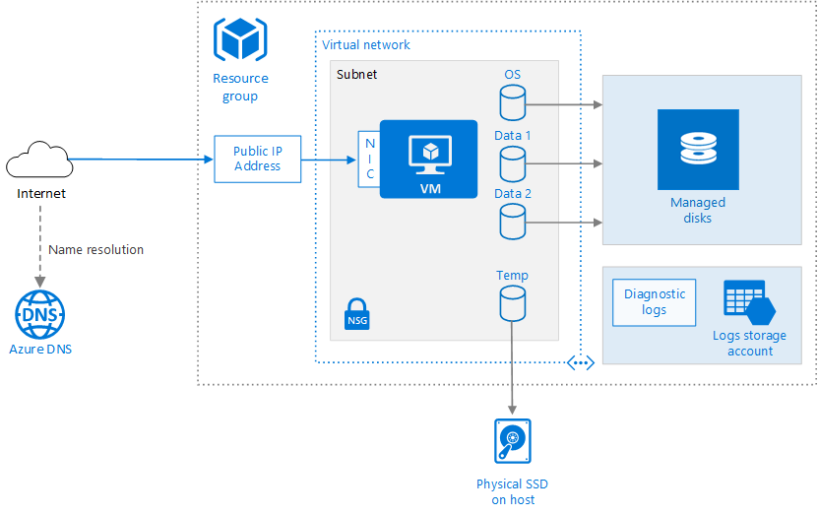
Running Linux and Windows Virtual Machines on Azure
Azure VM deployments include other resources
Networking
Storage
Place related resources in the same resource group to simplify
Management
Cost tracking
Deprovisioning

Slide 11
Lesson 02: Configure High Availability

Slide 12
Configure High Availability Overview
Availability Sets
Availability Zones

Slide 13
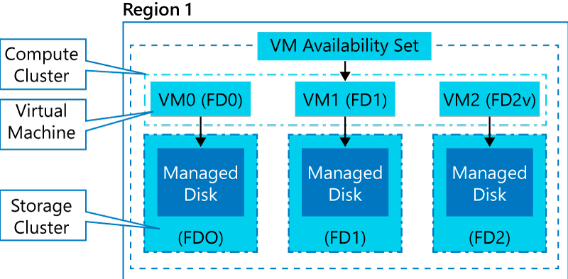
Availability Sets (1 of 2)
An availability set is a logical grouping of VMs within a datacenter
Automatically distributes VMs across fault and update domains on compute clusters
With managed disks, it provides equivalent resiliency on storage clusters
Provides 99.95% availability SLA (for 2 or more VMs)

Slide 14
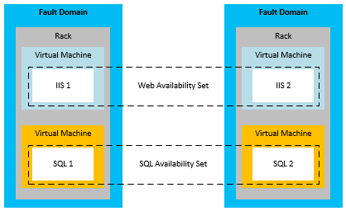
Availability Sets (2 of 2)
Update domains allows Azure to perform incremental or rolling upgrades across a deployment. During planned maintenance, only one update domain is rebooted at a time
Fault Domains are a group of Virtual Machines that share a common set of hardware, switches, that share a single point of failure. VMs in an availability set are placed in at least two fault domains
Notes:
✔️ Placing your Virtual Machines into an availability set does not protect your application from operating system or application-specific failures, it does limit the impact of potential physical hardware failures, network outages, or power interruptions. Can you see why this important and how this is implemented?

Slide 15
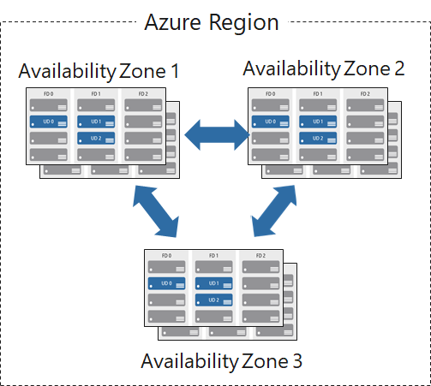
Availability Zones
Unique physical locations in a region
Each zone is equipped with independent power, cooling and networking
Provides fault and update domain protections like Availability Sets
Provides 99.99% availability SLA (for 2 or more VMs)
Notes:
Regions and Availability Zones in Azure - https://docs.microsoft.com/en-us/azure/availability-zones/az-overview

Slide 16
Lesson 03: Deploy Virtual Machine Scale Sets

Slide 17
Deploy Virtual Machine Scale Sets Overview
Scaling Concepts
Virtual Machine Scale Sets
Virtual Machine Scale Sets Benefits
Implementing Scale Sets
Demonstration – Create a VM scale set

Slide 18
Scaling Concepts
Vertical scaling (scale up and scale down) is the process of increasing or decreasing power to a single instance of a workload; usually manual​
Horizontal scaling (scale out and scale in) is the process of increasing or decreasing the number of instances of a workload; frequently automated
Notes:
Autoscaling - https://docs.microsoft.com/en-us/azure/architecture/best-practices/auto-scaling

Slide 19
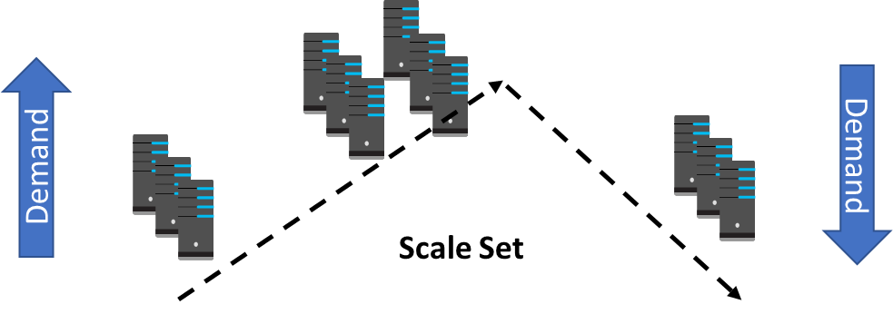
Virtual Machine Scale Sets (1 of 2)
Consists of identically configured, load balanced virtual machines
Supports manual, scheduled and automatic scaling
Automatically distributes VMs across fault domains and update domains
Notes:
What are virtual machine scale sets? - https://docs.microsoft.com/en-us/azure/virtual-machine-scale-sets/overview

Slide 20
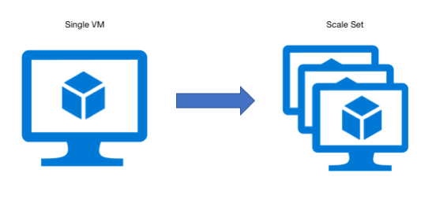
Virtual Machine Scale Sets (2 of 2)
Simplicity: All VM instances are created using the same OS image
Support for: Azure Load Balancer and Application Gateway
High availability: multiple instances of the same workload
Autoscaling: the number of instances adjusts dynamically based on demand
Scalability: up to 1,000 VM instances (600 when using custom images)

Slide 21
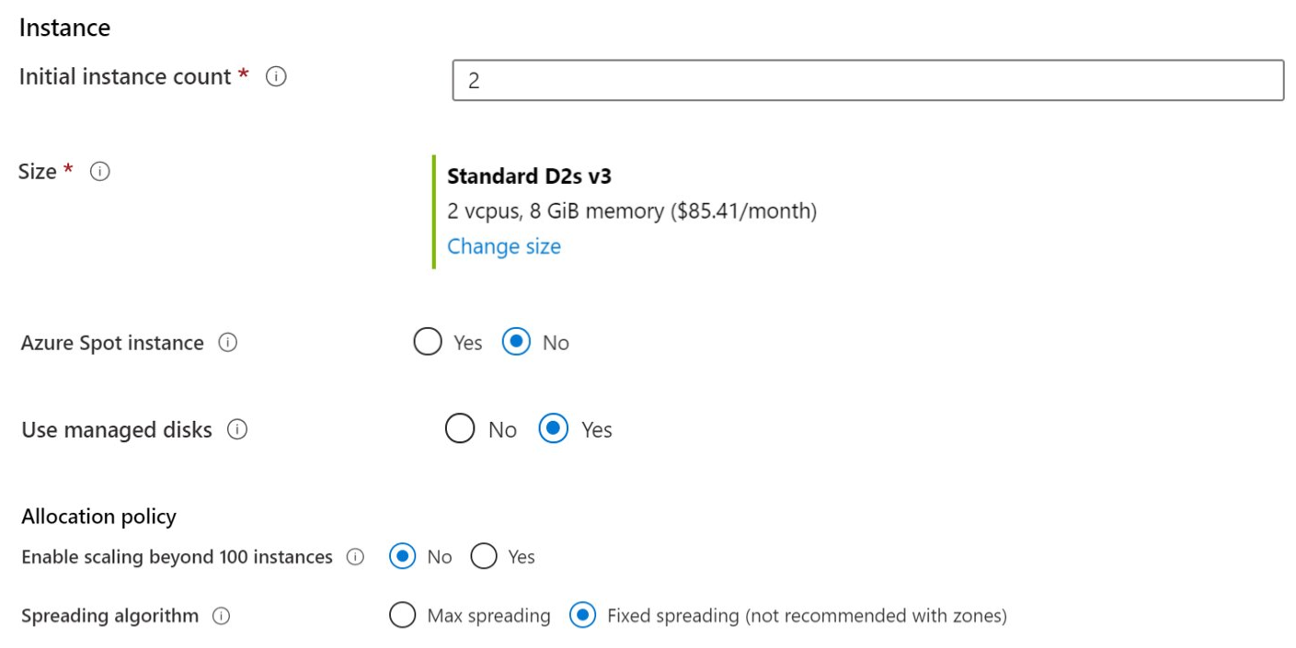
Implementing Scale Sets
Instance count. Number of VMs in the scale set (0 to 1000)
Instance size. The size of each virtual machine in the scale set
Azure Spot Instance. Unused capacity at a discounted rate
Uses managed disks
Enables scaling beyond 100 instances
Notes:
QuickStart: Create a virtual machine scale set in the Azure portal - https://docs.microsoft.com/en-us/azure/virtual-machine-scale-sets/quick-create-portal

Slide 22
Demonstration: Create a VM Scale Set
Create a Load Balancer
Create the virtual machine scale set

Slide 23
Lesson 05: Implement Azure Dedicated Hosts

Slide 24
Implement Azure Dedicated Hosts Overview
Azure Dedicated Hosts
High Availability Considerations
Azure Dedicated Hosts Capacity
Deploy Virtual Machines to Dedicated Hosts

Slide 25
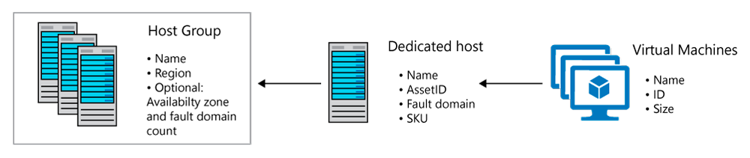
Azure Dedicated Hosts
Implement hardware isolation at the physical server level
Control impact of maintenance events initiated by the Azure platform

Slide 26
High Availability Considerations
Use Availability Zones for fault isolation
Create one host group per zone
Use Fault Domains for fault isolation
Assign a fault domain for each host in the same host group
Use Availability Zones and Fault Domains
Create one host group per zone
Assign a fault domain for each host in the same host group

Slide 27
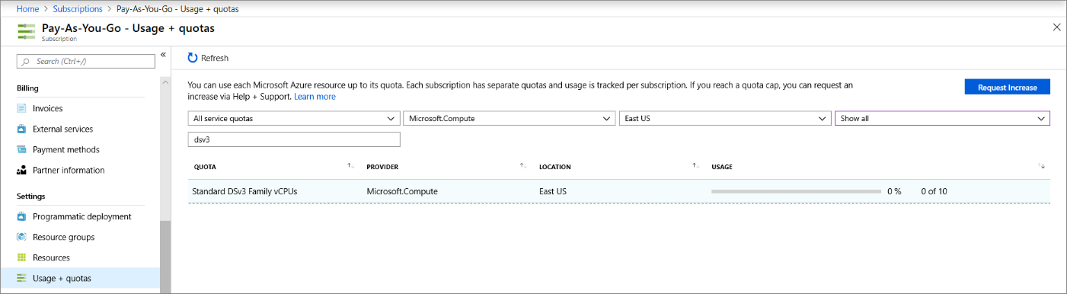
Azure Dedicated Hosts Capacity
Quotas
Limit vCPUs for dedicated hosts per region
Support quota increase
Pricing
Per dedicated host (regardless of the number of deployed VMs)
Based on VM family, type, and region

Slide 28
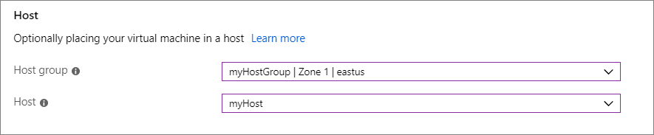
Deploy VMs to Dedicated Hosts
Limitations:
Virtual machine scale sets are supported on dedicated hosts
The sizes and hardware types available for dedicated hosts vary by region
To deploy highly available VMs to dedicated hosts:
Create one or more host groups
Create one or more hosts in each group
Create a VM on each host

Slide 29
Lesson 05: Deploy Azure Disk Encryption

Slide 30
Deploy Azure Disk Encryption Overview
Azure Encryption Technologies
Encrypt an Existing VM Disk

Slide 31
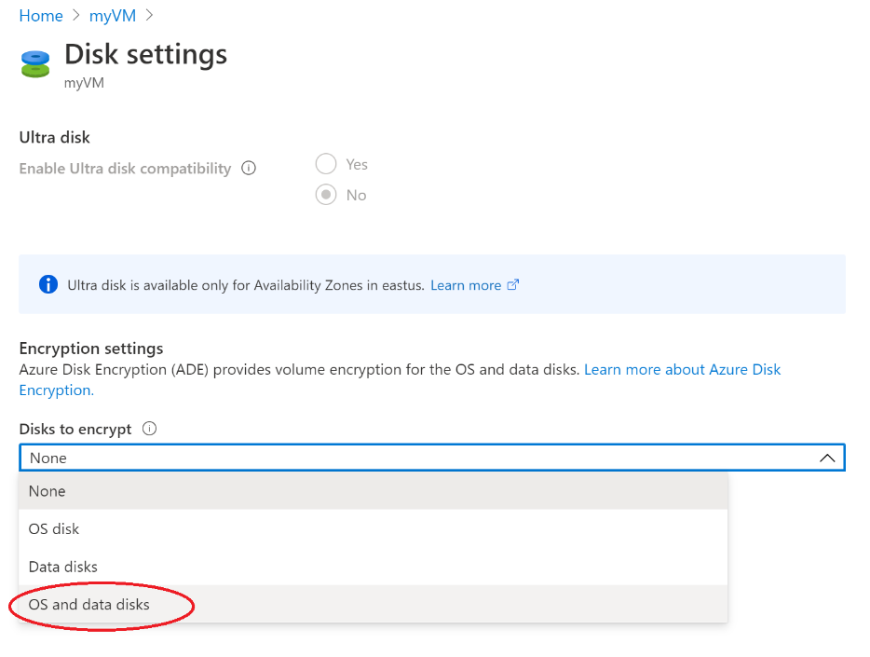
Azure Encryption Technologies
Two main encryption-based disk protection methods for Azure VMs
Storage Service Encryption (SSE)
Enabled for all new and existing storage accounts
Cannot be disabled
Azure Disk Encryption (ADE)
Managed by the VM owner
Uses BitLocker on Windows VMs and DM-Crypt on Linux VMs
Stores encryption keys in Azure Key Vault

Slide 32
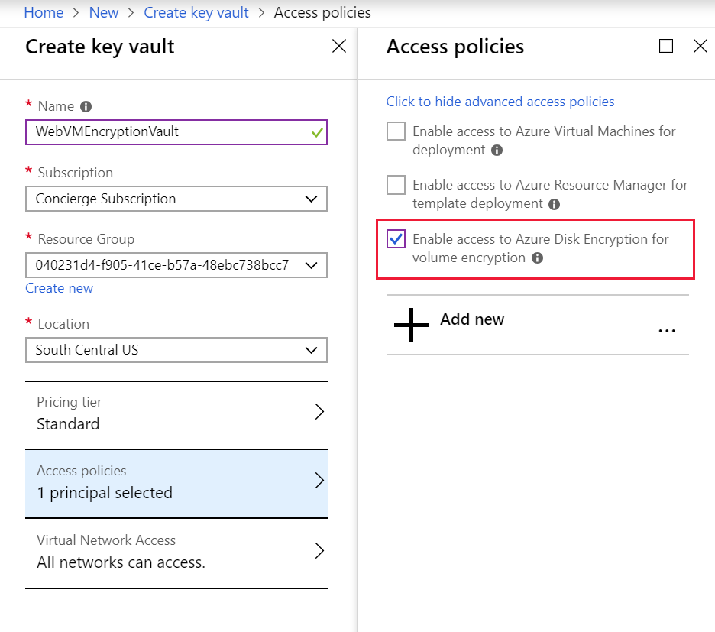
Encrypt an Existing VM Disk
Azure Disk Encryption prerequisites
An Azure key vault - The portal will prompt you to create one if necessary
A key vault access policy that enables support for disk encryption
ADE encryption keys stored in the key vault

Slide 33
Implement VMs for Windows and Linux - Review
Knowledge Check
Microsoft Learn Modules (docs.microsoft.com/Learn)
Choose the right disk storage for your virtual machine workload
Add and size disks in Azure virtual machines
Build a scalable application with virtual machine scale sets
Implement scale and high availability with Windows Server VM
Secure your Azure virtual machine disks
Notes:
Learn - https://docs.microsoft.com/en-us/learn/browse/

Slide 34
End of presentation

