Slide 1
AZ-303: Microsoft Azure Architect Technologies

Slide 2








Module 05: Implement Load Balancing and Network Security
Lesson 01: Implement Azure Load Balancer
Lesson 02: Implement Application Gateway
Lesson 03: Implement Azure Front Door
Lesson 04: Implement Azure Traffic Manager
Lesson 05: Implement Azure Firewall
Lesson 06: Implement Security Groups
Lesson 07: Implement Azure Bastion
Lab 05 – Load Balancing and Network Security

Slide 3
Lesson 01: Implement Azure Load Balancer

Slide 4
Implement Azure Load Balancer Overview
Select a Load Balancer
Distribute Traffic with a Load Balancer
Select a Load Balancer SKU
Configure a Public Load Balancer
Demonstration: Create a load balancer to balance virtual machines

Slide 5
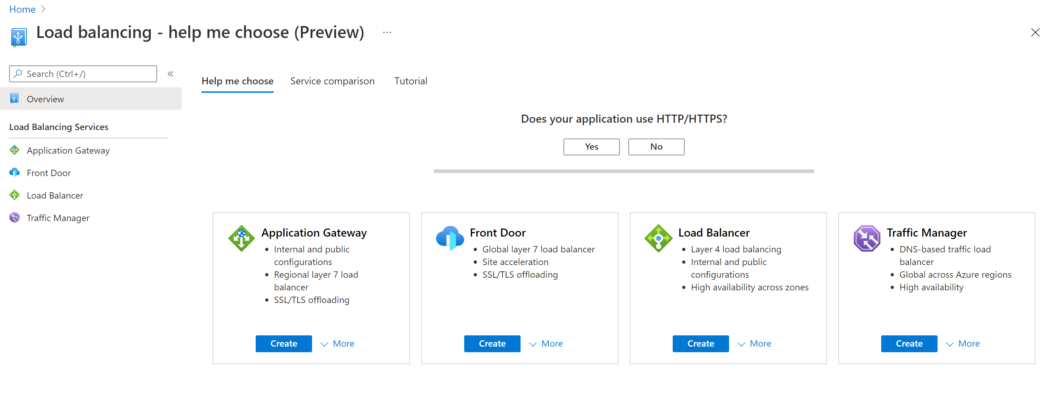
Select a Load Balancer
Azure provides several load balancing options
Notes:
This is a screenshot directly from the “Load balancing – help me choose” section of the Azure Portal

Slide 6
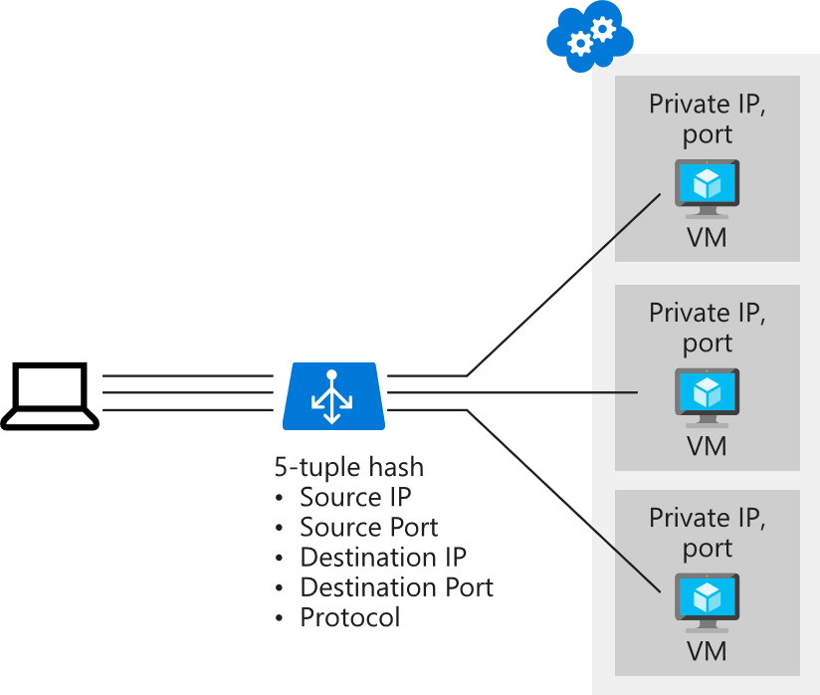
Distribute Traffic with Azure Load Balancer (1 of 3)
Distribute traffic based on:
Source IP
Source port
Destination IP
Destination port
Protocol type

Slide 7
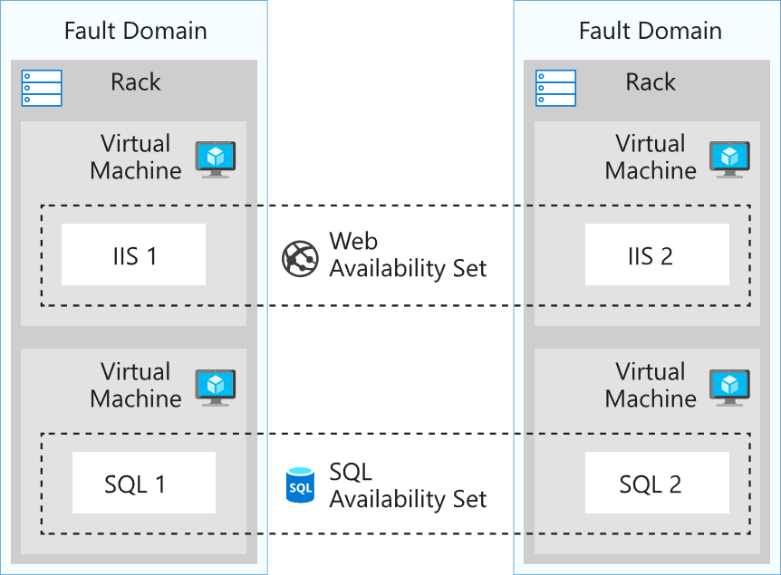
Distribute Traffic with Azure Load Balancer (2 of 3)
Supports Availability Set scenarios

Slide 8
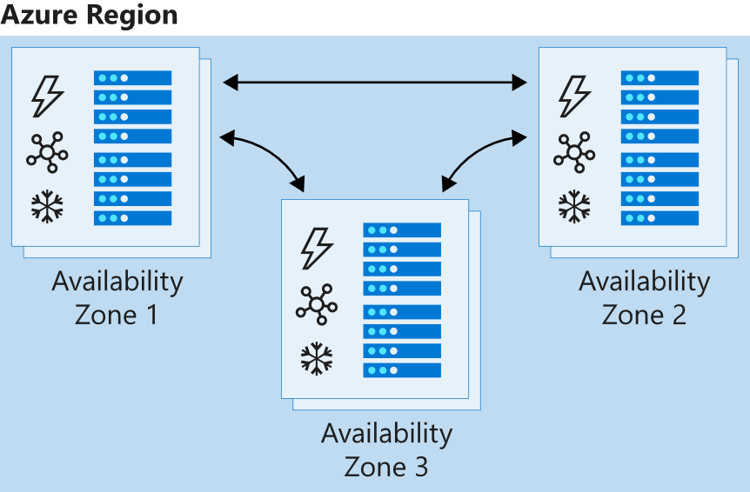
Distribute Traffic with Azure Load Balancer (3 of 3)
Supports Availability Zone scenarios

Slide 9
Select an Azure Load Balancer SKU
There are Basic and Standard Load Balancers
Basic Load Balancers
Port forwarding Automatic reconfiguration Health probes Outbound connections through source network address translation (SNAT) Diagnostics through Azure Log Analytics for public-facing load balancers
Standard Load Balancers
Supports all the basic features plus more HTTPS health probes Availability zones Diagnostics through Azure Monitor, for multidimensional metrics High availability (HA) ports Outbound rules A guaranteed SLA (99.99% for two or more virtual machines in different zones
Notes:
https://docs.microsoft.com/en-us/azure/load-balancer/skus

Slide 10
Configure a Public Load Balancer (1 of 3)
Distribution mode
Five-tuple hash

Slide 11
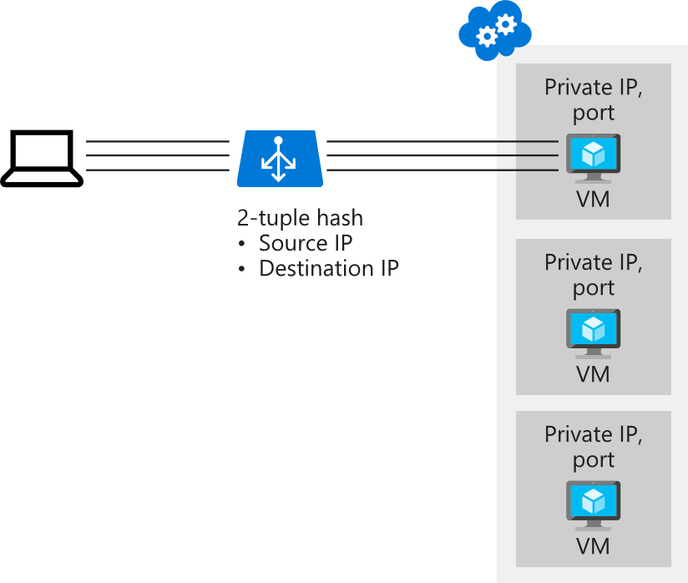
Configure a Public Load Balancer (2 of 3)
Distribution mode
Source IP affinity

Slide 12
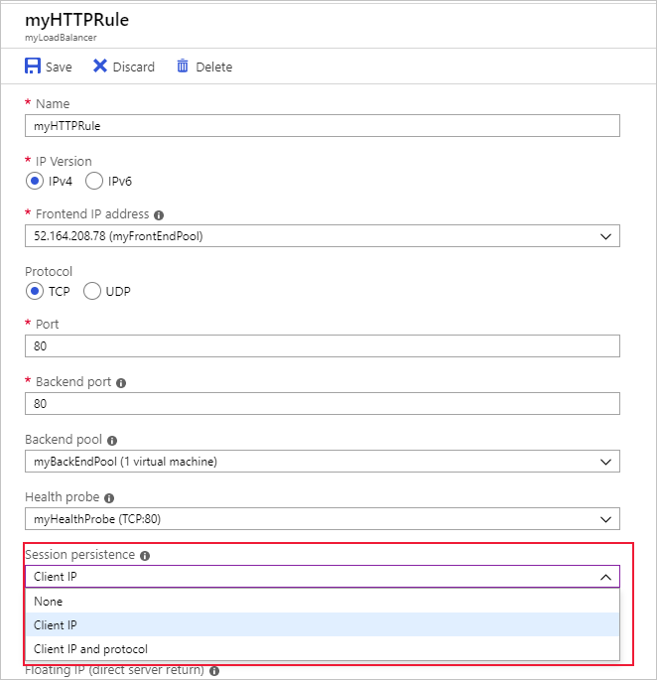
Configure a Public Load Balancer (3 of 3)
Session persistence
None
Client IP (use for Remote Desktop Gateway)
Client IP and protocol

Slide 13
Demonstration: Create a load balancer to balance virtual machines
Create a load balancer
Create load balancer resources
Create virtual machines
Create NSG Rule
Install IIS and test

Slide 14

Lesson 02: Implement an Application Gateway

Slide 15
Implement an Application Gateway Overview
Application Gateway
Application Gateway Routing
Application Gateway Configuration
Web Application Firewall Overview
Demonstration: Create an Application Gateway with WAF

Slide 16
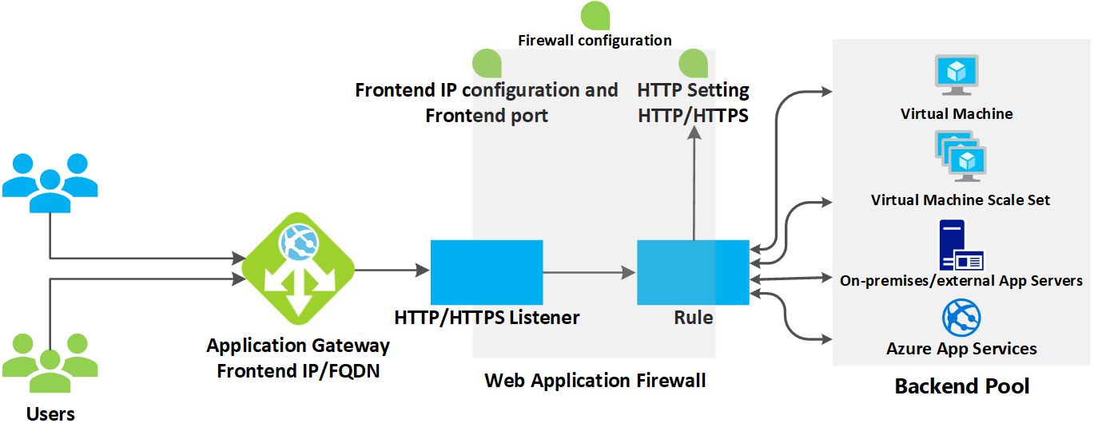
Application Gateway
How the Application Gateway works
Notes:
https://docs.microsoft.com/en-us/azure/application-gateway/overview
https://docs.microsoft.com/en-us/azure/application-gateway/features

Slide 17
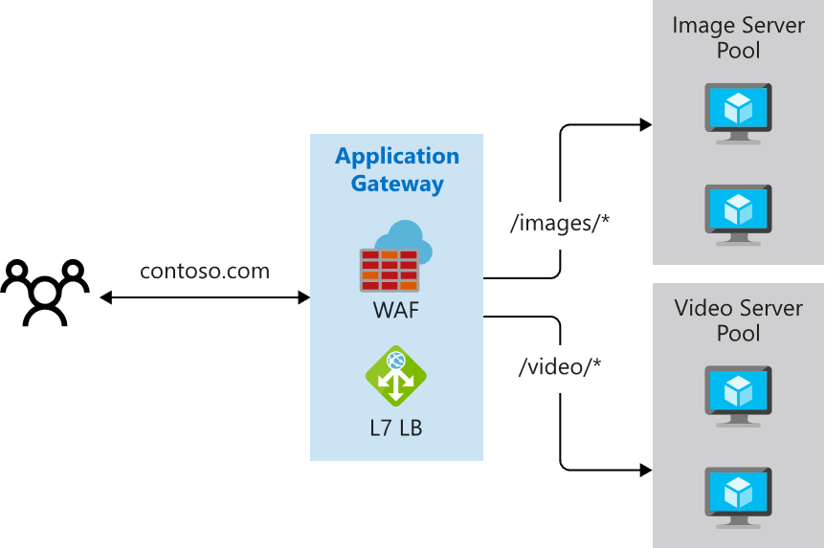
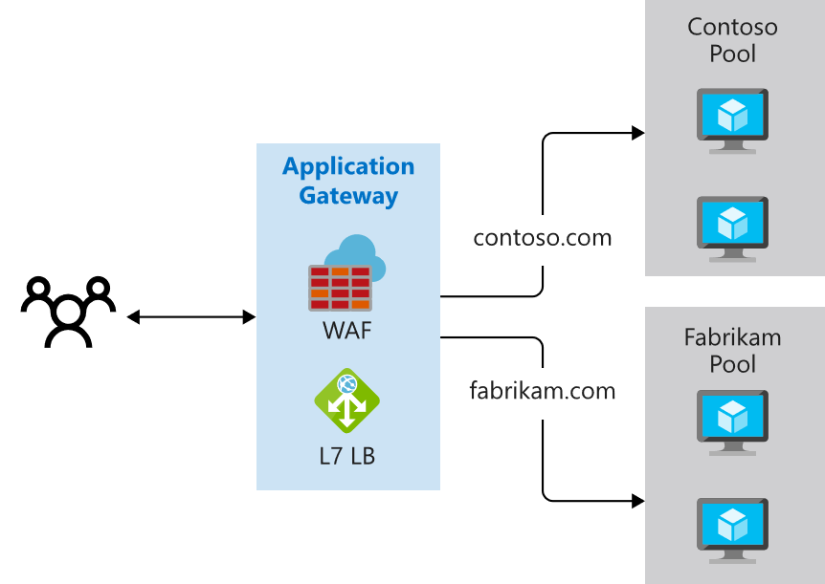
Application Gateway Routing (1 of 2)
Path-based routing
Multiple-site routing
Notes:
QuickStart: Direct web traffic with Azure Application Gateway - Azure portal - https://docs.microsoft.com/en-us/azure/application-gateway/quick-create-portal

Slide 18
Application Gateway Routing – Features (2 of 3)
Secure Sockets Layer (SSL/TLS) termination
Autoscaling
Zone redundancy
Static VIP
Web Application Firewall
URL-based routing
Multiple-site hosting
Redirection
Session affinity
… and many more
Notes:
https://docs.microsoft.com/en-us/azure/application-gateway/features

Slide 19
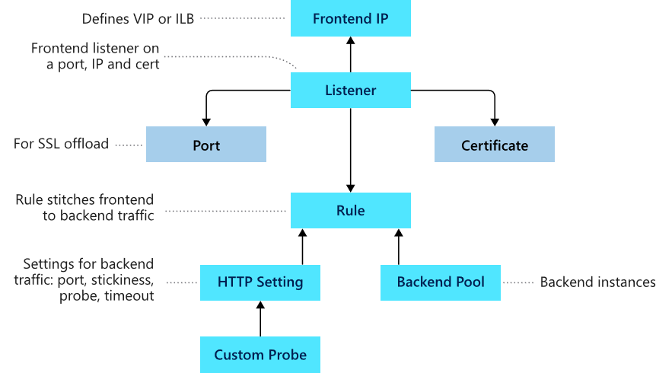
Application Gateway Configuration
Frontend IP
Listeners
Routing rules
Backend pools
Web application firewall (optional)
Health probes
Notes:
Load balance your web service traffic with Application Gateway - https://docs.microsoft.com/learn/modules/load-balance-web-traffic-with-application-gateway/

Slide 20
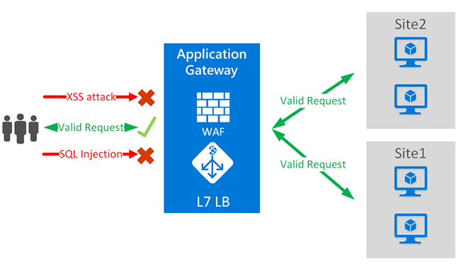
Web Application Firewall Overview
Protection via OWASP Core Rule Set (CRS)
Monitoring via Azure Monitor
Customization using rules or site-specific policies
Support for Azure Application Gateway, Front Door and Content Delivery Network (preview)
OWASP = Open Web Application Security Project
Notes:
Instructor Note: Rate limiting can be used wherever WAF policy can be applied, but rate limiting only usable for Front Door and CDN.
https://docs.microsoft.com/en-us/azure/web-application-firewall/ag/ag-overview
https://owasp.org/www-project-modsecurity-core-rule-set/

Slide 21
Demonstration: Create an Application Gateway with WAF
Create an application gateway
Configure the basic settings
Configure the frontends
Configure the backends
Add routing and test

Slide 22
Lesson 03: Implement Azure Front Door

Slide 23
Implement Azure Front Door Overview
Azure Front Door
Demonstration: Create an Azure Front Door

Slide 24
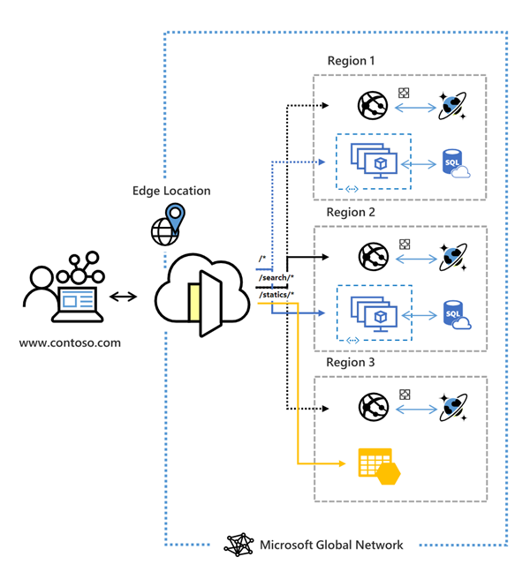
Azure Front Door (1 of 3)
Operates on Microsoft’s global edge network
Supports Azure and non-Azure hosts
OSI Layer 7 firewall
Offers various routing methods: latency priority, weighted, and session affinity
Notes:
Instructor - https://docs.microsoft.com/en-us/azure/frontdoor/front-door-overview

Slide 25
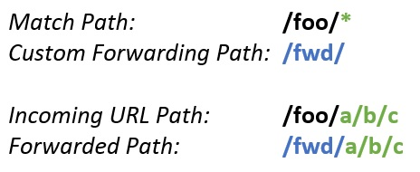
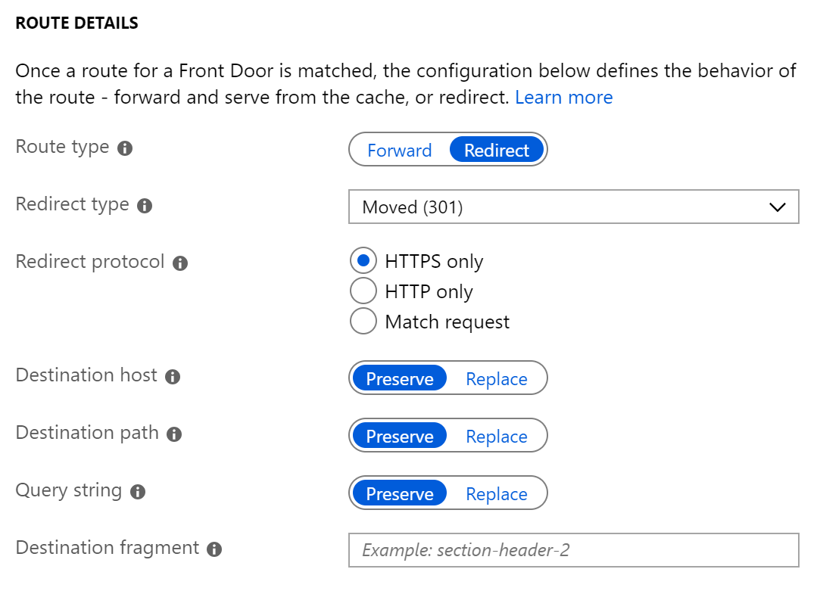
Azure Front Door (2 of 3 )
Accelerate application performance with optional CDN
Increase application availability with smart health probes
URL-based routing
Multiple-site hosting
TLS termination
Custom domains and certificate management
URL redirection
URL rewrite
Protocol support – IPv6 and HTTP/2

Slide 26
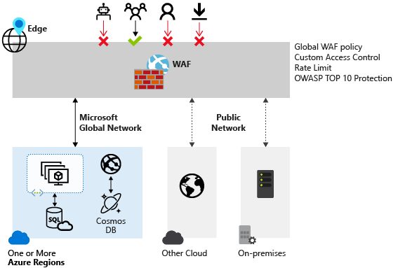
Azure Front Door (3 of 3)
Web Application Firewall (WAF) functionality can be enabled on Front Door
Notes:
https://docs.microsoft.com/en-us/azure/web-application-firewall/afds/afds-overview

Slide 27
Demonstration: Create an Azure Front Door
Add a frontend host
Add application backend and pools
Add routing rules
Test

Slide 28
Lesson 04: Implementing Azure Traffic Manager

Slide 29
Implement Azure Traffic Manager Overview
Azure Traffic Manager
Azure Traffic Manager Routing Methods
Load Balancing Service Comparison

Slide 30
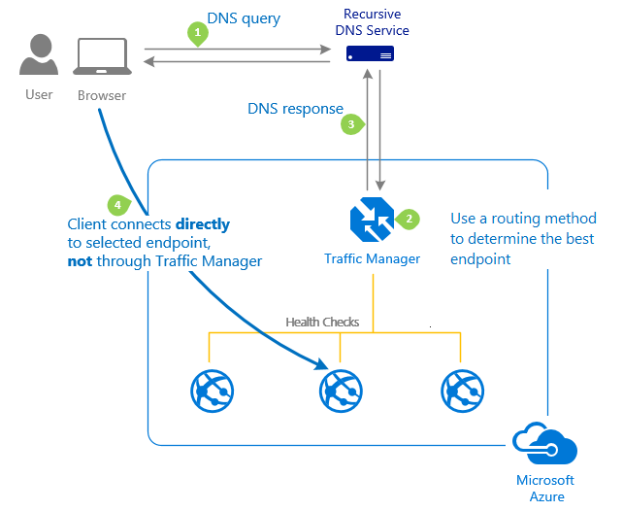
Azure Traffic Manager
Leverages DNS to direct requests to the most appropriate endpoint
Selects endpoints based on configured traffic routing method
Provides endpoint health checks and automatic failover

Slide 31
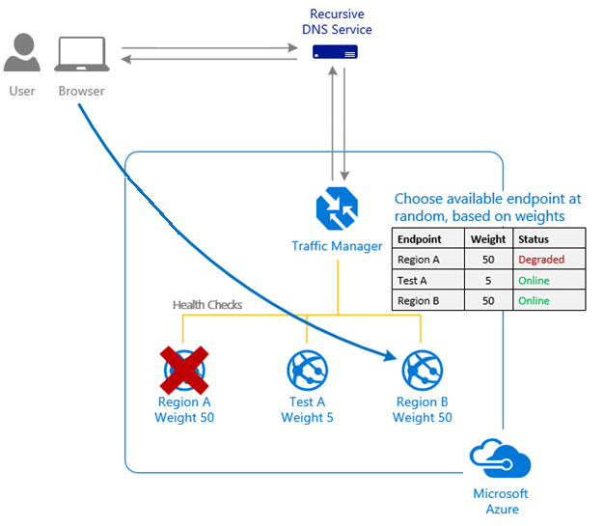
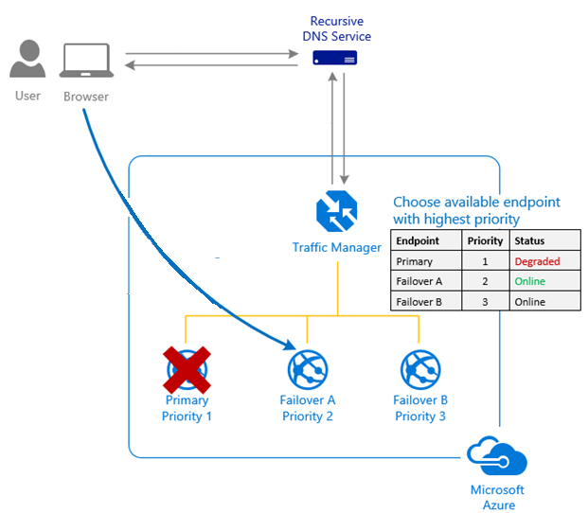
Azure Traffic Manager Routing Methods (1 of 2)
You want to distribute traffic across endpoints, either evenly or using different weights.
You want to use a prioritized list of service endpoints.
Weighted
Priority
Notes:
Student - https://docs.microsoft.com/en-us/learn/modules/distribute-load-with-traffic-manager/2-priority-routing

Slide 32
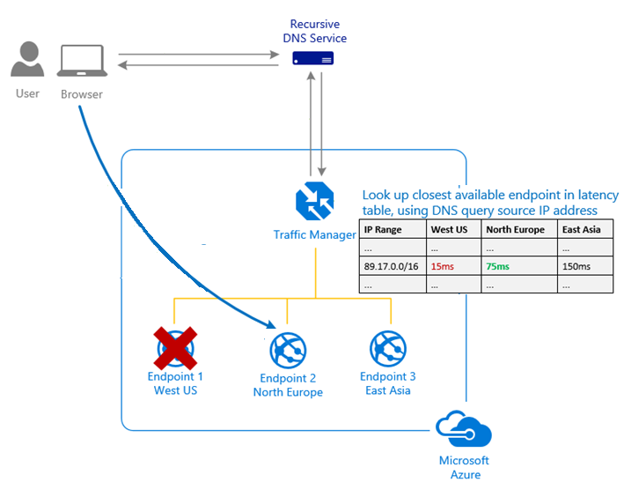
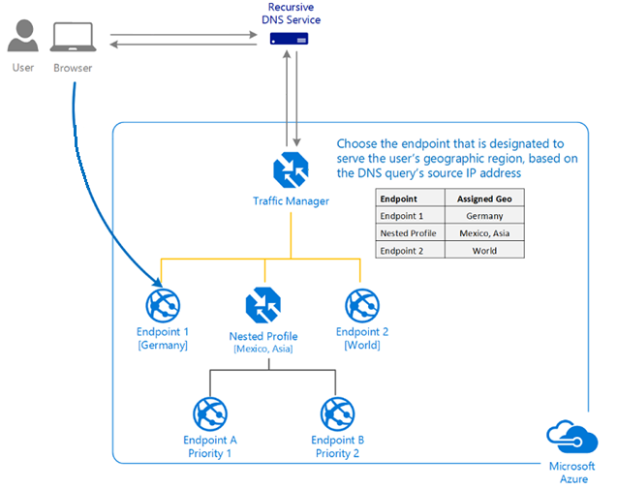
Azure Traffic Manager Routing Methods (2 of 2)
You want to send users to the endpoint with the best performance.
You want to direct users based on where their DNS query originates.
Performance
Geographic
Notes:
Student - https://docs.microsoft.com/en-us/learn/modules/distribute-load-with-traffic-manager/2-priority-routing
Subnet routing and multi-value routing do not have a separate slide but are discussed in the notes.

Slide 33
Load Balancing Service Comparison
Workloads available to untrusted networks or Internet?
Service | Load Balancer | Application Gateway | Traffic Manager | Front Door
Network Connectivity | External and Internal | External and Internal | External | External and Internal
Backends or Endpoints | Virtual machines and virtual machine scale sets | Azure Virtual Machines and Virtual Machine Scale Sets, Azure App Services, IP Addresses, and Hostnames | Azure Cloud Services, Azure App Services, Azure App Service Slots, and Public IP Addresses | Internet facing services hosted inside or outside of Azure
Notes:
Instructor - https://docs.microsoft.com/en-us/azure/cloud-adoption-framework/ready/considerations/networking-options

Slide 34
Lesson 05: Implement Azure Firewall

Slide 35
Implement Azure Firewall Overview
Azure Firewall
Implementing Azure Firewall
Azure Firewall Manager (add)
Demonstration: Deploy Azure Firewall
Notes:
No student content for Azure

Slide 36
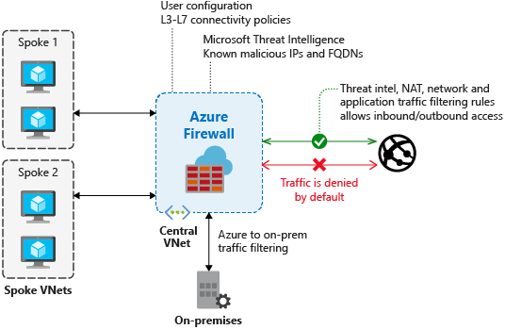
Azure Firewall
Built-in high availability including availability zones
Unrestricted cloud scalability with threat intelligence
Application FQDN filtering rules and network traffic filtering rules
Multiple public IP addresses

Slide 37
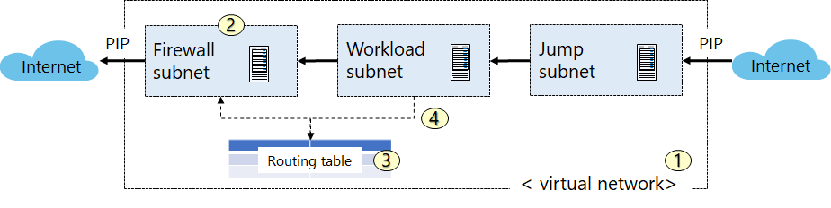
Implementing Azure Firewall
Create the network infrastructure
Deploy the firewall
Create a default route
Configure an application rule

Slide 38
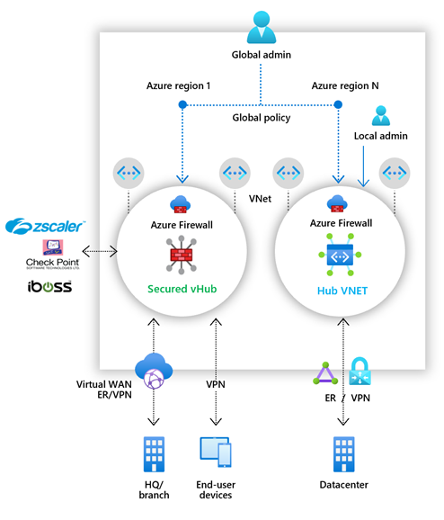
Azure Firewall Manager
Manages manually created hub virtual networks and secured virtual hubs (VWAN)
Central Azure Firewall deployment and configuration
Hierarchical policies
Integrated with 3rd party products for secured virtual hubs
Notes:
Integrated with third-party security-as-a-service offerings for secured virtual hub deployments
VNet to Internet traffic filtering
Branch to Internet traffic filtering
https://docs.microsoft.com/en-us/learn/modules/intro-to-azure-firewall-manager/

Slide 39
Demonstration: Deploy Azure Firewall
Configure the network
Create virtual machines
Deploy the firewall

Slide 40
Lesson 06: Implement Security Groups

Slide 41
Implement Security Groups Overview
Network Security Groups
Security Rules
Application Security Groups

Slide 42
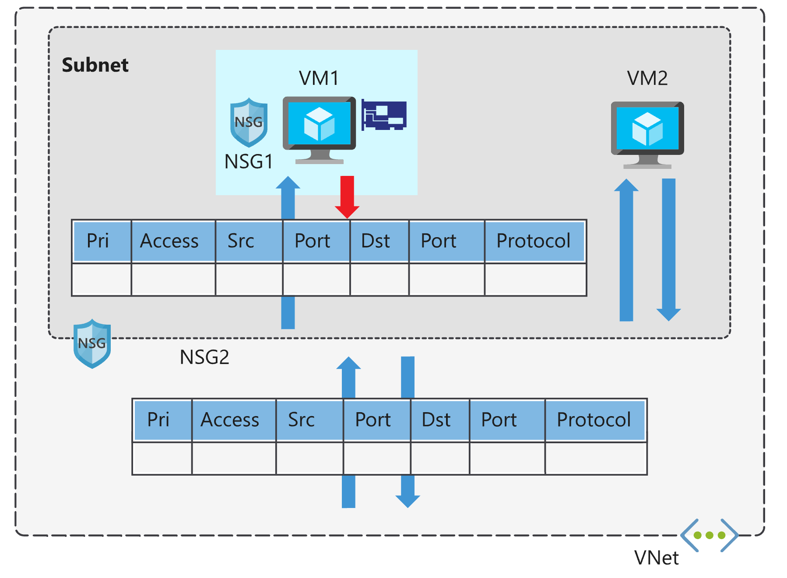
Network Security Groups
Limits network traffic to resources in a virtual network
Lists the security rules that allow or deny inbound or outbound network traffic
Associated to a subnet or a network interface
Can be associated multiple times

Slide 43
Security Rules (1 of 2)
NSG Rules properties:
Name
Priority
Source or destination
Protocol
Direction
Port range
Action
Augmented security rule options:
multiple IP addresses
multiple ports
service tags
application security groups

Slide 44
Security Rules (2 of 2)
Service tags simplify defining rules by designating services such as:
VirtualNetwork
AzureLoadBalancer
Internet
AzureTrafficManager
Storage
SQL
AppService

Slide 45
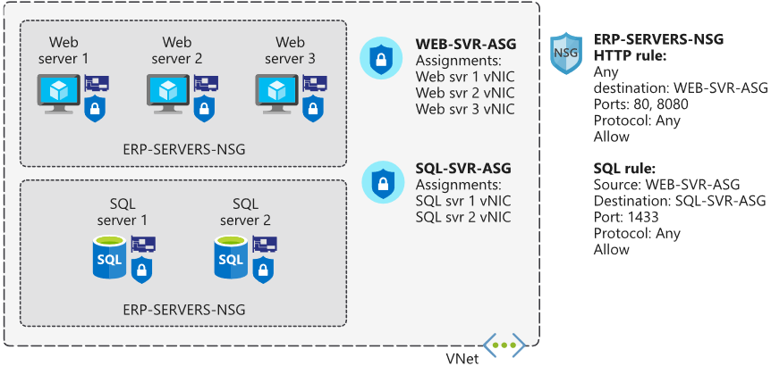
Application Security Groups
You want to group virtual machines and define network security policies based on those groups
You want to reuse your security policy at scale without manual maintenance of explicit IP addresses.
Notes:
Student - https://docs.microsoft.com/en-us/learn/modules/secure-and-isolate-with-nsg-and-service-endpoints/2-network-security-groups
Instructor - https://docs.microsoft.com/en-us/azure/virtual-network/application-security-groups

Slide 46
Lesson 07: Implement Azure Bastion

Slide 47
Implement Azure Bastion Overview
Azure Bastion
Demonstration: Create an Azure Bastion Host

Slide 48
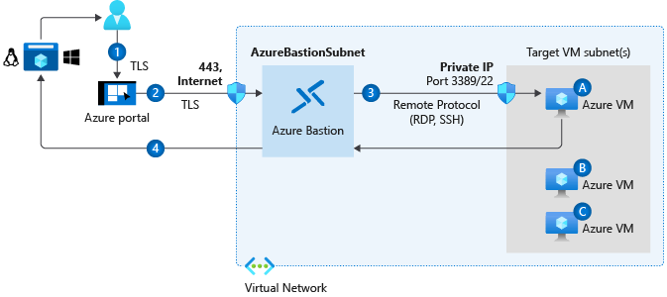
Azure Bastion (1 of 2)
Deployed in a dedicated subnet - RDP/SSH thru the Portal over SSL
No public IP address or managing NSGs
Protection against port scanning and zero-day exploits
Notes:
How to connect and sign on to an Azure virtual machine running Windows - https://docs.microsoft.com/en-us/azure/virtual-machines/windows/connect-logon
How to use SSH keys with Windows on Azure - https://docs.microsoft.com/en-us/azure/virtual-machines/linux/ssh-from-windows
What is Azure Bastion? - https://docs.microsoft.com/en-us/azure/bastion/bastion-overview

Slide 49
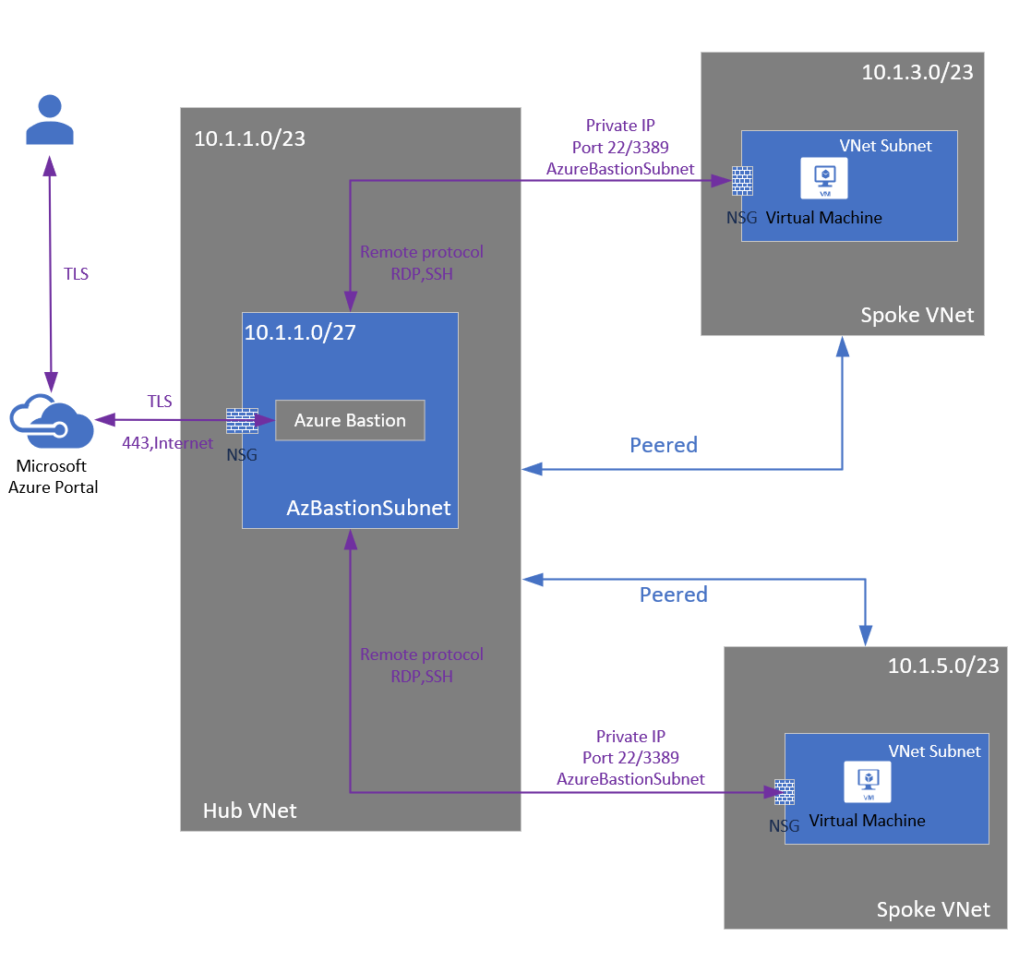
Azure Bastion and VNet Peering (2 of 2)
Azure Bastion supports VNet peering
Notes:
https://docs.microsoft.com/en-us/azure/bastion/vnet-peering

Slide 50
Demonstration: Create an Azure Bastion Host
Create the Bastion resource
Configure the resource

Slide 51
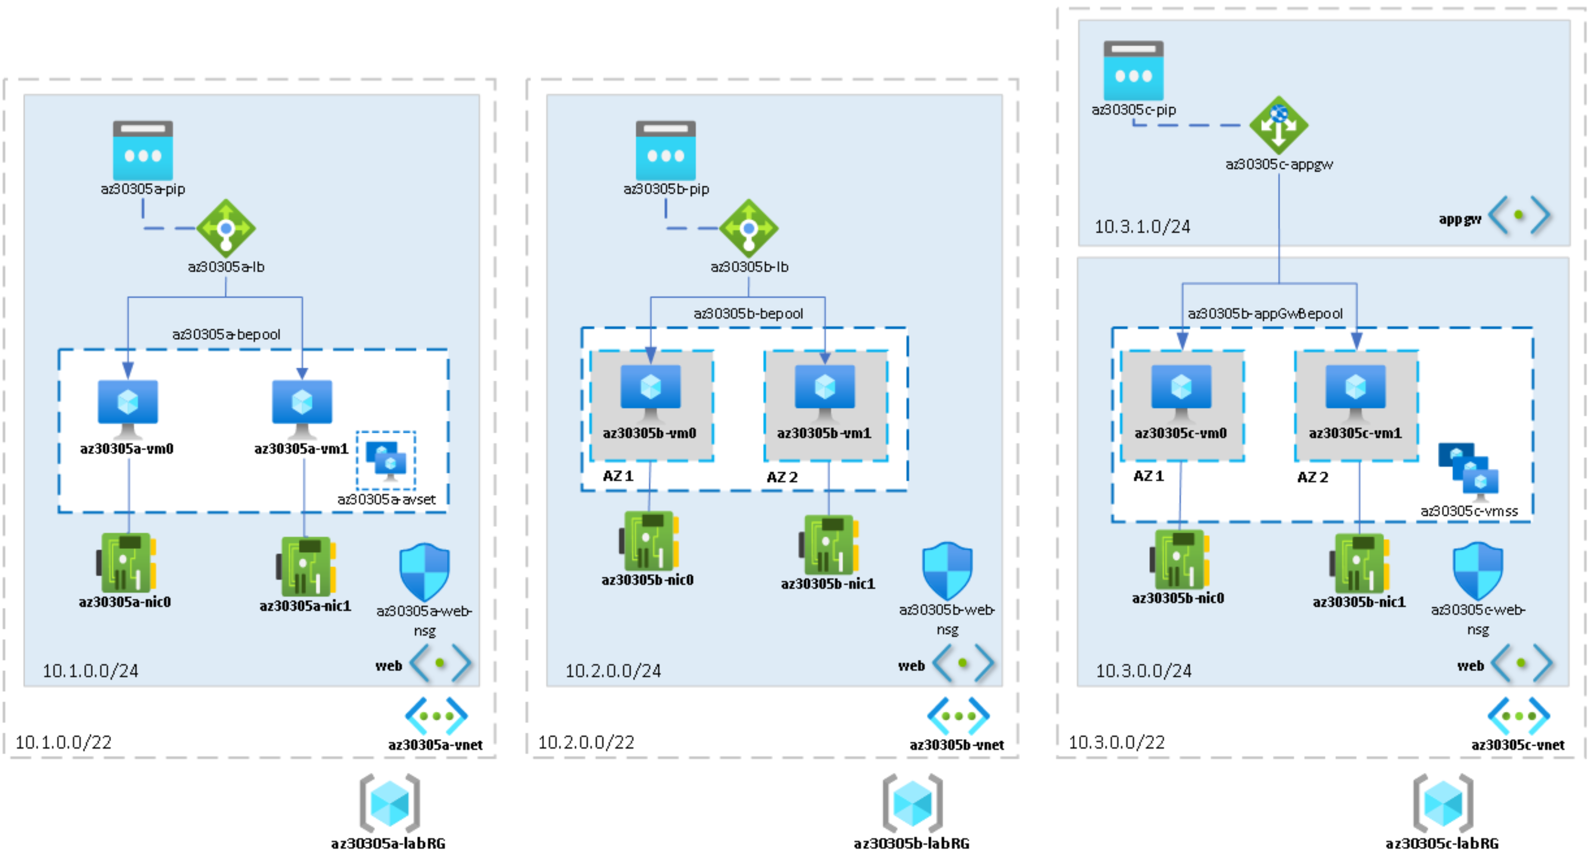
Lab 05: Highly Available Azure IaaS Compute Architectures

Slide 52
Implement Load Balancing and Network Security - Review
Knowledge Check
Microsoft Learn Modules (docs.microsoft.com/Learn)
Improve application scalability and resiliency by using Azure Load Balancer
Load balance your web service traffic with Application Gateway
Enhance your service availability and data locality by using Azure Traffic Manager
Introduction to Azure Front Door
Introduction to Azure Firewall
Secure and isolate access to Azure resources by using network security groups and service endpoints
Notes:
Learn - https://docs.microsoft.com/en-us/learn/browse/

Slide 53
End of presentation

