Slide 1
AZ-303: Microsoft Azure Architect Technologies

Slide 2




Module 06: Implement Storage Accounts
Lesson 01: Storage Accounts
Lesson 02: Blob Storage
Lesson 03: Azure Files
Lesson 04: Storage Security
Lesson 05: Storage Firewalls and Virtual Networks
Lab 6 – Implement Storage Accounts
Notes:
The last lesson, Managing Storage, is hidden at the end if you would like to include it.

Slide 3
Lesson 01: Storage Accounts

Slide 4
Storage Accounts Overview
Azure Storage
Azure Storage Services
Azure Storage Account Types
Azure Storage Account Replication Features
Accessing Storage
Data Transfer Tool Selection

Slide 5
Azure Storage
Cloud storage solution for modern data storage scenarios.
Durable and highly available with various redundancy options
All data is encrypted, and you have control over can access the data
Scalable and managed
Accessible with HTTP or HTTPS access from anywhere in the world
Client libraries available in a variety of programming languages
Three categories: storage for virtual machines, unstructured data, and structured data
Two tiers: standard and premium
Notes:
https://docs.microsoft.com/en-us/azure/storage/common/storage-introduction

Slide 6
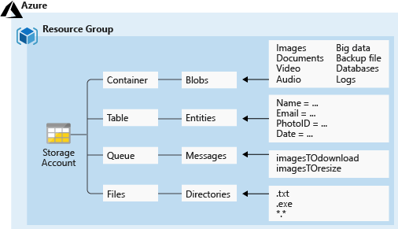
Azure Storage Services
Azure Blobs (Containers)
Accessible from anywhere - HTTP or HTTPS
Stores massive amounts of unstructured data, such as text or binary
Azure Files
Accessible from anywhere - SMB
Hosts highly available network file shares
Azure Queues
Accessible from anywhere - HTTP or HTTPS
Provides a queue-based mechanism for asynchronous communication
Azure Tables
Accessible from anywhere - HTTP or HTTPS
Stores NoSQL tables

Slide 7
Azure Storage Account Types
Storage Account | Recommended usage
Standard general-purpose v2 | Most scenarios including Blob, File, Queue, Table, and Data Lake Storage.
Premium block blobs | Block blob scenarios with high transactions rates, or scenarios that use smaller objects or require consistently low storage latency.
Premium file shares | Enterprise or high-performance file share applications.
Premium page blobs | Premium high-performance page blob scenarios.
Notes:
Storage account overview - https://docs.microsoft.com/en-us/azure/storage/common/storage-account-overview
Create an Azure Storage account - https://docs.microsoft.com/en-us/azure/storage/common/storage-account-create
Upgrade to a general-purpose v2 storage account - https://docs.microsoft.com/en-us/azure/storage/common/storage-account-upgrade
Create an Azure Storage account - https://docs.microsoft.com/learn/modules/create-azure-storage-account/

Slide 8
Azure Storage Account Replication Features (1 of 2)
Single region
Multiple regions
Typically, >300mi
Typically, >300mi
Z1
Async
Async
Z2
Z3
Primary
Secondary
Primary
Secondary
LRS
Three replicas, one region
Protects against disk, node, rack failures
Write is acknowledged when all replicas are committed
Superior to dual-parity RAID
ZRS
Three replicas, three zones, one region
Protects against disk, node, rack, and zone failures
Synchronous writes to all three zones
GRS
Six replicas, two regions (three per region)
Protects against major regional disasters
Asynchronous copy to secondary
RA-GRS
GRS + read access to secondary
Separate secondary endpoint
Recovery point objective (RPO) delay to secondary can be queried
Continued next slide
Notes:
An Azure Storage account always replicates your data to help ensure durability and high availability. Azure Storage copies data so that it’s protected from planned and unplanned events, including transient hardware failures, network or power outages, and natural disasters.
You can replicate data within the same datacenter, across zonal datacenters within the same region, or across geographically separated regions.
Locally redundant storage (LRS) replicates data three times within a single datacenter. LRS provides at least 99.999999999 (11 nines) percent durability of objects over a given year. LRS is the lowest-cost replication option, and it offers the least durability compared to other options.
Zone-redundant storage (ZRS) replicates data synchronously across three storage clusters in a single region. Each storage cluster is physically separated from the others and is in its own availability zone (AZ).
Geo-redundant storage (GRS) is designed to provide at least 99.99999999999999 (16 nines) percent durability of objects over a given year by replicating data to a secondary region that’s hundreds of miles away from the primary region.
Read-access geo-redundant storage (RA-GRS) is based on GRS. RA-GRS replicates data to another datacenter in a secondary region, and it also provides the option to read from the secondary region.

Slide 9
Azure Storage Account Replication Features (2 of 2)
Multiple regions
Typically, >300mi
Typically, >300mi
Z1
Z1
Secondary
Secondary
Z2
Z3
Z2
Z3
Async
Async Read
GZRS
Six replicas, 3+1 zones, two regions
Protects against disk, node, rack, zone, and region failures
Synchronous writes to all three zones and asynchronous copy to secondary
RA-GZRS
GZRS + read access to secondary
Separate secondary endpoint
RPO delay to secondary can be queried
Notes:
Geographically zone-redundant storage (GZRS) combines the high availability of ZRS with the protection from regional outages that GRS provides. A GZRS storage account replicates data across three Azure AZs in the primary region, and to a secondary geographic region for protection from regional disasters.
Optionally, you can enable read access to data in the secondary region with read-access geographically zone-redundant storage (RA-GZRS) if your applications must read data in the event of a disaster in the primary region.

Slide 10
Accessing Storage
Every object has a unique URL address – based on account name and storage type
Container service: https://mystorageaccount.blob.core.windows.net
Table service: https://mystorageaccount.table.core.windows.net
Queue service: https://mystorageaccount.queue.core.windows.net
File service: https://mystorageaccount.file.core.windows.net
If you prefer you can configure a custom domain name
CNAME record | Target
blobs.contoso.com | contosoblobs.blob.core.windows.net
Notes:
Secure access to your storage account - https://docs.microsoft.com/en-us/learn/modules/secure-azure-storage-account/
✔️A Blob storage account only exposes the Blob service endpoint. And, you can also configure a custom domain name to use with your storage account.

Slide 11
Data Transfer Tool Selection
Dataset | Network Bandwidth | Solution to use
Large Dataset | Low-bandwidth network or direct connectivity to on-premises storage is limited by organization policies | Azure Import/Export for export; Data Box Disk or Data Box for import where supported; otherwise use Azure Import/Export
Large Dataset | High-bandwidth network: 1 gigabit per second (Gbps) - 100 Gbps | AZCopy for online transfers; or to import data, Azure Stack Edge, or Azure Data Box Gateway
Large Dataset | Moderate-bandwidth network: 100 megabits per second (Mbps) - 1 Gbps | Azure Import/Export for export or Azure Stack Edge for import where supported
Small Dataset: a few GBs to a few TBs | Low to moderate-bandwidth network: up to 1 Gbps | If transferring only a few files, use Azure Storage Explorer, Azure portal, AZCopy, or AZ CLI
Notes:
Instructor note: Reference https://azure.microsoft.com/en-us/services/databox/

Slide 12
Lesson 02: Blob Storage

Slide 13
Blob Storage Overview
Blob Storage
Blob Containers
Blob Access Tiers
Blob Lifecycle Management
Uploading Blobs
Storage Pricing
Demonstration: Creating Blob Storage

Slide 14
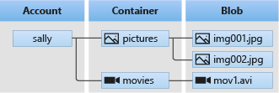
Blob Storage
Common uses:
Serving images or documents directly to a browser
Storing files for distributed access, such as installation
Streaming video and audio
Storing data for backup and restore, disaster recovery, and archiving
Storing data for analysis by an on-premises or Azure-hosted service
Blob service includes three resources:
The storage account
Containers in the storage account
Blobs in a container

Slide 15
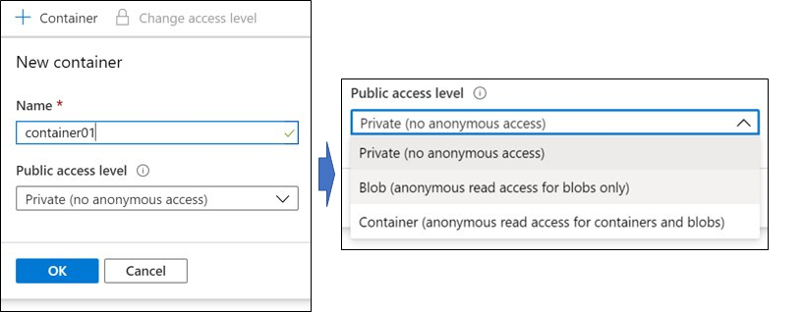
Blob Containers
To create a container, you specify:
Name
Public access level (private, blob, or container)

Slide 16
Blob Access Tiers
Hot tier – Optimized for frequent access of objects in the storage account
Cool tier – Optimized for storing large amounts of data that is infrequently accessed and stored for at least 30 days
Archive – Optimized for data that can tolerate several hours of retrieval latency and will remain in the Archive tier for at least 180 days

Slide 17
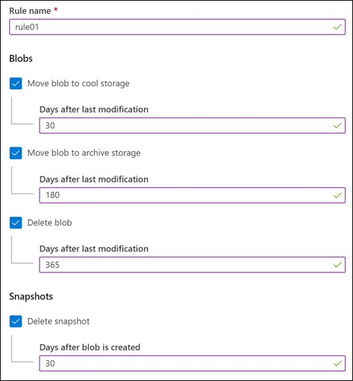
Blob Lifecycle Management
Transition blobs to a cooler storage tier (hot to cool, hot to archive, or cool to archive) to optimize for performance and cost
Delete blobs at the end of their lifecycle
Define rules to be run once per day at the storage account level
Apply rules to containers or a subset of blobs (using prefixes as filters)

Slide 18
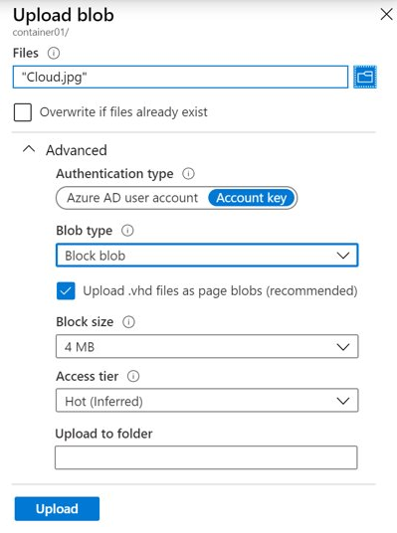
Uploading Blobs
Azure Storage supports three types of blobs:
Block blobs (default)
Append blobs
Page blobs
Blob upload tools include:
AzCopy
Azure Storage Data Movement Library
Azure Data Factory
Blobfuse
Azure Data Box Disk
Azure Import/Export

Slide 19
Storage Pricing
When using a storage account, the following billing considerations apply:
Performance tiers
Data access costs
Transaction costs
Geo-replication data transfer costs
Outbound data transfer costs
Changing the storage tier

Slide 20
Demonstration: Creating blob storage
Create a Blob container
Upload a block blob
Download a block blob

Slide 21
Lesson 03: Azure Files

Slide 22
Azure Files Overview
Compare Files to Blobs
Manage File Shares
Azure Files Storage Tiers

Slide 23
Compare Files to Blobs
Feature | Description | When to use
Azure Files | SMB interface, client libraries, and a REST interface that allows access from anywhere to stored files | Lift and shift an application to the cloud Store shared data across multiple virtual machines Store development and debugging tools that need to be accessed from many virtual machines
Azure Blobs | Client libraries and a REST interface that allows unstructured data (flat namespace) to be stored and accessed at a massive scale in block blobs | Support streaming and random-access scenarios Access application data from anywhere
Notes:
What is Azure Files? - https://docs.microsoft.com/en-us/azure/storage/files/storage-files-introduction
✔️ When selecting which storage feature to use, you should also consider pricing.

Slide 24
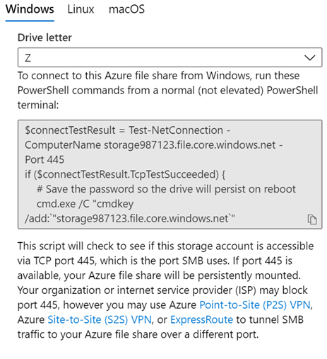
Manage File Shares
File share quotas
Windows – ensure port 445 is open
Linux – mount the drive
MacOS – mount the drive
Secure transfer required – SMB 3.0 encryption
Notes:
Use Azure Files with Linux - https://docs.microsoft.com/en-us/azure/storage/files/storage-how-to-use-files-linux
Create a persistent mount point for the Azure file share with /etc/fstab - https://docs.microsoft.com/en-us/azure/storage/files/storage-how-to-use-files-linux#create-a-persistent-mount-point-for-the-azure-file-share-with-etcfstab
Require secure transfer in Azure Storage - https://docs.microsoft.com/en-us/azure/storage/common/storage-require-secure-transfer

Slide 25
Azure Files Storage Tiers
Premium tier is backed by solid-state drives and uses a provisioned pricing model
Standard tier is backed by standard hard disk drives and uses a pay-as-you-go pricing model
Storage Tier | Usage
Premium file shares* | Provides consistent high performance and low latency, within single-digit milliseconds for most IO operations, for IO-intensive workloads.
Transaction optimized (standard tier) | Highest data at-rest storage price, but the lowest transaction prices of “standard tier” options. Uses Pay-as-you-go pricing model.
Hot (standard tier) | For active workloads that do not involve a large number of transactions, and has a slightly lower data at-rest storage price, but slightly higher transaction prices as compared to transaction optimized
Cool (standard tier) | For workloads that do not have much activity, offering the lowest data at-rest storage price, but the highest transaction prices
Notes:
https://docs.microsoft.com/en-us/azure/storage/files/storage-files-planning

Slide 26
Lesson 04: Storage Security

Slide 27
Storage Security Overview
Storage Security
Storage Service Encryption (SSE)
Customer Managed Keys
Storage Account Keys
Shared Access Signatures (SAS)
URI and SAS Parameters
Accessing Blobs and Queues
SAS Security Best Practices
Demonstration: SAS in the Portal

Slide 28
Storage Security
Storage Security
Encryption
Authentication and authorization
Network security controls
Authorization options:
Anonymous access to containers and blobs
Storage account keys
Shared access signatures
Azure Active Directory (Azure AD)

Slide 29
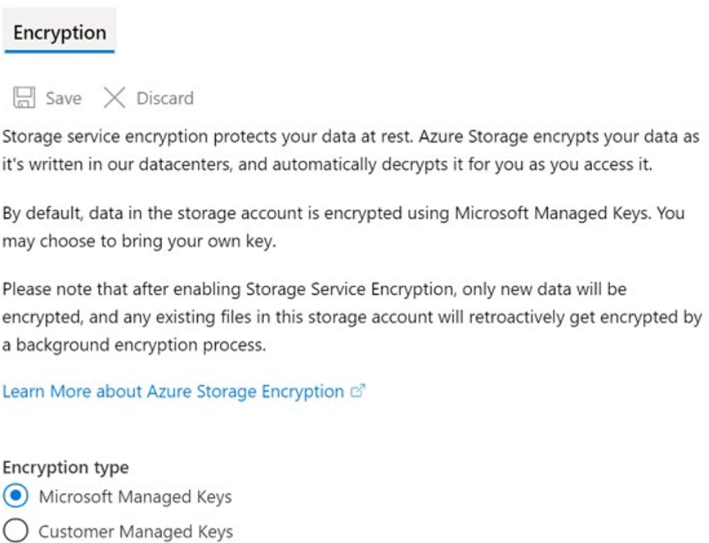
Storage Service Encryption (SSE)
Azure Storage Service Encryption (SSE) for data at rest helps protect data
SSE is enabled for all new and existing storage accounts and cannot be disabled

Slide 30
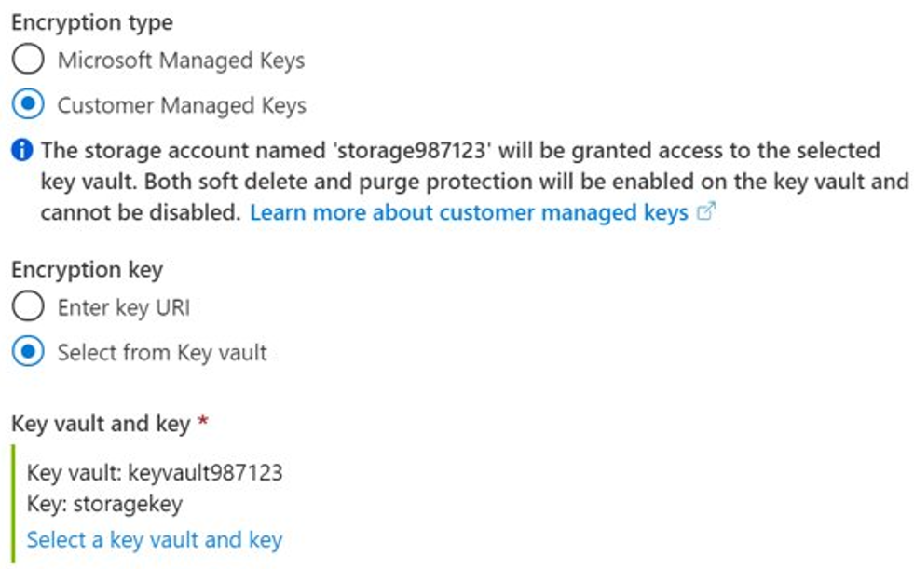
Customer Managed Keys
Use the Azure Key Vault to manage your encryption keys
Create your own encryption keys and store them in a key vault
Use Azure Key Vault's APIs to generate encryption keys
Custom keys give you more flexibility and control

Slide 31
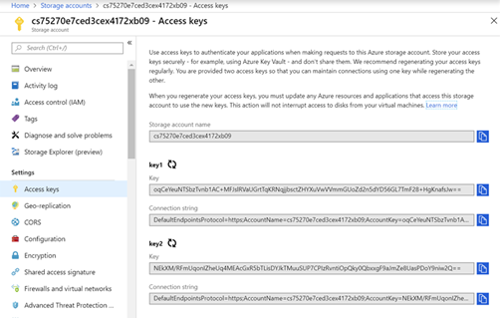
Storage Account Keys
Azure creates two keys (primary and secondary) for each storage account
Either of the keys provides full access to the account
You should regenerate keys on a regular basis or if they are compromised

Slide 32
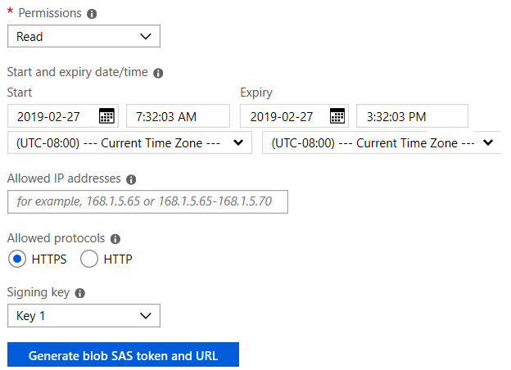
Shared Access Signatures
Shared Access Signatures grant restricted access rights to Azure Storage resources
An account-level SAS to delegate access to multiple storage services
A time interval during which the SAS is valid
Object and container level permissions
IP address range from which Azure Storage will accept the SAS token
The protocol over which Azure Storage will accept the SAS token

Slide 33
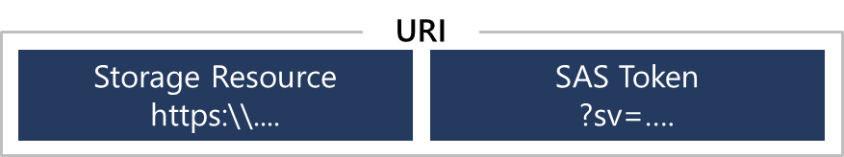
URI and SAS Parameters
A URI is created using parameters and tokens as you create your SAS
The URI consists of your Storage Resource URI and the SAS token
Example
https://myaccount.blob.core.windows.net/?restype=service&comp=properties&sv=2015-04-05&ss=bf&srt=s&st=2015-04-29T22%3A18%3A26Z&se=2015-04-30T02%3A23%3A26Z&sr=b&sp=rw&sip=168.1.5.60-168.1.5.70&spr=https &sig=F%6GRVAZ5Cdj2Pw4txxxxx

Slide 34
SAS Security Best Practices
Recommendations
Always use HTTPS to create or distribute a SAS Reference stored access policies where possible Use near-term expiration dates on an ad hoc SAS Have clients automatically renew the SAS Be careful with SAS start time Be specific with the resource to be accessed Your account will be billed for any usage Validate data written using SAS Don’t assume SAS is the correct choice Use Storage Analytics to monitor your application
Risks
If a SAS is compromised, it can be used by anyone who obtains it If a SAS provided to a client application expires and the application is unable to retrieve a new SAS from your service, then the application's functionality may be hindered

Slide 35
Accessing Blobs and Queues
For security authentication use Azure AD
Built-in RBAC roles like Storage Blob Data Owner and Storage Queue Data Contributor
User, group, or app
Authenticate
Authorize
You can scope access to the resources with containers or queues, accounts, resource groups, and subscriptions
Blob or Queue
Notes:
https://docs.microsoft.com/en-us/azure/storage/common/storage-auth-aad

Slide 36
Demonstration: Secure Access Signatures (Portal)
Create a SAS at the service level
Create a SAS at the account level

Slide 37
Lesson 05: Storage Firewalls and Virtual Networks

Slide 38
Storage Firewalls and Virtual Networks Overview
Azure Storage Firewalls and Virtual Networks
Change the Default Network Access Rule
Grant Access from a Virtual Network
Securing Storage Endpoints
Demonstration: Securing Storage Endpoints

Slide 39
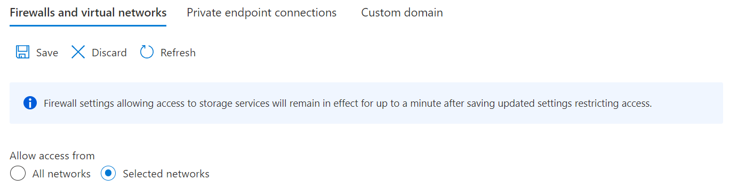
Azure Storage Firewalls and Virtual Networks
Azure Storage Firewall and Virtual Networks protect storage at the network level
Configure a rule to deny access from all networks and then grant access to traffic from specific virtual network subnets only
Network rules are enforced on all network protocols to Azure storage, including REST and SMB
If needed, configure rules to grant access to allow connections from specific internet or on-premises clients
Once network rules are applied, they're enforced for all requests, including those based on SAS

Slide 40
Change the Default Network Access Rule
Managing default network access rules
By default, storage accounts accept connections from clients on any network
To limit access to selected networks, you must first change the default action
Using the Azure portal
Use the Firewalls and virtual networks settings
Using Azure CLI
az storage account update --resource-group "myresourcegroup" --name "mystorageaccount" --default-action Deny
az storage account update --resource-group "myresourcegroup" --name "mystorageaccount" --default-action Allow

Slide 41
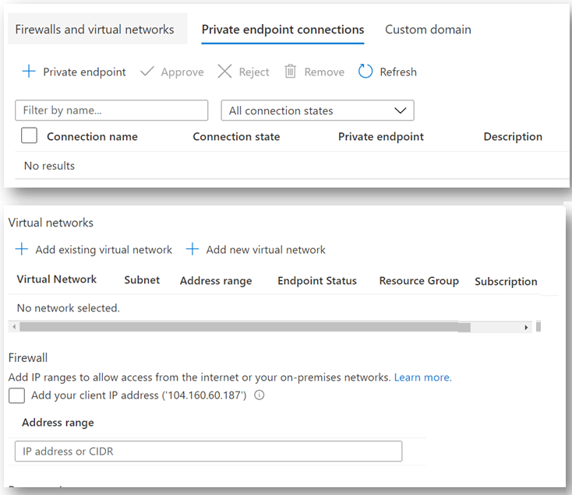
Grant Access from a Virtual Network
Access may be granted to:
Internet IP ranges
Virtual networks (service endpoints)
Private Endpoints

Slide 42
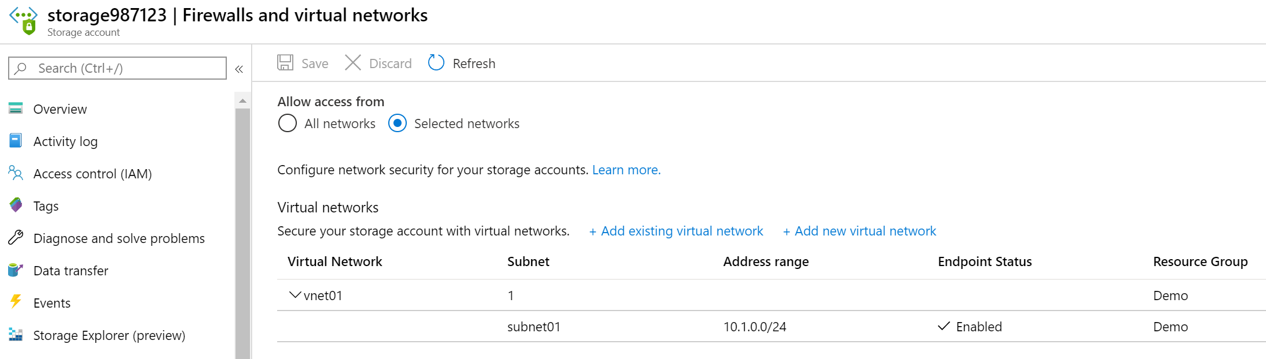
Securing Storage Endpoints
Firewalls and virtual networks settings allow restricting access to a storage account from specific virtual network subnets.
Subnets and Virtual Networks must exist in the same Azure Region or Region Pair as the Storage Account

Slide 43
Demonstration: Securing Storage Endpoints
Create a storage account
Upload a file
Secure the file endpoint

Slide 44
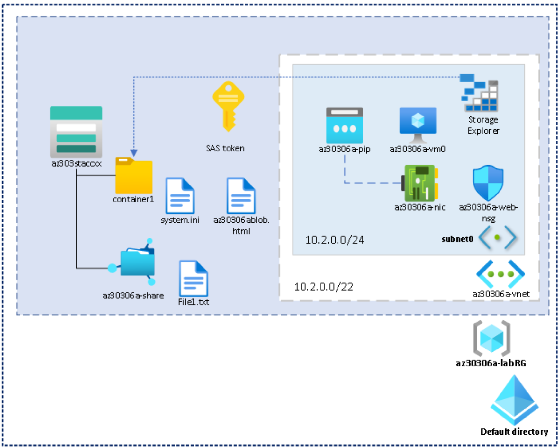
Lab 6: Azure Storage File and Blob Services

Slide 45
Implement Storage Accounts - Review
Knowledge Check
Microsoft Learn Modules (docs.microsoft.com/Learn)
Provide disaster recovery by replicating storage data across regions and failing over to secondary locations
Optimize storage performance and costs using Blob storage tiers
Control access to Azure Storage with shared access signatures
Store and share files in your app with Azure Files
Upload, download, and manage data with Azure Storage Explorer
Notes:
Learn - https://docs.microsoft.com/en-us/learn/browse/

Slide 46
End of presentation

Slide 47

Lesson 06: Managing Storage Data

Slide 48
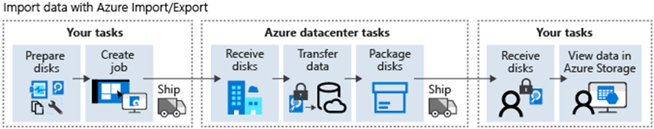
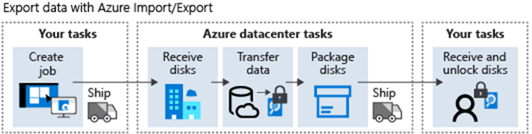
Import and Export Service
Migrating data to the cloud, content distribution, backup, and data recovery
Import jobs:
Export jobs:

Slide 49
AzCopy
AzCopy v10 features:
Supports Azure Data Lake Storage Gen2 APIs
Supports copying an entire account (Blob service only) to another account
Account to account copy is now using the new Put from URL APIs
List/Remove files and blobs in a given path
Supports wildcard patterns in a path
Improved resiliency
Authentication options:
Azure Active Directory
SAS tokens

Slide 50
Demonstration: AzCopy
Install AzCopy
Explore the help options
Download a blob from Azure storage
Upload files to Azure blob storage

