Slide 1
AZ-303: Microsoft Azure Architect Technologies

Slide 2



Module 07: Implement NoSQL Databases
Lesson 01: Configure Storage Account Tables
Lesson 02: Select Appropriate Cosmos DB APIs

Slide 3
Lesson 01: Configure Storage Account Tables

Slide 4
Configure Storage Account Tables Overview
Azure Table Storage
Table Service Design Considerations

Slide 5
Azure Table Storage (1 of 2)
Azure Table is a NoSQL datastore ideal for storing structured, non-relational data.
Common uses:
Storing TBs of structured data capable of serving web scale applications
Storing datasets that don't require complex joins, foreign keys, or stored procedures and can be denormalized for fast access
Quickly querying data using a clustered index
Accessing data using the OData protocol and LINQ queries with WCF Data Service .NET Libraries

Slide 6
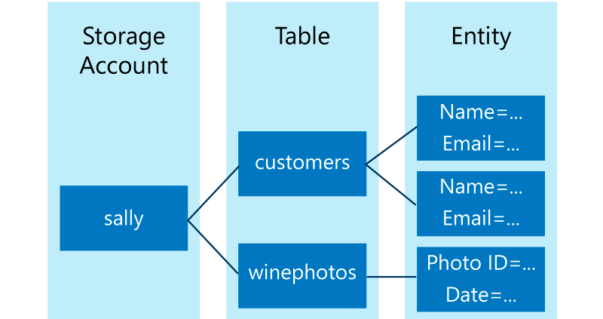
Azure Table Storage (2 of 2)
URL format
Accounts
Table
Entity
Properties
http://<storage account>.table.core.windows.net/<table>

Slide 7
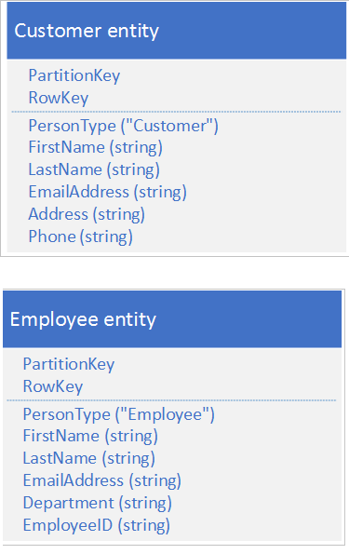
Table Service Design Considerations
Design your solution to be read-efficient
Design your tables for querying in read-heavy applications
Queries that include PartitionKey and RowKey are the most efficient
Consider storing duplicate copies of entities
When querying select just the fields you need
Design your solution to be write-efficient
Choose keys that enable you to spread your requests across multiple partitions at any point of time.
Smooth the traffic over a reasonable time period to avoid spikes
Consider the maximum throughput you must achieve
Notes:
https://docs.microsoft.com/en-us/azure/storage/tables/table-storage-design-guidelines

Slide 8

Lesson 02: Select Appropriate Cosmos DB APIs

Slide 9
Select Appropriate Cosmos DB APIs Overview
Overview of Azure Cosmos DB
High Availability with Cosmos DB
Azure Cosmos DB Supported APIs
Azure Cosmos DB Cassandra API
Azure Cosmos DB API for MongoDB
Azure Cosmos DB Gremlin API
Azure Cosmos DB Table API

Slide 10
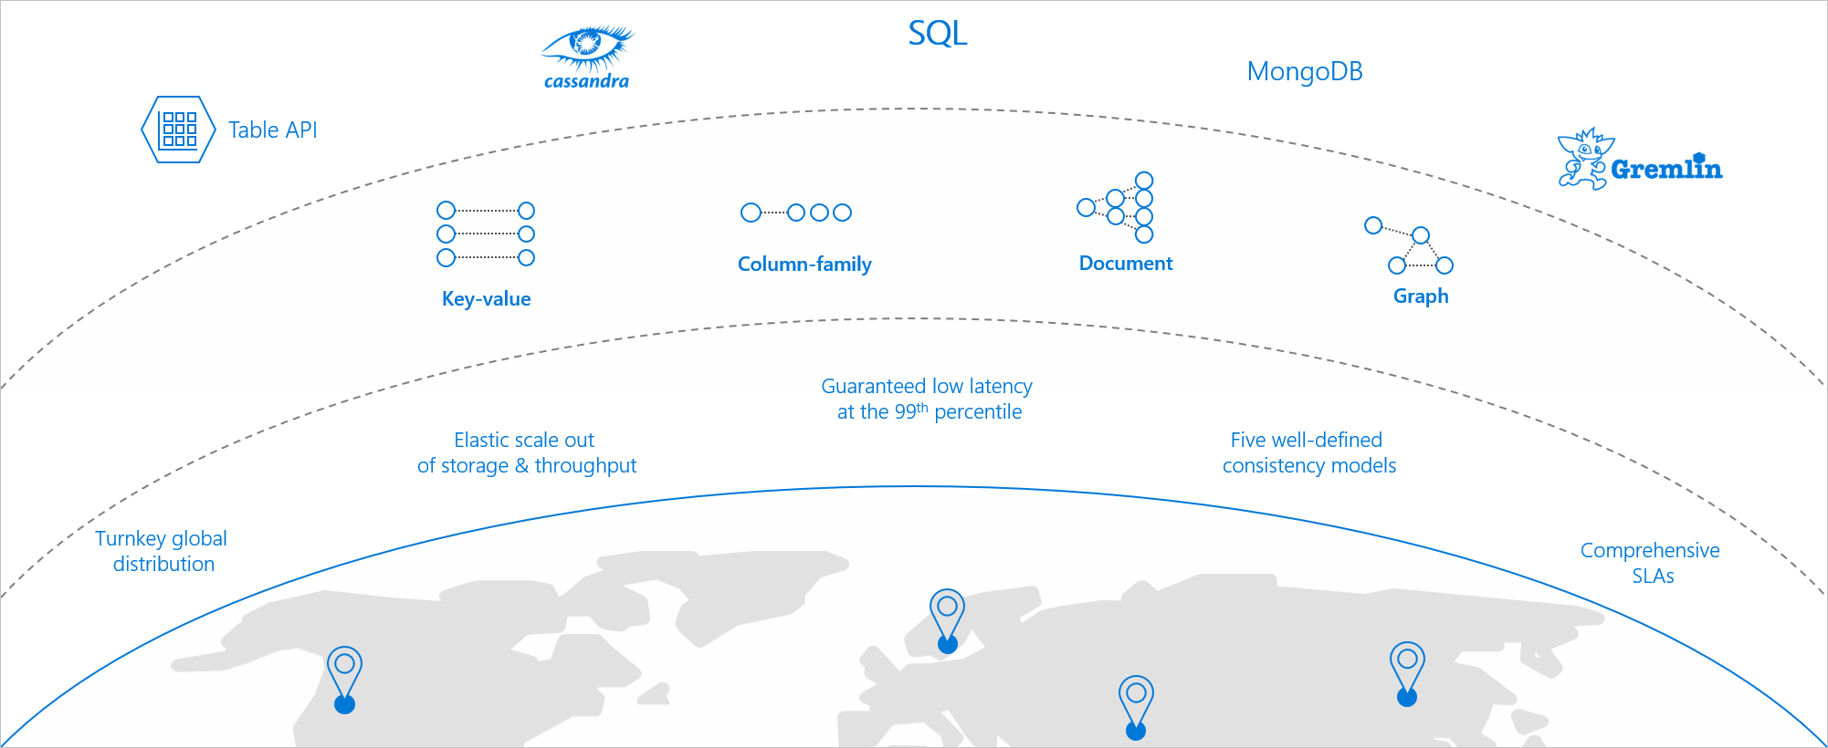
Overview of Azure Cosmos DB
Azure Cosmos DB is a globally distributed and elastically scalable database.

Slide 11
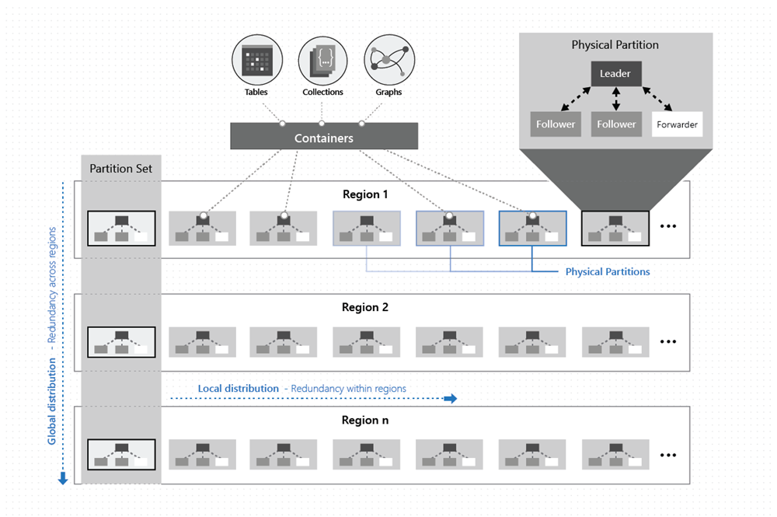
High Availability with Cosmos DB (1 of 3)
The data within Cosmos containers is horizontally partitioned.
Within each region, every partition is protected by a replica-set with all writes replicated and durably committed by most replicas. Replicas are distributed across as many as 10-20 fault domains.
Each partition across all the regions is replicated. Each region contains all the data partitions of a Cosmos container and can accept writes and serve reads.

Slide 12
High Availability with Cosmos DB (2 of 3)
Operation type | Single region | Multi-region (single region writes) | Multi-region (multi-region writes)
Writes | 99.99 | 99.99 | 99.999
Reads | 99.99 | 99.999 | 99.999
With Cosmos DB, before a write operation is acknowledged to the client, the data is durably committed by a quorum of replicas within the region that accepts the write operations
Multi-region accounts configured with multiple-write regions will be highly available for both writes and reads

Slide 13
High Availability with Cosmos DB (3 of 3)
Multi-region accounts with a single-write region (write region outage):
During a write region outage, the Cosmos account automatically promotes a secondary region to be the new primary write region
Any write data that was not replicated when the region failed, is made available through the conflicts feed.
When the impacted write region recovers, it becomes automatically available as a read region
Multi-region accounts with a single-write region (read region outage):
During a read region outage, Cosmos accounts using any consistency level or strong consistency with three or more read regions will remain highly available for reads and writes
The impacted region is automatically disconnected and will be marked offline
If none of the regions in the preferred region list is available, calls automatically fall back to the current write region
Availability Zone support

Slide 14
Azure Cosmos DB Supported APIs (add)
Azure Database for MySQL
MySql
Start
Azure Database for PostgreSQL
PostgreSQL
Yes
Require compatible format?
No
Relational data?
Yes
SQL Database
Azure Database for MariaDB
MariaDB
No
CosmosDB Cassandra API
Cassandra
Semi-structured data, schema-on-read?
Yes
CosmosDB SQL
CosmosDB MongoDB API
MongoDB
Notes:
https://docs.microsoft.com/azure/architecture/guide/technology-choices/data-store-decision-tree

Slide 15
Azure Cosmos DB Cassandra API
Compatible with existing Apache Cassandra libraries, drivers, tools, and applications
No operations management
Open-source standard
Performance management
Ability to use existing tools and code
Throughput and storage elasticity
Global distribution and availability
Choice of consistency
Enterprise grade
Event sourcing

Slide 16
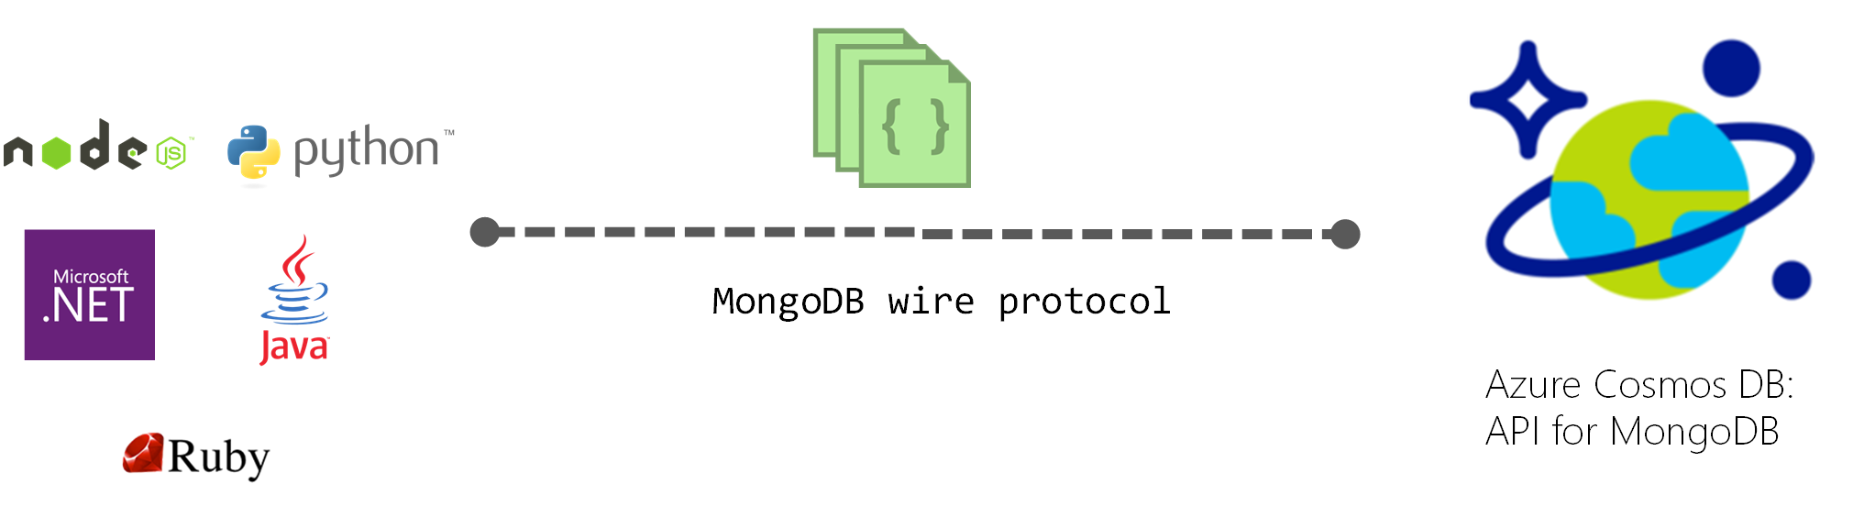
Azure Cosmos DB API for MongoDB
Compatible with existing MongoDB libraries, drivers, tools, and applications
Migrate applications to Cosmos DB while preserving existing application logic
Keeps applications portable and continuing to remain cloud vendor-agnostic
Financially backed SLAs for the common NoSQL APIs powered by Cosmos DB
Turnkey, global distribution with multi-master replication - wire protocol compatibility

Slide 17
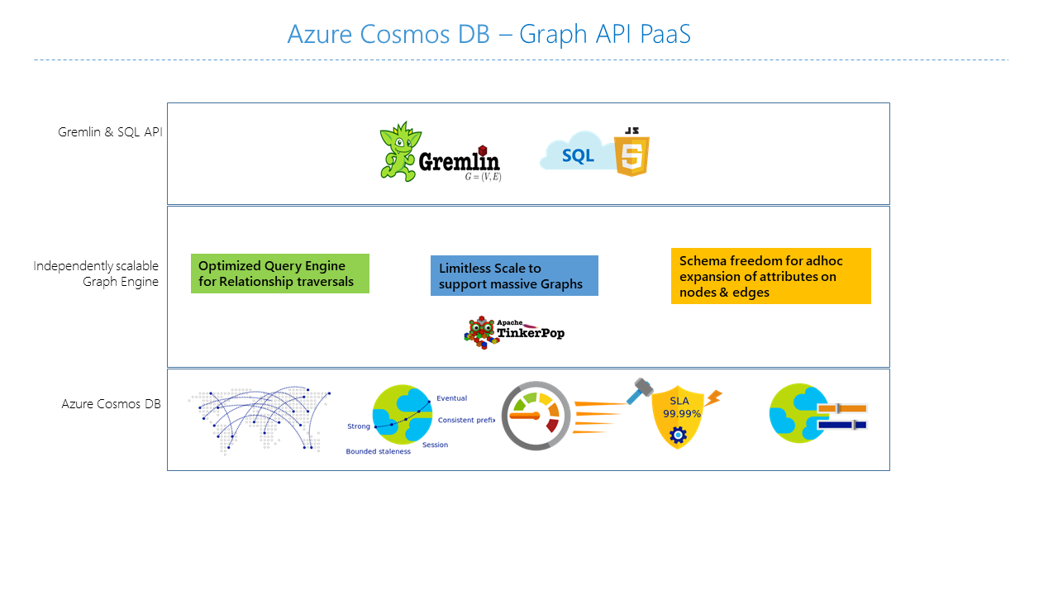

Azure Cosmos DB Gremlin API
A fully managed, horizontally scalable graph database service
Elastically scalable throughput and storage
Multi-region replication
Fast queries and traversals with the most widely adopted graph query standard
Fully managed graph database
Automatic indexing
Tunable consistency levels
Graph databases and property graph objects
Supports open graph APIs

Slide 18
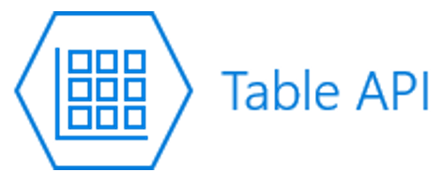
Azure Cosmos DB Table API
A key-value database service built to provide premium capabilities to existing Azure Table storage applications without making any app changes
Turnkey global distribution.
Dedicated throughput worldwide.
Single-digit millisecond latencies at the 99th percentile.
Guaranteed high availability
Indexing and consistency
Competitive pricing and SLAs

Slide 19
Implement NoSQL Databases - Review
Knowledge Check
Microsoft Learn Modules (docs.microsoft.com/Learn)
Distribute your data globally with Azure Cosmos DB
Create an Azure Cosmos DB database built to scale
Choose the appropriate API for Azure Cosmos DB
Optimize the performance of Azure Cosmos DB by using partitioning and indexing strategies
Notes:
Learn - https://docs.microsoft.com/en-us/learn/browse/

Slide 20
End of presentation

