Slide 1
AZ-303: Microsoft Azure Architect Technologies

Slide 2



Module 08: Implement Azure SQL Databases
Lesson 01: Configure Azure SQL Database
Lesson 02: High Availability and Azure SQL Database

Slide 3
Lesson 01: Configure Azure SQL Database

Slide 4
Implementing Azure SQL Overview
Azure SQL Deployment Models (bonus slide)
Azure SQL Database Service
Demonstration: Create an Azure SQL Database single database
Azure SQL Database Managed Instance
Demonstration: Create an Azure SQL Managed Instance

Slide 5
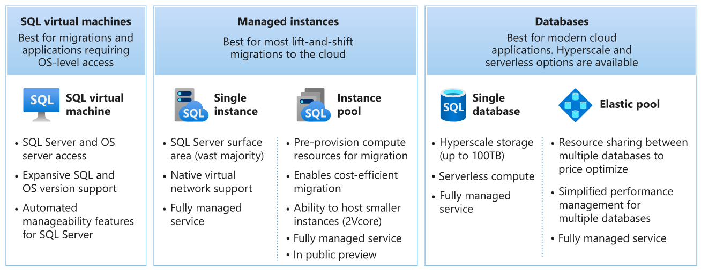
Azure SQL Deployment Models (bonus slide)
Notes:
https://docs.microsoft.com/learn/modules/azure-sql-intro/3-deployment-options

Slide 6



Azure SQL Database Service
A fully managed SQL Server database engine, based on the latest stable Enterprise Edition of SQL Server
Best for modern cloud applications that:
Want to use the latest stable SQL Server features
Have time constraints in development and marketing
Need to achieve up to 99.995% SLA
Includes serverless compute

Slide 7
Demonstration – Create an Azure SQL Database (Single Database)
Create a single database
Query the database

Slide 8
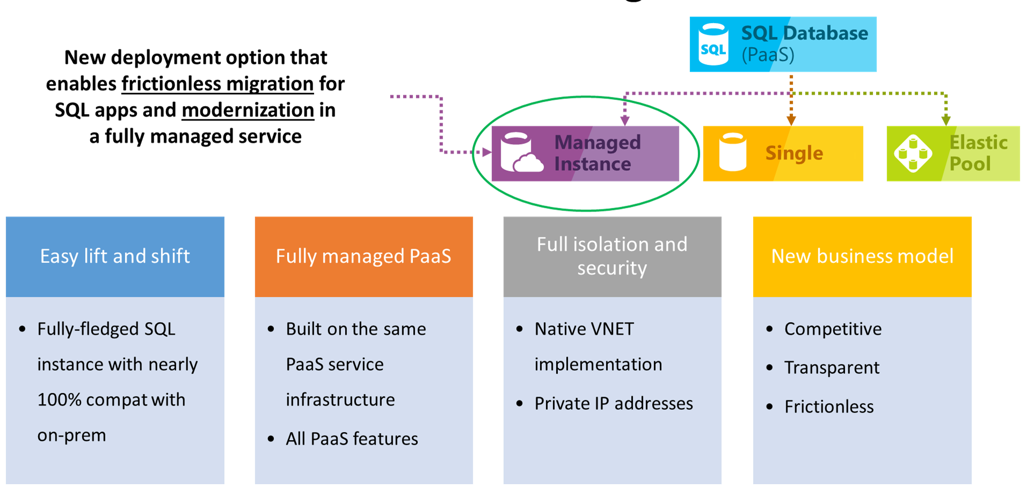
Azure SQL Database Managed Instance

Slide 9
Demonstration – Create an Azure SQL Database Managed Instance
Create a managed instance
Configure additional settings

Slide 10
Lesson 02: High Availability and Azure SQL

Slide 11
High Availability and Azure SQL Overview
High Availability and Azure SQL Database
Overview
High Availability Models
Database Service Tier
Geo-replication
Auto-failover Groups
Notes:
Indentation indicates there is only a single student topic.

Slide 12
High availability and Azure SQL Database (1 of 5)
Two high-availability models used in Azure SQL database:
Standard availability model that is based on a separation of compute and storage
Premium availability model that is based on a cluster of database engine processes
Basic, standard, and general-purpose service tier availability:
Stateless compute layer
Stateful data layer

Slide 13



High Availability and Azure SQL Database (2 of 5)
General purpose | Business critical
Application
Application
Gateways
Primary Replica VM
AlwaysOn
Availability Group
Control Ring
Primary
Replica VM
Failover
VM nodes with spare capacity
Failover
Secondary
Replica VMs
Secondary
Replica VMs
Notes:
Student - https://docs.microsoft.com/learn/modules/describe-high-availability-disaster-recovery-strategies/3-explore-high-availability-disaster-recovery-options
Instructor - https://docs.microsoft.com/azure/azure-sql/database/service-tier-hyperscale

Slide 14
High Availability and Azure SQL Database (3 of 5)
General purpose | Business critical | Hyperscale
Budget oriented balanced compute and storage Uses nodes with spare capacity to spin up a new SQL Server instances Uses LRS and RA-GRS (backup files) | High transaction rate and low IO latency Highest resilience to failures and fast failovers Deploys an Always On availability group using multiple synchronously updated replicas Uses local SSD storage and RA-GRS (backup files) | Support databases as large as 100 TB Capture instantaneous backups (using snapshots) Restore in minutes rather than hours and days Scale up or down in real time to accommodate workload changes
Workloads
Notes:
Instructor - https://docs.microsoft.com/azure/azure-sql/database/service-tier-hyperscale

Slide 15
High Availability and Azure SQL Database (4 of 5)
Geo-replication can be implemented on its own
Allows you to replicate your Azure SQL database to another region
Can be used for scaling out read operations
Auto-failover Groups
Implement and extend geo-replication
Provide automatic failover to another region

Slide 16
High Availability and Azure SQL Database (5 of 5)
Auto-failover groups can be configured at the logical server level
 | Geo-replication | Failover groups
Automatic failover | No | Yes
Fail over multiple databases simultaneously | No | Yes
User must update connection string after failover | Yes | No
SQL Managed Instance support | No | Yes
Can be in same region as primary | Yes | No
Multiple replicas | Yes | No
Supports read-scale | Yes | Yes
Notes:
Auto-failover groups - Azure SQL Database & SQL Managed Instance | Microsoft Docs

Slide 17
Implement Azure SQL - Review
Knowledge Check
Microsoft Learn Modules (docs.microsoft.com/Learn)
Introduction to Azure SQL
Deploy Azure SQL Database
Scale multiple Azure SQL Databases with SQL elastic pools
Migrate your relational data stored in SQL Server to Azure SQL Database
Back up and restore your Azure SQL database
Notes:
Learn - https://docs.microsoft.com/en-us/learn/browse/

Slide 18
End of presentation

