Slide 1
AZ-303: Microsoft Azure Architect Technologies

Slide 2





Module 09: Automate Deployment and Configuration of Resources
Lesson 01: Azure Resource Manager Templates
Lesson 02: Save a Template for a VM
Lesson 03: Configure a Virtual Hard Disk Template
Lesson 04: Deploy from a Template
Lesson 05: Automation Runbooks

Slide 3
Lesson 01: Azure Resource Manager Templates

Slide 4
Azure Resource Manager Templates Overview
Overview of Resource Manager Templates
What's in a Resource Manager Template?
Azure QuickStart Templates

Slide 5
Overview of Resource Manager Templates (1 of 2)
Improves consistency
ARM
Template
Express complex deployments
Reduce manual, error prone tasks
Development
Express requirements through code
Production
Promotes reuse
Modular and can be linked
Quality
Assurance
Simplifies orchestration
Notes:
What are ARM templates? - https://docs.microsoft.com/en-us/azure/azure-resource-manager/templates/overview

Slide 6
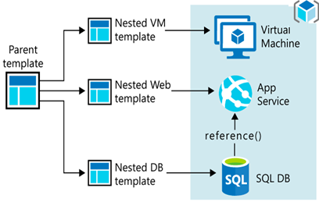
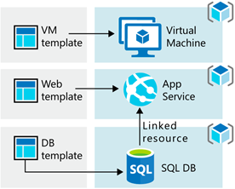
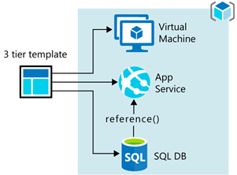
Overview of Resource Manager Templates (2 of 2)
A Resource Manager template precisely defines all the Resource Manager resources in a deployment
Separate templates to one resource group
Parent template with nested templates to one resource group
Separate templates to multiple resource groups

Slide 7
What's in a Resource Manager Template?
Defines all the Resource manager resources in a deployment
{
"$schema": "http://schema.management.
azure.com/schemas/2019-04- 01/deploymentTemplate.json#",
"contentVersion": "",
"parameters": {},
"variables": {},
"functions": [],
"resources": [],
"outputs": {}
}
Written in JSON
A collection of key-value pairs
Each key is a string
Each value can be a string, number, Boolean expression, list of values, object
Notes:
Understand the structure and syntax of ARM templates - https://docs.microsoft.com/en-us/azure/azure-resource-manager/templates/template-syntax

Slide 8
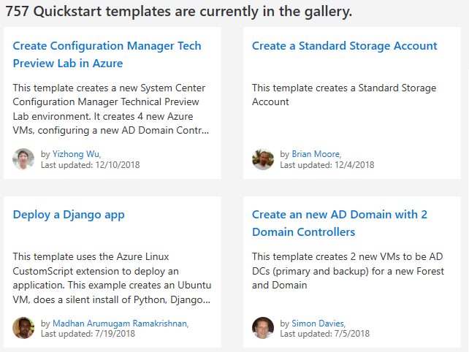
Azure QuickStart Templates
Resource Manager templates provided by the Azure community
Provides everything you need to deploy your solution or serves as a starting point for your template
https://azure.microsoft.com/en-us/resources/templates/
Notes:
QuickStart Templates - https://azure.microsoft.com/en-us/resources/templates/

Slide 9
Lesson 02: Save a Template for a VM

Slide 10
Save a Template for a VM Overview
Download the Template for a VM
Download the Template using PowerShell

Slide 11
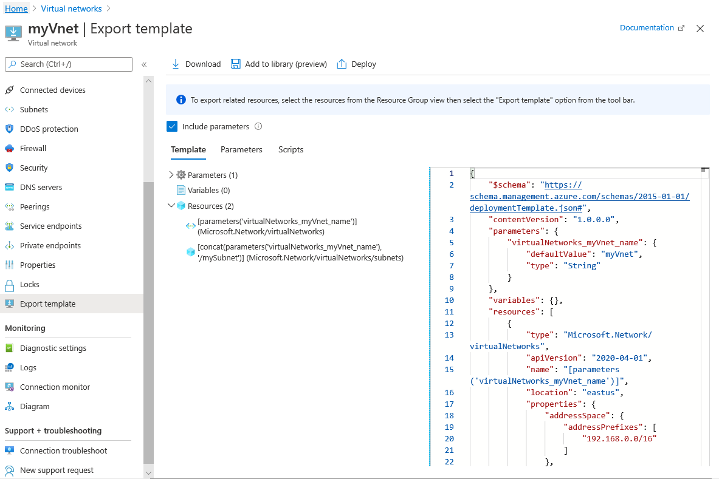
Download the Template for a VM
Export and download the template using the Azure portal

Slide 12
Download the Template using PowerShell
Export-AzResourceGroup ` -ResourceGroupName "myResourceGroup" ` -Path "C:\users\public\downloads"

Slide 13
Lesson 03: Configure a Virtual Hard Disk Template

Slide 14
Configure a Virtual Hard Disk Template Overview
Disk Images for VMs
Deploy an Azure VM from VHD
Virtual Hard Disk Deployment Template
Create a VM from VHD
Notes:
indentation indicating skillpipe topics rolled up under the one slide

Slide 15

Disk Images for Azure VMs
Deploy (template or script) a new VM with a generalized VHD image
What is a virtual machine image?
A VHD template for creating new VM instances
Azure Marketplace provides many virtual machine images
What is an Azure virtual hard disk (VHD)?
A virtual file in Azure – operating system, application, data
VMs can contain multiple VHDs
What is a generalized image?
A custom virtual machine image
What is a specialized virtual image?
A copy of a virtual machine at a specific state.

Slide 16
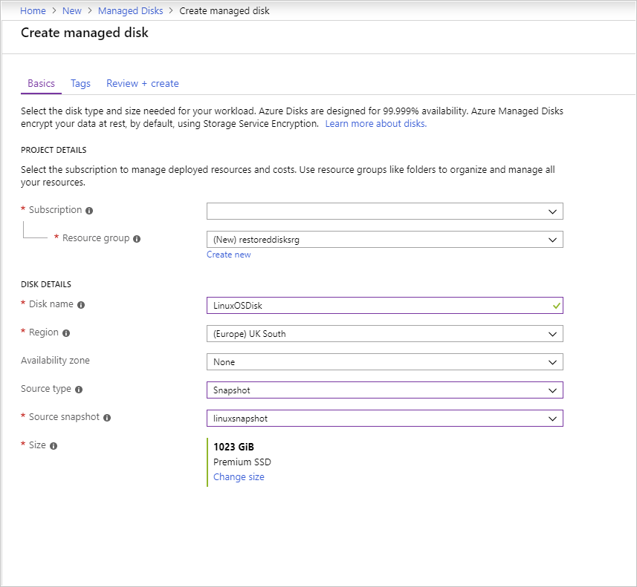
Create a VM from a VHD
Create a snapshot of each VHD
For each snapshot, create a managed disk
Create an Azure VM using the managed disks

Slide 17
Lesson 04: Deploy from a Template

Slide 18
Deploy from a Template Overview
Create and Deploy from an ARM Template
* Additional example in the student materials
Notes:
Deploy an Azure Resource Manager Template using CLI – not specifically covered.

Slide 19
Create and Deploy from an ARM Template
Sample deployment of an Azure storage account
az login
az group create --name myResourceGroup --location "Central US“
templateFile="{provide-the-path-to-the-template-file}"
az deployment group create --name blanktemplate \ --resource-group myResourceGroup --template-file $templateFile

Slide 20
Lesson 05: Automation Accounts

Slide 21
Automation Accounts Overview
Runbooks in Azure Automation
Import a PowerShell Runbook from the Gallery
Start a Runbook in Azure Automation
Demonstration - Automate Deployment and Configuration of Resources
Notes:
Indenting indicates a topic without a specific slide.

Slide 22
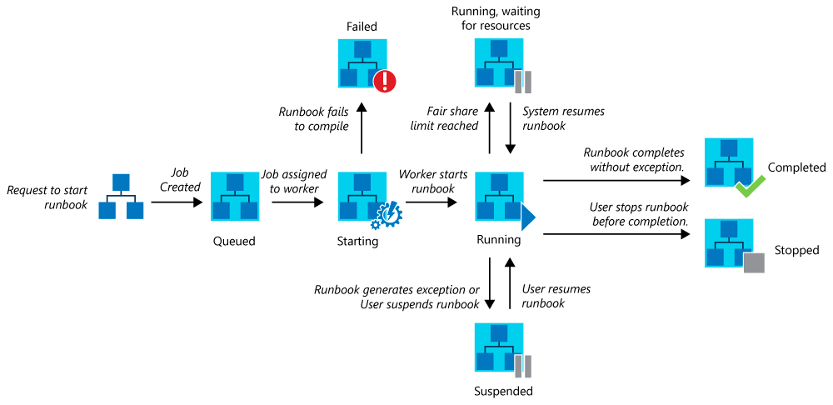
Runbooks in Azure Automation
Create and manage PowerShell, PowerShell Workflow, and graphical runbooks
Run either in an Azure sandbox (shared environment) or with a Hybrid Runbook Worker (directly on the computer that hosts the worker)

Slide 23
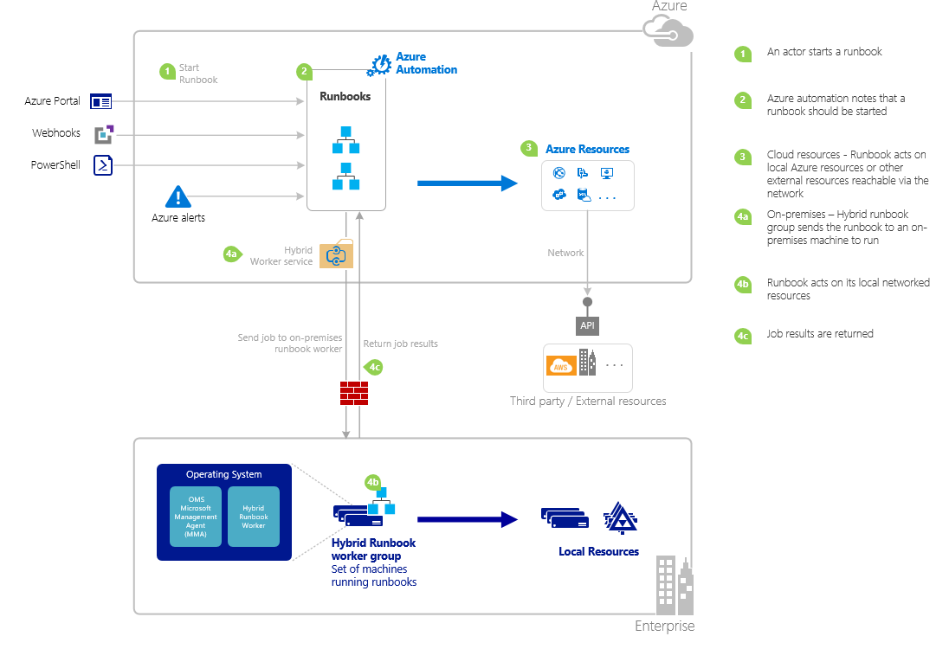
Import a PowerShell Runbook from the Runbook Gallery
You can import runbooks from the Runbooks Gallery
After importing you can run the runbook from the Portal or from PowerShell

Slide 24
Demonstration: Automate Deployment and Configuration of Resources
Create a new runbook
Add code to the runbook
Test the runbook
Publish and run the Runbook

Slide 25
Automate Deployment and Configuration of Resources - Review
Knowledge Check
Microsoft Learn Modules (docs.microsoft.com/Learn)
Build Azure Resource Manager templates
Deploy Azure virtual machines from VHD templates
Deploy Azure infrastructure by using ARM templates
Extend ARM templates by using deployment scripts
Notes:
Learn - https://docs.microsoft.com/en-us/learn/browse/

Slide 26
End of presentation

