Slide 1
AZ-303: Microsoft Azure Architect Technologies

Slide 2






Module 10: Implement and Manage Azure Governance Solutions
Lesson 01: Role-Based Access Control (RBAC)
Lesson 02: Azure AD Access Reviews
Lesson 03: Implement and Configure an Azure Policy
Lesson 04: Azure Blueprints
Lesson 05: Lab

Slide 3

Lesson 01: Role-Based Access Control (RBAC)

Slide 4
RBAC Overview
Role-Based Access Control (RBAC)
RBAC in the Portal
How RBAC Works
Administrator Roles, Azure Roles, and Azure AD Roles
Demonstration: Add an Azure Role Assignment

Slide 5
Role-Based Access Control
Concept | Description
Security principal | Object that represents something that is requesting access to resources​
Role definition | Collection of permissions that lists the operations that can be performed​
Scope | Boundary for the level of access that is requested​
Assignment | Attaching a role definition to a security principal at a particular scope
Fine-grained access management to Azure resources – built on Azure Resource Manager
Segregate duties within your team
Grant only the amount of access to users that they need to perform their jobs​

Slide 6
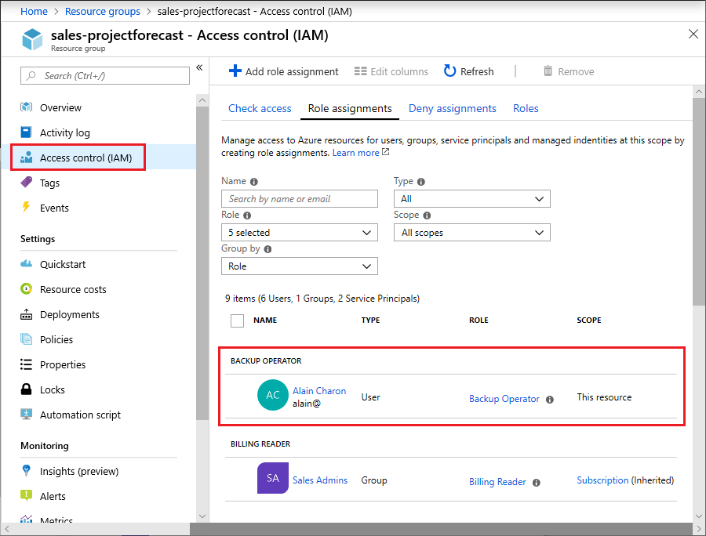
RBAC in the Azure Portal
Look for RBAC tasks in the Access control (IAM) blade

Slide 7




How RBAC Works (1 of 2)
To grant access, use a role assignment to bind a role definition to a security principal and then scope the assignment
1
Security principal
User
Group
Service principal
2
Role definition
Role assignment
3
Scope
Owner
Contributor
Reader
…
Backup Operator
Security Reader
Contributor
"Actions": [
"*"
],
"NotActions": [
"Auth/*/Delete",
"Auth/*/Write",
"Auth/elevate"
]
Management group
Marketing group
Subscription
Resource group
Pharma-sales Resource group
Reader Support Tickets
Virtual Machine Operator
Contributor
Resource

Slide 8

How RBAC Works (2 of 2)
RBAC supports deny assignments
Attaches a set of deny actions to a user, group, service principal, or managed identity at a particular scope for the purpose of denying access
Deny assignments block users from performing specified actions even if a role assignment grants them access.
Deny assignments take precedence over role assignments.
Deny assignments are currently read-only and are set by Azure Blueprints and Azure Managed Apps

Slide 9
Administrator Roles, Azure Roles, and Azure AD Roles (1 of 3)
Azure and Azure AD offer two types of roles
Azure RBAC roles | Azure AD roles
Manage access to Azure resources | Manage access to Azure AD objects
Scope can be specified at multiple levels | Scope is at the tenant level
Role information can be accessed in the Azure portal, Azure CLI, Azure PowerShell, Azure Resource Manager templates, REST API | Role information can be accessed in Azure portal, Microsoft 365 admin portal, Microsoft Graph, Azure Active Directory PowerShell for Graph
* Classic administrator roles should be avoided if using Azure Resource Manager

Slide 10
Administrator Roles, Azure Roles, and Azure AD Roles (2 of 3)
Type | Role | Permissions
Azure RBAC Roles | Owner | Full access to all resources Delegate access to others
 | Contributor | Create and manage all of types of Azure resources Create a new tenant in Azure Active Directory Cannot grant access to others
 | Reader | View Azure resources
 | User Access Administrator | Manage user access to Azure resources

Slide 11
Administrator Roles, Azure Roles, and Azure AD Roles (3 of 3)
Type | Role | Permissions
Azure AD Roles | Global Administrator | Manage access to Azure AD and federation services Assign administrator roles to others Reset the password for any user and all other administrators
 | User Administrator | Create and manage all aspects of users and groups Manage support tickets and monitor service health Reset passwords for users, Helpdesk admins, and other User admins
 | Billing Administrator | Make purchases and manage subscriptions Manage support tickets and monitor service health

Slide 12
Demonstration: Add an Azure Role Assignment
Review role assignments
Add a role assignment

Slide 13
Lesson 02: Azure AD Access Reviews

Slide 14
Azure AD Access Review Overview
Azure AD Access Reviews
Create an Azure AD Access Review

Slide 15
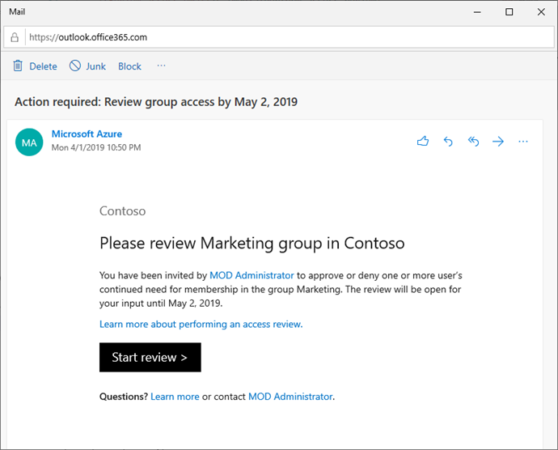
Azure AD Access Reviews
Enables organizations to recertify, attest, and audit user’s access to resources – Office groups, AD groups, Azure AD apps, Azure AD roles, RBAC roles
Approve or deny employees and guest users’ continued access
Select reviewers to be group owners, members themselves and individuals in the directory
Recommend decisions to the reviewer based on user’s sign-in activities – option to set up recurring reviews
Notes:
https://docs.microsoft.com/en-us/learn/modules/plan-implement-manage-access-review/

Slide 16
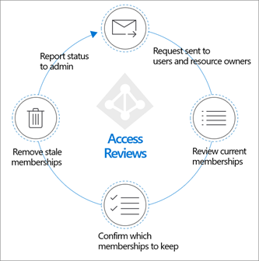
Create an Azure AD Access Review
Schedule regular reviews or perform ad-hoc reviews to see who has access to specific resources, such as applications and groups
Track reviews for insights, compliance, or policy reasons
Delegate reviews to specific admins, business owners, or end-users who can self-attest to the need for continued access
Use the insights to efficiently determine if users should continue to have access – automate review outcomes
Notes:
https://docs.microsoft.com/en-us/azure/active-directory/governance/deploy-access-reviews

Slide 17
Lesson 03: Implement and Configure an Azure Policy

Slide 18
Implement and Configure Azure Policy Overview
Azure Policy Overview
Demonstration: Create and manage policies
Implement a new custom policy

Slide 19
Azure Policy Overview (1 of 2)
Usage Cases
Allowed resource types – Specify the resource types that your organization can deploy
Allowed virtual machine SKUs – Specify a set of virtual machine SKUs that your organization can deploy
Allowed locations – Restrict the locations your organization can specify when deploying resources
Require tag and its value – Enforces a required tag and its value
Azure Backup should be enabled for Virtual Machines – Audit if Azure Backup service is enabled for all Virtual machines
A service to create, assign, and manage policies
Runs evaluations and scans for non-compliant resources
Benefits:
Enforcement and compliance
Apply policies at scale
Remediation

Slide 20

Azure Policy Overview (2 of 2)
Select a Policy Definition – built-in choices or create custom
Policy Definitions
Allowed resource types
Create an Initiative Definition – a bundle of Policy Definitions
Allowed locations
Initiative Definition
Scope the Initiative Definition - enforces the policy across specific resources
Review the policy evaluation results - look for non-compliant items
Resources

Slide 21
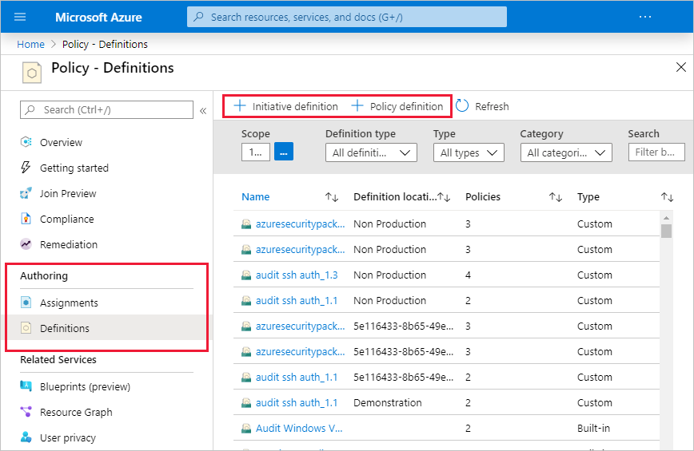
Implement a New Custom Policy
Scenario:
Create a new custom policy to save costs by validating that VMs created in your environment can't be in the G series.
Every time a user in your organization tries to create VM in the G series, the request is denied.

Slide 22
Demonstration: Create and Manage Policies to Enforce Compliance
Assign a policy
Create and assign an Initiative Definition
Review and resolve a non-compliant or denied resource

Slide 23
Lesson 04: Azure Blueprints

Slide 24
Azure Blueprints Overview
Azure Blueprints
Demonstration: Create a Blueprint

Slide 25
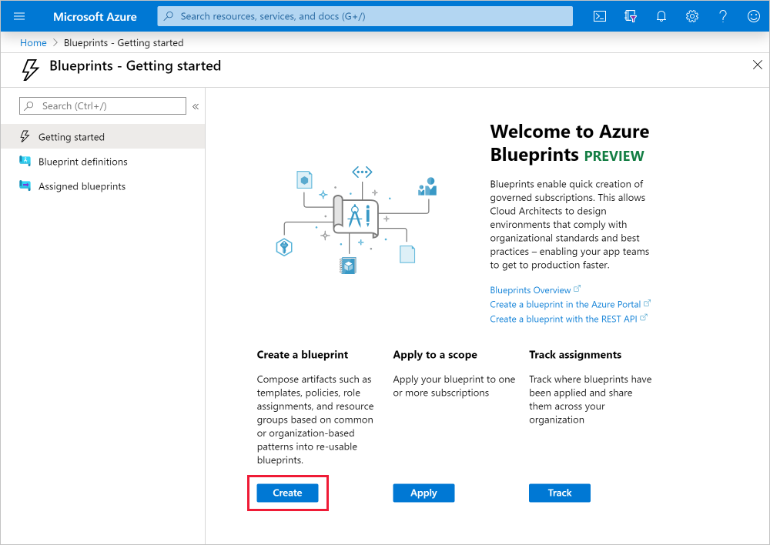
Azure Blueprints
Orchestrates the deployment of various resource templates and other artifacts
Could be applied to role assignments, policy assignments, ARM templates, and resource groups
A repeatable set of governance tools and standard Azure resources that your organization requires – defines a standard pattern of compliance
Notes:
https://docs.microsoft.com/en-us/learn/modules/build-cloud-governance-strategy-azure/10-govern-subscriptions-azure-blueprints

Slide 26
Demonstration: Create a Blueprint
Create a blueprint
Edit a blueprint (optional)
Publish a blueprint (optional)
Assign a blueprint
Track deployment
Notes:
https://docs.microsoft.com/en-us/azure/governance/blueprints/create-blueprint-portal

Slide 27
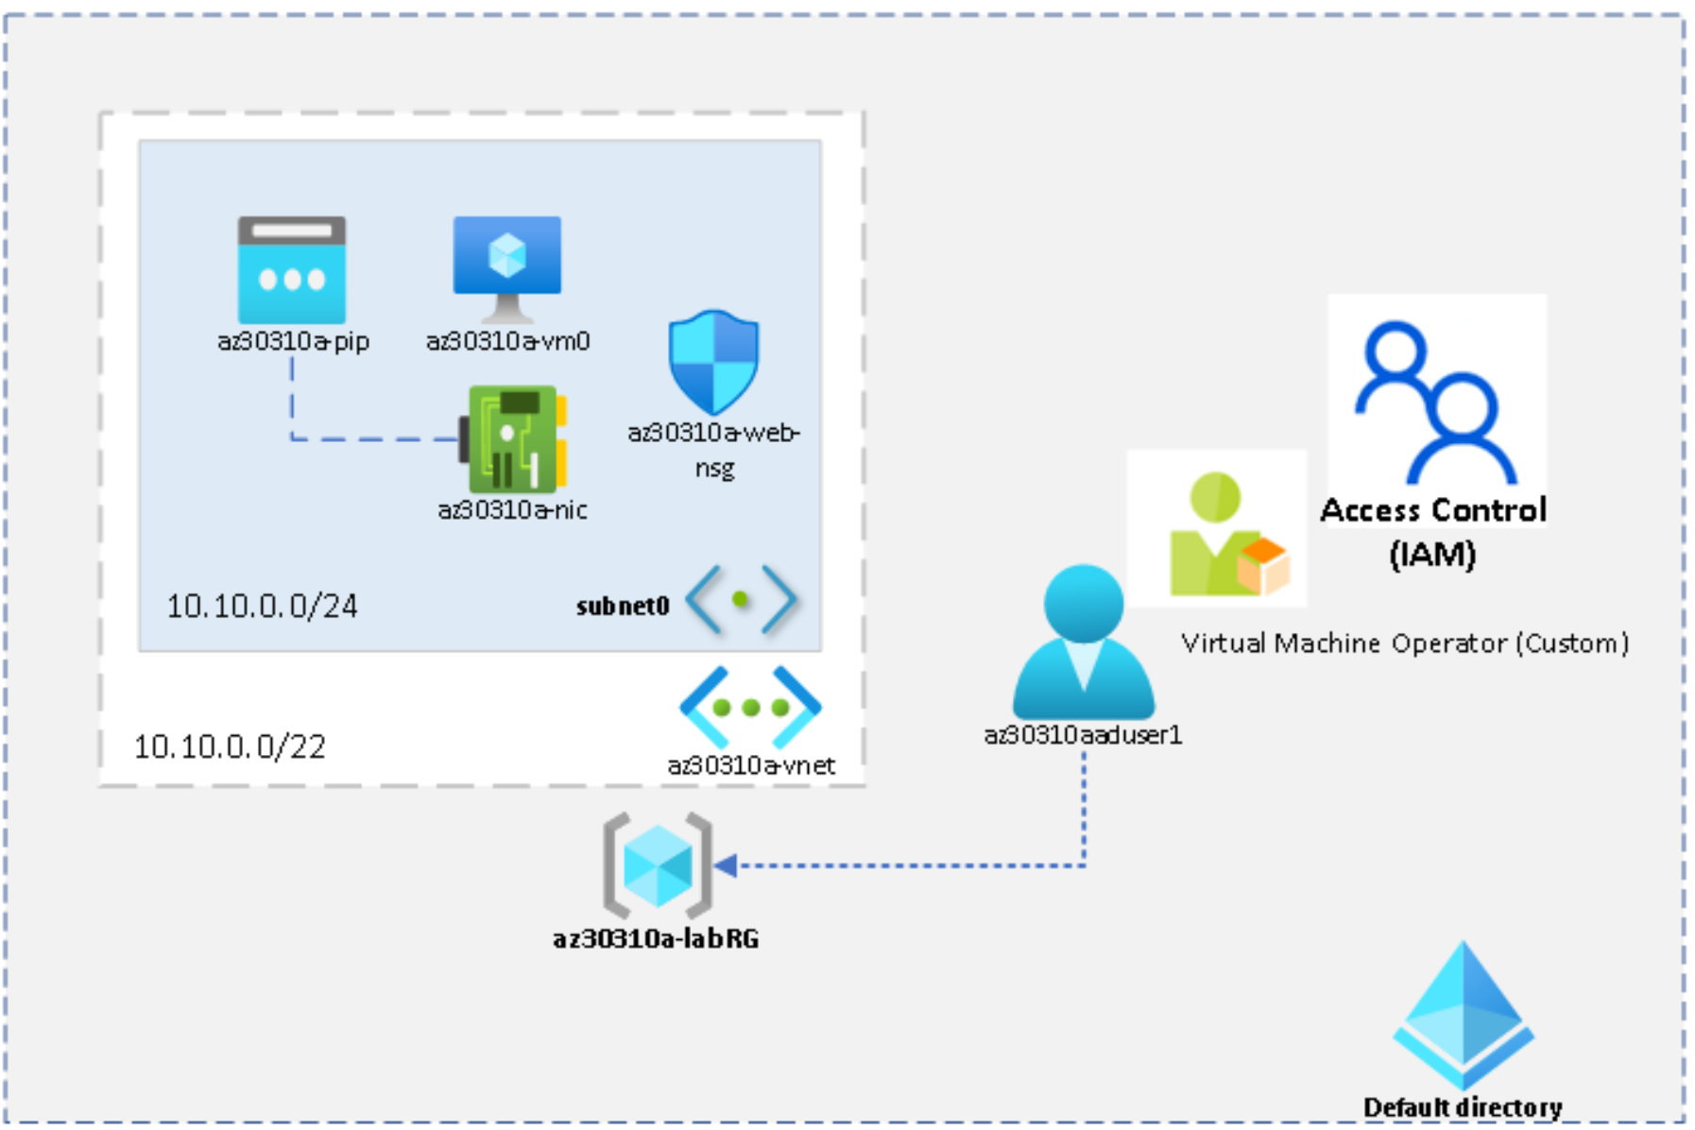
Lab: Managing Azure Role-Based Access Control

Slide 28
Implement and Manage Azure Governance Solutions - Review
Knowledge Check
Microsoft Learn Modules (docs.microsoft.com/Learn)
Manage access to an Azure subscription by using Azure role-based access control (RBAC)
Secure your Azure resources with role-based access control (RBAC)
Plan, implement, and manage access review
Apply and monitor infrastructure standards with Azure Policy
Build a cloud governance strategy
Notes:
Learn - https://docs.microsoft.com/en-us/learn/browse/

Slide 29
End of presentation

