Slide 1
AZ-303: Microsoft Azure Architect Technologies

Slide 2


Module 11: Manage Security for Applications
Lesson 01: Azure Managed Identity
Lesson 02: Azure Key Vault

Slide 3
Lesson 01: Azure Managed Identity

Slide 4
Azure Managed Identity Overview
Authentication with Azure Managed Identities
Using Managed Identities with Azure Resources

Slide 5
Authentication with Azure Managed Identities
A managed identity is automatically managed in Azure AD
Manages the credentials for authenticating a cloud application with an Azure service
App Service
Azure Service
(Azure Resource Manager, Key Vault)
Your code
Combines Azure AD authentication and Azure RBAC
Local token service
Credentials
Eliminates the need for rotating credentials or certificates
Azure (inject and roll credentials)
Notes:
https://docs.microsoft.com/en-us/learn/modules/explore-basic-services-identity-types/4-describe-identity-types?ns-enrollment-type=LearningPath&ns-enrollment-id=learn.wwl.describe-capabilities-of-microsoft-identity-access-management-solutions

Slide 6
Using Managed Identities with Azure Resources
Two types of managed identities: system-assigned and user-assigned
Property | System-assigned managed identity | User-assigned managed identity
Creation | Created as part of an Azure resource | Created as a standalone Azure resource.
Lifecycle | Shared lifecycle with the Azure resource | Independent lifecycle - must be explicitly deleted
Sharing across Azure resources | Cannot be shared – associated with a single Azure resource | Can be shared - associated with more than one Azure resource
Usage cases | Workloads that are contained within a single Azure resource. Workloads for which you need independent identities. | Workloads on multiple resources that share a single identity. Workloads that need preauthorization to a secure resource - provisioning flow. Workloads where resources are recycled frequently, but permissions should stay consistent.
Notes:
System-assigned: Workloads for which you need independent identities, such as an application that runs on a single virtual machine.
User-assigned:

Slide 7
Lesson 02: Azure Key Vault

Slide 8
Azure Key Vault Overview
Azure Key Vault
Key Vault Considerations
Demonstration: Configure Certificate Auto-Rotation in Key Vault

Slide 9
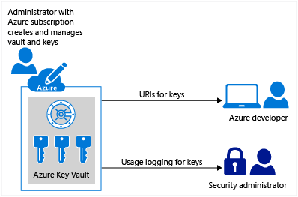
Azure Key Vault (1 of 2)
Designed to store configuration secrets for server applications
Tokens, passwords, certificates, API keys, and other secrets
Public and private SSL/TLS certificates
Hardware security modules (HSMs) secrets - Premium license
Not intended for user passwords
Two service tiers—standard and premium
Notes:
About Azure Key Vault - https://docs.microsoft.com/en-us/azure/key-vault/general/overview
Key Vault is designed to store configuration secrets for server applications. It's not intended for storing data belonging to your app's users, and it shouldn't be used in the client-side part of an app. This is reflected in its performance characteristics, API, and cost model. User data should be stored elsewhere, such as in an Azure SQL database with Transparent Data Encryption, or a storage account with Storage Service Encryption. Secrets used by your application to access those data stores can be kept in Key Vault.
If a user has contributor permissions (RBAC) to a key vault management plane, they can grant themselves access to the data plane by setting a key vault access policy. It's recommended that you tightly control who has contributor access to your key vaults, to ensure that only authorized persons can access and manage your key vaults, keys, secrets, and certificates.
Azure Key Vault helps address the following issues:
Secrets management. Azure Key Vault can securely store (with HSMs) and tightly control access to tokens, passwords, certificates, API keys, and other secrets.
Key management. Azure Key Vault is a cloud-based key management solution, making it easier to create and control the encryption keys used to encrypt your data. Azure services such as App Service integrate directly with Azure Key Vault and can decrypt secrets without knowledge of the encryption keys.

Slide 10
Azure Key Vault (2 of 2)
Facilitates the storage and management of secrets, keys, and certificates
Keys
Secrets
Certificates
Single instanced or can be versioned
Hardware-protected keys for cryptographic processing and key generation
Software-protected keys using software-based RSA and ECC algorithms
Small (less than 25K) data strings
Protected by a HSM-generated key
Simplifies the process of persisting sensitive settings
Create self-signed certificates directly in the Azure portal
Create an X.509 certificate signing request (CSR).
Notes:
https://docs.microsoft.com/en-us/learn/modules/configure-and-manage-azure-key-vault/

Slide 11
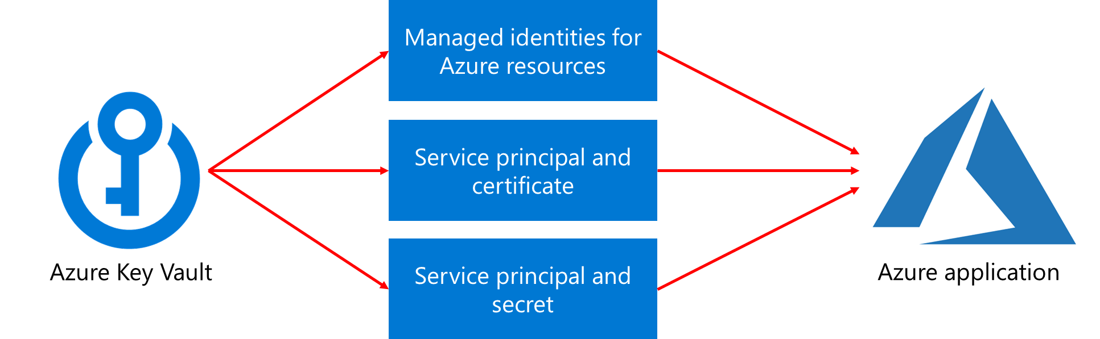
Key Vault Considerations
Tightly control what users can access
Access should only be given at specific scopes
Store all certificates in the Key Vault
Ensure that you can recover if the Key Vaults should get deleted/corrupted

Slide 12
Demonstration: Configure Certificate Auto-Rotation in the Key Vault
Manage a certificate in the Portal
Add a CA provider account
Update the certificate’s validity period
Update the certificate’s auto-rotation frequency
Update the CA’s attributes using PowerShell

Slide 13
Manage Security for Applications - Review
Knowledge Check
Microsoft Learn Modules (docs.microsoft.com/Learn)
Configure and manage secrets in Azure Key Vault
Manage secrets in your server apps with Azure Key Vault
Notes:
Learn - https://docs.microsoft.com/en-us/learn/browse/

Slide 14
End of presentation

