Slide 1
AZ-303: Microsoft Azure Architect Technologies

Slide 2


Module 13: Implement Container-Based Applications
Lesson 01: Azure Container Instances
Lesson 02: Azure Kubernetes Service

Slide 3
Lesson 01: Azure Container Instances

Slide 4
Azure Container Instances Overview
Azure Container Instances
Container Groups
Demonstration: Run Azure Container Instances

Slide 5
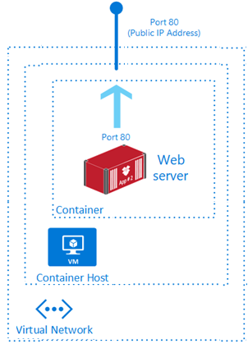
Azure Container Instances (1 of 1)
PaaS Service
Fast startup times
Public IP connectivity and DNS name
Hypervisor-level security
Isolation features
Custom sizes
Persistent storage
Linux and Windows containers
Co-scheduled groups
Virtual network deployment
Fastest way to run a container in Azure without provisioning a VM

Slide 6
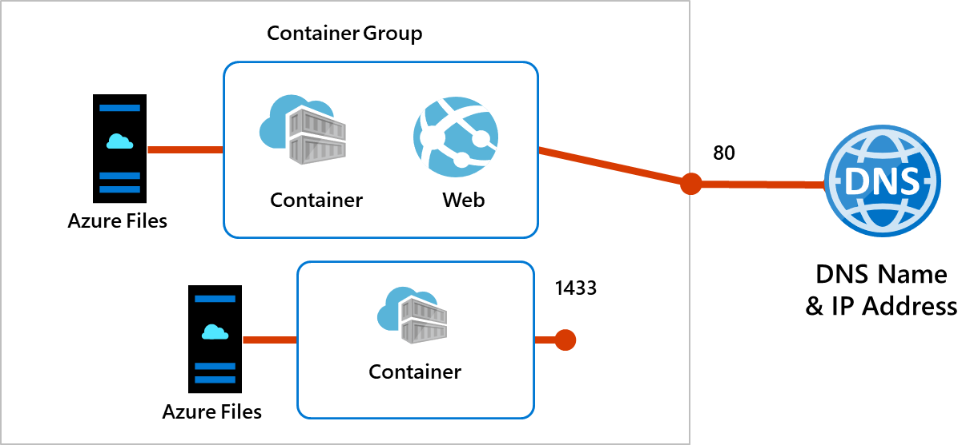
Azure Container Instances (2 of 2)
Top-level resource in Azure Container Instances
A collection of containers that get scheduled on the same host
The containers in the group share a lifecycle, resources, local network, and storage volumes

Slide 7
Container Groups
Top-level resource in Azure Container Instances
A collection of containers that get scheduled on the same host
The containers in the group share a lifecycle, resources, local network, and storage volumes
Notes:
Quickstart: Deploy a container instance in Azure using the Azure portal - https://docs.microsoft.com/en-us/azure/container-instances/container-instances-quickstart-portal

Slide 8
Demonstration: Run Azure Container Instances
Create a Container
Configure the Container

Slide 9
Lesson 02: Configure Azure Kubernetes Service

Slide 10
Configure Azure Kubernetes Service Overview
Azure Kubernetes Service
Demonstration: Deploy Kubernetes with AKS

Slide 11
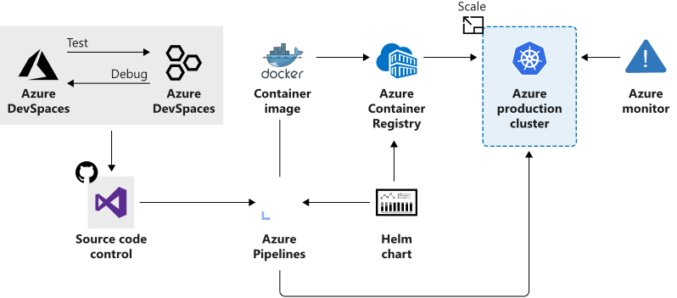
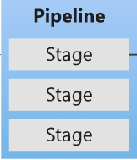
Azure Kubernetes Service (1 of 3)
Manages health monitoring and maintenance
Performs simple cluster scaling
Enables nodes to be fully managed by Microsoft
You’re responsible only for managing the agent nodes
You pay only for the agent nodes
Notes:
What is Kubernetes - https://azure.microsoft.com/en-us/topic/what-is-kubernetes/

Slide 12
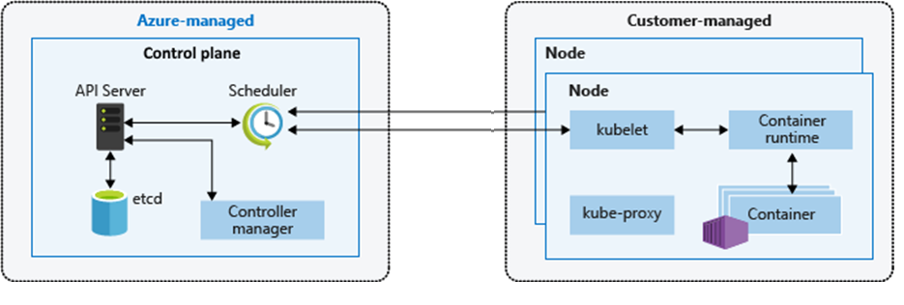
Azure Kubernetes Service (2 of 3)
An AKS cluster has Azure-managed and Customer-managed components
The Azure-managed control plane provides the core services and orchestration of application workloads
The Customer-managed nodes run your application workloads
Notes:
https://docs.microsoft.com/en-us/azure/aks/concepts-clusters-workloads

Slide 13


AKS Terminology
Term | Description
Pools | Groups of nodes with identical configurations
Nodes | Individual VMs running containerized applications
Pods | Single instance of an application. A pod can contain multiple containers
Deployment | One or more identical pods managed by Kubernetes​
Manifest | YAML file describing a deployment
Pool
Node
Deployment (YAML)
Pod
Pod
Node
Node
Notes:
Kubernetes core concepts for Azure Kubernetes Service (AKS) - https://docs.microsoft.com/en-us/azure/aks/concepts-clusters-workloads

Slide 14
Demonstration: Deploy Kubernetes with AKS
Create the infrastructure
Create the AKS Cluster
Test Cluster connectivity
Create a Kubernetes namespace

Slide 15
Implement Container-Based Applications - Review
Knowledge Check
Microsoft Learn Modules (docs.microsoft.com/Learn)
Run Docker containers with Azure Container Instances
Build a containerized web application with Docker
Introduction to the Azure Kubernetes Service
Introduction to Azure Kubernetes Service
Notes:
Learn - https://docs.microsoft.com/en-us/learn/browse/

Slide 16
End of presentation

