Slide 1
AZ-303: Microsoft Azure Architect Technologies

Slide 2








Module 14: Implement an Application Infrastructure
Lesson 01: Create and Configure Azure App Service
Lesson 02: Create an App Service Web App for Containers
Lesson 03: Create and Configure an App Service Plan
Lesson 04: Configure Networking for an App Service
Lesson 05: Create and Manage Deployment Slots
Lesson 06: Implement Logic Apps
Lesson 07: Implement Azure Functions
Labs – Implement Application Infrastructure

Slide 3
Lesson 01: Create and Configure Azure App Service

Slide 4
Create and Configure Azure App Service Overview
Azure App Service Overview
Demonstration: Azure App Service.

Slide 5
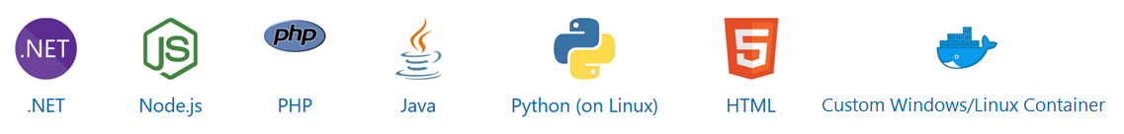
Azure App Service Overview (1 of 2)
Includes Web Apps, API Apps, Mobile Apps, and Function Apps
Fully managed environment enabling high productivity development – both Windows and Linux
HTTP-based service for hosting web applications, REST APIs, and mobile backends
Platform handles infrastructure so developers focus on core web apps and services
You can develop in.NET, .NET Core, Java, Ruby, Node.js, PHP, or Python
Integrates with Azure DevOps, GitHub, Bitbucket, FTP, or a local Git

Slide 6
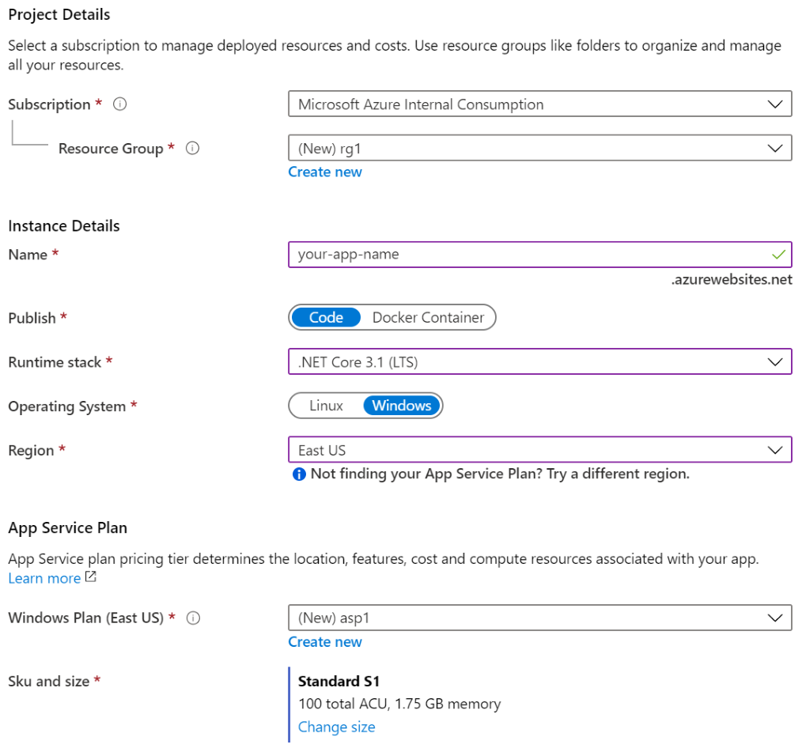
Azure App Service Overview (2 of 2)
Name must be unique
Access using azurewebsites.net – can map to a custom domain
Publish Code (Runtime Stack)
Publish Docker Container
Linux or Windows
Region closest to your users
App Service Plan

Slide 7
Demonstration: Azure App Service
Create an Azure App Service
Configure the web app

Slide 8
Lesson 02: Create an App Service Web App for Containers

Slide 9
Create an App Service Web App for Containers Overview
Azure Container Registry
Build an Image using Azure Container Registry
Deploy a Web App from a Docker Image

Slide 10
Azure Container Registry
Container Registry allows you to
create a private image registry
automate tasks such as redeploying an app when an image is rebuilt
To create a Container Registry, run
az acr create --name myregistry --resource-group mygroup --sku standard --admin-enabled true
To build images and store them in a Container Registry, run
az acr build --file Dockerfile --registry myregistry --image myimage .

Slide 11
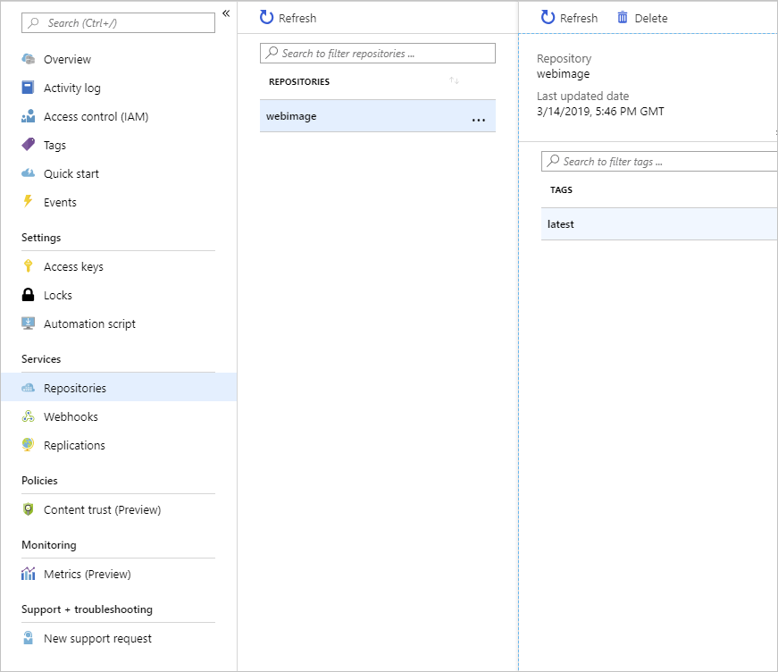
Build an Image using Azure Container Registry
Create a registry in Azure Container Registry
Build a Docker image and upload it to Azure Container Registry
Examine the container registry

Slide 12
Deploy a Web App from a Docker Image
Create a new web app by using the Docker image stored in Azure Container Registry
Test the web app
Property | Value
Subscription | The target Azure subscription in which you are allowed to create and manage resources.
Resource Group | A resource group name
Name | A globally unique name of the web app you are deploying
Publish | Docker Image
OS | Linux
App Service plan | Use the default

Slide 13
Lesson 03: Create and Configure an App Service Plan

Slide 14
Create and Configure an App Service Plan Overview
Azure App Service Plans
App Service Plan Pricing Tiers
App Service Plan Scaling
Demonstration: Create an App Service Plan

Slide 15
Azure App Service Plans
An App Service plan defines a set of compute resources for web apps
These compute resources are analogous to the server farm in the traditional web hosting
App Service plan determines capabilities and resources available to its web apps
Web apps can share the same App Service plan
Isolate your app into a new App Service plan when
The app is resource-intensive
You want to scale the app independently from other apps
The app needs resources in a different geographical region

Slide 16
App Service Plan Pricing Tiers
Selected Features | Free | Shared (dev/test) | Basic (dedicated dev/test) | Standard (production workloads) | Premium (enhanced scale and performance) | Isolated (high-performance, security and isolation)
Web, mobile, or API apps | 10 | 100 | Unlimited | Unlimited | Unlimited | Unlimited
Disk space | 1 GB | 1 GB | 10 GB | 50 GB | 250 GB | 1 TB
Auto Scale | – | – | – | Supported | Supported | Supported
Deployment Slots | 0 | 0 | 0 | 5 | 20 | 20
Max Instances | – | – | Up to 3 | Up to 10 | Up to 30 | Up to 100
Shared compute (Free and Shared). Run apps on the same Azure VM as other App Service apps, and the resources cannot scale out
Dedicated compute (Basic, Standard, Premium). Run apps in the same plan in dedicated Azure VMs
Isolated
Runs apps on dedicated Azure VMs in dedicated Azure virtual networks
Notes:
App Service pricing - https://azure.microsoft.com/en-us/pricing/details/app-service/windows/

Slide 17
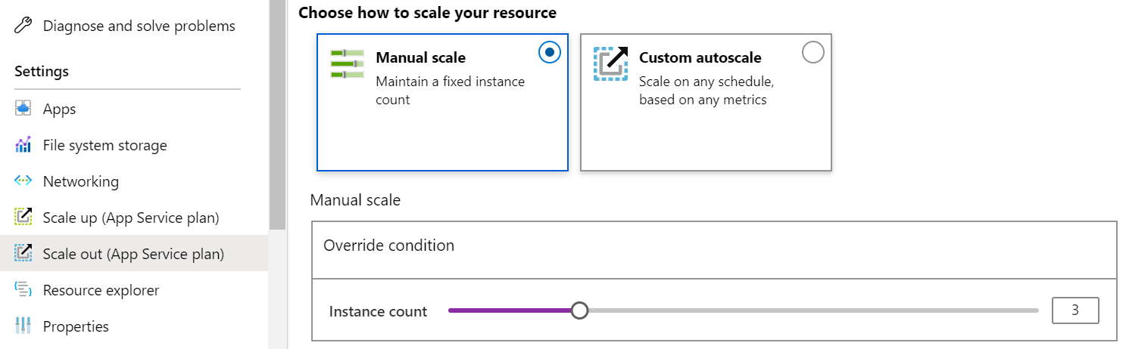
App Service Plan Scaling
Scale up (change the App Service plan):
More hardware (CPU, memory, disk)
More features (dedicated virtual machines, staging slots, autoscaling)
Scale out (increase the number of VM instances):
Manual (fixed number of instances)
Auto scale (based on predefined rules and schedules)
Notes:
Scale up an app in Azure App Service - https://docs.microsoft.com/en-us/azure/app-service/manage-scale-up

Slide 18
Demonstration: Create an App Service Plan
Create an App Service Plan
Review pricing tiers

Slide 19
Lesson 04: Configure Networking for an App Service

Slide 20
Configure Networking for an App Service Overview
Integrate an App with an Azure Virtual Network
Enable VNet Integration
Regional VNet Integration
Notes:
Indentation indicates Skillpipe pages which are also covered on that slide.

Slide 21
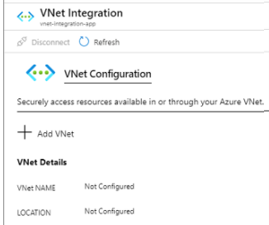
Integrate an App with Azure Virtual Network
VNet Integration feature is used in multitenant apps
Gives your app access to resources in your VNet
Doesn't grant inbound private access to your app from the VNet
Only used to make outbound calls from your app into your Vnet
Two variations: regional and gateway required
Notes:
https://docs.microsoft.com/en-us/azure/app-service/web-sites-integrate-with-vnet

Slide 22
Lesson 05: Create and Manage Deployment Slots

Slide 23
Create and Manage Deployment Slots Overview
Deployment Slots
Slots and Tiers
Create a Deployment Slot
Access a Deployment Slot

Slide 24



Deployment Slots
You can create multiple deployment slots within a single Azure App Service web app
Continuous Deployment with a Stage Slot
Each slot is a separate instance of that web app, and it has a separate host name
You can deploy a different version of your web app into each slot
Developer 1
GitHub
Swap
Each slot has its own URL and shares the resources of the same App Service plan
Staging
Production
Developer 2
Let's you fallback to a good known site
Notes:
Set up staging environments - https://docs.microsoft.com/en-us/azure/app-service/web-sites-staged-publishing?toc=%2Fazure%2Fapp-service%2Ftoc.json#add-a-deployment-slot
App Service Web App – block web access to non-production deployment slots - http://ruslany.net/2014/04/azure-web-sites-block-web-access-to-non-production-deployment-slots/
✔ Each App Service plan mode supports a different number of deployment slots. To find out the number of slots your app’s mode supports, see App Service Limits.

Slide 25
Slots and Tiers
The number of available deployment slots depends on the pricing tier of the App Service plan
Tier | Maximum staging slots
Free | 0
Shared | 0
Basic | 0
Standard | 5
Premium | 20
Isolated | 20

Slide 26
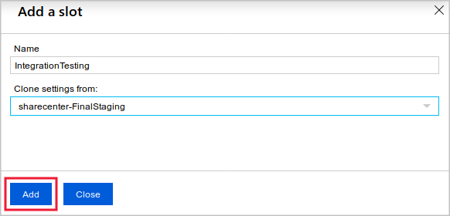
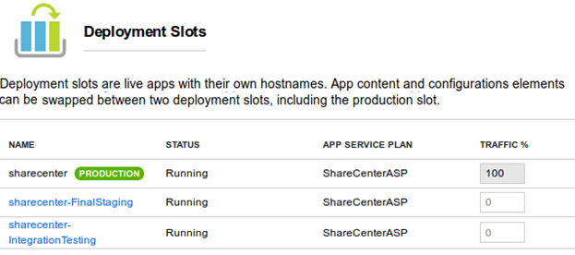
Create a Deployment Slot
Whenever possible, use deployment slots when deploying a new production build.
Deploy your app to a staging environment, validate your changes, and do smoke tests
When you are ready, you can swap your staging and production slots.
The swap operation warms up the necessary worker instances to match your production scale, thus eliminating downtime

Slide 27
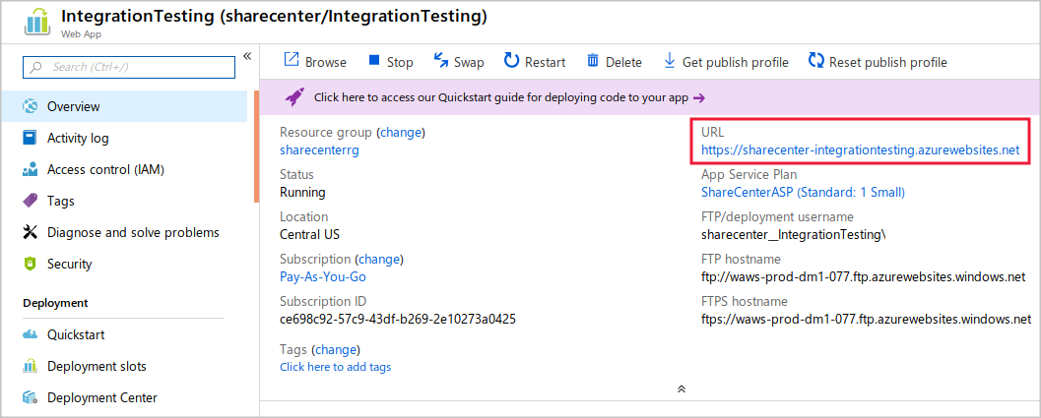
Access a Deployment Slot

Slide 28

Lesson 06: Implement Azure Functions

Slide 29
Implement Azure Functions Overview
Azure Functions
Demonstration: Create a Function App

Slide 30

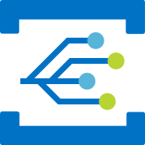





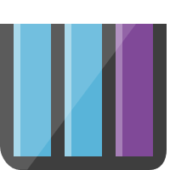
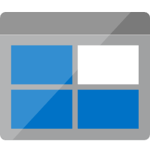
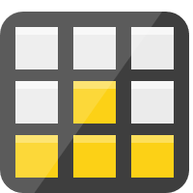


Azure Functions (1 of 2)
Run code based on HTTP requests
Process new and modified Azure Cosmos DB documents, Azure Storage blobs, and Azure Queue storage messages
Notification Hubs
Event Grid
Event Hubs
Cosmos DB
Twilio
Schedule code to run at predefined times
Azure
Functions
Storage
Service Bus
Respond to high volumes of Event Grid events by using subscriptions and filters
Respond to Azure Service Bus queue and topic messages
Queue
Blob
Table
Topics
Queues
Notes:
Lambda, Azure Functions, Azure Web-Jobs, and Azure Logic Apps
Azure Functions is the primary equivalent of AWS Lambda in providing serverless, on-demand code. However, Lambda functionality also overlaps with other Azure services:
WebJobs allow you to create scheduled or continuously running background tasks.
Logic Apps provides communications, integration, and business rule management services.
What can I do with Functions?
Azure Functions, much like AWS Lambda, is a solution for processing data, integrating systems, working with IoT, and building simple APIs and microservices. Consider Functions for tasks like image or order processing, file maintenance, or for any tasks that you want to run on a schedule.
Azure Functions provides templates to get you started with key scenarios.
Azure Functions supports triggers to start execution of your code, and bindings to simplify coding for input and output data. [slides on triggers and scaling follow in Lab 1 Exercise 1 section]
Azure Functions integrate with various Azure and 3rd-party services. These services can trigger your function and start execution, or they can serve as input and output for your code. The following service integrations are supported by Azure Functions:
Azure Cosmos DB
Azure Event Hubs
Azure Event Grid
Azure Notification Hubs
Azure Service Bus (queues and topics)
Azure Storage (blob, queues, and tables)
On-premises (using Service Bus)
Twilio (SMS messages)

Slide 31
Azure Functions (2 of 2)
Service | Trigger description
Blob Storage | Starts a function when a new or updated blob is detected.
Azure Cosmos DB | Start a function when inserts and updates are detected.
Event Grid | Starts a function when an event is received from Event Grid.
HTTP | Starts a function with an HTTP request.
Microsoft Graph Events | Starts a function for an incoming webhook from Microsoft Graph.
Queue Storage | Starts a function when a new item is received on a queue.
Service Bus | Starts a function in response to messages from a Service Bus queue.
Timer | Starts a function on a schedule.
Functions are event driven, which means they run in response to an event
The type of event that starts the function is called a trigger – you must configure a function with exactly one trigger

Slide 32
Demonstration: Create a Function App
Create a function app
Verify the function app

Slide 33
Lesson 07: Implement Logic Apps

Slide 34
Implement Logic Apps Overview
Azure Logic Apps
Build Logic Apps from Triggers and Actions
Logic Apps Designer
Demonstration: Create a workflow using Azure Logic Apps
Notes:
don't think we have to cover everything in the student content - narrowed it down

Slide 35
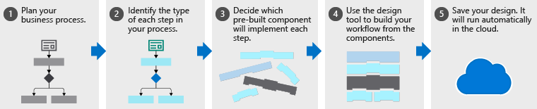
Azure Logic Apps
A cloud service used to schedule, automate, and orchestrate tasks, business processes, and workflows
Used to integrate apps, data, systems, and services across enterprises or organizations
Simplifies how you design and build scalable solutions

Slide 36
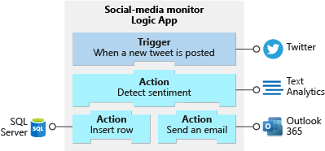
Build Logic Apps from Triggers and Actions
Example
Workflow starts with a trigger, which fires when an event happens, or new data meets specific criteria.
When trigger fires, Logic Apps engine creates a logic app instance that runs the actions in the workflow

Slide 37
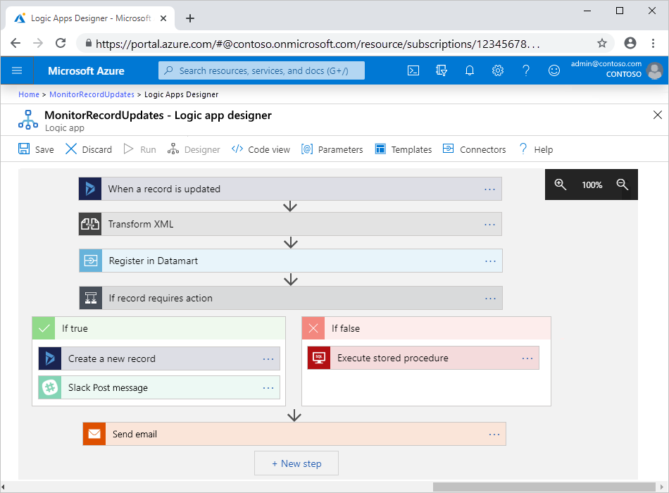
Logic Apps Designer
A graphical tool for creating workflows

Slide 38
Demonstration: Create a workflow using Azure Logic Apps
Create a logic app
Add the RSS trigger
Run the logic app

Slide 39
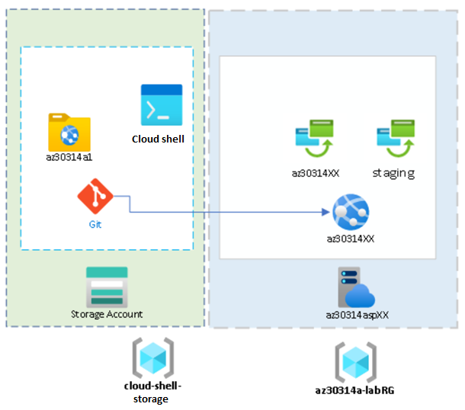
Lab 14A: Implementing an Azure App Service Web App with a staging slot

Slide 40
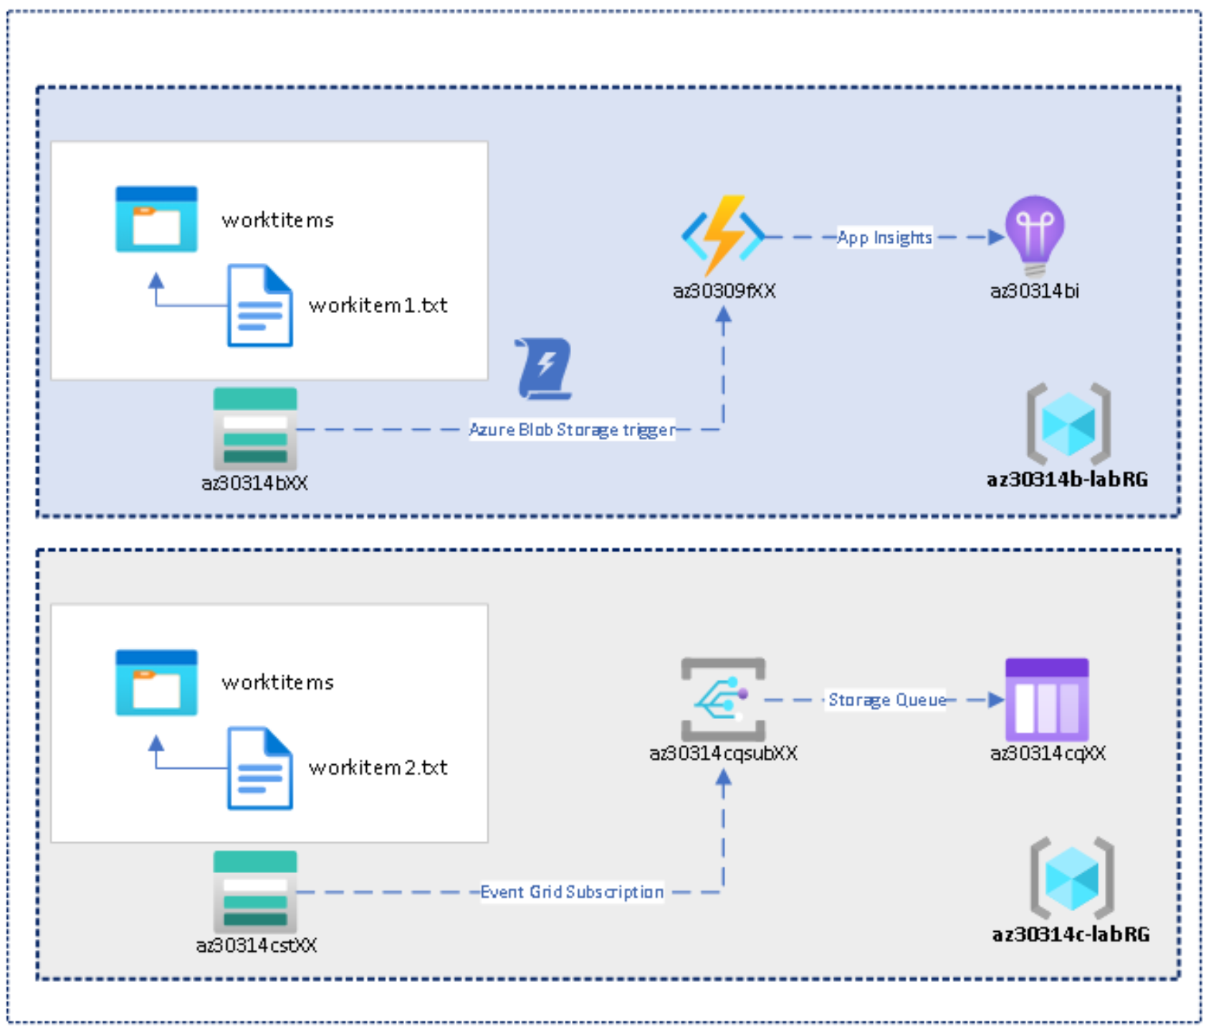
Lab 14B: Configure a message-based integration architecture

Slide 41
Implement an Application Infrastructure - Review
Knowledge Check
Microsoft Learn Modules (docs.microsoft.com/Learn)
Host a web application with Azure App service
Stage a web app deployment for testing and rollback by using App Service deployment slots
Scale an App Service web app to efficiently meet demand with App Service scale up and scale out
Create serverless logic with Azure Functions
Introduction to Azure Logic Apps
Notes:
Learn - https://docs.microsoft.com/en-us/learn/browse/

Slide 42
End of presentation

