Slide 1
AZ-303: Microsoft Azure Architect Technologies

Slide 2









Module 15: Implement Cloud Infrastructure Monitoring
Lesson 01: Azure Monitor
Lesson 02: Azure Workbooks
Lesson 03: Azure Alerts
Lesson 04: Log Analytics
Lesson 05: Network Watcher
Lesson 06: Azure Service Health
Lesson 07: Azure Application Insights
Lesson 08: Unified Monitoring in Azure
Lesson 09: Monitor Azure Costs
Notes:
Student Lesson 01, Azure Infrastructure Security Monitoring, is the Unified Monitoring in Azure lesson.

Slide 3
Lesson 01: Azure Monitor

Slide 4
Azure Monitor Overview
Azure Monitor Service
Key Capabilities
Monitoring Data Platform + Log Data
Azure Advisor
Activity Log
Query the Activity Log

Slide 5
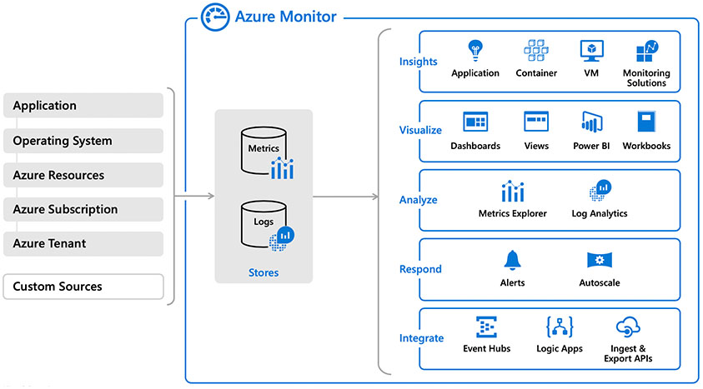
Azure Monitor Service
Data Types

Slide 6
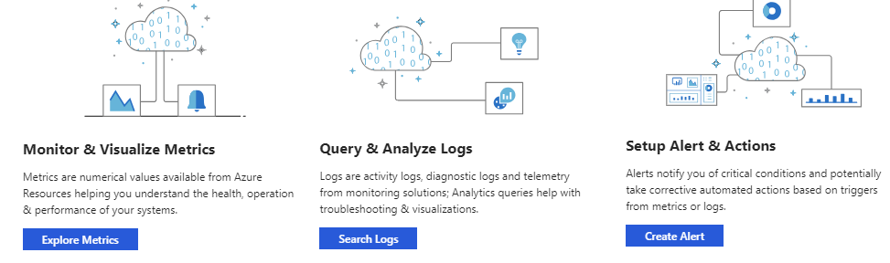
Key Capabilities
Core monitoring for Azure services
Collects metrics, activity logs, and diagnostic logs
Use for time critical alerts and notifications

Slide 7
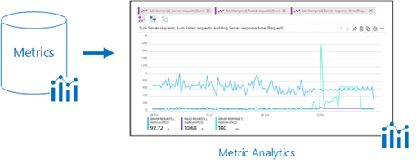
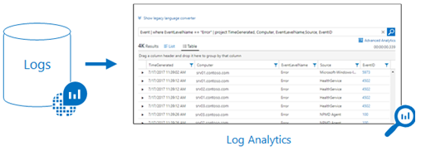
Monitoring the Data Platform
Metrics are numerical values that describe some aspect of a system at a point in time
They are lightweight and capable of supporting near real-time scenarios
Logs contain different kinds of data organized into records with different sets of properties for each type
Telemetry (events, traces) and performance data can be combined for analysis

Slide 8
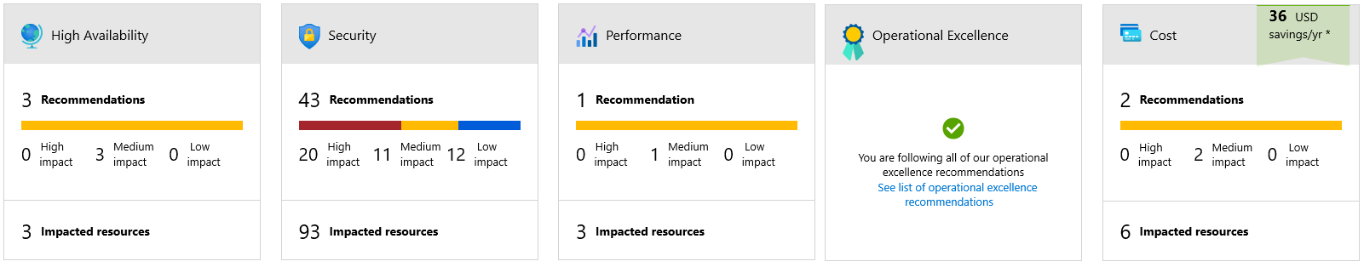
Azure Advisor
Is a personalized cloud consultant

Slide 9
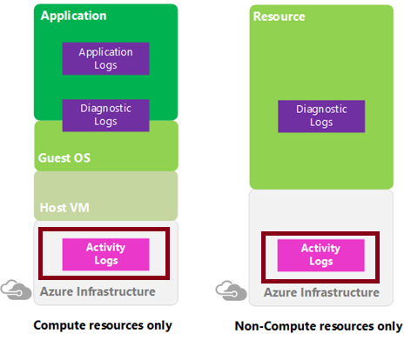
Activity Log
Azure Activity Log is a subscription log that provides insight into subscription-level events that have occurred in Azure
You can determine:
What operations (PUT, POST, DELETE) were taken on all resources
Who started the operation
When the operation occurred
The status of the operation
The values of other properties that might help you research the operation

Slide 10
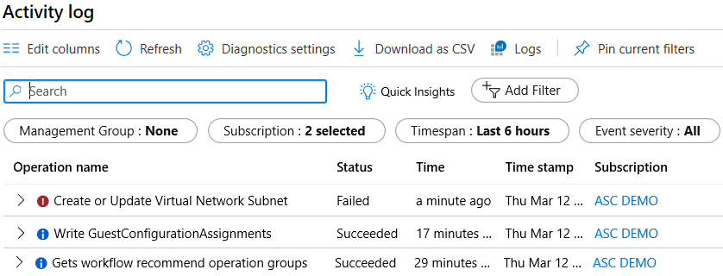
Query the Activity Log
Filter by Management group, Subscription, Timespan, and Event Severity
Add a filter, like Event Category (Security, Recommendations, Alerts)
Pin current filters and download as CSV

Slide 11
Lesson 02: Azure Workbooks

Slide 12
Azure Workbooks Overview
Azure Workbooks Overview
Using Azure Workbooks

Slide 13
Azure Workbooks Overview (1 of 2)
Provides a flexible canvas for data analysis and the creation of rich visual reports within the Azure portal
Data Sources
Logs
Metrics
Azure Resource Graph
Alerts (preview)
Workload health (preview)
Azure Resource Health (preview)
Azure Data Explorer (preview)
Visualization Types
Text
Charts
Grids
Tiles
Trees
Graphs

Slide 14
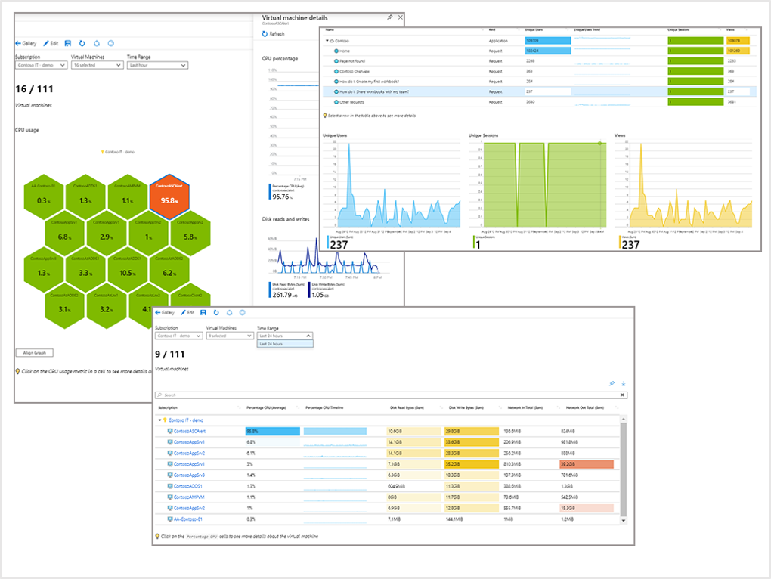
Azure Workbooks Overview (2 of 2)

Slide 15
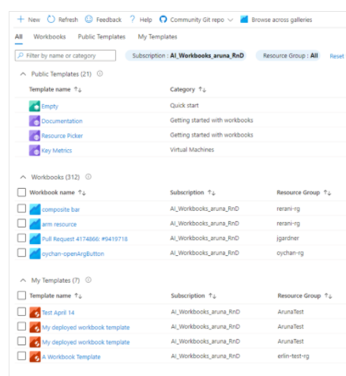
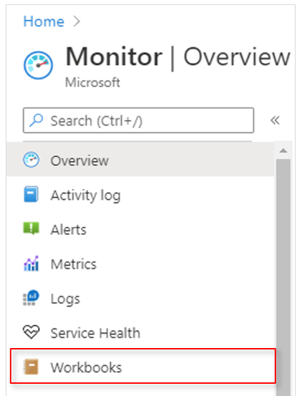
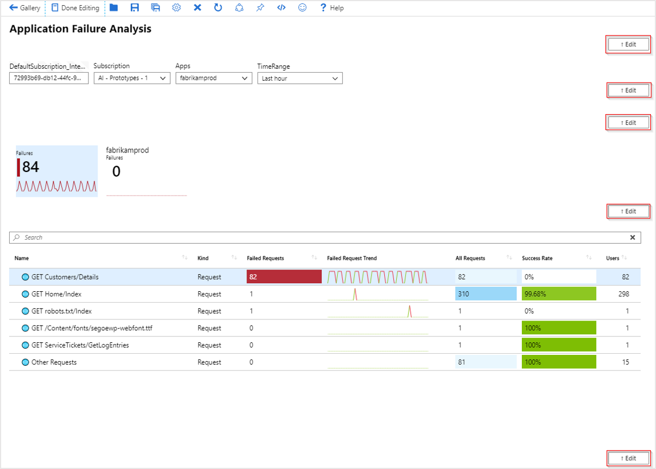
Using Azure Workbooks
Use the Portal
Workbooks and Workbook Templates
Edit and configure

Slide 16
Lesson 03: Azure Alerts

Slide 17
Azure Alerts Overview
Azure Monitor Alerts
Creating Alert Rules
Action Groups
Demonstration: Alerts

Slide 18
Azure Monitor Alerts
Based on:
Metric values
Log search queries
Activity log events
Health of the underlying Azure platform
Tests for web site availability
Alert states:
New
Acknowledged
Closed
Benefits:
Better notification system
A unified authoring experience
View Log analytics in Azure Portal
Separation of Fired Alerts and alert rules
Better workflow

Slide 19
Creating Alert Rules
Scope: Target selection, Alert criteria, and Alert logic
Alert rule details: name, description, and severity (0 to 4)
Action group: Notify your team via email and text messages or automate actions using webhooks and runbooks
Notes:
Respond to events with Azure Monitor Alerts - https://docs.microsoft.com/en-us/azure/azure-monitor/learn/tutorial-response
Create, view, and manage metric alerts using Azure Monitor - https://docs.microsoft.com/en-us/azure/azure-monitor/platform/alerts-metric

Slide 20
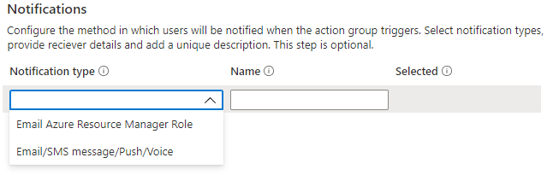
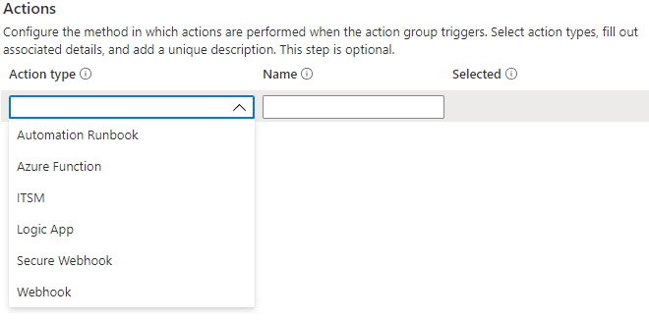
Action Groups
Configure the method in which users will be notified when the action group triggers
Configure the method in which actions are performed when the action group triggers
Notes:
Create and manage action groups in the Azure portal - https://docs.microsoft.com/en-us/azure/azure-monitor/platform/action-groups

Slide 21
Demonstration: Alerts
Create an alert rule
Explore alert targets
Explore alert conditions
Explore alert details

Slide 22
Lesson 04: Log Analytics

Slide 23
Log Analytics Overview
Log Analytics
Create a workspace
Connected Sources
Data Sources
Log Analytics Querying
Query Language Syntax

Slide 24
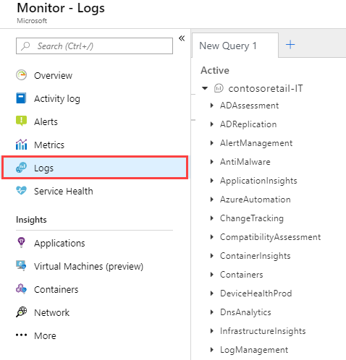
Log Analytics
A service that helps you collect and analyze data generated by resources in your cloud and on-premises environments
Write log queries and interactively analyze their results
Examples include assessing system updates and troubleshooting operational incidents
Notes:
Overview of Azure Monitor agents - https://docs.microsoft.com/en-us/azure/azure-monitor/platform/agents-overview

Slide 25
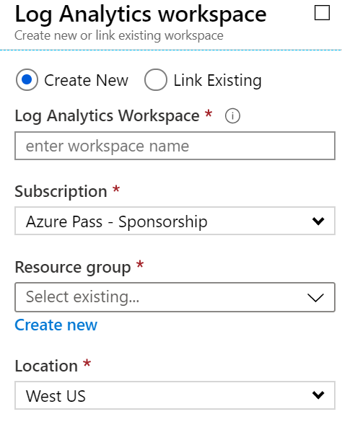
Create a Workspace
A workspace is an Azure resource and is a container where data is collected, aggregated, analyzed, and presented
You can have multiple workspaces per Azure subscription, and you can have access to more than one workspace
A workspace provides a geographic location, data isolation, and scope
Notes:
Create a Log Analytics workspace in the Azure portal -https://docs.microsoft.com/en-us/azure/azure-monitor/learn/quick-create-workspace

Slide 26
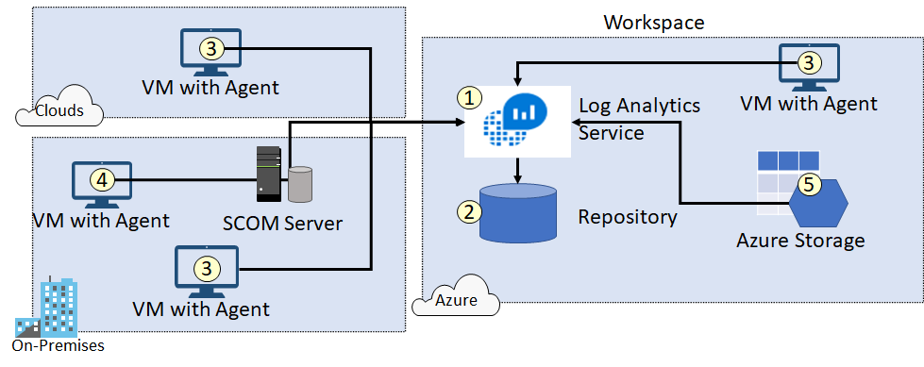
Connected Sources
Connected Sources generate data collected by Log Analytics
Data can be collected from Windows, Linux, SCOM and Azure Storage

Slide 27
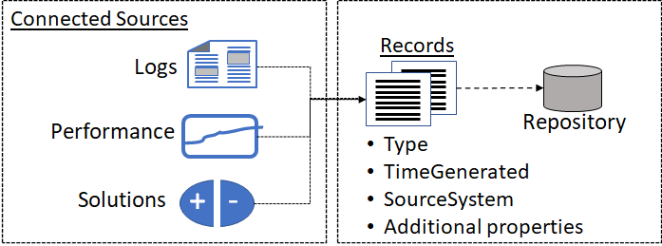
Data Sources
Data sources include Windows Event Logs, Windows Performance Counters, Linux Performance Counters, IIS Logs, Custom Fields, Custom Logs, and Syslog
Each data source has additional configuration options
Notes:
Agent data sources in Azure Monitor - https://docs.microsoft.com/en-us/azure/azure-monitor/platform/agent-data-sources

Slide 28
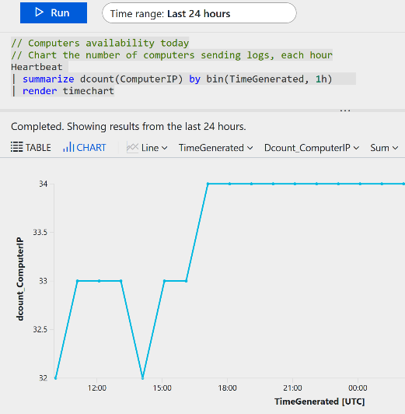
Log Analytics Querying
Log Analytics provides a query syntax
Quickly retrieve and consolidate data in the repository
Save or have log searches run automatically to create an alert
Export the data to Power BI or Excel
Notes:
Overview of log queries in Azure Monitor - https://docs.microsoft.com/en-us/azure/azure-monitor/log-query/log-query-overview
Get started with log queries in Azure Monitor - https://docs.microsoft.com/en-us/azure/azure-monitor/log-query/get-started-queries

Slide 29
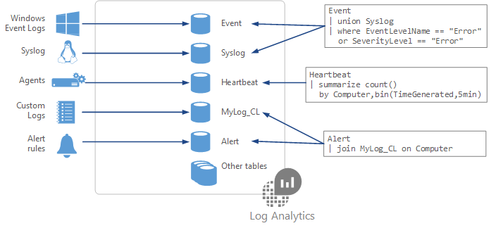
Query Language Syntax
Event
| where (EventLevelName == "Error")
| where (TimeGenerated > ago(1days))
| summarize ErrorCount = count() by Computer
| top 10 by ErrorCount desc
Notes:
Azure Monitor log queries - https://docs.microsoft.com/en-us/azure/azure-monitor/log-query/query-language
Azure Monitor log query examples - https://docs.microsoft.com/en-us/azure/azure-monitor/log-query/examples

Slide 30
Lesson 05: Azure Service Health

Slide 31
Azure Service Health Overview
Azure Service Health
Azure Status
Azure Resource Health

Slide 32
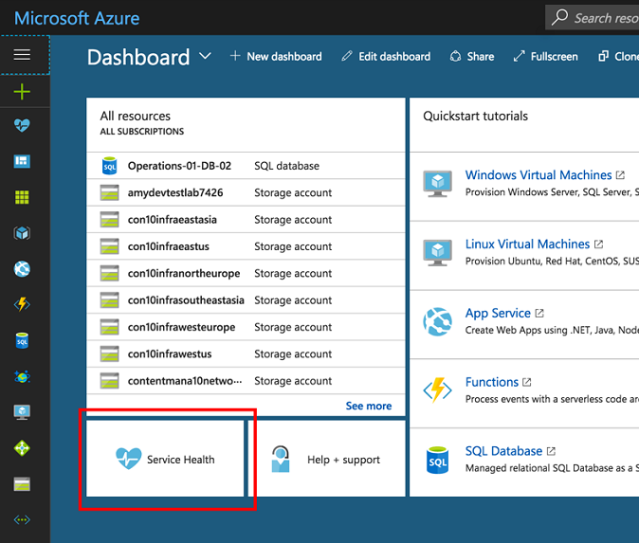
Azure Service Health
View Service issues, Planned maintenance, Health advisories, and Security advisories
Pin a personalized health map to your dashboard
Configure service health alerts
Get support from Microsoft
Get links and downloadable explanations
Notes:
https://docs.microsoft.com/en-us/learn/modules/monitoring-fundamentals/6-use-azure-service-health
https://azure.microsoft.com/en-us/features/service-health/

Slide 33
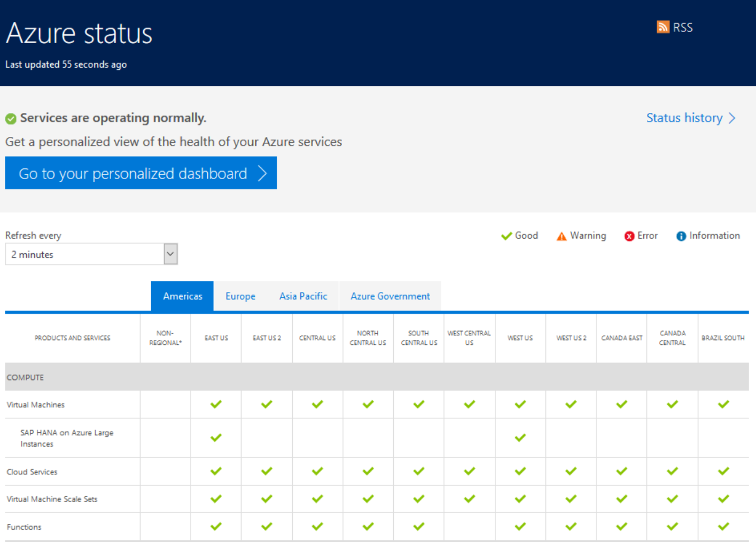
Azure Status
Azure status provides a global view of the health of Azure services and regions

Slide 34
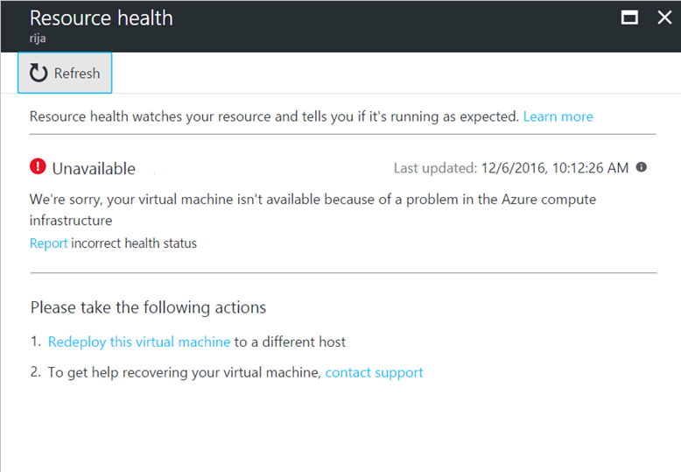
Azure Resource Health
Resource definition and health assessment with status:
Available
Unavailable (platform events and non-platform events)
Unknown
Degraded
Reporting an incorrect status and history information

Slide 35
Demonstration: Azure Service Health
Launch the dashboard
View current issues
View links and explanations
Pin the map to your dashboard

Slide 36
Lesson 06: Azure Application Insights

Slide 37
Azure Application Insights Overview
Integrate Application Insights
Monitor Applications Continuously

Slide 38
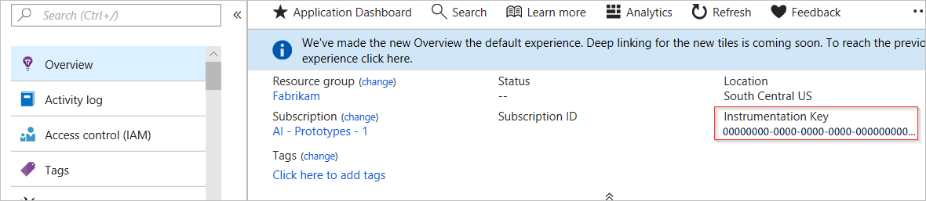
Integrate Application Insights (1 of 3)
Monitor your live applications to detect performance anomalies, diagnose issues and understand what users actually do with your app
Set up Application Insights resource
Install an instrumentation package in your application. The package will monitor your application and send log data to the Log Analytics workspace

Slide 39
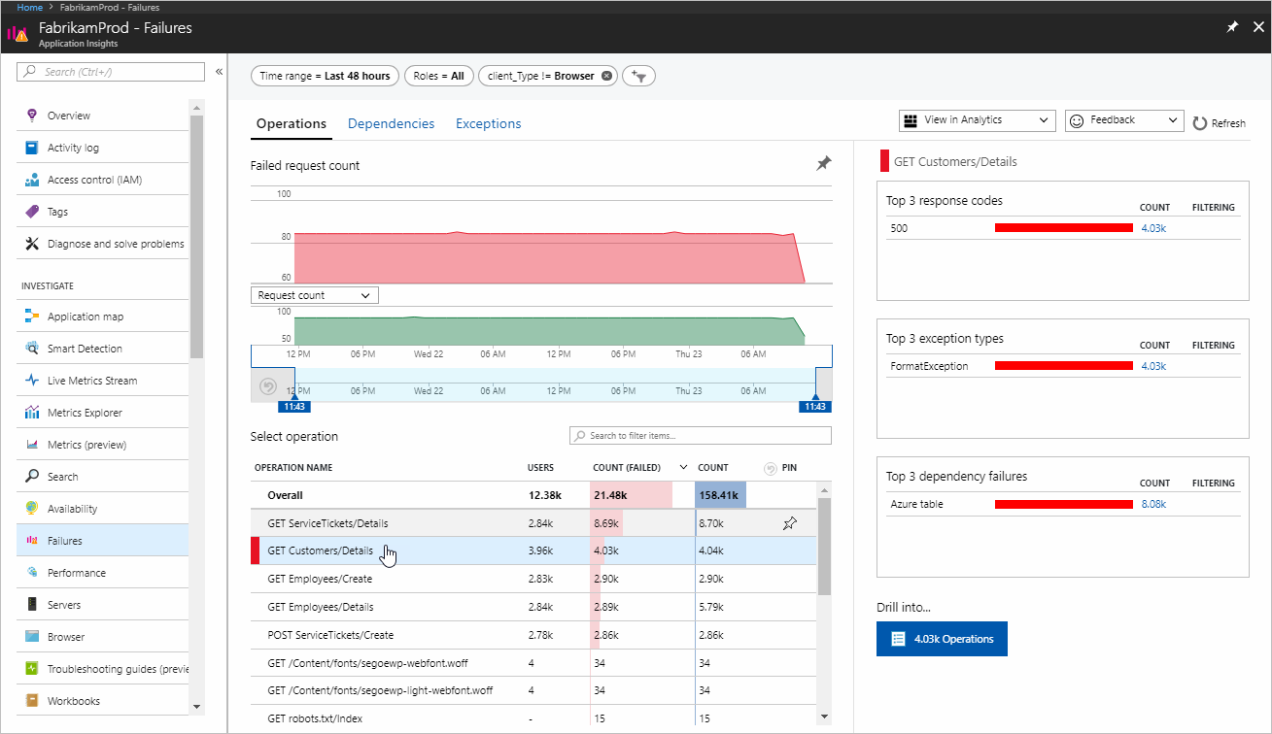
Integrate Application Insights (2 of 3)
For example, in a JavaScript web app, use a Node.js SDK as the instrumentation package
The SDK automatically gathers data about Node.js runtime during app usage
You can view this data in the Application Insights dashboard, in the Azure portal.

Slide 40
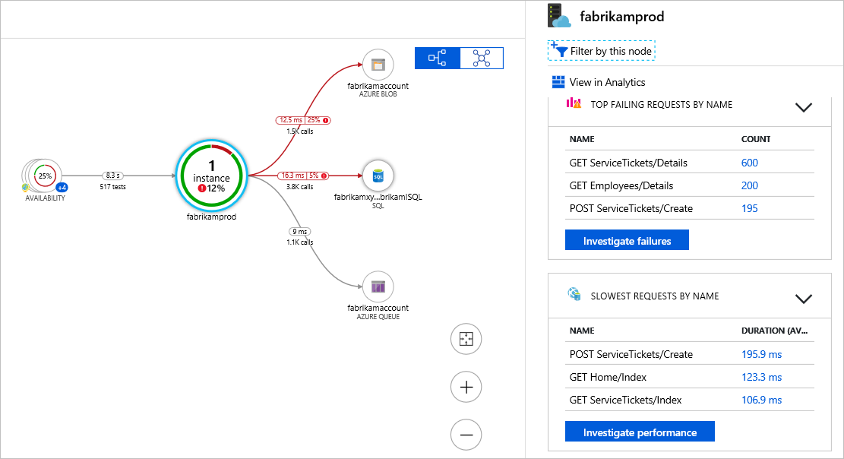
Integrate Application Insights (3 of 3)
The SDK also analyzes your application for a typology
You can analyze this typology by reviewing the Application map view

Slide 41
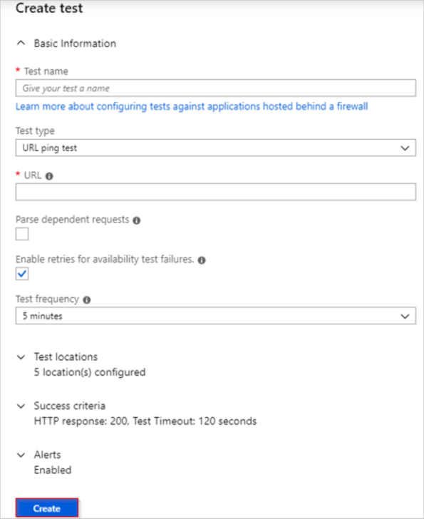
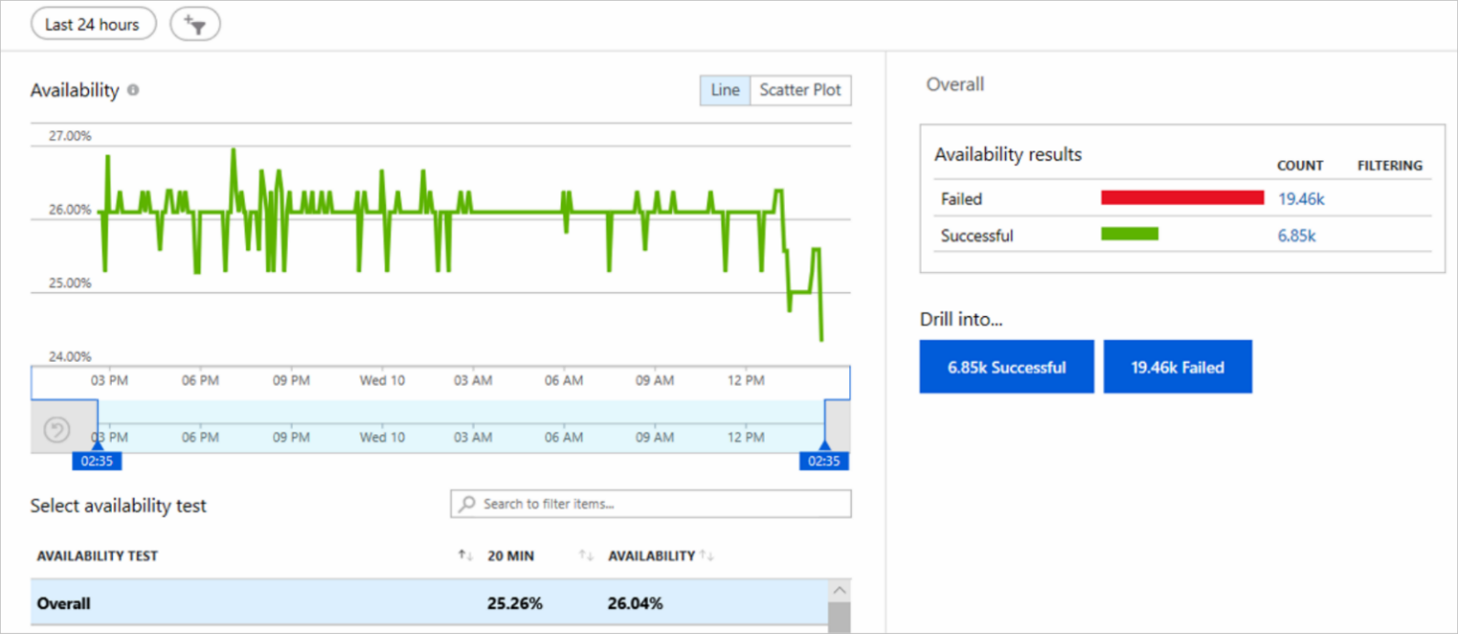
Monitor Applications Continuously
Application Insights sends automatically generated alerts
You can create availability tests to continuously monitor application health

Slide 42
Lesson 07: Network Watcher

Slide 43
Network Watcher Overview
Network Watcher Features
Diagnostics – IP Flow Verify
Diagnostics – Next Hop
Diagnostics – Effective Security Rules
Diagnostics – VPN Troubleshoot
Diagnostics – Packet Capture
Diagnostics – Connection Troubleshoot
Logs – NSG Flow Logs
Monitoring Topology
Notes:
Student content (Network Watcher and Network Watcher Diagnostics) is combined into the first slide.

Slide 44
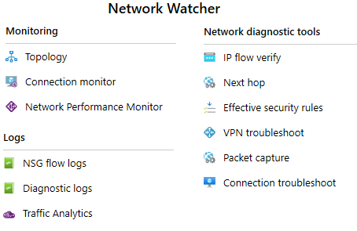
Network Watcher Features
Automate remote network monitoring with packet capture
Gain insight into your network traffic using flow logs
Diagnose VPN connectivity issues
Includes Connection Monitor and Network Performance Monitor

Slide 45
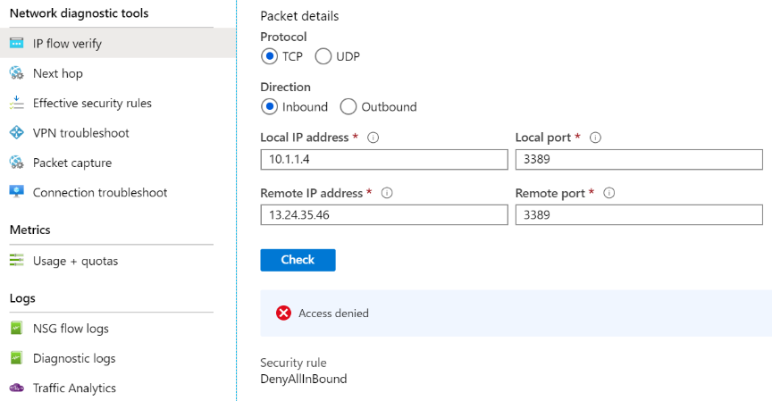
Diagnostics – IP Flow Verify
Helps diagnose connectivity issues from or to the internet and from or to on-premises environments
Notes:
Introduction to IP flow verify in Azure Network Watcher - https://docs.microsoft.com/en-us/azure/network-watcher/network-watcher-ip-flow-verify-overview

Slide 46
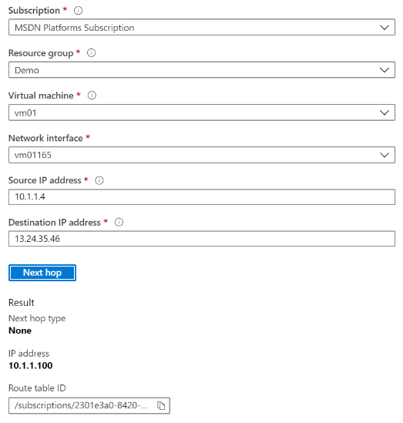
Diagnostics – Next Hop
Helps with determining whether traffic is being directed to the intended destination by showing the next hop
Notes:
Use next hop to diagnose virtual machine routing problems - https://docs.microsoft.com/en-us/azure/network-watcher/network-watcher-next-hop-overview

Slide 47
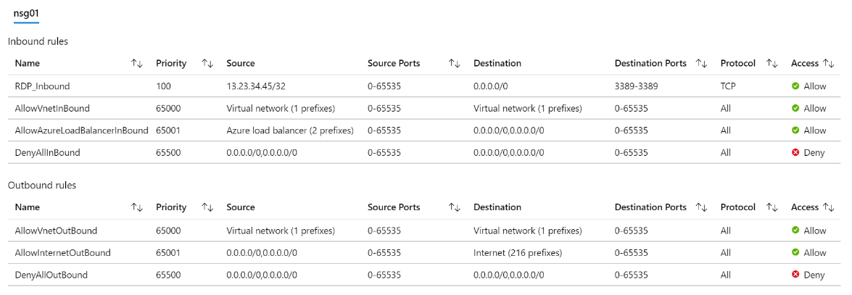
Diagnostics – Effective Security Rules
Details the Effective Security Rules (inbound and outbound) of the Network Interface card of a Virtual Machine
Notes:
Introduction to Effective security rules view in Azure Network Watcher - https://docs.microsoft.com/en-us/azure/network-watcher/network-watcher-security-group-view-overview

Slide 48
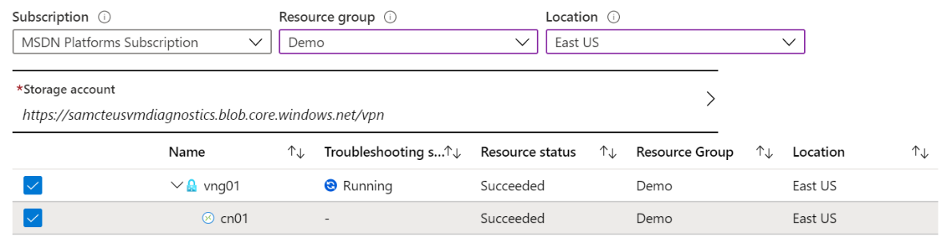
Diagnostics – VPN Troubleshoot
Helps you troubleshoot gateways and connections
Provides summary information and detailed information
Can troubleshoot multiple gateways or connections simultaneously
Notes:
Introduction to resource troubleshooting in Azure Network Watcher - https://docs.microsoft.com/en-us/azure/network-watcher/network-watcher-troubleshoot-overview

Slide 49
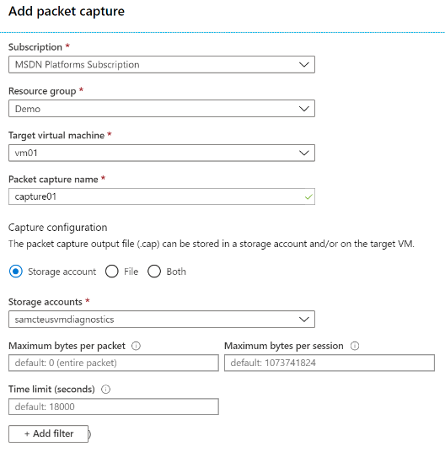
Diagnostics – Packet Capture
Captures inbound and outbound traffic from a Virtual Machine
Saves data to a storage account, a local file, or both
Notes:
Introduction to variable packet capture in Azure Network Watcher - https://docs.microsoft.com/en-us/azure/network-watcher/network-watcher-packet-capture-overview

Slide 50
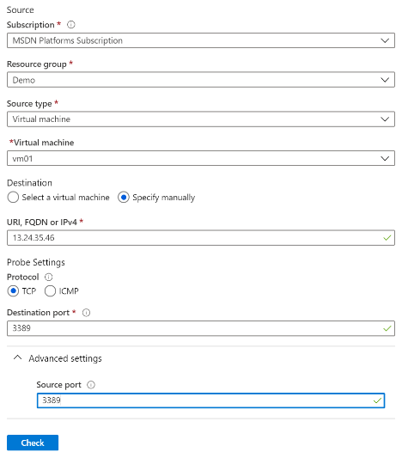
Diagnostics – Connection Troubleshoot
Check connectivity between source VM and destination
Identify configuration issues that are impacting reachability
Provide all possible hop by hop paths from the source to destination
Review hop by hop latency – min, max, and average between source and destination
View a graphical topology from your source to destination
Notes:
Troubleshoot connections with Azure Network Watcher using the Azure portal - https://docs.microsoft.com/en-us/azure/network-watcher/network-watcher-connectivity-portal

Slide 51
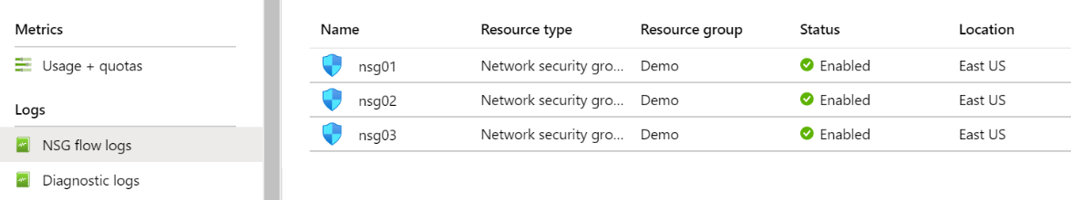
Logs – NSG Flow Logs
View information about ingress and egress IP traffic through an NSG
Flow logs are written in JSON format and show outbound and inbound flows on a per rule basis
The JSON format can be visually displayed in Power BI or third-party tools like Kibana
Notes:
Introduction to flow logging for network security groups - https://docs.microsoft.com/en-us/azure/network-watcher/network-watcher-nsg-flow-logging-overview

Slide 52
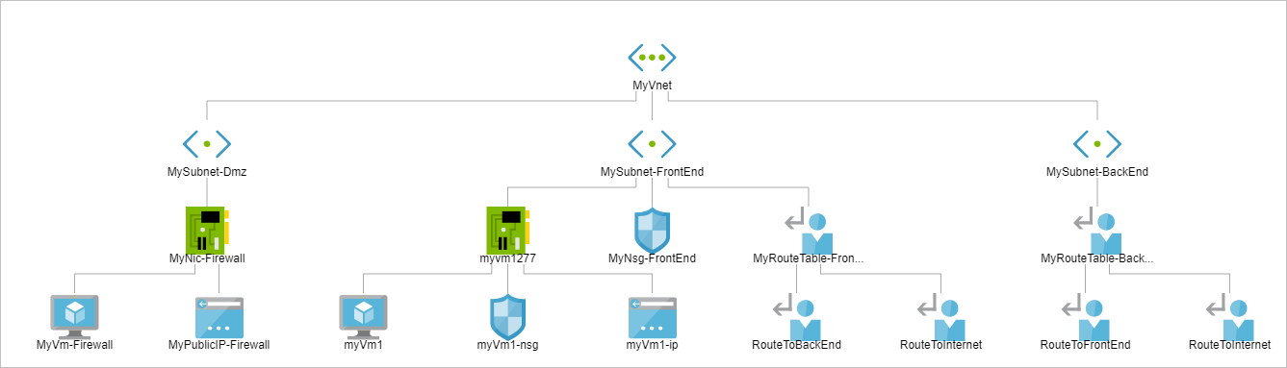
Monitoring – Topology
Provides a visual representation of your networking elements
View all the resources in a virtual network, resource to resource associations, and relationships between the resources
The Network Watcher instance in the same region as the virtual network
Notes:
View the topology of an Azure virtual network - https://docs.microsoft.com/en-us/azure/network-watcher/view-network-topology

Slide 53
Lesson 08: Unified Monitoring in Azure

Slide 54
Unified Monitoring Overview
Azure Infrastructure Monitoring
Security Posture
Strengthened Security Posture
Azure Security Center
Protect Against Threats with Azure Security Center

Slide 55
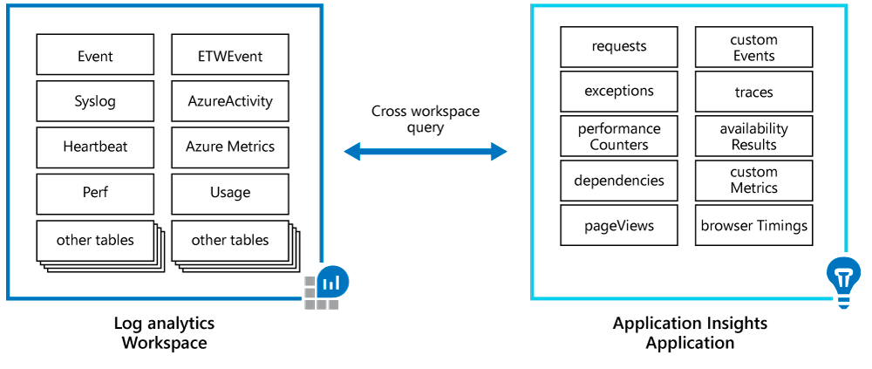
Azure Infrastructure Monitoring
Azure Application Insights and Azure Monitor are integrated

Slide 56
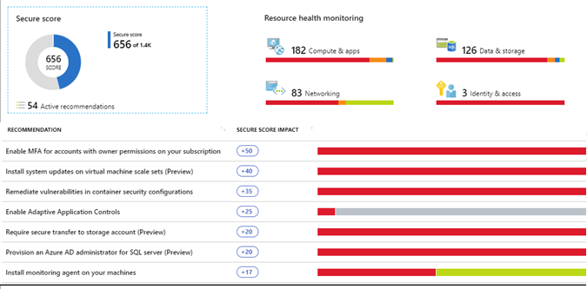
Security Posture
Have a proactive strategy that audits your resources to identify systems that do not meet organizational standards or best practices
View the security state of resources and any issues per resource type:
Monitor computer resources and apps
Monitor network resources
Monitor data and storage resources
Monitor your identity and access resources

Slide 57
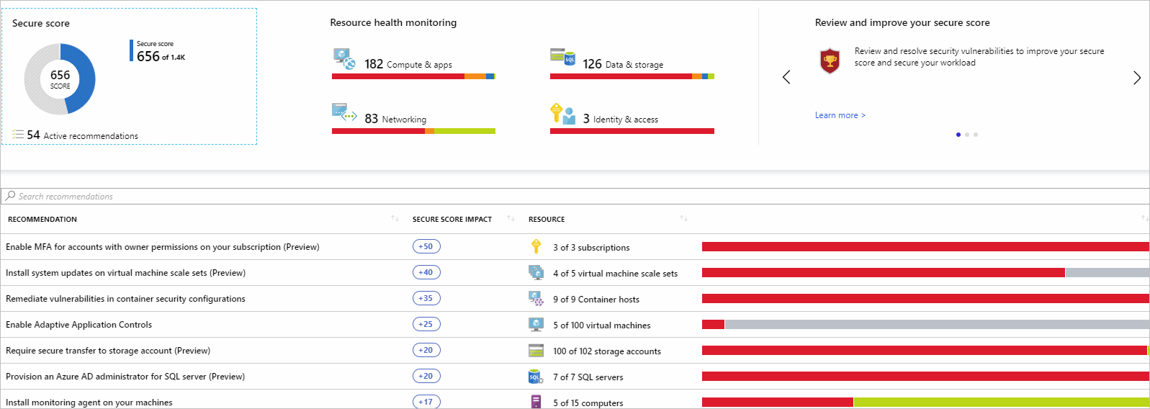
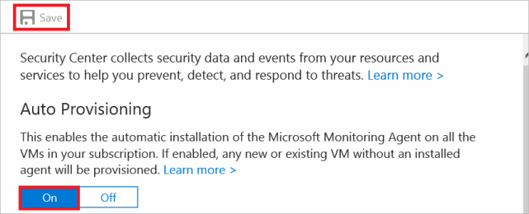
Azure Security Center
Addresses:
Rapidly changing workloads
Increasingly sophisticated attacks
Provides tools:
Strengthen security posture
Protect against threats
Get secure faster
Usage cases:
Identify and address risks and threats
You don’t have traditional in-house skills to secure an infrastructure
Need to secure an infrastructure consisting of on-premises and cloud resources

Slide 58
Protect Against Threats with Azure Security Center
Security Center gives a centralized view of all security alerts

Slide 59
Lesson 09: Monitor Azure Costs

Slide 60
Monitor Azure Costs Overview
Monitoring Azure Costs
Optimizing Azure Costs

Slide 61
Monitoring Azure Costs (1 of 2)
Azure Advisor Cost Analysis tool provides a view of spending over a period to help understand trends
Azure Advisor recommendations highlights over-provisioned services and recommends ways to lower costs.
Identify stakeholders
Determine frequency
Responding to cost alerts
Define budgets
Gather information

Slide 62
Monitoring Azure Costs (2 of 2)
An optimal design is not always a low-cost design. Low cost may add risk. Consider cost optimization with other aspects of design.
Cost vs reliability: Does the cost of high-availability components exceed the acceptable downtime?
Cost vs. performance efficiency: Fixed or consumption-based provisioning (Azure regions, caching, batch or real-time processing)
Cost vs operation excellence: Investing in systems monitoring and automation might increase the cost initially, but over time will reduce cost.
Cost vs. security: Increasing security of the workload will increase cost. For example, for specific security and compliance requirements, deploying to differentiated regions will be more expensive. Premium security features can also increase the cost.

Slide 63
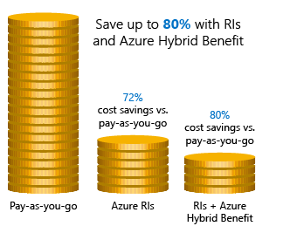
Optimizing Cost Savings (1 of 2)
Azure Reservations helps you save money by pre-paying for services.
Azure Hybrid Benefits use Windows Server and SQL Server on-premises licenses with Software Assurance.
Azure Credits allows you to experiment with, develop, and test new solutions on Azure.
Azure Regions are separately priced - choose low-cost locations
Notes:
Cost savings - https://docs.microsoft.com/en-us/learn/modules/predict-costs-and-optimize-spending/4-save-on-infrastructure-costs
Instructor Note: you may want to navigate to the Cost savings page with students https://azure.microsoft.com/en-us/overview/azure-vs-aws/cost-savings/
Azure V AWS Cost Savings
Azure Reservations compares with AWS RI (Reserved Instances)
Azure Hybrid Benefits – AWS License Manager and BYOL (Bring your own Licenses)
Azure Credits is monthly Azure credit for Visual Studio subscribers – no direct comparison
Azure Regions compares with AWS Regions – both vary in price by region selected

Slide 64
Optimizing Azure Costs (2 of 2)
Enterprise agreement
Enterprise Dev Test Subscription
Cloud Service Provider (Partner program)
Azure Hybrid Use Benefit
Azure Reserved Instances

Slide 65
Implement Cloud Infrastructure Monitoring - Review
Knowledge Check
Microsoft Learn Modules (docs.microsoft.com/Learn)
Design a holistic monitoring strategy on Azure
Monitor and troubleshoot your end-to-end Azure network infrastructure by using network monitoring tools
Improve incident response with alerting on Azure
Choose the best monitoring service for visibility, insight, and outage mitigation
Analyze costs and create budgets with Azure Cost Management
Notes:
Learn - https://docs.microsoft.com/en-us/learn/browse/

Slide 66
End of presentation

Slide 67



Data Types
Application monitoring data – Performance and functionality of the code you have written, regardless of its platform
Guest OS monitoring – Azure, another cloud, or on-premises
Azure resource monitoring
Azure subscription monitoring – Operation and management of an Azure subscription, as well as data about the health and operation of Azure itself
Azure tenant monitoring – Operation of tenant-level Azure services, such as Azure Active Directory

