Slide 1
AZ-304: Microsoft Azure Architect Design

Slide 2
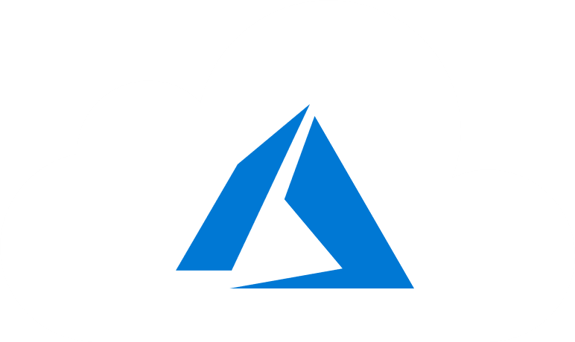
Course Outline
Module 1: Design a Compute Solution
Module 2: Design a Network Solution
Module 3: Design for Migration
Module 4: Design Authentication and Authorization
Module 5: Design Governance
Module 6: Design a Solution for Databases
Module 7: Select an Appropriate Storage Account
Module 8: Design Data Integration
Module 9: Design a Solution for Logging and Monitoring
Module 10: Design a Solution for Backup and Recovery
Module 11: Design for High Availability
Module 12: Design for Cost Optimization
Module 13: Design an Application Architecture
Module 14: Design Security for Applications
NOTE: The module order listed above aligns with the learning objectives described on the AZ-304: Microsoft Azure Architect Design certification page.

Slide 3
Module 2: Design a Network Solution
Virtual Networks, Network Security, and Hybrid Networks

Slide 4
Learning Objectives
Plan Virtual Networks
Recommend a Solution for Network Addressing and Name Resolution
Recommend Solutions for Network Security
Recommendation for Hybrid Networks
Implement a Secure Hybrid Network
Module Review Questions

Slide 5
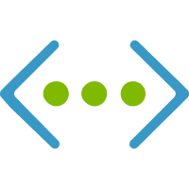
Planning for Virtual Networks

Slide 6
Planning for Virtual Networks
Address space – (RFC 1918)
Addresses assigned from selected address space
Subnets – Used to segment Vnet
Resources will be assigned address within the subnet range (excluding reserved Ips)
Regions: VNet is scoped to a single region/location
Use Vnet Peering
Subscription: VNet is scoped to a subscription
Multiple VNets can be assigned to a single subscription
Notes:
Address space: When creating a VNet, custom private IP address space is specified using public and private (RFC 1918) addresses.
Azure assigns resources in a virtual network a private IP address from the address space that has been given during configuration.
Subnets: Subnets enable segmenting a virtual network into one or more sub-networks and allocating a portion of the virtual network's address space to each subnet.
Azure resources are deployed to a specific subnet that is segmented using the VNet address space.
Regions: VNet is scoped to a single region/location.
Multiple virtual networks from different regions can be connected using Virtual Network Peering.
Subscription: VNet is scoped to a subscription.
Implement multiple virtual networks within each Azure subscription and Azure region.

Slide 7
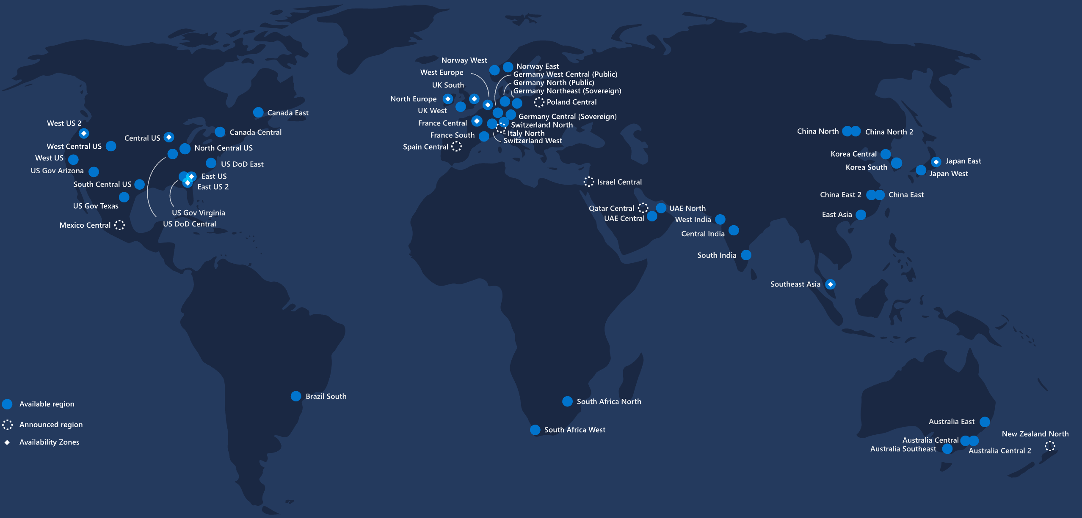
Naming and Regions
All Azure resources are created in an Azure region and subscription
A resource can only be created in a virtual network that exists in the same region and subscription as the resource.
When deciding which region(s) to deploy resources in, consider where consumers of the resources are physically located:
Users want the lowest network latency to their resources
Choose a region that aligns to the requirements—data residency, sovereignty, compliance, or resiliency requirements
Deploy resources to different availability zones within the same virtual network for resiliency across Azure Availability Zones within the same Azure region

Slide 8
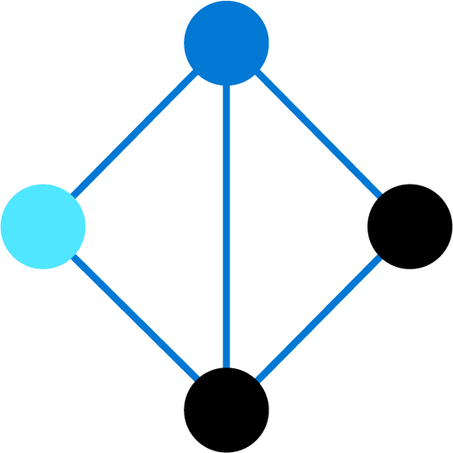
Segmentation
Create multiple virtual networks per subscription and per region
Create multiple subnets within each virtual network
Each subnet must have a unique address range, specified in CIDR format, within the address space of the virtual network
Azure routes network traffic between all subnets in a virtual network
You can override Azure's default routing to prevent Azure routing between subnets, or to route traffic between subnets through a network virtual appliance
Each network security group contains rules, which allow or deny traffic to and from sources and destinations

Slide 9
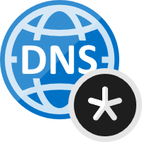
Connectivity
Peering:
Virtual networks can be in the same, or different, supported Azure regions
Virtual networks can be in the same or different Azure subscriptions
VPN gateway
Azure VPN Gateway connects a virtual network to on-premises network using site-to-site VPN or Azure ExpressRoute
Combine peering and a VPN gateway to create hub and spoke networks
Name resolution
Resources in one virtual network cannot resolve the names of resources in a peered virtual network with Azure's built-in DNS
To resolve names in a peered virtual network, deploy a DNS server, or use Azure DNS private domains
Resolving names between resources in a virtual network and on-premises networks requires deploying of your own DNS server

Slide 10

Permissions and Policy
Permissions are assigned to a scope in the following hierarchy: management group, subscription, resource group, and individual resource
To work with Azure virtual networks (peering, network security groups, service endpoints) assign members built-in Owner, Contributor, or Network contributor roles
Azure Policy allows for create, assign, and manage policy definitions
Azure Policy runs an evaluation of resources, scanning for resources that are not compliant with the policy definitions
Policies are applied to the following hierarchy: management group, subscription, and resource group

Slide 11
Recommend a Solution for Network Addressing and Name Resolution

Slide 12
Name Resolution for Resources in Azure Virtual Networks
 | Scenario | Solution | DNS Suffix
Between VMs in the same Vnet, Cloud Services role instances |  | Azure DNS Private Zone, Azure-Provided name resolution | Hostname or FQDN
Between VMs in different VNet or instances in different cloud services |  | Azure DNS Private Zones, Customer-managed DNS forwarding to Azure (DNS Proxy0 | Hostname or FQDN
From App Service (Web App, Function or Bot) using VNet integration to VM in the same VNet |  | Customer-managed DNS forwarding to Azure (DNS Proxy) | FQDN only
From App Service Web App to VMs in the same VNet |  | Customer-managed DNS forwarding to Azure (DNS Proxy) | FQDN only
App Service Web app to VM in different VNet |  | Customer-managed DNS forwarding to Azure (DNS Proxy) | FQDN only
Notes:
https://docs.microsoft.com/en-us/azure/virtual-network/virtual-networks-name-resolution-for-vms-and-role-instances#:~:text=Azure%20provided%20name%20resolution%20provides%20only%20basic%20authoritative,names%20or%20the%20life%20cycle%20of%20DNS%20records.

Slide 13
Name Resolution for Resources in Azure Virtual Networks (Cont.)
 | Scenario | Solution | DNS Suffix
On-prem computer and service name from VMs or role instances in Azure |  | Customer Managed DNS | FQDN only
Azure hostnames from on-prem computers |  | Forward queries to a customer Managed DNS proxy server in the corresponding VNet. | FQDN only
Reverse DNS for Internal IP |  | Azure DNS private zones or Azure-provided name resolution or Customer own DNS | Not applicable
Between VMs in different cloud services, not in Virtual Networks |  | Not supported | Not supported
Notes:
https://docs.microsoft.com/en-us/azure/virtual-network/virtual-networks-name-resolution-for-vms-and-role-instances#:~:text=Azure%20provided%20name%20resolution%20provides%20only%20basic%20authoritative,names%20or%20the%20life%20cycle%20of%20DNS%20records.

Slide 14
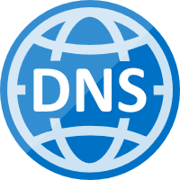
Azure-Provided Name Resolution
Azure-provided name resolution provides basic authoritative DNS capabilities
Use Azure DNS private zones or Customer-managed DNS servers for full-featured DNS
Internal name resolution for VMs and role instances in the same virtual network or cloud service
VMs and instances in a cloud service share the same DNS suffix - host name alone is sufficient
For virtual networks deployed using the ARM deployment model, the DNS suffix is consistent across all virtual machines within a virtual network
FQDN is not needed
DNS names can be assigned to both VMs and network interfaces
Notes:
Azure-provided name resolution provides basic authoritative DNS capabilities.
DNS zone names and records will be automatically managed by Azure—you cannot control the DNS zone names or the life cycle of DNS records.
Use Azure DNS private zones or Customer-managed DNS servers for full featured DNS.
Azure provides internal name resolution for VMs and role instances in the same virtual network or cloud service.
VMs and instances in a cloud service share the same DNS suffix, so the host name alone is sufficient.
For virtual networks deployed using the ARM deployment model, the DNS suffix is consistent across all virtual machines within a virtual network—FQDN is not needed.
DNS names can be assigned to both VMs and network interfaces.

Slide 15
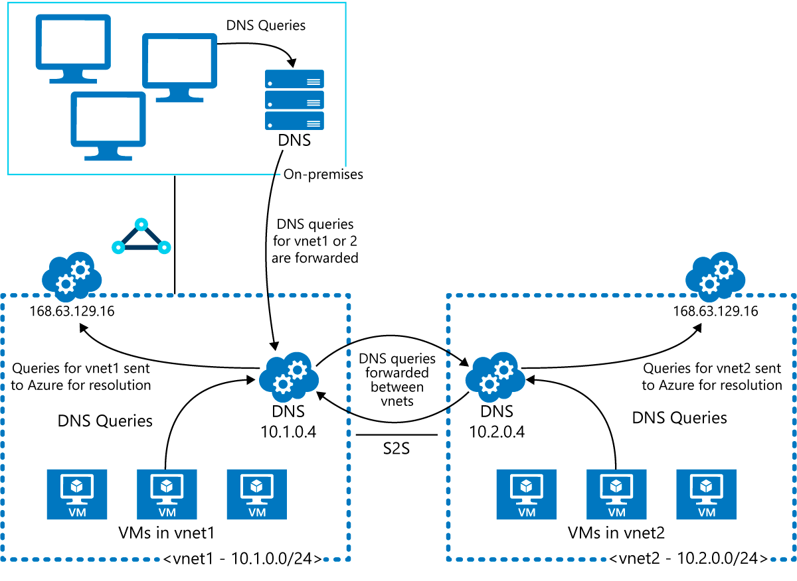
Name Resolution using Customer-Provided DNS Server
DNS forwarding enables DNS resolution between virtual networks allowing on-premises machines to resolve Azure-provided host names
To resolve a VM's host name, the DNS server VM must reside in the same virtual network and be configured to forward host name queries to Azure
Because the DNS suffix is different in each virtual network, use conditional forwarding rules to send DNS queries to the correct virtual network for resolution
az network nic show --resource-group <rg_name> --name <nickname>
Notes:
When you are using Azure-provided name resolution, Azure Dynamic Host Configuration Protocol (DHCP) provides an internal DNS suffix (.internal.cloudapp.net) to each VM. This suffix enables host name resolution because the host name records are in the internal.cloudapp.net zone. When you are using your own name resolution solution, this suffix is not supplied to VMs because it interferes with other DNS architectures (like domain-joined scenarios). Instead, Azure provides a non-functioning placeholder (reddog.microsoft.com).

Slide 16
Recommend Solutions for Network Security

Slide 17
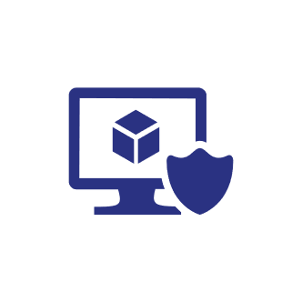
Network Security
Network security focuses on the following areas:
Securing traffic flow between applications and the internet
Securing traffic flow amongst applications
Securing traffic flow between users and the application
Securing traffic between applications and the internet limits exposure outside your network
Secure flow between applications and their tiers, environments, and services within a network
Azure Network Security Best Practices

Slide 18
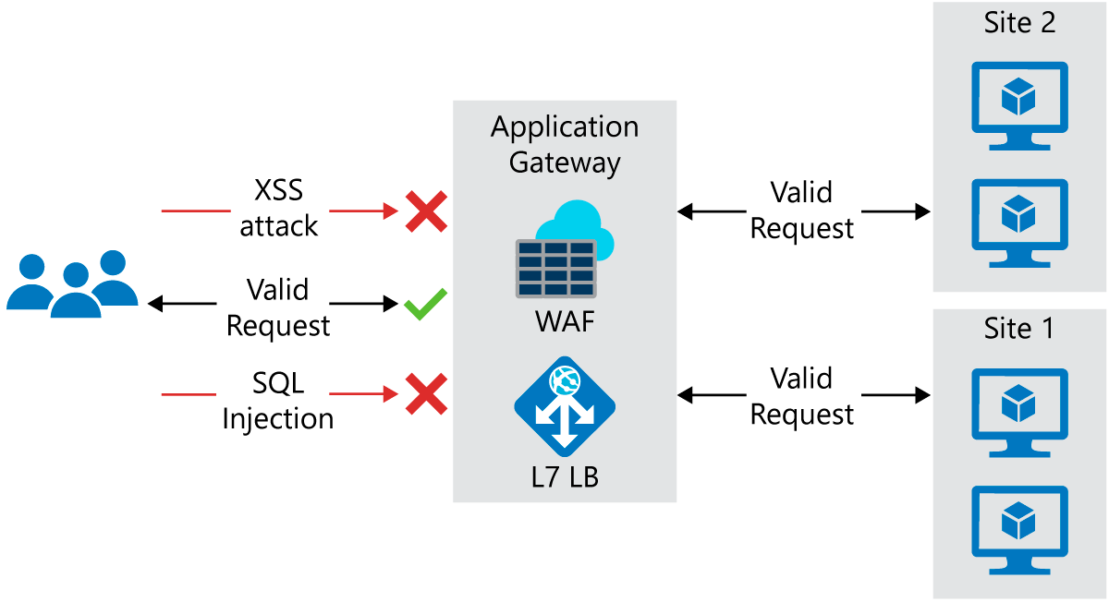
Internet Protection
Identify resources that are allowing inbound network traffic and ensure they are restricted to the required ports/protocols
Azure Security Center identifies internet-facing resources that aren’t assigned network security groups
Application Gateway is a Layer 7 load balancer with a Web Application Firewall (WAF) for securing HTTP-based services

Slide 19
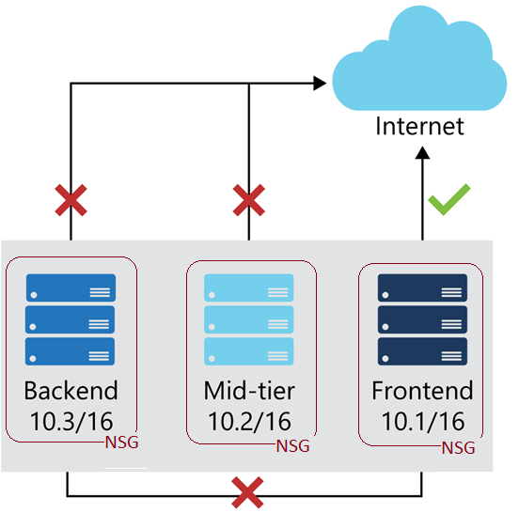
Virtual Network Security
Network security groups operate in layers 3 & 4 allowing communication between network interfaces
NSGs lock down network communication between virtual machines
NSGs to isolate applications between environments, tiers, and services
Use virtual network service endpoints to isolate services, enabling communication between virtual networks

Slide 20
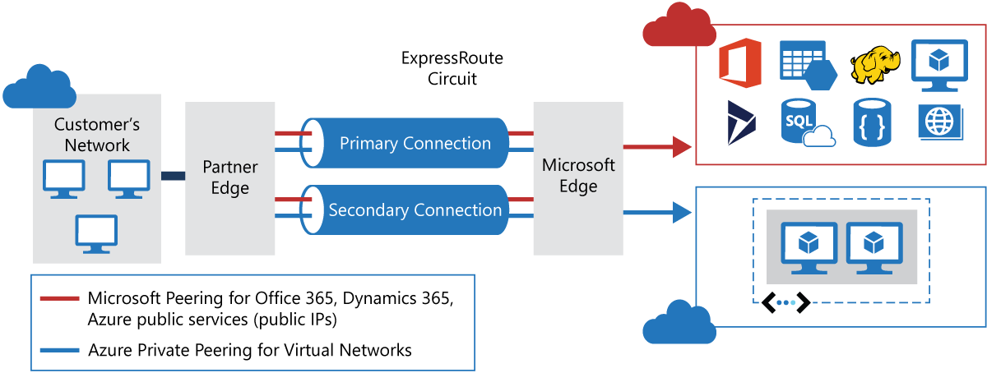
Network Integration

Slide 21
Recommendation for Hybrid Networks

Slide 22
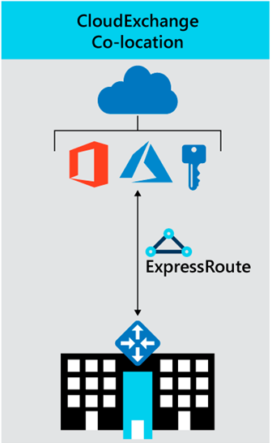
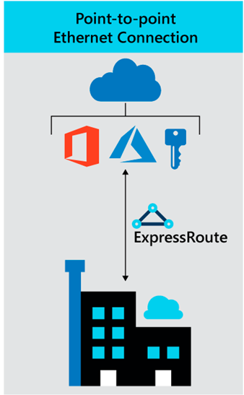
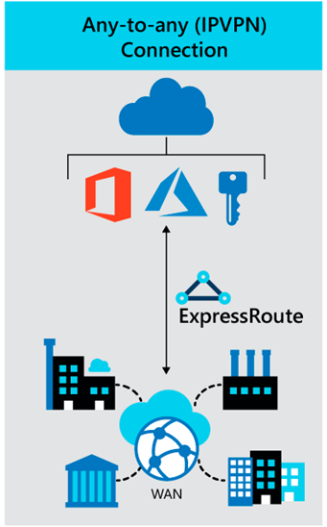
Azure ExpressRoute for Hybrid Networks

Slide 23

ExpressRoute Circuits
A Circuit is an ExpressRoute logical connection between an on-premises network and an Azure network
Configure traffic management and routing in ExpressRoute using circuits
Multiple circuits can exist across various regions
ExpressRoute circuits supports connections using various connectivity providers
Each circuit has multiple routing domains and peerings
An ExpressRoute circuit does not map to anything physical
Azure private peering
Private peering is a trusted extension of a core network in Azure with bidirectional connectivity
Connect to virtual machines and cloud services directly using private IP addresses
Microsoft peering
Microsoft peering provides connectivity to all Microsoft online services
Requires a public IP address
Each circuit is assigned a globally unique identifier (GUID), or service key
Circuit bandwidth
Have as many circuits as you need to match bandwidth requirements
Notes:
A Circuit is an ExpressRoute logical connection between an on-premises network and an Azure network.
Configure traffic management and routing in ExpressRoute using circuits.
Multiple circuits can exist across various regions.
ExpressRoute circuits supports connections using various connectivity providers.
Each circuit has multiple routing domains and peerings.
An ExpressRoute circuit does not map to anything physical.
Azure private peering
Private peering is a trusted extension of a core network in Azure with bidirectional connectivity.
Connect to virtual machines and cloud services directly using private IP addresses.
Microsoft peering
Microsoft peering provides connectivity to all Microsoft online services.
Requires a public IP address.
Each circuit is assigned a globally unique identifier (GUID), or service key.
Circuit bandwidth
Have as many circuits as you need to match bandwidth requirements.

Slide 24
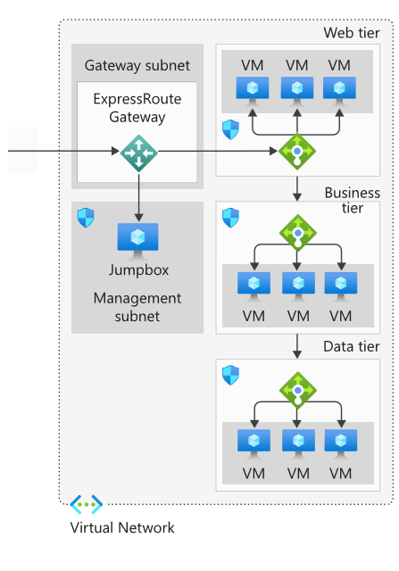
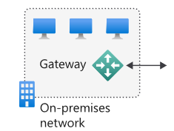
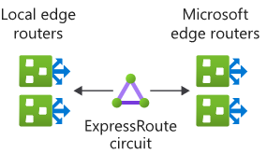
ExpressRoute Reference Architecture
See: Azure Architecture Center

Slide 25
ExpressRoute Considerations
Requires working with connectivity providers
Requires on-premises high-bandwidth routers
Circuit is managed by the connectivity provider
No support for Hot Standby Router Protocol (HSRP), enable a Border Gateway Protocol (BGP) configuration
Operates at layer 3 and requires a network security appliance to manage threats
Use Azure Connectivity Toolkit to monitoring the connectivity between on-premises networks and Azure
Requires network security appliances between the provider's edge routers and on-premises networks

Slide 26
Implement a Secure Hybrid Network

Slide 27
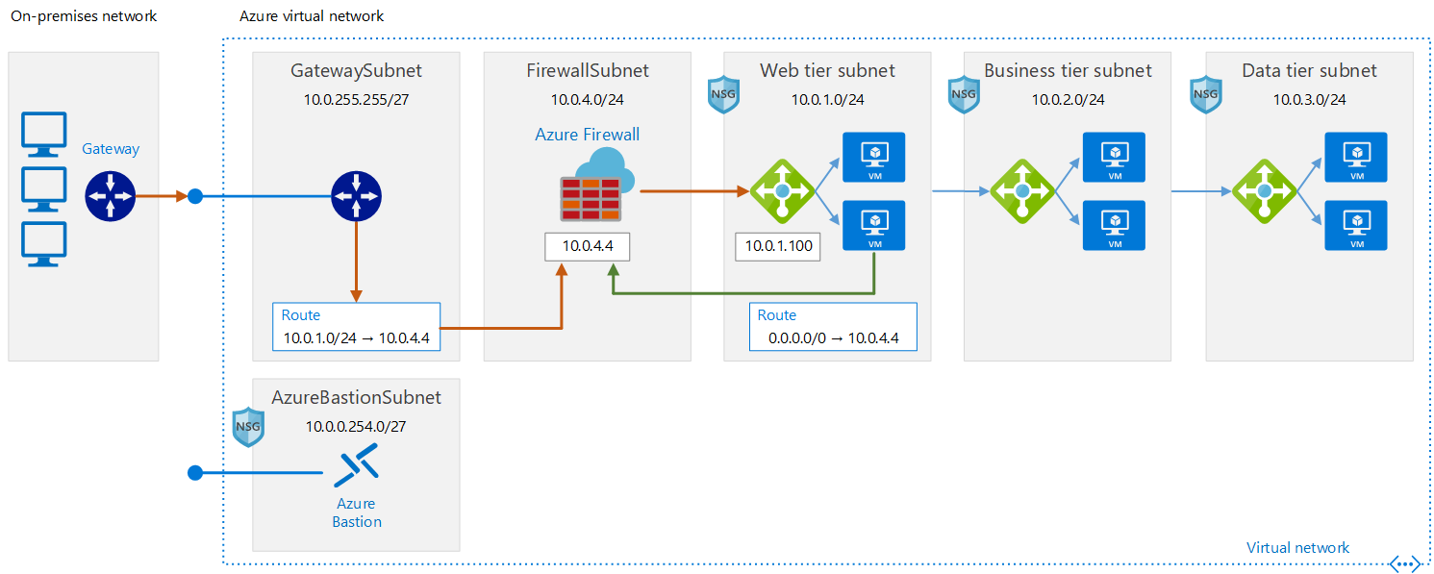
Implement a Perimeter Network to On-Premises Datacenter
Gateway subnet: traffic sent to the web-tier subnet (10.0.1.0/24) is routed through the Azure Firewall instance
Web tier subnet: Web tier instances communicate directly without an Azure Firewall

Slide 28
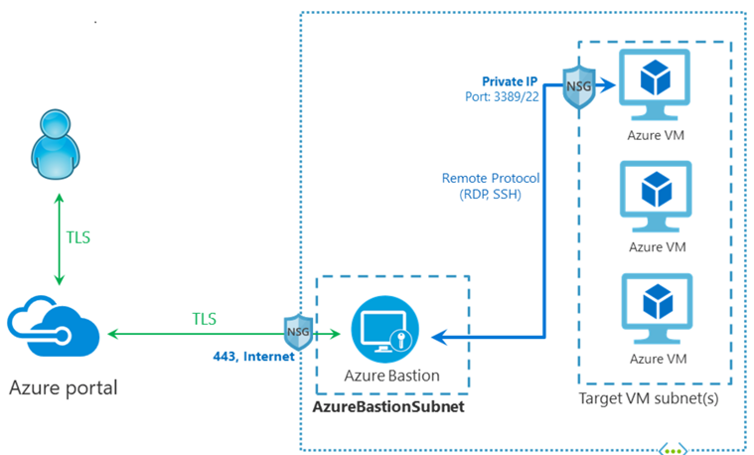
Architecture
Azure virtual network
Gateway
Azure Firewall
Virtual network routes
Network security groups
Bastion
Notes:
Azure virtual network
Gateway. Providing connectivity between routers located on-premises and the virtual network. The gateway is placed in its own subnet.
Azure Firewall. The Firewall instance resides within its own subnet.
Virtual network routes. Virtual network routes define the flow of IP traffic within the Azure virtual network.
Network security groups
Bastion. Azure Bastion allows logging into VMs located inside the virtual network by SSH or remote desktop protocol (RDP).

Slide 29

Recommendations
Access control recommendations
Use role-based access control (RBAC) to manage the resources in your application
Create roles: DevOps role, centralized IT administrator role, and security IT administrator role
Resource group recommendations
Assign RBAC roles to each resource group to restrict access
Create a resource group containing VMs, NSGs, and gateways and assign the centralized IT administrator role to it
Create a resource group containing the VMs for the Azure Firewall instance and gateway subnet routes and assign the security IT administrator role to it
Separate resource groups for each application tier that contain the load balancer and VMs and assign the DevOps role to it
Networking recommendations
Destination address = Public IP address of the firewall instance
Translated address = Private IP address within the virtual network

Slide 30
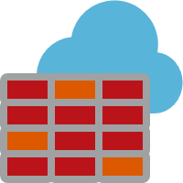
Security Considerations
Route on-premises user requests through Azure Firewall
The user-defined route in the gateway subnet blocks all user requests other than those received from on-premises
The route passes allowed requests to the firewall… these requests are passed to the application based on firewall rules
Use NSGs to block/pass traffic between application tiers
Traffic between tiers is restricted by using NSGs
The business tier blocks all traffic that doesn't originate in the web tier
The data tier blocks all traffic that doesn't originate in the business tier
Assign DevOps access
Use RBAC to restrict the operations that DevOps can perform on each tier
When granting permissions, use the principle of least privilege

Slide 31
Module 2 Review Questions

Slide 32
Online Role-based training resources: Microsoft Learn https://docs.microsoft.com/en-us/learn/

Slide 33
Thank you.

