Slide 1

Course Outline
Module 1: Design a Compute Solution
Module 2: Design a Network Solution
Module 3: Design for Migration
Module 4: Design Authentication and Authorization
Module 5: Design Governance
Module 6: Design a Solution for Databases
Module 7: Select an Appropriate Storage Account
Module 8: Design Data Integration
Module 9: Design a Solution for Logging and Monitoring
Module 10: Design a Solution for Backup and Recovery
Module 11: Design for High Availability
Module 12: Design for Cost Optimization
Module 13: Design an Application Architecture
Module 14: Design Security for Applications
NOTE: The module order listed above aligns with the learning objectives described on the AZ-304: Microsoft Azure Architect Design certification page.

Slide 2
AZ-304: Microsoft Azure Architect Design

Slide 3
Module 3: Design for Migration
Migrate Servers, Databases, and On-Premises using Azure Migrate

Slide 4
Learning Objectives
Planning Azure Migration
Assessments using Azure Migrate
Migrating Servers with Azure Migrate
Migrating Databases with Azure Database Migration Service
Migrating On-Premises Data to Cloud Storage with AzCopy
Lab: Migrating Hyper-V VMs to Azure by using Azure Migrate
Module Review Questions

Slide 5

Planning Azure Migration

Slide 6

Migration Journey
Assess
Start with a full assessment of your current environment.
Migrate
You'll need destination systems and services on Azure to migrate to.
Optimize
After your services are migrated, it's important to optimize them to ensure that they're running efficiently.
Monitor
Azure Monitor captures health and performance information from Azure VMs using Log Analytics agent.
Cloud Adoption Framework

Slide 7
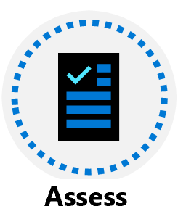
Migration Strategy
Rehost
Refactor
Rearchitect
Rebuild
Replace
Notes:
Rehost: Recreate existing infrastructure by moving virtual machines from the data center to VMs on Azure.
Refactor: Move services running on VMs to platform-as-a-service (PaaS) services reduce operational requirements, improves release agility, and keeps costs low.
Rearchitect: Rearchitect some systems so that they can be migrated—apps could be changed to become cloud native or located containers and microservices.
Rebuild: Rebuild software if the cost to rearchitect it is more than that of starting from scratch.
Replace: Third-party applications could replace custom applications—Evaluate SaaS options to replace existing applications.

Slide 8
Migration Planning
Create a Cloud Migration Plan (requirements, environment, tools)
Involve Stakeholders (business and IT)
Calculate TCO
Discover, evaluate, and document applications
Tools and Partners

Slide 9
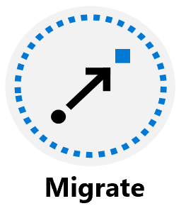
Migration Steps
Prepare the source (vCenter Server) and target (Azure) environments
Set up and start replication
Test replication
Fail over to Azure
Database migrations steps
Assess your on-premises databases
Migrate the schemas
Create and run an Azure Database Migration Service
Monitor migration

Slide 10
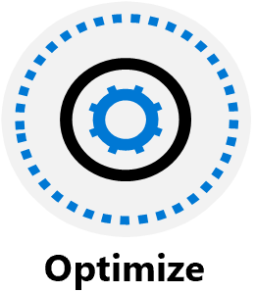
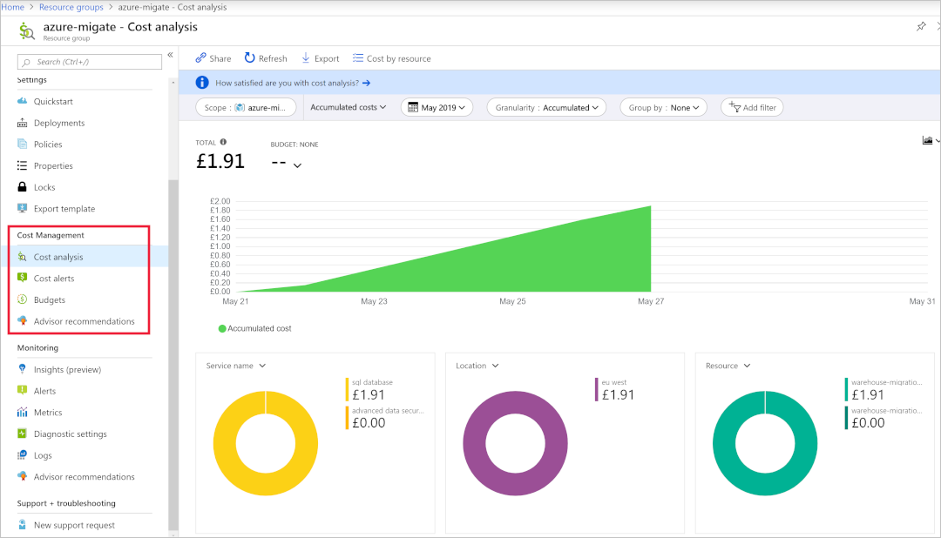
Use Azure Cost Management to analyze Azure costs for various management scopes
Azure Network Security Best Practices

Slide 11

Azure Monitor captures health and performance information from Azure VMs (Log Analytics agent).
Set up alerts based on data sources:
Specific metric values like CPU usage
Specific text in log files
Health metrics
An Autoscale metric

Slide 12
Assessments using Azure Migrate

Slide 13
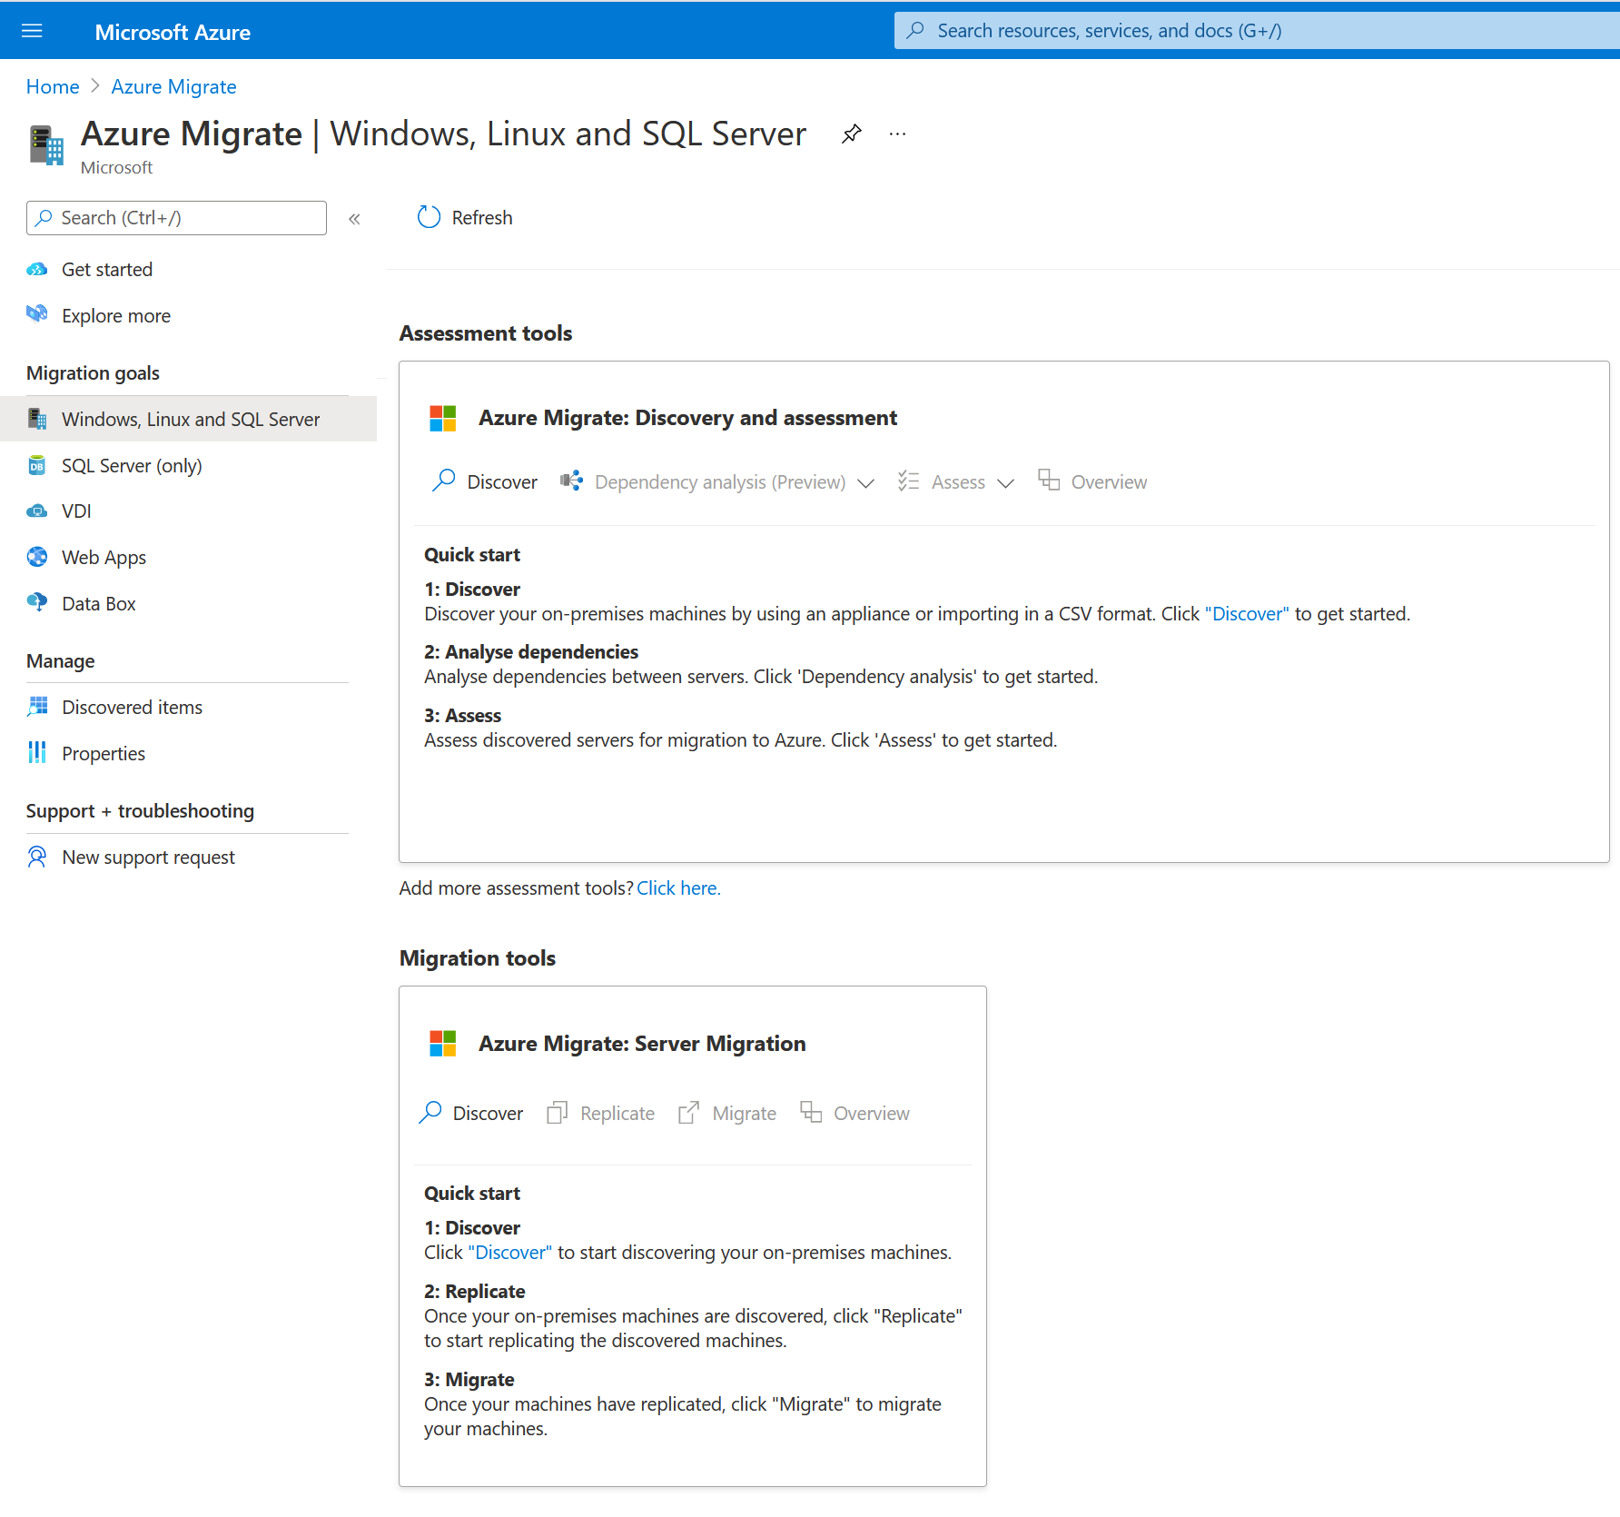
Using Azure Migrate to Assess Environment
Azure Migrate assessments are created within a project
Group VMs according types of VM workloads
Assessment Steps:
Discover virtual machines
Create assessments
Notes:
https://docs.microsoft.com/en-us/azure/migrate/tutorial-prepare-vmware

Slide 14
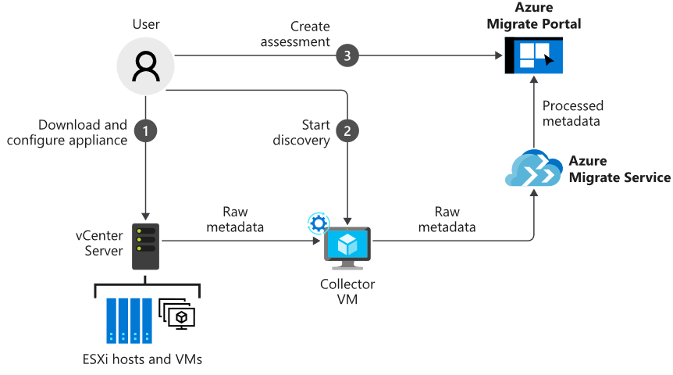
Discover Machines
Import and spin up the collector appliance into Hyper-V or VMware host
Collector gathers data on VM cores, memory, disk sizes, and network adapters
Gathers performance data: CPU and memory usage, disk IOPS, disk throughput, and network output
Output of data collection pushed to Azure Migrate project
View discovered systems in Azure portal

Slide 15
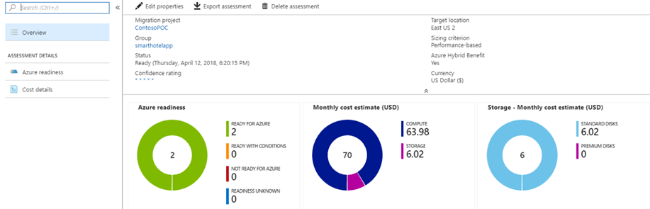
Create an Assessment
Azure Migrate assesses an environment's readiness to be migrated to Azure in the portal

Slide 16
Migrating Servers with Azure Migrate

Slide 17
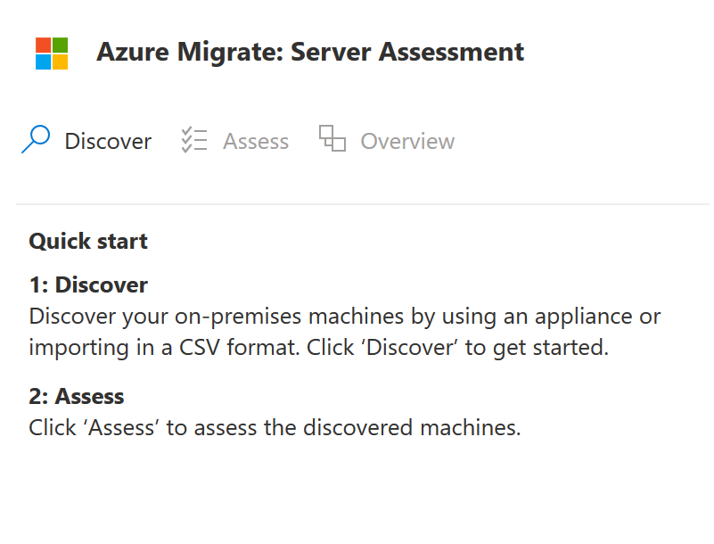
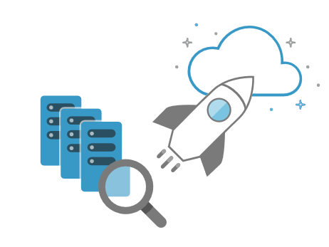
Migrate Servers with Azure Migrate
Azure Migrate assessment identifies candidates for server migration to Azure
Azure Migrate runs agentless migration of virtual and physical servers into Azure

Slide 18
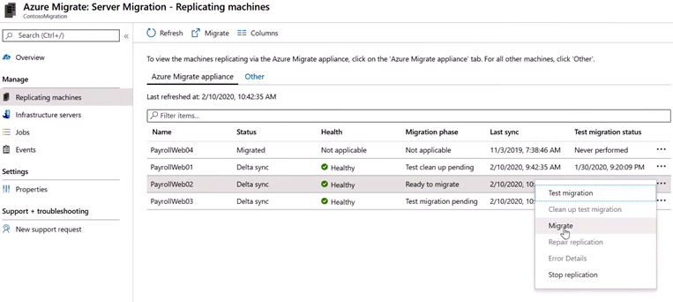
Migrating the Virtual Machines to Production
Select Migrate from the replicating machines
Shut down the VMs for final replication
Migrate during off-peak hours

Slide 19

Post-Migration Steps
After the migration:
Review security settings of virtual machines.
Restrict network access for unused services (NSG)
Deploy Azure Disk Encryption
Increase resilience:
Add a backup schedule that uses Azure Backup
Replicate machines to a secondary region using Azure Site Recovery
Complete clean-up tasks for the remaining on-premises servers (Remove servers from local backups, remove raw disk files from SAN storage to free up space
Update documentation for migrated servers to reflect new IP addresses and locations in Azure

Slide 20
Migrating Databases with Azure Database Migration Service

Slide 21
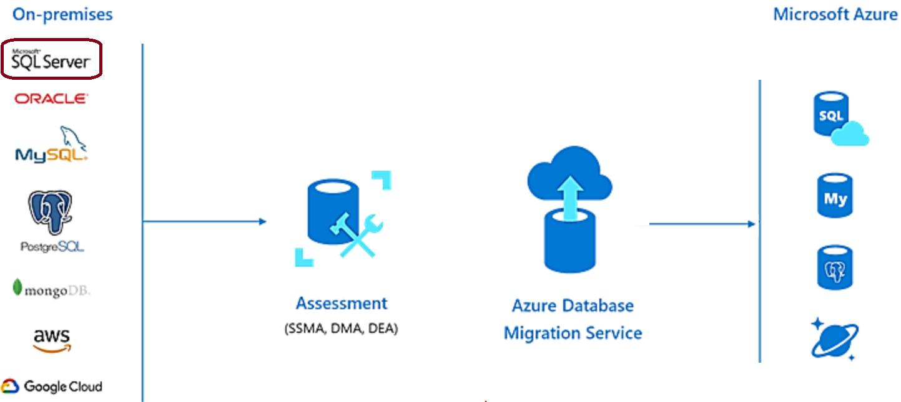
Migrate Databases with Azure Database Migration Service
Offline migration requires shutting down the server at the start of the migration for service
Online migration uses a continuous synchronization of live data, allowing a cutover to the Azure replica database at any time

Slide 22
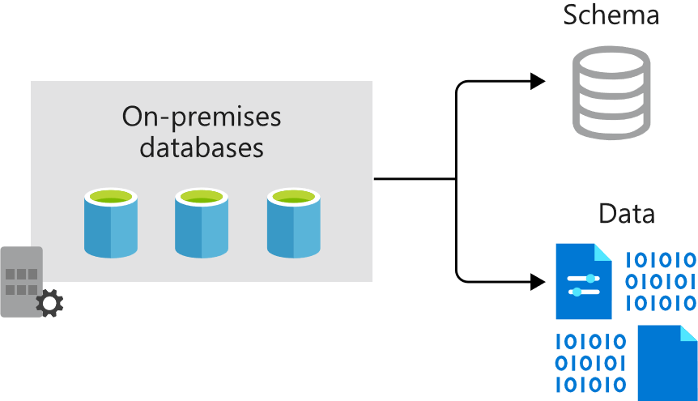
Overview of Database Migration
Offline and online migrations prerequisites:
Download the Data Migration Assistant
Create an Azure Virtual Network instance
Configure the network security group
Configure the Windows Firewall
Configure credentials
Notes:
Offline and online migrations prerequisites:
Download the Data Migration Assistant: Download and to on-premises servers running SQL Server.
Create an Azure Virtual Network instance: For the Azure Database Migration Service using the Azure Resource Manager deployment model—provides connectivity to the on-premises.
Configure the network security group: NSG associated with the new virtual network should allow inbound connectivity to the service via ports 443, 53, 9354, 445, and 12000.
Configure the Windows Firewall: Configure the firewall allowing the Database Migration Service to connect over port 1433. Open port 1434 if multiple named instances on dynamic ports exist on the same server.
Configure credentials

Slide 23
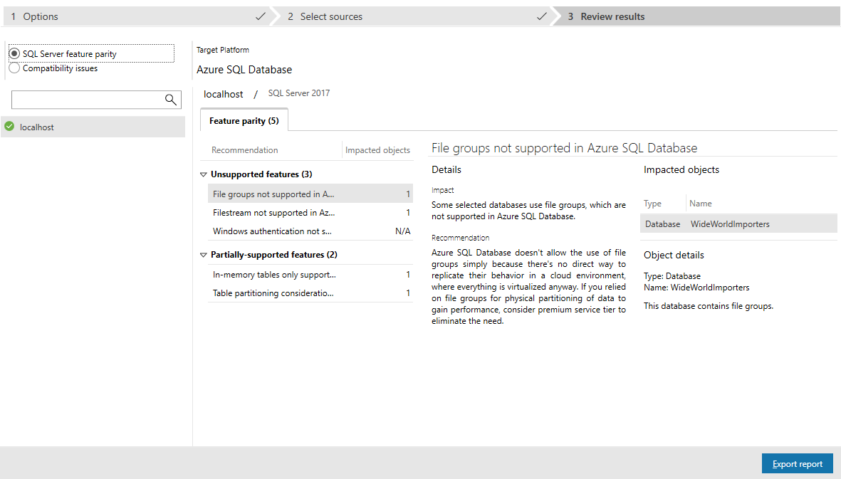
Assess the On-Premises Databases
Use Data Migration Assistant to create an Assessment project
Select the source and target servers
Provide the connection details and permissions
Choose the database to migrate
Notes:
Use the Data Migration Assistant to create an Assessment project
Select the source and target servers. Provide the connection details for the source server, including credentials with permission to access it.
Choose the database you want to migrate.

Slide 24
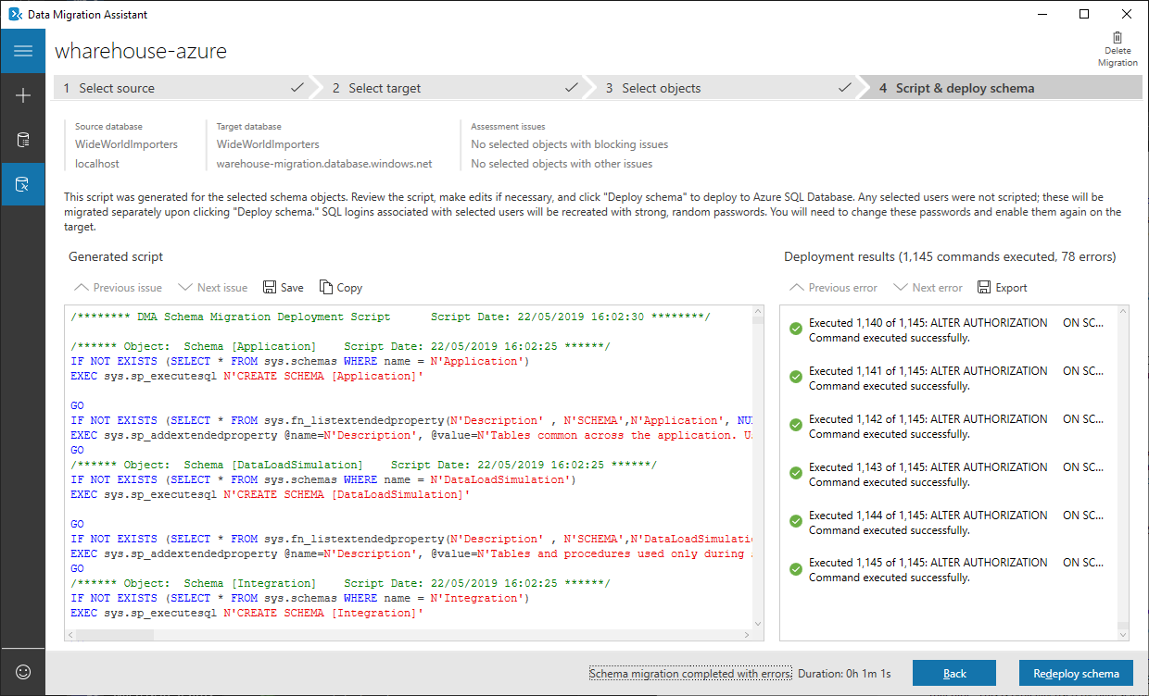
Migrate the Schema using the Data Migration Assistant
Select an on-premises SQL Server instance as the source server
Set the Azure SQL Database instance as the target server
Set the scope of the migration to Schema Only
Once connected to the source database, choose the schema objects to deploy to the new SQL database
Data Migration Assistant will create a script of actions
Select Deploy Schema to run the script
Once the script has run, check the target server to make sure it has been configured correctly

Slide 25

Migrate Data with Database Migration Service
Create an instance of Azure Database Migration Service
Create a new migration project
Specify source and target server details
Identify the databases
Run and monitor the migration
Review migrated content
Notes:
Create an instance of Azure Database Migration Service. Choose the pricing tier.
Create a new migration project. Choose the type of migration you want to perform( offline or online).
Specify source and target server details, including the authentication information.
Identify the databases. Map the relevant target database on the target server to the source server.
Run and monitor the migration.
Select the Run migration button to start the migration. The migration activity screen will appear.
Track the progress until the process shows as completed.
After all the required databases are migrated, check them to make sure they're working

Slide 26
Migrating On-Premises Data to Cloud Storage with AzCopy

Slide 27

Migrate On-Premises Data to Cloud Storage with AzCopy
AzCopy is a command-line tool for copying data to, or from, Azure Blob storage, Azure Files, and Azure Table storage.
In this lesson, you will see how to:
Create a storage account
Use AzCopy to upload all your data
Modify the data for test purposes
Create a scheduled task or cron job to identify new files to upload

Slide 28
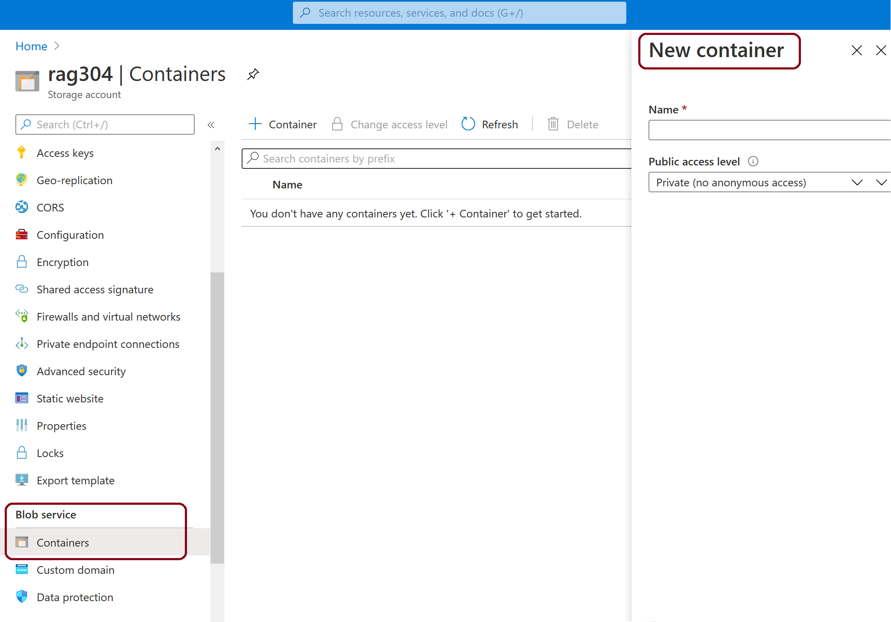
Create a Container
Blobs must be uploaded into a container.
Select the Storage account
Select Containers under Blob Services

Slide 29
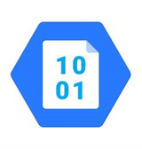
Authenticate with Azure AD
Storage Blob Data Contributor
azcopy <enter>
Authentication URL (code provided)
Sign into your Azure account.
Begin using AzCopy

Slide 30
Upload Contents of a Folder to Blob Storage
Upload blob:
azcopy copy "<local-folder-path>" "https://<storage-account-name>.<blob or dfs>.core.windows.net/<container-name>" --recursive=true
To upload the contents of the specified directory to Blob storage recursively, specify the –recursive option.

Slide 31
Upload Modified Files to Blob Storage
Use AzCopy to upload files based on their last-modified time by entering the following AzCopy command:
azcopy sync "<local-folder-path>" "https://<storage-account-name>.blob.core.windows.net/<container-name>" --recursive=true

Slide 32
Create a Scheduled Task
Using AzCopy:
Copy the AzCopy command to a text editor (Windows or Linux)
Update the parameter values
Save the file as script.sh (Linux) or script.bat (Windows)
Schtasks enables an administrator to create, delete, query, change, run, and end scheduled tasks on a local or remote computer.
CRON enables Linux and Unix users to run commands or scripts at a specified date and time.
Cronjob entry:
crontab -e */5 * * * * sh /path/to/script.sh
For Windows, using PowerShell:
schtasks /CREATE /SC minute /MO 5 /TN "AzCopy Script" /TR C:\script.bat
Notes:
You can create a scheduled task that runs an AZCopy script to synchronize changed content between a source location and Azure Storage on either Windows using schtasks or on Linux using crontab.
Create an script file that has the details of the AzCopy command using a .bat extension for Windows and a .sh for Linux.
Windows: azcopy sync "C:\myFolder" "https://mystorageaccount.blob.core.windows.net/mycontainer" --recursive=true
Linux: azcopy sync "/mnt/myfiles" "https://mystorageaccount.blob.core.windows.net/mycontainer" --recursive=true
NOTE: you may have to add additional information to the Azure Container string.
To schedule the script file run:
Windows schtasks /CREATE /SC minute /MO 5 /TN "AzCopy Script" /TR C:\script.bat (this is a sample path to the location of the batch file)
Linux crontab -e */5 * * * * sh /path/to/script.sh

Slide 33
Lab

Slide 34
Lab: Migrating Hyper-V VMs to Azure by using Azure Migrate
Lab tasks include:
Prepare Hyper-V for assessment and migration by using Azure Migrate
Assess Hyper-V for migration by using Azure Migrate
Migrate Hyper-V VMs by using Azure Migrate

Slide 35

Review Questions

Slide 36
Online Role-based training resources: Microsoft Learn https://docs.microsoft.com/en-us/learn/

Slide 37
Thank you.

