Slide 1

Course Outline
Module 1: Design a Compute Solution
Module 2: Design a Network Solution
Module 3: Design for Migration
Module 4: Design Authentication and Authorization
Module 5: Design Governance
Module 6: Design a Solution for Databases
Module 7: Select an Appropriate Storage Account
Module 8: Design Data Integration
Module 9: Design a Solution for Logging and Monitoring
Module 10: Design a Solution for Backup and Recovery
Module 11: Design for High Availability
Module 12: Design for Cost Optimization
Module 13: Design an Application Architecture
Module 14: Design Security for Applications
NOTE: The module order listed above aligns with the learning objectives described on the AZ-304: Microsoft Azure Architect Design certification page.

Slide 2
AZ-304: Microsoft Azure Architect Design
Presenter, MCT

Slide 3
Module 5: Design Governance
Azure Policy, Azure Blueprints

Slide 4
Learning Objectives
Governance
Recommend a Solution for using Azure Policy
Recommend a Solution for using Azure Blueprint
Module Review Questions

Slide 5

Governance

Slide 6
Governance
Governance:
How is the organization’s security going to be monitored, audited, and reported?
How does the organization know that things are actually working?
Are there new requirements?
Is there mandatory reporting?
Risk:
What types of risks does the organization face while trying to protect identifiable information, Intellectual Property (IP), financial information?
Who may be interested or could use this information if stolen, including external and internal threats as well as unintentional or malicious?
A commonly forgotten but extremely important consideration within risk is addressing Disaster Recovery and Business Continuity.
Compliance:
Are there specific industry, government, or regulatory requirements that dictate or provide recommendations on criteria that your organization’s security controls must meet?
See: Governance, risk, and compliance

Slide 7
Clear Lines Of Responsibility
Designate groups (or individual roles) that will be responsible for these key functions:
Network Security
Typically existing network security team. Configuration and maintenance of Azure Firewall, Network Virtual Appliances (and associated routing), WAFs, NFGs, ASGs, etc.
Network Management
Typically existing network operations team. Enterprise-wide virtual network and subnet allocation
Server Endpoint Security
Typically IT operations, security, or jointly. Monitor and remediate server security (patching, configuration, endpoint security, etc.)
Incident Monitoring and Response
Typically security operations team. Investigate and remediate security incidents In Security Information and Event Management (SIEM) or source console
Policy Management
Typically GRC team + Architecture. Set Direction for use of Role Based Access Control (RBAC), Azure Security Center, Administrator protection strategy, and Azure Policy to govern Azure resources
Identity Security and Standards
Typically Security Team + Identity Team jointly. Set direction for Azure AD directories, PIM/PAM usage, MFA, password/synchronization configuration, Application Identity Standards

Slide 8
Audit and Enforce Policy Compliance
Audit environment
Policy monitoring
Use Azure Policy to create and manage policies that enforce compliance
See: Audit and enforce policy compliance
Notes:
Ensure that the security team is auditing the environment to report on compliance with the security policy of the organization.
Policy monitoring is critical to check that initial configurations are correct and that it continues to be compliant over time.
Use Azure Policy to create and manage policies that enforce compliance.
Azure Policies are built on the underlying Azure Resource Manager capabilities in the Azure platform (and Azure Policy can also be assigned via Azure Blueprints).

Slide 9
Recommend a Solution for using Azure Policy

Slide 10

Compliance with Azure Policy
Azure Policy is an Azure service you use to create, assign and, manage policies
Enforce rules
Evaluate Noncompliance
Audit Policies
Integrate with Azure DevOps
Notes:
Azure Policy is an Azure service you use to create, assign and, manage policies.
Policies enforce rules on resources, so they remain compliant with corporate standards and SLAs.
Azure Policy evaluates resources for noncompliance with assigned policies.
After a policy is implemented, new and existing resources are evaluated for compliance.
Azure Policy will audit all the existing VMs in an organization to ensure the policy is enforced.
Integrate Azure Policy with Azure DevOps for continuous integration and delivery pipeline policies for pre-deployment and post-deployment of applications.

Slide 11
Azure Policy Initiatives or Azure Policies
Azure Policy is three components:
Policy definition - conditions which you want controlled
Policy assignment - scope of what the policy definition
Policy parameters - characteristics and values of the policy
Notes:
Policy definition are the conditions which you want controlled.
There are built in definitions such as controlling what type of resources can be deployed to enforcing the use of tags on all resources.
Policy assignment is the scope of what the policy definition can take effect around.
Scope of assignment can be assigned to a individual, resource, resource group or management group. Policy assignments are inherited by all child resources.
Policy parameters are used by reducing the number of policy definitions you must create.
Parameters would be used to define which type of VM SKUs to deploy or defining a specific location.

Slide 12
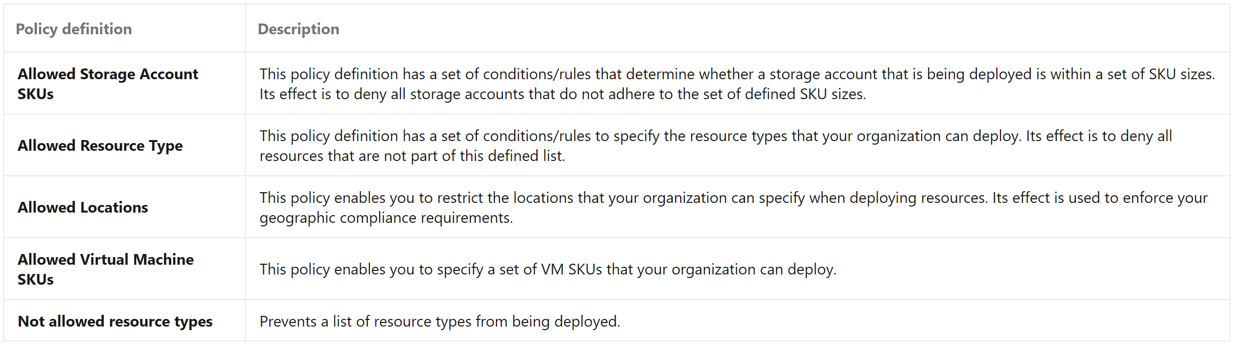
Creating a Policy
Creating an Azure Policy begins with creating a policy definition.
To apply a policy:
Create a policy definition
Assign a definition to a scope of resources
View policy evaluation results

Slide 13
Applying Azure Policy
To apply a policy with Azure PowerShell by adding the Microsoft.PolicyInsights extension:
# Register the resource provider if it’s not already registered
Register –AzResourceProvider –ProviderNamespace ‘Microsoft.PolicyInsights’
Example of a policy definition that identifies virtual machines not using managed disks.
# Get a reference to the resource group that will be the scope of the assignment
$rg = GetAzREsourceGroup –name ‘<resourceGroupName>’
# Get a reference to the built-in policy definition that will be assigned
$definition = Get-AzPolicyDefinition | Where-Object { $_.Properties.DisplayName –eq ‘Audit VMs that do not use managed disks’ }
# Create the policy assignment with the built-in definition against your resource group
New-AzPolicyAssignment –Name ‘audit-vm-manageddisks’ –Displayzname ‘Audit VMs without managed disks Assignment’ –Scope $rgResourceId –PolicyDefiniton $definiton

Slide 14
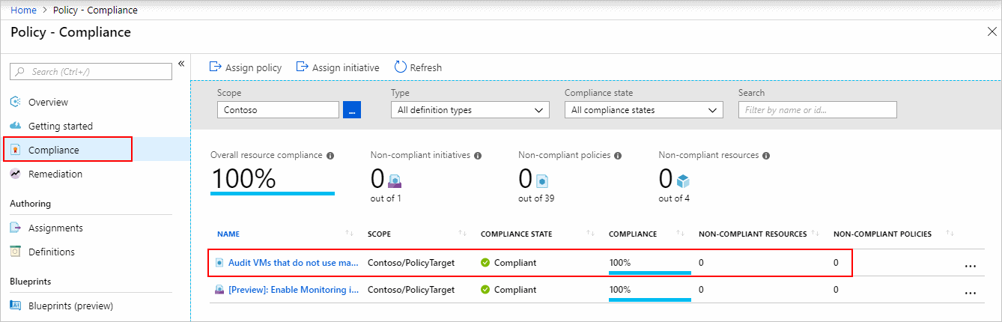
Identifying Non-Compliant Resources
Use the applied policy definition to identify resources that aren't compliant with the policy assignment using the Azure portal

Slide 15
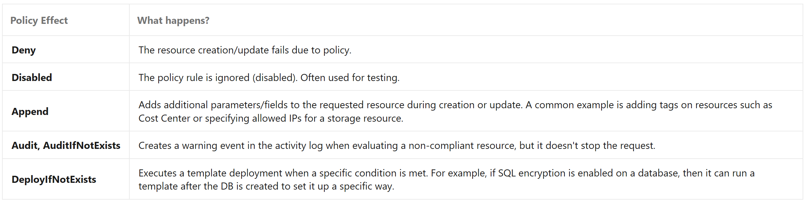
Policy Effects
Requests to create or update a resource through Azure Resource Manager are evaluated by Azure Policy first
Policy creates a list of all assignments that apply to the resource and then evaluates the resource against each definition
Policy processes several of the effects before handing the request to the appropriate Resource Provider to avoid any unnecessary processing if the resource violates policy
Notes:
Requests to create or update a resource through Azure Resource Manager are evaluated by Azure Policy first.
Policy creates a list of all assignments that apply to the resource and then evaluates the resource against each definition.
Policy processes several of the effects before handing the request to the appropriate Resource Provider to avoid any unnecessary processing if the resource violates policy.

Slide 16
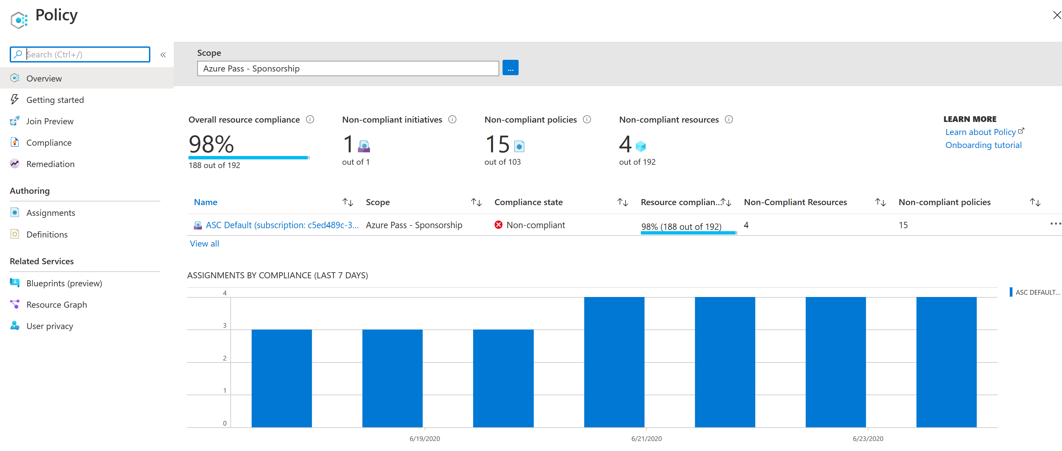
View Policy Evaluation Results
Lorem

Slide 17
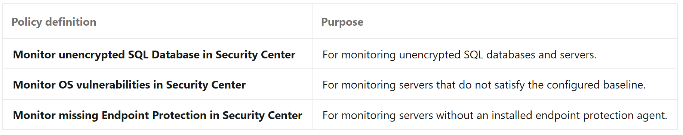
Organize Policy with Initiatives
Initiative definitions simplify the process of managing and assigning policy definitions by grouping a set of policies into a single item

Slide 18
Demonstration - Manage Tag Governance with Azure Policy
Azure Policy's Modify effect is designed to aid in the governance of tags no matter what stage of resource governance you are in.
You’ll view the following tasks:
Identify your business requirements
Map each requirement to a policy definition
Group the tag policies into an initiative

Slide 19
Recommend a Solution for using Azure Blueprint

Slide 20
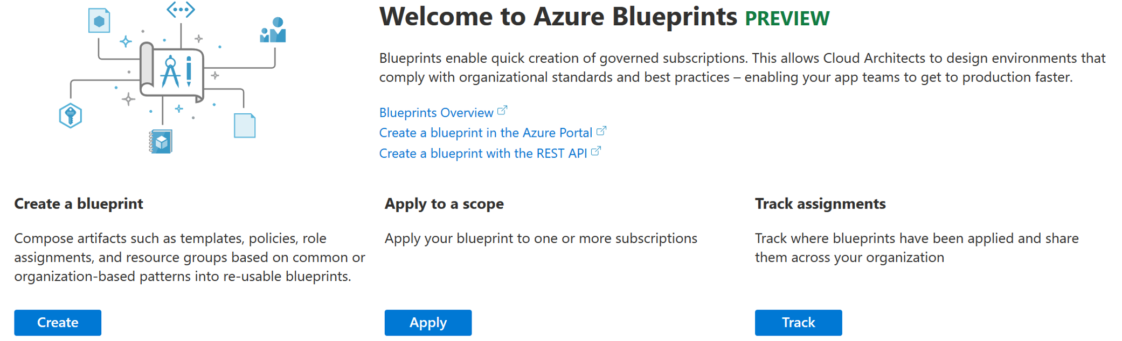
Azure Blueprints
Blueprints are a declarative way to orchestrate the deployment of various resource templates and other artifacts such as:
Role Assignments
Policy Assignments
Azure Resource Manager templates (ARM templates)
Resource Groups
Notes:
For Example:
Just as a blueprint allows an engineer or an architect to sketch a project's design parameters, Azure Blueprints enables the definition of a repeatable set of Azure resources that implements and adheres to an organization's standards, patterns, and requirements.
Azure Blueprints allow for the rapid build of new environments with trust they're building within organizational compliance.
Blueprints are a declarative way to orchestrate the deployment of various resource templates and other artifacts such as:
Role Assignments
Policy Assignments
Azure Resource Manager templates (ARM templates)
Resource Groups

Slide 21

How Blueprints Differ from Resource Manager Templates
Blueprints are designed for environment setup
Template are used for deployments – no active connection post deployment.
Blueprints preserves relationship between the blueprint definition (what should be deployed) and the blueprint assignment (what was deployed)
Blueprints can upgrade multiple subscriptions at once
Blueprints consist of zero or more templates
Templates are reusable in Blueprints
Notes:
The Azure Blueprints service is designed to help with environment types—a set of resource groups, policies, role assignments, and Resource Manager template deployments.
A blueprint is a package of these types brought together to compose and version.
Note: Resource Manager templates are documents that are stored locally or in source control.
The template gets used for deployments of one or more Azure resources—once those resources deploy there's no active connection or relationship to the template.
With Blueprints, the relationship between the blueprint definition (what should be deployed) and the blueprint assignment (what was deployed) is preserved.
Blueprints can upgrade multiple subscriptions that governed by the same blueprint at once.
Each blueprint can consist of zero or more Resource Manager template artifacts.
Resource Manager templates are reusable in Blueprints.
Azure Resource Manager (ARM) Template
are stored locally or in source code
once run they are no longer related to the object(s) they create
changes to a template will not impact objects created with the original template
can appear in zero or more Blueprints
Azure Blueprint
are created and stored within Azure
changes to a Blueprint will enact the change on the objects that were originally deployed by the Blueprint
consist of zero or more ARM Templates

Slide 22
How Blueprints Differ from Azure Policy
Blueprints are packages with sets of standards, patterns, and requirements related to the implementation of Azure cloud services
A policy focused on resource properties
A policy can be included as one of many artifacts in a blueprint definition
Notes:
A blueprint is a package composing focus-specific sets of standards, patterns, and requirements related to the implementation of Azure cloud services.
A policy is a default-allow and explicit-deny system focused on resource properties during deployment and for already existing resources.
Including a policy in a blueprint enables the creation of the right pattern or design during assignment of the blueprint.
The policy inclusion makes sure that only approved or expected changes can be made to the environment to protect ongoing compliance to the intent of the blueprint.
A policy can be included as one of many artifacts in a blueprint definition.

Slide 23
Module 5 Review Questions

Slide 24
Online Role-based training resources: Microsoft Learn https://docs.microsoft.com/en-us/learn/

Slide 25
Thank you.

