Slide 1

Course Outline
Module 1: Design a Compute Solution
Module 2: Design a Network Solution
Module 3: Design for Migration
Module 4: Design Authentication and Authorization
Module 5: Design Governance
Module 6: Design a Solution for Databases
Module 7: Select an Appropriate Storage Account
Module 8: Design Data Integration
Module 9: Design a Solution for Logging and Monitoring
Module 10: Design a Solution for Backup and Recovery
Module 11: Design for High Availability
Module 12: Design for Cost Optimization
Module 13: Design an Application Architecture
Module 14: Design Security for Applications
NOTE: The module order listed above aligns with the learning objectives described on the AZ-304: Microsoft Azure Architect Design certification page.

Slide 2
AZ-304: Microsoft Azure Architect Design

Slide 3
Module 6: Design a Solution for Databases
Solutions using Azure Data Storage, Dynamic Scale, and Encrypting Data

Slide 4
Learning Objectives
Selecting an Appropriate Data Platform Based on Requirements
Overview of Azure Data Storage
Recommend Database Service Tier Sizing
Dynamically Scale Azure SQL Database and Azure SQL Managed Instances
Recommend a Solution for Encrypting Data at Rest, Transmission, and In Use
Lab: Implementing Azure SQL Database-Based Applications
Module Review Questions

Slide 5
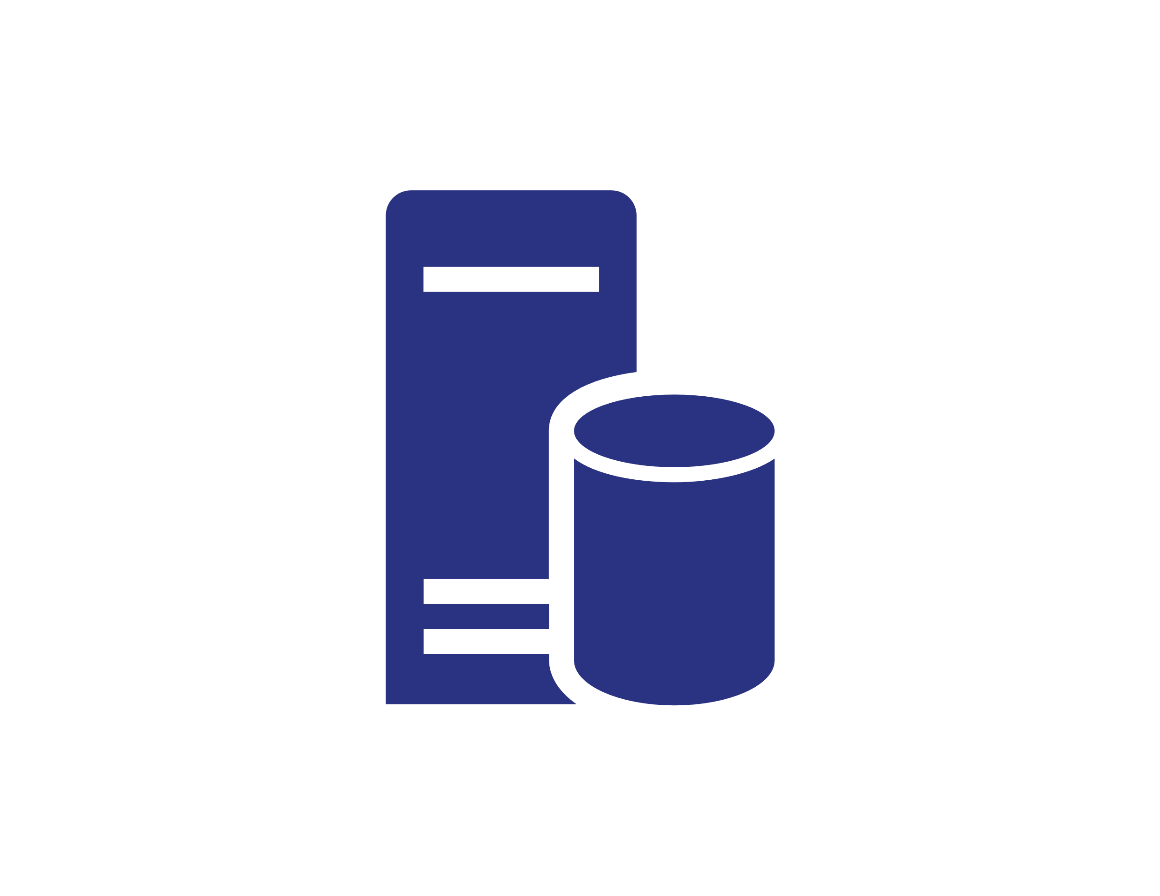
Select an Appropriate Data Platform Based on Requirements

Slide 6

Recommending the Right Data Store
This lesson provides an overview of the following database systems:
Relational database management systems
Key/Value stores
Document databases
Graph databases
Data analytics

Slide 7

Relational Database Management Systems
Relational databases organize data as a series of two-dimensional tables with rows and columns
Each table has its own columns, and every row in a table has the same set of columns
Based on Structured Query Language (SQL)
RDBMS implements a transactionally consistent mechanism that conforms to the ACID (Atomic, Consistent, Isolated, Durable) model for updating information
An RDBMS is useful when strong consistency guarantees are important
Relevant Azure services:
Azure SQL Database
Azure Database for MySQL

Slide 8
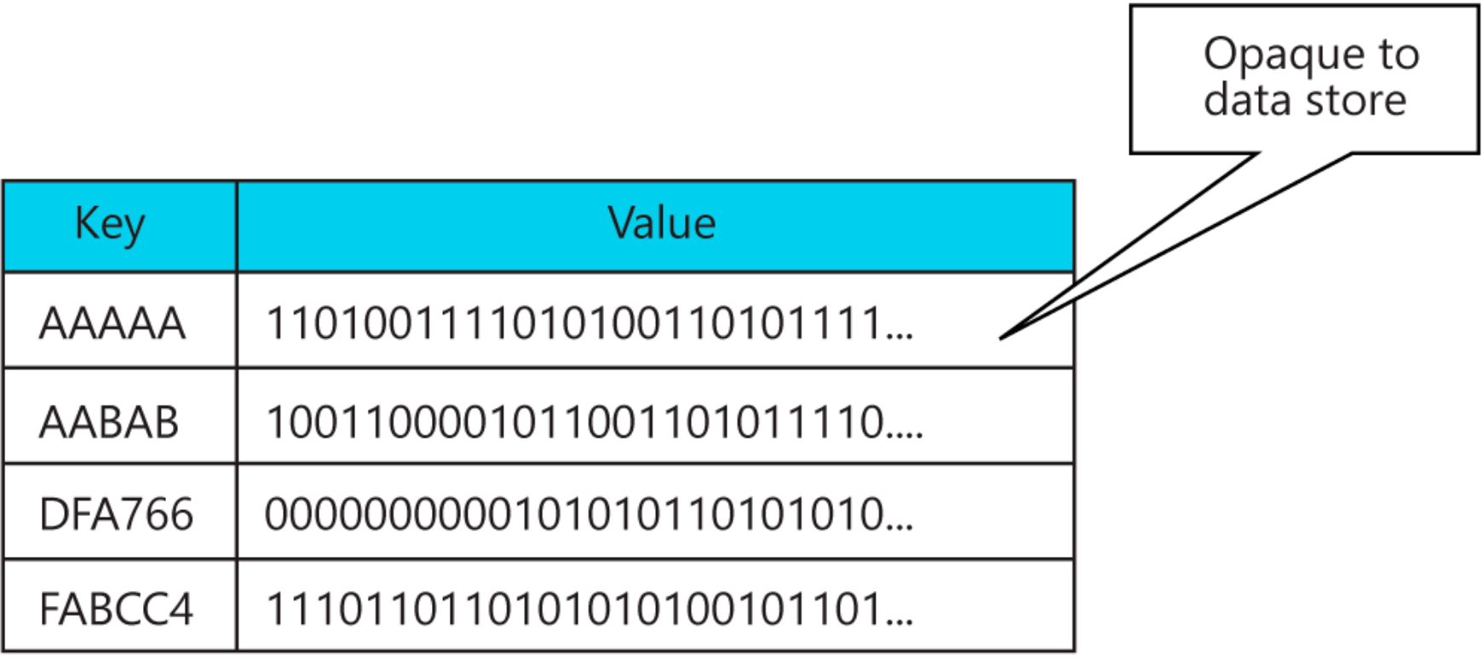
Key/Value Stores
A key/value store is a large hash table
Associate each data value with a unique key
Most key/value stores only support simple query, insert, and delete operations.
An application can store arbitrary data as a set of values,
Some key/value stores impose limits on the maximum size of values
Relevant Azure services:
Cosmos DB
Azure Cache for Redis
Azure Tables
Notes:
A key/value store is a large hash table.
Associate each data value with a unique key… the key/value store uses this key to store the data by a hashing function.
Most key/value stores only support simple query, insert, and delete operations.
An application can store arbitrary data as a set of values, although some key/value stores impose limits on the maximum size of values.

Slide 9
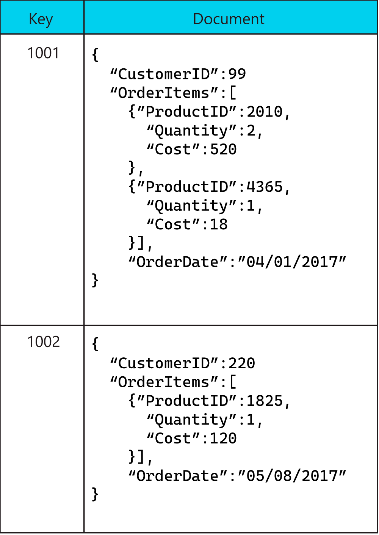
Document Databases
A document database is conceptually like a key/value store, except that it stores a collection of named fields and data
Data fields of a document can be encoded, including XML, YAML, JSON, BSON
Fields in documents are exposed to the storage management system, enabling an application to query and filter data by using the values in these fields
A document store does not require that all documents have the same structure
Relevant Azure services:
Cosmos DB
Notes:
A document database is conceptually like a key/value store, except that it stores a collection of named fields and data.
Data fields of a document can be encoded, including XML, YAML, JSON, BSON.
Fields in documents are exposed to the storage management system, enabling an application to query and filter data by using the values in these fields.
A document store does not require that all documents have the same structure.

Slide 10
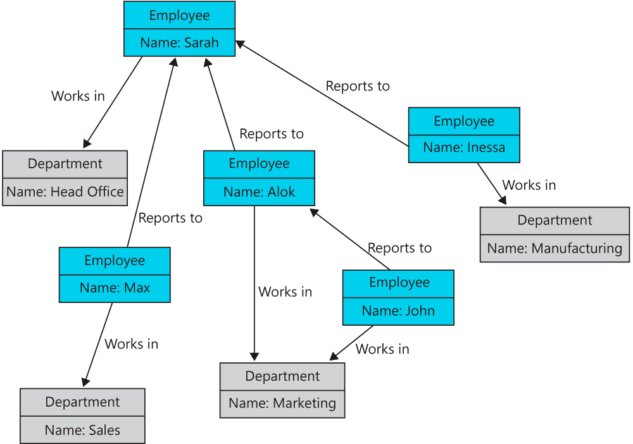
Graph Databases
A graph database stores two types of information, nodes and edges
Nodes are entities
Edges which specify the relationships between nodes
Both nodes and edges can have properties that provide information about that node or edge, like columns in a table
Edges can also have a direction indicating the nature of the relationship
Relevant Azure services:
Cosmos DB
Notes:
The purpose of a graph database is to allow an application to efficiently perform queries that traverse the network of nodes and edge and analyze relationships between entities.

Slide 11
Overview of Azure Data Storage

Slide 12
Azure SQL Database (slide 1 of 2)
Azure SQL Database is a fully managed platform as a service (PaaS) database engine)
High-performance, reliable, fully managed and secure
Multiple programming languages
Migrate your existing SQL Server databases using the Azure Database Migration Service
Azure SQL Database deployment options for a database:
Single database represents a fully managed, isolated database
Elastic pool is a collection of single databases with a shared set of resources, such as CPU or memory
Notes:
Azure SQL Database is a fully managed platform as a service (PaaS) database engine based on the latest stable version of the Microsoft SQL Server database engine.
High-performance, reliable, fully managed and secure database.
Multiple programming languages of your choice without needing to manage infrastructure.
Migrate your existing SQL Server databases using the Azure Database Migration Service.
Uses the Microsoft Data Migration Assistant to generate assessment reports that provide recommendations and changes prior to a migration.
Azure SQL Database provides the following deployment options for a database:
Single database represents a fully managed, isolated database. You might use this option if you have modern cloud applications and microservices that need a single reliable data source. A single database is similar to a contained database in the SQL Server database engine.
Elastic pool is a collection of single databases with a shared set of resources, such as CPU or memory. Single databases can be moved into and out of an elastic pool.

Slide 13
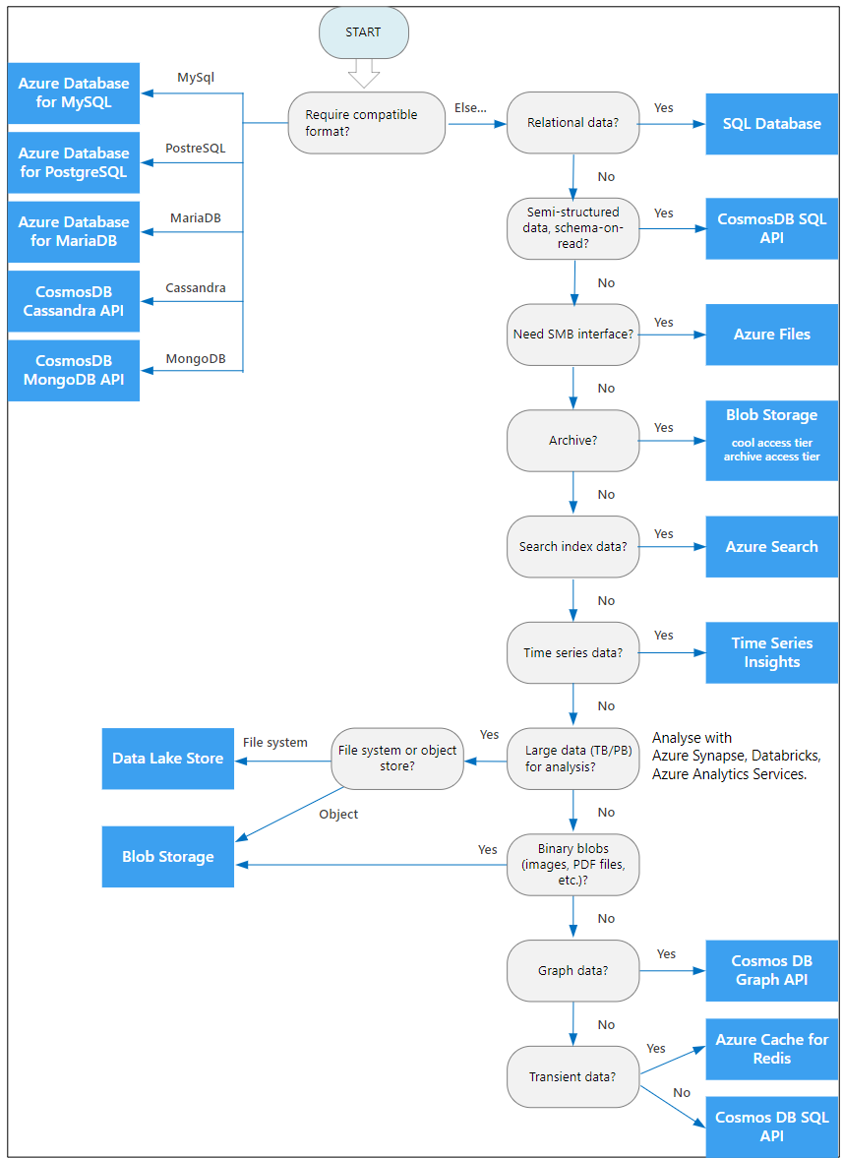
Azure SQL Database (slide 2 of 2)
Use the flowchart to select a candidate data store.
Azure offers a number of managed data storage solutions, each providing different features and capabilities.
If your application consists of multiple workloads, evaluate each workload separately. A complete solution may incorporate multiple data stores.
Notes:
Azure offers a number of managed data storage solutions, each providing different features and capabilities.
If your application consists of multiple workloads, evaluate each workload separately. A complete solution may incorporate multiple data stores.
Use the following flowchart to select a candidate data store.

Slide 14
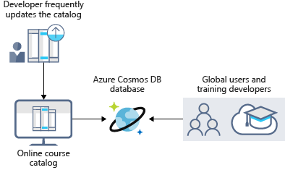
Azure Cosmos DB
Azure Cosmos DB features:
Geo-replication
Elastic scaling of throughput and storage worldwide
Five well-defined consistency levels

Slide 15

Azure Blob Storage
Azure Blob Storage is unstructured
Highly scalable
Thousands of simultaneous uploads
Anywhere in the world
Notes:
Azure Blob Storage is unstructured with no restrictions on the kinds of data it can hold.
Blobs are highly scalable and apps work with blobs similar to files on a disk: reading and writing data.
Manage thousands of simultaneous uploads, massive amounts of video data, constantly growing log files, reached from anywhere with an internet connection.
Azure Blob storage allows streaming large video/audio files directly to browsers from anywhere in the world.

Slide 16
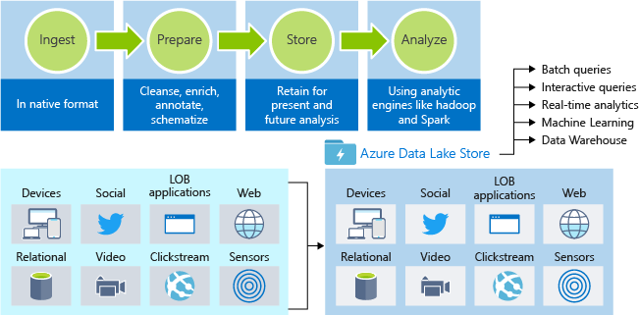
Azure Data Lake Storage
Structured and unstructured data
Hyperscale repository for big data analytic workloads
No limits on account sizes, file sizes, or the amount of data
Hadoop accessed (available through HDInsight) using WebHDFS-compatible REST APIs
Notes:
Data Lake is a large repository that stores both structured and unstructured data.
An enterprise-wide hyperscale repository for big data analytic workloads.
Does not impose limits on account sizes, file sizes, or the amount of data that can be stored.
Can be accessed from Hadoop (available through HDInsight) using the WebHDFS-compatible REST APIs.

Slide 17
Comparison - Azure Data Lake Store and Azure Blob Storage Containers
Category | Azure Data Lake Storage Gen1 | Azure Blob Storage
Purpose | Optimized storage for big data analytics workloads | General purpose object store for a wide variety of storage scenarios
Use Cases | Batch, interactive, streaming analytics and machine learning data such as log files, IoT data, click streams, large datasets | Any type of text or binary data, such as application back end, backup data, media storage for streaming and general-purpose data
Structure | Hierarchical file system | Object store with flat namespace
Authentication | Based on Azure Active Directory Identities | Based on shared secrets - Account Access Keys and Shared Access Signature Keys.
Authentication Protocol | OAuth 2.0. Calls must contain a valid JWT (JSON Web Token) issued by Azure Active Directory | Hash-based Message Authentication Code (HMAC). Calls must contain a Base64-encoded SHA-256 hash over a part of the HTTP request.
Authorization | POSIX Access Control Lists (ACLs). ACLs based on Azure Active Directory Identities can be set at the file and folder level. | For account-level authorization – Use Account Access Keys
 |  | For account, container, or blob authorization - Use Shared Access Signature Keys
Auditing | Available. | Available
Encryption data at rest | Transparent, Server side | Transparent, Server side / Client-Side encryption
Developer SDKs | .NET, Java, Python, Node.js | .NET, Java, Python, Node.js, C++, Ruby, PHP, Go, Android, iOS
Analytics Workload Performance | Optimized performance for parallel analytics workloads. High Throughput and IOPS. | Optimized performance for parallel analytics workloads.
Size limits | No limits on account sizes, file sizes, or number of files | For specific limits
Geo-redundancy | Locally redundant (multiple copies of data in one Azure region) | Locally redundant (LRS), zone redundant (ZRS), globally redundant (GRS), read-access globally redundant (RA-GRS). See here for more information

Slide 18
Azure Files
Azure Files are fully managed file shares accessible via SMB protocol or Network File System (NFS) protocol
Can be mounted concurrently by cloud or on-premises resources
VM mountable
Notes:
Azure Files are fully managed file shares accessible via the industry standard Server Message Block (SMB) protocol.
Can be mounted concurrently by cloud or on-premises deployments of Windows, Linux, and macOS.
Applications running in Azure VMs or cloud services can mount a file storage share to access file data.

Slide 19
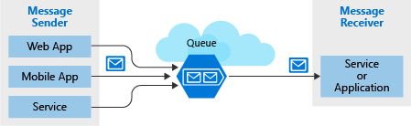
Azure Queues
Storing large numbers of messages
Accessed from anywhere in the world
Provides asynchronous message queueing
Use queue storage to:
Create a backlog of work
Pass messages between services
Distribute load
Build resilience against component failures
Notes:
Azure Queue storage is a service for storing large numbers of messages that can be accessed from anywhere in the world.
Queue storage provides asynchronous message queueing for communication between application components… running in the cloud, desktop, on-premises, or mobile devices.
Use queue storage to:
Create a backlog of work and to pass messages between different Azure web servers.
Distribute load among different web servers/infrastructure and to manage traffic bursts.
Build resilience against component failure when multiple users access your data at the same time.

Slide 20
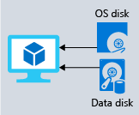
Disk Storage
Provides disks for virtual machines, applications, and other services
Persistent virtual hard disk storage
Disks can be managed or unmanaged
Solid-state drives (SSDs) and hard disk drives (HDDs)
Standard SSD and HDD disks
Premium SSD for mission-critical applications
Notes:
Disk storage provides disks for virtual machines, applications, and other services to access and use.
Allows data to be persistently stored and accessed from an attached virtual hard disk.
Disks can be managed or unmanaged by Azure.
Solid-state drives (SSDs) and hard disk drives (HDDs) with varying performance.
Can use standard SSD and HDD disks for less critical workloads
Premium SSD disks for mission-critical production applications.

Slide 21

Walk-Through: Working with Azure Storage Queues in .NET Core
You will see how to:
Create an Azure storage account
Create the app
Add the Azure client libraries
Add support for asynchronous code
Create a queue
Insert messages into a queue
Dequeue messages

Slide 22
Recommend Database Service Tier Sizing

Slide 23

Azure SQL Database and Azure SQL Managed Instance Service Tiers
General purpose - budget-oriented workloads
Business critical - low-latency workloads with high resiliency to failures and fast failovers
Hyperscale, (Azure SQL) - most business workloads, providing highly scalable storage, read scale-out, and fast database restore capabilities
When to choose this service tier
The default service tier in Azure SQL Database and Azure SQL Managed Instance
See: Azure SQL Database and Azure SQL Managed Instance Service Tiers
Notes:
Two service tiers are used by Azure SQL Database and Azure SQL Managed Instance, each with a different architectural model.
General purpose, which is designed for budget-oriented workloads.
Business critical, which is designed for low-latency workloads with high resiliency to failures and fast failovers.
Azure SQL Database has an additional service tier:
Hyperscale, which is designed for most business workloads, providing highly scalable storage, read scale-out, and fast database restore capabilities.
When to choose this service tier
The General Purpose service tier is a default service tier in Azure SQL Database and Azure SQL Managed Instance that is designed for most of generic workloads. If you need a fully managed database engine with 99.99% SLA with storage latency between 5 and 10 ms that match SQL Server on an Azure virtual machine in most of the cases, the General Purpose tier is the option for you.
SQL Logical Server:
In Azure SQL Database and Azure Synapse Analytics, a server is a logical construct that acts as a central administrative point for a collection of databases. At the server level, you can administer logins, firewall rules, auditing rules, threat detection policies, and auto-failover groups.
https://docs.microsoft.com/en-us/azure/azure-sql/database/logical-servers

Slide 24
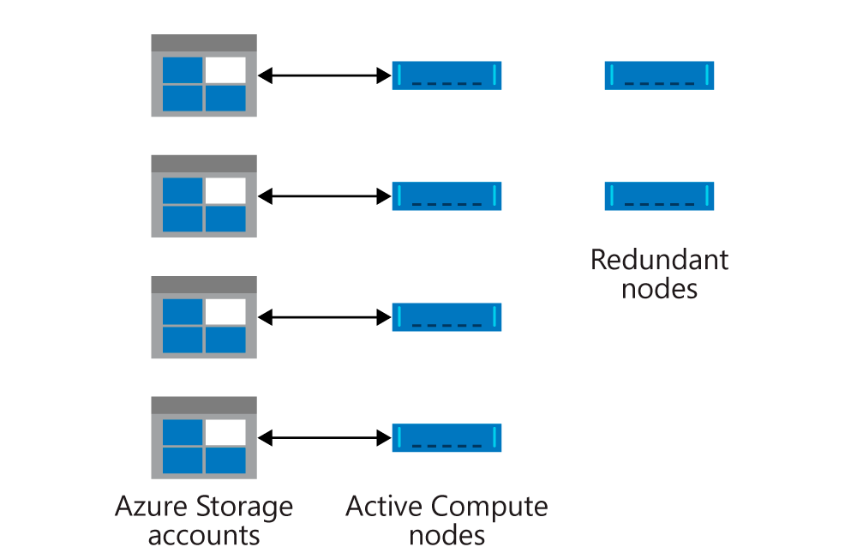
General Purpose Service Tier for Azure SQL Database & SQL Managed Instance
99.99% availability
Separation of compute and storage (general purpose)
Use Azure Blob storage to replicate database files
General-purpose service:
A stateless compute layer - contains only transient and cached data
A stateful data layer - files (.mdf/.ldf) stored in Azure Blob storage
Notes:
General-purpose service:
A stateless compute layer that is running the sqlservr.exe process and contains only transient and cached data.
A stateful data layer with database files (.mdf/.ldf) that are stored in Azure Blob storage.

Slide 25
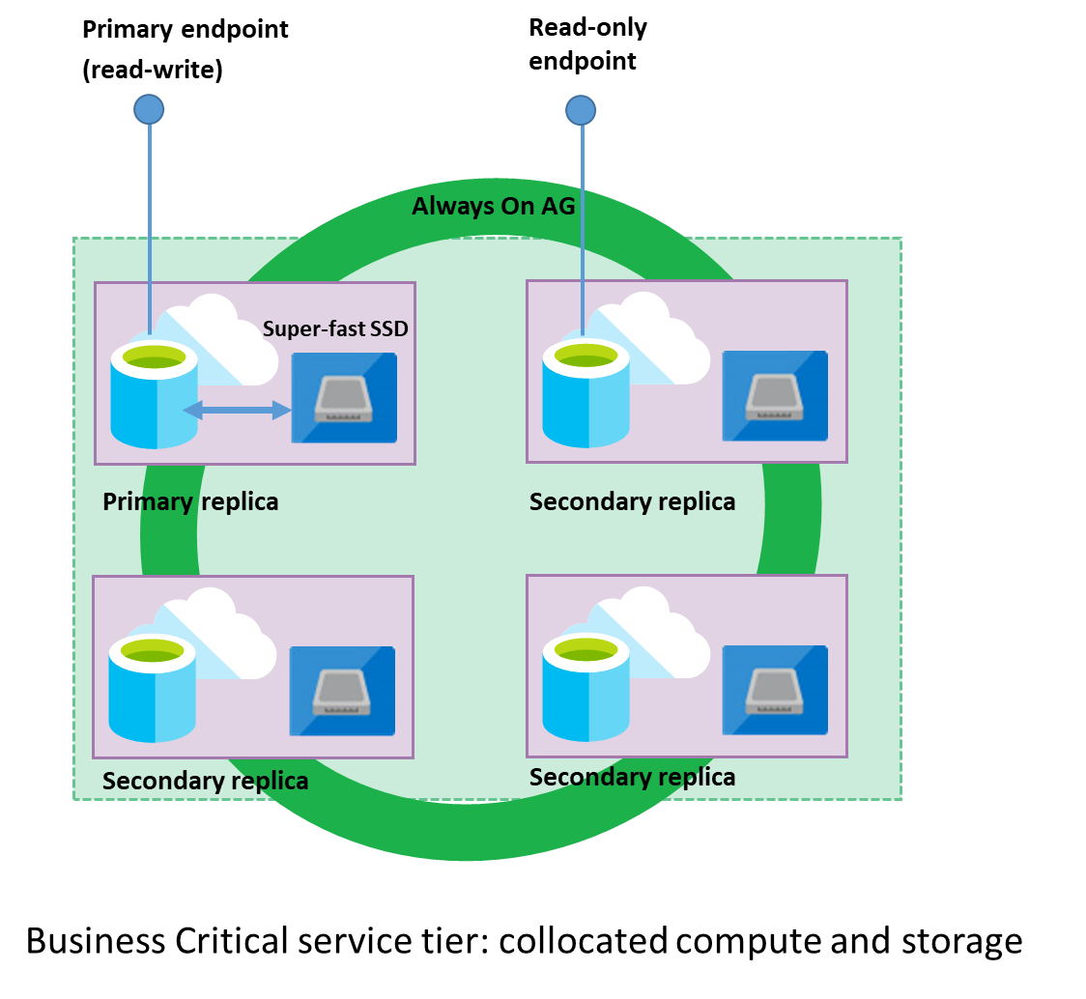
Business Critical Tier for Azure SQL Database & SQL Managed Instance
Premium/Business Critical service tier is based on a cluster of database engine processes
Premium availability is enabled in Premium and Business Critical service tiers
Compute and storage is integrated on the single node in the premium model
Notes:
Premium/Business Critical service tier is based on a cluster of database engine processes.
Premium availability is enabled in Premium and Business Critical service tiers for intensive workloads
Compute and storage is integrated on the single node in the premium model.

Slide 26
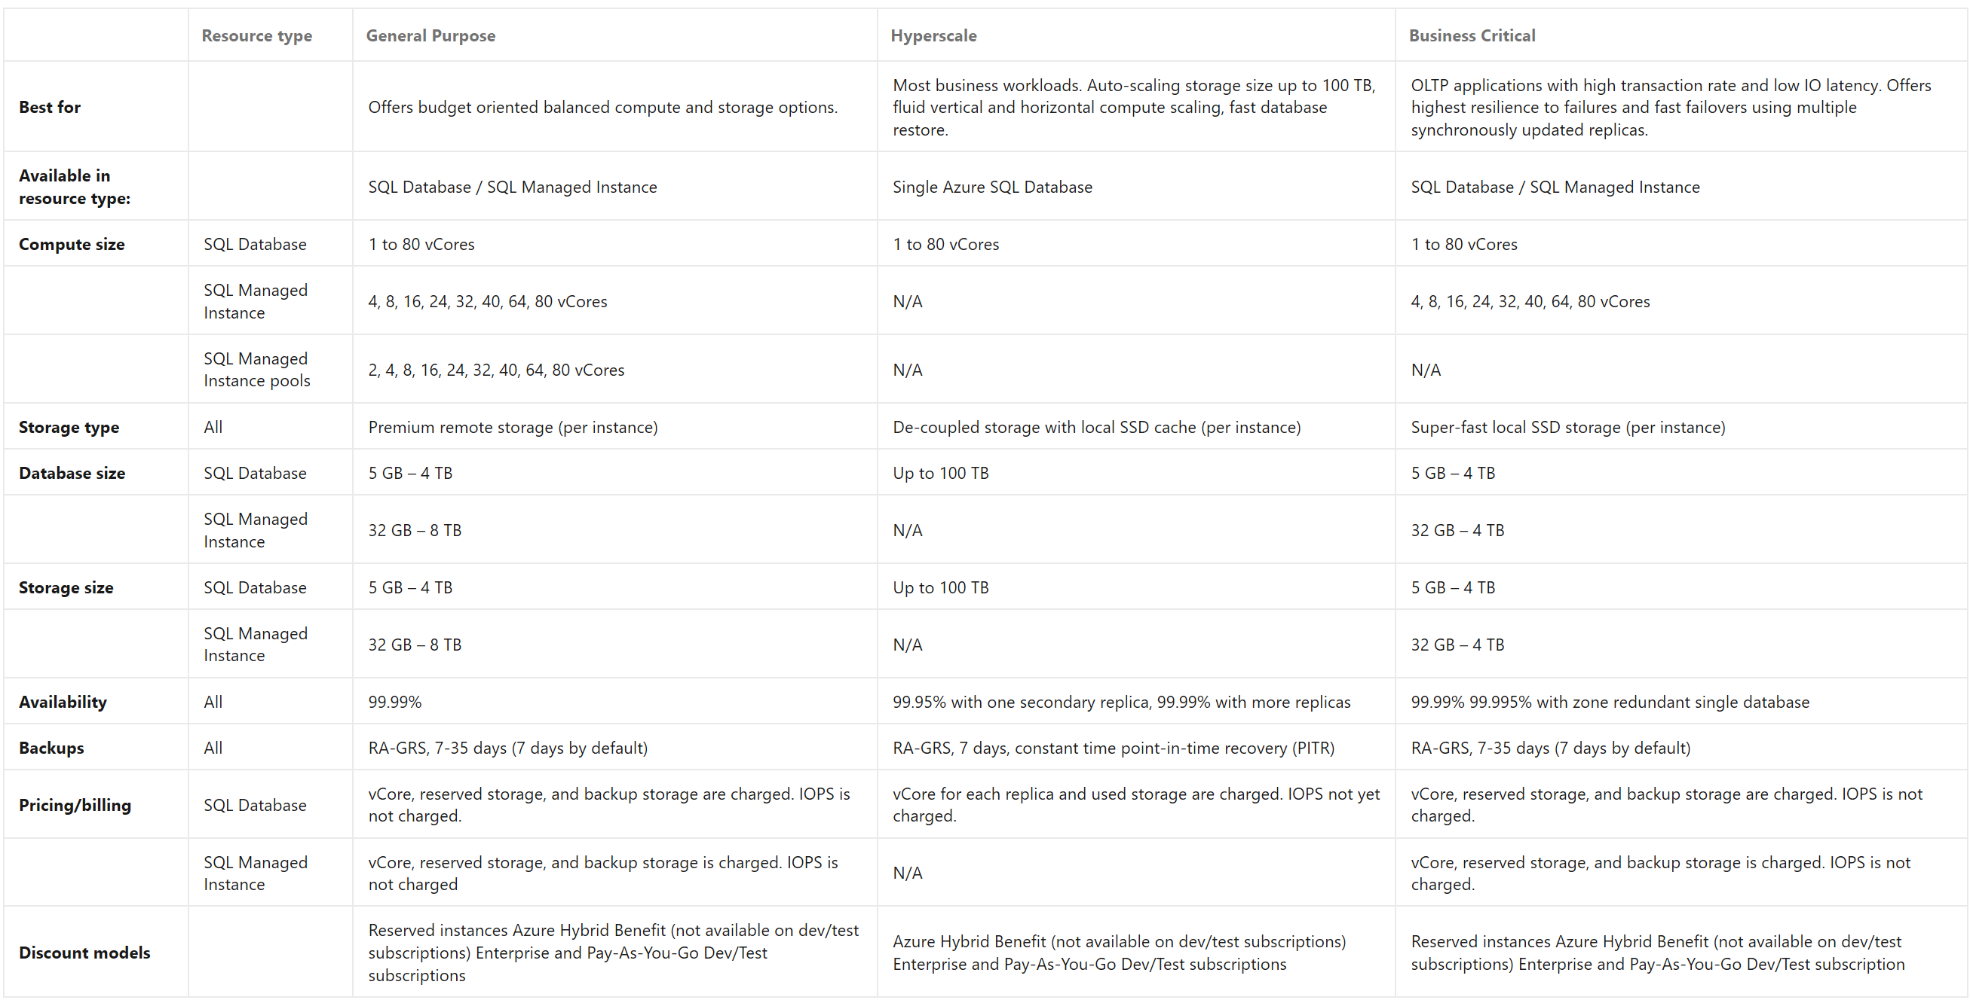
Service Tier Comparison (Azure SQL and SQL Managed Instance)
Notes:
https://docs.microsoft.com/en-us/azure/azure-sql/database/features-comparison

Slide 27
Dynamically Scale Azure SQL Database and Azure SQL Managed Instances

Slide 28
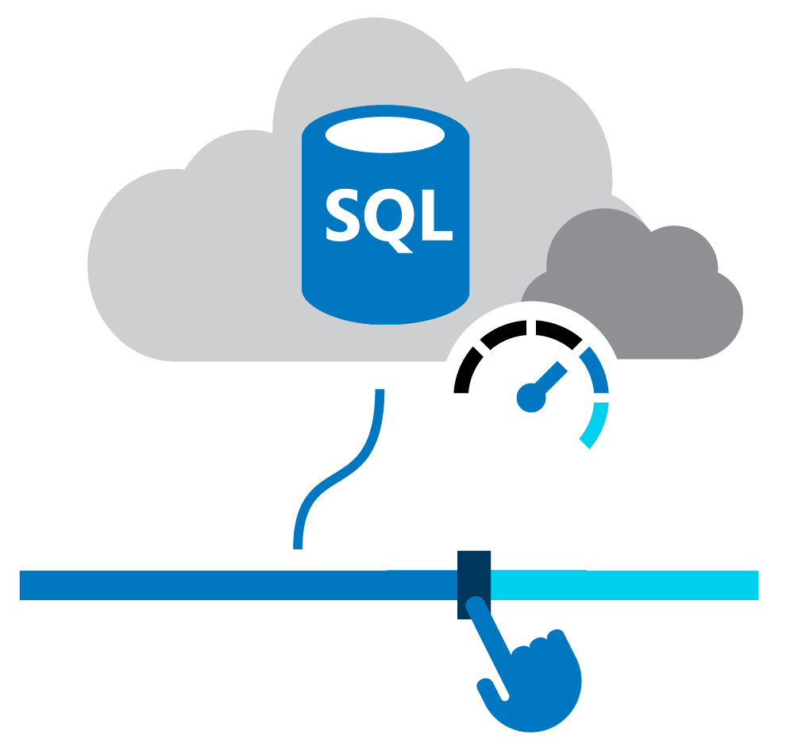
Dynamically Scale Azure SQL Database and Azure SQL Managed Instance
Azure SQL Database – DTU / vCore
Azure SQL Managed Instance - vCore
DTU-based purchasing model - Basic, Standard, and Premium.
vCore-based purchasing - General Purpose, Business Critical, and Hyperscale
Notes:
SQL Logical Server:
In Azure SQL Database and Azure Synapse Analytics, a server is a logical construct that acts as a central administrative point for a collection of databases. At the server level, you can administer logins, firewall rules, auditing rules, threat detection policies, and auto-failover groups.
https://docs.microsoft.com/en-us/azure/azure-sql/database/logical-servers

Slide 29
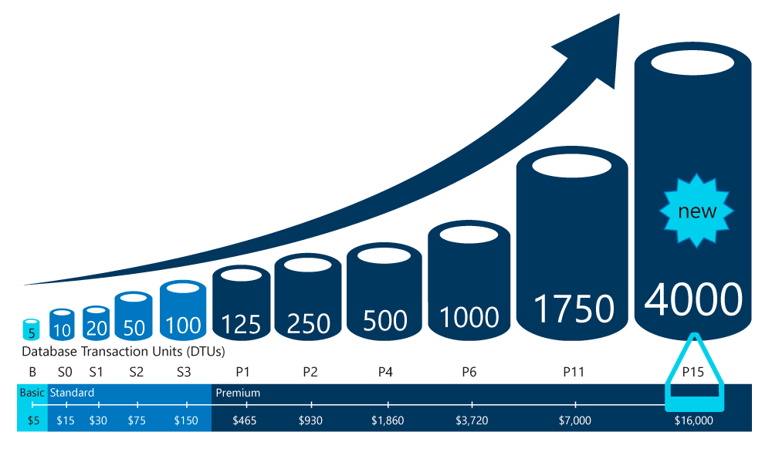
Scale Single Databases in Azure SQL Database
Single databases in Azure SQL Database support manual dynamic scalability
You can change DTU service tiers or vCore characteristics at any time with minimal downtime

Slide 30
Recommend a Solution for Encrypting Data at Rest, Transmission, and in Use

Slide 31

Data Encryption
There are two top-level types of encryption: symmetric and asymmetric
Symmetric encryption uses the same key to encrypt and decrypt the data
Asymmetric encryption uses a public key and private key pair
Either key can encrypt but cannot decrypt its own encrypted data
To decrypt, you need the paired key
Asymmetric encryption is used for things like TLS (used in https), and data signing
See: Azure encryption overview

Slide 32
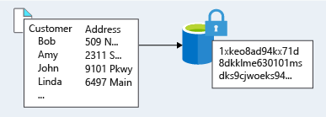
Encryption at Rest
Data at rest is the data that has been stored on a physical medium
Unreadable without the keys and secrets
Azure Disk Encryption uses Windows BitLocker, Linux dm-crypt
Azure Storage and Azure SQL Database encrypt data at rest by default
Use Azure Key Vault to maintain control of keys
Encrypt drives before you write sensitive data
See: Encryption of data at rest
Notes:
Data at rest is the data that has been stored on a physical medium.
Data at rest is data stored on the disk of a server, database, or in a storage account.
Ensures that stored data is unreadable without the keys and secrets required to decrypt it.
Azure Disk Encryption uses Windows BitLocker feature and the Linux dm-crypt feature for volume encryption for OS and the data disks.
Azure Storage and Azure SQL Database encrypt data at rest by default.
Use Azure Key Vault to maintain control of keys that access and encrypt data.
Encrypt drives before you write sensitive data to them.

Slide 33
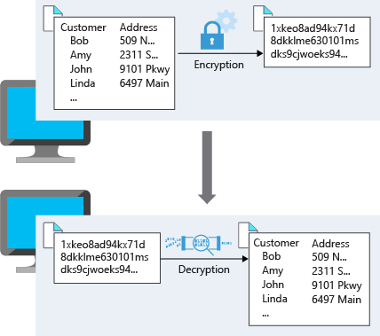
Encryption in Transit
Encrypting data in transit protects the data from outside observers
Microsoft uses the Transport Layer Security (TLS)
Microsoft datacenters negotiate a TLS connection with client systems
See: Encryption of data in transit
Notes:
Encrypting data in transit protects the data from outside observers and provides a mechanism to transmit data while limiting risk of exposure.
Microsoft uses the Transport Layer Security (TLS) protocol to protect data when it’s traveling between the cloud services and customers.
Microsoft datacenters negotiate a TLS connection with client systems that connect to Azure services.

Slide 34
Identify and Classify Data
 | Data Classification | Explanation | Example
Restricted |  | Data Classified as restricted poses significant risk if exposed, altered, or deleted. Strong levels of protection are required for this data. | Data containing SS numbers, CC numbers personal health records
Private |  | Data classified as private poses moderate risk if exposed, altered, or deleted. Reasonable levels of protection are required for this data. Data that is not classified as restricted or public will be classified as private. | Personal records containing information such as address, phone numbers, personal health records
Public |  | Data classified as public poses no risk if exposed, altered, or deleted. No protection is required for this data. | Public financial reports, public policies, product documentation for customers

Slide 35
Encrypting Raw Storage
Azure Storage Service Encryption (SSE) for data at rest protects data to meet organizational security and compliance commitments
The Azure storage platform automatically encrypts data with 256-bit Advanced Encryption Standard (AES)
All Azure Storage services including Azure Managed Disks, Azure Blob storage, Azure Files, Azure Queue storage, and Azure Table storage
Both performance tiers (Standard and Premium)
Both deployment models (Resource Manager and classic)
Notes:
Azure Storage Service Encryption (SSE) for data at rest protects data to meet your organizational security and compliance commitments.
The Azure storage platform automatically encrypts data with 256-bit Advanced Encryption Standard (AES) encryption before persisting it to disk and decrypts the data during retrieval.
Encryption, encryption at rest, decryption, and key management in SSE is transparent to applications using the services – no need to add code or enable features.
SSE automatically encrypts data in:
All Azure Storage services including Azure Managed Disks, Azure Blob storage, Azure Files, Azure Queue storage, and Azure Table storage
Both performance tiers (Standard and Premium)
Both deployment models (Resource Manager and classic)

Slide 36
Encrypting Virtual Machines
Azure Disk Encryption (ADE) encrypts Windows and Linux IaaS virtual machine disks
ADE use BitLocker on Windows and the DM-Crypt feature of Linux
ADE is integrated with Azure Key Vault
IaaS VMs are secured at rest by using industry-standard encryption
IaaS VMs boot under customer-controlled keys and policies
Can be audit in KeyVault
Notes:
Azure Disk Encryption (ADE) encrypts Windows and Linux IaaS virtual machine disks.
ADE use BitLocker on Windows and the DM-Crypt feature of Linux to provide volume encryption for the OS and data disks.
ADE is integrated with Azure Key Vault to control and manage the disk-encryption keys and secrets.
Disk Encryption for Windows IaaS and Linux VMs is in General Availability in all Azure public regions and Azure Government regions for Standard VMs and VMs with Azure Premium Storage.
Disk Encryption management fulfills the following:
IaaS VMs are secured at rest by using industry-standard encryption technology to address organizational security and compliance requirements.
IaaS VMs boot under customer-controlled keys and policies.
You can audit their usage in your key vault.

Slide 37
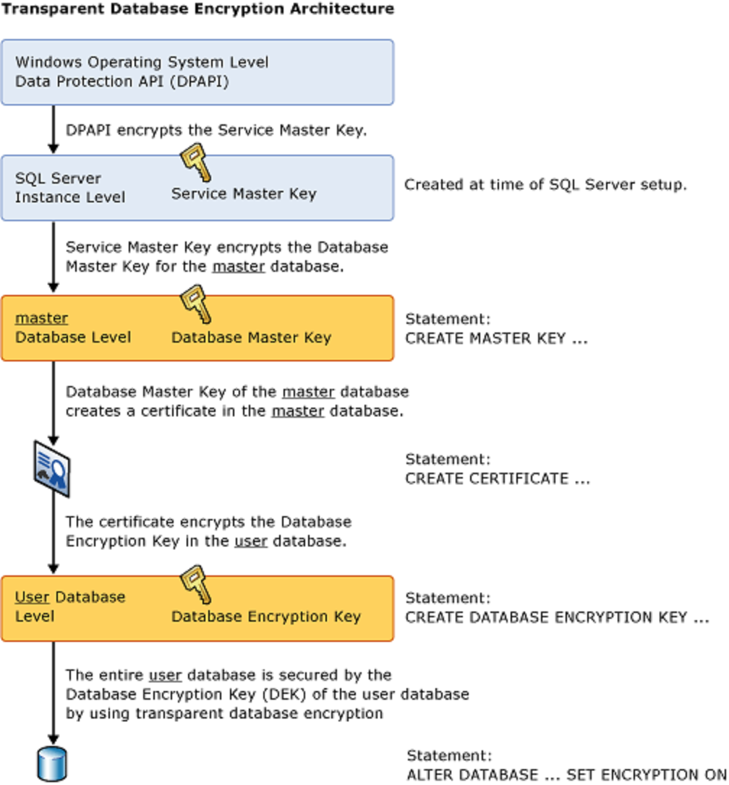
Encrypting Databases
Transparent data encryption (TDE) helps protect Azure SQL Database and Azure Data Warehouse
Real-time encryption and decryption
Enabled by default
Uses symmetric key called the database encryption key
Unique encryption key per logical SQL Server
Bring-your-own-key is also supported with keys stored in Azure Key Vault
Notes:
Transparent data encryption (TDE) helps protect Azure SQL Database and Azure Data Warehouse
Real-time encryption and decryption of the database, associated backups, and transaction log files at rest without requiring to the app.
By default, TDE is enabled for all newly deployed Azure SQL Databases.
TDE encrypts the storage of an entire database by using a symmetric key called the database encryption key.
By default, Azure provides a unique encryption key per logical SQL Server and handles all the details. Bring-your-own-key is also supported with keys stored in Azure Key Vault.
Since TDE is enabled by default, your organization can be confident they have the proper protections in place for data stored in their databases.

Slide 38
Encrypting Secrets
Vaults are backed by hardware security modules (HSMs)
Helps reduce the chances of accidental loss of security information
Key Vaults control and log all access
Can handle requesting and renewing Transport Layer Security (TLS) certificates
Supports passwords, database credentials, API keys and, certificates
See: About Azure Key Vault

Slide 39
Lab: Implementing Azure SQL Database-Based Applications

Slide 40
Lab: Implementing Azure SQL Database-Based Applications
After completing this lab, you will be able to:
Implement serverless tier of Azure SQL Database
Configure .NET Core-based console apps that use Azure SQL Database as their data store

Slide 41
Module 6 Review Questions

Slide 42
Online Role-based training resources: Microsoft Learn https://docs.microsoft.com/en-us/learn/

Slide 43
Thank you.

