Slide 1

Course Outline
Module 1: Design a Compute Solution
Module 2: Design a Network Solution
Module 3: Design for Migration
Module 4: Design Authentication and Authorization
Module 5: Design Governance
Module 6: Design a Solution for Databases
Module 7: Select an Appropriate Storage Account
Module 8: Design Data Integration
Module 9: Design a Solution for Logging and Monitoring
Module 10: Design a Solution for Backup and Recovery
Module 11: Design for High Availability
Module 12: Design for Cost Optimization
Module 13: Design an Application Architecture
Module 14: Design Security for Applications
NOTE: The module order listed above aligns with the learning objectives described on the AZ-304: Microsoft Azure Architect Design certification page.

Slide 2
AZ-304: Microsoft Azure Architect Design

Slide 3
Module 7: Select an Appropriate Storage Account
Solutions using Storage Tiers and Storage Management Tools

Slide 4
Learning Objectives
Recommend Storage Management Tools
Provisioning Solutions for Azure Compute Infrastructure
Module Review Questions

Slide 5
Choose Between Storage Tiers

Slide 6

Design for Azure Blob Storage Access Tiers
Hot and cool access tiers - Account level - Blob level during upload
Hot, cool, and archive tiers - Blob level during upload or after upload.
Data in the cool tier - high durability, retrieval latency, throughput
For cool data – SLA, availability, cost
Archive – Off-line
See: Introduction to Azure Blob storage
Notes:
Azure storage offers different access tiers, which allow you to store blob object data in the most cost-effective manner.
Only the hot and cool access tiers can be set at the account level. The archive access tier isn't available at the account level.
Hot, cool, and archive tiers can be set at the blob level during upload or after upload.
Data in the cool access tier can tolerate slightly lower availability, but still requires high durability, retrieval latency, and throughput characteristics like hot data.
For cool data, a slightly lower availability service-level agreement (SLA) and higher access costs compared to hot data are acceptable trade-offs for lower storage costs.
Archive storage stores data offline and offers the lowest storage costs but also the highest data rehydrate and access costs.

Slide 7
Support Tiering for Storage Accounts
Hot:
Active, frequent read-write
Cool:
Short-term backup and disaster recovery
Older content not viewed frequently
Large data sets stored cost effectively
Archive:
Long-term backup, secondary backup, and archival
Notes:
Usage scenarios for the hot access tier:
Data that's in active use or expected to be accessed (read from and written to) frequently.
Data that's staged for processing and eventual migration to the cool access tier.
Usage scenarios for the cool access tier:
Short-term backup and disaster recovery datasets.
Older media content not viewed frequently anymore but is expected to be available immediately.
Large data sets that need to be stored cost effectively while more data is being gathered for future processing.
Usage scenarios for the archive access tier:
Long-term backup, secondary backup, and archival datasets.
Original (raw) data that must be preserved, even after it has been processed into final usable form.
Compliance and archival data that needs to be stored for a long time and is seldom accessed.

Slide 8
Common Questions - Storage Tiers
Should I use Blob storage or GPv2 accounts if I want to tier my data?
Can I store objects in all three (hot, cool, and archive) access tiers in the same account?
Can I change the default access tier of my Blob or GPv2 storage account?
Can I set my default account access tier to archive?
Do the blobs in the cool access tier behave differently than the ones in the hot access tier?
Are the operations among the hot, cool, and archive tiers the same?
Notes:
Should I use Blob storage or GPv2 accounts if I want to tier my data?
Use GPv2 instead of Blob storage accounts for tiering.
Can I store objects in all three (hot, cool, and archive) access tiers in the same account?
Yes. The Access Tier attribute set at the account level is the default account tier that applies to all objects in that account.
Can I change the default access tier of my Blob or GPv2 storage account?
Yes, you can change the default account tier by setting the Access tier attribute on the storage account.
Can I set my default account access tier to archive?
No. Only hot and cool access tiers may be set as the default account access tier.
Do the blobs in the cool access tier behave differently than the ones in the hot access tier?
Blobs in the hot access tier have the same latency as blobs in GPv1, GPv2, and Blob storage accounts. Blobs in the cool access tier have a similar latency as blobs in GPv1, GPv2, and Blob storage accounts.
Are the operations among the hot, cool, and archive tiers the same?
All operations between hot and cool are 100% consistent.

Slide 9
Recommend Storage Management Tools

Slide 10
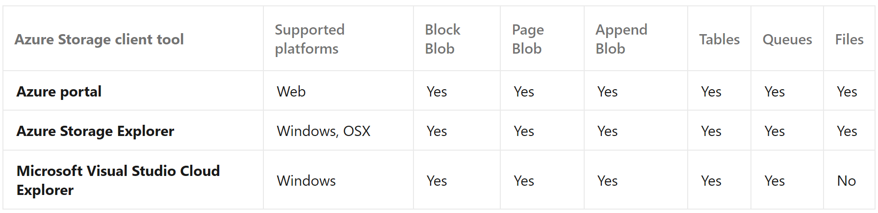

Tools for Working with Azure Storage
Linux
Storage Explorer is available in the Snap Store for most common distributions of Linux. We recommend Snap Store for this installation. The Storage Explorer snap installs all of its dependencies and updates when new versions are published to the Snap Store.
For supported distributions, see the snapd installation page.

Slide 11
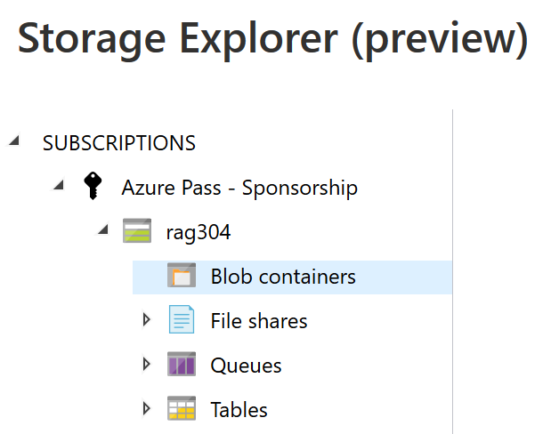
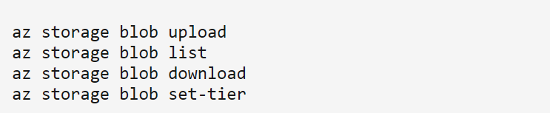
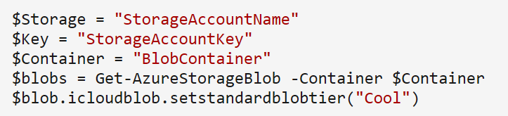
Demonstration - Manage Tiered Storage using Azure Tools
In this demonstration, you'll compare the methods for configuring and managing storage tiers using Azure tools.
There are several tools available to manage Azure Storage:
Azure portal
Azure Storage Explorer
Azure CLI
Azure PowerShell

Slide 12
Module 7 Review Questions

Slide 13
Online Role-based training resources: Microsoft Learn https://docs.microsoft.com/en-us/learn/

Slide 14
Thank you.

