Slide 1
AZ-304: Microsoft Azure Architect Design

Slide 2
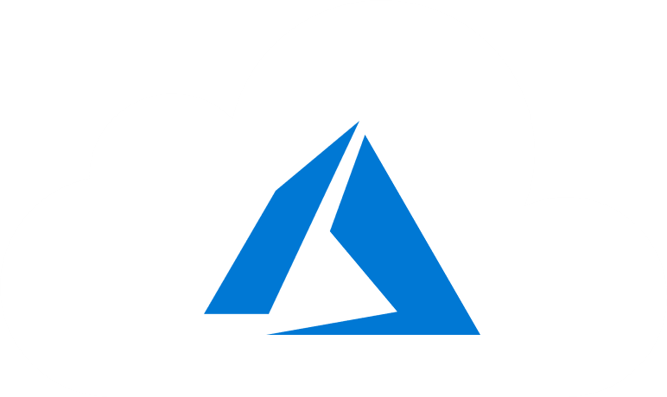
Course Outline
Module 1: Design a Compute Solution
Module 2: Design a Network Solution
Module 3: Design for Migration
Module 4: Design Authentication and Authorization
Module 5: Design Governance
Module 6: Design a Solution for Databases
Module 7: Select an Appropriate Storage Account
Module 8: Design Data Integration
Module 9: Design a Solution for Logging and Monitoring
Module 10: Design a Solution for Backup and Recovery
Module 11: Design for High Availability
Module 12: Design for Cost Optimization
Module 13: Design an Application Architecture
Module 14: Design Security for Applications
NOTE: The module order listed above aligns with the learning objectives described on the AZ-304: Microsoft Azure Architect Design certification page.

Slide 3
Module 11: Design for High Availability
Solutions for Applications in Multiple Azure Regions for High Availability

Slide 4
Learning Objectives
High Availability
Applications in Multiple Azure Regions for High Availability
Design HA Applications to Handle Disaster Recovery
Module Review Questions

Slide 5
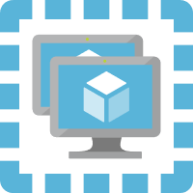
High Availability
See: Building solutions for high availability using Availability Zones

Slide 6
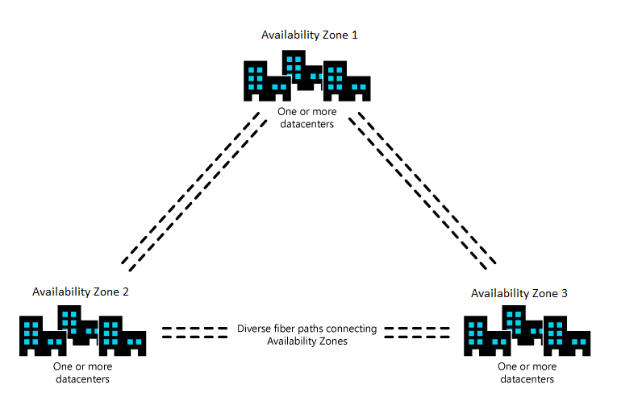
Building Solutions for High Availability using Availability Zones
Availability Zones are unique physical locations within an Azure region
A zone is made up of one or more datacenters with independent power, cooling, and networking
The physical separation of Availability Zones within a region limits the impact to applications
Zones are designed to support services, capacity, and availability from other zones in the region
Notes:
Availability Zones are unique physical locations within an Azure region.
Each zone is made up of one or more datacenters with independent power, cooling, and networking.
The physical separation of Availability Zones within a region limits the impact to applications and data from zone failures (large-scale flooding, major storms, and other events).
Associated datacenters are designed if one zone is compromised, then services, capacity, and availability are supported by the other Availability Zones in the region.

Slide 7


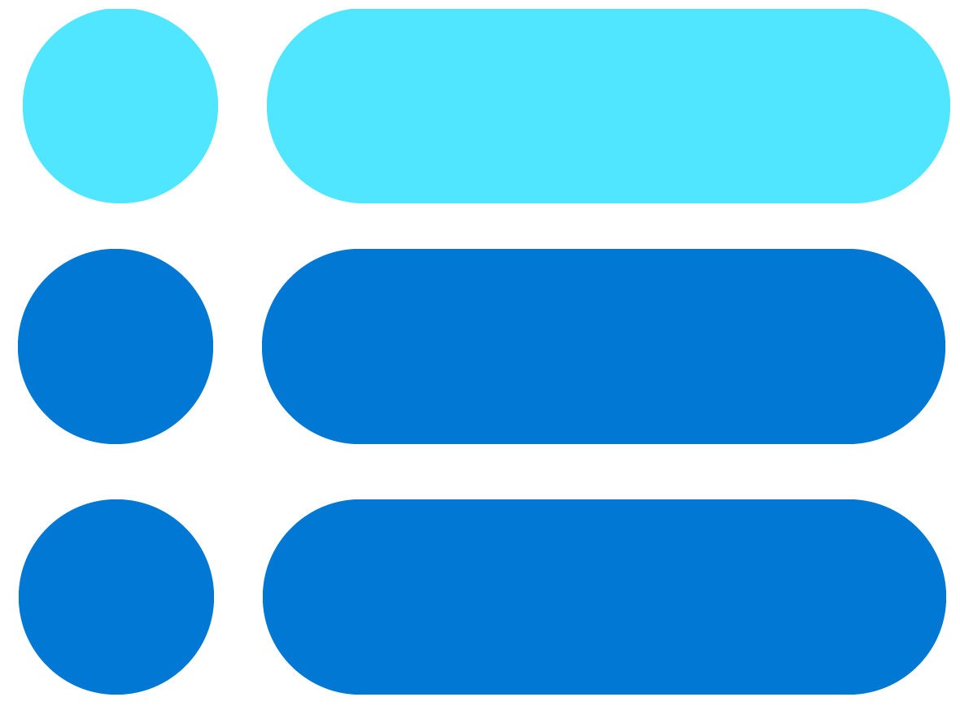
Delivering Reliability in Azure
Designing solutions that continue to function despite failure is key to improving the reliability
Resilient foundation
Resilient services
Resilient applications
Foundation is the Microsoft investment in the platform, including Availability Zones
Services support high availability, such as zone-redundant storage (ZRS)
Applications should be architected to support resiliency

Slide 8
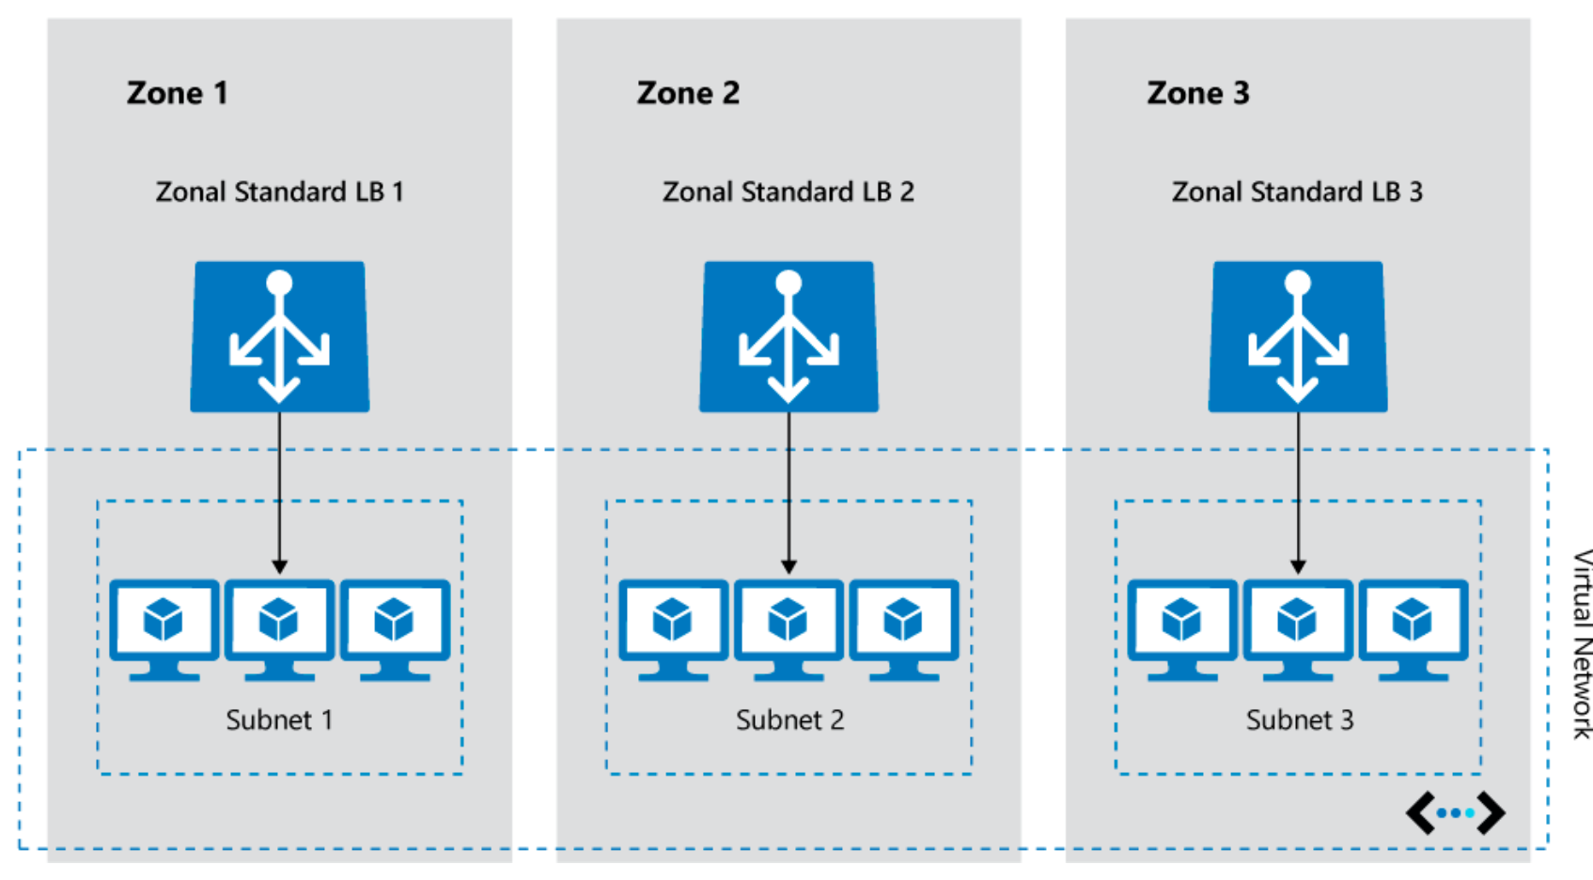
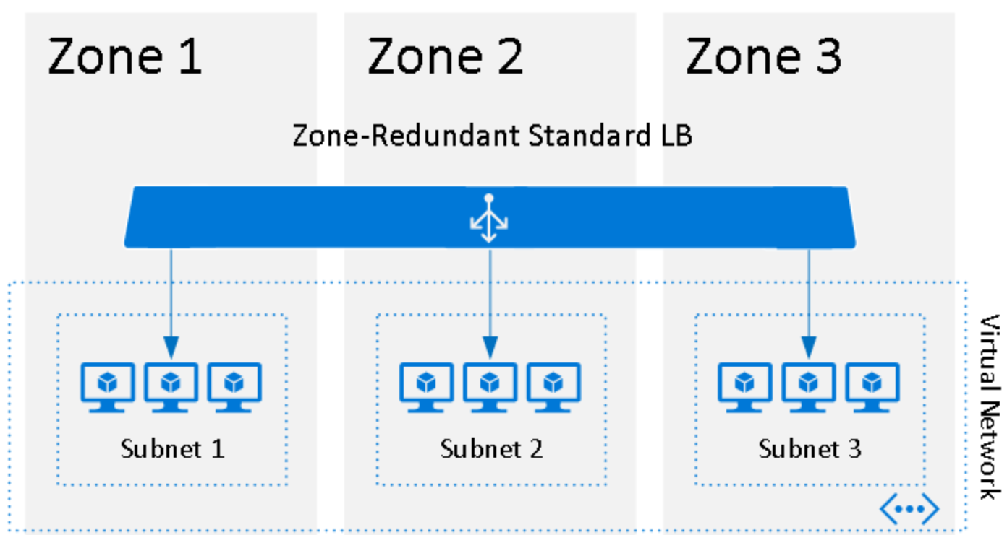
Zonal vs. Zone-Redundant Architecture
Individual load balancers deployed to specific zones
Zone-redundant load balancer
See: Zonal vs. zone-redundant architecture

Slide 9
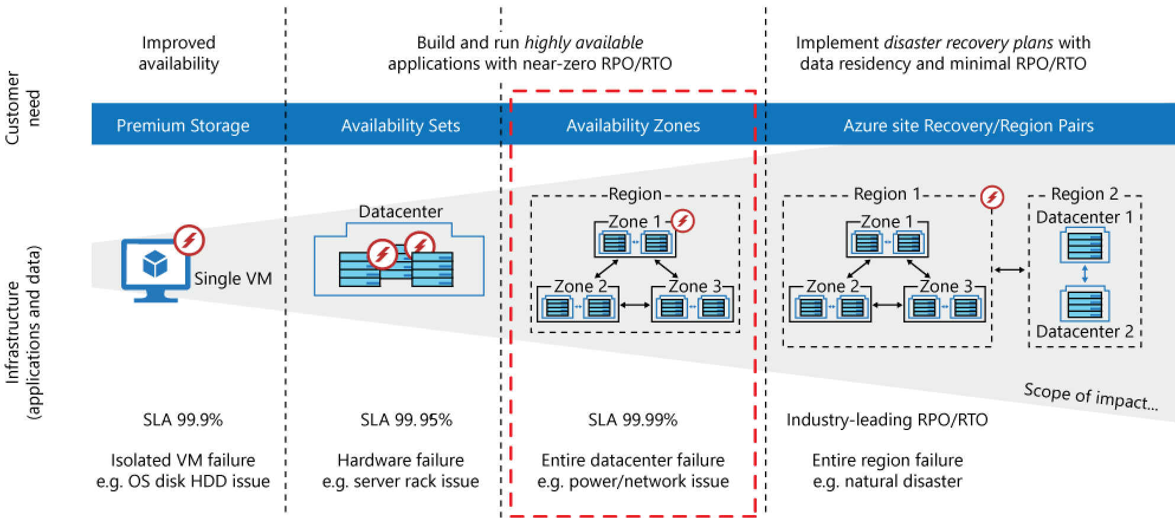
SLA Offered by Availability Zones
High Availability offered by a single VM, Availability Sets, and Availability Zones

Slide 10
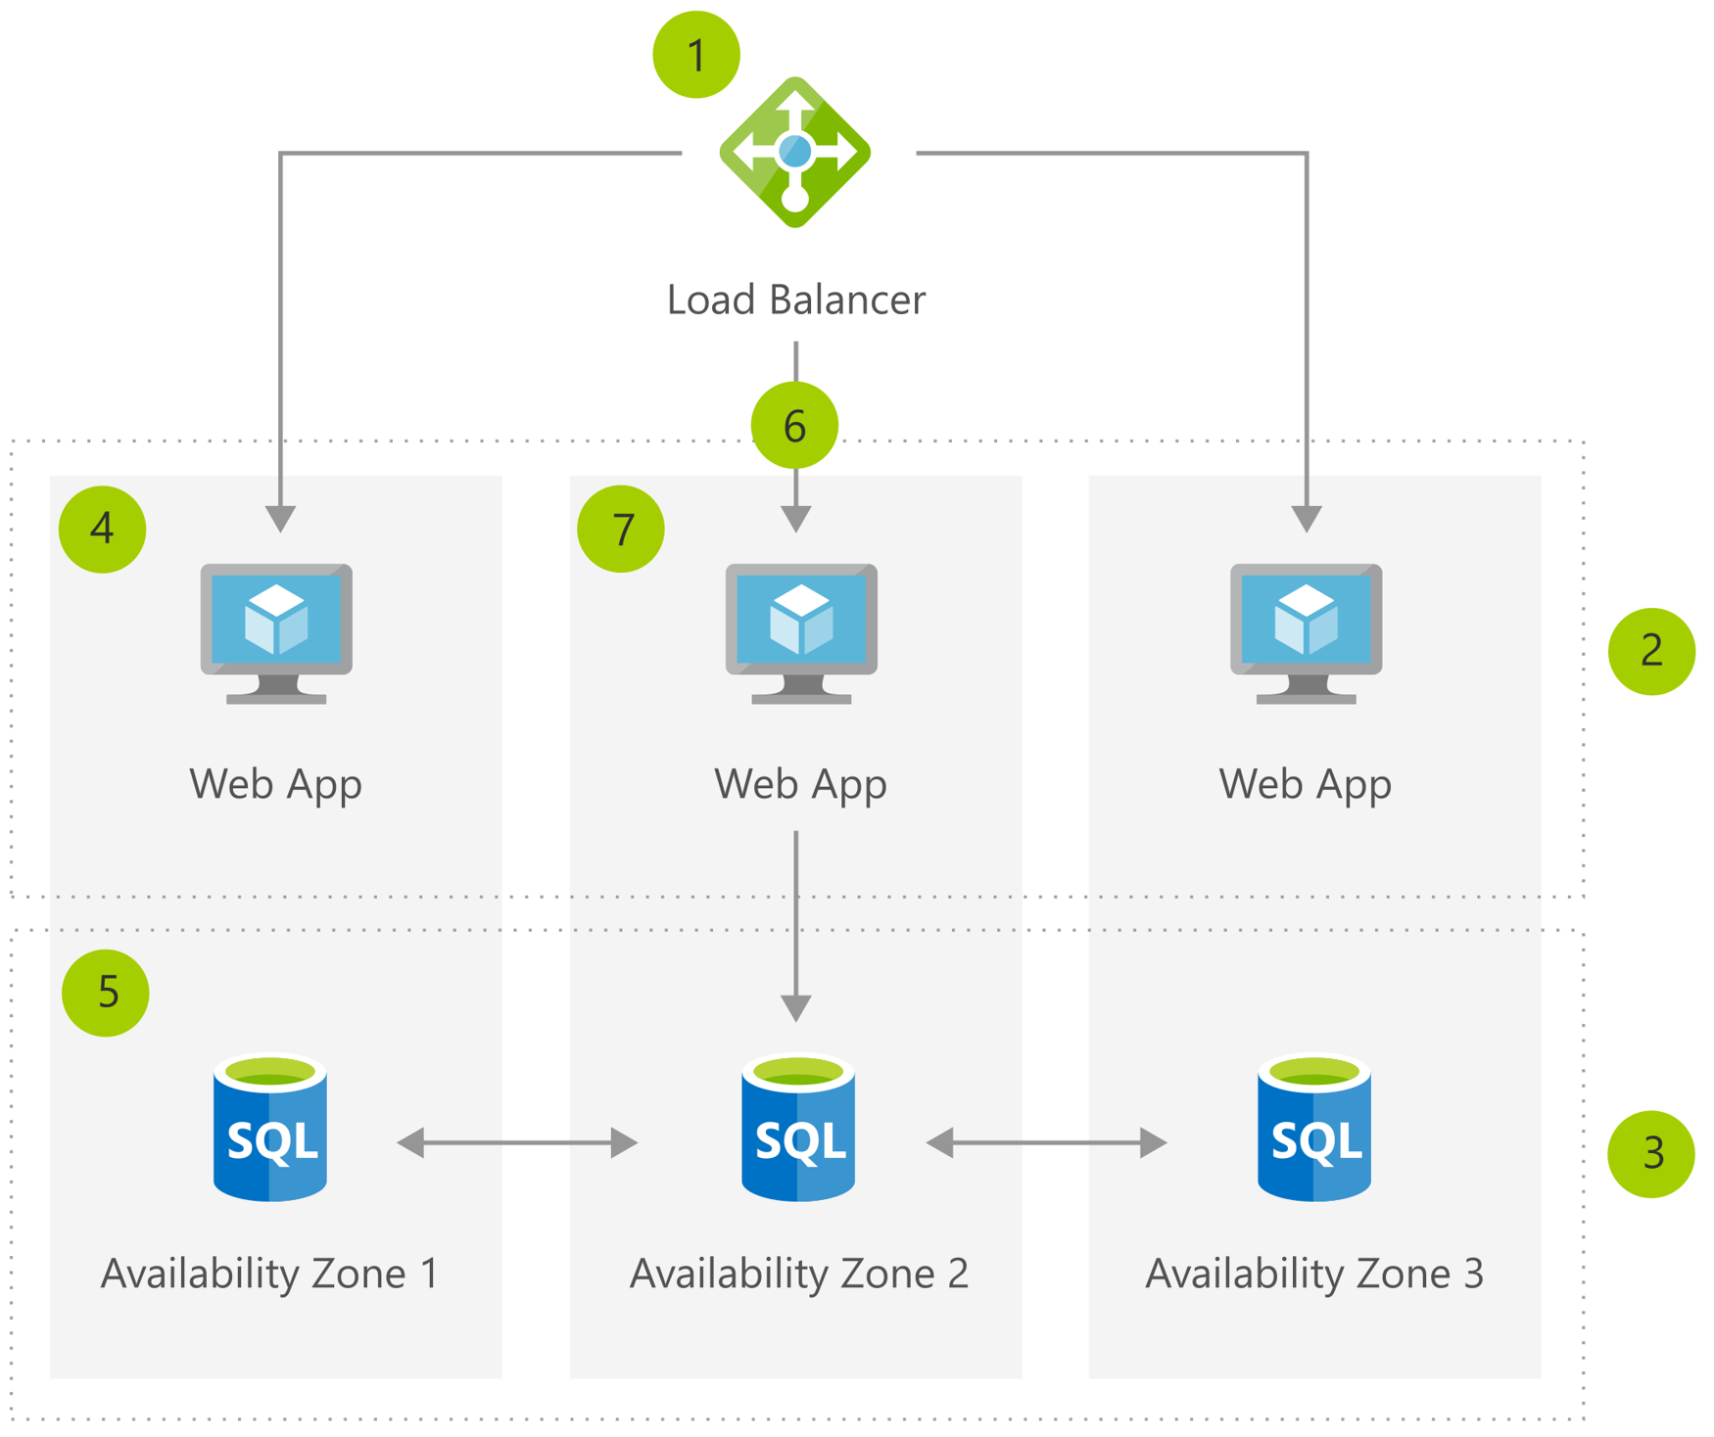
High Availability for Business Continuity and Disaster Recovery
Create zone-redundant Load Balancer
Create front-end subnet
Create DB subnet
Create VMs in three Availability Zones
Configure zone-redundant SQL DB
Add VMs to the load balancer's back-end pool
Deploy your application on VMs for redundancy and high availability

Slide 11
Applications in Multiple Azure Regions for High Availability

Slide 12
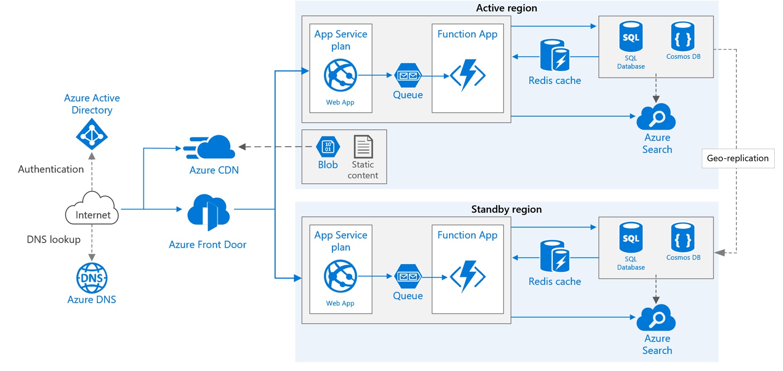
Multiple Azure Regions for High Availability
Primary and secondary regions
Front Door
Geo-replication
Recommendations:
Regional pairing
Resource groups
Front Door configuration
Routing
Health probe
See: Recommendations
Notes:
https://docs.microsoft.com/en-us/azure/architecture/reference-architectures/app-service-web-app/multi-region
Primary and secondary regions. Two regions to achieve higher availability. The application is deployed to each region.
Front Door. Routes incoming requests to the primary region. If the application running that region becomes unavailable, Front Door fails over to the secondary region.
Geo-replication of SQL Database and/or Cosmos DB.
Recommendations:
Regional pairing
Each Azure region is paired with another region within the same geography
Choose regions from the same regional pair
Resource groups
Place the primary region, secondary region, and Traffic Manager into separate resource groups—manage the resources deployed to each region as a single collection.
Front Door configuration
Routing. Front Door sends all requests to the primary region unless the endpoint for the region becomes unreachable—it so, it automatically fails over to the secondary region.
Set the backend pool with different priority values, 1 for the active region and 2 or higher for the standby or passive region.
Health probe. Front Door uses an HTTP (or HTTPS) probe to monitor the availability of each back end.
The probe gives Front Door a pass/fail test for failing over to the secondary region.

Slide 13
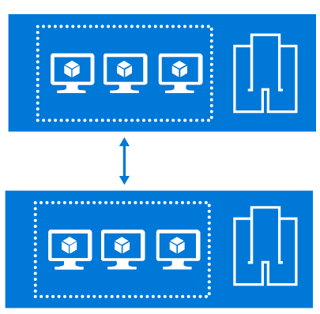


Multi-Region High Availability Recommendations
Regional pairing
Resource groups
Front Door configuration
Routing
Health probe
Notes:
Regional pairing
Each Azure region is paired with another region within the same geography
Choose regions from the same regional pair
Resource groups
Place the primary region, secondary region, and Traffic Manager into separate resource groups so you can manage the resources deployed to each region as a single collection.
Front Door configuration
Routing. Front Door sends all requests to the primary region unless the endpoint for the region becomes unreachable. At this point, it automatically fails over to the secondary region.
Set the backend pool with different priority values, 1 for the active region and 2 or higher for the standby or passive region.
Health probe. Front Door uses an HTTP (or HTTPS) probe to monitor the availability of each back end.
The probe gives Front Door a pass/fail test for failing over to the secondary region.

Slide 14
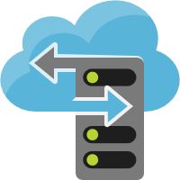
RA-GRS Storage
If outage on primary region: possible to read from secondary RA-GRS
If regional outage: Azure will fail-over to secondary region
Asynchronous data replication: On fail-over, data-loss is possible if unable to read from primary region
Transient failures, such as network, will not trigger a storage fail-over
Notes:
If a storage outage occurs, there is a time when no write-access to the data occurs—it is possible to read from the secondary endpoint during the outage.
If a regional outage affects the primary location and the data there cannot be recovered, the Azure Storage team will perform a geo-failover to the secondary region.
Data replication to the secondary region is performed asynchronously. Therefore, if a geo-failover is performed, some data loss is possible if the data can't be recovered from the primary region.
Transient failures, such as a network outage, will not trigger a storage failover. Design your application to be resilient to transient failures.
https://docs.microsoft.com/en-us/azure/architecture/reference-architectures/app-service-web-app/multi-region#storage

Slide 15
Design HA Applications to Handle Disaster Recovery

Slide 16
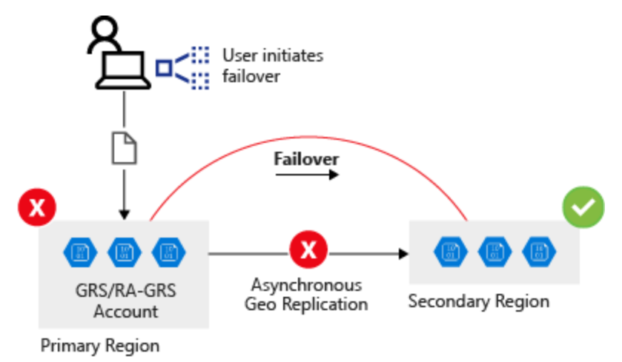
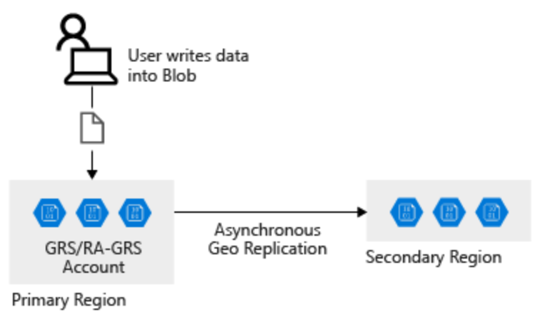
Design HA Applications to Handle Disaster Recovery
The client writes data to the primary endpoint or region.
Data is automatically replicated across to the secondary region.
Failover occurs, the secondary region becomes your new primary region,
Data is accessible from this new primary region.

Slide 17
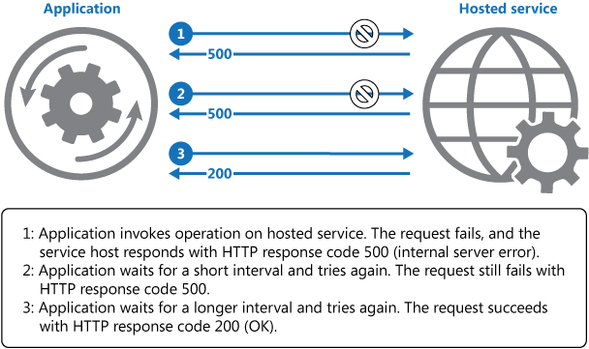
Best Practices for Cloud-based Applications with RA-GRS
Retry transient failures
Handle failed writes
Applications using the Azure Storage client library can set the LocationMode for a read request to one of the following values:
PrimaryOnly
PrimaryThenSecondary
SecondaryOnly
SecondaryThenPrimary
Notes:
Retry transient failures
Possible causes of transient failures include disconnected database, temporary loss of network, or latency issues that slow service response times.
Applications must detect the faults and be able to retry a service if the fault is transient before to listing it as failed.
Handle failed writes
RA-GRS replicates writes across locations. If the primary location fails, direct read operations toward the secondary location.
The secondary location is read-only.
For extended outages (more than a few seconds) at the primary location, the application must run in read-only mode.
Applications using the Azure Storage client library can set the LocationMode for a read request to one of the following values:
PrimaryOnly: The read request fails if the primary location is unavailable.
PrimaryThenSecondary: Try the primary location first, and then try the secondary location. Fail if the secondary location is also unavailable.
SecondaryOnly: Try only the secondary location and fail if it's not available.
SecondaryThenPrimary: Try the secondary location first, and then try the primary location.
Graphic:
https://docs.microsoft.com/en-us/azure/architecture/patterns/retry
The diagram illustrates invoking an operation in a hosted service using this pattern. If the request is unsuccessful after a predefined number of attempts, the application should treat the fault as an exception and handle it accordingly.

Slide 18

The Circuit Breaker Pattern
Forces the application to fail over to a secondary site allowing the application to resume its normal service.
Continues to check if primary site are back online
Allows the application to reconnect to the primary site
Acts as a proxy
Difference between the Circuit Breaker pattern and the Retry pattern
Retry pattern allows an application to keep retrying
Circuit Breaker pattern prevents this behavior and fails over the application to the secondary connection.
Notes:
Forces the application to fail over to a secondary site—allowing the application to resume its normal service.
Continues to check if primary site are back online
It allows the application to reconnect to the primary site.
Acts as a proxy. It monitors the service, and if there's a failure in the service, it prevents the application from retrying the endpoint and forces it to go to an alternative endpoint.
Difference between the Circuit Breaker pattern and the Retry pattern
The Retry pattern allows an application to keep retrying a connection to a resource, which might be offline.
The Circuit Breaker pattern prevents this behavior and fails over the application to the secondary connection.

Slide 19

Module 11 Review Questions

Slide 20
Online Role-based training resources: Microsoft Learn https://docs.microsoft.com/en-us/learn/

Slide 21
Thank you.

