Slide 1
AZ-304: Microsoft Azure Architect Design

Slide 2
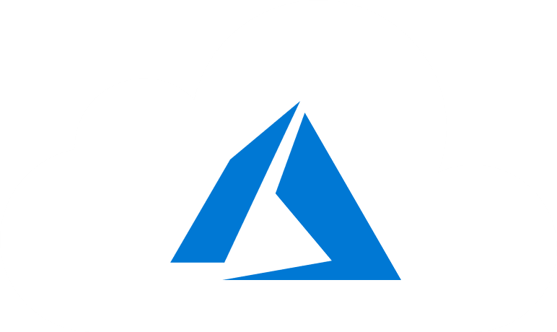
Course Outline
Module 1: Design a Compute Solution
Module 2: Design a Network Solution
Module 3: Design for Migration
Module 4: Design Authentication and Authorization
Module 5: Design Governance
Module 6: Design a Solution for Databases
Module 7: Select an Appropriate Storage Account
Module 8: Design Data Integration
Module 9: Design a Solution for Logging and Monitoring
Module 10: Design a Solution for Backup and Recovery
Module 11: Design for High Availability
Module 12: Design for Cost Optimization
Module 13: Design an Application Architecture
Module 14: Design Security for Applications
NOTE: The module order listed above aligns with the learning objectives described on the AZ-304: Microsoft Azure Architect Design certification page.

Slide 3
Module 13: Design an Application Architecture
Solutions for Event-Based Cloud Automation, Microservices, and APIs on Azure

Slide 4
Learning Objectives
Recommend Event-Based Cloud Automation on Azure
Microservices Architecture on Azure Service Fabric
Designing APIs for Microservices
Lab: Implement Azure Logic Apps Integration with Azure Event Grid
Module Review Questions

Slide 5

Recommend Event-Based Cloud Automation on Azure

Slide 6
Event-Based Cloud Automation on Azure
Scenario 1: Cost center tagging
This implementation tracks the cost centers of each Azure resource
Azure Policy service tags new resources in a group with a default cost center ID
Event Grid monitors resource creation events, and then calls an Azure function
The function interacts with Azure Active Directory and validates the cost center ID for the new resource
If different, it updates the tag and sends out an email to the resource owner
Scenario 2: Throttling response
This implementation monitors a Cosmos DB database for throttling
Azure Monitor alerts are triggered when data access requests to CosmosDB exceed the capacity in Request Units (or RUs)
Azure Monitor action group calls the automation function in response to alerts
The function scales the RUs to a higher value, increasing the capacity and in turn stopping the alerts
Notes:
Scenario 1: Cost center tagging: This implementation tracks the cost centers of each Azure resource.
Azure Policy service tags new resources in a group with a default cost center ID.
Event Grid monitors resource creation events, and then calls an Azure function.
The function interacts with Azure Active Directory and validates the cost center ID for the new resource.
If different, it updates the tag and sends out an email to the resource owner.
Scenario 2: Throttling response: This implementation monitors a Cosmos DB database for throttling.
Azure Monitor alerts are triggered when data access requests to CosmosDB exceed the capacity in Request Units (or RUs).
Azure Monitor action group calls the automation function in response to alerts.
The function scales the RUs to a higher value, increasing the capacity and in turn stopping the alerts.

Slide 7
Patterns in Event-Based Automation
Respond to events on resources
Scheduled tasks
Process Azure alerts
Orchestrate with external systems
Expose as a web hook or API
Create ChatOps interface
Notes:
Respond to events on resources. Responses to events such as an Azure resource or resource group getting created, deleted, changed, and so on. Uses Event Grid to trigger the function for such events.
Scheduled tasks. These are typically maintenance tasks executed using timer-triggered functions.
Process Azure alerts. Leverages integrating Azure Monitor alerts and action groups with Azure Functions.
Orchestrate with external systems. Enables integration with external systems, using Logic Apps to orchestrate the workflow.
Expose as a web hook or API. Automation tasks using Azure Functions can be integrated into third-party applications or even command-line tools, by exposing the function as a web hook/API using HTTP trigger.
Create ChatOps interface. Creates a chat-based operational interface and run development and operations functions and commands in-line with human collaboration.

Slide 8

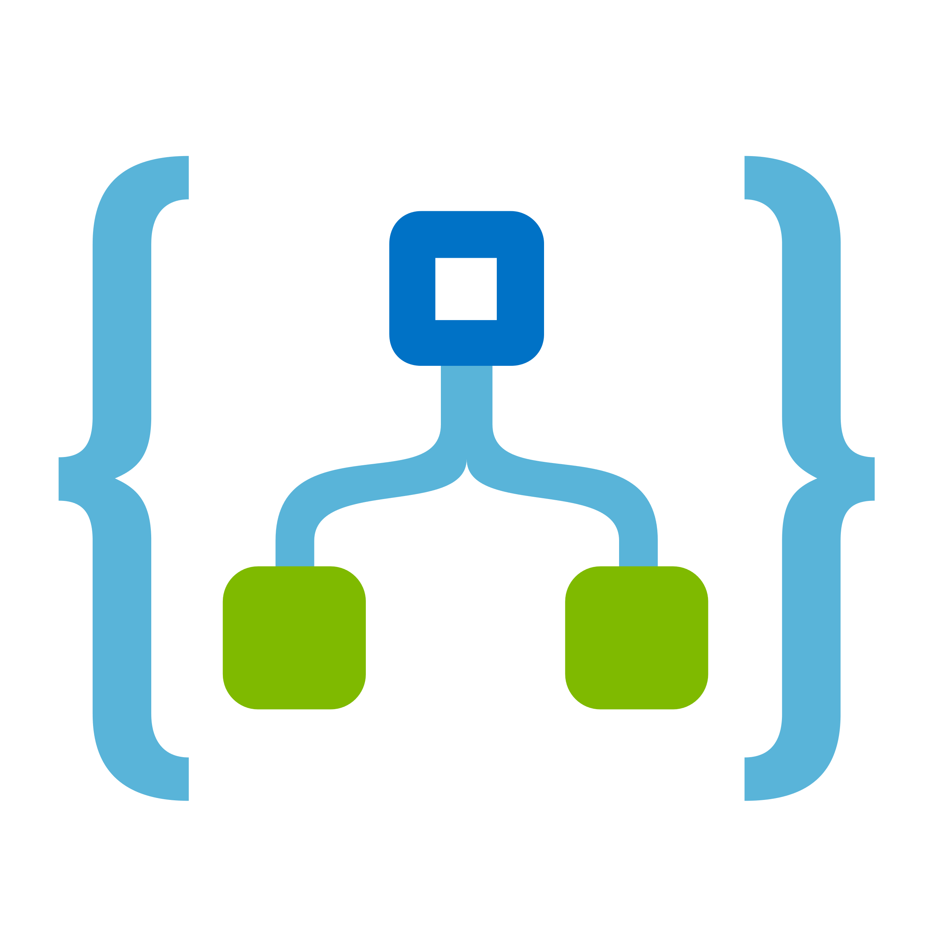
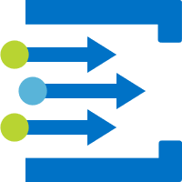

Architecture
The architecture consists of the following blocks:
Azure Functions. Provide the event-driven, serverless compute capabilities in this architecture. A function performs automation tasks, when triggered by events or alerts.
Logic Apps. Used to perform simpler tasks, easily implemented using the built-in connectors. Tasks can range from email notifications, to integrating with external management applications.
Event Grid. Built-in support for events from other Azure services, as well as custom events (also called custom topics).
Azure Monitor. Alerts can monitor for critical conditions, and take corrective action using Azure Monitor action groups.
Automation action. Represents other services that a function can interact with, to provide the automation functionality.
Notes:
https://docs.microsoft.com/en-us/azure/azure-functions/functions-overview
https://docs.microsoft.com/en-us/azure/logic-apps/logic-apps-overview
https://docs.microsoft.com/en-us/azure/event-grid/overview
https://docs.microsoft.com/en-us/azure/azure-monitor/overview
https://docs.microsoft.com/en-us/azure/automation/automation-intro

Slide 9
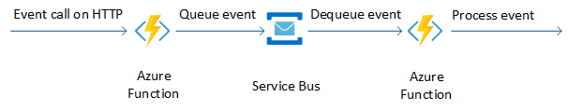
Resiliency
Azure Functions: To avoid HTTP timeouts for a longer automation task, queue the event in a Service Bus, and handle the actual automation in another function.
Event Grid: Check if there are a high volume of generated events… enough to clog the grid. The cost center workflow does not implement additional checks for this, because it only watches for resource creation events in a resource group.
Azure Monitor: If many alerts are generated, and the automation updates Azure resources, throttling limits of the Azure Resource Manager might be reached. Avoid this situation by limiting the frequency of alerts getting generated by the Azure Monitor.
Notes:
https://docs.microsoft.com/en-us/azure/architecture/reference-architectures/serverless/cloud-automation#handle-http-timeouts

Slide 10
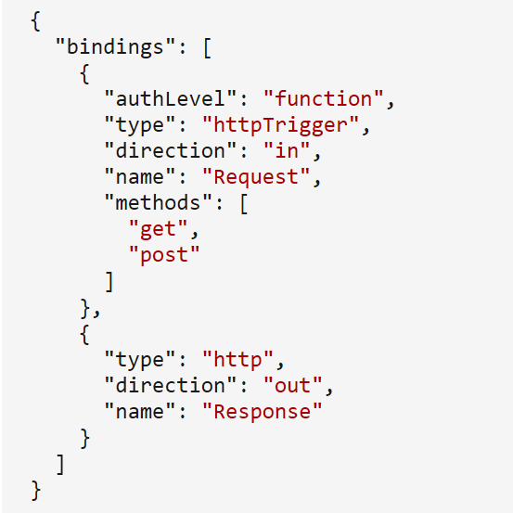
Security
Control access to the function
Restrict access to an HTTP-triggered function by setting the authorization level. With anonymous authentication, the function is accessible with a URL:
http://<APP_NAME>.azurewebsites.net/api/<FUNCTION_NAME>
Control function access
Managed identities for Azure resources simplifies how a function authenticates and accesses other Azure resources and services.
The code does not need to manage the authentication credentials because it is managed by Azure AD.
Two types of managed identities:
System-assigned managed identities: Created as part of the Azure resource and cannot be shared among multiple resources. These get deleted when the resource is deleted.
User-assigned managed identities: Created as stand-alone Azure resources. These can be shared across multiple resources and need to be explicitly deleted.
Notes:
https://docs.microsoft.com/en-us/azure/architecture/reference-architectures/serverless/cloud-automation#control-access-to-the-function
https://docs.microsoft.com/en-us/azure/architecture/reference-architectures/serverless/cloud-automation#control-what-the-function-can-access
https://docs.microsoft.com/en-us/azure/app-service/overview-managed-identity?tabs=dotnet#add-a-system-assigned-identity
https://docs.microsoft.com/en-us/azure/app-service/overview-managed-identity?tabs=dotnet#add-a-user-assigned-identity

Slide 11
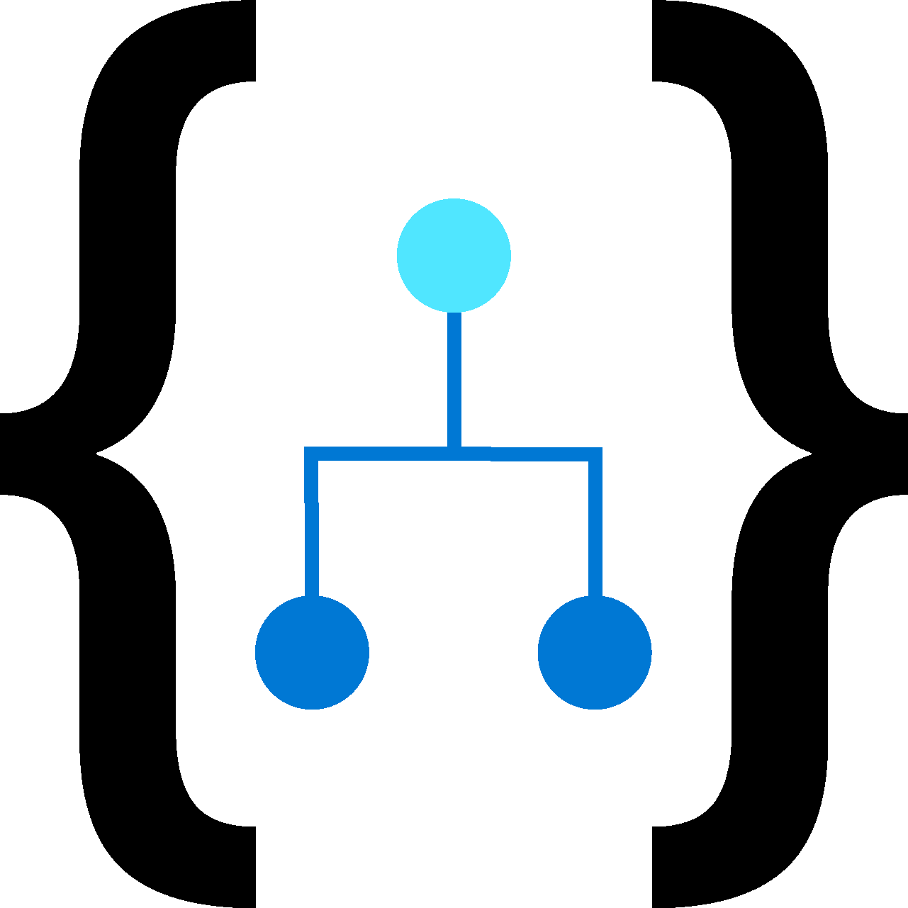


Costs
Azure Logic Apps
App Service plan
Pay-as-you-go/fixed pricing models
Azure Functions
Consumption plan
Premium plan
Azure Cosmos DB

Slide 12

Microservices Architecture on Azure Service Fabric

Slide 13
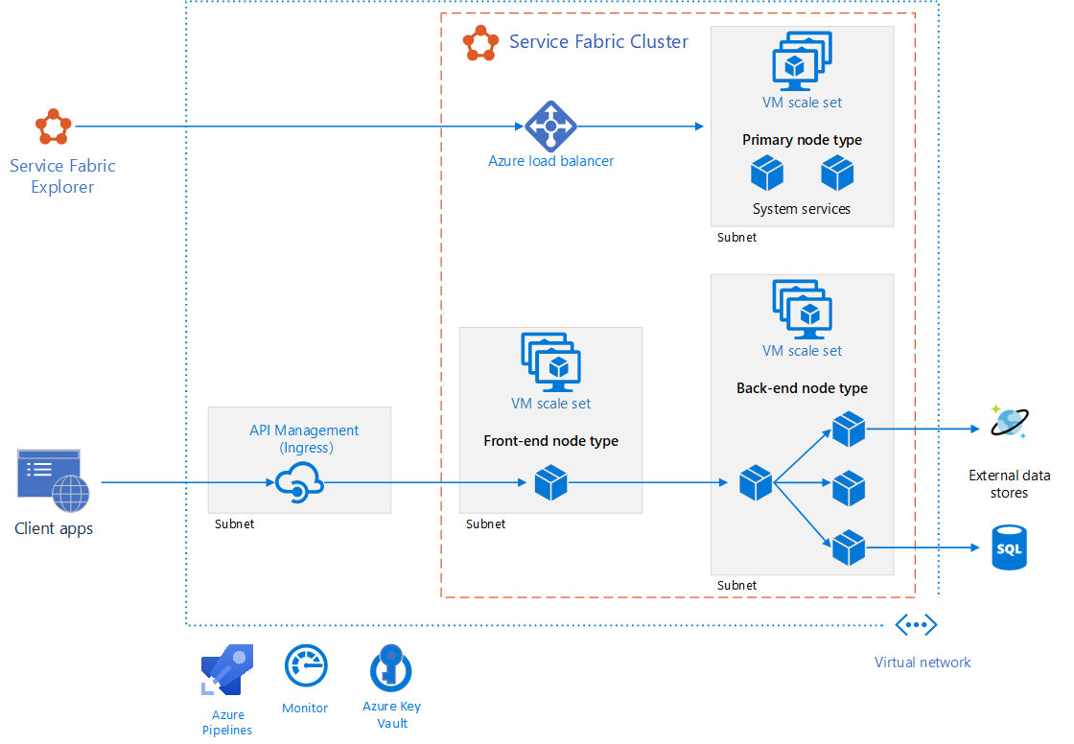
Microservices Architecture on Azure Service Fabric
Reference architecture of a cluster configuration used as a deployment starting point
See: https://github.com/mspnp/microservices-reference-implementation-servicefabric

Slide 14


Architecture
Service Fabric cluster
Virtual machine scale sets
Nodes
Node types
Services
Service Fabric Explorer
Azure Pipelines
Azure Monitor
Azure Key Vault
Azure API Management
Notes:
Service Fabric cluster. Network-connected set of virtual machines (VMs) into which your microservices are deployed and managed.
Virtual machine scale sets. Can create and manage a group of identical, load balanced, and autoscaling VMs.
Nodes. The nodes are the VMs that belong to the Service Fabric cluster.
Node types. Represents a virtual machine scale set that deploys a collection of nodes. One must be declared the Primary node type.
Services. Performs a standalone function that can start and run independently of other services. Instances of services get deployed to nodes in the cluster. Two types in Service Fabric: Stateless and Stateful service.
Service Fabric Explorer. For inspecting and managing Service Fabric clusters.
Azure Pipelines. Pipelines is part of Azure DevOps Services and runs automated builds, tests, and deployments.
Azure Monitor. Collects and stores metrics and logs, including platform metrics for the Azure services in the solution and application telemetry.
Azure Key Vault. Stores any application secrets used by the microservices, such as connection strings.
Azure API Management. In this architecture, API Management acts as an API gateway that accepts requests from clients and routes them to services.

Slide 15

Design
Discoverable through service discovery mechanisms
Each service is self-contained
Autoscaling, state management, and self-resilience
Application is a collection of microservices described in an application manifest file
An API gateway (ingress) routes requests from clients to microservices
Notes:
https://docs.microsoft.com/en-us/azure/architecture/reference-architectures/microservices/service-fabric#design-considerations

Slide 16
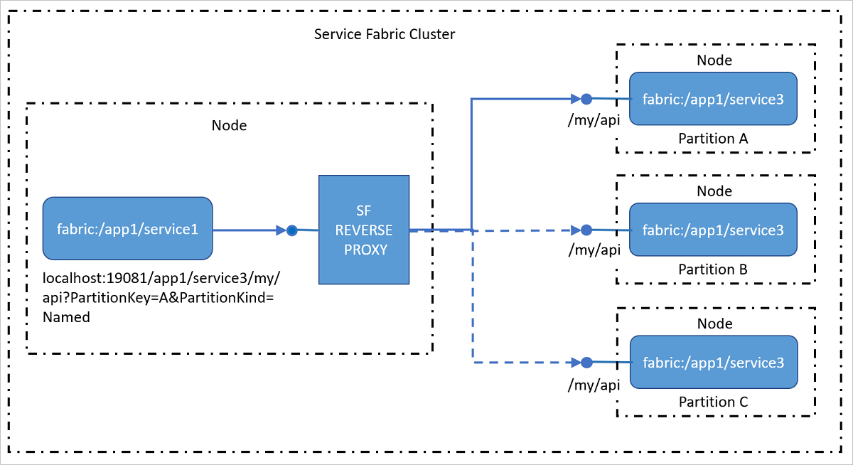
Interservice Communication
Communication protocol - HTTP supports a wide range of tools and HTTP servers available in different languages, all supported by Service Fabric
Service discovery – Service Fabric Naming Service and built-in reverse proxy service

Slide 17
Designing APIs for Microservices

Slide 18
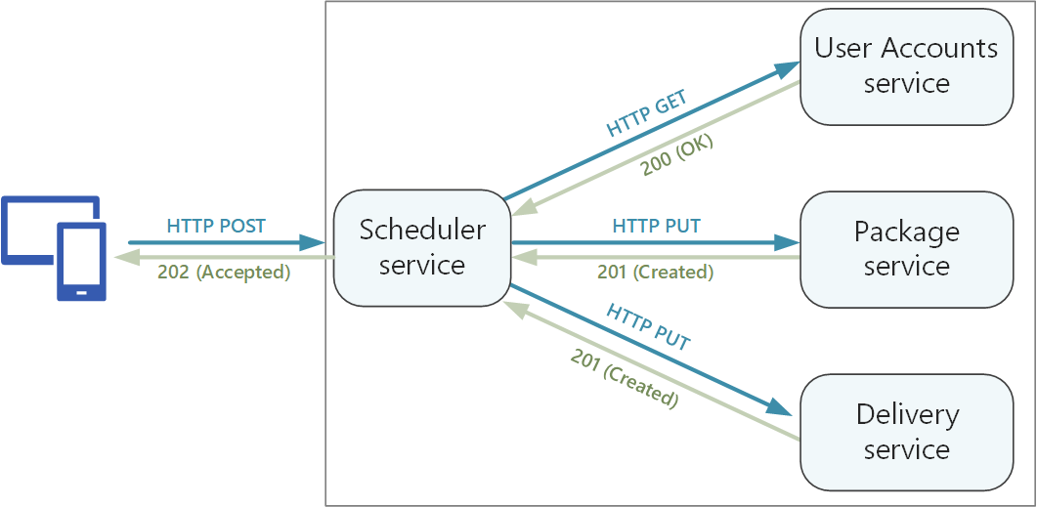
Designing APIs for Microservices
Two types of APIs:
Public APIs that client applications call
Must be compatible with client applications (browser applications or native mobile applications)
Use REST over HTTP
Backend APIs that are used for interservice communication
Backend APIs affect network performance
Notes:
https://docs.microsoft.com/en-us/azure/architecture/microservices/design/api-design

Slide 19

Further Considerations
Tradeoffs between using a REST-style interface or an RPC-style interface.
REST: Defines a uniform interface based on HTTP verbs. Includes well-defined semantics for idempotency, side effects, and response codes.
RPC: Based on operations or commands. RPC interfaces can affect the design with overly chatty APIs.
Most common choice is REST over HTTP using JSON for a RESTful interface.
For RPC-style interfaces, use gRPC, Apache Avro, and Apache Thrift.
In general, gRPC-based interfaces are faster than REST over HTTP.
Baseline recommendation: Choose REST over HTTP unless you need the performance benefits of a binary protocol. REST over HTTP requires no special libraries.

Slide 20
Lab - Implement Azure Logic Apps Integration with Azure Event Grid

Slide 21
Lab - Azure Logic Apps Integration with Azure Event Grid
After completing this lab, you will be able to:
Integrate Azure Logic Apps with Event Grid
Trigger execution of Logic Apps in response to an event representing a change to a resource within a resource group

Slide 22
Lab: Implementing Azure SQL Database-Based Applications
After completing this lab, you will be able to:
Implement serverless tier of Azure SQL Database
Configure .NET Core-based console apps that use Azure SQL Database as their data store

Slide 23
Module 13 Review Questions

Slide 24
Online Role-based training resources: Microsoft Learn https://docs.microsoft.com/en-us/learn/

Slide 25
Thank you.

