Slide 1
AZ-305T00A Designing Microsoft Azure Infrastructure Solutions

Slide 2
Module 01: Design a governance solution

Slide 3
Introduction
Design for governance
Design for management groups
Design for Azure subscriptions
Design for resource groups
Design for resource tagging
Design for Azure Policy and RBAC
Design with Azure Blueprints
Case study
Summary and resources
AZ-305: Design Identity, Governance, and Monitoring Solutions (25-30%)
Design Governance
Recommend an organizational and hierarchical structure for Azure resources
Recommend a solution for enforcing and auditing compliance
Notes:
Exam page - https://docs.microsoft.com/learn/certifications/exams/az-305
Prerequisites
- Conceptual knowledge of governance policies, resource organization, and subscription management.
- Working experience with organizing resources, applying governance policies, and enforcing compliance requirements.

Slide 4

Design for governance

Slide 5







Govern resources in Azure
Governance provides mechanisms and processes to maintain control over your applications and resources in Azure.
Overview
Tenant root group
Governance provides mechanisms and processes to maintain control over your applications and resources in Azure.
Governance involves determining your requirements, planning your initiatives, and setting strategic priorities.
Management
groups
Subscriptions
A typical Azure hierarchy has four levels:
Resource
groups
Management groups
Subscriptions
Resource groups
Resources
Resources
Notes:
Azure governance documentation - https://docs.microsoft.com/azure/governance/
Overview of Azure subscriptions, management groups, and resources - https://docs.microsoft.com/learn/modules/azure-architecture-fundamentals/overview
Organize your Azure resources effectively - https://docs.microsoft.com/azure/cloud-adoption-framework/ready/azure-setup-guide/organize-resources?tabs=AzureManagementGroupsAndHierarchy
Stay at high level there are slides for item in the hierarchy. Review why governance is important.
Management groups help you manage access, policy, and compliance for multiple subscriptions.
Subscriptions are logical containers that serve as units of management and scale. Subscriptions are also billing boundaries.
Resource groups are logical containers into which Azure resources are deployed and managed.
Resources are instances of services that you create. For example, virtual machines, storage, and SQL databases.

Slide 6
Design for management groups

Slide 7
Plan your management groups
Management groups manage access, policy, and compliance for multiple subscriptions.
Keep the management group hierarchy reasonably flat
Consider a top-level management group
Consider an organizational or departmental structure
Consider a geographical structure
Consider a production management group
Consider a sandbox management group
Consider isolating sensitive information in a separate management group
Tenant root group
Tailwinds
Sales
Corporate
IT
Production
Notes:
What are Azure management groups? - https://docs.microsoft.com/azure/governance/management-groups/overview
Manage resources with Azure management groups - https://docs.microsoft.com/azure/cloud-adoption-framework/migrate/azure-best-practices/migrate-best-practices-security-management#best-practice-manage-resources-with-azure-management-groups

Slide 8

Design for Azure subscriptions

Slide 9


Designing for multiple subscriptions
Azure subscription are logical containers for management and billing.
Align your subscriptions with business needs and priorities – consider billing and cost reporting
Consider subscription scale limits – specialized workloads, IoT, SAP
Consider administrative management – centralized or decentralized
Consider a dedicated shared services subscription – common services everyone shares
Group subscriptions together under management groups – apply common policies and role assignments.
Make subscription owners aware of their roles and responsibilities
Notes:
Subscription decision guide - https://docs.microsoft.com/azure/cloud-adoption-framework/decision-guides/subscriptions/
There next slide provides an example.

Slide 10
When to use subscriptions - example
Secure workloads that require additional policies and role-based access control to achieve compliance
Specialized workloads and the need to scale outside the subscription limits
Manage and track costs for your organizational structure
Identify different environments such as development, test, and production that are often isolated from a management perspective
Tenant root group
Tailwinds
Corporate
IT
HR
Legal
Production
R&D
App1
App2
Shared
Notes:
You may want to bring up that some resources, such as networking, don’t span subscriptions without special configuration. This is a specific example of how subscriptions can help with isolation and management.

Slide 11

Design for resource groups

Slide 12

Plan your resource groups
A resource group is a container that holds related resources for an Azure solution.
Single resource group
Multiple resource groups
RG1
RG1
RG2
RG3
Subscription A
Subscription A
Group resources that share the same life cycle
Group by type, app, department, location, or billing
Apply RBAC and policies to a group of resources
Use resource locks to protect individual resources from deletion or change
Notes:
What is Azure Resource Manager - https://docs.microsoft.com/azure/azure-resource-manager/management/overview
Name resource groups - https://docs.microsoft.com/azure/cloud-adoption-framework/migrate/azure-best-practices/migrate-best-practices-security-management#best-practice-name-resource-groups
Implement delete locks for resource groups - https://docs.microsoft.com/azure/cloud-adoption-framework/migrate/azure-best-practices/migrate-best-practices-security-management#best-practice-implement-delete-locks-for-resource-groups

Slide 13

Design for resource tagging

Slide 14
Plan your resource tagging
Resource tagging can be business-aligned or IT-aligned
Consider your organization’s taxonomy
Determine the reason for the tagging - functional, classification, accounting, partnership, or purpose
Start with a few tags (mission-critical resources) and then scale out
Policies could be used to apply tags and enforce tagging rules and conventions - mimic inheritance
Tenant root group
Tailwinds
Corporate
IT
HR
Legal
Production
R&D
Classification: Internal, NDA
App1
App2
Shared
Product: App1, App2, Shared
Notes:
Quick review – do not dwell and teach tags this is a WHY you should use tags.
Resource naming and tagging decision guide - https://docs.microsoft.com/azure/cloud-adoption-framework/decision-guides/resource-tagging/
Define your tagging strategy - https://docs.microsoft.com/azure/cloud-adoption-framework/ready/azure-best-practices/resource-tagging
Tag resources effectively - https://docs.microsoft.com/azure/cloud-adoption-framework/migrate/azure-best-practices/migrate-best-practices-security-management#best-practice-tag-resources-effectively
Resource tagging patterns - https://docs.microsoft.com/azure/cloud-adoption-framework/decision-guides/resource-tagging/?toc=/azure/azure-resource-manager/management/toc.json#resource-tagging-patterns
Tag limits: https://docs.microsoft.com/azure/azure-resource-manager/management/azure-subscription-service-limits
Discussion questions:
What are specific examples of leveraging tags? (cost reporting, targeting automation scripts, integrating with 3rd party applications, etc.)
Will you implement a chargeback or show back accounting system? Will you need to associate resources with accounting information for departments, business groups, and teams in more detail than a simple subscription-level breakdown allows?
Does tagging need to represent details such regulatory compliance requirements for a resource? What about operational details such as uptime requirements, patching schedules, or security requirements?
What tags will be required for all resources based on centralized IT policy? What tags will be optional? Are individual teams allowed to implement their own custom tagging schemes?

Slide 15

Design for Azure Policy and RBAC
Notes:
There are 2 Learn units, one for Policy and one for RBAC.

Slide 16

When to use Azure Policy
Azure Policy helps to enforce organizational standards and to assess compliance at-scale.
Virtual machines limited to certain SKUs
Enforce product tag and value
Production
Deploy only in certain locations – different for each app
Enable auditing and logging for SQL apps
App1
App2
Large number of built-in policies and you can create custom policies
Examples
Allow only certain virtual machines sizes for your project
Ensure all resources are correctly tagged – if not, apply the tag
Recommend system updates on your servers
Enable multifactor authentication for all subscription accounts
Notes:
What is Azure Policy -https://docs.microsoft.com/azure/governance/policy/overview
Azure Built-in Policy List - https://docs.microsoft.com/azure/governance/policy/samples/built-in-policies#general
There is a second slide on considerations.

Slide 17
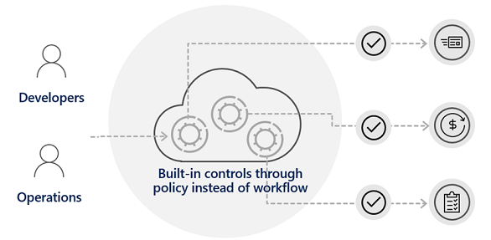
Considerations for Azure Policy
Apply policy at the highest scope possible
Know when policies are evaluated
Decide what to do if a resource is non-compliant
Consider when to automatically remediate non-compliant resources
Use the Azure policy compliance dashboard for auditing and review
Effectively combine Azure policy with RBAC (next slide)

Slide 18
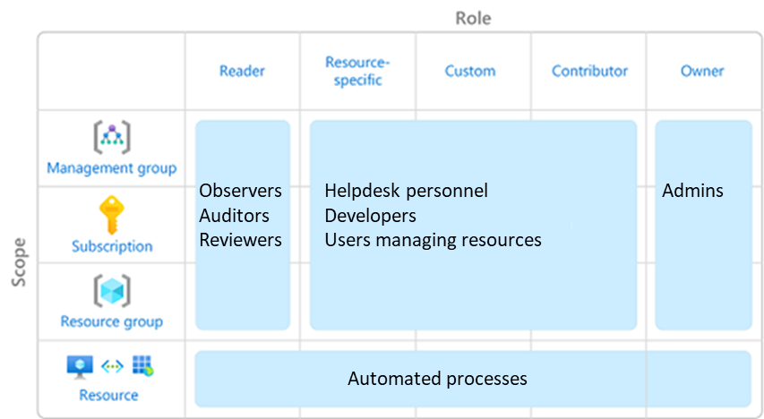
Design for Azure role-based access control (RBAC)
Azure RBAC allows you to grant access to Azure resources that you control.
Only grant users the access they need
Assign at the highest scope level that meets the requirements
Assign roles to groups, not users
Know when to create a custom role
Consider what happens if you have overlapping role assignments
Notes:
Only grant the access users need - https://docs.microsoft.com/azure/role-based-access-control/best-practices#only-grant-the-access-users-need
Understand resource access permissions - https://docs.microsoft.com/azure/cloud-adoption-framework/migrate/azure-best-practices/migrate-best-practices-security-management#best-practice-understand-resource-access-permissions
Limit the number of subscription owners - https://docs.microsoft.com/azure/role-based-access-control/best-practices#limit-the-number-of-subscription-owners
Use Azure AD Privileged Identity Management - https://docs.microsoft.com/azure/role-based-access-control/best-practices#use-azure-ad-privileged-identity-management
Assign roles to groups, not users - https://docs.microsoft.com/azure/role-based-access-control/best-practices#assign-roles-to-groups-not-users
Review subscriptions and resource permissions - https://docs.microsoft.com/azure/cloud-adoption-framework/migrate/azure-best-practices/migrate-best-practices-security-management#best-practice-review-subscriptions-and-resource-permissions
Discussion: How to allow some users to control the virtual machines in an environment but prevent them from modifying networking and other resources in the same resource group or Azure subscription? Create a role assignment through Azure role-based access control (Azure RBAC). Azure RBAC enables you to create roles that define access permissions. You might create one role that limits access only to virtual machines and a second role that provides administrators with access to everything.

Slide 19



When to combine Azure Policy and Azure RBAC
Deny
Cloud resource
Cloud resource
No
Yes
RBAC
Azure Policy
Deploy cloud resource
Does the Admin have the necessary rights?
Yes
Is a restricting policy defined?
No
Cloud resource
Azure Admin
RBAC examples
Does the Admin have the right to deploy?
Does the Admin have the right to deploy this resource type?
Does the Admin have the right to deploy this resource group?
Policy examples
Is the region restricted?
Is the resource type restricted?
Should a tag be applied?
Notes:
Discussion: How is policy different from RBAC? How do they complement one another?
RBAC examples
Does the Admin have the right to deploy? Contributor or owner.
Does the Admin have the right to deploy this resource type? VM contributor.
Does the Admin have the right to deploy this resource group.
Policy examples
Is the region restricted? US West or Europe.
Is the resource type restricted? Only virtual machines.
Should a tag be applied?

Slide 20

Design for Azure Blueprints

Slide 21

Design with Azure Blueprints
Azure Blueprints lets you define a repeatable set of governance tools and standard Azure resources that your organization requires.
Compose
Manage
Scale
ARM templates
Blueprints definition
Subscription A
Resource groups
Subscription B
Role-based access control
Blueprints assignment
Subscription C
Policy definitions
Notes:
Azure Blueprints - https://azure.microsoft.com/services/blueprints
Deploy Azure Blueprints - https://docs.microsoft.com/learn/modules/enterprise-governance/10-azure-blueprints
Discussion: How are Azure Blueprints different from Azure Policy? Blueprints is a set of standards, patterns, or requirements. A policy is focused on the properties of resources.
Discussion: How are Azure Blueprints different from templates? A template is a key building block (artifact) of a blueprint definition. All your existing templates can be used in new blueprints.
Example: Enable an organization's development team to rapidly provision and run new resources, in a repeatable way that is in line with the organization’s compliance requirements.

Slide 22
Review

Slide 23
Case study – Cost and accounting
Tailwind Traders has two main business units that handle Apparel, and Sporting Goods.
Each of the business units consist of three departments: Product Development, Marketing, and Sales.
Each business unit and subunit will be responsible for tracking their Azure spend.
The Enterprise IT team will be responsible for providing company-wide Azure cost reporting.
What are different ways Tailwind Traders could organize their subscriptions and management groups. Which would be the best to meet their requirements?
Design two alternative hierarchies and explain your decision-making process.

Slide 24
Instructor – Cost and accounting
Tenant root group
Tailwinds
Apparel
Sporting Goods
Product Dev
Marketing
Sales
Product Dev
Marketing
Sales
Notes:
Use a whiteboard or this slide to discuss student solutions. Use the icons on the right to show where management groups, subscriptions, resource groups, policies, blueprints, and tags could be applied.

Slide 25
Case study – New development project
The company has a new development project for customer feedback.
The CFO wants to ensure all costs associated with the project are captured.
For the testing phase workloads should be hosted on lower cost virtual machines.
The virtual machines should be named to indicate they are part of the project.
Any instances of non-compliance with resource consistency rules should be automatically identified.
What are the different way Tailwind Traders could track costs for the new development project?
How are you ensuring compliance with the requirements for virtual machine sizing and naming?
Propose at least two ways of meeting the requirements. Explain your final decision.
Notes:
There is no separate Instructor slide for this case study. Use the Instructor solution to discuss how tagging, policy, subscriptions, or resource groups could be used.

Slide 26
Summary and resources
Check your knowledge
Microsoft Learn Modules (docs.microsoft.com/Learn)
Control and organize Azure resources with Azure Resource Manager
Describe core Azure architectural components
Build a cloud governance strategy on Azure
Notes:
Learn more with self-paced training
Build a cloud governance strategy on Azure - Learn | Microsoft Docs - https://docs.microsoft.com/learn/modules/build-cloud-governance-strategy-azure/
Describe core Azure architectural components - Learn | Microsoft Docs - https://docs.microsoft.com/learn/modules/azure-architecture-fundamentals/
Microsoft Cloud Adoption Framework for Azure - Learn | Microsoft Docs - https://docs.microsoft.com/learn/modules/microsoft-cloud-adoption-framework-for-azure/

Slide 27

End of presentation

