Slide 1

WS-011 Windows Server 2019 Administration

Slide 2
Module 02: Identity services in Windows Server

Slide 3
Module overview
This module describes how to implement identity services in a Windows Server 2019 environment
Lessons:
Lesson 1: Overview of AD DS
Lesson 2: Deploying Windows Server domain controllers
Lesson 3: Overview of Azure AD
Lesson 4: Implementing Group Policy
Lesson 5: Overview of AD CS

Slide 4
Lesson 1: Overview of AD DS

Slide 5
Lesson 1 overview
This lesson describes the core logical components and physical components that make up an AD DS deployment
Topics:
What is AD DS?
AD DS objects
AD DS forests and domains
OUs
AD DS schema
Overview of AD DS replication
AD DS sign-in process
Overview of AD DS administration tools
Demonstration: Use tools to manage objects and properties in AD DS
Notes:
Provide an overview of the topics that you will discuss with students in this lesson.

Slide 6
What is AD DS?
AD DS is composed of both logical and physical components
Logical components | Physical components
Partitions Schema Domains Domain trees Forests Sites OUs Containers | Domain controllers Data stores Global catalog servers RODCs
Notes:
Explain the logical and physical components that make up AD DS. Provide a brief description of each one.

Slide 7
AD DS objects
User objects
Group objects
Group types: Security and distribution
Group scopes: Local, Domain-local, Global, and Universal
Computer objects
Notes:
Consider demonstrating these object types as you discuss them.

Slide 8
AD DS forests and domains
A forest:
Is a security boundary
Is a replication boundary
A domain:
Is a replication boundary
Is an administrative center
Provides:
Authentication
Authorization
Trust relationships:
Provide access to resources in a complex AD DS environment
Types of trust:
Parent and child
Tree-root
External
Realm
Forest
Shortcut
Notes:
Explain the relationships among the forest root domain, a child domain, and another tree. Emphasize that there is no administrative difference between the child domain and the other tree, apart from the names.
Suggest you use the whiteboard to record a typical multidomain, or even a multiforest, AD DS environment. Identify the types of trusts on your diagram.

Slide 9
OUs
Use containers to group objects within a domain:
You cannot apply GPOs to containers
Containers are used for system objects and as the default location for new objects
Create OUs to:
Configure objects by assigning GPOs to them
Delegate administrative permissions
Notes:
Emphasize the difference between organizational units (OUs) and containers and explain that containers are not OUs. Although containers can hold objects, they cannot have Group Policy Objects (GPOs) linked to them. Therefore, if you want to assign a GPO other than a domain-level GPO to an object, it must be in an OU. Explain to students that objects can become orphaned. This often occurs when an administrator on one domain controller deletes a container object, and an administrator on a different domain controller creates a child object in that container before the deletion replicates. Remind students that the OU structure does not usually match the organizational chart. Rather, it supports the delegation of administration and should be a framework to support GPO linking. In a large organization—one with 50,000 users and computers, for example—it is much more practical to divide those objects into OUs than to manage them in one large unit. Discuss some of the criteria that might drive the OU structure design, such as geographical location, department, object type, and cost center.

Slide 10
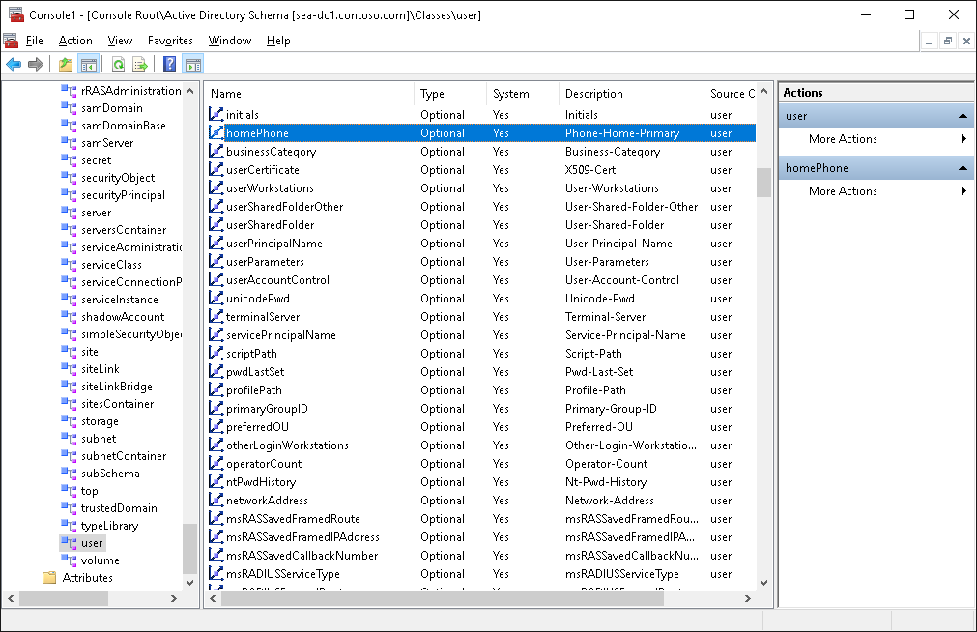
AD DS schema
Notes:
Reinforce the concept that the schema defines the rules and syntax of the AD DS database and provides the blueprint for the objects within it. Optionally, you can demonstrate the Active Directory Schema snap-in to depict how the objects consist of attributes. You can also illustrate the hierarchy of objects and the inherited attributes. For example, the parent object for User is Organizational Person, the parent object for Organizational Person is Person, and the parent object for Person is an object called Top. Point out that each level in the hierarchy defines attributes. This means that the User object contains all the attributes that are defined on the User class and all the attributes defined further up in the hierarchy (Organizational Person, Person, Top).
Note: If you want to demonstrate the schema, on SEA-ADM1, in an elevated command prompt, run regsvr32 schmmgmt.dll. Then, open the management console and add the Active Directory Schema to the console.

Slide 11
Overview of AD DS replication
Within an AD DS infrastructure, standard domain controllers replicate Active Directory information by using a multimaster replication model
Active Directory data is separated logically into several partitions:
Configuration partition
Schema partition
Domain partition
Application partition
Characteristics of AD DS replication include:
Multimaster
Pull-based
Store and forward
Data store partitioning
Automatic generation of an efficient and robust replication topology
Attribute-level replication
Distinct control of intersite replication
Collision detection and management
Notes:
Consider opening the Active Directory Sites and Services tool to show students the replication structure.

Slide 12
AD DS sign-in process
The user account is authenticated to the domain controller
The domain controller returns a TGT back to client
The client uses the TGT to apply for access to the workstation
The domain controller grants access to the workstation
The client uses the TGT to apply for access to the server
The domain controller returns access to the server
Notes:
In the first phase of sign in, the user account is authenticated to the domain controller. In the second phase, the user account applies to the domain controller for a ticket to gain authorization to connect with the local computer.
A centralized directory service such as AD DS provides a single identity store, authentication service, and point of management for administration. Emphasize the advantages of a single identity store for security enhancement and manageability.
Explain the numbered sequence on the slide to your students.

Slide 13
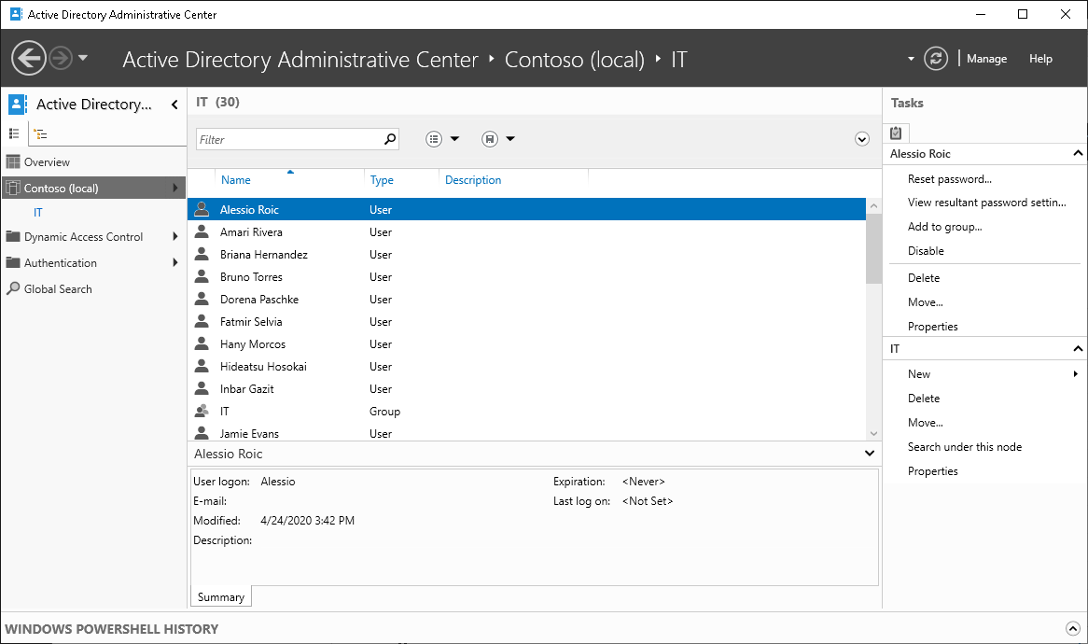
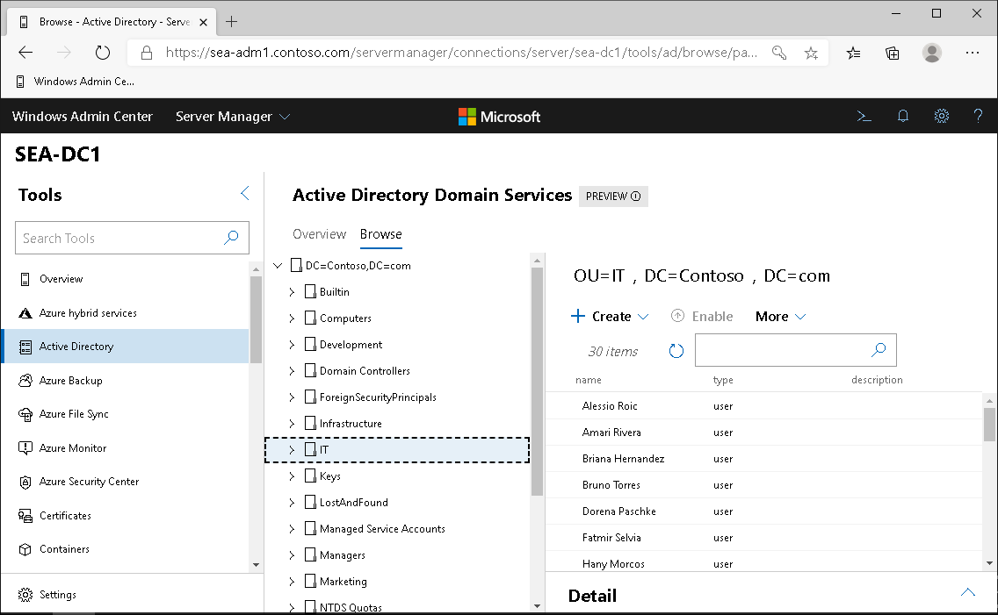
Overview of AD DS administration tools
Notes:
Consider demonstrating each tool on SEA-ADM1 as you discuss it. The next topic provides the steps for this demonstration.

Slide 14
Demonstration: Use tools to manage objects and properties in AD DS
Navigate within the Active Directory Administrative Center
Perform an administrative task within the Active Directory Administrative Center
Create objects
View all object attributes
Use the Windows PowerShell History viewer
Notes:
When you complete this demonstration, leave the virtual machines running for later demonstrations. Be sure to point out the visual difference between an OU and a container: a folder with a book (or square) on it represents an OU, and a blank folder represents an OU.
Demonstration Steps
Navigate within the Active Directory Administrative Center
On SEA-ADM1, sign in as Contoso\administrator and then, in Server Manager, select Tools, and then select Active Directory Administrative Center.
Select Contoso (local), select Dynamic Access Control, and then select Global Search.
In the navigation pane, select the Tree View tab, and then expand the Contoso (local) node to display the details of the Contoso.com domain.
Perform an administrative task within the Active Directory Administrative Center
In the Active Directory Administrative Center, select Overview.
In the Reset Password box, in the User name box, enter Contoso\Bruno.
In the Password and Confirm password boxes, enter Pa55w.rd.
Clear the User must change password at next log on check box, and then select Apply.
In the Global Search box, in the Search box, enter "sea," and then select Enter.
Create an object
In the Active Directory Administrative Center, in the navigation pane tree view, expand Contoso (local), and then select the Computers container.
In the Tasks pane, in the Computers section, select New, and then select Computer.
In the Create Computer dialog box, enter the following information, and then select OK:
Computer name: SEA-CL4
Computer (NetBIOS) name: SEA-CL4
Review all object attributes
In the Active Directory Administrative Center, double-click Contoso (local) or select Contoso (local), and then select Enter.
In the management list, double-click Computers or select it, and then select Enter.
Select SEA-CL4, and then in the Tasks pane, in the SEA-CL4 section, select Properties.
In the SEA-CL4 window, scroll to the Extensions section, select the Attribute Editor tab, and then note that all the attributes of the computer object are available here.
Select Cancel to close the SEA-CL4 window.
Use the Windows PowerShell History viewer
In the Active Directory Administrative Center, select the Windows PowerShell History toolbar on the screen.
Review the details for the New-ADComputer cmdlet that you used to perform the most recent task. On SEA-ADM1, close all open windows.

Slide 15
Lesson 1: Test your knowledge
Refer to the Student Guide for lesson-review questions

Slide 16
Lesson 2: Deploying Windows Server domain controllers

Slide 17
Lesson 2 overview
This lesson describes the purpose and functionalities of using domain controllers in a Windows Server environment
Topics:
What is a DC?
What is the global catalog?
What are operations masters?
Install a DC
Upgrade from a previous version of AD DS
DC cloning
Overview of DC SRV records
Demonstration: Explore DC SRV records in DNS
Transfer and seize roles
Deploy a DC in Azure IaaS
Notes:
Provide an overview of the topics that you will discuss with students in this lesson.

Slide 18
What is a DC?
Domain controllers:
Are servers that host the AD DS database (Ntds.dit) and SYSVOL
Host the Kerberos authentication service and KDC services to perform authentication
Have best practices for:
Availability:
Use at least two domain controllers in a domain
Security:
Use an RODC or BitLocker
Notes:
Ensure that students understand that domain controllers are servers that perform the AD DS role. They host the AD DS database, SYSVOL, the Kerberos authentication service, and other AD DS services. For redundancy purposes, it is best to have at least two available domain controllers. Explain that all the domain controllers in a domain are essentially equal. Each domain controller contains a copy of the directory store. You can make updates to the AD DS data on all domain controllers, except for read-only domain controllers (RODCs). Emphasize the importance of having multiple domain controllers in each domain. This provides load balancing, but more importantly, it also provides recoverability if a server failure occurs. Mention that all domain controllers engage in authentication and authorization. Therefore, the system has redundancy with fewer fail points. This topic does not provide much information about best practices. If students are interested, you can provide more detail about installing domain controllers in remote sites to help protect against an unavailable wide area network (WAN) connection. You also can talk about increasing the number of domain controllers to account for redundancy and performance.

Slide 19
What is the global catalog?
The global catalog:
Hosts a partial attribute set for other domains in the forest
Supports queries for objects throughout the forest
In a single domain, you should configure all the domain controllers to hold a copy of the global catalog
In a multiple-domain environment, the infrastructure master should not be a global catalog server unless all the domain controllers in the domain are also global catalog servers
When you have multiple sites, you should also make at least one domain controller at each site a global catalog server
Notes:
Describe the role of the global catalog server in searches for objects across domains in a forest. Define a global catalog as a domain controller that replicates the partial attribute set (PAS) for each domain in the forest. The domain controller does not need the PAS for its own domain because it already has the full copy of the domain database, and it needs only the changes made to other domains. That is why, in a single-domain environment, making every domain controller a global catalog server adds no significant replication.

Slide 20
What are operations masters?
In the multimaster replication model, some operations must be single master operations
Many terms are used for single master operations in AD DS, including:
Operations master (or operations master role)
Single master role
FSMO
The five FSMOs
Forest:
Domain naming master
Schema master
Domain:
RID master
Infrastructure master
PDC emulator master
Notes:
Discuss each operations master role in as much depth as you think is appropriate for the students. Be sure to point out that most master roles are so specific that the master can be offline for a short period without causing any problems. For example, you do not need the schema master until you make changes to the schema, and you do not need the domain naming master until you add or remove a domain in the forest. Point out that other domain services might be slow or disrupted if a domain controller is offline and unavailable. Be sure to point out that these roles all run on domain controllers, so the loss of a domain controller can cause serious problems. Domain operations master roles are needed on a more regular basis than those in the forest root domain, particularly the primary domain controller (PDC) emulator. The relative ID (RID) master provides a pool of RIDs for each domain controller. If this master is not available, eventually a domain controller will attempt to create an account and be unable to do so. Describe the three PDC functions at the level of detail that the student manual provides. Emphasize that if the PDC emulator master is unavailable or slow to respond, problems in the domain are more likely. You can determine which domain controllers are operations master holders by using the netdom query fsmo command.

Slide 21
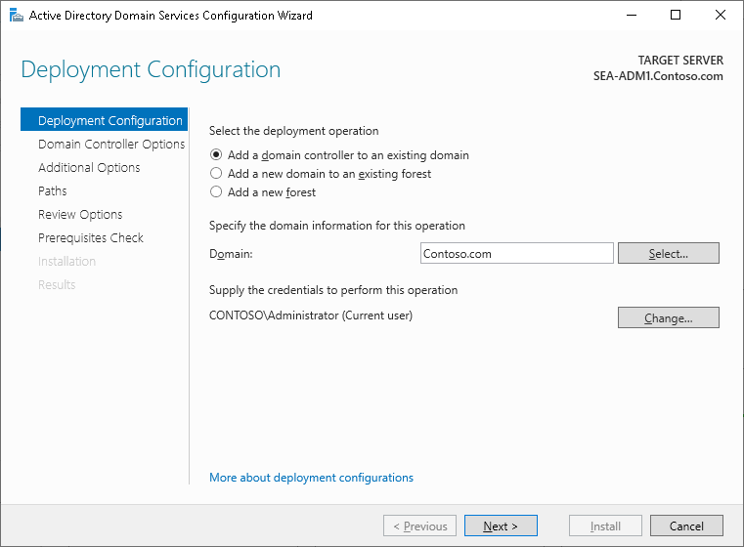
Install a DC
Install a domain controller from Server Manager
Install a domain controller on a Server Core installation of Windows Server
Install a domain controller by installing from media
Notes:
Use Server Manager to describe the initial process of installing an AD DS domain controller. Explain that the Active Directory Domain Services Installation Wizard is obsolete. However, you can run the dcpromo command with an answer file. AD DS retained this functionality to allow companies that use automation to convert to Windows PowerShell deployments. Explain that the initial pass installs the files for AD DS and that you can then continue to configure the AD DS installation.
Consider performing the first part of the module lab to demonstrate how to deploy a new domain controller.

Slide 22
Upgrade from a previous version of AD DS
You have two options for upgrading AD DS to Windows Server 2019:
Perform an in-place upgrade from Windows Server 2008 or later to Windows Server 2019:
Benefit: Except for the prerequisite checks, all the files and programs stay in place, and no additional work is required
Risk: It might leave obsolete files and dynamic-link libraries
Introduce a new server running Windows Server 2019 into the domain, and then promote it to be a domain controller (this option is usually preferred):
Benefit: The new server has no obsolete files and settings
Risk: It might require additional work to migrate administrators’ files and settings
Notes:
Describe the different methods for upgrading a forest and domain, and discuss the risks and benefits of each method. Explain that the process is the same for upgrading from any version of Windows Server starting with Windows Server 2012.

Slide 23
DC cloning
You might clone domain controllers for:
Rapid deployment
Private clouds
Recovery strategies
To clone a source domain controller:
Add the domain controller to the Cloneable Domain Controllers group
Verify app and service compatibility
Create a DCCloneConfig.xml file
Export it once, and then create as many clones as needed
Start the clones
Notes:
Explain the process of how a newly cloned domain controller starts, describing each of the following steps: The clone checks whether a virtual machine generation identifier exists. This is required, and if a virtual machine generation identifier does not exist, the computer either starts normally when no DCCloneConfig.xml exists or renames DCCloneConfig.xml and restarts in Directory Services Restore Mode (DSRM). Starting in DSRM is a safeguard, and a domain administrator must fix the issue to optimize the domain controller’s functionality. The clone checks whether the virtual machine generation identifier changed, and performs one of the following actions: If it did not change, it is the original source domain controller. If DCCloneConfig.xml exists, then it is renamed. In both cases, a normal startup occurs, and the domain controller is functional again. If it did change, the virtualization safeguards trigger, and the process continues. The clone checks whether DCCloneConfig.xml exists. If not, a check for a duplicate IP address determines whether the computer starts normally or in DSRM. If the DCCloneConfig.xml file exists, the computer gets the new computer name and IP address settings from the file. The AD DS database is modified, and the initialization steps continue, thereby controlling a new domain controller.

Slide 24
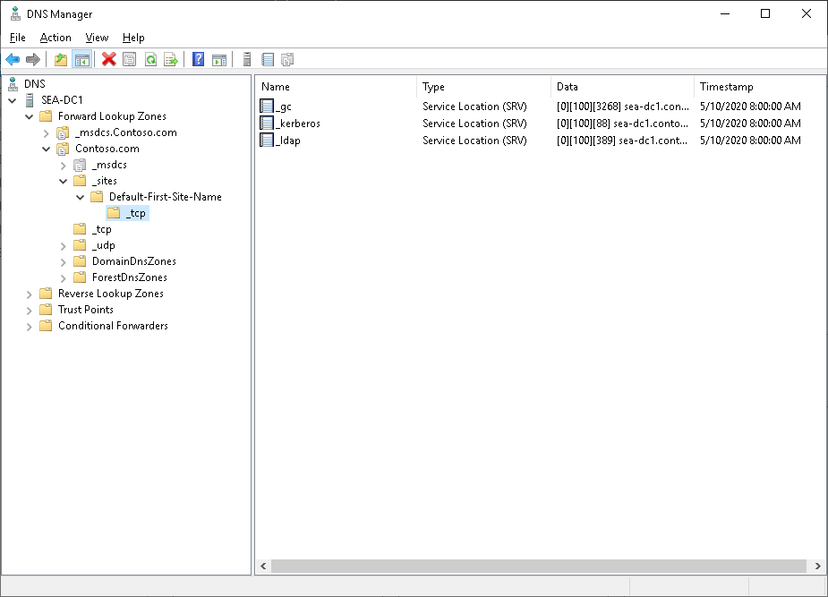
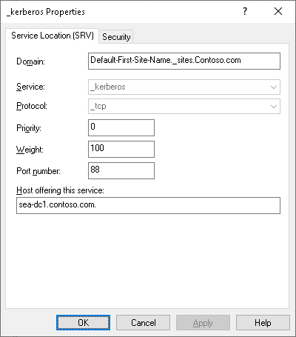
Overview of DC SRV records
Notes:
Use the next topic to demonstrate SRV records.

Slide 25
Demonstration: Explore DC SRV records in DNS
Use DNS Manager to view SRV records
Notes:
Spend as much time demonstrating the SRV records in DNS as is appropriate based on students’ experience or interest.
After depicting the subdomains that start with an underscore (_), explain that domain controllers register several SRV records so that you can search them in multiple ways. Search for an SRV record in _tcp.Default‑First‑Site‑Name._sites.Contoso.com that is offering the Kerberos authentication service. Examine the record, and show that the SEA‑DC1.Contoso.comserver is offering the Kerberos authentication service over TCP port 88 and that the server is answering for the site Default‑First‑Site‑Name. This is the preferred domain controller, because the domain controller is in the same AD DS site as the client computer.
Point out that because domain controllers register SRV records in different ways, you can find an alternative if the preferred domain controller is not available. Alternatively, refer to C:\windows\system32\config, open netlogon.dns in Notepad, and display all the SRV records that each domain controller will register in DNS.
Note that the Net Logon service that is running on each domain controller registers the SRV records in DNS. If it does so incorrectly, you can trigger the domain controller to reregister those records by restarting the Net Logon service on that domain controller. This reregisters only the SRV records. If you want to reregister the host record information in DNS, you must run ipconfig /registerdns from the command prompt, just as you would for any other computer. After you complete the demonstration, revert to the virtual machine.
Demonstration steps
Review the SRV records by using DNS Manager
On SEA-ADM1, sign in with the username Contoso\Administrator and the password Pa55w.rd.
In Server Manager, select the Tools menu.
In the Tools list, select DNS.
In the DNS Manager window, on the tree menu, expand SEA-ADM1.Contoso.com, expand Forward Lookup Zones, and then select Contoso.com. Display the following four Domain Name System (DNS) subzones:
_msdcs
_sites
_tcp
_udp
Expand Contoso.com, expand _sites, expand Default‑First‑Site‑Name, expand _tcp, and then select the following record:
_ldap Service Location (SRV) [0][100][389] sea-dc1.Contoso.com
If students have sufficient expertise and interest, open c:\windows\system32\config, and then open the netlogon.dns file in Notepad. Display all the service records (SRV records) that this domain controller will register in DNS.

Slide 26
Transfer and seize roles
Transferring is:
Planned
Performed using the latest data
Achieved through snap-ins, Windows PowerShell, or ntdsutil.exe
Seizing is:
Unplanned and a last resort
Performed with incomplete or out-of-date data
Accomplished through Windows PowerShell or ntdsutil.exe
Notes:
Consider demonstrating these procedures for your students. However, to perform a demonstration, you must first add a new DC to the Contoso domain. The lab covers this process.

Slide 27
Deploy a DC in Azure IaaS
Scenarios in which you might deploy AD DS on an Azure virtual machine include:
Disaster recovery
Geo-distributed domain controllers
User authentication for isolated applications
Considerations during deployment include:
Network topology
Site topology
Service healing
IP addressing
DNS
Hard disk read/write caching
Notes:
Discuss the different scenarios in which you might choose to deploy an AD DS domain controller on a Microsoft Azure virtual machine. If an organization intends to deploy AD DS to Azure infrastructure as a service (IaaS), discuss the different requirements that the students must first consider and how requirements might vary depending on the needs of the organization.
Indicate to students that deploying AD DS on an Azure virtual machine is entirely different than integrating AD DS with Azure Active Directory. The two approaches are not interchangeable and are intended to address different organizational requirements.

Slide 28
Lesson 2: Test your knowledge
Refer to the Student Guide for lesson-review questions

Slide 29
Lesson 3: Overview of Azure AD

Slide 30
Lesson 3 overview
This lesson describes how you can use Azure AD to provide authentication and authorization for cloud-based services and apps
Topics:
What is Azure AD?
Azure AD versions
Connect AD DS with Azure AD by using Azure AD Connect
Benefits of integrating Azure AD with AD DS
Notes:
Provide an overview of the topics that you will discuss with students in this lesson.

Slide 31
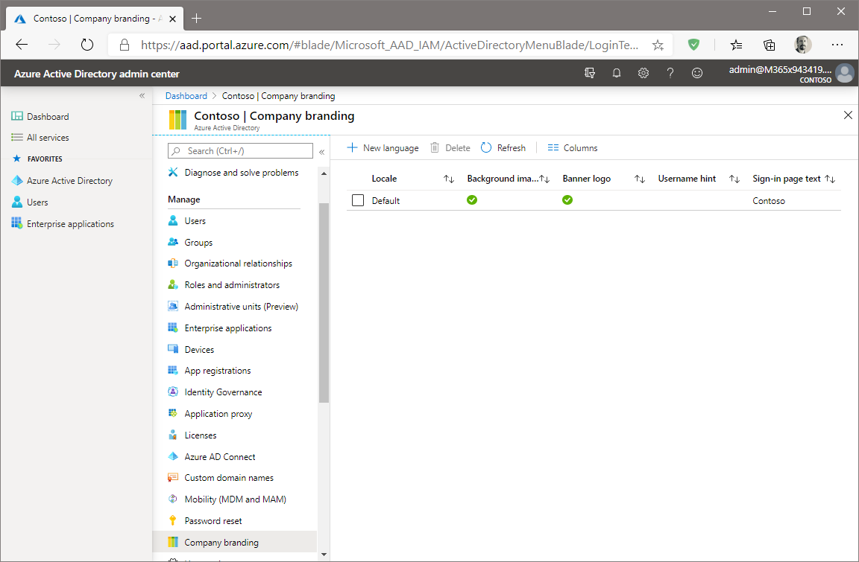
What is Azure AD?
Notes:
Consider demonstrating Azure AD by using the portal if you have a trial account.

Slide 32
Azure AD versions
Free
Office 365 Apps
Premium P1
Premium P2
Notes:
Identify the key differences between the available versions.

Slide 33
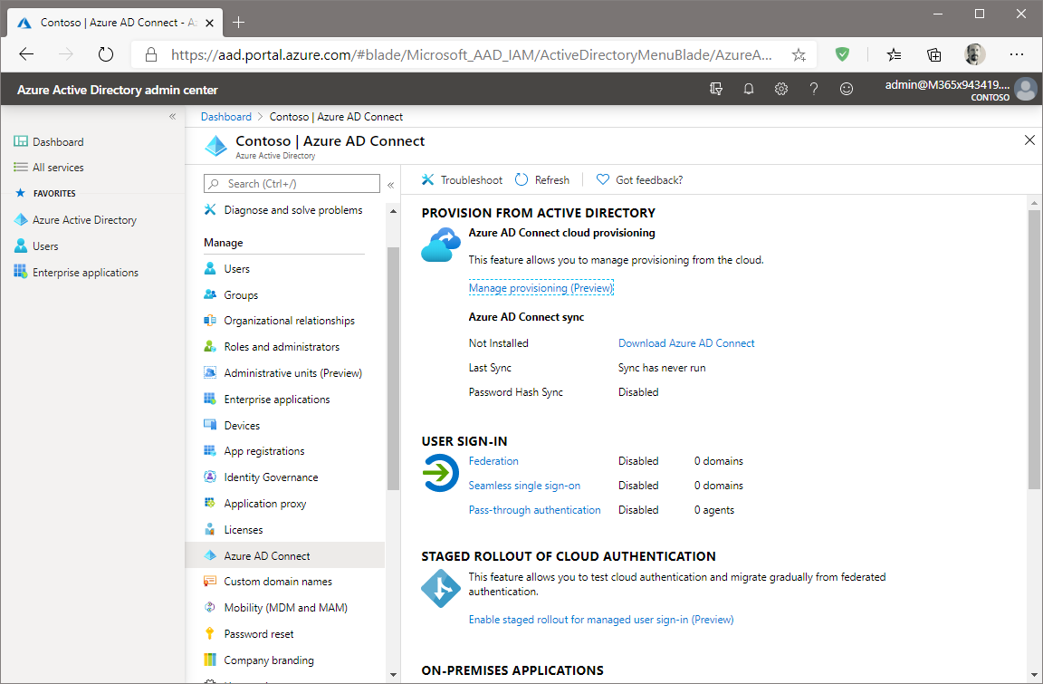
Connect AD DS with Azure AD by using Azure AD Connect
Notes:
Describe Azure AD connect. Explain that the primary purpose is to enable integration of AD DS and Azure AD.

Slide 34
Benefits of integrating Azure AD with AD DS
Azure Information Protection
Self-service password reset
Endpoint co-management
Manage apps
Notes:
Discuss the advantages of hybrid Azure AD and AD DS. Provide examples:
Some organizations might choose to implement Azure AD in addition to their on-premises AD DS infrastructure. For some, this might be a temporary measure during a staged migration from AD DS to the cloud. For others, it might be a permanent configuration. In hybrid environments, administrators can use both on-premises and cloud-based provisioning and management tools to manage their users devices. Consequently, there are numerous benefits to operating in this hybrid environment.

Slide 35
Lesson 3: Test your knowledge
Refer to the Student Guide for lesson-review questions

Slide 36
Lesson 4: Implementing Group Policy

Slide 37
Lesson 4 overview
This lesson describes how to manage a Windows Server environment by using the Group Policy infrastructure
Topics:
What are GPOs?
Overview of GPO scope and inheritance
What are domain-based GPOs?
Default domain GPO objects
Demonstration: Create and configure a domain-based GPO
Overview of GPO storage
What are starter GPOs?
What are administrative templates?
Overview of the Central Store
Notes:
Provide an overview of the topics that you will discuss with students in this lesson.

Slide 38
What are GPOs?
Group Policy is a powerful administrative tool
You can use it to enforce various types of settings to a large number of users and computers
Typically, you use GPOs to:
Apply security settings
Manage desktop application settings
Deploy application software
Manage Folder Redirection
Configure network settings
Notes:
Consider demonstrating these benefits by using the Group Policy Management tools on SEA-ADM1 while you cover the content in this topic.

Slide 39
Overview of GPO scope and inheritance
You can scope GPOs by using:
GPO links
Security filters
WMI filters
GPOs are processed on a client computer in the following order:
Local GPOs
Site-level GPOs
Domain-level GPOs
OU GPOs, including any nested (child) OUs
Notes:
There is an extensive demonstration in this lesson. Consider using it as the basis for discussing this content.

Slide 40
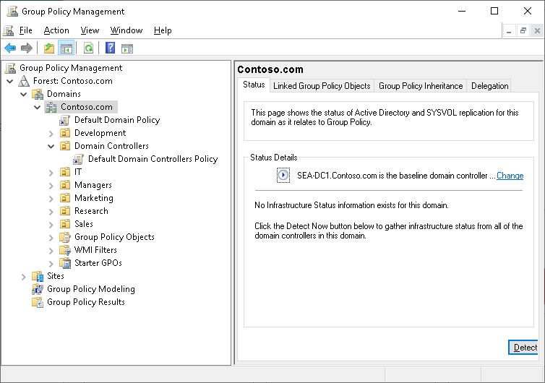
What are domain-based GPOs?
Notes:
Explain the purpose of the two default domain-based GPOs. Also, tell students that we do not recommend that they change settings in these GPOs. Rather, they should create new ones. Emphasize that the Default Domain Controllers Policy is used only on domain controllers.
Briefly mention local GPOs, but do not focus much on them. Emphasize that domain-based GPOs take precedence because of the processing order.
There is an extensive demonstration in this lesson. Consider using it as the basis for discussing this content.

Slide 41
Default domain GPO objects
A domain has two default GPOs:
Default Domain Policy
Default Domain Controllers Policy
Notes:
There is an extensive demonstration in this lesson. Consider using it as the basis for discussing this content.

Slide 42
Demonstration: create and configure a domain-based GPO
Manage objects in AD DS
Create and edit a GPO
Link the GPO
View the effects of the GPOs settings
Create and link the required GPOs
Verify the order of precedence
Configure the scope of a GPO with security filtering
Verify the application of settings
Notes:
Demonstration detailed steps
Manage objects in AD DS
Switch to SEA-ADM1.
Switch to Windows PowerShell (Admin).
Create an OU called Seattle in the domain by running the following command:
New-ADOrganizationalUnit -Name:"Seattle" -Path:"DC=Contoso,DC=com" -ProtectedFromAccidentalDeletion:$true -Server:"SEA-DC1.Contoso.com"
Create a user account for Ty Carlson in the Seattle OU by running the following command:
New-ADUser -Name Ty -DisplayName "Ty Carlson" -GivenName Ty -Surname Carlson -Path "ou=Seattle,dc=contoso,dc=com"
Set the password for the account by running the following command:
Set-ADAccountPassword Ty
When you receive a prompt for the current password, select Enter.
When you receive a prompt for the desired password, enter Pa55w.rd, and then select Enter.
When you receive a prompt to repeat the password, enter Pa55w.rd, and then select Enter.
To enable the account, run the following command:
Enable-ADAccount Ty
Test the account by switching to SEA-CL1, and then sign in as Ty with the password Pa55w.rd.
On SEA-ADM1, in the Administrator: Windows PowerShell window, run the following command:
New-ADGroup SeattleBranchUsers -Path "ou=Seattle,dc=contoso,dc=com" -GroupScope Global -GroupCategory Security
In the Administrator: Windows PowerShell window, run the following command:
Add-ADGroupMember SeattleBranchUsers -Members Ty
Confirm that the user is in the group by running the following command:
Get-ADGroupMember SeattleBranchUsers
Create and edit a GPO
On SEA-ADM1, from Server Manager, select Tools, and then select Group Policy Management.
If necessary, switch to the Group Policy Management window.
In Group Policy Management Console, in the navigation pane, expand Forest: Contoso.com, Domains, and Contoso.com, and then select the Group Policy Objects container.
In the navigation pane, right-click the Group Policy Objects container, and then select New.
In the Name text box, enter CONTOSO Standards, and then select OK.

Slide 43
Demonstration: create and configure a domain-based GPO (hidden slide 1)
Notes:
In the details pane, right-click or access the context menu for the CONTOSO Standards Group Policy Object (GPO), and then select Edit.
In the Group Policy Management Editor window, in the navigation pane, expand User Configuration, expand Policies, expand Administrative Templates, and then select System.
Double-click the Prevent access to registry editing tools policy setting or select the setting and then select Enter.
In the Prevent access to registry editing tools dialog box, select Enabled, and then select OK.
In the navigation pane, expand User Configuration, expand Policies, expand Administrative Templates, expand Control Panel, and then select Personalization.
In the details pane, double-click the Screen saver timeout policy setting or select the setting, and then select Enter.
In the Screen saver timeout dialog box, select Enabled, in the Seconds text box, enter 600, and then select OK.
Double-click the Password protect the screen saver policy setting or select the setting, and then select Enter.
In the Password protect the screen saver dialog box, select Enabled, and then select OK.
Close the Group Policy Management Editor window.
Link the GPO
In the Group Policy Management window, in the navigation pane, right-click or access the context menu for the Contoso.com domain, and then select Link an Existing GPO.
In the Select GPO dialog box, select CONTOSO Standards, and then select OK.
Review the effects of the GPO’s settings
Switch to SEA-CL1, and then sign in as Contoso\Administrator with the password Pa55w.rd.
In the search box on the taskbar, enter Control Panel.
In the Best match list, select Control Panel.
Select System and Security, and then select Allow an app through Windows Firewall.
In the Allowed apps and features list, select the following check boxes, and then select OK:
Remote Event Log Management
Windows Management Instrumentation (WMI)
Sign out, and then sign in as Contoso\Ty with the password Pa55w.rd.
In the search box on the taskbar, enter Control Panel.
In the Best match list, select Control Panel.
In the search box in Control Panel, enter screen saver, and then select Change screen saver. It may take a few minutes for the option to appear.

Slide 44
Demonstration: create and configure a domain-based GPO (hidden slide 2)
Notes:
In the Screen Saver Settings dialog box, notice that the Wait option is dimmed. You can't change the time-out. Notice that the On resume, display logon screen option is selected and dimmed and that you can't change the settings.
Note: If the On resume, display logon screen option is not selected and dimmed, then open a command prompt, run gpupdate /force, and repeat the preceding steps.
Right-click Start or access the context menu, and then select Run.
In the Run dialog box, in the Open text box, enter regedit, and then select OK.
In the Registry Editor dialog box, select OK.
Create and link the required GPOs
On SEA-ADM1, in Group Policy Management Console, in the navigation pane, if necessary, expand Forest: Contoso.com, expand Domains, expand Contoso.com, and then select Seattle.
Right-click the Seattle organizational unit (OU) or access the context menu, and then select Create a GPO in this domain, and Link it here.
In the New GPO dialog box, in the Name text box, enter Seattle Application Override, and then select OK.
In the details pane, right-click the Seattle Application Override GPO or access the context menu, and then select Edit.
In the console tree, expand User Configuration, expand Policies, expand Administrative Templates, expand Control Panel, and then select Personalization.
Double-click the Screen saver timeout policy setting, or select the setting and then select Enter.
Select Disabled, and then select OK.
Close the Group Policy Management Editor window.
Verify the order of precedence
In the Group Policy Management Console tree, select the Seattle OU.
Select the Group Policy Inheritance tab.
Notice that the Seattle Application Override GPO has higher precedence than the CONTOSO Standards GPO. The screen saver time-out policy setting that you just configured in the Seattle Application Override GPO is applied after the setting in the CONTOSO Standards GPO. Therefore, the new setting will overwrite the standards setting and will prevail. Screen saver time-out will be unavailable for users within the scope of the Seattle Application Override GPO.

Slide 45
Demonstration: create and configure a domain-based GPO (hidden slide 3)
Notes:
Configure the scope of a GPO with security filtering
On SEA-ADM1, in Group Policy Management Console, in the navigation pane, if necessary, expand the Seattle OU, and then select the Seattle Application Override GPO under the Seattle OU.
In the Group Policy Management Console dialog box, read the message, select the Do not show this message again check box, and then select OK.
In the Security Filtering section, you will notice that the GPO applies by default to all authenticated users.
In the Security Filtering section, select Authenticated Users, and then select Remove.
In the Group Policy Management dialog box, select OK.
In the details pane, select Add.
In the Select User, Computer, or Group dialog box, in the Enter the object name to select (examples): text box, enter SeattleBranchUsers, and then select OK.
In the details pane, under Security Filtering, select Add.
In the Select User, Computer, or Group dialog box, select Object Types.
In the Object Types dialog box, select the Computers check box and then select OK.
In the Select User, Computer, or Group dialog box, in the Enter Object Names to select (Examples) text box, enter SEA-CL1, and then select OK.
Verify the application of settings
In Group Policy Management, select Group Policy Results in the navigation pane.
Right-click Group Policy Results or access the context menu, and then select Group Policy Results Wizard.
In the Group Policy Results Wizard, select Next.
On the Computer Selection page, select Another Computer, and then enter SEA-CL1 in the text box. Select Next.
On the User Selection page, in the list of users, select CONTOSO\Ty, and then select Next.
On the Summary of Selections page, select Next.
Select Finish when prompted.
In the details pane, select the Details tab, and then select show all.
In the report, scroll down until you locate the User Details section, and then locate the Control Panel/Personalization section. You should observe that the Screen save timeout settings are obtained from the Seattle Application Override GPO.
Close Group Policy Management Console.

Slide 46
Overview of GPO storage
Group Policy settings are presented as GPOs in AD DS user interface tools, but a GPO is actually two components:
The Group Policy container
The Group Policy template
The Group Policy container and the Group Policy template both replicate between all domain controllers in AD DS. However, these two items use different replication mechanisms:
The Group Policy container in AD DS replicates by the Directory Replication Agent
The Group Policy template in the SYSVOL replicates by using the Distributed File System Replication
Notes:
Consider displaying to students the Group Policy template and Group Policy container.

Slide 47
What are Starter GPOs?
A Starter GPO:
Stores administrative template settings on which new GPOs will be based
Can be exported to .cab files
Can be imported into other areas of an organization
Notes:
Explain that you can store preconfigured administrative template settings in Starter GPOs that act as templates for creating new GPOs. You can export these Starter GPOs into .cab files that you can import easily into other areas of your organization. This can help provide consistency in large organizations. You can store comments about the Starter GPO in the template itself.

Slide 48
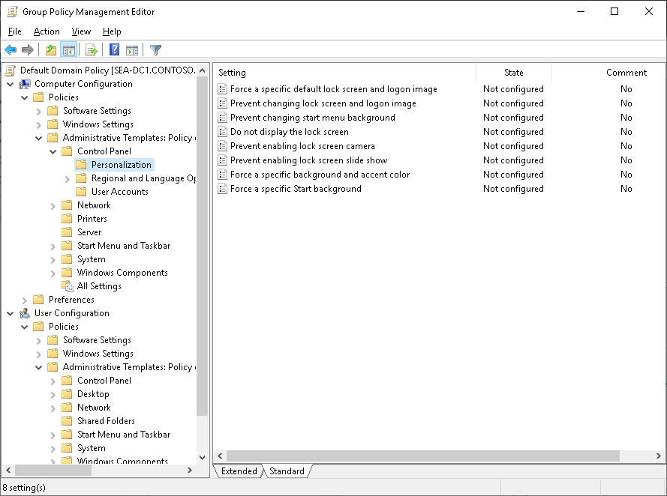
What are administrative templates?
Notes:
Explain that administrative templates are the primary means of configuring the client computer’s registry settings through Group Policy. Explain that administrative templates are a repository of registry-based changes. By using the Administrative Templates node of the GPO, you can deploy modifications to both the computer (the HKEY_LOCAL_MACHINE hive in the registry) and the user (the HKEY_CURRENT_USER hive in the registry) portions of the registry. Mention that many of the new settings only apply to newer versions of Windows operating systems. Discuss how you can use administrative templates to control the environment of the operating system and user experience. As an example, explain how you can limit or prohibit user access to Control Panel and desktop items. Mention that you can add custom administrative templates with the Group Policy Management Console (GPMC).

Slide 49
Overview of the Central Store
The Central Store:
Is a central repository for .admx and .adml files
Is stored in SYSVOL
Must be created manually
Is detected automatically by Windows Vista, Windows Server 2008, and newer operating systems
Notes:
Explain that a central store provides a central repository for .admx files. A central store is stored in SYSVOL, and you must create and update a central store manually. Active Directory Domain Services (AD DS) replication and DFS replication ensure that the central store copies to all domain controllers. Explain that the central store provides consistency for administrators who edit GPOs from multiple workstations running Windows Vista or later. Consider doing a short demonstration of how to create a central store.

Slide 50
Lesson 4: Test your knowledge
Refer to the Student Guide for lesson-review questions

Slide 51
Lesson 5: Overview of AD CS

Slide 52
Lesson 5 overview
This lesson describes how to deploy and manage CAs to manage, distribute, and validate digital certificates
Topics:
What is AD CS?
Options for implementing CA hierarchies
Standalone vs. enterprise CAs
Demonstration: Manage CAs
What are certificate templates?
What are CRLs and CRL distribution lists?
Configure trust for certificates
Demonstration: Enroll for a certificate
Notes:
Provide an overview of the topics that you will discuss with students in this lesson.

Slide 53
What is AD CS?
Allows you to implement a PKI for your organization:
Issue and manage certificates
AD CS role services in Windows Server:
Certification Authority
Certification Authority Web Enrollment
Online Responder
Network Device Enrollment Service
Certificate Enrollment Web Service
Certificate Enrollment Policy Web Service
Notes:
Define PKI, certificates, and the technologies and benefits that PKI provides, such as confidentiality, integrity, authenticity, nonrepudiation, and availability.
Introduce Active Directory Certificate Services (AD CS) and explain the purpose of each role service. Mention the changes with AD CS since Windows Server 2012 R2, such as improved Trusted Platform Module key attestation.

Slide 54
Options for implementing CA hierarchies
Typically, CA hierarchies have two levels:
A root CA at the top level
A subordinate issuing CA on the second level
In general, CA hierarchies fall into one of following categories:
CA hierarchies with a policy CA
CA hierarchies with cross-certification trust
CAs with a two-tier hierarchy
Notes:
Highlight various usage scenarios for CAs. This should help students understand the typical scenarios in an enterprise environment. Contrast these scenarios with a typical usage scenario in a small environment, such as a single-server PKI. Make sure that students understand that a single CA does not represent a CA hierarchy, although it is still a fully functional PKI.

Slide 55
Standalone vs. enterprise CAs
Standalone CAs | Enterprise CAs
Must be used if any CA (root/intermediate/policy) is offline because a standalone CA is not joined to an AD DS domain | Requires the use of AD DS and stores information in AD DS
Must be used if any CA (root/intermediate/policy) is offline because a standalone CA is not joined to an AD DS domain | Can use Group Policy to propagate certificates to the trusted root CA certificate store
Users must provide identifying information and specify the type of certificate | Publishes user certificates and CRLs to AD DS
Does not support certificate templates | Issues certificates based on a certificate template
All certificate requests are kept pending until administrator approval | Supports autoenrollment for issuing certificates
Notes:
Discuss the following:
Standalone and enterprise CAs, and their differences.
CAs that issue certificates to clients over the internet.
You typically configure a root CA as a standalone CA.
Mention that business requirements often dictate the types of CAs that students might use. For example, autoenrollment requires an enterprise CA.

Slide 56
Demonstration: Manage CAs
Create a new template based on the Web Server template
Configure templates so that they can be issued
Notes:
Demonstration detailed steps
Create a new template based on the Web Server template
On SEA-ADM1, in Server Manager, select Tools, and then select Certification Authority.
In the Microsoft Active Directory Certificate Services dialog box, select OK.
In the certsrv - [Certification Authority (Local)] dialog box, select the Certification Authority (Local) node, and then select Retarget Certification Authority.
In the Certification Authority dialog box, select Another computer, and then enter SEA-DC1 and select Finish.
In the Certification Authority console, expand ContosoCA, right-click or access the context menu for Certificate Templates, and then select Manage.
In the Certificate Templates Console, locate the Web Server template in the list, right-click or access the context menu for it, and then select Duplicate Template.
Select the General tab, in the Template display name text box, enter Production Web Server, and then enter 3 in the Validity period text box.
Select the Request Handling tab, select Allow private key to be exported, and then select OK. Minimize the Certificate Templates Console.
In the Certification Authority console on SEA-ADM1, right-click or access the context menu for Revoked Certificates, select All Tasks, select Publish, and then select OK twice.
Configure templates so that they can be issued
On SEA-ADM1, in the Certification Authority console, right-click or access the context menu for Certificate Templates, point to New, and then select Certificate Template to Issue.
In the Enable Certificate Templates window, select Production Web Server, and then select OK.

Slide 57
What are certificate templates?
A certificate template defines:
The format and contents of a certificate
The process for creating and submitting a valid certificate request
The security principals that are allowed to read, enroll, or use autoenrollment for a certificate that will be based on the template
The permissions that are required to modify a certificate template
Notes:
You should start by defining a certificate. Ask students to provide their definition of a certificate. After that, start introducing templates. The installation of Active Directory Certificate Services (AD CS) includes a set of default templates. Explain that students can duplicate and modify these default templates to meet business requirements. Later topics cover specific template versions and features. Also, emphasize that in Windows Server 2008 R2 and later, the Standard edition operating system also works with certificate templates.

Slide 58
What are CRLs and CRL distribution lists?
The following are the steps in the certificate revocation lifecycle:
A certificate is revoked
A CRL is published
A client computer verifies certificate validity and revocation
Notes:
Discuss with students the following steps regarding certificate revocation:
You revoke a certificate from the CA Microsoft Management Console (MMC)snap-in. During revocation, you should specify a reason code, a date, and a time.
The certificate revocation list (CRL) publishes through the CA console, or the scheduled revocation list publishes automatically based on the configured value.
When client computers running Windows are presented with a certificate, they use a process to verify revocation status by querying the issuing CA. That check determines whether the certificate is revoked and presents the information to the application that requested the verification. At the end, briefly discuss the Online Responder service as an alternative method for revocation checking.

Slide 59
Configure trust for certificates
When using certificates for different purposes, it is important to consider who (or rather what) might be expected to assess the digital certificate as a form of proof of identity
Generally, there are three types of certificate that you can use:
Internal certificates from a private CA such as a server installed with the AD CS role
External certificates from a public CA such as an organization on the internet
A self-signed certificate
Notes:
Discuss the content with your students.

Slide 60
Demonstration: Enroll for a certificate
Enroll the Web Server certificate on sea-adm1
Notes:
Demonstration detailed steps
Enroll the Web Server certificate on SEA-ADM1
Switch to Windows PowerShell and run the following command:
Install-WindowsFeature Web-Server -IncludeManagementTools
From Server Manager, select Tools, and then select Internet Information Services (IIS) Manager.
Select SEA-ADM1, and then in the central pane, select Server Certificates, and then select Enter.
In the Actions pane, select Create Domain Certificate.
On the Distinguished Name Properties page, complete the following fields, and then select Next:
Common name: sea-adm1.Contoso.com
Organization: Contoso
Organizational unit: IT
City/locality: Seattle
State/province: WA
Country/region: US
On the Online Certification Authority page, select Select, select ContosoCA, and then select OK.
In the Friendly name text box, enter sea-adm1, and then select Finish.
Ensure that the certificate displays in the Server Certificates console.
In the IIS console, expand sea-adm1, expand Sites, and then select Default Web Site.
In the Actions pane, select Bindings.
In the Site Bindings window, select Add.
In the Add Site Binding window, select https from the Type drop-down list. In the SSL certificate drop-down list, select sea-adm1, select OK, select Yes, and then select Close.
Close Internet Information Services (IIS) Manager.

Slide 61
Lesson 5: Test your knowledge
Refer to the Student Guide for lesson-review questions

Slide 62
Instructor-led labs: Implementing identity services and Group Policy
Deploying a new domain controller on Server Core
Configuring Group Policy
Deploying and using certificate services

Slide 63
Lab: Implementing identity services and Group Policy
Exercise 1: Deploying a new domain controller on Server Core Exercise 2: Configuring Group Policy Exercise 3: Deploying and using certificate services
Sign-in information for the exercise(s):
Virtual Machines:
WS-011T00A-SEA-DC1
WS-011T00A-SEA-SVR1
WS-011T00A-SEA-ADM1
WS-011T00A-SEA-CL1
Username: Contoso\Administrator
Password: Pa55w.rd
Notes:
Exercise 1: Deploying a new domain controller on Server Core
In this exercise, you will deploy a new domain controller and create AD DS objects.
Exercise 2: Configuring Group Policy
In this exercise, you create and configure GPOs.
Exercise 3: Deploying and using certificate services
In this exercise, you implement certificates.

Slide 64
Lab scenario
You are working as an administrator at Contoso, Ltd. The company is expanding its business with several new locations. The Active Directory Domain Services (AD DS) Administration team is currently evaluating methods available in Windows Server for rapid and remote domain controller deployment
The team is also looking for a way to automate certain AD DS administrative tasks. Additionally, the team wants to establish configuration management based on Group Policy Objects (GPO) and enterprise certificate authority (CA) hierarchy

Slide 65
Lab-review questions
During the lab, you collected data in a data collector set. What is the advantage of collecting data in this way?

Slide 66
Lab-review answers
During the lab, you collected data in a data collector set. What is the advantage of collecting data in this way?
Answer: You can review data in a data collector set periodically for comparative purposes

Slide 67
Module-review questions
What are the two reasons to create organizational units (OUs) in a domain?
If the domain controller that holds the primary domain controller (PDC) Emulator operations master role is going to be offline for an extended period, what should you do?
True or false? Azure AD is hierarchical
If you have a new version of Microsoft Office to deploy in your on-premises environment, and you want to configure settings with Group Policy Objects (GPOs), what would you do?
What is a certificate template?
Notes:
(More notes on the next slide)

Slide 68
Module-review answers (slide 1 of 2)
What are the two reasons to create organizational units (OUs) in a domain?
Answer: The first reason is because you want to group users and computers, perhaps by geography or department. The second reason is that you might then want to delegate administration on the OU or configure the objects in an OU by using Group Policy Objects (GPOs)
If the domain controller that holds the primary domain controller (PDC) Emulator operations master role is going to be offline for an extended period, what should you do?
Answer: You should transfer the operations master role to another server in the same domain ahead of the planned outage
True or false? Azure AD is hierarchical
Answer: False. Azure AD has a flat structure

Slide 69
Module-review answers (slide 2 of 2)
If you have a new version of Microsoft Office to deploy in your on-premises environment, and you want to configure settings with Group Policy Objects (GPOs), what would you do?
Answer: You could download and install the latest .admx files for Office. If you install these into the Central Store, you could configure the new Office settings in one location
What is a certificate template?
Answer: Certificate templates define how you can request or use a certificate, such as for file encryption or email signing

Slide 70
Thank you.
Notes:
Always end the presentation with the Thank You slide. Do not remove.

