Slide 1
WS-011 Windows Server 2019 Administration

Slide 2
Module 04: File servers and storage management in Windows Server

Slide 3
Module Overview
This module describes how to configure file servers and storage in Windows Server:
Lessons:
Volumes and file systems in Windows Server
Implementing sharing in Windows Server
Implementing Storage Spaces in Windows Server
Implementing Data Deduplication
Implementing iSCSI
Deploying Distributed File System

Slide 4
Lesson 01: Volumes and file systems in Windows Server

Slide 5
Lesson 1 Overview
This lesson describes file systems and volumes in Windows Server:
Topics:
Overview of file systems in Windows Server
Why use ReFS in Windows Server?
Overview of disk volumes
Demonstration: Manage volumes in Windows Server
Overview of File Server Resource Manager
Manage permissions on volumes
Notes:
Lesson overview

Slide 6
Overview of file systems in Windows Server
When selecting a file system, consider the differences between FAT, NTFS file system, and ReFS:
FAT provides:
Basic file system
Partition size limitations
FAT32 to enable larger disks
exFAT developed for flash drives
NTFS provides:
Metadata
Auditing and journaling
Security (ACLs and encryption)
ReFS provides:
Backward compatibility support for NTFS
Enhanced data verification and error correction
Support for larger files, directories, and volumes
Notes:
Provide an overview of the available file systems in Windows operating systems:
file allocation table (FAT)
NT file system (NTFS)
Resilient File System (ReFS)
In particular, be sure to explain that Windows Server 2012 introduced ReFS to ensure that error verification and correction was still possible on very large volumes.
Discuss when you would use which file system, but stress that ReFS currently is the best solution for servers because it provides better error checking, better reliability, and less corruption.

Slide 7
Why use ReFS in Windows Server?
ReFS has many advantages over NTFS:
Metadata integrity with checksums
Integrity streams with user data integrity
Allocation on write transactional model
Large volume, file, and directory sizes (2^78 bytes with 16 KB cluster size)
Storage pooling and virtualization
Data striping for performance and redundancy
Disk scrubbing for protection against latent disk errors
Resiliency to corruptions with recovery
Shared storage pools across machines
Notes:
Explain Resilient File System (ReFS). Start with the reasons why Microsoft implemented this file system. Mention that the requirements for larger volumes increase as a result of the current trend in virtualization technologies.
Discuss the issues that prevent NTFS file systems from managing very large volumes when the file system doesn't provide sufficient error-tracking and self-repairing mechanisms, especially for multi-terabyte (TB) volumes.

Slide 8
Overview of disk volumes
When selecting a type of disk for use in Windows Server, you can choose between:
Basic disk
Dynamic disk
Regardless of which type of disk you use, you must configure the following volumes on one of the server’s hard disks:
System volumes
Boot volumes
In Windows Server, if you are using dynamic disks, you can create a number of different types of disk
volumes:
Simple volumes
Spanned volumes
Striped volumes
Mirrored volumes
RAID-5 volumes
Notes:
Begin by mentioning that Microsoft is deprecating the support for dynamic disks in favor of Storage Spaces, which you will cover in Lesson 3. This content is made available for those still working with upgraded Windows Server systems that still retain this type of disk.

Slide 9
Demonstration: Manage volumes in Windows Server
Create and format a volume using Windows PowerShell
Create a mirrored volume using Server Manager
Notes:
At the time of this writing, it's not possible to use the Windows Admin Center or Server Manager to convert basic disks into dynamic disks and create a simple mirror from them. In fact, dynamic disks are being deprecated in Microsoft. Microsoft recommends using basic disks and Storage Spaces when you need to poll disks together into larger volumes. You will cover Storage Spaces, their creation, provisioning, and use, in Lesson 3 of this module.
Preparation steps
If necessary, start WS-011T00A-SEA-DC1, WS-011T00A-SEA-ADM1 and WS-011T00A-SEA-SVR3. Sign in to SEA-ADM1 and SEA-SVR3 with the username Contoso\Administrator and the password Pa55w.rd.
Demonstration detailed steps
Create a new mirrored volume with Diskpart
On SEA-SVR3, in the Command window, enter diskpart, and then select Enter.
At the Diskpart command prompt, enter the following command, and then select Enter: List disk
Enter the following command, and then select Enter: Select disk 1
Enter the following command, and then select Enter: attributes disk clear readonly
Enter the following command, and then select Enter: online disk noerr
Enter the following command, and then select Enter: Convert dynamic
Enter the following command, and then select Enter: Select disk 2
Repeat steps 4-6 on disk 2.
Enter the following command, and then select Enter: create volume mirror disk=1,2
Enter the following command, and then select Enter: format fs=ntfs quick label "Mirrored Volume"
Enter the following command, and then select Enter: Assign letter=M:
Enter the following command, and then select Enter: Exit

Slide 10
Demonstration: Manage volumes in Windows Server (2 of 3)
Create and format a volume using Windows PowerShell
Create a mirrored volume using Server Manager
Notes:
Use the Windows Admin Center to create a share on the remote server
Go to SEA-ADM1.
On the taskbar, select the Microsoft Edge icon.
In Microsoft Edge, from the Favorites menu, select the Windows Admin Center (WAC) tab.
In the Windows security window, in the Username text box, enter Contoso\Administrator, in the Password text box, enter Pa55w.rd, and then select OK.
In the All connections list, select the SEA-SVR3 hyperlink.
In the Specify your credentials window, select the Use another account for this connection radio button.
In the Username text box, enter Contoso\Administrator, in the Password text box, enter Pa55w.rd. Select the Use these credentials for all connections check box, and then select Continue.
In the WAC console tree, scroll down and select the Files node.
In the Files details blade, select the Mirrored Volume (M:) object.
In the M: details blade, select the New Folder object.
In the Create new folder blade, in the New folder name text box, enter CorpData, and then select Submit.
In the M: blade, with Corp Data selected, select the More drop-down menu, and then select Share.
In the Share blade, in the Group or user name text box, enter Managers, and then select + Add.
In the new Managers object, in the Permission column, change the Readdrop-down arrow to Read/Write, and then select Submit.
Demonstrate some of the features available in the More drop-down arrow for a folder. Explain that Microsoft might add addition features here in the future.

Slide 11
Demonstration: Manage volumes in Windows Server (3 of 3)
Create and format a volume using Windows PowerShell
Create a mirrored volume using Server Manager
Notes:
Copy files to Mirrored Volume\Corpdata, break mirror, and note Corpdata still exists
On SEA-SVR3, select Start, and then select Windows PowerShell.
At the Windows PowerShell command prompt, enter the following command, and then select Enter:
C:\labfiles\mod04\CreateLabFiles.cmd \\sea-SVR3\Corpdata
Close Windows PowerShell.
Return to SEA-SVR3.
At the Windows PowerShell command prompt, enter the following commands, and then select Enter:
M:
Cd corpdata
Dir
You should notice the CreateLabfiles.cmd file.
Enter the following command, and then select Enter.
diskpart
At the Diskpart command prompt, enter the following command, and then select Enter:
List volume
Diskpart will return a list of volumes. Note the Volume number for drive M:.
At the Diskpart command prompt, enter the following command, replacing with the volume number from the list, and then select Enter:
Select volume M
Enter the following command, and then select Enter:
Break disk=2
Enter the following command to close Diskpart.
Exit
At the Windows PowerShell command prompt, enter the following command, and then select Enter:
Dir
Note: Drive M:, Corpdata, Labfiles, and the CreateLabFiles.cmd document still exist.
At the command prompt, enter the following command, and then select Enter:
diskpart
At the Diskpart command prompt, enter the following command, and then select Enter:
List volume
Note: The mirrored volume lists two drive letters, E and M.
Leave the virtual machines running for the next demonstration.

Slide 12
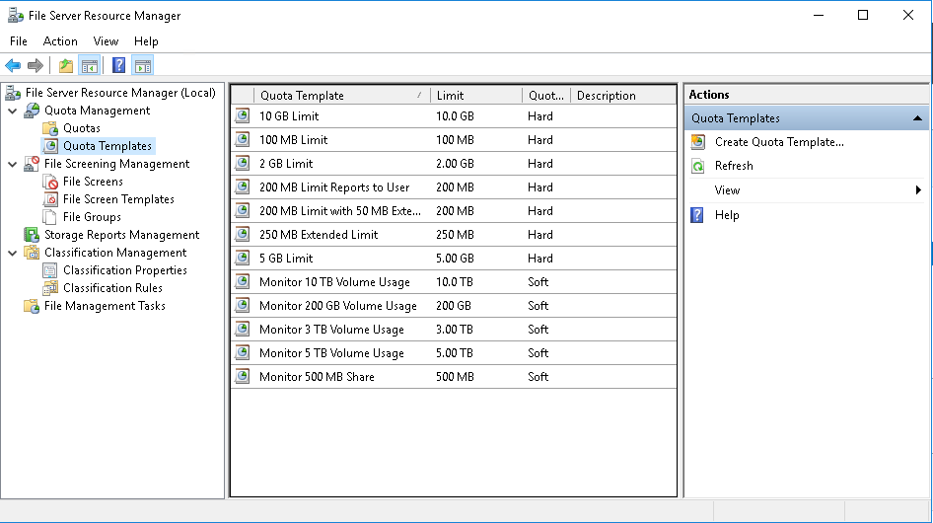
Overview of File Server Resource Manager
Use FSRM to manage and classify data that is stored on file servers:
Notes:
Explain that the purpose of File Server Resource Manager (FSRM) is to manage and classify data that's stored on a file server. You then can discuss its features, or just the features that students either are not aware of or familiar with.

Slide 13
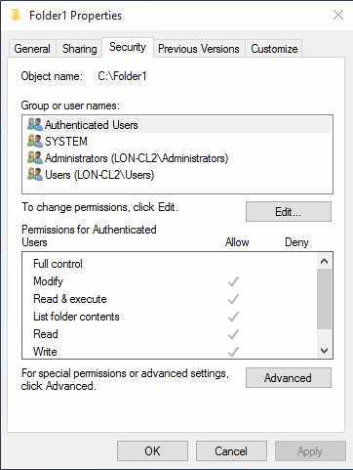
Manage permissions on volumes
Control access on NTFS and ReFS file system:
Can be added for groups, users, and computers:
Cumulative for group members
Can be assigned to:
Files
Folders
Volumes (root folder)
Permissions:
Allow
Deny (takes precedence)
Basic and advanced
Notes:
Remind students that permissions control access only on the NTFS file system and Resilient File System (ReFS), and not on the FAT file system. Most students will most likely already be familiar with permissions, so try to engage them in a discussion on how they use them. For example, ask to whom you can add permissions and why its strongly recommended that you add permissions to groups and not to individual users. Then explain that permissions are cumulative, which means that users have permissions that you grant specifically to them, in addition to those permissions that you grant to groups of which they are members. Remind students that a Deny permission takes precedence over the Allow permission that is set at the same level. Don't go into details of inheritance because the next topic details it.
Discuss basic permissions, and explain that each basic permission is composed of several advanced permissions. You can use the workbook as a reference, and you can use the second slide to help explain advanced permissions that compose Read permission. Additionally, explain what represents Special permissions.
Question If a user’s permissions are set to Special permissions, what file permissions does the user have?
Answer If a user has a combination of advanced file permissions that cannot be listed as basic file permissions, the user’s permissions will be set to as Special permissions.
Question If a user with Read permissions only is a member of a group that has Write permissions, what type of permissions does the user actually have?
Answer The user has cumulative permissions, which apply to the user and to the group of which the user is a member. In the given scenario, the user will have both Read and Write permissions to the file.

Slide 14
Lesson 1: Test your knowledge
Refer to the Student Guide for lesson-review questions

Slide 15
Lesson 02: Implementing sharing in Windows Server

Slide 16
Lesson 2: Overview
This lesson describes SMB and how to implement sharing in Windows Server:
Topics:
What is SMB?
Configure SMB shares
Demonstration: Configure SMB shares by using Server Manager and Windows PowerShell
Best practices for sharing Resources
Overview of NFS
Notes:
Lesson overview

Slide 17
What is SMB?
SMB is the file-sharing protocol that Windows client and server operating systems use
Each new version has additional features
SMB 3.0 introduced large performance benefits
SMB 3.0.2 added:
Scale-Out File Server
Removable SMB 1.x
SMB 3.1.1 added:
Pre-authentication integrity
SMB encryption improvements
Cluster dialect fencing
Notes:
Point out to students that they can search for detailed information about the various Server Message Block SMB versions, and explain the following key points:
Each version of SMB introduces new capabilities that enable Windows features to function properly.
You can disable SMB 1.x.

Slide 18
Configure SMB shares
There are three SMB share profiles:
Quick
Advanced
Applications
Windows PowerShell cmdlets for SMB share management:
New-SmbShare
Set-SmbShare
Remove-SmbShare
Get-SmbShare
Get-SmbSession
Get-SmbOpenFile
Set-SmbBandwidthLimit
Notes:
Describe the Server Message Block (SMB) share profiles that are available, and the Windows PowerShell cmdlets that you can use to manage SMB shares.

Slide 19
Demonstration: Configure SMB shares by using Server Manager and Windows PowerShell
Create an SMB share by using Server Manager
Create an SMB share by using Windows PowerShell
Notes:
At the end of the demonstration, revert the VMs WS-011T00A-SEA-DC1, WS-011T00A-SEA-ADM1, and WS-011T00A-SEA-SVR3.
Preparation notes
If necessary, start WS-011T00A-SEA-DC1, WS-011T00A-SEA-ADM1, and WS-011T00A-SEA-SVR3. Sign in to SEA-ADM1 and SEA-SVR3 with the username Contoso\Administrator and the password Pa55w.rd.
Demonstration detailed steps
Create a Server Message Block (SMB) share by using Server Manager
On SEA-ADM1, select Start, and then select Server Manager.
In Server Manager, in the navigation pane, select File and Storage Services, and then select Shares.
In the SHARES area, right-click or access the context menu for SEA-SRV3, and then select New Share.
In the New Share Wizard, on the Select the profile for this share page, in the File share profile box, select SMB Share – Quick, and then select Next.
On the Select the server and path for this share page, in the Server:section, select SEA-SVR3. In the Share location: area, select Select by volume, select M:, and then select Next.
On the Specify share name page, in the Share name text box, enter SalesShare, and then select Next.
On the Configure share settings page, select the Enable access-based enumeration check box, and then select Next.
On the Specify permissions to control access page, select Customize permissions.
In the Advanced Security Settings for SalesShare dialog box, select Add.
In the Permission Entry for SalesShare window, select the Select a principal hyperlink.
In the Select User, Computer, Service Account, or Group window, in the Enter the object name to select text box, enter Sales, select Check names, and then OK.
In the Permission Entry for SalesShare window, select the Modify check box in the Basic permissions: area, and then select OK twice.
On the Specify permissions to control access page, select Next.
On the Confirm selections page, select Create.
When creation of the share is complete, select Close.

Slide 20
Demonstration: Configure SMB shares by using Server Manager and Windows PowerShell (2 of 2)
Create an SMB share by using Server Manager
Create an SMB share by using Windows PowerShell
Notes:
Create an SMB share by using Windows PowerShell Remote
Right-click or access the context menu for the Start button, and then select Windows PowerShell (Admin).
At the Windows PowerShell prompt, enter the following command, and then select Enter:
Enter-PSSession -ComputerName SEA-SVR3
At the Windows PowerShell prompt for SEA-SVR3, enter the following command, and then select Enter:
Mkdir M:\Shares\SalesShare2
Enter the following command, and then select Enter:
New-SmbShare -Name SalesShare2 -Path M:\Shares\SalesShare2 -FolderEnumerationMode AccessBased
Enter the following command, and then select Enter:
Get-SmbShare
Enter the following command, and then select Enter:
Get-SmbShare SalesShare2 | FL
To review the SMB session information, on SEA-ADM1, on the taskbar, select File Explorer.
In File Explorer on SEA-ADM1, in the address bar, enter \SEA-SVR3\SalesShare2, and then select Enter.
Return to the Windows PowerShell session on SEA-SVR3, enter the following command, and then select Enter:
Get-SmbSession
Enter the following command, and then select Enter:
Get-SmbSession -ClientUserName Contoso\Administrator | FL
Close the Windows PowerShell window.
On SEA-ADM1, close File Explorer.
Revert the virtual machines to their initial state
On the host computer, start Hyper-V Manager.
In the Virtual Machines list, right-click or access the context menu for SEA-SRV3, and then select Revert.
In the Revert Virtual Machine dialog box, select Revert.
Repeat steps 2 and 3 for both *SEA-ADM1, and SEA-DC1.

Slide 21
Best practices for sharing resources
The following best practices for sharing resources are:
Use RDMA network adapters for best performance
Use SMB Direct to coordinate the transfer of large amounts of data
Use SMB Multichannel to enable the use of multiple network adapters
Use large, resilient physical disks
Use Offloaded Data Transfer to quickly move data between devices

Slide 22
Overview of NFS
NFS is a file system based on open standards
Current version is 4.1
Windows NFS components include:
Client for NFS
Server for NFS
Support for Kerberos v5 authentication
Primary uses for NFS:
Storage for VMware virtual machines
Sharing data across multiple operating systems
Sharing data across different IT infrastructures after a company merger
Notes:
Explain the high-level summary of network file system (NFS) in the Student Handbook, and then discuss the evolution of NFS support in Windows. Ensure that students understand that NFS provides the same service as Server Message Block (SMB), but in a different way. Also mention the scenarios that the Student Handbook details, and consider mentioning alternatives to NFS that each scenario presents.

Slide 23
Lesson 2: Test your knowledge
Refer to the Student Guide for lesson-review questions

Slide 24
Lesson 03: Implementing Storage Spaces in Windows Server

Slide 25
Lesson 3: Overview
This lesson describes how to deploy Storage Spaces technology in Windows Server
Topics:
What are Storage Spaces?
Components and features of Storage Spaces
Storage Spaces usage scenarios
Provisioning a Storage Space
Demonstration: Configure Storage Spaces
Storage Spaces Direct overview
Demonstration: Configure Storage Spaces Direct
Notes:
Lesson overview

Slide 26
What are Storage Spaces?
Physical disk
Use Storage Spaces to:
Add physical disks of any type and size to a storage pool
Create highly-available virtual disks from the pool:
To create a virtual disk, you need:
One or more physical disks
A storage pool that includes the disks
Virtual disks (or storage spaces) that are created with disks from the storage pool
Disk drives that are based on virtual drives
Storage pool
Virtual disk
Disk drive
Notes:
Provide an overview of what is required to create a virtual disk that is available as a volume: physical disks, a storage pool, virtual drives, and disk drives.
Mention that virtual drives are not the same as virtual hard drives; instead, you should consider them as similar to disks in Disk Manager. Emphasize that with the Storage Spaces feature, you get a storage area network (SAN)-like functionality. The Storage Spaces Direct feature is discussed later in the module.

Slide 27
Components and features of Storage Spaces
Feature | Options
Storage layout | Simple Two-way or three-way mirrors Parity
Disk sector size | 512 or 512e 4 KB
Drive allocation | Data-store Manual Hot spare
Provisioning schemes | Thin provisioning space Fixed provisioning space
Stripe parameters | Number of columns Interleave
Notes:
Discuss the different components and features of Storage Spaces and their configuration.

Slide 28
Storage Spaces usage scenarios
Storage Spaces was designed to enable storage administrators to:
Implement and easily manage scalable, reliable, and inexpensive storage
Use inexpensive storage with or without external storage
Combine multiple drives into storage pools that administrators can manage as a single entity
Implement different types of storage in the same pool
Grow storage pools as required
Provision storage as required from existing storage pools
Designate specific drives as hot spares
Notes:
Describe each of the points on the slide.

Slide 29
Provision a storage space
Feature | Options
Disk sector size | 512 or 512e
Drive allocation | Automatic Manual Hot spare
Provisioning schemes | Thin provisioning Fixed provisioning
Notes:
If the students have experience with the Storage Spaces feature, you can spend less time on this topic.

Slide 30
Demonstration: Configure Storage Spaces
Create a storage pool
Create a mirrored virtual disk and volume
Examine disk properties in Windows Admin Center
Notes:
When you have finished the demonstration, revert the virtual machines to their initial state.
Preparation steps
To prepare for this demonstration, complete the following steps:
If necessary, start WS-011T00A-SEA-DC1, WS-011T00A-SEA-ADM1, and WS-011T00A-SEA-SVR3.
Sign in to SEA-ADM1 and SEA-SVR3 with the username Contoso\Administrator and the password Pa55w.rd.
Demonstration detailed steps
Create a storage pool
On SEA-ADM1, select Start, and then select Server Manager.
In Server Manager, in the navigation pane, select File and Storage Services, and then select Disks.
In the Disks pane, scroll down, and note that the SEA-SVR3 disks 1 through 4 are set to Unknown.
Right-click or access the context menu for each offline disk, select Bring Online, and then select Yes.
Verify that all disks are online, and then select Storage Pools.
In Server Manager, in the STORAGE POOLS area, in the TASKS list, select New Storage Pool.
In the New Storage Pool Wizard, on the Before you begin page, select Next.
On the Specify a storage pool name and subsystem page, in the Name text box, enter SP1. In the Description text box, enter Storage Pool 1, and then select Next.
On the Select physical disks for the storage pool page, select the check box for the first two disks, and then select Next.
On the Confirm selections page, review the settings, and then select Create.
Select Close.

Slide 31
Demonstration: Configure Storage Spaces (2 of 3)
Create a storage pool
Create a mirrored virtual disk and volume
Examine disk properties in Windows Admin Center
Notes:
Create a mirrored virtual disk
In Server Manager, in Storage Pools, select SP1.
In the VIRTUAL DISKS area, select TASKS, and then select New Virtual Disk.
In the Select the storage pool dialog box, select SP1, and then select OK.
In the New Virtual Disk Wizard, on the Before you begin page, select Next.
On the Specify the virtual disk name page, in the Name box, enter Mirrored, and then select Next.
On the Specify enclosure resiliency page, select Next.
On the Select the storage layout page, select Mirror, and then select Next.
On the Specify the provisioning enter page, select Thin, and then select Next.
On the Specify the size of the virtual disk page, in the Specify size box, enter 25, and then select Next.
On the Confirm selections page, review the settings, and then select Create.
On the View results page, clear the Create a volume when this wizard closes check box, and then select Close.
Create a volume for corporation data
In Server Manager, in the navigation pane, select Volumes.
In the VOLUMES area, select TASKS, and then select New Volume.
In the New Volume Wizard, on the Before you begin page, select Next.
On the Select the server and disk page, select SEA-SVR3, select Mirrored, and then select Next.
On the Specify the size of the volume page, select Next.
On the Assign to a drive letter or folder page, select Drive letter, select M, and then select Next.
On the Select file system settings page, in the Volume label box, enter Corp Data, and then select Next.
On the Confirm selections page, select Create.
On the Completion page, select Close.
Close Server Manager.

Slide 32
Demonstration: Configure Storage Spaces (3 of 3)
Create a storage pool
Create a mirrored virtual disk and volume
Examine disk properties in Windows Admin Center
Notes:
Examine disk properties in Windows Admin Center
On SEA-ADM1, in the WAC, connect to SEA-SVR3 with the Contoso\Administrator credentials.
Open the Files node and examine the new Storage Spaces drive named Corp Data.
Note: When you have finished the demonstration, revert the virtual machines.

Slide 33
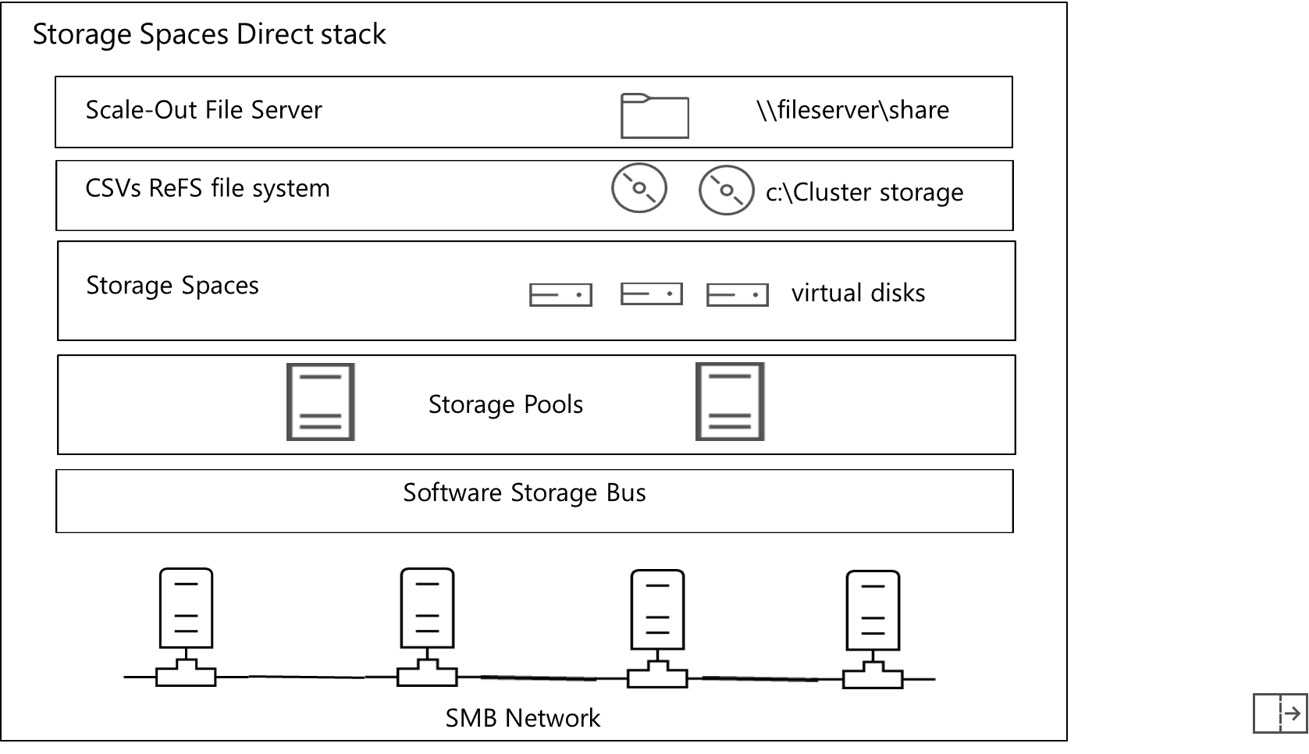
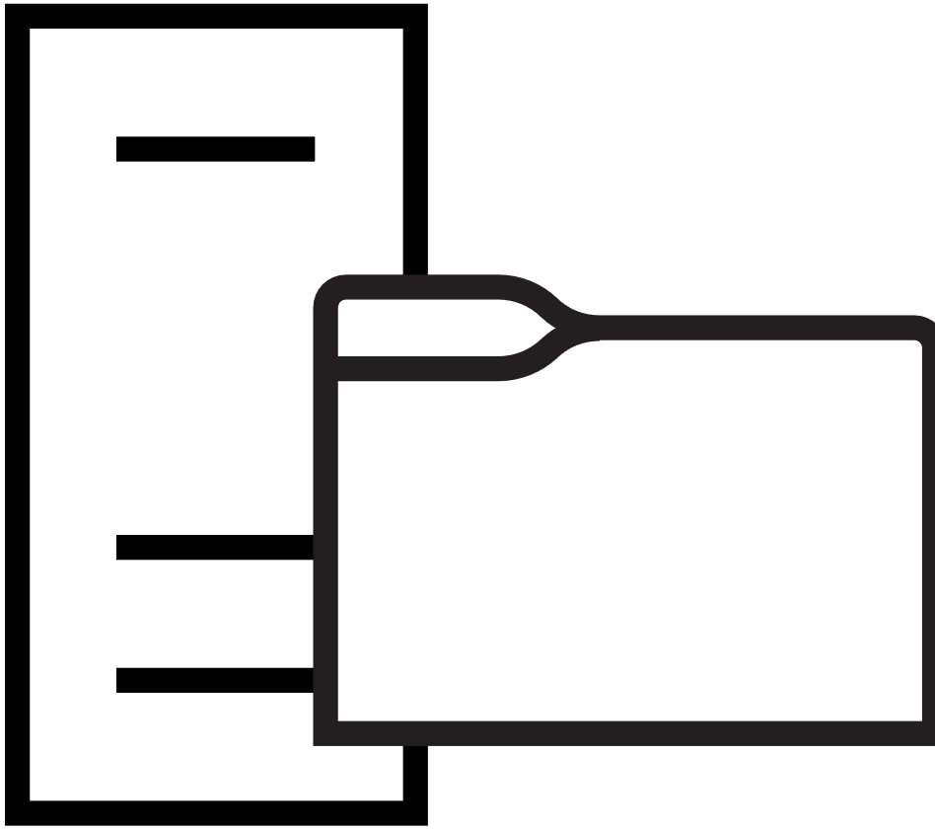

Overview of Storage Spaces Direct (1 of 3)
Storage spaces direct stack
Scale-Out file server
\\fileserver\share
CSVs ReFS file system
c:\Cluster storage
Storage spaces
Virtual disks
Storage Pools
Software Storage Bus
SMB Network
Notes:
Storage Spaces Direct is a new Windows Server 2019 feature, so you should plan on explaining this in depth to students. Go through the script that students use in the lab exercise, "Implementing the Storage Spaces Direct feature," and then explain the different steps to students.

Slide 34

Overview of Storage Spaces Direct (2 of 3)
Disaggregated Storage Spaces Direct scenario:
Hyper – V cluster
SMB storage fabric
Storage Spaces Direct with Scale out File Server
Notes:
Ensure that the students understand the difference between the two-cluster solution and the one-cluster solution. Explain to the students that the two-cluster solution scales better because you choose when to upgrade the compute side and/or storage side of the solution, and that the one cluster scenario is a solution with both storage and Hyper-V on the same servers.

Slide 35
Overview of Storage Spaces Direct (3 of 3)
Hyper-converged Storage Spaces Direct scenario
Hyper-converged stack
Hyper-V VMs
CSVs ReFS file system
c:\Cluster storage
Storage spaces
Virtual disks
Storage Pools
Software Storage Bus
SMB network
Notes:
Explain to the students that the one cluster scenario is a solution with both storage and Hyper-V on the same servers.

Slide 36
Demonstration: Configure Storage Spaces Direct
Install the Windows Server roles and features for Failover Clustering
Validate cluster configuration and create a cluster
Enable the Storage Spaces Direct feature, create a storage pool, virtual disk, file server, and file share
Test high availability for the storage
Notes:
Preparation steps
This demonstration script is divided into eight steps. Each step has a number of commands. Run the commands by highlighting each and selecting **F8**, one after the other, in accordance with the following instructions. Verify each step finishes—that is, goes from Stop operation (a red square) to Run selection (a green arrow) in the menu bar—before starting the next.
To prepare for this demonstration, complete the following steps:
If necessary, start WS-011T00A-SEA-DC1, WS-011T00A-SEA-ADM1, and WS-011T00A-SEA-SVR3.
Sign in to SEA-ADM1 and SEA-SVR3 with the username Contoso\Administrator and the password Pa55w.rd.
Demonstration detailed steps
Create a storage pool
On SEA-ADM1, select Start, and then select Server Manager.
In Server Manager, in the navigation pane, select File and Storage Services, and then select Disks.
In the Disks pane, scroll down, and note that the SEA-SVR3 disks 1 through 4 are set to Unknown.
Right-click or access the context menu for each offline disk, select Bring Online, and then select Yes.
Verify that all disks are online, and then select Storage Pools.
In Server Manager, in the STORAGE POOLS area, in the TASKS list, select New Storage Pool.
In the New Storage Pool Wizard, on the Before you begin page, select Next.
On the Specify a storage pool name and subsystem page, in the Nametext box, enter SP1. In the Description text box, enter Storage Pool 1, and then select Next.
On the Select physical disks for the storage pool page, select the check box for the first two disks, and then select Next.
On the Confirm selections page, review the settings, and then select Create.
Select Close.

Slide 37
Demonstration: Configure Storage Spaces Direct (2 of 3)
Install the Windows Server roles and features for Failover Clustering
Validate cluster configuration and create a cluster
Enable the Storage Spaces Direct feature, create a storage pool, virtual disk, file server, and file share
Test high availability for the storage
Notes:
Create a mirrored virtual disk
In Server Manager, in Storage Pools, select SP1.
In the VIRTUAL DISKS area, select TASKS, and then select New Virtual Disk.
In the Select the storage pool dialog box, select SP1, and then select OK.
In the New Virtual Disk Wizard, on the Before you begin page, select Next.
On the Specify the virtual disk name page, in the Name box, enter Mirrored, and then select Next.
On the Specify enclosure resiliency page, select Next.
On the Select the storage layout page, select Mirror, and then select Next.
On the Specify the provisioning enter page, select Thin, and then select Next.
On the Specify the size of the virtual disk page, in the Specify size box, enter 25, and then select Next.
On the Confirm selections page, review the settings, and then select Create.
On the View results page, clear the Create a volume when this wizard closes check box, and then select Close.
Create a volume for corporation data
In Server Manager, in the navigation pane, select Volumes.
In the VOLUMES area, select TASKS, and then select New Volume.
In the New Volume Wizard, on the Before you begin page, select Next.
On the Select the server and disk page, select SEA-SVR3, select Mirrored, and then select Next.
On the Specify the size of the volume page, select Next.
On the Assign to a drive letter or folder page, select Drive letter, select M, and then select Next.
On the Select file system settings page, in the Volume label box, enter Corp Data, and then select Next.
On the Confirm selections page, select Create.
On the Completion page, select Close.
Close Server Manager.

Slide 38
Demonstration: Configure Storage Spaces Direct (3 of 3)
Install the Windows Server roles and features for Failover Clustering
Validate cluster configuration and create a cluster
Enable the Storage Spaces Direct feature, create a storage pool, virtual disk, file server, and file share
Test high availability for the storage
Notes:
Examine disk properties in Windows Admin Center
On SEA-ADM1, in the WAC, connect to SEA-SVR3 with the Contoso\Administrator credentials.
Open the Files node and examine the new Storage Spaces drive named Corp Data.
Note: When you have finished the demonstration, revert the virtual machines.

Slide 39
Lesson 3: Test your knowledge
Refer to the Student Guide for lesson-review questions

Slide 40
Lesson 04: Implementing Data Deduplication

Slide 41
Lesson 4: Overview
This lesson describes how to implement the Data Deduplication feature:
Topics:
Data Deduplication components
Data Deduplication process
Deploying Data Deduplication
Usage scenarios for Data Deduplication
Demonstration: Implementing Data Deduplication
FSRM overview
Backup and restore considerations with Data Deduplication
Notes:
Lesson overview

Slide 42
Data Deduplication components (1 of 3)
The Data Deduplication role service consists of several components including:
A filter driver, which monitors local or remote I/O
The Deduplication service, which controls the four available job types:
Optimization
Garbage collection
Scrubbing
Unoptimization
Notes:
Describe the architecture of the Data Deduplication role service. Explain the savings that you gain through its use. Also, explain the different components of the Data Deduplication infrastructure.

Slide 43
Data Deduplication components (2 of 3)
A view of optimized data (80% savings)
After deduplication
Chunk
store
2 TB physical size
Optimized
file stubs
Savings = 8 TB
Non-optimized
files
Before deduplication
10 TB
Notes:
Explain the savings that you gain through its use.

Slide 44

Data Deduplication components (3 of 3)
Server
Manager
Windows
PowerShell
WMI
The different components of the Data Deduplication infrastructure.
Management
File
I/0
Deduplication service
Collect
garbage
Scrub
data
Optimize
Deduplication jobs
Deduplication filter driver
Deduplication Job Access
Regular storage
File
metadata
NTFS file system
Chunk store
Notes:
Also, explain the different components of the Data Deduplication infrastructure. Explain the graphics by mentioning that the disk is formatted with NTFS file system, which contains the file metadata, regular storage, and the chunk store. Also describe the deduplication management components, including Server Manager, Windows PowerShell, and WMI; the deduplication service; the deduplication jobs including collect garbage, scrub data, and optimize; and the deduplication job access component. Also inform the students that the file I/O process uses the deduplication filter driver to deduplicate data.

Slide 45
Deploy Data Deduplication (1 of 2)
Prior to installing and configuring Data Deduplication in your environment, plan your deployment using the following steps:
Determine target deployments
Determine which volumes are candidates for deduplication
Evaluate savings with the Deduplication Evaluation Tool
Plan the rollout, scalability, and deduplication policies
Notes:
Explain what students must consider while planning Data Deduplication.

Slide 46
Deploy Data Deduplication (2 of 2)
After completing your planning, deploy Data Deduplication to a server in your environment by performing the following steps:
Install Data Deduplication components on the server
Enable Data Deduplication
Configure Data Deduplication jobs
Configure Data Deduplication schedules
Notes:
Explain the steps involved in configuring Data Deduplication.

Slide 47








Usage scenarios for Data Deduplication (1 of 2)
Consider using Data Deduplication for the following areas:
File shares
VHD libraries
Software deployment
shares
User
documents
Notes:
Describe each of the common scenarios for using Data Deduplication.

Slide 48
Usage scenarios for Data Deduplication (2 of 2)
Example deduplication savings on data at rest
0%
10%
20%
30%
40%
50%
60%
70%
80%
90%
100%
User home folder
(MyDocs)
General file share
Software
deployment share
VHD library
Notes:
Explain that the bar graph compares the potential disk savings when data deduplication is enabled. Deduplicating user home folders might result in 30% savings, general file shares might result in 50% savings, software deployment share might result in 75% savings, and VHD library might result in 90% savings.

Slide 49
Demonstration: Implement Data Deduplication
Install the Data Deduplication role service
Enable Data Deduplication
Check the status of Data Deduplication
Notes:
Preparation steps
If necessary, start WS-011T00A-SEA-DC1, WS-011T00A-SEA-ADM1, and WS-011T00A-SEA-SVR3. Sign in to both SEA-ADM1 and SEA-SVR3with the username Contoso\Administrator and the password Pa55w.rd.
Before starting this demonstration, recreate the mirrored volume (Mirrored Volume M:) you made in the Storage Spaces demo, including the , which was the first demo in Lesson 3. Ensure the CreateLabfiles.cmd command file is run again in the same location.
Demonstration detailed steps
To perform this demonstration, complete the following tasks.
Install the Data Deduplication Role Service
To install the Data Deduplication Role Service:
On SEA-ADM1, select the Windows button, and then select Server Manager.
in Server Manager, in the navigation pane, select Dashboard.
In the details pane, select Add roles and features.
In the Add Roles and Features Wizard, on the Before you begin page, select Next.
On the Select installation page, enter page, and then select Next.
On the Select destination server page, select SEA-SVR3, and then select Next.
On the Select server roles page, in the Roles list, expand File and Storage Services (4 of 12 installed).
Expand File, and then expand iSCSI Services (3 of 11 installed).
Select the Data Deduplication check box, and then select Next.
On the Select features page, select Next.
On the Confirm installation selections page, select Install.
When the installation is complete, on the Installation progress page, select Close.
On the taskbar, select the File Explorer icon.
In File Explorer, expand the drive C.
,Right-click or access the context menu for the Labfiles directory, select Give access to, and then select Specific people….
In the Network access window, select Share.
When the Your folder is shared section displays, select Done.
Switch to SEA-SVR3.
In the command prompt window, enter the following command, and then select Enter: Net use x: \\SEA-ADM1\Labfiles
Enter the following command, and then select Enter: M:
Enter the following command, and then select Enter: Md Data
Enter the following command, and then select Enter: copy x:\mod04\createlabfiles.cmd M:
Enter the following command, and then select Enter: CreateLabFiles.cmd
Enter the following command, and then select Enter: Cd data
Enter the following command, and then select Enter: dir
Make note of the M:\Data free space.

Slide 50
Demonstration: Implement Data Deduplication (2 of 3)
Install the Data Deduplication role service
Enable Data Deduplication
Check the status of Data Deduplication
Notes:
Enable Data Deduplication
To enable Data Deduplication:
In Server Manager, in the navigation pane, select File and Storage Services, and then select Disks.
In the Disks pane, select the Mirrored Volume on SEA-SVR3.
Under VOLUMES, select M.
Right-click or access the context menu for D, and then select Configure Data Deduplication.
In the Mirrored Volume (M:) Deduplication Settings dialog box, in the Data deduplication list, select General purpose file server.
In the Deduplicate files older than (in days) text box, enter 1.
Select Set Deduplication Schedule.
In the SEA-SVR3 Deduplication Schedule dialog box, select the Enable throughput optimization check box, and then select OK.
In the Mirrored Volume (M:) Deduplication Settings dialog box, select Add.
In the Select Folder dialog box, expand Mirrored Volume (M:),and then select shares.
Select Select Folder, and then select OK.

Slide 51
Demonstration: Implement Data Deduplication (3 of 3)
Install the Data Deduplication role service
Enable Data Deduplication
Check the status of Data Deduplication
Notes:
Check the Status of Data Deduplication
To check the Data Deduplication status:
On the taskbar, select the Microsoft Edge icon.
In Microsoft Edge, in the Favorites menu, select the Windows Admin Center (WAC) tab.
In the Windows security window, in the Username text box, enter Contoso\Administrator, in the Password text box, enter Pa55w.rd, and then select OK.
In the All connections list, select the SEA-SVR3 hyperlink.
In the Specify your credentials window, use the following settings, and then select Continue:
Use another account for this connection: selected
Username: Contoso\Administrator
Password: Pa55w.rd
Use these credentials for all connections: selected
In the PowerShell node, enter the following command, and then select Enter: Get-DedupStatus
In the Windows PowerShell command prompt window, enter the following command, and then select Enter: Get-DedupStatus | fl
Enter the following command, and then select Enter: Get-DedupVolume
Enter the following command, and then select Enter: Get-DedupVolume |fl
Enter the following command, and then select Enter:
Start-DedupJob M: -Type Optimization –Memory 50
Note: Because most the files on drive M are small, you might not notice a significant amount of saved space.
Close all open windows.
Revert the virtual machines (VMs) to their initial state
To revert the VMs:
On the host computer, start Microsoft Hyper-V Manager.
In the Virtual Machines list, right-click or access the context menu for SEA-SRV3, and then select Revert.
In the Revert Virtual Machine dialog box, select Revert.
Repeat steps 2 and 3 for SEA-ADM1,and SEA-DC1.

Slide 52

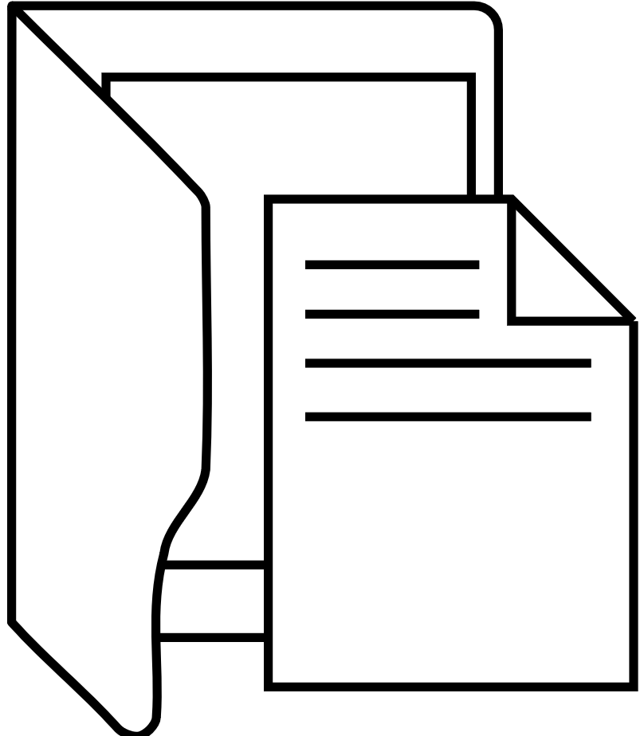


Backup and restore considerations with Data Deduplication
One of the benefits of using Data Deduplication is that backup and restore operations typically are faster
Notes:
Describe the considerations for using backup and restore programs for volumes that are being deduplicated.

Slide 53
Lesson 4: Test your knowledge
Refer to the Student Guide for lesson-review questions

Slide 54
Lesson 05: Implementing iSCSI

Slide 55
Lesson 5: Overview
This lesson describes how to implement iSCSI
Topics:
What is iSCSI?
iSCSI components
Considerations for implementing iSCSI
iSCSI scenarios of usage
Demonstration: Configuring and connecting to an iSCSI target
Notes:
Lesson overview

Slide 56
What is iSCSI? (1 of 2)
Component | Description
IP network | Network that provides high performance and redundancy
iSCSI targets | Servers that run on the storage device and enable access to the disks
iSCSI initiators | Software component or host adapter on the server that provides access to iSCSI targets
iSCSI IQN | Globally unique identifier that iSCSI uses to address initiators and targets on an iSCSI network
iSCSI transmits SCSI commands over IP networks
Notes:
Highlight that internet small computer system interface (iSCSI) storage area networks (SANs) typically are easier to implement than Fibre Channel SANs. However, because iSCSI uses the standard IP network and network devices, you don't need special skills to deploy the network infrastructure. If your storage device has many disks, and multiple servers connect to the SAN, you still need to plan your deployment carefully.

Slide 57
What is iSCSI? (2 of 2)
iSCSI client that runs the iSCSI initiator
TCP/IP protocol
Storage
array
iSCSI Target Server
Notes:
Use the slide illustration to explain how an iSCSI initiator connects to an iSCSI target.

Slide 58
iSCSI components (1 of 3)
The iSCSI Target Server:
Is available as a role service in Windows Server 2019
Provides the following functionality:
Network or diskless boot
Server application storage
Heterogeneous storage
Lab environments
Has the following features:
Authentication
Query initiator computer for ID
Virtual hard disks
Scalability
Manageability
Notes:
Provide an overview of the Internet Small Computer System Interface (iSCSI) Target Server, and the features that are available in Windows Server.

Slide 59
iSCSI components (2 of 3)
The iSCSI initiator:
Runs as a service in the operating system
Is installed by default on Windows Vista and Windows Server 2008 and later
Requires only to be started and configured to connect the computer to the iSCSI target

Slide 60
iSCSI components(3 of 3)
iSNS provides discovery and zoning of iSCSI targets and initiators
DCB provides network convergence by running iSCSI traffic without dedicated cabling
Notes:
Explain the need to create zones with Internet Storage Name Service (iSNS). You can use Domain Name System (DNS) as a comparison. Explain the two high-availability technologies of iSCSI, and when to use Data Center Bridging.

Slide 61
Considerations for implementing iSCSI
The primary factors to consider when planning on using iSCSI are:
Network speeds and performance
High availability
Security
Vendor information
Infrastructure staff
Application teams
Alternative solutions to iSCSI:
Fibre Channel
Fibre Channel over Ethernet
Notes:
Discuss the primary factors to consider for Internet Small Computer System Interface (iSCSI) deployments based on the information in the Student Handbook. Explain the alternative solutions and ask students if they can think of scenarios in which they would use each alternative solution. Some examples include:
A stock and bond trading organization. Performance is the primary concern because fractions of a second can cause significant financial losses. For this ssituation InfiniBand would be the appropriate solution.
Existing Fibre Channel in organizations that want to use Ethernet in the future. Fibre Channel over Ethernet is the appropriate solution.
A new datacenter. Performance is a key factor, but if the budget doesn't have enough room for InfiniBand, Fibre Channel is the appropriate solution.

Slide 62
iSCSI usage scenarios
Two technologies for implementing iSCSI for high availability are:
MCS. In the event of a failure, all outstanding iSCSI commands are reassigned to another connection automatically
MPIO. If you have multiple network interface cards in your iSCSI initiator and iSCSI Target Server, you can use MPIO to provide failover redundancy in the event of network outages

Slide 63
Demonstration: Configure and connect to iSCSI target
Add an iSCSI Target Server role service
Create iSCSI virtual disks and an iSCSI target
Connect to an iSCSI target
Verify the presence of the iSCSI drive
Notes:
(More notes on the next slide)
Preparation Steps
To prepare for this demonstration:
If necessary, start WS-011T00A-SEA-DC1, WS-011T00A-SEA-ADM1 and WS-011T00A-SEA -SVR3.
Sign in to SEA-ADM1 and SEA-SVR3 with the username Contoso\Administrator and the password Pa55w.rd.
Demonstration detailed steps
Add iSCSI Target Server role services on SEA-ADM1 and SEA-SVR3 and prepare disks on SEA-SVR3
On SEA-ADM1, on the taskbar, right-click or access the context menu for the Windows key, and then select Windows PowerShell (Admin).
In the Administrator: Windows PowerShell window, enter the following command, and then select Enter:
Invoke-Command -ComputerName SEA-ADM1, SEA-SVR3 -ScriptBlock {Install-WindowsFeature –Name FS-iSCSITarget-Server –IncludeManagementTools}
Wait for the iSCSI Target Server role to successfully install on both computers.
In the Administrator: Windows PowerShell window, enter the following command, and then select Enter:
Enter-PSSession -ComputerName SEA-SVR3 -Credential Contoso\Administrator
In the Windows Security pop-up window, in the Password field, enter Pa55w.rd, and then select OK.
In the Administrator: Windows PowerShell window, enter the following command, selecting Enter after each line:
Get-Disk
Initialize-Disk -Number 1
New-Partition -DiskNumber 1 -UseMaximumSize –AssignDriveLetter
Determine the drive letter that is assigned.
In the Administrator: Windows PowerShell window, enter the following command (Where X is equal to the drive letter you made note of in step 7), and then select Enter: Format-Volume -DriveLetter _X_ -FileSystem ReFS
Repeat steps 1-3 for Disk 2 and Disk 3.
In the Administrator: Windows PowerShell window, enter the following two commands, selecting Enter at the end of each line: New-NetFirewallRule -DisplayName 'iSCSITargetIn' -Profile 'Any' -Direction Inbound -Action Allow -Protocol TCP -LocalPort 3260 New-NetFirewallRule -DisplayName 'iSCSITargetOut' -Profile 'Any' -Direction Outbound -Action Allow -Protocol TCP -LocalPort 3260
In the Administrator: Windows PowerShell window, enter the following command, and then select Enter: Exit-PSSession
Do not close Windows PowerShell.

Slide 64
Demonstration: Configure and connect to iSCSI target (2 of 3)
Add an iSCSI Target Server role service
Create iSCSI virtual disks and an iSCSI target
Connect to an iSCSI target
Verify the presence of the iSCSI drive
Notes:
(More notes on the next slide)
Select the Create two iSCSI virtual disks and an iSCSI target on SEA-SVR3:
On SEA-ADM1, select the Windows key, and then select Server Manager.
in Server Manager, in the navigation pane, select File and Storage Services.
In the File and Storage Services pane, select Disks.
Ensure the entry for SEA-SRV3 contains the three disks that were just formatted.
In the File and Storage Services pane, select iSCSI.
In the iSCSI VIRTUAL DISKS pane, select TASKS, and then in the TASKSdrop-down list box, select New iSCSI Virtual Disk.
In the New iSCSI Virtual Disk Wizard, in the Server: location area, select the SEA-SVR3 entry.
On the Select iSCSI virtual disk location page, under Storage location, select E:, and then select Next.
On the Specify iSCSI virtual disk name page, in the Name text box, enter iSCSIDisk1, and then select Next.
On the Specify iSCSI virtual disk size page, in the Size text box, enter 5.
Ensure that GB is selected in the drop-down list box, ensure that Dynamically expanding is selected as an option, and then select Next.
On the Assign iSCSI target page, select New iSCSI target, and then select Next.
On the Specify target name page, in the Name text box, enter iSCSIFarm, and then select Next.
In the Specify access servers page, select the Add button.
In the Select a method to identify the initiator window, select the Browse button.
In the Select Computer window, in the Enter the object name to selecttext box, enter SEA-DC1, select Check Names, and then select OK.
On the Specify access servers page, select Next.
On the Enable Authentication page, select Next.
On the Confirm selections page, select Create.
On the View results page, wait until the creation process completes, and then select Close.
In the iSCSI VIRTUAL DISKS pane, select TASKS, and then in the TASKSdrop-down list box, select New iSCSI Virtual Disk.
In the New iSCSI Virtual Disk Wizard, in the Server: location area, select SEA-SVR3.
On the Select iSCSI virtual disk location page, under Storage location, select F:, and then select Next.
On the Specify iSCSI virtual disk name page, in the Name text box, enter iSCSIDisk2, and then select Next.
On the Specify iSCSI virtual disk size page, in the Size text box, enter 5.
Ensure that GB is selected in the drop-down list box, ensure that Dynamically expanding is selected as an option, and then select Next.

Slide 65
Demonstration: Configure and connect to iSCSI target (3 of 3)
Add an iSCSI Target Server role service
Create iSCSI virtual disks and an iSCSI target
Connect to an iSCSI target
Verify the presence of the iSCSI drive
Notes:
(More notes on the next slide)
On the Assign iSCSI target page, select iSCSIFarm, and then select Next.
On the Confirm selections page, select Create.
On the View results page, wait until the creation process completes, and then select Close.
Connect SEA-DC1 to the iSCSI target:
On SEA-DC1, in the command prompt window, enter PowerShell.
In the Administrator: Windows PowerShell window, enter the following command, and then select Enter: Start-Service msiscsi
Enter the following command, and then select Enter: iscsicpl
Note: The iscsicpl command will bring up an iSCSI Initiator Propertiesdialog box.
In the iSCSI Initiator Properties dialog box, on the Targets tab, in the Target text box, enter SEA-SVR3, and then select Quick Connect.
In the Quick Connect window, in the Discovered targets section, select iqn.1991-05.com.microsoft:SEA-SVR3-iSCSIFarm-target, and then select Done.
In the iSCSI Initiator Properties dialog box, select OK.
Verify the presence of the iSCSI disks**
To verify the presence of the iSCSI disks:
In Server Manager, in the tree pane, select File and Storage Services, and then select Disks.
Ensure the entry for SEA-DC1 contains the two new 5-GB disks that are offline. Point out that the bus enter is iSCSI. If you are in the File and Storage Services section of Server Manager, you might need to select the refresh button to find the two new disks.
Revert the virtual machines (VMs) to their initial state
To revert the VMs:
On the host computer, start Microsoft Hyper-V Manager.
In the Virtual Machines list, right-click or access the context menu for SEA-SRV3, and then select Revert.
In the Revert Virtual Machine dialog box, select Revert.
Repeat steps 2 and 3 for SEA-ADM1,and SEA-DC1.

Slide 66
Lesson 5: Test your knowledge
Refer to the Student Guide for lesson-review questions

Slide 67
Lesson 06: Deploying DFS

Slide 68
Lesson 6: Overview
This lesson describes how to manage DFS databases
Topics:
DFS overview
Deploy DFS
Implement DFS replication
DFS namespaces and replication
Manage DFS databases
Overview of Azure File Sync
Notes:
Lesson overview

Slide 69

Overview of DFS
Three DFS scenarios:
Branch office
Hub site or branch office
Sharing files across branch offices
Branch office
Hub site
Data collection
Branch office
Hub site
Data distribution
Notes:
Identify the key scenarios for using Distributed File System (DFS) to provide access to file shares for branch office locations. Consider asking students the following question:
Question: Why should you avoid using DFS to replicate high volume, transaction-based databases?
Answer Databases with high-volume transactions typically leave several database files open in order to process the transactions. DFS cannot replicate files if they are held open by an application. Therefore, if you use DFS to replicate a high-volume, transaction-based database, the replicated copies of the database are not consistent with the data.

Slide 70



Deploy DFS
User in
New York
1
2
Server
in New York
\\Contoso.com\Marketing
DFS Replication
\\NYC-SRV-01\ProjectDocs
Folder
Targets
\\LON-SRV-01\ProjectDocs
User in
London
1
2
Namespace
Server
in London
User enters : \\contoso.com\marketing Client computers contact a namespace server and receive a referral
Client computers cache the referral and then contact the first server in the referral
Notes:
Fully describe the Distributed File System (DFS) deployment process using the flowchart on the slide.
When a user attempts to access a folder in the namespace (1), the client computer contacts a namespace server. The namespace server sends the client computer a referral that contains a list of servers that host the shared folders (called folder targets) associated with the folder. The client computer caches the referral and then contacts the first server in the referral (2). This typically is a server in the client’s own site unless no same-site servers exist, or the administrator configures target priority. The shared folders are kept synchronized by Distributed File System Replication (DFSR). The fact that multiple servers host the folder is transparent to the user, who notices only a single folder in the namespace. If one of the servers becomes unavailable, the client computer fails over to the remaining server.

Slide 71
Implement DFS replication
When you implement DFSR, it then:
Uses remote differential compression
Uses a staging folder to stage a file before sending or receiving the file
Detects changes on the volume by monitoring the USN journal
Uses a vector version exchange protocol
Recovers from failure
Configure and manage DFSR by using the cmdlets from the DFSR module for Windows PowerShell
Notes:
Identify the primary functions of Distributed File System Replication (DFSR), including how it's implemented. Point out the DFSR module for Windows PowerShell, including the example commands, and how to get information about all available commands.

Slide 72
DFS namespaces and replication (1 of 2)
DFS namespaces can be configured as:
Domain-based namespaces
Standalone namespaces
To configure a namespace for publishing content:
Create a namespace
Create a folder in the namespace
Add folder targets
Set the ordering method for targets in referrals
Notes:
Introduce the concept of a Distributed File System (DFS) namespace and how it's used. Describe the two namespace types, and explain how DFS namespaces are configured in Windows Server 2019.

Slide 73
DFS namespaces and replication (2 of 2)
You can optimize DFS by:
Renaming or moving a folder
Disabling referrals to a folder
Specifying referral cache duration
Configuring namespace polling
Configuring replication groups
Creating multiple replicated folders
Modifying replication topology
Notes:
Identify and describe the primary tasks for optimizing DFS namespaces and replication.

Slide 74
Manage DFS databases
When managing a DFS database:
Use these cmdlets to clone a DFS database:
Export-DfrsClone
Import-DfrsClone
Use these cmdlets to recover a DFS database:
Get-DfsrPreservedFiles
Restore-DfsrPreservedFiles
Notes:
Explain how to clone and how to recover a Distributed File System (DFS) database.

Slide 75
Overview of Azure File Sync
Azure File Sync:
Automatically replicates local file shares to a central Azure storage location
Administrators continue to support local data access
Allows applications that need local and Azure data to use the same data sets
Automatically backs up disparate branch office data
Allows cloud tiering—non-used data moves off premises to Azure
Uses SSL encryption through well-known port number 443

Slide 76
Lesson 6: Test your knowledge
Refer to the Student Guide for lesson-review questions

Slide 77
Instructor-led labs: Implementing storage solutions in Windows Server
Implementing Data Deduplication
Configuring iSCSI storage
Configuring redundant storage spaces
Implementing Storage Spaces Direct

Slide 78
Lab: Implementing storage solutions in Windows Server (1 of 2)
Exercise 1: Implementing Data Deduplication
Exercise 2: Configuring iSCSI storage
Exercise 3: Configuring redundant Storage Spaces
Exercise 4: Implementing Storage Spaces Direct
Notes:
Estimated time: 90 minutes
Exercise 1: Implementing Data Deduplication
You decide to install the Data Deduplication role service by using Server Manager. You determine that drive M is heavily used, and you suspect that it contains duplicate files in some folders. You decide to enable and configure the Data Deduplication role to reduce the consumed space on this volume.
Exercise 2: Configuring iSCSI storage
Executives at Contoso are exploring the option of using iSCSI to decrease the cost and complexity of configuring centralized storage. To test this, you must install and configure the iSCSI targets, and configure the iSCSI initiators to provide access to the targets.
Exercise 3: Configuring redundant Storage Spaces
o meet some of the requirements for high availability, you decided to evaluate redundancy options in Storage Spaces. Additionally, you want to test the provisioning of new disks to the storage pool.
Exercise 4: Implementing Storage Spaces Direct
You want to test whether using local storage as highly available storage is a viable solution for your organization. Previously, your organization has only used storage area networks (SANs) for storing VMs. The new features in Windows Server 2019 make it possible to use only local storage, so you want to implement Storage Spaces Direct as a test implementation.

Slide 79
Lab: Implementing storage solutions in Windows Server (2 of 2)
Sign-in information for the exercises:
Virtual machines:
For Exercises 1-3:
WS-011T00A-SEA-DC1
WS-011T00A-SEA-SVR3
WS-011T00A-SEA-ADM1
For Exercise 4:
WS-011T00A-SEA-DC1
WS-011T00A-SEA-SVR1
WS-011T00A-SEA-SVR2
WS-011T00A-SEA-SVR3
WS-011T00A-SEA-ADM1
User Name: Contoso\Administrator
Password: Pa55w.rd

Slide 80
Lab scenario
At Contoso, Ltd, you need to implement the Storage Spaces feature on the Windows Server 2019 servers to simplify storage access and provide redundancy at the storage level. Management wants you to test Data Deduplication to save storage. They also want you to implement Internet Small Computer System Interface (iSCSI) storage to provide a simpler solution for deploying storage in the organization. Additionally, the organization is exploring options for making storage highly available and researching the requirements that it must meet for high availability. You want to test the feasibility of using highly available storage, specifically Storage Spaces Direct.

Slide 81
Module-review questions
You attach five 2-TB disks to your Windows Server 2012 computer. You want to simplify the process of managing the disks. In addition, you want to ensure that if one disk fails, the failed disk’s data is not lost. What feature can you implement to accomplish these goals?
Your manager has asked you to consider the use of Data Deduplication within your storage architecture. In what scenarios is the Data Deduplication role service particularly useful?
Can you use both local and shared storage with the Storage Spaces Direct feature?

Slide 82
Module-review answers (1 of 2)
You attach five 2-TB disks to your Windows Server 2012 computer. You want to simplify the process of managing the disks. In addition, you want to ensure that if one disk fails, the failed disk’s data is not lost. What feature can you implement to accomplish these goals?
Answer: You can use the Storage Spaces feature to create a storage pool of all five disks, and then create a virtual disk with parity or mirroring to make it highly available.
Your manager has asked you to consider the use of Data Deduplication within your storage architecture. In what scenarios is the Data Deduplication role service particularly useful?
Answer: You should consider using deduplication for the following areas:
File shares, including group content publication or sharing, user home folders, and profile redirection for accessing offline files. With the release to manufacturing (RTM) version of Windows Server 2012, you could save approximately 30 to 50 percent of your system’s disk space. With the Cluster Shared Volume (CSV) support in Windows Server 2012 R2, the disk savings can increase up to 90 percent in certain scenarios.
Software deployment shares. This includes software binaries, images, and updates. You might be able to save approximately 70 to 80 percent of your disk space.
.vhd and .vhdx file libraries. This includes .vhd and .vhdx file storage for provisioning to hypervisors. You might be able to save disk space of approximately 80 to 95 percent.

Slide 83
Module-review answers (2 of 2)
3. Can you use both local and shared storage with the Storage Spaces Direct feature?
Answer: No. Storage Spaces Direct can use only local storage. A standard storage space can use shared storage.

Slide 84
Thank you.

