Slide 1
WS-011 Windows Server 2019 Administration

Slide 2
Module 7: Disaster Recovery in Windows Server

Slide 3
Module overview
BCDR is an important consideration for most companies. Microsoft Hyper-V includes the Hyper-V Replica feature, which provides an affordable disaster recovery solution for protecting the individual virtual machines. For backup purposes, Windows Server includes integrated Windows Server Backup software.
Lessons:
Lesson 1: Hyper-V Replica
Lesson 2: Back up and restore infrastructure in Windows Server

Slide 4
Lesson 1: Hyper-V Replica

Slide 5
Lesson 1 overview
Hyper-V Replica is a disaster recovery feature that is built into Hyper-V. You can use it to replicate a running VM to a secondary location and to extend the replication to a tertiary location.
Topics:
Overview of Hyper-V Replica
Plan for Hyper-V Replica
Configure and implement Hyper-V Replica
Demonstration: Implement Hyper-V Replica
Overview of Azure Site Recovery

Slide 6

Overview of Hyper-V Replica (1 of 2)
Hyper-V Replica in Windows Server enables you to replicate a single VM over a WAN or LAN network to another host. Hyper-V Replica components include:
Replication engine
Change tracking
Network module
Hyper-V Replica Broker role
Management tools
Primary site
Replication traffic
Replica site
Recovery virtual machines
WAN link
P1
P2
R1
R2
SAN/NAS
Notes:
Introduce students to the Hyper-V Replica feature. Explain the prerequisites and discuss usage scenarios. Make sure that you also cover the main components of Hyper-V Replica and security considerations.

Slide 7
Overview of Hyper-V Replica (2 of 2)
You can establish Hyper-V Replica with a Hyper-V host regardless of its location and domain membership, providing you have network connectivity with it
You also can implement Hyper-V Replica when Hyper-V hosts are members of untrusted domains, if you configure certificate-based authentication
Hyper-V creates a local security group named Hyper-V Administrators
When you limit replication to specific servers, you need to specify a trust group, which is used to identify the servers within which a virtual machine can move
The replica Hyper-V host can authenticate a primary Hyper-V host by using Kerberos authentication or certificate authentication
You should configure Windows Defender Firewall to allow either HTTP or HTTPS Hyper-V Replica traffic

Slide 8
Plan for Hyper-V Replica
There are four different configurations in which you can use Hyper-V Replica:
Both Hyper-V hosts are standalone servers
The Hyper-V host at the primary location is a node in a failover cluster and the Hyper-V Replica is on a standalone server
Each Hyper-V host is a node in a different failover cluster
The Hyper-V host at the primary location is a standalone server, and the Hyper-V host at the secondary location is a node in a failover cluster
Important replication settings you should plan:
Replica server
Connection parameters
Replicated VHDs
Replication frequency
Additional recovery points
Initial replication method and schedule
Extended replication
Notes:
Explain the configurations that can be applied to Hyper-V Replica. After that, discuss configuration settings that customers should plan before implementing Hyper-V Replica. Try to provide some real-life examples for specific configuration selections.

Slide 9
Configure and implement Hyper-V Replica (1 of 2)
To configure Hyper-V Replica, you should:
Enable Hyper-V server as a replica server
Configure Hyper-V settings
Specify both the replica server name and the connection options
Select the VHDs to replicate
Start the replication
Notes:
Describe the process of configuring and implementing Hyper-V Replica. Additionally, explain how to monitor replication health and the parameters to watch. Discuss failover scenarios. Because this is critical to understand, ensure that students understand how they can use different failover options.

Slide 10
Configure and implement Hyper-V Replica (2 of 2)
Hyper-V Replica failover scenarios include:
Test failover
Planned failover
Failover
Other Hyper-V replication-related actions include:
Pause replication
Resume replication
View replication health
Extend replication
Remove recovery points
Remove replication

Slide 11
Demonstration: Implement Hyper-V Replica
Implement Hyper-V Replica feature on a Windows Server running Server Core
Notes:
Preparation steps
You need the WS-011T00A-SEA-ADM1, WS-011T00A-SEA-SVR1, and WS-011T00A-SEA-SVR2 VMs for this demonstration.
Demonstration detailed steps
On SEA-ADM1, sign in as Contoso\Administrator with password Pa55w.rd.
Select Start, and then enter powershell. Right-click or access the context menu for Windows PowerShell, and then select Run as administrator.
In the Administrator: Windows PowerShell window, enter the following command, and then select Enter:
$cred=Get-Credential
When prompted, sign in as Contoso\Administrator with password Pa55w.rd.
In the Administrator: Windows PowerShell window, enter the following command, and then select Enter:
$sess = New-PSSession -Credential $cred -ComputerName sea-svr1.contoso.com
Next, enter the following command, and then select Enter:
Enter-PSSession $sess
You should get a [sea-svr1.contoso.com] title in your command prompt.
From this point, all commands that you enter run on SEA-SVR1.
In the Administrator: Windows PowerShell window, enter the following command, and then select Enter:
Get-Netfirewallrule -displayname "Hyper-V Replica HTTP Listener (TCP-In)"
You'll receive the properties of this firewall rule. Search for the value of the Enabled variable. It should be set to False by default. To set SEA-SVR1 as the replication host, you must enable this firewall rule.
In the Administrator: Windows PowerShell window, enter the following command, and then select Enter:
Enable-Netfirewallrule -displayname "Hyper-V Replica HTTP Listener (TCP-In)"
In the Administrator: Windows PowerShell window, enter the following command, and then select Enter:
Get-Netfirewallrule -displayname "Hyper-V Replica HTTP Listener (TCP-In)"
You'll receive the properties of this firewall rule. Search for the value of the Enabled variable. Now, it should be set to True.
To configure SEA-SVR1 as a Replica server for Hyper-V Replica, enter the following command in the Administrator: Windows PowerShell window, and then select Enter:
Set-VMReplicationServer -ReplicationEnabled $true -AllowedAuthenticationType Kerberos -ReplicationAllowedFromAnyServer $true -DefaultStorageLocation c:\ReplicaStorage
In the Administrator: Windows PowerShell window, enter the following command, and then select Enter:
Get-VMReplicationServer
You should receive the configuration setting that you configured in the previous step, as follows:
RepEnabled:True AuthType:KerbKerAuthPort:80 CertAuthPort:443AllowAnyServer:True

Slide 12
Demonstration: Implement Hyper-V Replica (2 of 2)
Implement Hyper-V Replica feature on a Windows Server running Server Core
Notes:
In the Administrator: Windows PowerShell window, enter the following command, and then select Enter:
Get-VM
You should get SEA-CORE1 listed as a VM that's configured on this Hyper-V server. Leave the Administrator: Windows PowerShell window open.
Select Start, and then enter powershell. Right-click or access the context menu for Windows PowerShell, and then select Run as administrator. This will open another instance of Windows PowerShell.
In the Administrator: Windows PowerShell window, enter the following command, and then select Enter:
$cred=Get-Credential
When prompted, sign in as Contoso\Administrator with password Pa55w.rd.
In the Administrator: Windows PowerShell window, enter the following command, and then select Enter:
$sess1 = New-PSSession -Credential $cred -ComputerName sea-svr2.contoso.com
Next, enter the following command, and then select Enter:
Enter-PSSession $sess1
You should get a [sea-svr2.contoso.com] title in your command prompt. From this point, all commands that you enter run on SEA-SVR2.
Repeat steps 5 through 10 in the PowerShell window where you have the session opened on sea-svr2.contoso.com. This will configure SEA-SRV2 for Hyper-V Replica. In step 10, you should get no result when running the Get-VM command, because no VMs are configured on SEA-SVR2.
Switch to the PowerShell window where you have the remote PowerShell session opened for sea-svr1.contoso.com, enter the following command, and then select Enter:
Enable-VMReplication SEA-CORE1 -ReplicaServerName SEA-SVR2.contoso.com -ReplicaServerPort 80 -AuthenticationType Kerberos -computername SEA-SVR1.contoso.com
After you have verified that you didn't receive any error message from the previous command, enter the following command, and then select Enter:
Start-VMInitialReplication SEA-CORE1
This starts the initial replication process for the SEA-CORE1 VM, from SEA-SVR1 to SEA-SVR2.
After you have verified that you didn't receive any error message from the previous command, enter the following command, and then select Enter:
Get-VMReplication
This command retrieves the replication status.

Slide 13

Overview of Azure Site Recovery (1 of 2)
BCDR solution:
Replicates data and can provide orchestrated failover
Used for many scenarios:
Disaster recovery
Workload migration to Microsoft Azure
Cloud bursting
DevTest
Analytics and reporting
Requires Azure subscription
Replica
Replica
On-premises
Microsoft Azure
On-premises
On-premises
Notes:
Introduce Azure Site Recovery. Explain scenarios of usage. Mention that you need an Azure subscription for this service.

Slide 14
Overview of Azure Site Recovery (2 of 2)
Azure Site Recovery can protect:
Hyper-V virtual machines (without VMM)
Hyper-V virtual machines in a VMM cloud
VMWare virtual machines
Physical servers running Windows Server or Linux
Use Azure Site Recovery to:
Coordinate and monitor asynchronous replication
Manage the failover of virtual machines and VMM clouds
Manage virtual network mappings between sites
Continually monitor service availability
Test the recovery

Slide 15
Lesson 1: Test your knowledge
Refer to the Student Guide for lesson-review questions

Slide 16
Lesson 2: Backup and restore infrastructure in Windows Server

Slide 17
Lesson 2 overview
Having a backup infrastructure is mandatory for each organization. You can choose to use built-in tools to perform backup or you can use third-party tools. Windows Server has built-in backup software called Windows Server Backup.
Topics:
Overview of Windows Server Backup
Implement backup and restore
Back up and restore Hyper-V VMs
Overview of Azure Backup
Implement backup and restore with Azure Backup
Notes:
Ensure that you cover the Microsoft Azure Recovery Services vault, deploying the agent, performing backup and restore, and Azure Backup Server.

Slide 18
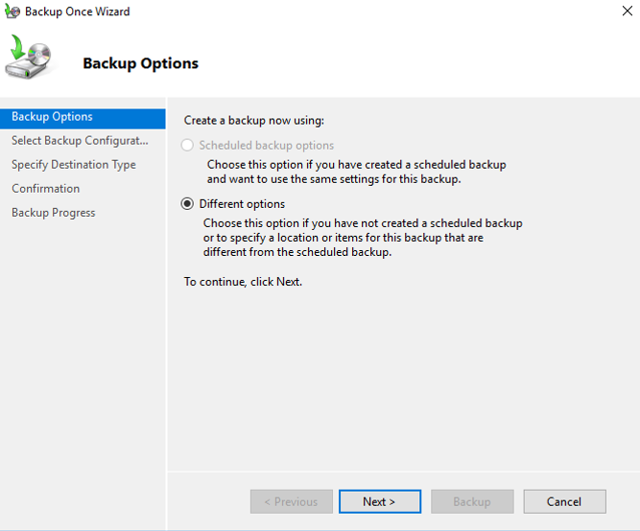
Overview of Windows Server Backup
Windows Server Backup provides you with the ability to perform backup and recovery in a Windows Server environment
By using Windows Server Backup you can backup:
A full server (all volumes), or just selected volumes
Individual files and folders
System state
Individual virtual machines on a Hyper-V host
Microsoft Exchange Server databases
Cluster shared volumes
WBAdmin is a command-line utility built into Windows Server
Notes:
Introduce Windows Server Backup and its features. Ensure that you explain that while Windows Server Backup can be used in various scenarios, it doesn't provide any complex features.

Slide 19
Implement backup and restore
Depending on what you need to backup, the procedures and options in Windows Server Backup might vary
Some of the most common backup procedures that you should consider include:
Backing up file servers and web servers
Backing up AD DS
Backing up Microsoft Exchange Server
Notes:
Explain the scenarios in which you can use Windows Server Backup.

Slide 20
Back up and restore Hyper-V VMs
You can use the following methods to back up VMs:
Backup the VM from the host
Backup the VM’s VHDs
Backup inside the VM
You can perform online backups that do not incur VM downtime, if you meet the following conditions:
The VM being backed up has integration services installed and enabled
Each disk that the VM uses is running NTFS file system basic disks
The VSS is enabled on all volumes within the VM, and snapshots for each volume are stored on the same volume
Notes:
Explain scenarios for backup and restore for virtualized environments. Ensure that students understand the differences between host and guest backups.

Slide 21
Overview of Azure Backup
Azure Backup is a subscription service that you can use to provide off-site protection against critical data loss caused by disasters
Azure Backup replaces or extends your existing on-premises or off-site backup solution
Some of the most important features in Azure Backup include:
Automatic storage management
Unlimited scaling
Multiple storage options
Data encryption
Offload on-premises backup
Back up Azure IaaS VMs
Retain short and long-term data
Multiple storage options
Notes:
Introduce the Microsoft Azure Backup service and its features.

Slide 22
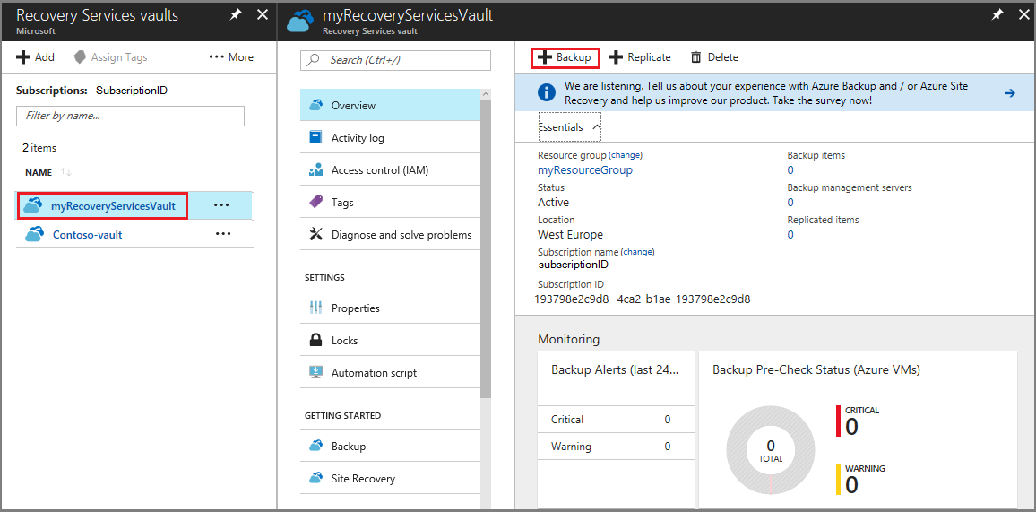
Implement backup and restore with Azure Backup
To use Azure Backup, you need to install a backup agent on your local servers, and you need to configure an Azure Recovery Services vault
You can use Recovery Services vaults to hold backup data for various Azure services such as IaaS VMs (Linux or Windows) and Azure SQL databases
Within an Azure subscription, you can create up to 25 Recovery Services vaults per region
Azure Backup for files and folders relies on the Azure Recovery Services agent to be installed on the Windows client or server
Notes:
Describe the process of creating a Microsoft Azure Recovery Services vault and implementing Azure Backup.

Slide 23
Lesson 2: Test your knowledge
Refer to the Student Guide for lesson-review questions

Slide 24
Instructor-led labs: Implementing Hyper-V Replica and Windows Server Backup
Implementing Hyper-V Replica
Implementing backup and restore with Windows Server Backup

Slide 25
Lab: Implementing Hyper-V Replica and Windows Server Backup
Exercise 1: Implementing Hyper-V Replica
Exercise 2: Implementing backup and restore with Windows Server Backup
Sign-in information for the exercise(s):
Virtual machines:
WS-011T00A-SEA-DC1
WS-011T00A-SEA-SVR1
WS-011T00A-SEA-SVR2
WS-011T00A-SEA-ADM1
Username: Contoso\Administrator
Password: Pa55w.rd
Notes:
Estimated time: 45 minutes
Exercise 1: Implementing Hyper-V Replica
Before you start with a cluster deployment, you have decided to evaluate the new technology in Hyper-V for replicating VMs between hosts. You want to be able to manually mount a copy of a VM on another host if the active copy or host fails.
Exercise 2: Implementing backup and restore with Windows Server Backup
You must evaluate Windows Server Backup for your member servers. You decided to configure Windows Server Backup of the SEA-SVR1 server and to perform a trial backup to the network share on SEA-ADM1.

Slide 26
Lab scenario
You're working as an administrator at Contoso, Ltd. Contoso wants to assess and configure new disaster recovery and backup features and technologies. As the system administrator, you have been tasked with performing that assessment and implementation. You decided to evaluate Hyper-V Replica and Windows Server Backup.

Slide 27
Lab-review questions
How can you limit the primary Hyper-V hosts to access only VMs that originate from the same company?
Can you modify the replication settings on a replicated VM at a disaster site?
Is it possible to use Windows Server Backup to back up specific custom apps?

Slide 28
Lab-review answers
How can you limit the primary Hyper-V hosts to access only VMs that originate from the same company?
Answer: When you configure a Hyper-V host as a replica, you can specify the trust group. If you do so, the Hyper-V host will be able to access only VMs that originate from the same trust group.
Can you modify the replication settings on a replicated VM at a disaster site?
Answer: No. Replication settings on a replicated VM at a disaster site are read-only and you cannot modify them; you can modify them only on a primary VM. However, you can modify Failover TCP/IP settings on a replicated VM at a disaster site.
Is it possible to use Windows Server Backup to back up specific custom apps?
Answer: No. You can only back up on app level for apps supported by Windows Server Backup.

Slide 29
Module-review questions
How can you monitor VM replication health from Windows PowerShell?
What is the difference between planned failover and failover?
Is Azure Site Recovery used only as a disaster recovery solution?
Can you use Azure Backup to back up virtual machines?

Slide 30
Module-review answers
How can you monitor virtual machine replication health from Windows PowerShell?
Answer: From a Windows PowerShell command prompt, you can run the Get-VMReplication and Measure-VMReplication cmdlets.
What is the difference between planned failover and failover?
Answer: You can perform planned failover when both the Hyper-V hosts—at the primary site and at the recovery site—are available, and planned failover is performed without any data loss. When this is not possible, for example if the primary site is no longer available because of a disaster, you can perform failover, which means unplanned failover. After failover, you will be able to use a replicated VM, but changes at the primary site that were not yet replicated will be lost.
Is Azure Site Recovery used only as a disaster recovery solution?
Answer: No. You can use it to manage the failover of VMs and VMM clouds, coordinate and monitor asynchronous replication, continually monitor service availability, test the recovery, and manage virtual network mappings between sites.
Can you use Azure Backup to back up VMs?
Answer: Yes. It is possible to back up both on-premises and Azure VMs with Azure Backup.

Slide 31
Thank you.
Notes:
Always end the presentation with the Thank You slide. Do not remove.

