Slide 1

WS-011 Windows Server 2019 Administration
Notes:
Presentation: 70 minutes
Lab: 45 minutes
After completing this module, students should be able to:
Plan a VPN (Virtual Private Network) solution.
Describe how to implement VPN access.
Understand and configure NPS (Network Policy Server) in Windows Server.
Describe Always On VPN functionality.
Understand and configure Web Server (IIS) in Windows Server.

Slide 2
Module 10: Remote access and web services in Windows Server

Slide 3
Module overview
Lessons:
Lesson 1: Implementing VPNs
Lesson 2: Implementing NPS
Lesson 3: Implementing Always on VPN
Lesson 4: Implementing Web Server in Windows Server
Notes:
Briefly introduce the module content to the students and ask them about their experience with traditional VPNs and Always On VPNs. Ask them if and how they are using IIS in their organization.
Always On VPN might be new to you and before you teach this module, you should try to set up Always On VPN following the guidelines at: Step 6. Configure Windows 10 client Always On VPN connections. If you haven´t worked with Network Policy Server, it's imperative that you install it and learn about the interface and settings. It's also important that you know how the policy evaluation in NPS works because that often confuses students.
© Microsoft Corporation

Slide 4
Lesson 1: Implementing VPNs
Notes:
© Microsoft Corporation

Slide 5
Lesson 1 overview
Topics:
VPN scenarios
Site-to-site VPN
Options for VPN tunneling protocols
VPN authentication options
What is VPN reconnect?
Configure a VPN by using the Getting Started Wizard
Demonstration: Configure VPN
Notes:
Provide a brief overview of the lesson content.
© Microsoft Corporation

Slide 6
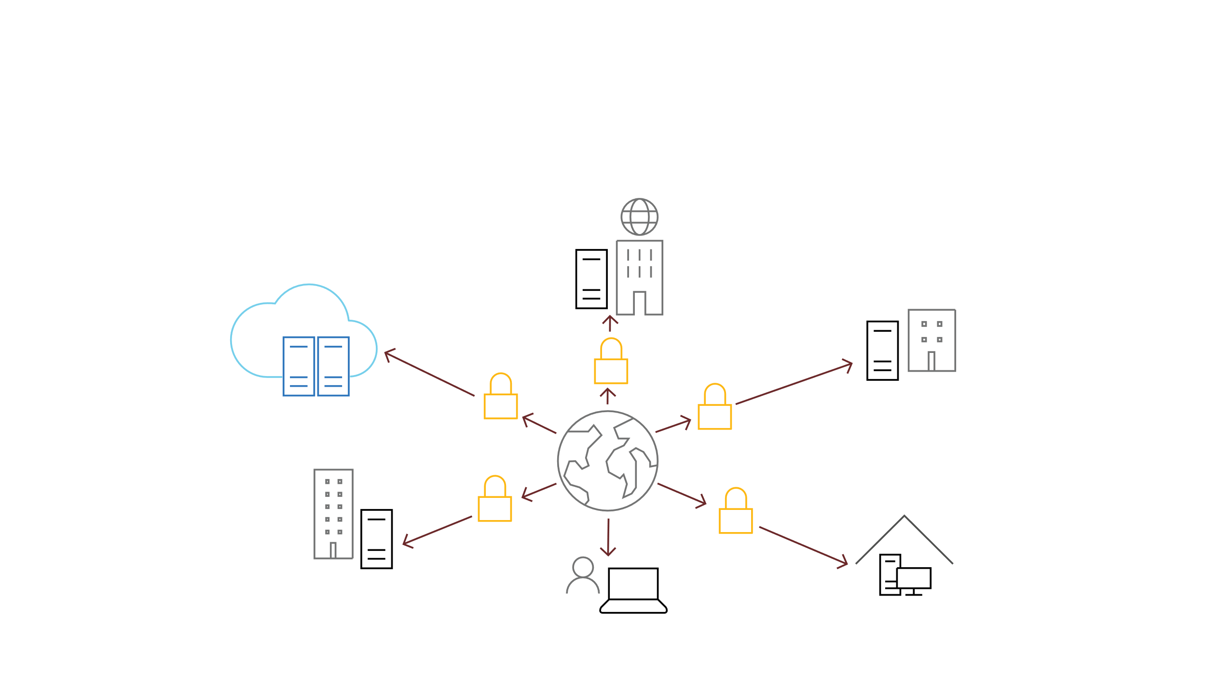
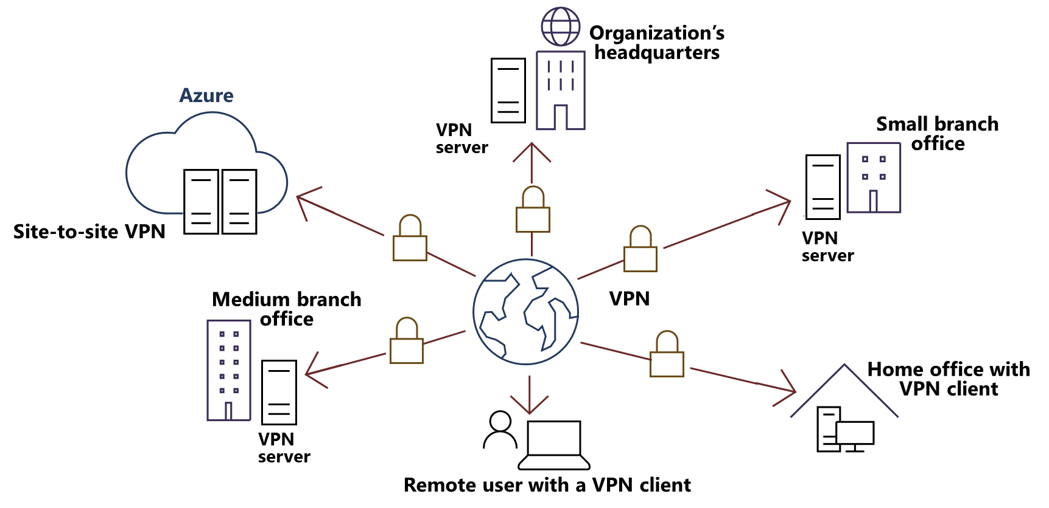
VPN Scenarios
A VPN provides a point-to-point connection between a private network’s components by using a public network, such as the Internet.
Notes:
Describe how you can use a VPN connection in Windows Server to connect remote network clients. Present the slide while explaining the benefits of using a public network (the internet) to tunnel securely into the organization’s local area network (LAN) and gain access to resources.
Explain that even though dial-up connections still exist as a technology, it's rarely used.
Briefly explain the properties of a VPN connection, including:
Encapsulation
Authentication
Data encryption
© Microsoft Corporation

Slide 7
Site-to site VPN
Connects two portions of a private network
The calling router (the VPN client) authenticates itself to the answering router (the VPN server)
Requires that you create a demand-dial interface
You can create three types of site-to-site VPNs
PPTP
L2TP
IKEv2
Can be persistent or on-demand
You can control traffic by using either IP demand-dial filters or dial-out filters
Notes:
Explain how a site-to-site VPN works and how to configure it correctly. You could use Azure as an example and find more information here: VPN Gateway FAQ.
Also, consider demonstrating how to create a demand-dial interface on SEA-ADM1. You must install the Remote Access role before you demonstrate. Emphasize that the name of the answering router’s demand-dial interface must match the name of the user account that you specify on the calling router. Finally, mention that it's important to avoid using the Point-to-Point Tunneling Protocol (PPTP) because it isn't secure.
© Microsoft Corporation

Slide 8
Options for VPN tunneling protocols
Windows Server supports four VPN tunneling protocols.
Tunneling protocol | Firewall access | Description
PPTP | TCP port 1723 | Provides data confidentiality, but not data integrity or data authentication
L2TP/IPsec | UDP port 500, UDP port 1701, UDP port 4500, and IP protocol ID 50 | Uses either certificates or preshared keys for authentication; certificate authentication is recommended.
SSTP | TCP port 443 | Uses SSL to provide data confidentiality, data integrity, and data authentication
IKEv2 | UDP port 500 | Supports the latest IPsec encryption algorithms to provide data confidentiality, data integrity, and data authentication
Notes:
Explain the support for each of the client protocols and discuss the following port requirements for each VPN protocol:
To implement PPTP, configure the firewall to pass Transmission Control Protocol (TCP) port 1723 and IP protocol ID 47.
To implement Layer 2 Tunneling Protocol (L2TP), configure the firewall to pass User Datagram Protocol (UDP) port 500, UDP port 1701, UDP port 4500, and IP Protocol ID 50.
To implement Secure Socket Tunneling Protocol (SSTP), configure the firewall to open TCP port 443.
To implement Internet Key Exchange version 2 (IKEv2), configure the firewall to open UDP port 500.
© Microsoft Corporation

Slide 9
VPN authentication options
Protocol | Description | Security level
PAP | Uses plaintext passwords. Typically used if the remote access client and remote access server cannot negotiate a more secure form of validation. | The least secure authentication protocol. Does not protect against replay attacks, remote client impersonation, or remote server impersonation.
CHAP | A challenge-response authentication protocol that uses the industry-standard MD5 hashing scheme. | An improvement over PAP in that the password is not sent over the PPP link. Requires a plaintext version of the password to validate the challenge response. Does not protect against remote server impersonation.
MS-CHAPv2 | An upgrade of MS-CHAP. Provides two-way authentication, also known as mutual authentication. The remote access client receives verification that the remote access server to which it is dialing in to has access to the user’s password. | Provides stronger security than CHAP.
EAP | Allows for arbitrary authentication of a remote access connection through the use of authentication schemes, known as EAP types. | Offers the strongest security by providing the most flexibility in authentication variations.
Notes:
Discuss each of the different authentication protocols, and explain that because of nonexistent or weak encryption, you shouldn't allow the use of Password Authentication Protocol (PAP), Challenge Handshake Authentication Protocol (CHAP), or Microsoft Challenge Handshake Authentication Protocol version 2 (MS-CHAP v2) as options for a Routing and Remote Access service solution.
However, explain that MS-CHAP v2 is useful to support legacy clients that cannot use newer, stronger authentication methods, and that CHAP is useful to support some older versions that are based on Microsoft client operating systems. Explain EAP and Protected Extensible Authentication Protocol (PEAP) authentication, and the requirement of X.509 certificates.
© Microsoft Corporation

Slide 10
What is VPN Reconnect?
VPN Reconnect:
Provides seamless and consistent VPN connectivity
Uses the IKEv2 technology
Automatically re-establishes VPN connections when connectivity is available
Maintains the connection if users move between different networks
Provides transparent connection status to users
Maintains connectivity across network outages
Notes:
Provide an overview of VPN Reconnect and give an example for VPN Reconnect. For example, if a user has a laptop that is running Windows 10, when the user travels to work on a train, they connect to the internet by using the 4G data connection on their phone, and then establish a VPN connection to the organization’s network. When the train passes through a tunnel, they lost the internet connection. After the train leaves the tunnel, the user must redial the VPN connection each time they lose internet connectivity. However, if VPN Reconnect is configured, the user’s computer will maintain internet connectivity. The client will reconnect automatically to the VPN server after the underlying network connectivity is reestablished.
Remember to mention the prerequisites for using VPN Reconnect. The system requirements for using the VPN Reconnect feature include:
A computer that is running Windows Server 2012 or later as a VPN server with IKEv2.
A computer that is running Windows 10, Windows 8, Windows Server 2012 or later, or Windows 7 as a VPN client.
A public key infrastructure (PKI), because VPN Reconnect requires a computer certificate for a remote connection. You can use certificates that an internal certification authority (CA) or a public CA issue.
© Microsoft Corporation

Slide 11
Configure a VPN by using the Getting Started Wizard (1 of 2)
Configure VPN by using the Getting Started Wizard in the Remote Access Management console
Requirements for VPN server configuration include:
Two network interfaces (public and private)
Using only one network interface is supported as well
IP Address allocation (static pool or DHCP)
Authentication provider (NPS/RADIUS or the VPN server)
DHCP relay agent considerations
Membership in the local Administrators group or equivalent
Notes:
Explain the requirements for a VPN server. Emphasize that two network interfaces is not required.
© Microsoft Corporation

Slide 12
Configure a VPN by using the Getting Started Wizard (2 of 2)
To configure your VPN solution, you might need to:
Configure static packet filters
Configure services and ports
Adjust logging levels for routing protocols
Configure the number of available VPN ports
Create a Connection Manager profile for users
Add AD CS
Increase remote access security
Increase VPN security
Implement VPN Reconnect
Notes:
Explain that even after enabling the Remote Access service, there are additional tasks that students must complete to secure their Routing and Remote Access solution and to meet the necessary requirements, including:
Add static filters (inbound/outbound) to create network-traffic restrictions and allowances.
Adjust logging options to monitor utilization and to troubleshoot connectivity issues.
Configure available VPN ports. For example, you might want to increase L2TP and remove all PPTP and SSTP connections. You should configure ports to support the number of users and types of connections that you want to allow.
Create Connection Manager profiles to automate the configuration of Routing and Remote Access connections on the client computers.
Add Certificate Services if you will be using authentication methods that require user/computer certificates.
Increase security by clearing authentication protocols that you don't want to allow.
© Microsoft Corporation

Slide 13
Demonstration: Configure VPN
Install Routing and Remote Access Server (VPN) using Powershell
Configure and enable VPN configuration
Review the default VPN configuration
Notes:
Preparation Steps
For this demonstration, you will use the following virtual machines:
WS-011T00A-SEA-DC1
WS-011T00A-SEA-ADM1
WS-011T00A-SEA-SVR1
WS-011T00A-SEA-CL1
Sign in by using the following credentials:
User Name: Contoso\Administrator
Password: Pa55w.rd
Note: You do not need to sign in to WS-011T00A-SEA-DC1.
After completing the demonstration, leave all the virtual machines running. You will use them in a later demonstration.
Demonstration steps
Install Routing and Remote Access Server (VPN) using PowerShell
On SEA-ADM1, open a Windows PowerShell command prompt, enter the following command, and then select Enter: Install-WindowsFeature -name RemoteAccess,Routing -IncludeManagementTools Wait for the command to complete, which should take approximately 1 minute.
Request certificate for SEA-ADM1
On SEA-ADM1, open a command prompt, enter the following command, and then select Enter: mmc
Add the Certificates snap-in for the Computer account and Local computer.
In the Certificates snap-in console tree, navigate to Certificates (local)\Personal, and then request a new certificate.
Under Request Certificates, configure the Contoso Web Server certificate with the following setting:
Subject name: Under Common name, enter vpn.contoso.com
Friendly name: Contoso VPN
In the Certificates snap-in, expand Personal and select Certificates, and then, in the details pane, verify that a new certificate with the name vpn.contoso.com is enrolled with Intended Purposes of Server Authentication.
Close the Microsoft Management Console (MMC). When you receive a prompt to save the settings, select No.
© Microsoft Corporation

Slide 14
Demonstration: Configure VPN (2 of 3)
Notes:
Change the HTTPS bindings
Open the Internet Information Services (IIS) Manager console.
In Internet Information Services (IIS) Manager, in the console tree, navigate to SEA-ADM1/Sites, and then select Default Web site.
Configure site bindings by selecting Contoso VPN as SSL Certificate. When prompted, select Yes.
Close the Internet Information Services (IIS) Manager console.
Configure and enable VPN configuration
On SEA-ADM1, open Routing and Remote Access.
Right-click SEA-ADM1 (local) or access the context menu, and then select Configure and Enable Routing and Remote Access.
On the Welcome to Routing and Remote Access Server Setup Wizard, select Next.
On the Configuration page, select Custom configuration, and then select Next.
On the Custom Configuration page, select VPN access and LAN routing, and then select Next.
On the Completing the Routing and Remote Access Server Setup Wizard page, select Finish. When prompted, select Start service.
Review the default VPN configuration
Expand SEA-ADM1 (local), right-click Ports or access the context menu, and then select Properties.
Verify that 128 ports exist for Wan Miniport (SSTP), Wan Miniport (IKEv2), and Wan Miniport (L2TP). Change the number of ports to five, for each type of connection. Disable the use of Wan Miniport (PPTP).
Close the Ports Properties dialog box, and when prompted, select Yes.
Right-click SEA-ADM1 (local) or access the context menu, and then select Properties.
On the General tab, verify that IPv4 Remote access server is selected.
On the Security tab, select the drop-down arrow next to Certificate, and then select vpn-contoso.com.
Select Authentication Methods, and then verify that EAP is selected as the authentication protocol.
On the IPv4 tab, verify that the VPN server is configured to assign IPv4 addressing by using a Dynamic Host Configuration Protocol (DHCP).
To close the SEA-ADM1 (local) Properties dialog box, select OK, and then when you receive a prompt, select Yes.
After completing the demonstration, leave all the virtual machines running. You will use them in a later demonstration.

Slide 15
Lesson 2: Implementing NPS
Notes:
© Microsoft Corporation

Slide 16
Lesson 2 overview
Topics:
Overview of NPS
Plan NPS deployment
Overview of connection request processing
Configure policies on NPS
Implement RADIUS with NPS
Demonstration: Manage NPS
Notes:
Provide a brief overview of the lesson content.
© Microsoft Corporation

Slide 17
Overview of NPS
NPS is the Microsoft implementation of a RADIUS server
NPS provides the following functions:
RADIUS server
RADIUS proxy
RADIUS accounting
Notes:
Describe the NPS role service. The students should understand that policies created on Remote Access servers are local to the server that is hosting the role. In the case of NPS as a RADIUS server, an environment with numerous Remote Access servers can store all the policies in one place: on the NPS RADIUS (Remote Authentication Dial-In User Service) server. This eliminates the need to duplicate the policies on individual servers. Detailed logging and accounting is also available when you use the RADIUS authentication and authorization service.
When using NPS as a RADIUS server, you configure the following network access servers (NASs):
VPN servers
Wireless access points
Remote Desktop (RD) Gateway servers
Outsourced VPN, dial-up or wireless access
Internet access
Authenticated access to extranet resources for business partners.
NPS can also function as a RADIUS proxy. In this scenario, you configure the NPS server as a RADIUS proxy that forwards connection requests to remote RADIUS server groups in two different, nontrusted domains. The default connection request policy is deleted, and two new connection request policies are created to forward requests to two different domains. In this example, NPS doesn't process any connection requests on the local server. Instead, it forwards connection requests to NPS or other RADIUS servers.
Mention to the students that the Network Policy Server can't be installed on Server Core editions of Windows Server.
© Microsoft Corporation

Slide 18
Plan NPS deployment (1 of 2)
Once NPS is installed, you will have support for central authentication and authorization for RADIUS clients. You must decide which polices to create and if you want to use RADIUS accounting.
The following tools can be used to manage NPS:
NPS management console
Netsh NPS commands
Windows PowerShell
Notes:
Give a brief overview of the tools you can use to configure and manage NPS.
© Microsoft Corporation

Slide 19
Plan NPS deployment (2 of 2)
Authentication methods for an NPS server identified here from most to least secure:
EAP
Most secure and recommended
Requires certificates for users, clients’ computers, and NPS server
MS-CHAP v2
MS-CHAP
Challenge Handshake Authentication Protocol (CHAP)
Shiva Password Authentication Protocol (SPAP)
Password Authentication Protocol (PAP)
PAP, SPAP, CHAP or MS-CHAP should not be used in a production environment as they are considered highly insecure
Notes:
We don't recommend password-based authentication because it doesn't provide strong security. When you allow password-based authentication, it's processed from the most secure, MS-CHAPv2, to the least secure, unauthenticated access. Ensure that the students realize that, if the clients using the service are all Microsoft clients, MS-CHAPv2 (Microsoft Challenge Handshake Authentication Protocol version 2) should be the only method allowed for a password-based solution. If you require support for clients that aren't associated with Microsoft, you should consider upgrading those os´es as nearly all modern os supports EAP. Password Authentication Protocol (PAP) is plain text and any packet sniffer can capture the transmission in plain text. Unauthenticated access is required for guest account access and you should never use it.
Emphasize that students should avoid using PAP, SPAP, CHAP, or MS-CHAP. They are highly insecure.
© Microsoft Corporation

Slide 20
Overview of connection request processing
Configuration | Description
Local vs. RADIUS authentication | Local authentication takes place against the local security account database or Active Directory Domain Services. RADIUS authentication forwards the connection request to a RADIUS server for authentication.
RADIUS server groups | Used where one or more RADIUS servers are capable of handling connection requests. The connection requests are load-balanced on specified criteria.
Default ports for accounting and authentication by using RADIUS | The ports required for accounting and authentication requests being forwarded to a RADIUS server are UDP 1812/1645 and UDP 1813/1646, respectively.
Notes:
Explain to the students that they should understand the following:
RADIUS is ideal for environments that have multiple remote access servers because it centralizes all of the policies and enables you to create them only once in NPS
The benefits of RADIUS server groups in load-balancing activities
The security benefits of having a RADIUS proxy outside the firewall
The security benefits of having firewall policies that allow User Datagram Protocol (UDP) 1812/1645 and 1813/1646 to open for communication between the proxy and RADIUS server internally
© Microsoft Corporation

Slide 21
Configure policies on NPS (1 of 2)
NPS supports Connection Request Policies and Network Policies.
Connection Request Policies:
Connection Request Policies are sets of conditions and settings that designate which RADIUS servers perform the authentication and authorization of connection requests that NPS receives from RADIUS clients
Network Policies:
Allow you to designate which users are authorized to connect to your network and the circumstances under which they can or cannot connect.
A Network Policy contains a set of conditions, constraints, and settings.
Notes:
Provide a description of connection request policies and network policies. Tell the students that you will describe to them how to configure and work with NPS policies in the upcoming demonstration.
Ask the students about what kind of policies they are currently using in their environments.
© Microsoft Corporation

Slide 22
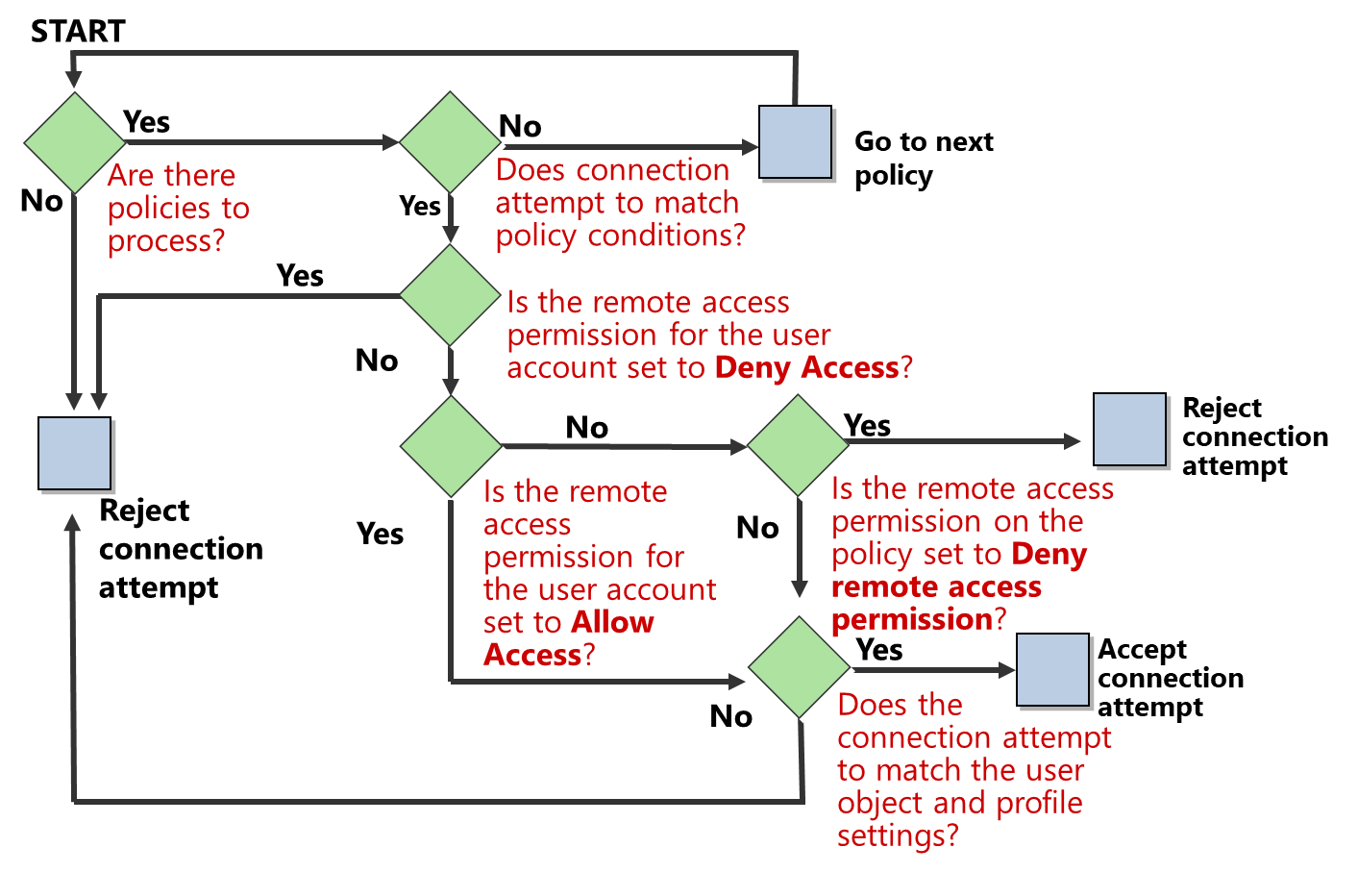
Configure policies on NPS (2 of 2)
Notes:
It is imperative that you fully understand the NPS policy processing engine. Study the topic content and familiarize yourself with the NPS policies.
Mention to the students that when you first deploy the NPS role, the two default network policies deny remote access to all connection attempts. You can then configure additional network policies to manage connection attempts.
Observe the diagram with your students.
© Microsoft Corporation

Slide 23
Implement RADIUS with NPS (1 of 2)
RADIUS is an industry-standard authentication protocol that supports the exchange of authentication information between elements of a remote-access solution. It is typically used to centralize your organization’s remote-authentication needs.
RADIUS clients are usually :
VPN servers
Wireless access points
Remote Desktop (RD) Gateway servers
Client computers that use VPN servers are not RADIUS clients. Only devices that support the RADIUS protocol are RADIUS clients.
Notes:
Ask students if they know of other types of RADIUS clients than those mentioned on the slide. Emphasize that connecting clients are not RADIUS clients.
© Microsoft Corporation

Slide 24
Implement RADIUS with NPS (2 of 2)
A RADIUS proxy receives connection attempts from RADIUS clients, and then forwards them to the appropriate RADIUS server or another RADIUS proxy for further routing
A RADIUS proxy is required for:
Offering outsourced dial-up, VPN, or wireless network-access services by service providers
Providing authentication and authorization for user accounts that are not Active Directory members
Performing authentication and authorization by using a database that is not a Windows account database
Load-balancing connection requests among multiple RADIUS servers
Providing RADIUS for outsourced service providers and limiting traffic types through the firewall
Notes:
Explain that when you configure NPS as a RADIUS proxy, it receives connection attempts from RADIUS clients, and then forwards them to the appropriate RADIUS server or another RADIUS proxy for further routing. Explain the instances when an organization might require a RADIUS proxy. For example:
In a service provider environment such as that of an internet service provider (ISP) that offers wireless network-access services to multiple customers
When load balancing a large number of connection requests across multiple RADIUS servers
In multiple domain environments
In an environment with a mix of workgroup and domain computers
Ask the students for some examples where a RADIUS proxy is useful. Engage the students’ ideas to further the discussion and help solidify their understanding.
© Microsoft Corporation

Slide 25
Demonstration: Manage NPS
Configure the Remote Access policies
Create a VPN profile on a Windows client
Connect to the VPN server using a Windows client
Notes:
Preparation steps
The required virtual machines (WS-011T00A-SEA-DC1, WS-011T00A-SEA-ADM1, and WS-011T00A-SEA-CL1) should be running after the previous demonstration.
After completing the demonstration, leave all the virtual machines running. You will use them in a later demonstration.
Demonstration steps
Configure the Remote Access policies
On SEA-ADM1, from Server Manager, open the Network Policy Server console.
In the Network Policy Server console, in the navigation pane, expand Policies, and then select Network Policies.
Create a new network policy by using the New Network Policy Wizard with the following settings:
Policy name: Contoso IT VPN
Type of network access server: Remote Access Server(VPN-Dial up)
Windows Groups: IT
Specify Access Permission: Access granted
Configure Authentication Methods:
Add Microsoft Secured password (EAP-MSCHAP v2)
Add Microsoft: Smart Card or other certificate
Clear the Microsoft Encrypted Authentication (MS-CHAP) check box
Complete the New Network Policy Wizard by accepting the default settings on the other pages.
Close all open windows.
Create a VPN profile on a Windows client
On SEA-CL1, right-click Start or access the context menu, and then select Network Connections.
In Network & Internet, select VPN, and then select Add a VPN connection.
In the Add a VPN connection wizard, use the following values and then select Save:
VPN provider: Windows (built-in)
Connection Name: Contoso VPN
Server name or address: vpn.contoso.com
VPN type: Secure Socket Tunneling Protocol (SSTP)
Type of sign-in info: User name and password
Remember my sign-in info: Cleared
© Microsoft Corporation

Slide 26
Demonstration: Manage NPS (2 of 2)
Notes:
Connect to the VPN using a Windows client
In Network & Internet, select Contoso VPN, and then select Connect.
In the Sign in dialog box, in the User name text box, enter contoso\jane, and in the Password text box, enter Pa55w.rd, and then select OK.
Verify your connection to the VPN server.
Verify connection on client and VPN server
On SEA-CL1 , right-click Start or access the context menu, and then select Windows PowerShell (Admin)
Enter the following command, and then select Enter: Get-NetIPConfiguration
Examine the output and verify that Contoso VPN is listed next to InterfaceAlias. Also verify that the Contoso VPN has been issued an IP Address. This is the IP address for VPN connection assigned by RRAS.
Switch to SEA-ADM1 and maximize the Routing and Remote Access snap-in.
In the Routing and Remote Access snap-in, select Remote Access Clients (0) and verify that Contoso\jane is listed under the User Name column. This indicates that the user is connected to the VPN Server.
Maximize Server Manager and the Tools menu, and then select Remote Access Management.
In the Remote Access Management Console, select Remote Client Status and verify that CONTOSO\jane is listed under Connected Clients. Notice that the VPN protocol used displays under the Protocol/Tunnel field as Sstp.

Slide 27
Lesson 3: Implementing Always On VPN
Notes:
© Microsoft Corporation

Slide 28
Lesson 3 overview
Topics:
What is Always On VPN?
Prerequisites for Always On VPN deployment
Always On VPN features and functionalities
Why choose Always On VPN over Windows VPN?
Deploy Always On VPN
Notes:
Provide a brief overview of the lesson content.
© Microsoft Corporation

Slide 29
What is Always On VPN?
Always On VPN:
Enables remote users running Windows 10 to securely access corporate resources
Was designed to be the successor of DirectAccess
Connects securely to the VPN server without any user intervention
Client detects whether it needs to trigger the VPN connection or not
Notes:
Start by defining Always On VPN as an automatic VPN solution. Ask if the students know about DirectAccess. You will provide more detail about Always On VPN in the next topics.
Depending on their answers, you can elaborate further about DirectAccess so the students know why Always On VPN replaces DirectAccess.
© Microsoft Corporation

Slide 30
Prerequisites for Always On VPN deployment
To deploy and configure Always On VPN, your organization must support the following infrastructure components:
Always On VPN Gateway (VPN Server)
Always On VPN Clients
Network Policy Server (NPS)
An Active Directory domain
Group Policy
Firewall configuration
Public key infrastructure (PKI)
Domain Name System (DNS) server
Notes:
Refer to the various infrastructure components that are either required or recommended for Always On VPN.
Emphasize that students can use most VPN server implementations and that the client's machine must be running Windows 10. Emphasize that students must implement certificates for authentication for every user that will participate in Always ON VPN communication. If you are using tunnel mode, then every Windows 10 client requires a computer authentication certificate. The VPN server requires a Server Authentication Certificate and the NPS server. If using the SSTP protocol for Always On VPN, you can use a public SSL certificate. If you are using the IKEv2 authentication protocol you must use a certificate for your internal PKI.
© Microsoft Corporation

Slide 31
Always On VPN features and functionalities
Always On VPN offers many features and enhancements when compared to traditional VPN solutions such as:
Automatic triggering
Application triggering and name triggering
Tunnel mode
User Tunnel
Device Tunnel
Security
Supports the latest RSA algorithms and EAP
Supports all Windows 10 editions
Both domain-joined and workgroup
Works equally well with both IPv4 and IPv6
Notes:
Explain to the students about the Always On VPN features. Emphasize the difference between user tunnels and device tunnels and their respective requirements.
Mention to the students that Always On VPN has support for cloud services such as support for Azure MFA, Azure conditional access, Windows Hallo for Business and Windows Information Protection (WIP).
© Microsoft Corporation

Slide 32
Why choose Always on VPN over Windows VPN?
Feature | Always On VPN | Traditional VPN | Direct Access
Domain join required | Not required for user tunnel, but required for device tunnel | Not required | Required for all clients
Client built-in | Built-in and 3. party | Built-in and 3. party | Only built-in
Manual or auto connect | Always automatic | Manual | Always automatic
Firewall requirements | Depends on the protocols used, but normal VPN ports are typically blocked from hotels etc. | Depends on the protocols used, but normal VPN ports are typically blocked from hotels etc. | Only port 443 with IP-HTTPS
Manual disconnect | Yes | Yes | No
Os support | Only Windows 10 | Support for every Os and device | Only Windows 10 and 7
Notes:
Start by describing what kind of functionality you get with a traditional (normal) VPN solution. Then ask the students to compare what they have already learned about Always On VPN.
Use the table for a discussion about when to choose Always On VPN versus other remote access solutions.
Explain that Always On VPN can use any VPN Server implementation because all the features of an Always on VPN solution are configured on the Windows 10 client in the form of a special VPN profile.
© Microsoft Corporation

Slide 33
Deploy Always On VPN
In order to properly implement and support Always On VPN in your environment, it is best to understand how to plan, configure, and scope your Always On VPN implementation.
Follow these steps:
1. Always On VPN deployment planning
2. Always On VPN server infrastructure configuration
3. Remote Access Server configuration for Always On VPN
4. NPS Server installation and Configuration
5. Firewall and DNS configuration
6. Windows 10 Client configuration for Always On VPN
Notes:
Give an overview of each of the steps on the slide. Describe each of the steps and explain the details about the actions for each step.
© Microsoft Corporation

Slide 34
Lesson 4: Implementing Web Server in Windows Server
Notes:
© Microsoft Corporation

Slide 35
Lesson 4 overview
Topics:
IIS in Windows Server
What´s new in IIS 10.0?
Overview of IIS architecture
Overview of the Web Server server role
Install and configure Web Server
Demonstration: Create and configure a new site in IIS
Notes:
Provide a brief overview of the lesson content.
© Microsoft Corporation

Slide 36
IIS in Windows Server
IIS is an HTTP web server
HTTP is an application-level protocol that runs over TCP
A kernel-mode http.sys driver accepts incoming requests and passes them to user-mode worker processes
Supports HTTPS when combined with a digital certificate
All websites should be protected using HTTPS
Hosts both static and dynamic content
Static: usually web pages
Dynamic: content created by running code or web applications.
Web requests and responses are essentially stateless
Notes:
Briefly explain to the students that IIS in Windows Server is a HTTP web server. Most students should already be familiar with the concept of a web server.
Make sure students understand the difference between static and dynamic content.
Emphasize to the students that all websites should use HTTPS. Most of the popular web browsers require HTTPs to access content on websites.
© Microsoft Corporation

Slide 37
What´s new in IIS 10.0?
IIS 10.0 is the version of the Web Server included in the Windows Server 2016 and later.
In IIS 10.0, the following new functionality were introduced:
IIS on Nano Server
IIS in Containers
Wildcard Host Headers
Managing IIS
HTTP/2
IIS Thread Pool Ideal CPU Optimization for NUMA hardware
Bullet point
Notes:
Briefly explain the new functionality in IIS 10.0. Be prepared to elaborate on containers but don´t provide too much detail. To get an overview of Windows and containers, refer to: Windows and containers.
© Microsoft Corporation

Slide 38
Overview of IIS architecture (1 of 2)
IIS 7 and later uses a request-processing architecture which includes:
The Windows Process Activation Service (WAS)
A customizable web server engine. Add or remove modules depending on what functionality is needed.
Integrated request-processing pipelines from IIS and ASP.NET
IIS consists of various components that each perform functions for the web server and application such as reading configuration files and listening for requests made IIS
These components are either services or protocol listeners and include the following:
Protocol listeners
HTTP.sys
Services
World Wide Web Publishing Service (WWW service)
Windows Process Activation Service (WAS)
Notes:
Give an overview of the protocol listeners and services in IIS.
© Microsoft Corporation

Slide 39
Overview of IIS architecture (2 of 2)
Application pools have the following features:
Provide memory and CPU isolation between different websites
Is serviced by one or more worker processes
Each worker process is assigned its own area of memory by the operating system
Can be configured to support different behaviors
Can be assigned to a different application pool
Worker processes:
An application pool can be configured to use multiple worker processes
Additional overhead is required for each worker process
Worker process recycling terminates the process and returns all memory to the operating system
Notes:
Explain to the students that the earliest versions of IIS ran both types of code in a single process. That meant all the code ran in the same area of memory and was assigned a single priority by the operating system. The problem with that approach is that poorly written user code could make the web server run slowly or even crash. If a web server hosted multiple websites, then a single poorly written website could make them all run slowly or even become unavailable.
Application pools were created to help provide memory and central processing unit (CPU) isolation between different websites running on IIS. Each application pool is serviced by one or more worker processes. These worker processes can be run on separate processes within the computer, and each worker process is assigned its own area of memory by the operating system.
© Microsoft Corporation

Slide 40
Overview of the Web Server server role
IIS is installed as an optional server role named Web Server (IIS) on Windows Server
Numerous optional role services provide additional functionality
Static content
Dynamic content
Logging
Web Platform Installer (Web PI) can download and install additional free components
Many of the IIS components installed by Server Manager or by Windows PowerShell are called modules
A module is a binary component that is installed on the server
It can provide functionality to all websites on the server
A module can consist of native dynamic link library (DLL) files, or .NET assemblies
A module must be enabled to access its functionality
Notes:
Explain to the students that IIS is a Server Role in Windows. Most of IIS´s functionality comes from module, which you can add when you need their functionality. If you don´t need a certain functionality, remove the module from IIS as this will reduce the attack surface of the web server.
Emphasize that a module must be enabled after it has been added so that you can use it.
© Microsoft Corporation

Slide 41
Install and configure Web Server (1 of 2)
IIS is available in Windows Server 2019 and in Windows 10.
IIS 10 has specific hardware and software requirements:
2 GHz minimum processor speed
2 GB minimum RAM
10 GB minimum disk space
Plus additional resources as needed for the server workload
Notes:
Give an overview of the hardware requirements for IIS. The important takeaway for students is that they should always perform extensive testing in a lab environment to estimate the capacity of a given hardware configuration for a given website or web application.
© Microsoft Corporation

Slide 42
Install and configure Web Server (2 of 2)
Web clients require the IP address of a web server to send requests
For public websites, the IP address needs to be a registered, public IP address
Firewalls are configured to allow incoming traffic
Port 80 for HTTP
Port 443 for HTTPS
For public/private access, a DNS record is configured for the web server’s host computer
Create a record in DNS
IIS can be managed using the following tools:
IIS Manager, part of RSAT
Windows PowerShell
Using the Microsoft IIS Web Manager extension for Windows Admin Center (currently in preview)
Notes:
Describe the topics on the slide and emphasize that IIS are common targets of attack. That means that web servers require well-planned security. If time permits, you should describe the demonstration that's coming up next and give the students a quick tour of the various locations and options in IIS. You can use the text in the topic under IIS management for inspiration.
© Microsoft Corporation

Slide 43
Demonstration: Create and configure a new site in IIS
Install the Web Server role using Powershell.
Verify the installation of the web server role
Create a new site in IIS and verify it
Notes:
Preparation steps
The required virtual machines (WS-011T00A-SEA-DC1, WS-011T00A-SEA-ADM1, WS-011T00A-SEA-SVR1, and WS-011T00A-SEA-CL1) should be running after the previous demonstration.
Demonstration steps
Install the Web Server role using PowerShell
On SEA-ADM1, open a Windows PowerShell command prompt, enter the following command, and then select Enter: Install-WindowsFeature -ComputerName SEA-SVR3 -name Web-Server -IncludeManagementTools Wait for the command to complete, which should take approximately 1 minute.
Verify the installation of the Web Server role
On SEA-ADM1, open Microsoft Edge, and in the address bar, enter http://SEA-SVR3.
Verify that the IIS displays the default webpage.
In the address bar, enter http://172.16.10.14.
Verify that IIS displays the default webpage.
Configure a website in IIS and verify it
Open the Internet Information Services (IIS) Manager console.
In Internet Information Services (IIS) Manager, in the console tree, navigate to SEA-ADM1/Sites, and then select Default Web site.
Configure site bindings by selecting Contoso VPN as SSL Certificate. When prompted, select Yes.
Close the Internet Information Services (IIS) Manager console.
After you complete this demonstration, revert all virtual machines that are running.
© Microsoft Corporation

Slide 44
Instructor-led labs: Deploying network workloads
Implementing VPN in Windows Server
Deploying and configuring web server
Notes:
© Microsoft Corporation

Slide 45
Lab: Deploying network workloads
Exercise 1: Implementing VPN in Windows Server
Exercise 2: Deploying and configuring web server
Sign-in information for the exercise(s):
Virtual machines:
WS-011T00A-SEA-DC1
WS-011T00A-SEA-ADM1
WS-011T00A-SEA-SVR1
WS-011T00A-SEA-CL1
Username: Contoso\Administrator
Password: Pa55w.rd
Notes:
© Microsoft Corporation

Slide 46
Lab scenario
The employees in the IT department at Contoso need to be able to access server systems outside of business hours in order to correct issues that arise during weekends or holidays. Some of the employees are using computers that are not members of the contoso.com domain. Other users are running non-Windows operating systems on their computers. To enable remote access for these users, you must deploy a secure VPN solution using the SSTP VPN protocol.
You are a web server administrator for Contoso and your company is preparing to deploy a new intranet web application on an internal web server. You need to verify the server configuration and install IIS. The website must be accessible using a friendly DNS name and all web connections to and from the server must be encrypted.
Notes:
© Microsoft Corporation

Slide 47
Lab-review questions
Why did you disable the PPTP authentication protocol when you configured the ports of the VPN Server?
Notes:
© Microsoft Corporation

Slide 48
Lab-review answers
Why did you disable the PPTP authentication protocol when you configured the ports of the VPN Server?
Answer: The PPTP protocol is considered highly insecure and should not be used at all.
Notes:
© Microsoft Corporation

Slide 49
Module-review questions (1 of 2)
What are the requirements for the Windows 10 client using a Device Tunnel with Always On VPN?
Choose all that apply.
Windows 10 Enterprise edition
Domain membership
Group Policy
Windows 10 Professional edition
A Computer Authentication certificate
2. Why should only the IKEv2 or SSTP VPN protocols be used with Always On VPN?
Notes:
© Microsoft Corporation

Slide 50
Module-review questions (2 of 2)
3. What is the name of the script used to create the two configuration files for the Always On VPN client profile?
Windows 10 Enterprise edition
Domain membership
Group Policy
Windows 10 Professional edition
A Computer Authentication certificate
4. Does Always On VPN require IPv6 as was the case with DirectAccess?
Notes:
© Microsoft Corporation

Slide 51
Module-review answers
What are the requirements for the Windows 10 client using a Device Tunnel with Always On VPN?
Windows 10 Enterprise edition
Domain membership
A Computer Authentication certificate
Why should only the IKEv2 or SSTP VPN protocols be used with Always On VPN?
Because they are modern VPN protocol and considered secure. IKEv2 is designed for mobility and considered the most secure but could be blocked in firewalls. SSTP is also considered quite secure and is usually not blocked in firewalls because it uses port 443
What is the name of the script used to create the two configuration files for the Always On VPN client profile?
MakeProfile.ps1
Does Always On VPN require IPv6 as was the case with DirectAccess?
Always On VPN works equally well with both IPv4 and IPv6
Is not dependent on IPv6 like DirectAccess
Notes:
© Microsoft Corporation

Slide 52
Thank you.
Notes:
Always end the presentation with the Thank You slide. Do not remove.
© Microsoft Corporation

