Slide 1
AZ-104T00A Administer Identity
Notes:
These Learn modules are part of the AZ-104: Manage identities and governance in Azure (https://docs.microsoft.com/learn/paths/az-104-manage-identities-governance/) path.

Slide 2
Learning Objectives
Configure Microsoft Entra ID
Configure User and Group Accounts
Lab 01 - Manage Microsoft Entra ID Identities

Slide 3
Administer Identity whiteboard
Sync
Microsoft Entra ID
B2B
External identity providers
guest users
creates a profile
On-premises identities
users
- licenses
- administrative units
- bulk updates
groups
profiles
Group types
– Security
– Microsoft 365
Assignment types
– Assigned
– Dynamic
Notes:
Optional whiteboard slide to introduce the module or review the content. Use the whiteboard diagram directly or recreate the image during the class.

Slide 4
Configure Microsoft Entra ID

Slide 5
Learning Objectives – Microsoft Entra ID
Describe Microsoft Entra ID Benefits and Features
Describe Microsoft Entra ID Concepts
Compare Microsoft Entra ID to Active Directory Domain Services
Select Microsoft Entra ID Plans & Pricing
Configure Device Identities (optional)
Implement Self-Service Password Reset
Learning Recap
Manage Azure identities and governance (20–25%): Manage Microsoft Entra ID users and groups
Manage licenses
Configure self-service password reset (SSPR)

Slide 6
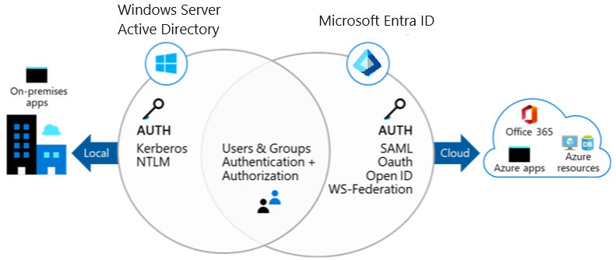
Describe Microsoft Entra ID Benefits and Features
A cloud-based suite of identity management capabilities that enables you to securely manage access to Azure services and resources for your users
Provides application management, authentication, device management, and hybrid identity
Notes:
What is Microsoft Entra ID? - https://docs.microsoft.com/azure/active-directory/fundamentals/active-directory-whatis

Slide 7
Describe Microsoft Entra ID Concepts
Concept | Description
Identity | An object that can be authenticated
Account | An identity that has data associated with it
Microsoft Entra ID account | An identity created through Microsoft Entra ID or another Microsoft cloud service
Tenant/directory | A dedicated and trusted instance. A tenant is automatically created when your organization signs up for a Microsoft cloud service subscription​. ​ Additional instances can be created​ Microsoft Entra ID is the underlying product providing the identity service​ The term Tenant means a single instance representing a single organization​ The terms Tenant and Directory are often used interchangeably​
Azure subscription | Used to pay for Azure cloud services
Notes:
Terminology - https://docs.microsoft.com/azure/active-directory/fundamentals/active-directory-whatis#terminology

Slide 8
Compare Microsoft Entra ID to Active Directory Domain Services
Microsoft Entra ID is primarily an identity solution
Queried using the REST API over HTTP and HTTPS
Uses HTTP and HTTPS protocols such as SAML, WS-Federation, and OpenID Connect for authentication (and OAuth for authorization)
Includes federation services, and many third-party services (such as Facebook)
Microsoft Entra ID users and groups are created in a flat structure, and there are no Organizational Units (OUs) or Group Policy Objects (GPOs)
Notes:
Compare Active Directory to Microsoft Entra ID- https://docs.microsoft.com/azure/active-directory/fundamentals/active-directory-compare-azure-ad-to-ad
✔️ Microsoft Entra ID is a managed service. You only manage the users, groups, and policies. Deploying AD DS with virtual machines using Azure means that you manage the deployment, configuration, virtual machines, patching, and other backend tasks. Do you see the difference? How are they similar?

Slide 9
Select Microsoft Entra ID Plans (examples)
Feature | Free | P1 | P2 | Governance
Single Sign-On (unlimited) | Π | Π | Π
Cloud and Federated authentication | Π | Π | Π
Advanced group management |  | Π | Π
Self-service account management portal | Π | Π | Π
Multifactor authentication (MFA) | Π | Π | Π
Conditional access |  | Π | Π
Risk-based Conditional Access (sign-in risk, user risk) |  |  | Π
Automated user and group provisioning to apps |  | Π | Π | Π
Privileged identity management (PIM) |  |  | Π | Π
Notes:
Just picked a few items for this slide. Please use the links for more information.
Microsoft Entra Plans & Pricing - https://azure.microsoft.com/pricing/details/active-directory/
Advanced group management - https://www.microsoft.com/security/business/identity-access/azure-active-directory-pricing
Select the best option - https://www.microsoft.com/en-us/security/business/microsoft-entra-pricing
✔️ Did you look through the pricing list to determine which features your organization needs and to compare edition capabilities?

Slide 10




Configure Device Identities (optional)
Registered devices | Joined devices | Hybrid joined devices
Supports Bring Your Own Device Registered devices sign-in using a Microsoft account Attached to an account granting access to resources Control using Mobile Device Management (MDM) tools like Microsoft Intune OS – Windows 10⁺, iOS, Android, and MacOS | Intended for cloud-first or cloud-only organizations Organization-owned devices Joined only to Azure - organizational account required Can use Conditional Access policies OS – Windows 10⁺ devices | You have Win32 apps deployed to these devices You want to continue to use Group Policy to manage the device You want to use existing image solutions to deploy devices OS - Windows 7⁺ devices
Notes:
Microsoft Entra registered devices - https://docs.microsoft.com/azure/active-directory/devices/concept-azure-ad-register
Microsoft Entra joined devices - https://docs.microsoft.com/azure/active-directory/devices/concept-azure-ad-join
Microsoft Entra hybrid joined devices - https://docs.microsoft.com/azure/active-directory/devices/concept-azure-ad-join-hybrid

Slide 11
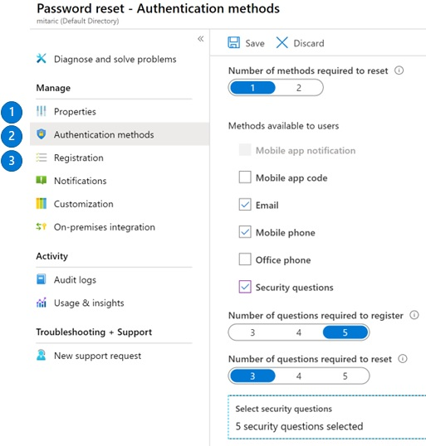
Implement Self-Service Password Reset
Determine who can use self-service password reset
Choose the number of authentication methods required and the methods available (email, phone, questions)
You can require users to register for SSPR (same process as MFA)
Notes:
Plan an Microsoft Entra ID self-service password reset deployment - https://docs.microsoft.com/azure/active-directory/authentication/howto-sspr-deployment

Slide 12
Learning Recap – Configure Microsoft Entra ID
Understand Microsoft Entra ID
Allow users to reset their password with self-service password reset (sandbox)
Implement and manage hybrid identity
A sandbox indicates an additional hands-on exercise.
Notes:
Additional questions are available in Office Forms - https://forms.office.com/Pages/ShareFormPage.aspx?id=v4j5cvGGr0GRqy180BHbR5NEFZBpuAZBgxPOGXi_gX5UNlQyT1BLOTZYNjNBTk5NREk5NzFPOFpFWS4u&sharetoken=ms6pe4tvOByStLZxuG5B&wdLOR=cF86857FF-7E68-42CA-B255-DA42AE56590A
Describe the following concepts: identity, account, tenant, and subscription. How are these different?
Answer: Identity is an object that can be authenticated. An account is an identity that has data associated with it. A tenant is a dedicated and trusted instance, A tenant is automatically created when your organization signs up for a Microsoft cloud service subscription​. An Azure subscription is used to pay for Azure cloud services.
How is Microsoft Entra ID different from Azure Active Directory Domain Services?
Answer: Microsoft Entra ID is primarily an identity solution and designed for HTTP and HTTPS communications. Microsoft Entra ID can be queried with a REST API, instead of LDAP. Microsoft Entra ID uses federation services, and many third-party services (such as Facebook). Microsoft Entra ID users and groups are created in a flat structure. Microsoft Entra ID does not have Organizational Units (OUs) or Group Policy Objects (GPOs).
Describe the Self-Service Password Reset authentication methods can be configured for users.
Answer: Self-Service Password Reset authentication methods include mobile app notification, mobile app code, email, mobile phone, office phone, and security questions. A combination of authentication methods can be used.

Slide 13
Configure User and Group Accounts

Slide 14
Learning Objectives - User and Group Accounts
Create User Accounts
Manage User Accounts
Create Bulk Accounts (optional)
Create Group Accounts
Assign Licenses to Users and Groups (extra topic)
Create Administrative Units (optional)
Demonstration – Users and Groups
Summary and Resources
Manage Azure identities and governance (20–25%): Manage Microsoft Entra ID users and groups
Create users and groups
Manage user and group properties
Manage external users
Manage licenses

Slide 15
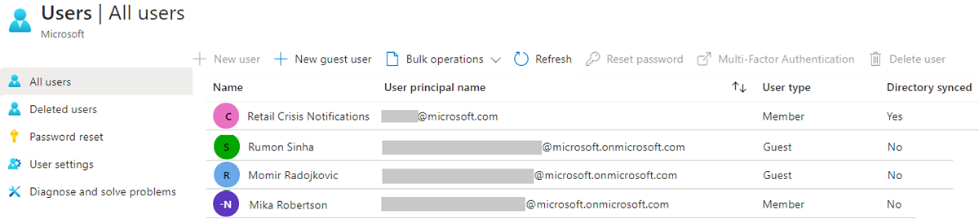
Create User Accounts
All users must have an account
The account is used for authentication and authorization
Each user account has additional properties
Notes:
✔️ Have you given any thought as to the type of users you will need?

Slide 16
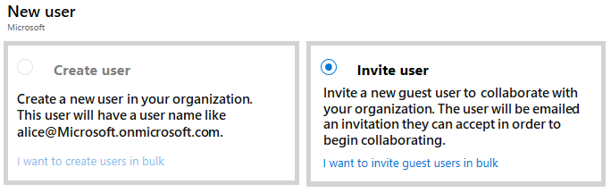
Manage User Accounts
Must be Global Administrator or User Administrator to manage users
User profile (picture, job, contact info) is optional
Deleted users can be restored for 30 days
Sign in and audit log information is available
Notes:
Add or delete users - https://docs.microsoft.com/azure/active-directory/fundamentals/add-users-azure-active-directory

Slide 17
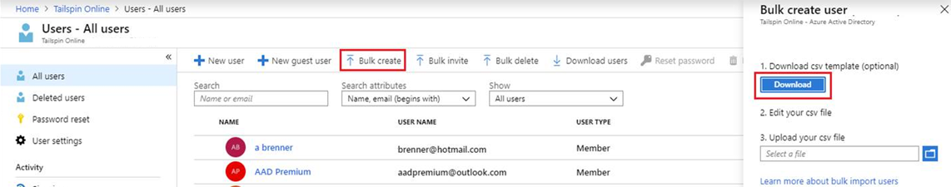
Perform bulk account updates (optional)
Supports bulk user and group member updates
Create the comma-separated values (CSV) template you can download from the Portal
Must be signed in as a Global administrator or User administrator
Notes:
The latest JTA (Jan 2022) now states, Perform bulk updates. Previously this was just bulk user accounts.
Bulk create users in Microsoft Entra ID - https://docs.microsoft.com/azure/active-directory/users-groups-roles/users-bulk-add
Bulk add group members in Microsoft Entra ID - https://docs.microsoft.com/azure/active-directory/enterprise-users/groups-bulk-import-members
✔️ Establish or implement a naming convention for usernames, display names and aliases. The password for the new users needs to conform to the password complexity rules you have set for your directory. User parameters include User Principal Name, Display Name, Given Name, Department, and Job Title.

Slide 18
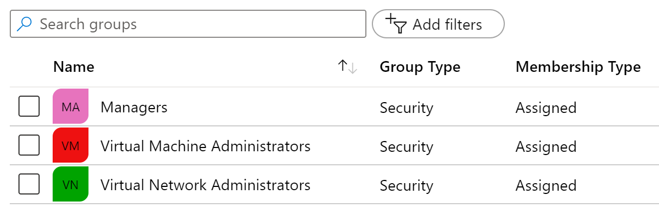
Create Group Accounts
Group Types
Security groups
Microsoft 365 groups
Membership Types
Assigned
Dynamic User
Dynamic Device (Security groups only)
Notes:
Learn about groups and access rights in Microsoft Entra ID – https://docs.microsoft.com/azure/active-directory/fundamentals/active-directory-manage-groups
Quickstart: Create a group with members and view all groups and members- https://docs.microsoft.com/azure/active-directory/fundamentals/active-directory-groups-view-azure-portal
✔️ Have you given any thought to which groups you need to create? How will you assign users to groups?

Slide 19
Assign Licenses to Users and Groups
Azure is a cloud service that provides many built-in services for free.
Microsoft Entra ID comes as a free service
Gain additional functionality with a P1 or P2 license
View license plans and plan details
Set the Usage Location parameter
Assign licenses to users and groups
Change license plans for users and groups
Remove a license
Additional Services (like O365 are paid cloud services)
Microsoft paid cloud services require licenses
Licenses are assigned to those who need access to the services
Each user or group requires a separate paid license
Administrators use management portals and PowerShell cmdlets to manage licenses
Notes:
Assign or remove licenses in the Azure portal - https://docs.microsoft.com/azure/active-directory/fundamentals/license-users-groups
Take a minute to show in the Portal the basic licensing tasks. This topic is not in the student content.

Slide 20
Create Administrative Units (optional)
Create an administrative unit
Populate the administrative unit with users or groups
Create a role with appropriate permissions scoped to the administrative unit
Add IT members to the role
Microsoft Entra ID P1 or P2 Privileged Role Administrator or Global Administrator
Notes:
It can be useful to restrict administrative scope by using administrative units in organizations that are made up of independent divisions of any kind. Consider the example of a large university that's made up of many autonomous schools (School of Business, School of Engineering, and so on). Each school has a team of IT admins who control access, manage users, and set policies for their school.
A central administrator could:
Administrative units in Microsoft Entra ID - https://docs.microsoft.com/azure/active-directory/roles/administrative-units
Create a role with administrative permissions over only users in the business school administrative unit.
Create an administrative unit for the School of Business.
Populate the administrative unit with only the business school students and staff.
Add the business school IT team to the role, along with its scope.

Slide 21
Demonstration – Users and Groups
Review license and domain information
Explore user accounts
Explore group accounts
Notes:
Configure user and group accounts - https://microsoftlearning.github.io/AZ-104-MicrosoftAzureAdministrator/Instructions/Demos/01%20-%20Administer%20Identity.html#configure-user-and-group-accounts

Slide 22
Learning Recap – Configure User and Group Accounts
Create Azure users and groups in Microsoft Entra ID
Manage users and groups
Notes:
Additional questions are available in Office Forms - https://forms.office.com/Pages/ShareFormPage.aspx?id=v4j5cvGGr0GRqy180BHbR5NEFZBpuAZBgxPOGXi_gX5UNlQyT1BLOTZYNjNBTk5NREk5NzFPOFpFWS4u&sharetoken=ms6pe4tvOByStLZxuG5B&wdLOR=cF86857FF-7E68-42CA-B255-DA42AE56590A
List three features of a user account and two ways a user can be assigned to group.
Answer: All users must have a user account. The user account is used for authentication and authorization. Each user account can have additional properties (user profile), like phone number. You must be a Global Administrator or User Administrator to manage users. Users can be assigned to groups either directly or dynamically. Dynamic assignment lets you create complex attribute-based rules.

Slide 23
Lab - Manage Microsoft Entra ID Identities

Slide 24
Lab 01 – Manage Microsoft Entra ID Identities (Lab simulation)
Job Skills
In this lab, you learn about users and groups.
Users and groups are the basic building blocks for an identity solution.
You create a new user and invite a guest user.
You also create a group and add a member and owner.
Task 1: Create and configure user accounts.
Task 2: Create groups and add members.
Next slide for an architecture diagram
Notes:
This is the shortest lab in the course. Take this opportunity to introduce the lab environment, how to access the portal, and where the login information is located. Also review how the labs are organized emphasizing the day-to-day job skills and scenarios that are covered. Review additional labs that may be available in your hosting environment.
If you are using the Skillable environment, instructions have been added to create a new tenant. This is the only lab that requires additional lab setup. Creating a new tenant is necessary to add the new user. If the students cannot create a new tenant (captcha error), just review an existing user account.
Lab 01 - https://microsoftlearning.github.io/AZ-104-MicrosoftAzureAdministrator/Instructions/Labs/LAB_01-Manage_Entra_ID_Identities.html

Slide 25


Lab 01 – Manage Entra ID Identities
Task 1
User1
IT Lab Administrator
Invited guest
IT Lab Administrator
Task 2
IT Lab Administrators

Slide 26

Lab 01 – Manage Entra ID Identities (interactive lab simulation)
Adatum Corporation (default)
Adatum Lab
Task 2
IT Lab Administrators
IT Lab Administrators
Task 3
IT Cloud Administrators
IT System Administrators
Task 4
IT System Administrators
Task 1
User1
Cloud Administrator
User2
System Administrator
LabUser1
Notes:
This is the architecture diagram for the interactive lab simulation.

Slide 27
End of presentation

