Slide 1
AZ-104T00A Administer Intersite Connectivity
Notes:
These Learn modules are part of the AZ-104: Configure and manage virtual networks for Azure administrators (https://docs.microsoft.com/learn/paths/az-104-manage-virtual-networks/) learning path.

Slide 2
Learning Objectives – Administer Intersite Connectivity
Configure VNet Peering
Configure Network Routing and Endpoints
Lab 05 - Implement Intersite Connectivity
Notes:
The 28 July 23 course update moved Routing and Endpoints here to balance out the module.
VPN Gateway and ER/VWAN moved to the end. This content will be removed during the next update. Look to AZ-700 for content.

Slide 3


Administer Intersite Connectivity whiteboard
What is virtual network peering? Advantages?
What is the difference between system-defined routes and user-defined routes?
What is the difference between a service endpoint and a private endpoint?
Azure virtual networks
??
??
??
Local on-premises networks
Notes:
Optional whiteboard slide to introduce the module or review the content. Use the whiteboard diagram directly or recreate the image during the class. Focus this discussion on intersite connectivity.

Slide 4
Configure VNet Peering

Slide 5
Learning Objectives – Configure VNet Peering
Determine VNet Peering Uses
Determine Gateway Transit and Connectivity Needs
Create VNet Peering
Determine Service Chaining Uses
Demonstration – VNet Peering
Learning Recap
Implement and manage virtual networking (15–20%): Configure and manage virtual networks in Azure
Create and configure virtual network peering

Slide 6
Determine VNet Peering Uses
Region 1
Region 2
VNet1
Global
VNet Peering
VNet2
Regional
VNet Peering
VNet3
Two types of peering: Global and Regional
Connects two Azure virtual networks – you can peer across subscriptions and tenants
Peered networks use the Azure backbone for privacy and isolation
Easy to setup, seamless data transfer, and great performance
Notes:
Virtual network peering - https://docs.microsoft.com/azure/virtual-network/virtual-network-peering-overview

Slide 7
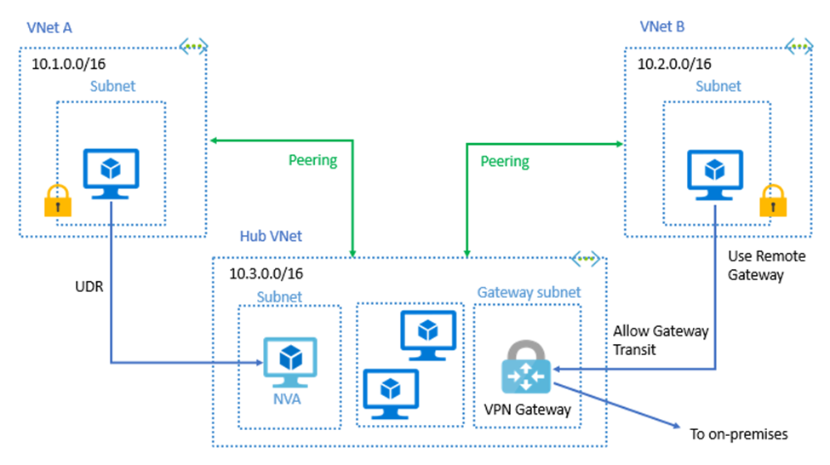

Determine Gateway Transit and Connectivity Needs
Gateway transit allows peered virtual networks to share the gateway and get access to resources
No VPN gateway is required in the peered spoke virtual network
Default VNet peering provides full connectivity
IP address spaces of connected networks can't overlap
Notes:
Azure Virtual Network frequently asked questions (FAQ) VNet Peering - https://docs.microsoft.com/azure/virtual-network/virtual-networks-faq

Slide 8
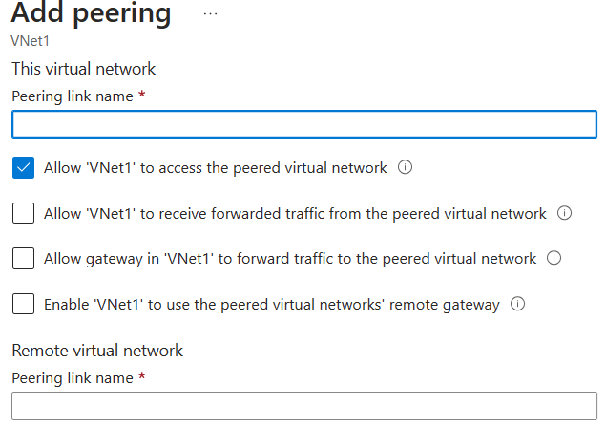
Create VNet Peering
Allow virtual network access settings
Configure forwarded traffic settings
Status should show “connected”
Notes:
Create, change, or delete a virtual network peering - https://docs.microsoft.com/azure/virtual-network/virtual-network-manage-peering#requirements-and-constraints
Tutorial: Connect virtual networks with virtual network peering using the Azure portal - https://docs.microsoft.com/azure/virtual-network/tutorial-connect-virtual-networks-portal
✔️ When you add a peering on one virtual network, the second virtual network configuration is automatically added.

Slide 9
Determine Service Chaining Uses
Leverage user-defined routes and service chaining to implement custom routing
Implement a VNet hub with a network virtual appliance or a VPN gateway
VNet2
Hub VNet
Network Virtual Appliance or
VPN Gateway
Service chaining enables you to direct traffic from one virtual network to a virtual appliance, or virtual network gateway, in a peered virtual network, through user-defined routes
VNet3
Notes:
Distribute your services across Azure virtual networks and integrate them by using virtual network peering - https://docs.microsoft.com/learn/modules/integrate-vnets-with-vnet-peering

Slide 10
Demonstration – Virtual Network Peering
Configure VNet peering on the first virtual network
Confirm VNet peering on the second virtual network
Notes:
Demonstration Virtual Network Peering- https://microsoftlearning.github.io/AZ-104-MicrosoftAzureAdministrator/Instructions/Demos/05%20-%20Administer%20Intersite%20Connectivity.html#configure-vnet-peering

Slide 11
Learning Recap – Configure VNet Peering
Distribute your services across Azure virtual networks and integrate them by using virtual network peering (sandbox)
A sandbox indicates an additional hands-on exercise.
Notes:
Additional questions are available in Office Forms - https://forms.office.com/Pages/ShareFormPage.aspx?id=v4j5cvGGr0GRqy180BHbR5NEFZBpuAZBgxPOGXi_gX5UQVNHMlgwTVlJRUFaTThRMTlBWFI0OEdVSS4u&sharetoken=qJgpgzD82bgxMb7uu7Bf&wdLOR=cA90F021B-4D8D-4F08-B45D-4C2FF7466064
What is virtual network (VNet) peering and why would use it?
Answer: VNet peering connects two Azure virtual networks. Peering can be regional or global. Peered networks use the Azure backbone which provides for privacy and isolation. VNet peering is easy to configure and offers great performance.

Slide 12
Configure Network Routing and Endpoints

Slide 13
Configure Network Routing and Endpoints Introduction
Review System Routes
Identify User-Defined Routes
Demonstration – Custom Routing tables
Determine Service Endpoint Uses
Identify Private Link Uses
Learning Recap
Implement and manage virtual networking (15–20%): Configure and manage virtual networks in Azure
Configure user-defined network routes
Implement and manage virtual networking (15–20%): Configure secure access to virtual networks
Configure service endpoints for Azure platform as a service (PaaS)
Configure private endpoints for Azure PaaS

Slide 14

Review System Routes
Directs network traffic between virtual machines, on-premises networks, and the internet
Traffic between VMs in the same subnet
Between VMs in different subnets in the same virtual network
Data flow from VMs to the internet
Communication between VMs using a VNet-to-VNet VPN
Site-to-Site and ExpressRoute communication through the VPN gateway
Internet
System
Route
System
Route
Frontend Subnet
Backend Subnet
Routing Table
Virtual Network
Notes:
System routes - https://docs.microsoft.com/azure/virtual-network/virtual-networks-udr-overview#system-routes

Slide 15
Identify User-Defined Routes
A route table contains a set of rules, called routes, that specifies how packets should be routed in a virtual network
Internet
User defined route
VM/Appliance
IP Forwarding
User-defined routes are custom routes that control network traffic by defining routes that specify the next hop of the traffic flow
System
Route
Frontend Subnet
Backend Subnet
The next hop can be a virtual network gateway, virtual network, internet, or virtual appliance
User defined route
VM/Appliance
IP Forwarding
Virtual Network
Notes:
Virtual network traffic routing - https://docs.microsoft.com/azure/virtual-network/virtual-networks-udr-overview
✔ Each route table can be associated to multiple subnets, but a subnet can only be associated to a single route table. There are no additional charges for creating route tables in Microsoft Azure. Do you think you will need to create custom routes?

Slide 16
Demonstration – Custom Routing Tables
Create a route table
Add a route
Associate a route table to a subnet
Notes:
Demonstration – Configure routing and endpoints - https://microsoftlearning.github.io/AZ-104-MicrosoftAzureAdministrator/Instructions/Demos/05%20-%20Administer%20Intersite%20Connectivity.html#configure-network-routing-and-endpoints

Slide 17
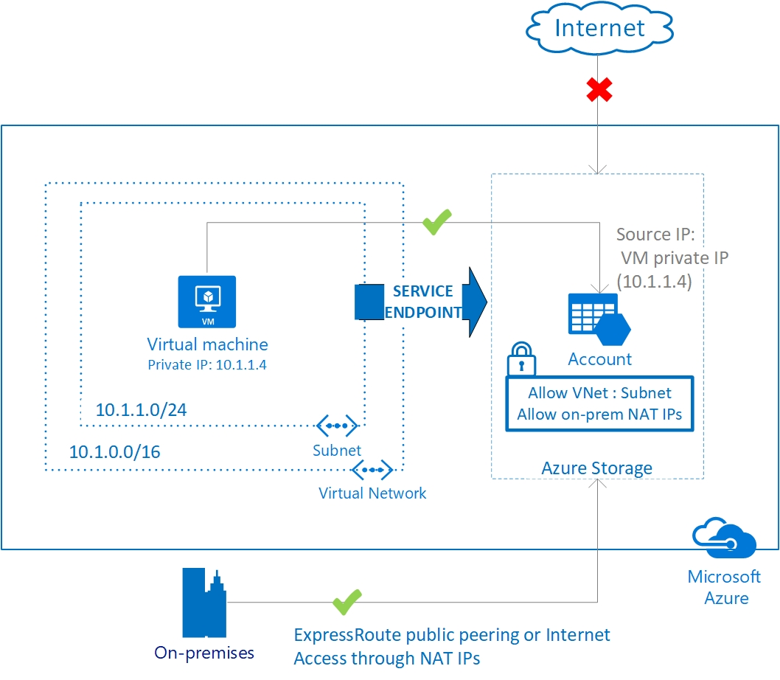
Determine Service Endpoint Uses
Endpoints limit network access to specific services
Adding service endpoints can take up to 15 minutes to complete
Notes:
This is 2 topics in the student content.
Virtual network service endpoints - https://docs.microsoft.com/azure/virtual-network/virtual-network-service-endpoints-overview
Tutorial: Restrict network access to PaaS resources with virtual network service endpoints using the Azure portal - https://docs.microsoft.com/azure/virtual-network/tutorial-restrict-network-access-to-resources
Improved security for your resources
Optimal routing for your services
Uses the Azure backbone and is simple to configure
✔️ Can you see a use for service endpoints in your organization?

Slide 18
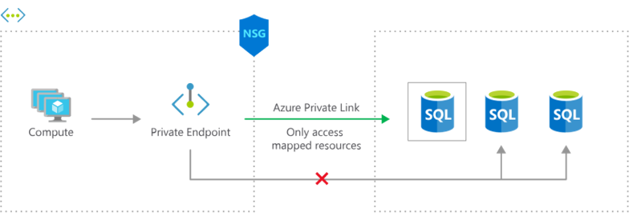
Identify Private Link Uses
Private connectivity to services on Azure. Traffic remains on the Microsoft network, with no public internet access
Integration with on-premises and peered networks
In the event of a security incident within your network, only the mapped resource would be accessible
Notes:
Private Link Documentation - https://docs.microsoft.com/azure/private-link/

Slide 19
Learning Recap – Configure Network Routing and Endpoints
Manage and control traffic flow in your Azure deployment with routes (sandbox)
Introduction to Azure Private Link
A sandbox indicates an additional hands-on exercise.
Notes:
Additional questions are available in Office Forms - https://forms.office.com/Pages/ShareFormPage.aspx?id=v4j5cvGGr0GRqy180BHbR5NEFZBpuAZBgxPOGXi_gX5UQVNHMlgwTVlJRUFaTThRMTlBWFI0OEdVSS4u&sharetoken=qJgpgzD82bgxMb7uu7Bf&wdLOR=cA90F021B-4D8D-4F08-B45D-4C2FF7466064
What is the difference between system-defined routes and user-defined routes? Give an example where each type of route would be used.
Answer: System-defined routes direct network traffic between virtual machines, on-premises networks, and the internet. System-defined routes are the default behavior for Azure routing. Examples include traffic between VMs in the same subnet, between VMs in different subnets in the same virtual network, and data flow from VMs to the internet. User-defined (custom) routes override the system routes or add routes to the routing table. Examples include routing through gateways and virtual appliances.
What is the difference between a service endpoint and a private endpoint?
Answer: A service endpoint limits network access to specific subnets and IP addresses. A service endpoint is a web address (URL) at which clients of a specific service can gain access to it. Service endpoints are supported for a variety of services including Storage, Key Vault, and SQL. A private endpoint. A private endpoint is a network interface that uses a private IP address from your virtual network. This network interface connects you privately and securely to a service through a private link. Private link integrates with on-premises and peered networks.

Slide 20
Lab - Implement Intersite Connectivity

Slide 21













Module Review Activity
??
On-premises machine
??
Name?
Name?
??
Name?
Name?
??
On-premises network
Application
gateway
Azure
firewall
Load
balancer
NAT
Private
endpoint
Service
endpoint
VNet Peering
VPN
Gateway
Notes:
Use the diagram to engage students and reinforce topics that have just been covered. If you remove the green square (??) the product icon will show. Discuss the options with the students.
Site to site = On-premises networks to Azure virtual networks
Point to Site = On-premises machines to Azure virtual networks
Gateway subnet name = GatewaySubnet
Azure firewall subnet name = AzureFirewallSubnet

Slide 22
Lab 05 – Implement intersite connectivity
Job Skills
Task 1: Create a virtual machine and virtual network.
Task 2: Create a virtual machine in a different virtual network.
Task 3: Use Network Watcher to test the connection between virtual machines.
Task 4: Configure virtual network peering between virtual networks.
Task 5: Use Azure PowerShell to test the connection between virtual machines. RDP optional.
Task 6: Create a custom route.
In this lab, you will explore communication between virtual networks.
You will implement virtual network peering and test connections.
You will also learn about the Network Watcher tool.
Next slide for an architecture diagram
Notes:
For Task 5 you could use RDP rather than Run Command and Test-Connection. This lab uses Network Watcher which isn’t covered until the next module.
Lab 05- https://microsoftlearning.github.io/AZ-104-MicrosoftAzureAdministrator/Instructions/Labs/LAB_05-Implement_Intersite_Connectivity.html

Slide 23





Lab 05 – Architecture diagram
az104-rg5
East US
East US
Task 3
CoreServicesVnet
(10.0.0.0/16)
ManufacturingVnet
(172.16.0.0/16)
Task 6
Task 1
Core
(10.0.0.0/24)
Task 2
Manufacturing
(172.16.0.0/24)
Perimeter
(10.0.1.0/24)
CoreServicesVM
Task 4
ManufacturingVM
Task 5

Slide 24
Lab 05 – Architecture diagram (interactive lab simulation)
Region1
Task 1
az104-05-rg1
az104-05-vnet0 10.50.0.0/22
Region2
Subnet0 10.50.0.0/24
Task 2, Task 3
az104-05-rg1
az104-05-vm0
10.50.0.4
Global Peering
az104-05-vnet2 10.52.0.0/22
Subnet0 10.52.0.0/24
az104-05-rg1
Local Peering
Global Peering
az104-05-vm2
10.52.0.4
Subnet0 10.51.0.0/24
az104-05-vm1
10.51.0.4
az104-05-vnet1 10.51.0.0/22
Notes:
This architecture diagram is for the interactive lab simulation, if you want to review that.

Slide 25
End of presentation

