Slide 1
AZ-104T00A Administer Monitoring

Slide 2
Learning Objectives - Administer Monitoring
Configure Azure Monitor
Configure Azure Alerts
Configure Log Analytics
Lab 11 – Implement Monitoring
Notes:
This content is part of the AZ-104: Monitor and back up Azure resources (https://docs.microsoft.com/learn/paths/az-104-monitor-backup-resources/) learning path.
Configure Azure Alerts is being retired. The link will redirect to Improve incident response with alerting on Azure.

Slide 3
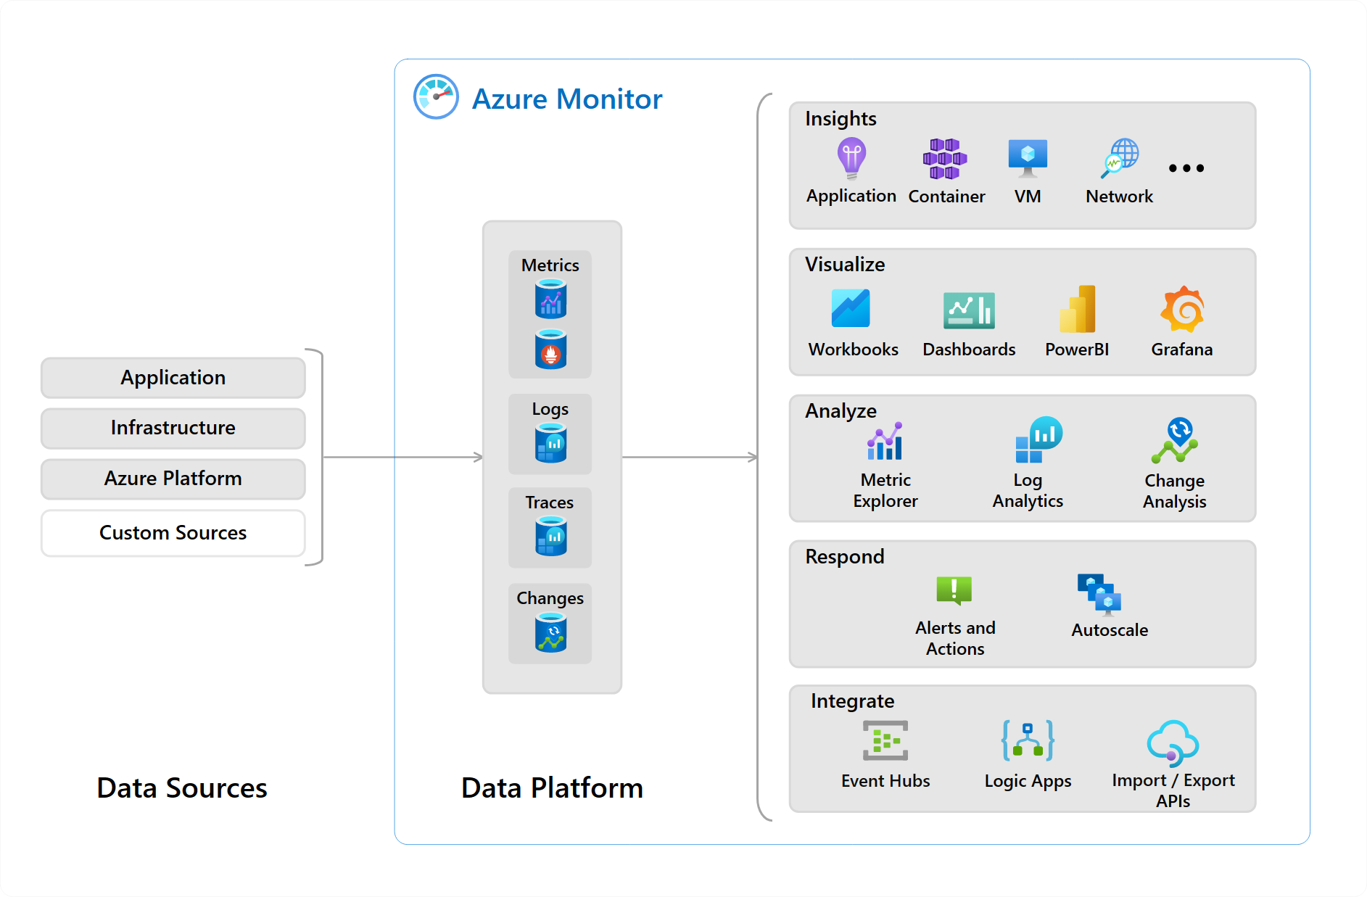
Administer Monitoring whiteboard
Notes:
Optional whiteboard slide to introduce the module or review the content. Use the whiteboard diagram directly or recreate the image during the class.

Slide 4
Configure Azure Monitor

Slide 5
Learning Objectives - Configure Azure Monitor
Describe Azure Monitor Key Capabilities
Describe Azure Monitor Components
Define Metrics and Logs
Identify Data Types
Describe Activity Log Events
Learning Recap
Monitor and maintain Azure resources (10–15%): Monitor resources in Azure
Interpret metrics in Azure Monitor
Configure log settings in Azure Monitor
Configure and interpret monitoring of virtual machines, storage accounts, and networks by using Azure Monitor Insights

Slide 6
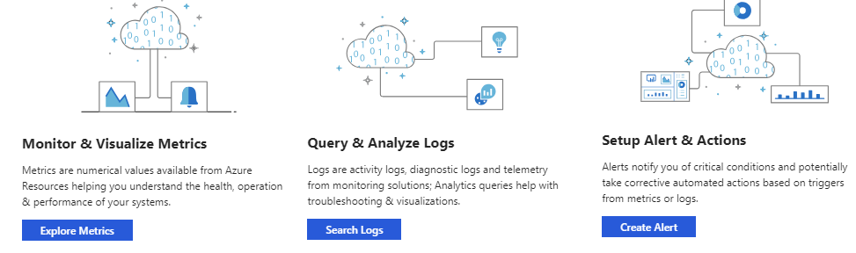
Describe Azure Monitor Key Capabilities
Core monitoring for Azure services
Collects metrics, activity logs, and diagnostic logs
Use for time critical alerts and notifications

Slide 7
Understand Azure Monitor Components
Application monitoring data
Guest OS monitoring
Azure resource monitoring
Azure subscription monitoring
Azure tenant monitoring
Notes:
What is Azure Monitor - https://docs.microsoft.com/azure/azure-monitor/overview
Sources of monitoring data for Azure Monitor - https://docs.microsoft.com/azure/azure-monitor/platform/data-sources

Slide 8
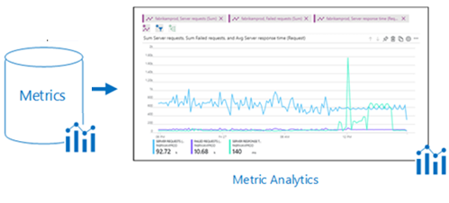
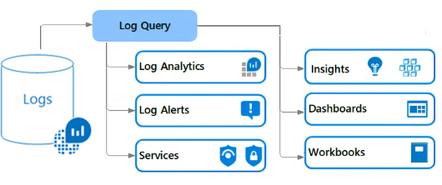
Define Metrics and Logs
Metrics are numerical values that describe some aspect of a system at a point in time
They are lightweight and capable of supporting near real-time scenarios
Logs contain different kinds of data organized into records with different sets of properties for each type
Telemetry (events, traces) and performance data can be combined for analysis
Notes:
Metrics - https://docs.microsoft.com/azure/azure-monitor/platform/data-platform-metrics
Logs - https://docs.microsoft.com/azure/azure-monitor/platform/data-platform-logs

Slide 9
Describe Activity Log Events
Send data to Log Analytics for advanced search and alerts
Application
Resource
Application logs
Query or manage events in the Portal, PowerShell, CLI, and REST API
Diagnostic logs
Diagnostic logs
Stream information to Event Hub
Guest OS
Host virtual machine
Archive data to a storage account
Activity logs
Activity logs
Analyze data with Power BI
Azure infrastructure
Azure infrastructure
Compute
resources only
Non-compute
resources only
Notes:
Azure Activity log - https://docs.microsoft.com/azure/azure-monitor/platform/activity-log
Send Azure Activity log to Log Analytics workspace using Azure portal - https://docs.microsoft.com/azure/azure-monitor/learn/quick-collect-activity-log-portal

Slide 10
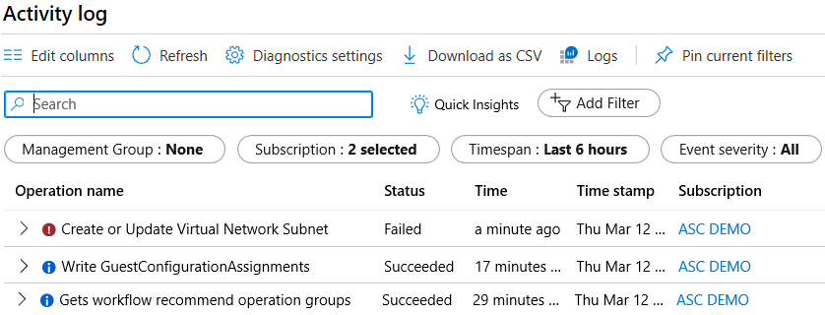
Query the Activity Log
Filter by Management group, Subscription, Timespan, and Event Severity
Add a filter, like Event Category (Security, Recommendations, Alerts)
Pin current filters and download as CSV
Notes:
Query the Activity Log in the Azure portal - https://docs.microsoft.com/azure/monitoring-and-diagnostics/monitoring-overview-activity-logs#query-the-activity-log-in-the-azure-portal

Slide 11
Learning Recap – Configure Azure Monitor
Analyze your Azure infrastructure by using Azure Monitor logs (sandbox)
Monitor your Azure virtual machines with Azure Monitor
Monitor, diagnose, and troubleshoot your Azure storage (sandbox)
A sandbox indicates an additional hands-on exercise.
Notes:
Additional questions in Office Forms - https://forms.office.com/Pages/ShareFormPage.aspx?id=v4j5cvGGr0GRqy180BHbR5NEFZBpuAZBgxPOGXi_gX5UOFlRUEszMlRFTkpFT0E3Q1oxRjlQVk81MS4u&sharetoken=8yKD9q6v9z0tcrXy3tS5&wdLOR=c3820A896-48CD-46AD-BE50-F09068C1280F
Name at least three data sources that can be used by Azure Monitor.
Answer: Azure Monitor can ingest many different data sources. Sources include application code, operating system, resource, subscription, and tenant data. You can even create your own custom data source. Data sources generally fall into two categories metrics and logs. Metrics are numerical values that describe some aspect of a system at a point in time. For example, virtual machine CPU performance. Logs contain data organized into records with different sets of properties for each type. For example, the activity log shows subscription-level events. This includes such information as when a resource is modified or when a virtual machine is started.

Slide 12
Configure Azure Alerts

Slide 13
Configure Azure Alerts Overview
Manage Azure Monitor Alerts
Create Alert Rules
Create Action Groups
Demonstration – Alerts
Learning Recap
Monitor and maintain Azure resources (10–15%): Monitor resources in Azure
Set up alert rules, action groups, and alert processing rules in Azure Monitor
Notes:
There is a new module for this is Improve incident response with alerting on Azure - Training | Microsoft Learn, https://learn.microsoft.com/training/modules/incident-response-with-alerting-on-azure/. The slides cover the certification topics and do not match the new module exactly. There are exercises in the new module that we are not using.

Slide 14
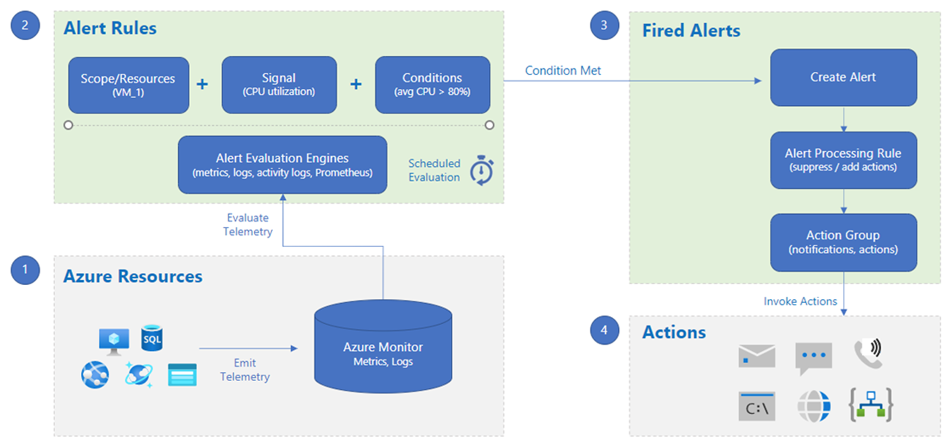
Manage Azure Monitor Alerts
Notes:
The new alerts experience in Azure Monitor - https://docs.microsoft.com/azure/monitoring-and-diagnostics/monitoring-overview-unified-alerts

Slide 15
Demonstration – Alerts
Create and configure an alert rule
Review alerts
Notes:
Demonstration Azure Alerts - https://microsoftlearning.github.io/AZ-104-MicrosoftAzureAdministrator/Instructions/Demos/11%20-%20Administer%20Monitoring.html#configure-azure-alerts

Slide 16
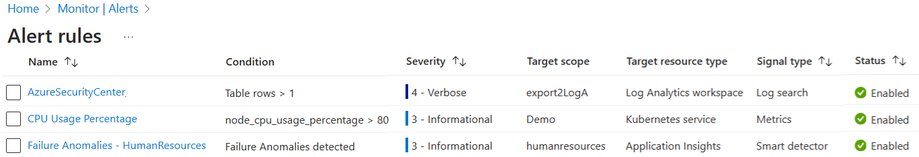
Create Alert Rules
Alert rules combine the resources to be monitored, the signal or data from the resource, and the conditions.
You can enable recommended out-of-the-box alert rules in the Azure portal.
Notes:
Respond to events with Azure Monitor Alerts - https://docs.microsoft.com/azure/azure-monitor/learn/tutorial-response
Create, view, and manage metric alerts using Azure Monitor - https://docs.microsoft.com/azure/azure-monitor/platform/alerts-metric
Recommended out-of-the-box alert rules - https://learn.microsoft.com/azure/azure-monitor/alerts/alerts-manage-alert-rules#enable-recommended-alert-rules-in-the-azure-portal

Slide 17
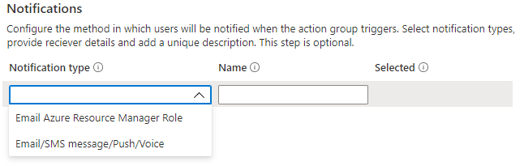
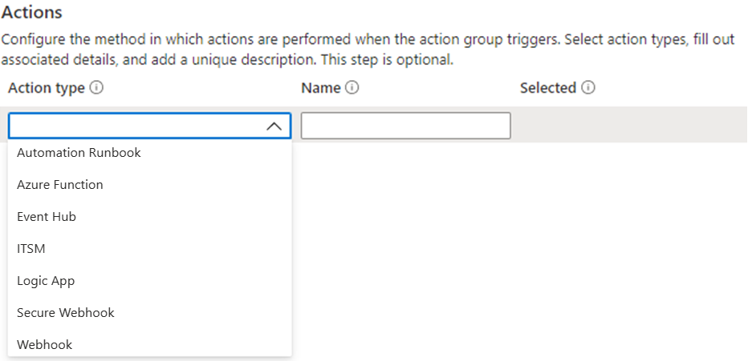
Create Action Groups
Defines a set of notifications and/or actions when an alert is triggered
You can add up to five action groups to an alert rule. Multiple alert rules can use the same action group.
Notes:
Create and manage action groups in the Azure portal - https://docs.microsoft.com/azure/azure-monitor/platform/action-groups

Slide 18
Learning Recap – Configure Azure Alerts
Improve incident response with alerting on Azure (sandbox)
Configure for alerts and detections in Microsoft Defender for Endpoint
Remediate security alerts using Microsoft Defender for Cloud
A sandbox indicates an additional hands-on exercise.
Notes:
Additional questions in Office Forms - https://forms.office.com/Pages/ShareFormPage.aspx?id=v4j5cvGGr0GRqy180BHbR5NEFZBpuAZBgxPOGXi_gX5UOFlRUEszMlRFTkpFT0E3Q1oxRjlQVk81MS4u&sharetoken=8yKD9q6v9z0tcrXy3tS5&wdLOR=c3820A896-48CD-46AD-BE50-F09068C1280F
You need to configure several Azure alerts. How will you assign/notify the help desk personnel when an alert is triggered? What methods can be used to notify them?
Answer: The help desk personnel should be added to an action group. An action group is a collection of notification preferences. Alerts use action groups to notify users that an alert has been triggered. Various alerts may use the same action group or different action groups depending on the user's requirements. Notification methods include push notifications to the Azure mobile app, email, SMS, and voice.
You are reviewing the Azure Monitor alerts page. What alert states (statuses) are possible?
Answer: There are three alert states New, Acknowledged, and Closed. New indicates an issue has been detected and hasn’t been reviewed. Acknowledged indicates an administrator has reviewed the alert and started working on it. Closed indicates the issue has been resolved. You can reopen a closed alert if the issue returns.

Slide 19
Configure Log Analytics
Notes:
Monitor and maintain Azure resources (10–15%)
Monitor resources by using Azure Monitor
Configure and interpret metrics
Configure Azure Monitor Logs

Slide 20
Learning Objectives - Configure Log Analytics
Determine Log Analytics Uses
Create a Workspace
Query Log Analytics Data
Structure Log Analytics Queries
Demonstration – Log Analytics
Learning Recap
Monitor and maintain Azure resources (10–15%): Monitor resources in Azure
Query and analyze logs in Azure Monitor

Slide 21
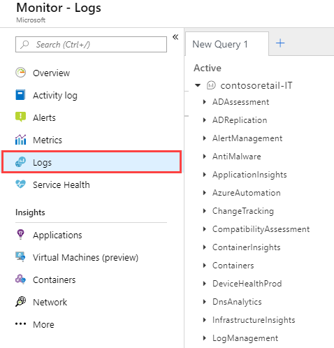
Determine Log Analytics Uses
A service that helps you collect and analyze data generated by resources in your cloud and on-premises environments
Write log queries and interactively analyze their results
Examples include assessing system updates and troubleshooting operational incidents
Notes:
Overview of Azure Monitor agents - https://docs.microsoft.com/azure/azure-monitor/platform/agents-overview

Slide 22
Demonstration – Log Analytics
Review built-in log queries
Review the KQL language
Notes:
Demonstration Log Analytics - https://microsoftlearning.github.io/AZ-104-MicrosoftAzureAdministrator/Instructions/Demos/11%20-%20Administer%20Monitoring.html#configure-log-analytics

Slide 23
Create a Workspace
A workspace is an Azure resource and is a container where data is collected, aggregated, analyzed, and presented
You can have multiple workspaces per Azure subscription, and you can have access to more than one workspace
A workspace provides a geographic location, data isolation, and scope
Notes:
Create a Log Analytics workspace in the Azure portal -https://docs.microsoft.com/azure/azure-monitor/learn/quick-create-workspace

Slide 24
Query Log Analytics Data
Common queries and a query language (KQL) for custom searches
Quickly retrieve and consolidate data in the repository
Save or have log searches run automatically to create an alert
Export the data to Power BI or Excel
Notes:
Overview of log queries in Azure Monitor - https://docs.microsoft.com/azure/azure-monitor/log-query/log-query-overview
Get started with log queries in Azure Monitor - https://docs.microsoft.com/azure/azure-monitor/log-query/get-started-queries

Slide 25
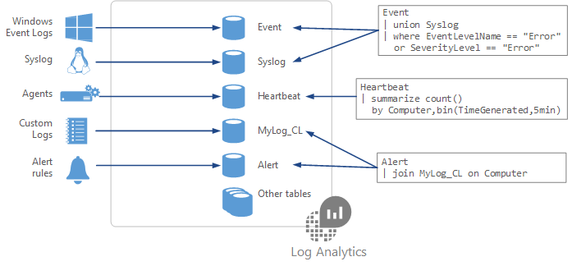
Structure Log Analytics Queries
Event
| where (EventLevelName == "Error")
| where (TimeGenerated > ago(1days))
| summarize ErrorCount = count() by Computer
| top 10 by ErrorCount desc
Notes:
Azure Monitor log queries - https://docs.microsoft.com/azure/azure-monitor/log-query/query-language
Azure Monitor log query examples - https://docs.microsoft.com/azure/azure-monitor/log-query/examples

Slide 26
Learning Recap – Configure Log Analytics
Write your first query with Kusto Query Language
Notes:
Additional questions in Office Forms - https://forms.office.com/Pages/ShareFormPage.aspx?id=v4j5cvGGr0GRqy180BHbR5NEFZBpuAZBgxPOGXi_gX5UOFlRUEszMlRFTkpFT0E3Q1oxRjlQVk81MS4u&sharetoken=8yKD9q6v9z0tcrXy3tS5&wdLOR=c3820A896-48CD-46AD-BE50-F09068C1280F
You would like to structure queries against the Windows Event log. Specifically, you would like to identify any errors. What product should you use? What query language is available to construct the query?
Answer: You should use a Log Analytics workspace. The workspace can receive data from the Windows Event log. The event records can then be visualized or queried. Azure uses the Kusto query language. Windows Event logs are stored in the Event table. to query the event table for errors, use this command: Event | where (EventLevelName == "Error").

Slide 27
Lab 11 – Implement Monitoring

Slide 28
Lab 11 – Implement monitoring
Job Skills
Task 1: Use a template to provision an infrastructure.
Task 2: Create an alert.
Task 3: Configure action group notifications.
Task 4: Trigger an alert and confirm it is working.
Task 5: Configure an alert rule.
Task 6: Use Azure Monitor log queries.
In this lab, you learn about Azure Monitor.
You learn to create an alert to be sent to an action group.
You trigger the alert and check the activity log.
Next slide for an architecture diagram
Notes:
This last lab is little shorter but puts together a practical example of monitoring.
Lab 11 - https://microsoftlearning.github.io/AZ-104-MicrosoftAzureAdministrator/Instructions/Labs/LAB_11-Implement_Monitoring.html

Slide 29







Lab 11 – Architecture diagram
az104-rg11
Task 2
Task 1
Alert- delete virtual machine
Task 3
az104-11-vm0
Action – send email
Task 6
Task 4
Trigger the alert
Log Queries
Task 5
Add a processing rule

Slide 30
End of presentation

