Slide 1
AZ-305T00A Designing Microsoft Azure Infrastructure Solutions

Slide 2



Thank you for attending this course
Here are some reminders
Celebrate your new skills
Let us know how we did
Become Microsoft Certified
Redeem your achievement
Share with us and your network
Give us your feedback
Survey will be sent via email
Explore additional resources to help prepare
Schedule your exam

Tag us social: #AlwaysLearning

Slide 3
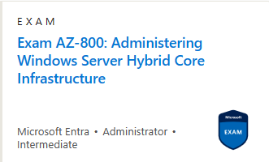

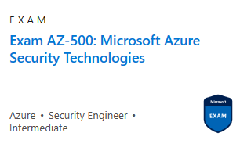
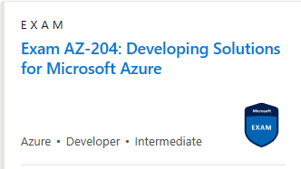
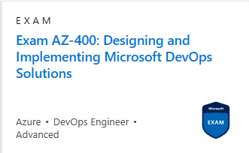

What could be next in your learning journey?
Consider specializing in an area of interest

Find more information about this course at: learn.microsoft.com/training/courses/browse

