Slide 1
RIPE-Atlas-tools
Hackdub18

Slide 2
Realtimeness
Starting points
Current tools – wait minutes, need fast, better!
Need more data – like ASNs
Need more operator useful data/use-cases
Beginners need an API key :-(
Maybe create some API keys with some credit pool?

Slide 3
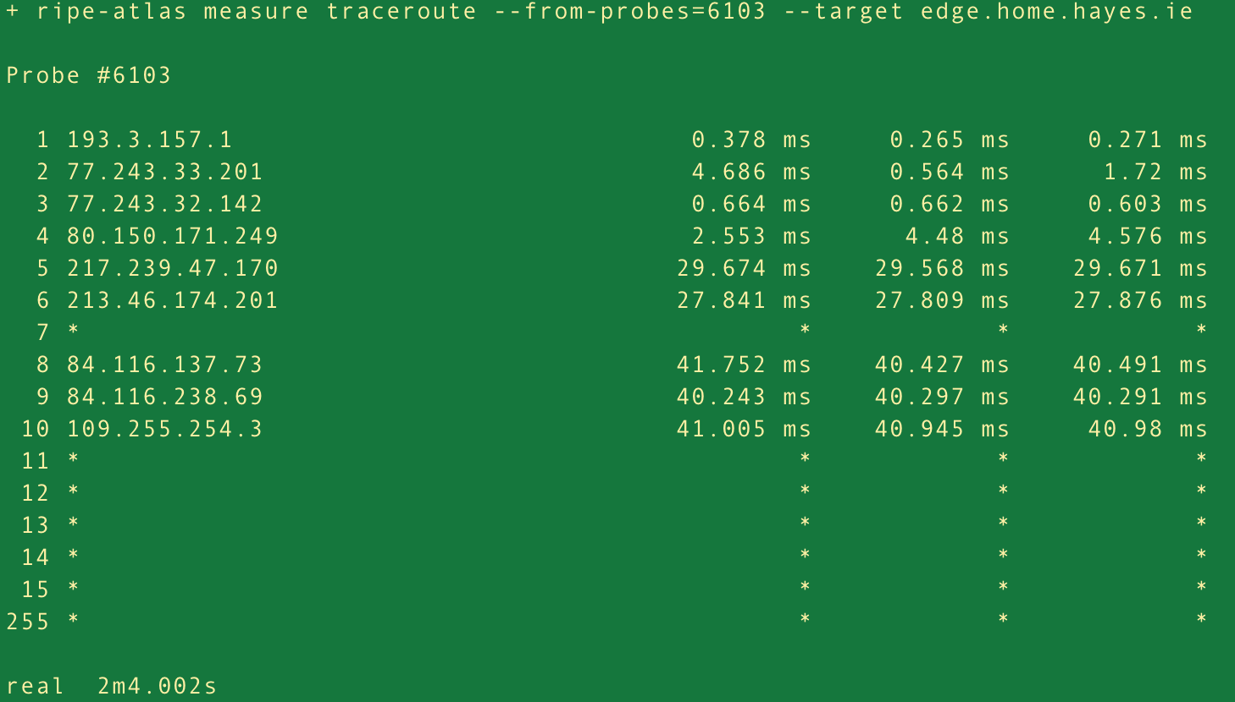
Doing a traceroute initially / before

Slide 4
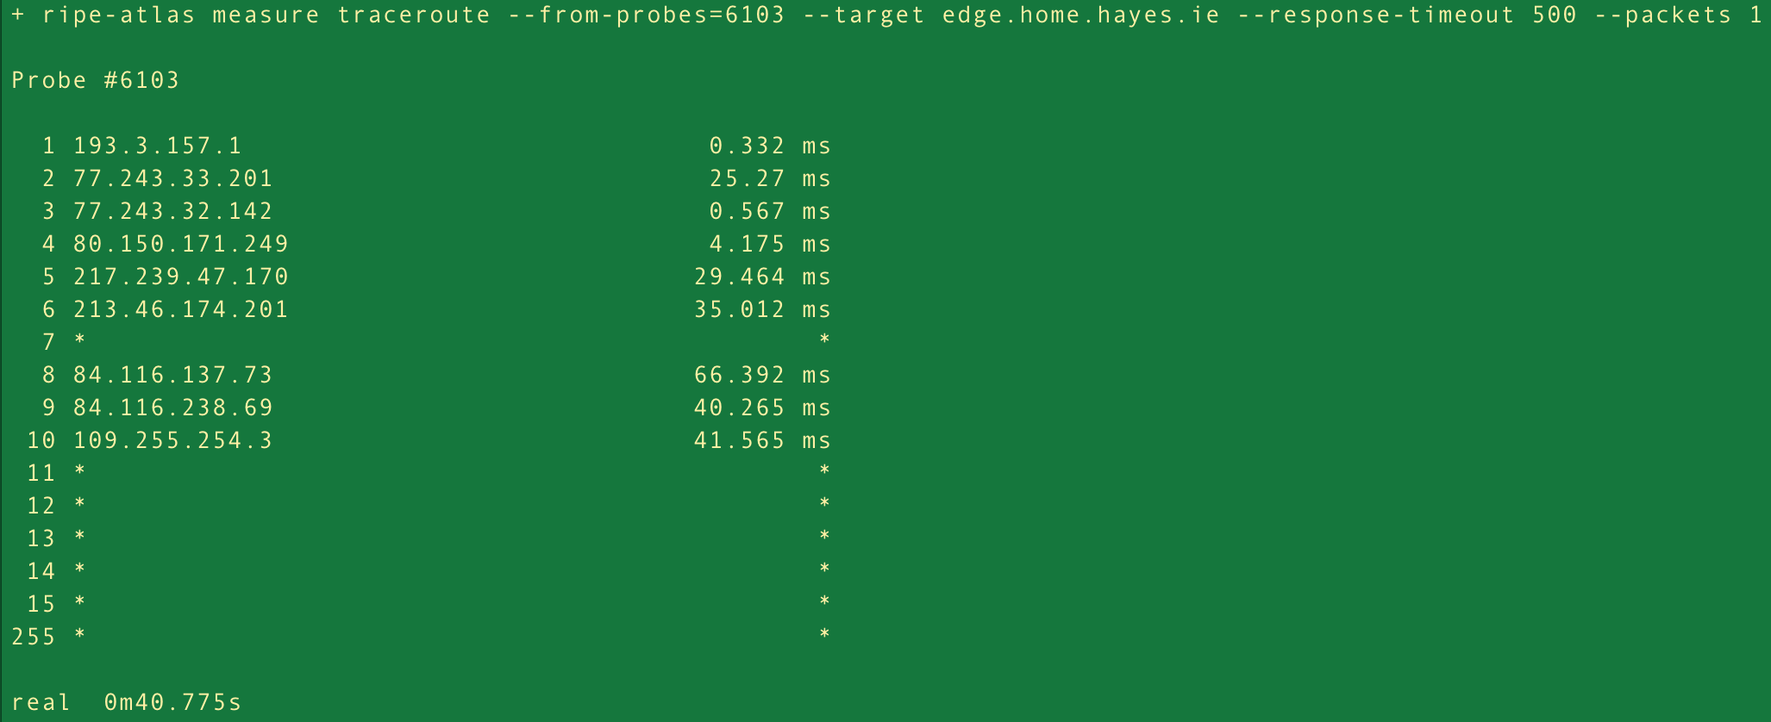
Faster traceroute
Changing the default matter a lot

Slide 5
Feature request
Annika had a use-case not covered by tools
Fine grained probe selection
Country AND ASN – match both
Branch https://github.com/kramse/ripe-atlas-tools/tree/probe-search
Needs a little cleanup before it can be sent upstream

Slide 6
Easier for newcomers
Made small changes to ripe-atlas-tools
More user-friendly, report missing API key?
Extend with new commands with sane default
- current tools can do all, but loooong command lines
Just a few simple Git pull requests, to learn :-)
https://github.com/RIPE-NCC/ripe-atlas-tools/pull/203
https://github.com/RIPE-NCC/ripe-atlas-tools/pull/201
Branch https://github.com/kramse/ripe-atlas-tools/tree/doc-healthcheck

Slide 7
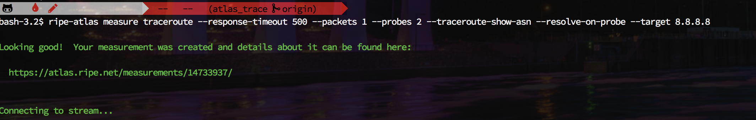
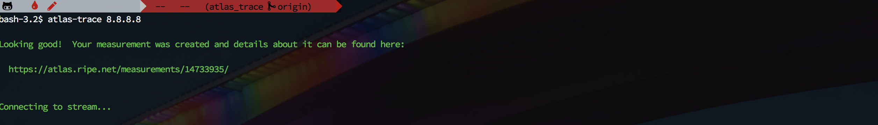
Improve usability
Canned commands with useful default
atlas-trace
Have a set of recipes
Before and after, easier running a traceroute

Slide 8
Improvement colourise-traceroute
Adding hostnames, ASN, colour and latency bars
Using database of 15 million data points
Colours by round trip time (RTT) anomalies
Latency bars added for further visibility
ripe-atlas report --render traceroute_asboundry 14680937

Slide 9
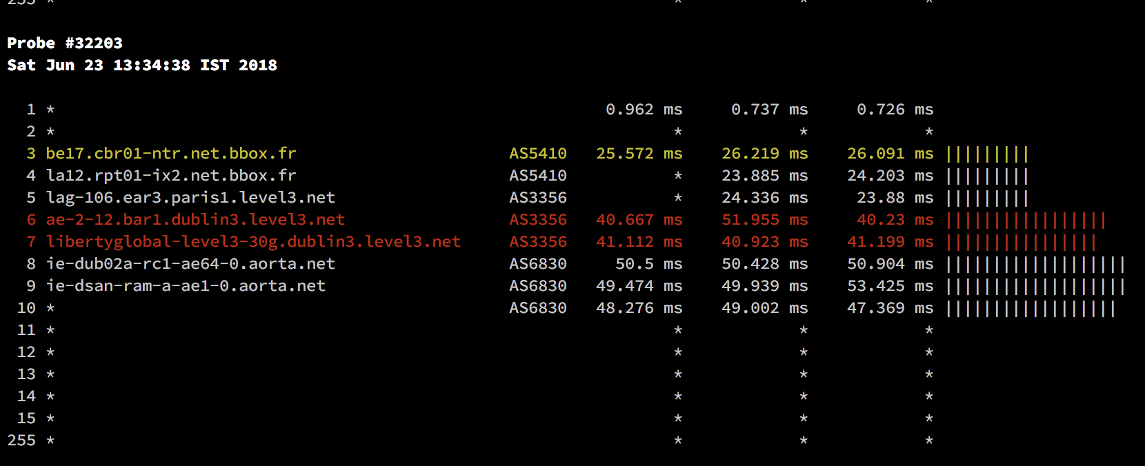
screenshot

Slide 10
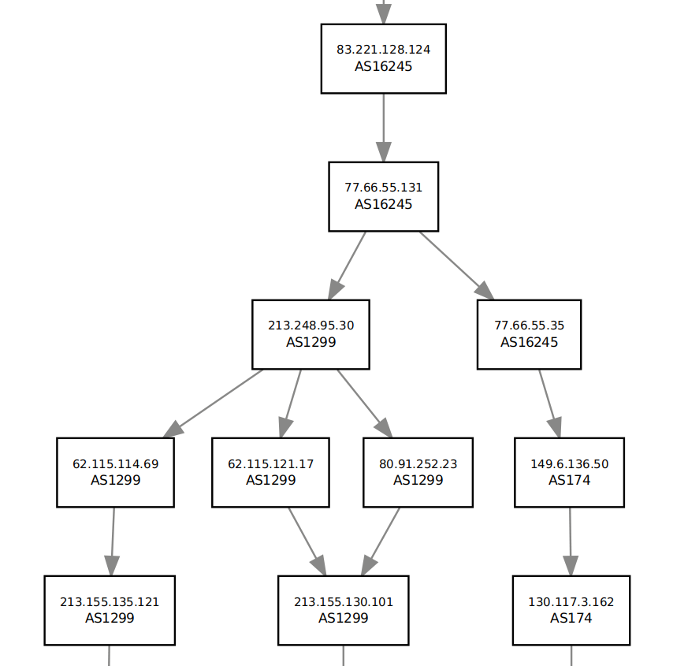
Graphing traceroute from measurement
Idea from https://ring.nlnog.net/toolbox/ ring-trace tool can do some really nice graphs with Graphviz
Lots of problems - “its a PoC”
Branch https://github.com/kramse/ripe-atlas-tools/tree/graph-traceroute
Better to use pygraphviz?
https://pygraphviz.github.io/

