Slide 1
State of the Network
BornHack 2017
NOC Team
noc@bornhack.org

Slide 2
Important stuff
So, we think you should know!
We do NOT collect data for “fun” (or profit)
We respect your privacy
NO packet captures, except for solving problems
We dont even have central mirror port for sniffing pre-configured
NO IDS or traffic analysis, not even netflow
DHCPD has the MAC addresses, but only HLK has access, and will delete before leaving BH
UniFi controller has MAC addresses, but will ALSO be deleted before leaving BH
Note: Upstream ISP required by law to do some logging in DK

Slide 3
Preparations
Before getting here, we did:
Asked RIPE NCC for IPv4, IPv6 and AS number
Asked Bornfiber Peter Krupl for assistance in configuring uplink, thank you Peter
Gathered some devices, cables, found the ones from last year
Created a NOC team on the BornHack page
but forgot to plan when those people would arrive :-)

Slide 4
Hardware used
Core switching Juniper EX3300
Core routing Juniper SRX240
(next year OpenBSD if I am doing it)
PoPs made with boxes from the BRK
Wired Brocade switches in PoPs
Three series and OLD, SSH needs insecure config to connect
Wifi Ubiquity UniFi AP Pro, AC Lite, and old AP
Service VMs on VMware ESXi, shout out to Tobias for providing server and help

Slide 5
Major problems
Beginning:
DHCP floods, ARP floods, duplicates
AP=> switchport misconfiguration and wirelessly uplinked APs
Power outages, rain and water
Fiber converter, fried by thunder
Didn't got around to making the 802.1x – very sorry

Slide 6
Minor problems
UniFi Controller, some wireless uplinks by default
Relearning my Brocade skills, will forget them in a week
Rogue DHCP server, will need to have better switches/switchport security
Some other funky DHCP problems reported by a few users, but “works for me” was checked on tent by Morten
GeoIP puts us in Germany, always a problem for temp networks

Slide 7
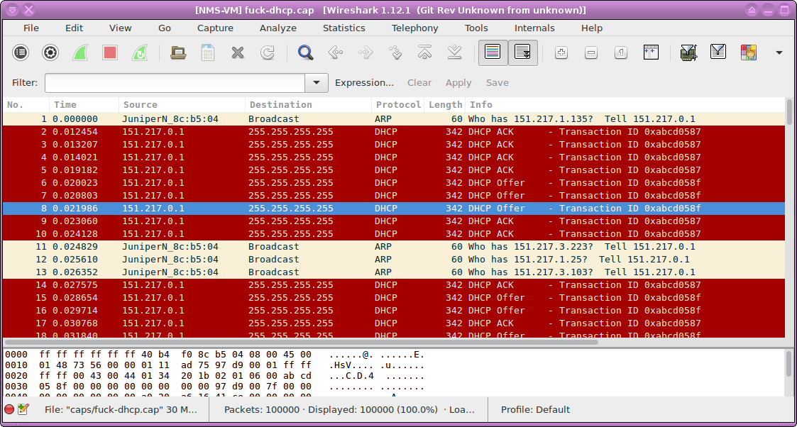
Flooding

Slide 8
Succes and achivements
With NOC supporter help we have solved lots of problems, made new friends, learned $stuff
Built a network spanning 350m from North1 PoP to South3 PoP
8 PoPs including the core room with server hosting
Put out MORE than 1km of network cable to connect main sites, achievement unlocked :-) around 900m fiber, rest copper
Provided a reasonable stable network with some people reporting 480Mbps/620Mbps at times
Some phones reported 8ms latency and 220/220Mbps on wireless, monday before the event really started
My phone has reported 150/150Mbps during event at times, mostly latency has been in range of 8-20ms – to Copenhagen servers
Lot more usage than last year, use moar bandwidth

Slide 9
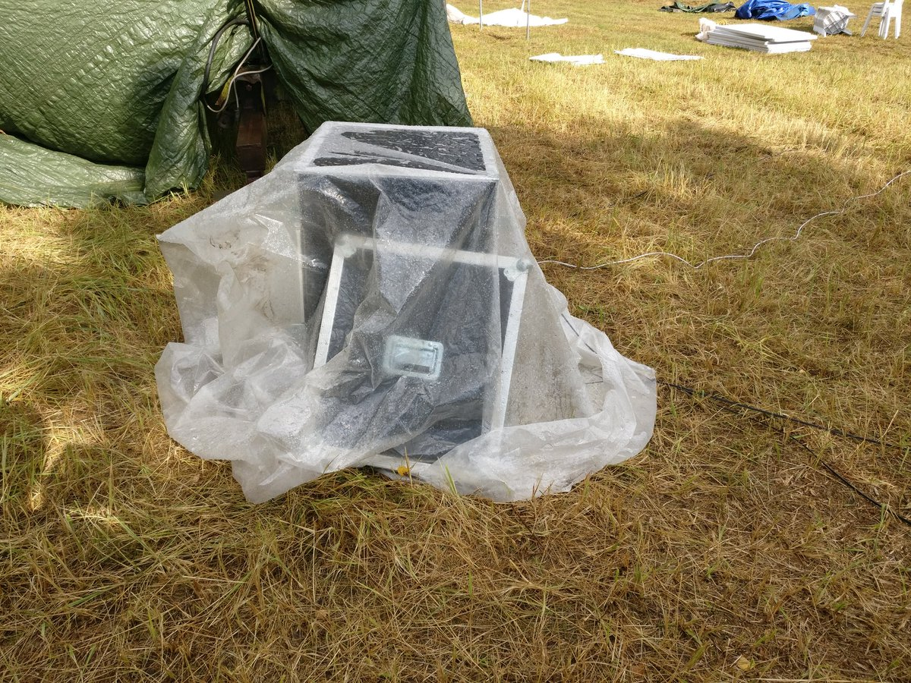
PoPs / datenklos

Slide 10
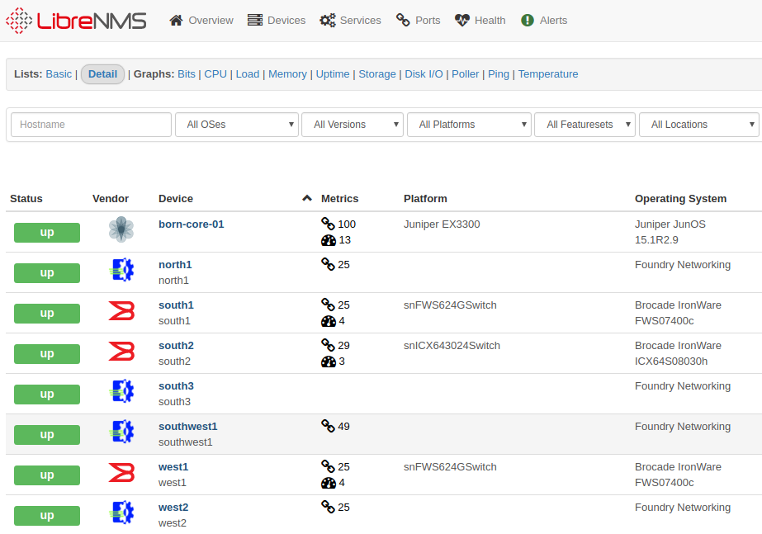
LibreNMS switches

Slide 11
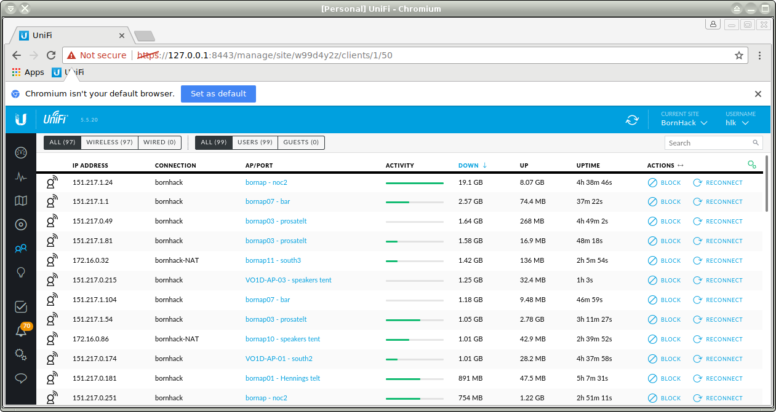
Wireless 12 APs working

Slide 12
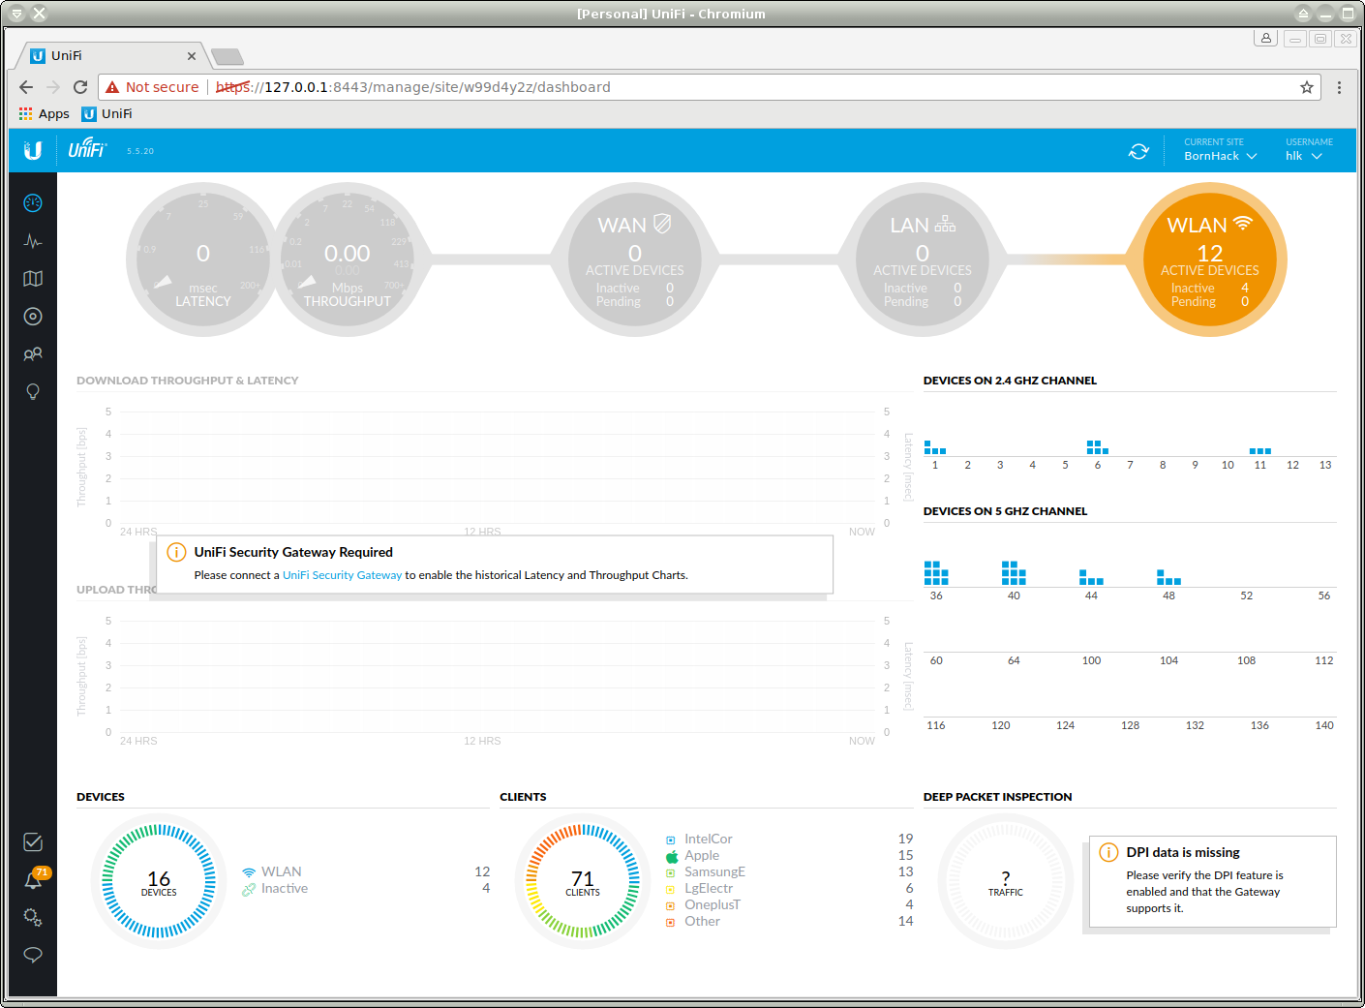
UniFi is pretty easy, and “OK”
UniFi is pretty easy, and “OK”

Slide 13
Some stats
UniFi controller reports 469 clients seen!
One client has downloaded 128Gb :-)
Another client uploaded 40Gb

Slide 14
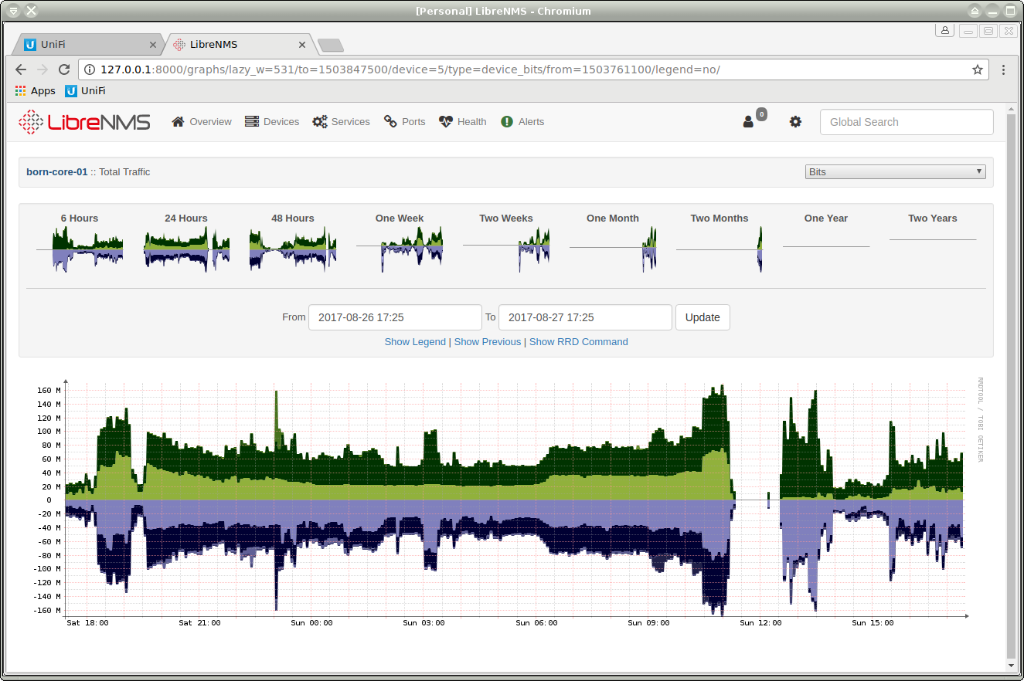
Bandwidth and power outage

Slide 15
Lessons learned
Second year, was not prepared enough
Project requires NOC architects, Server people, NOC Helpdeskers – initially we had me on-site on Sunday and Monday…
BUT then 8 people showed up and helped, sorry for not remembering all names, but Mortenx2, Eightdot etc. you saved me/us!
Goal next year, have 2x JN-CIS SP, 2x server people, +5 NOC support
Bring more fiber converters, one fried and cheap

Slide 16
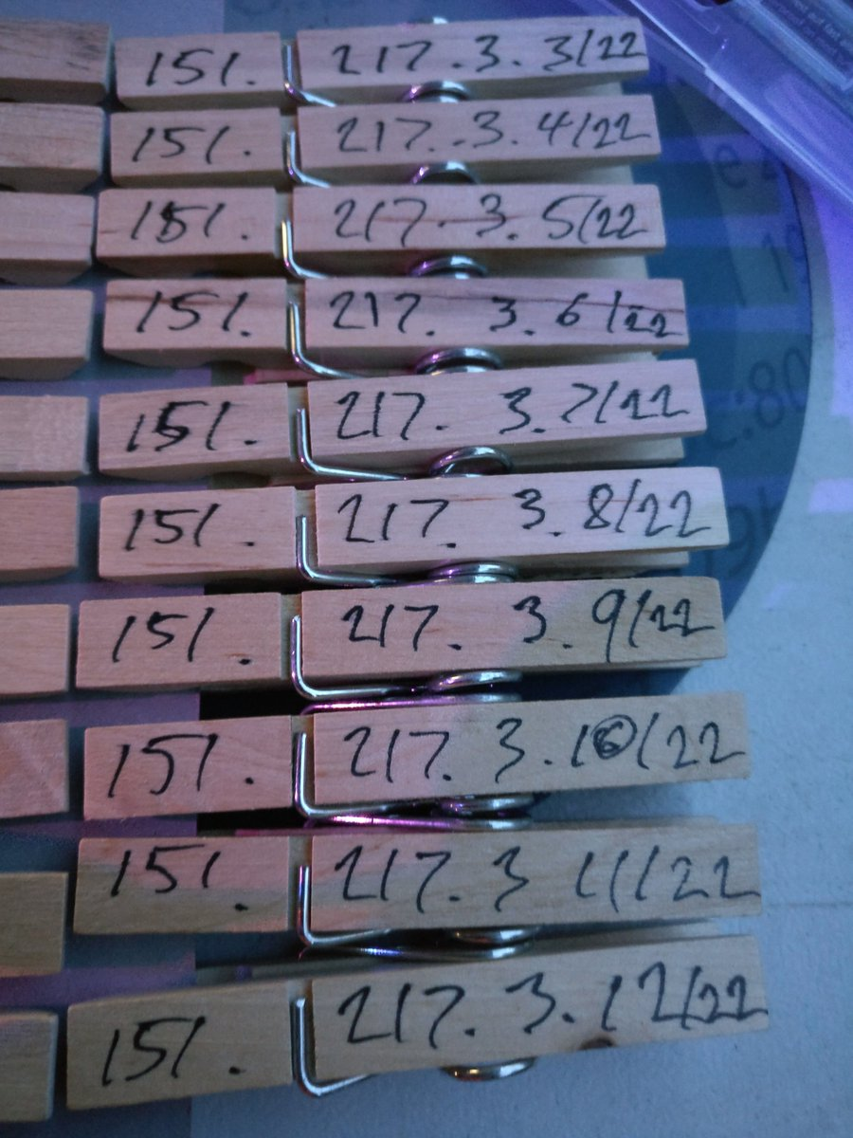
PEG DHCP
PEG DHCP RFC2322 was implemented https://en.wikipedia.org/wiki/Peg_DHCP
PEG DHCP worked REALLY well, “DHCP giving you problems, take a peg, done”
Make PEGs for wifi and wired, two colors
We are splitting this up next year

Slide 17
Conclusion
We did it, there was a network
We need more preparation, pre-camp NOC setup meeting

Slide 18
Some software tools used
UniFi Controller running on Ubuntu, easy
OpenBSD conserver, DHCPD and other stuff
http://conserver.com/ - serial connections
LibreNMS for stats – autodiscover yay!
https://www.librenms.org/
Oxidized for getting config from devices
https://github.com/ytti/oxidized
Plus usual suspects, tcpdump, wireshark, ping, nmap, traceroute

