Slide 1
Digital Supply Chain Platform for UMGI
R2 interface | 16th September 2010

Slide 2
Agenda
Introduction
Process overview
Fileset validation
Staging 1: data load
Staging 2: data transformation
Post staging: Data cleaning and performance
R2 interface: validation and mapping
Ingestion in Asset Management
Error handling / Monitoring
Questions and Answers

Slide 3
Agenda
Introduction
Process overview
Fileset validation
Staging 1: data load
Staging 2: data transformation
Post staging: Data cleaning and performance
R2 interface: validation and mapping
Ingestion in Asset Management
Error handling / Monitoring
Questions and Answers

Slide 4
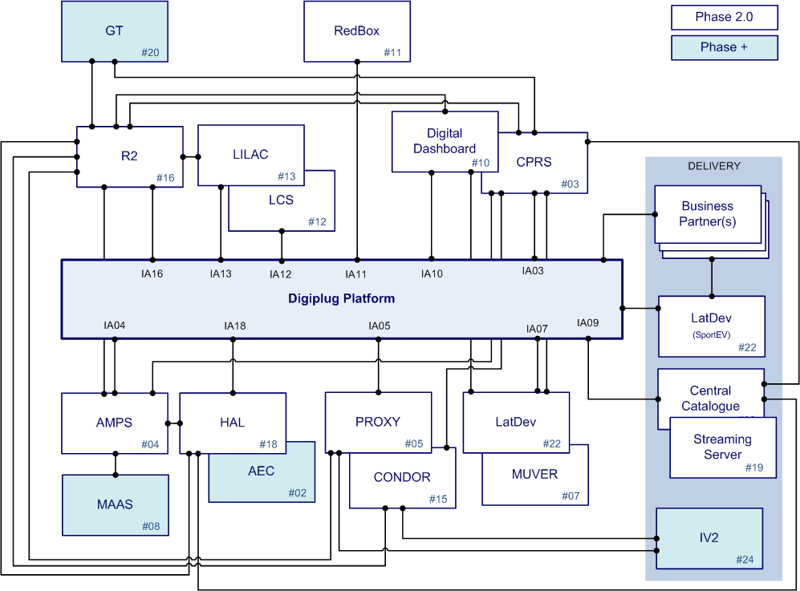
Introduction: Integration Architecture with UMGI
Notes:
#02 – AEC - Web Application (Extranet) for uploading graphic assets, including cover art and photos for exchange between operating companies and external partners.
#03 – CPRS (aka Central Production Release Schedule) - UMGI’s Global production planning and process management application (Scheduling). Supports both the physical and digital supply chains.
#04 – AMPS (aka Audio Management Preservation System) - System which UMGI uses for management of audio production asset inputs (DDP)
#05 – PROXY - System which manages the manufacture of Mobile Edits (Mobile Assets).
#07 – MUVER - UMGI system used to handle the video production and encoding of short-form (less 30m) video
#08 – MAAS - (aka Media Asset Archiving System) Central deep archive system for UMGI that stores several types of media assets which support the Physical and Digital Supply Chain, currently with a focus on CD Audio and DVD DDP
#09 – Central Catalogue - Central Catalogue is the foundation system which consolidates and aggregates content from a number of Universal Music’s Global Systems. Central Catalogue aggregated content will power external B2Bs and Data Feeds.
#10 – Digital Dashboard - Web Application which provides a global overview of the Product in the different stages of the Digital Supply Chain.
#11 – Redbox - UMGI system used to process DSP sales reports. Loads and validates sales files, resulting in monthly invoices to DSPs and exports to global royalties, financial and sales reporting systems.
#12 – LCS – UMHK Label Copy System used for metadata translation into Chinese Character set
#13 – LILAC – UMLLC (Japan) Label Copy System used for metadata translation into Japanese Character set
#15 – CONDOR - "Creative" Management System for Mobile products for UMGI. This system manages the ordering of the creation of Mobile Edits. Dependent of PROXY.
#16 - R2 - Re-designed master system for metadata for owned repertoire which will substitute both RMS (owned-repertoire) and P&D RMS (for non-owned repertoire, which comes in from third party labels as a result of press/distribution deals)
#18 – HAL - (aka Huge Asset Library) Application which manages storage for digital resources (DDP, WAV, Images, PDF, etc... Manages manufacturing of orders for encoding and fulfilment of digital audio.
#19 – Streaming Server – Digiplug System which provides UMGI with Media Streaming Services for Audio

Slide 5
Introduction: Repertoire Management System
R2 (which stands for Repertoire Management System v2.0) is Universal Music’s central application that enables the input and management of repertoire information and to generate Label Copies.
This interface is used to retrieve metadata from R2 to define the products in the Platform.
Label copies (or metadata) for all releases (products in DSC) are sent on a periodic basis (every 2 hours) to the DSC platform.

Slide 6
Agenda
Introduction
Process overview
Fileset validation
Staging 1: data load
Staging 2: data transformation
Post staging: Data cleaning and performance
R2 interface: validation and mapping
Ingestion in Asset Management
Error handling / Monitoring
Questions and Answers

Slide 7
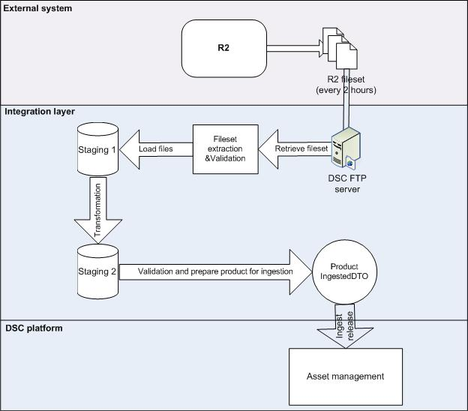
Process overview

Slide 8
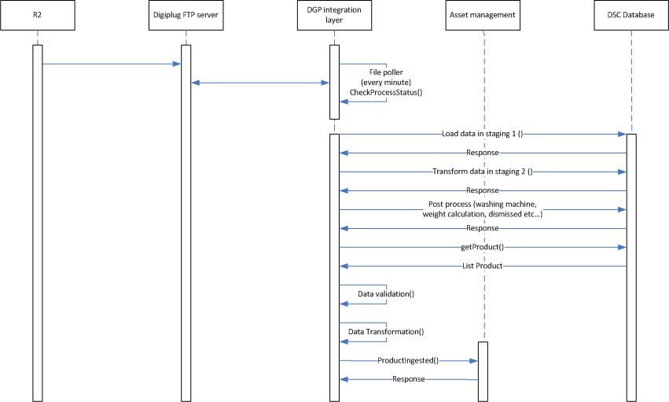
Process overview (Sequence diagram)

Slide 9
Agenda
Introduction
Process overview
Fileset validation
Staging 1: data load
Staging 2: data transformation
Post staging: Data cleaning and performance
R2 interface: validation and mapping
Ingestion in Asset Management
Error handling / Monitoring
Questions and Answers

Slide 10
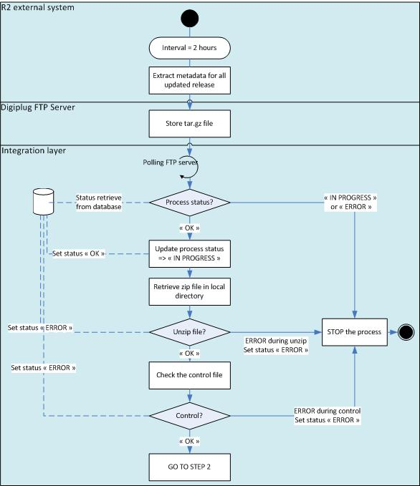
R2 interface: Fileset validation

Slide 11
Agenda
Introduction
Process overview
Fileset validation
Staging 1: data load
Staging 2: data transformation
Post staging: Data cleaning and performance
R2 interface: validation and mapping
Ingestion in Asset Management
Error handling / Monitoring
Questions and Answers

Slide 12
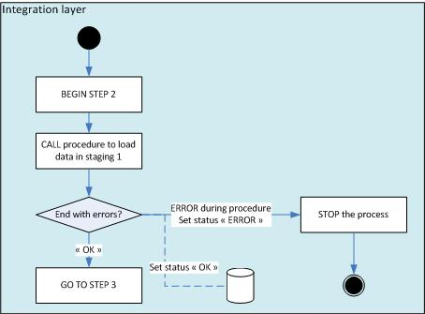
Staging 1: data load
The “R2” system provides flat files packaged in a “.tar.gz” compressed archived file. Before processing the content of the files to ingest the products in the Digiplug Platform, the files must be loaded in the database because it is easier to manipulate data with SQL.
After validation of R2 files, all files are loaded in a database (staging 1). In case of errors, the batch must be halted.
1 File = 1 table
Ex:
dgpr_release_xxx.txt load into LR2_RELEASE
dgpr_resource_xxx.txt load into LR2_RESOURCE
etc…
No data manipulation in this step of the process (i.e no data cleaning)
If any errors occur, the R2 process is stopped. Only IT can restart the interface.

Slide 13
Agenda
Introduction
Process overview
Fileset validation
Staging 1: data load
Staging 2: data transformation
Post staging: Data cleaning and performance
R2 interface: validation and mapping
Ingestion in Asset Management
Error handling / Monitoring
Questions and Answers

Slide 14
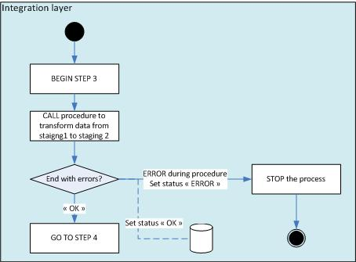
Staging 2: data transformation
This step transforms the data provided by the R2 system to a “simplified” R2 data model. Here, the main objective is to dispatch the R2 data into two types: the data used by the DSC Platform as entity data and the data stored by the DSC Platform in order to be able to provide it to the Business Partners (data known in the DSC Platform as Metadata).
Create a core and local view for each product/Release_id at release and resource level
Keep only data required for DSC (~50% of metadata)
Business rules implemented:
Cleaning enhanced products
Manage screengrab for esingleVideo
Transpose metadata not accurate for DSC
Manage contribution at work level (copy from resource level)
Log the products blacklisted
Technologies used: OWB + procedure

Slide 15
Agenda
Introduction
Process overview
Fileset validation
Staging 1: data load
Staging 2: data transformation
Post staging: Data cleaning and performance
R2 interface: validation and mapping
Ingestion in Asset Management
Error handling / Monitoring
Questions and Answers

Slide 16
Post staging: Data cleaning and performance
Washing machine (data cleaning)
Re-calculation based on track eligibility
Removed discarded resources
Calculation of new sequences, total tracks, total duration
Product weight calculation (performance)
Weight is based on number of local rows, tracks and contributions
Weight will be used to optimize ingestion (big vs. small products)
Manage dismissed releases (data cleaning)
Release type must be commercial, premium or third party
Release with account 2, 5 and 7 are dismissed
Product identify in the black list are dismissed
Physical part of a digital/physical equivalent is dismissed
Physical only products dismissed (information from CPRS)
Product with a configuration out of scope is dismissed

Slide 17
Agenda
Introduction
Process overview
Fileset validation
Staging 1: data load
Staging 2: data transformation
Post staging: Data cleaning and performance
R2 interface: validation and mapping
Ingestion in Asset Management
Error handling / Monitoring
Questions and Answers

Slide 18
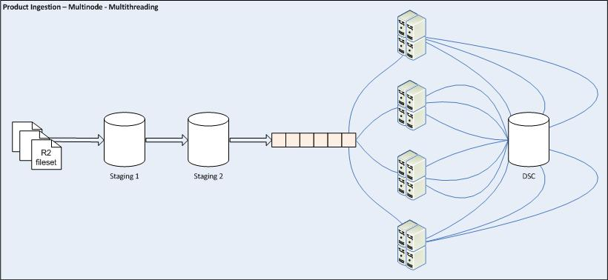

R2 interface (1/2)
Fileset ingestion
File by file.
Multi nodes available
7 nodes in production
Multi threads available
3 threads per node

Slide 19
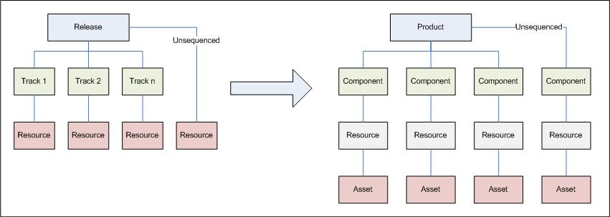
R2 interface (2/2)
3 different type of product
Mobile
Package
Other
Validation and mapping

Slide 20
Agenda
Introduction
Process overview
Fileset validation
Staging 1: data load
Staging 2: data transformation
Post staging: Data cleaning and performance
R2 interface: validation and mapping
Ingestion in Asset Management
Error handling / Monitoring
Questions and Answers

Slide 21
Asset Management
Pre ingestion
Additional mapping rules
Validation
Check if the product is compliant with DSC rules
Mapping
Prepare the mapping with hibernate
Creation or update
Store product in database

Slide 22
Agenda
Introduction
Process overview
Fileset validation
Staging 1: data load
Staging 2: data transformation
Post staging: Data cleaning and performance
R2 interface: validation and mapping
Ingestion in Asset Management
Error handling / Monitoring
Questions and Answers

Slide 23
Error handling / Monitoring / Re-order
R2_Monitoring
Monitor the ingestion file by file
R2_monitoring_UPC
Monitor the ingestion by Release_id and file
R2_monitoring_error
Describe the errors raised for a product (by release_id)
R2_monitoring_error_cause
Keep the stack trace when a technical occurs for a release_id
R2_monitoring_country
Monitor the latest status of products by UPC/Country in DSC
R2_release_order
Queue of UPCs to re-order (capacity to re-order 100/hour).

Slide 24
Agenda
Introduction
Process overview
Fileset validation
Staging 1: data load
Staging 2: data transformation
Post staging: Data cleaning and performance
R2 interface: validation and mapping
Ingestion in Asset Management
Error handling / Monitoring
Questions and Answers

Slide 25
Questions & Answers
Questions & Answers

Slide 26
Thanks for your attention
This document contains proprietary materials, trade secrets and otherwise confidential information owned by Digiplug. Access to and use of the materials and information is strictly limited and controlled by Digiplug. This document may not be copied, distributed, or otherwise disclosed outside except under appropriate precautions to maintain the confidentiality hereof, and may not be used in any way not expressly authorized by Digiplug.

