Slide 1
Digital Supply Chain Platform for UMGI Binary interfaces | 23th September 2010

Slide 2
Agenda
Introduction
Process overview
Bundle integrity validations
Functional Validations
Transformations
Ingestion process
Error handling / Monitoring
Questions and Answers

Slide 3
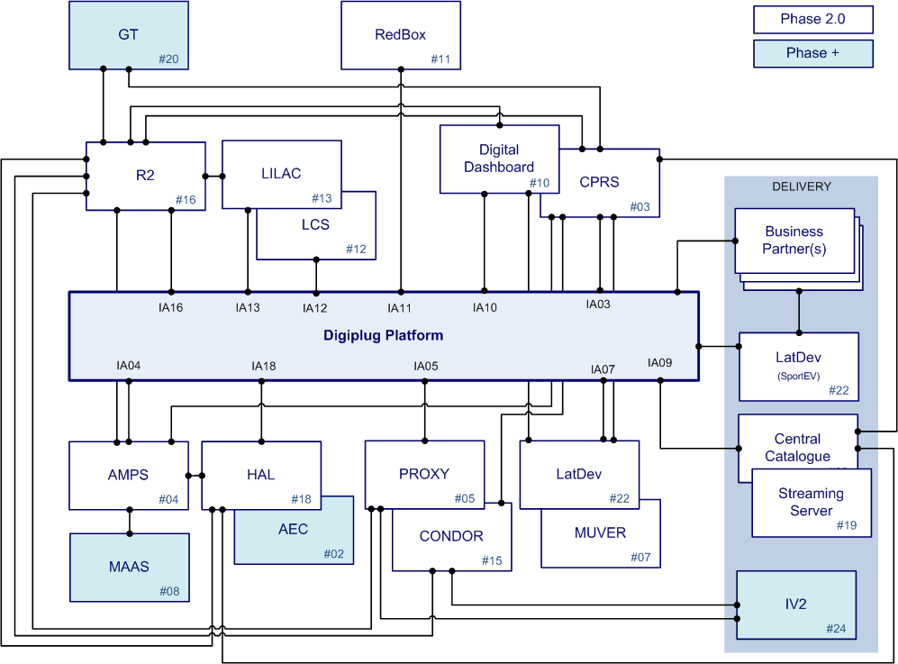
Introduction: Integration Architecture with UMGI

Slide 4
Introduction: Binary interfaces who’s who
4 external systems are responsible for sending the binary files to DSC:
HAL (Huge Asset Library) is UMG-NA central repository for audio content and images (album covers, tv episode covers, video covers, booklets etc.)
AMPS (Audio Management Preservation System) is UMGI central repository for audio content.
Proxy manages the mobile edits, the manufacturing of mobile edits done by Sonacom
LatDev (Lateral Development) is UMGI central repository for video content like tv episode, video clips, DVD.

Slide 5
Process Overview
All the binary interfaces follow more or less the same process.
UPLOADING
- Polls of a ftp folder
- Performs bundle integrity validation
PROCESSING
- Functional checks
INGESTION
- Technical validations
- Binding in Asset Management
SPLITTING
- Creation of wave files
- Creation of ingestion requests

Slide 6
Bundle integrity validations
2 types of integrity validations are done:
Existance of mandatory files such as ingestion ticket & asset map (description of the product) and associated binaries
Checksum validations to verify that the bundle is not corrupted
Ingestion ticket in bundle?
Asset map & binary files ok?
MD5 validation
YES
YES
NO
NO
NO

Slide 7
Functional Validations
Once the integrity of the bundle has been checked, we still need to perform some functional validations to know if :
The product exists, has the right assets.
We are allowed to upload new binaries or to update binaries
Product exist in AM?
Is ingestion locked & orderable?
LOCKED
YES
YES
NO
NO
ON HOLD
Continue ingestion

Slide 8
Transformation (1/2)
Transformations depends on the input format and are solely for audio files:
DDP (Disc Description Protocol) which contains the following description files
DDPID which specifies the version of the DDP and can also be used to add some free text to describe the DDP
DDPMS describes the content of the DDP bundle
DDPPQ or PQDESC describes how the tracks are concatenated in the image file
Image file which contains the tracks
WMA lossless files

Slide 9
Transformation (2/2)
DDP
wma
wma
wma
wma
JAVA Contizer (2.46)
C++ Contizer (2.44)
Transcoder
wma
wma
wma
wma
wma
wma
wav
wav
Now we are ready to ingest

Slide 10



Ingestion process (1/3)
Step 1, creation of a bulk (a zip file containing the wav files and description file)
Bulk
wav files
Bulk info
Interface
Creates
Step 2, store the bulk in the repository
Bulk
wav files
Bulk info
Provisioning
stores
Step 3, call the ingestion request interface with the bulk id
Interface
Ingestion System
calls

Slide 11
Ingestion process (2/3)
The ingestion system is a multi-threaded job which is in charge of the actual ingestion of the master files in the system
Bulk info compliant?
Files are valid?
BIND
YES
YES
NO
NO

Slide 12
Ingestion process (3/3)
Technical verification are done using the edit type of the corresponding asset
PRV_MASTER_FORMAT_DEFINITION table stores the technical requirement per edit type
There are several formats per edit type, for instance images can be TIFF, JPEG or GIF
The exhaustive list of echnical verifications can be found in the DSC Product Configuration document.
The bind is done by the Asset Management module:
With UPC & Edit type for mobile products
With ISRC for images
With UPC & ISRC for products

Slide 13
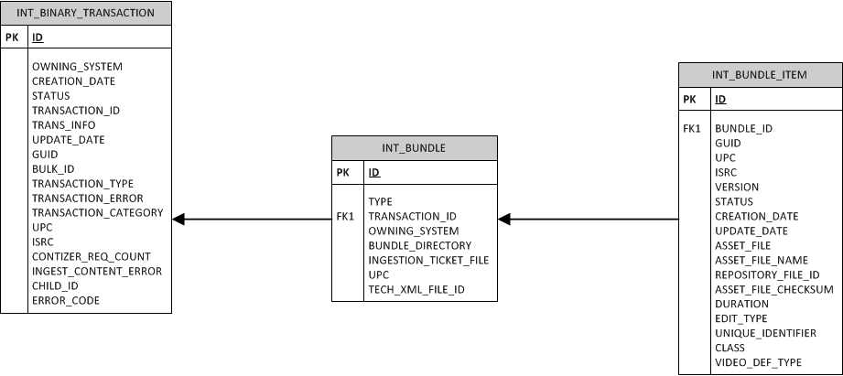
Error handling and monitoring
Errors are documented in confluence: http://confluence.pro.paris.digiplug.com/confluence/display/ATLC/IT+Support+Documentation+-+Home
Errors are stored in INT_BINARY_TRANSACTION table, interesting fields for investigations are:
TRANS_INFO which contains a message describing the error
ERROR_CODE

Slide 14
Questions and answers

