Slide 1
Head First in Distribution
Pierre Bar
07/10/2010

Slide 2
The world view by Chinese people
Europeans have a common way to draw a planisphere, with the Europe at the center of the map. It is completely natural because they have done that since they are young.
It is more useful because they use Europe as a referential.
But let’s have a view on the common planisphere for a Chinese young guy.

Slide 3
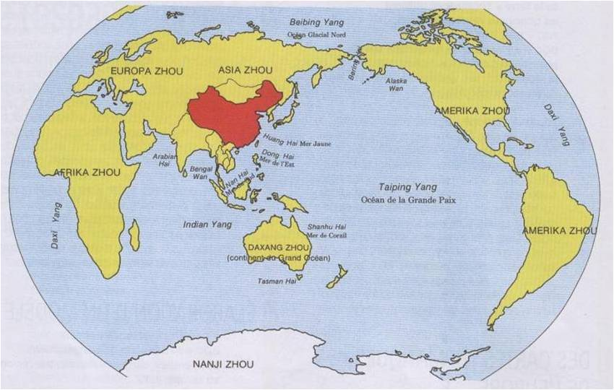
The world view by chinese people

Slide 4
DSC view from Distribution
Now let’s try to imagine the global map of DSC from the Distribution view
Asset Management, Pricing and BP Conf are referential data container
Distribution and Provisioning manage the operational data
Order Processing is a decisional component which manage the creation of orders
Batch Provisioning is a decisional component which manage the creation of provisioning requests

Slide 5
DSC view from Distribution
Decisional
Order processing
Batch Provisioning
Distribution
Operational
Provisioning
AM
Pricing
BP Conf
Referential

Slide 6
Distribution workflow
Order messages processing
Ordering
Provisioning
Delivery
Packaging
Notification

Slide 7
Order messages processing
Order messages processing
Ordering
Provisioning
Delivery
Packaging
Notification

Slide 8
Order messages processing
Asset Management
OPM Messages*
OPM Messages
UPC1 | metadata
UPC2 | right
BP Conf
BP1 | conf
BP2 | conf
UPC3/BP2 | price
Pricing
* Order Processing Manager Messages

Slide 9
Order messages processing
Every change in the referential components, Asset Management (right or metadata), Pricing, BP configuration is tracked in the table dedicated for the order processing manager messages.

Slide 10
Order messages processing
Order1
BP1
UPC2
INSERTION
OPM Messages
UPC1 | metadata
UPC2 | right
BP1 | conf
UPC3/BP2 | price
Order2
BP2
UPC1
META UPDATE
Order
Process
Message
job
Order3
BP1
UPC3,UPC4,UPC5,UPC6,…
BPCONF UPDATE

Slide 11
Order messages processing
Frequently, the Order Process Message job is triggered.
It analyses and processes the event posted by the referential components
For a metadata update or a right update :
Do some BPs have already the product in their catalog ?
Yes → one update order per BP
Do some BPs have not the product in their catalog and have the right to have it ?
Yes → one insertion auto order per BP
For BP conf update :
Several update orders (with 1 000 products in each one) are created for all the products already in the BP catalog
For a pricing update :
One update order is created

Slide 12

Order messages rationalization
Metadata update V2
Metadata update V1
Metadata update V3
Metadata update V1
Metadata update V2
Order
BP x
UPC y
META UPDATE
V3

Slide 13

Order messages rationalization
Several messages could be posted for one product between two run of the Order Process Message job
Two avoid to create several orders, the job rationalizes the messages to keep only the last one.
The other messages are simply ignored.
This rationalization is important to avoid to create orders which will be processed and finally ignored because are duplicates

Slide 14
Ordering
Order messages processing
Ordering
Provisioning
Delivery
Packaging
Notification

Slide 15
Order specification
Orders are placed automatically as we have seen when there is an update of the entities in the referential components
But orders can also be placed manually by the user interface.
A user can place a cherry pich order for a choosen limited number of products
Or he can place a bulk order for a catagory of products
Order’s attributes
A start date
An end date
A collection of selected products
A collection of Business Partner
An order is composed by BP Orders (one BP order per BP). The Distribution generally deals with BP Orders rather that Orders

Slide 16


Order validation triggering
Order1
BP1
UPC2
INSERTION
SUBMITTED
Order1
BP1
UPC2
INSERTION
PENDING VALIDATION
BP Input 1
WORKING
WAITING
BPINPUT message
Order2
BP2
UPC1
META UPDATE
PENDING VALIDATION
Order2
BP2
UPC1
META UPDATE
SUBMITTED
BP Input 2
BP Input
Client job
WAITING
WORKING
BPINPUT message
BP Input 3
One message per BP
WAITING

Slide 17
Order validation triggering
BP orders are posted to the BP Inputs
A BP Input is like a messaging queue. There is one BP Input per BP.
A BP Input has 3 status :
WAITING
WORKING
ONHOLD
The BP Input Client job is triggered frequently. If there are some BP orders posted for a BP Input :
It updates the BP Input status (WAITING → WORKING)
It throws a message to process the posted BP orders

Slide 18
Order validation and processing (INSERTION)
BP1 catalog
UPC X | INSERTED | SYNCHRONIZED
UPC Y | TO_BE_INSERTED | OUT_OF_SYNCH
…
UPC 2 | TO_BE_INSERTED | OUT_OF_SYNCH
…
Order1
BP1
UPC2
INSERTION
PROGRESSING
Order1
BP1
UPC2
INSERTION
PENDING VALIDATION
Sync Instruction UPC2
Sync Instruction UPC Z
Sync Instruction UPC Y
Batch for BP1

Slide 19
Order validation and processing (INSERTION)
Order validation
We check that the BP has all the required rights in terms of product type, countries, usages
A new Catalog Item is inserted in the BP Catalog
TO_BE_INSERTED
OUT_OF_SYNCH
A synch instruction is created
BP
Product id
rights
If there is already an available batch, the sync instruction is added in it. Else a new batch is created

Slide 20
Catalog Item lifecycle for a given BP/Product
Create new SI
Sync Instruction
SYNCHRONIZED
OUT_OF_SYNCH
BEING_SYNCH
Delivered
Packaging

Slide 21
Order validation and processing (UPDATE)
BP1 catalog
UPC X | INSERTED | SYNCHRONIZED
UPC Y | TO_BE_INSERTED | OUT_OF_SYNCH
UPC 2 | INSERTED | SYNCHRONIZED
…
UPC 2 | INSERTED | OUT_OF_SYNCH
…
Order1
BP1
UPC2
META UPDATE
PROGRESSING
Order1
BP1
UPC2
META UPDATE
PENDING VALIDATION
Sync Instruction UPC2
Sync Instruction UPC Z
Sync Instruction UPC Y
Batch for BP1

Slide 22
Order validation and processing (UPDATE)
Order validation
We check that the BP has all the required rights in terms of product type, countries, usages
We compare them with the rights set on the catalog item to identify some updates
The existing catalog item is updated
SYNCHRONIZED → OUT_OF_SYNCH
A synch instruction is created
BP
Product id
Updated rights
If there is already an available batch, the sync instruction is added in it. Else a new batch is created

Slide 23
Order validation and processing (RATIONALIZATION)
BP1 catalog
UPC X | INSERTED | SYNCHRONIZED
UPC Y | TO_BE_INSERTED | OUT_OF_SYNCH
UPC 2 | INSERTED | OUT_OF_SYNCH
…
UPC 2 | INSERTED | OUT_OF_SYNCH
…
Order1
BP1
UPC2
META UPDATE
PROGRESSING
Order1
BP1
UPC2
META UPDATE
PENDING VALIDATION
Sync Instruction UPC2
Sync Instruction UPC2
Sync Instruction UPC Z
Sync Instruction UPC Y
Batch for BP1

Slide 24
Order validation and processing (RATIONALIZATION)
Order validation
We check that the BP has all the required rights in terms of product type, countries, usages
We compare them with the rights set on the catalog item to identify some updates
We identify that a sync instruction is already created for this BP/product (Catalog Item is OUT_OF_SYNCH)
The BP order is linked to the existing Sync Instruction
The synch instruction is updated
Updated rights

Slide 25
Batch specification
Batch’s attributes
A status (PROVISIONING, PROVISIONED, PACKAGING, …)
A start date
An end date
A priority (TOP, STANDARD, LOW)
A lock status (OPEN, CLOSED)
A category (INSERTION, UPDATE, TAKEDOWN)
A capacity limit (inherited from the BP configuration)

Slide 26
What about the batching policy ?
The batching policy is related to the type of order. Briefly :
Products for a cherry pick order are put in a batch with a standard priority. The start date is set to now and we have 24h to deliver the batch
Products for a bulk order are put in batches which are planned in the future regarding the BP constraints (number of batches per day, number max of products in batch) and the system constraints (max total number of products per day). Priority of batches for bulk products is LOW.
Products for an auto order (INSERTION) or a update order are put in batches with a start date specified by the system (every day at 8h pm in DSC prod)
The priority of the batch can be manually change before its delivery to be rush or put on top of the queue

Slide 27
Provisioning
Order messages processing
Ordering
Provisioning
Delivery
Packaging
Notification

Slide 28
Provisioning
Provisioning is triggered just after the order processing
The packaging plugins are responsible to create the provisioning directives because the provisioning is related to the plugin capabilities :
Metadata only support or not
Differentials capabilities
Component level capabilities
The next step, packaging, is only triggered when provisioning is over
Provisioning is going to have is own dedicated presentation

Slide 29
Packaging
Order messages processing
Ordering
Provisioning
Delivery
Packaging
Notification

Slide 30
Packageable batches
A batch has a lock status equals to CLOSED when :
The batch is full
After a DeltaT from the batch’s start date (6 hours in production)
A batch is packageable if
Start date < now
Lock status = CLOSED
The packaging priority is related to
The batch priority
The batch start date

Slide 31
Packaging triggering
BATCH_PROCESS message
Priority 100
Executor
job
BATCH_PROCESS message
Priority 50
Packageable
batches
BATCH_PROCESS message
Priority 200
One message per batch

Slide 32
Packaging triggering
The Executor job is frequently triggered
It throws a message for each packageable batch
The batch status is updated
PROVISIONED → TO_BE_PACKAGED

Slide 33
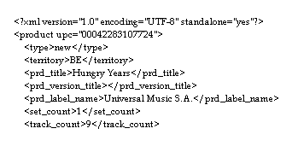
Packaging
Packaging process
Manifest files
Metadata
Prices
Binaries
AM
Pricing
Provisioning
0100010101010
0100010101010
0100010101010
0100010101010
Binary files

Slide 34
Packaging checks
The packaging checks that the product version is the last one in the Asset Management
It checks also that the ordering configuration set on the batch is the last one in the BP Conf
If one of them is not the last one, the batch immediately returns to the status PACKAGED because it is waiting for the product update or bp conf update rationalization
This is the so called “oscillation” issue which is in fact a defensive process to avoid to sent out of date data to the BP.

Slide 35
Packaging
The packaging fetches
The product metatada from Asset Management
The produt and track prices from the Pricing
The binaries from the Provisioning
It creates deliverables that the BP can ingest
Each BP can have its own deliverable format but commonly, the packaging creates
Product metadata files
Manifest files which describe the content of the delivery
One or many archive files which contains the metadata files, the manifest files and the binary files
The files really sent to the BP are Delivery Items

Slide 36
Result of Packaging
Delivery Item
File
Delivery Item Group
Delivery Item
File
Delivery Item
Batch
File
Delivery Item Group
Delivery Item
File

Slide 37
Delivery item
A delivery item is a deliverable which will be finally delivered to the Business Partner
A delivery item could be :
A binary file
A metadata file (xml, csv, xls, …)
A manifest file (xml, csv, xls, …)
A zip file
…

Slide 38
Delivery
Order messages processing
Ordering
Provisioning
Delivery
Packaging
Notification

Slide 39
Delivery triggering
BATCH_DELIVER message
Executor
job
BATCH_DELIVER message
Packaged
batches
BATCH_DELIVER message
One message per batch

Slide 40
Delivery triggering
The Executor job is frequently triggered
It throws a message for each packaged batch
The batch status is updated
PACKAGED → TO_BE_DELIVERED

Slide 41
Delivery
Delivery is done by delivery plugins
2 families of plugins
Push based
Pull based
Push based plugins
FTP
SFTP
Apple Transporter
Pull based plugins
FTP
Hal Teleporter
UCS
There is no limitation to create any new delivery plugin

Slide 42
Notification
Order messages processing
Ordering
Provisioning
Delivery
Packaging
Notification

Slide 43
Notification triggering
BATCH_NOTIFY message
Executor
job
BATCH_NOTIFY message
Delivered
batches
BATCH_NOTIFY message
One message per batch

Slide 44
Notification triggering
The Executor job is frequently triggered
It throws a message for each delivered batch
The batch status is updated
DELIVERED → NOTIFY

Slide 45
Notification
Notification is usually a mail sent to the BPs with the list of products delivered
As packaging and delivery, notification is done by plugins. So any ad hoc notification can be implemented

Slide 46
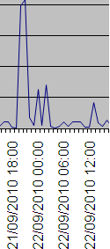
Quiz ?
The graph below is a common representation of the number of deliveries done per hour along a day by the DSC.
Are you able to explain the 3 first pics ? (20h pm, midnight and 2h am)

Slide 47
Thanks for your attention
This document contains proprietary materials, trade secrets and otherwise confidential information owned by Digiplug. Access to and use of the materials and information is strictly limited and controlled by Digiplug. This document may not be copied, distributed, or otherwise disclosed outside except under appropriate precautions to maintain the confidentiality hereof, and may not be used in any way not expressly authorized by Digiplug.

