Slide 1
Digital Supply Chain Platform for UMGI Pricing 2 | 10th November 2010

Slide 2
Agenda
Video pricing
Intervals merging
Tasks
Data model
Questions and Answers

Slide 3



Video pricing – basic principles
Video pricing is quite similar with the audio pricing but the algorithm is less complex
For products, a specific configuration table is used to find the appropriate information which will be used to do the lookup in the PRC_REFERENTIAL table
For video tracks, we use an algorithm based on the concatenation just as for the audio tracks:
Music type | Product type | Config code | Component count
POP | ALBVIDEO | P | (1)
POP | ALBVPACK | P | (2)
POP | LONGVIDEO | P | (1)
POP | SHORTVIDEO | EP | (1)
POP | SINGLVIDEO | Z | (1)
TVTP
Price band
Track type
Music type

Slide 4
Video pricing – how to calculate a video product price code
Let’s take an example for a pop video album with 2 tracks
For the product, we need to get the config code and the component count. This is done by doing a lookup in the PRC_VIDEO_CONF table:
Music type | Product type | Config code | Component count
POP | ALBVIDEO | P | (1)
POP | ALBVPACK | P | (2)
POP | LONGVIDEO | P | (1)
POP | SHORTVIDEO | EP | (1)
POP | SINGLVIDEO | Z | (1)
Config is then P and component count (2). We now have the component count, the config code, the default price band (T) and the music type which can be used to find the price code in the PRC_REFERENTIAL table:
Music type | Price code | Price band | Config code | Component | Description
POP | TVEP | T | EP | (1) | Video EP
POP | TVP | T | P | (1) | Video Bundle
POP | TVP(2) | T | P | (2) | Video Bundle 2

Slide 5
Video pricing – how to calculate a video track price code
Let’s continue with our pop video album with 2 tracks
Contrary to the algorithm used for audio tracks, duration is not taken into account. Only the music type and price band matter.
Default price band is T
Default asset type is VT
Music type is POP, price code is then:
VT
P
T
For classical, just replace the P by a C. It would then have been TVTC.

Slide 6
Interval merging
Interval merging is basically done to provide the entire price life cycle for a product. This is currently only interesting for apple but who knows ☺. Let’s take an example:
Merged intervals for this product for apple in France would be:
STSP
TSP
AppleEurope
FR
t
D1
ZSP
CMSP
t
FR
D2
CMSP
AppleEurope
FR
t
D4
D5
TSP
STSP
t
Today
D3
STSP
CMSP
TSP
t
D4
D5

Slide 7
Interval merging – basic principles
Intervals have virtual priorities:
Priority 1
Campaigns
Priority 2
Baselines set at product, country and BP level
Priority 3
Base lines set at product and country level
Priority 4
Baselines set at product level
When merging intervals, one should always take the priority 1 if it exists and then switch to priority 2 etc.
In any case, if there are no country/BP baselines or campaign, a product has always a baseline (Unpriced is also considered as a valid baseline)

Slide 8
Tasks – basic principles
Goal is to resolve conflicts which could occur.
Asset are not mutualized in DSC: we have 2 different assets for the same ISRC if they are in different products so they could be priced differently. This is covered by the price mismatch task
When an R2 update is done on metadata which could affect the auto-pricing, we could end up with a different price. This is covered by the Product & Asset price change task
Some tracks share the same title and artist but have different ISRCs. In that case, users would like to be warned if the price is different for the 2 tracks. This is covered by the Track title & Artist mismatch

Slide 9
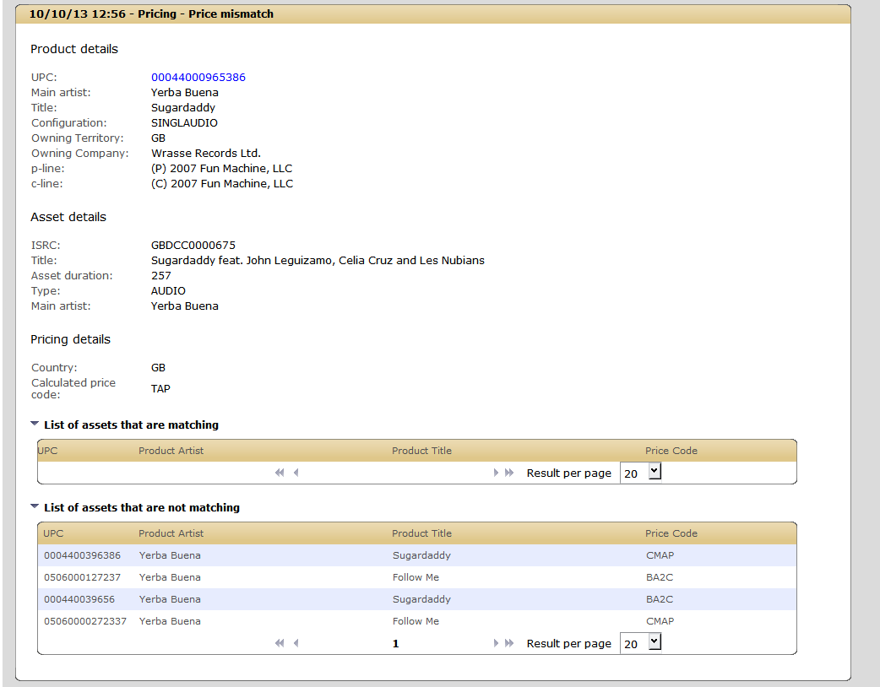
Tasks – Example

Slide 10
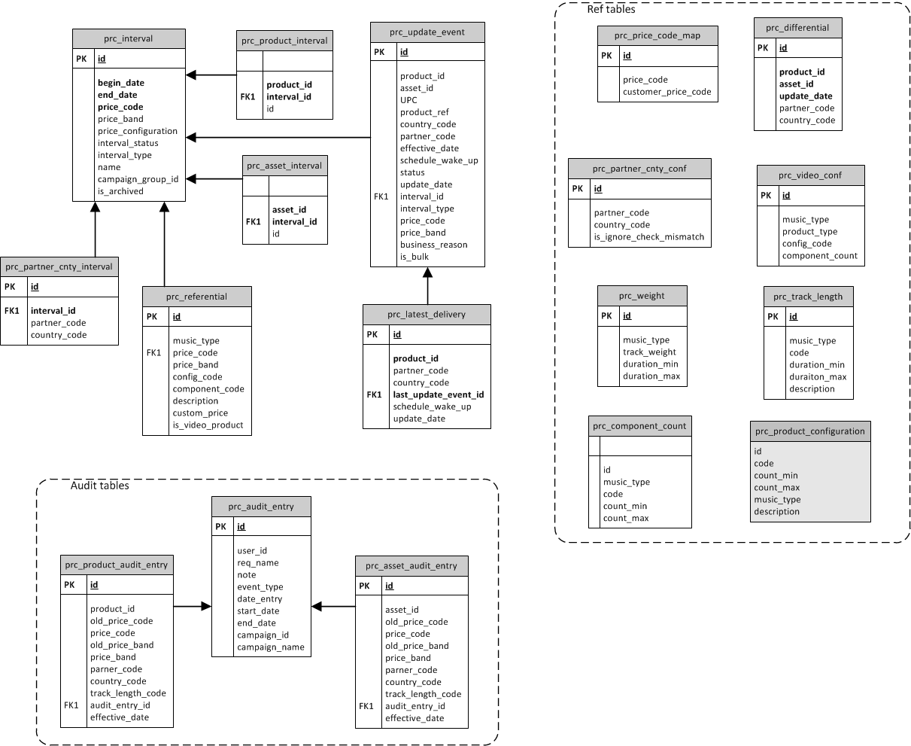
Data model

Slide 11
Questions and answers

