Slide 1
Digital Supply Chain Platform for UMGI Provisioning | 18th November 2010

Slide 2
Summary
Business
Workflow
Module dependencies
Business objects
Details
Ingestion of master files
From Batch to Manufacturing Request (nominal case)
From Batch to Manufacturing Request (additional cases)
From SIPR to FPRs
From FPRs to mF
Performances
Reminder
Questions and Answers

Slide 3


Business
The Provisioning module aims to
stock the master files (ingestion)
stock/request/provide the manufactured files (manufacturing/distribution).
Provisioning
ingestion
(master files)
provisioning
(manufactured files)
For BPs
For internal preview
A master file is
- a binary sended by Universal
- technical parameters
- source of several manufactured files
We ingest a master file
we transform it into several formats
A manufactured file is
- a binary created by the UMGI platform
- technical parameters
- a deliverable file to the BPs

Slide 4
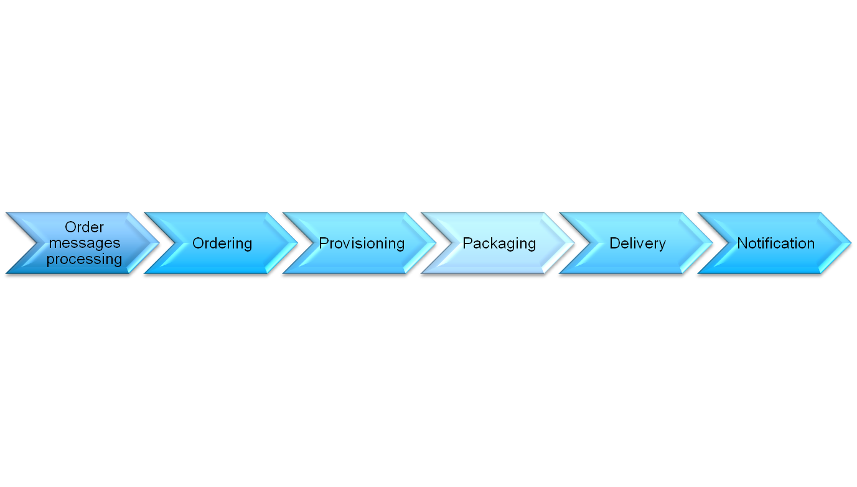
Workflow
The Provisioning module
Master files ingestion
Manufactured files provisioning
Interfaces
Ingest
Process
Provisioning
Asset
Management

Slide 5
Module dependencies
Distribution
Batch-Provisioning
& Provisioning
BP Configuration
Asset Management
Repository
Manufacturing

Slide 6
Business Objects
ingestion
(master files)
provisioning
(manufactured files)
For BPs
For internal preview
Bulk
BulkItems
MasterFormatDefinition
MasterFile
Batch (distribution)
SyncInstruction (distribution)
ProvisioningRequest
SyncInstruction (SIPR)
File (FPR)
Clip (internal preview) (ClipPR)
ManufacturedFile
ManufacturingRequest
Provisioning

Slide 7
Ingestion of master file – IngestionService
Sl 1/1
Call by the Process Ingest Job
IngestionService – CheckAndStore
MasterFileFromBulkItem
bulkItem
ingestMasterFileDto
Extract from Bulk to Repository
Retrieve Technical Parameters
Find Master Format Definition
Create file in repository as MASTER
RepositoryFileInfoMediaRequest
% MediaType
%EditType
Match between definitions & Technical Parameters
Create Dto as Response
Create Master File
Update BulkItem
Using the extracted file, the Technical Parameters, the Master Format Definition
Set the Master File Id
Return informations for the Process Ingest

Slide 8
Provisioning - From Batch to Manufacturing Request (nominal case)
Sl 1/4
Batch
1
*
SI
1
1
SIPR
1
*
FPR
*
1
mF
1
*
PMR
BatchProvisioningJob
ProvisioningLifecycleJob
Manufacturing
1) Get Batches Out Of Sync Prov
2) Get SIs Out Of Sync Prov
a) case NEW_SI : create SIPR
3) Get Pending SIPRs
Create (*) FPRs
4) Create mFs
Bind FPRs to mFs (*)
7) Create PMRs
8) Treat PMRs
a) PMR Finished => Publish mF
9) Get updated mFs
a) mF published => FPR Finished
10) Get updated FPRs
a) All FPRs Finished => SIPR Finished
11) Get updated SIPRs
a) SIPR finished => SI Provisioned
All SIs provisioned => Batch Provisioned

Slide 9
Provisioning - From Batch to Manufacturing Request (additional cases)
Sl 2/4
Batch
1
*
SI
1
1
SIPR
1
*
FPR
*
1
mF
1
*
PMR
BatchProvisioningJob
ProvisioningLifecycleJob
Manufacturing
1) Get Batches Out Of Sync Prov
2) Get SIs Out Of Sync Prov
a) case NEW_SI : create SIPR
b) case CANCEL_SI : cancel SIPR & cancel FPRs
c) case UPDATE_SI : update SIPR
d) case UPDATE_PRI : update SIPR priority
3) Get Pending / Updating SIPRs
Create (*) / Cancel / Update FPRs
4) Create mFs
Bind FPRs/ClipPRs to mFs (*)
5) Reset Cancelled and Expired mFs
6) Cancel mFs and PMRs
7) Create PMRs
8) Treat PMRs
a) PMR Finished => Publish mF
b) PMR Error => Error mF
9) Get updated mFs
a) mF published => FPR/ClipPr Finished
b) mF error => FPR/ClipPr Error
10) Get updated FPRs
a) All FPRs Finished => SIPR Finished
b) 1 FPR Error => SIPR Error
11) Get updated SIPRs
a) SIPR finished => SI Provisioned
All SIs provisioned => Batch Provisioned
b) SIPR Error => Batch Provisioning Error

Slide 10
Provisioning - From SIPR to FPRs
Sl 3/4
Call by the Provisioning Lifecycle Job
BatchProvisioningService – treatProvisioningRequest
SIPR
FPRs
Get the BP Configuration
Get the Provisioning Directives
Get the Product
Get Master Files & ID3 metadata per ProductType, AssetType, EditType, MusicType
Get Manufacturing Lines per ProductType, AssetType, EditType, MusicType
= additional Filters
Compute new FPRs
Merge with existing FPRs
Update the SIPR
Search all compatibilities
Calcul ID3 Metadata
Filter per ProvisioningDirectives
Set to INPROGRESS
Persist new FPRs
Cancel unused FPRs
Retry cancelled FPRs
Update FPR priorities

Slide 11
Provisioning - From FPR to Manufactured File
Sl 4/4
Call by the Provisioning Lifecycle Job
ProvisioningServiceImpl – bindFileProvisioningRequests
FPRs
mFs
Create missing Manufactured Files
Bind FPRs to Manufactured Files
update FPRs
Several FPRs for 1 Manufactured File
Depending to the FileStatus of the Manufactured File
Rationalization per {MasterFile, ManufacturingLine, Metadata, ProductId, AssetId}
BP1 / Product A => ml2, master3
FPR
FPR
BP2 / Product A => ml2, master3
mF

Slide 12
Performances
SQL Package : several steps of the ProvisioningLifeCycleJob are executed in SQL. See PRV$LIFECYCLE
BIND_MF_TO_FPR, BIND_MF_TO_CLIPPR
CANCEL_MF, CANCEL_PMR
CREATE_PMR
RESET_CANCELLED_MF, RESET_EXPIRED_MF
UPDATE_FPR, UPDATE_SIPR, UPDATE_CLIPR
PRV_ROWNUM : max updates per step in SQL
PRV_WATERMARK : minimum date to work from per step. Updated if all is done per step
ProvisioningLifeCycleJob loops while there are remaining updates to do
Parallelization of the ProvisioningLifeCycleJob

Slide 13
Reminder
Batch
Batch
Distribution
SI
SI
SI
Batch-Provisioning
SIPR
SIPR
SIPR
Provisioning
FPR
FPR
FPR
FPR
ClipPR
MF
mF
mF
mF
mF
ML
PMR
PMR
PMR
PMR
PMR
Manufacturing

Slide 14
Questions and answers

