Slide 1
DDEX XML Reader Tool
Overview

Slide 2
Contents
DDEX XML Reader - Overview
DDEX XML Reader – Pre-requisites
How to use the DDEX XML Reader

Slide 3
DDEX XML Reader Tool – Overview
The DDEX standard is currently being rolled out throughout the industry by music labels and BP.
UMGI are currently setting up new BP with the DDEX.
The DDEX XML is designed to be read by computers.
Reading the DDEX XML by the naked eye is difficult.
There are programs that allow you easily read the DDEX XML.
Digiplug however has designed a tool to make the XML more usable and interactive (dynamic).

Slide 4
Contents
DDEX XML Reader - Overview
DDEX XML Reader – Pre-requisites
How to use the DDEX XML Reader

Slide 5
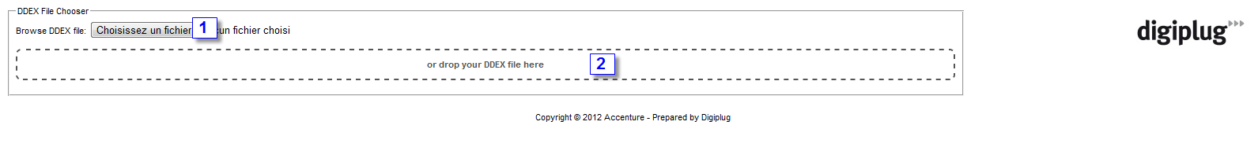
DDEX XML Reader Tool – Prerequisites
Connect to the following url : http://xml.digiplug.com/xsl/atlc-exp-ddex-metadata/parse/index.html
The following page is displayed in your browser*
Click on button to upload your DDEX XML** or
Drag and drop your DDEX XML directly into the dashed zone
You can then view the the DDEX XML as described in the next slides
Note: Large file could take time to load and lower your computer performance
(*)Firefox, Chrome, Opera recommended // (**) Use recent XML where link to the tool is automatically integrated

Slide 6
Contents
DDEX XML Reader - Overview
DDEX XML Reader – Pre-requisites
How to use the DDEX XML Reader

Slide 7
DDEX XML Reader Tool – Overview
Open the XML with the Tool as described in the previous slide.
The default view of the XML will be as follows:
Header
Product Structure (Summary)
Resources,Releases,Deals (XML Sections)

Slide 8
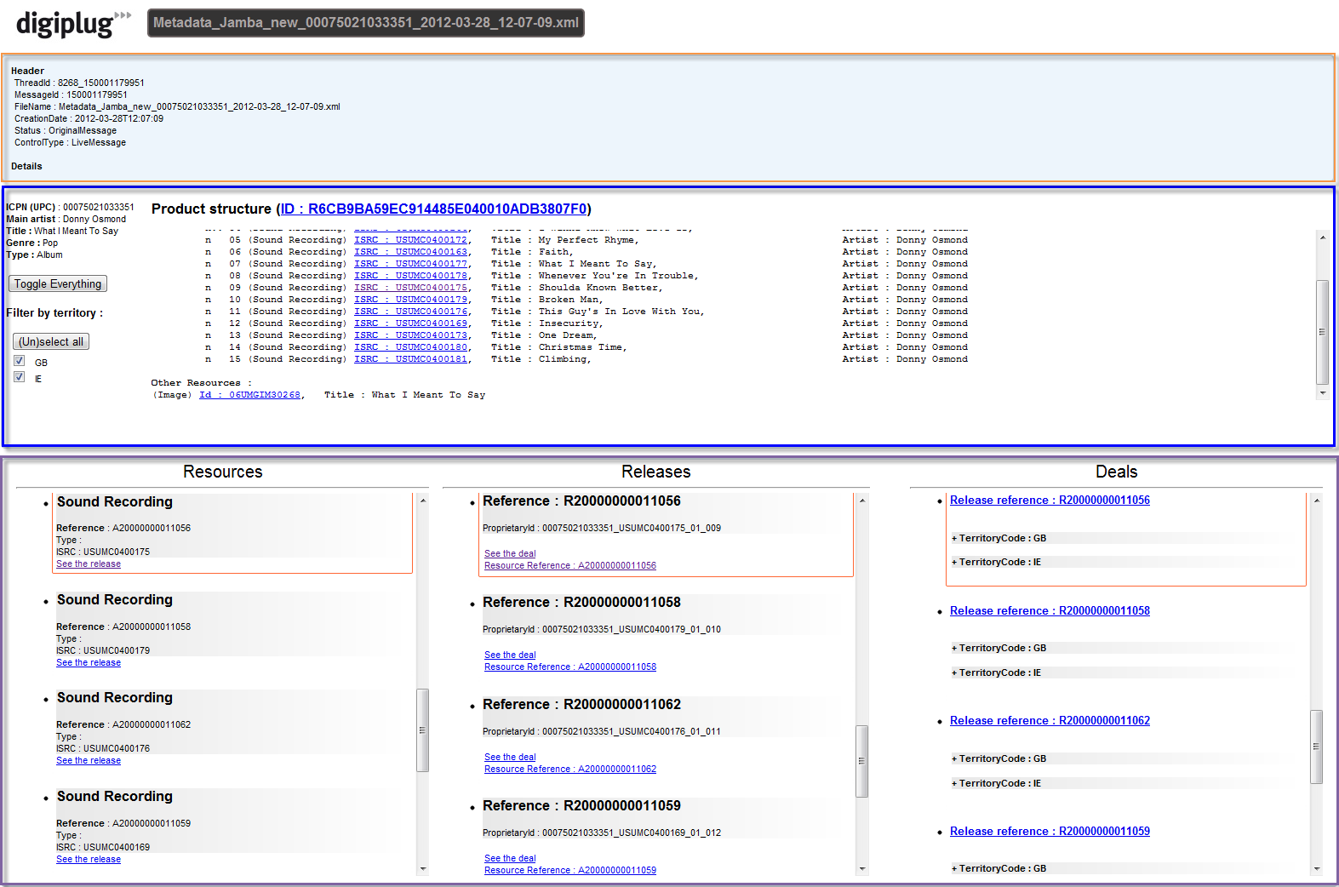
DDEX XML Reader Tool – Overview
Header
Summary
Xml Sections

Slide 9
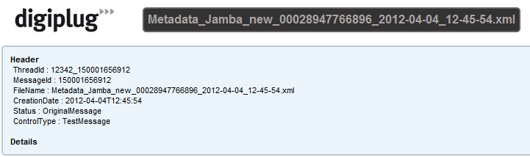
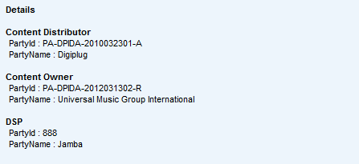

DDEX XML Reader Tool – Overview
Header
Header:
ThreadId → Batch ID
MessageID→
FileName→
CreationDate → Date of the message
Status: OriginalMessage (New) or UpdateMessage (Update) → Update or New message
ControlType→TestMessage or Live Messsage
DSP Party Name (details) → BP name
Details:
Content Distributor→ DPID / Digiplug
Content Owner→ DPID / UMGI
DSP → DPID / BP name
One click to expand
Notes:
ThreadId : batch ID MessageId : Batch_Catalogue item ID FileName : File name CreationDate : XML creation date Status : New or Update message ControlType : Test delivery (TestMessage) or production delivery (LiveMessage)

Slide 10
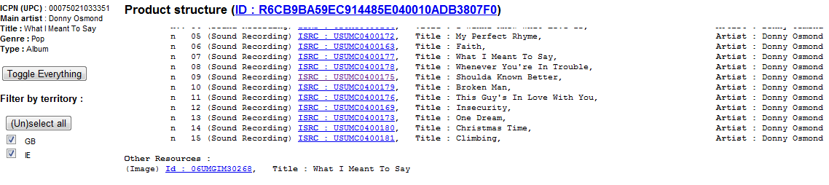
DDEX XML Reader Tool – Overview
Product Structure (Summary)
Product information:
UPC, Artist name, title, Music genre, Product type
→Click on « Toggle Everything » to expand/collapse « Sections»
Product structure:
Volumes
Works (Classical products)
Tracks details → Click on ISRC to view corresponding “Sections” highlighted (see next slide)
Un-sequenced Assets details – Other Resources (image, Video, etc)
Territories listing:
Only selected territories are viewable in “Sections” part
→ Click on « (Un)Select All » to select/unselect all territories
1
2
3

Slide 11
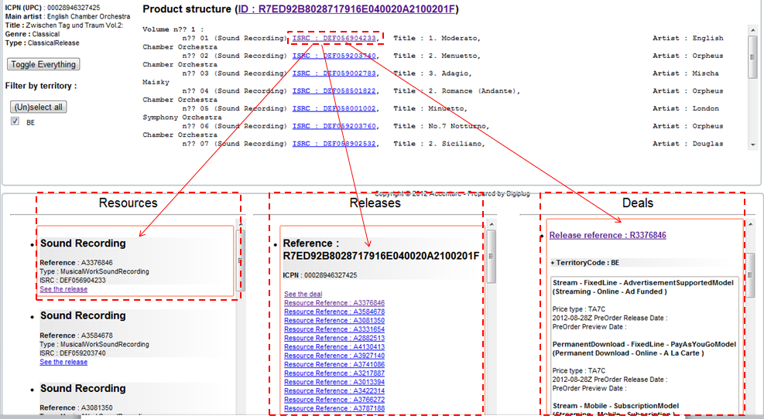
Coming next !

Slide 12
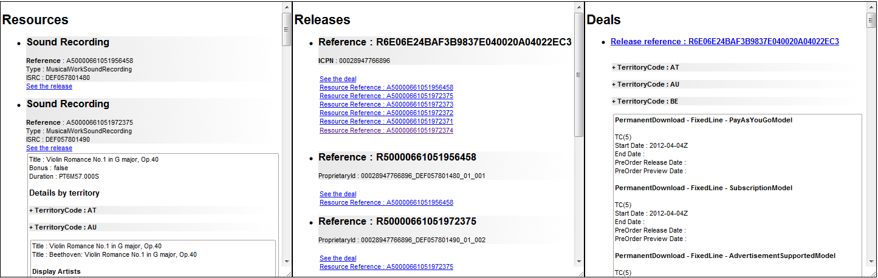
DDEX XML Reader Tool – Overview
Xml Sections
1
2
3
Resources details Information regrouped by Sound recording → Click to view details Details regrouped by Territories Click to view details for each territory Click on a Resource ID from Summary to highlight the corresponding resources details here Click on “See the release” to highlight the corresponding release section details Click on section title « Resources » to expand/collapse all the section | Releases details Information regrouped by Releases → Click to view details Details regrouped by Territories Click to view details for each territory Click on a Resource ID from this section to highlight the corresponding Resources section details Click on “See the deal” to highlight the corresponding deals section details Click on section title « Release » to expand/collapse all the section | Deals details Information regrouped by Releases → Click to view details Details regrouped by Territories Click to view details for each territory Click on a Release ID from this section to highlight the corresponding Release section details Click on section title « Deals» to expand/collapse all the section

Slide 13
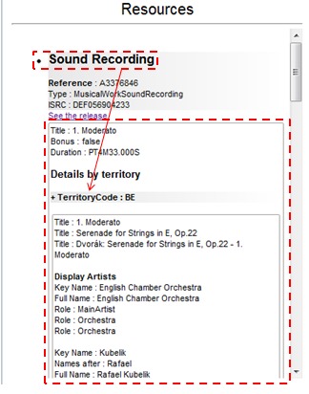
DDEX XML Reader Tool – Resources
Click on “Sound Recording” to view Title, Bonus and Duration information.
Click on the territory to view further information including Display Artist, Contributors and Technical Details.

Slide 14
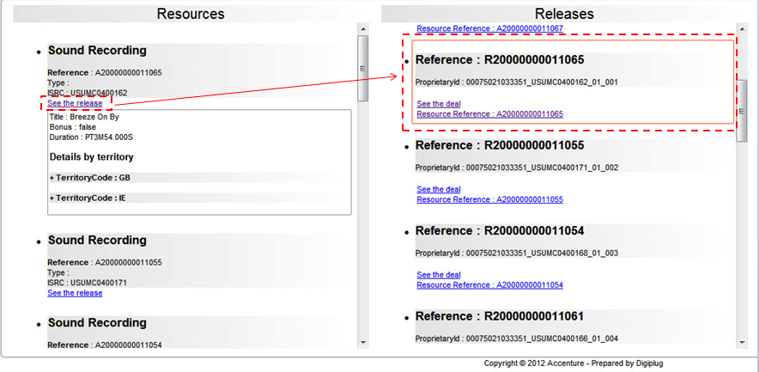
DDEX XML Reader Tool – Releases
Click on “See the release” to highlight the corresponding release section details.

Slide 15
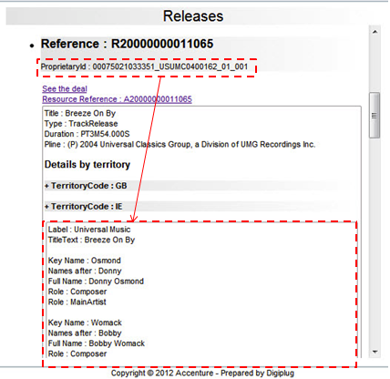
DDEX XML Reader Tool – Releases
Click on the ProprietaryID to view the release information.

Slide 16
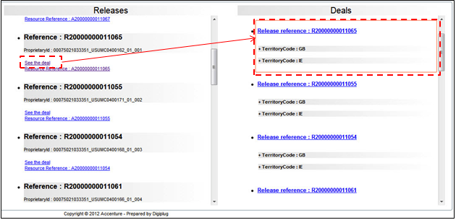
DDEX XML Reader Tool – Deals
Click on “See the deal” to highlight the corresponding deals section details.

Slide 17
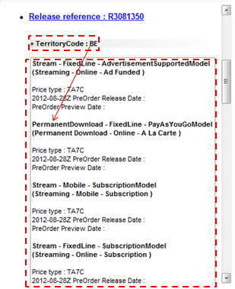
DDEX XML Reader Tool – Deals
Click on the Territory to view the deal information.

Slide 18


