Slide 1

DATA Face Recognition Model
Here is where your presentation begins
Introduced by :
Khalil Bessaad & Malek Fehri

Slide 2
OUR PROCESS
Goal
Overview
Model Choice
Web Application
Model Evaluation
Next Step

Slide 3
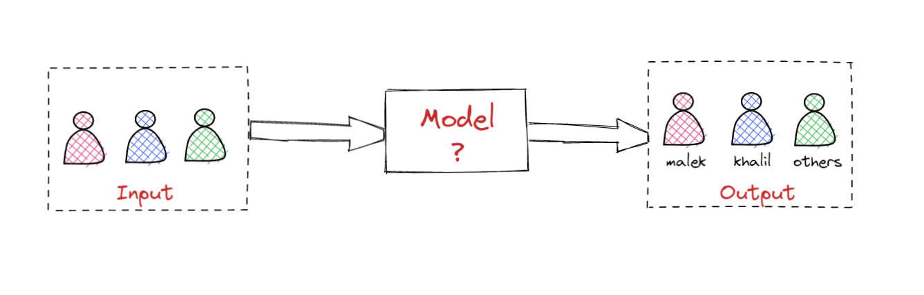
Goal
Mercury is the closest planet to the Sun and the smallest one in the Solar System—it’s only a bit larger than the Moon. The planet’s name has nothing to do with the liquid metal

Slide 4
Model choice
What is CNN?
Convolutional Neural Network
It’s a Deep Learning
technique
Why CNN?
CNN is a more accurate way for image classification problems.
CNN

Slide 5
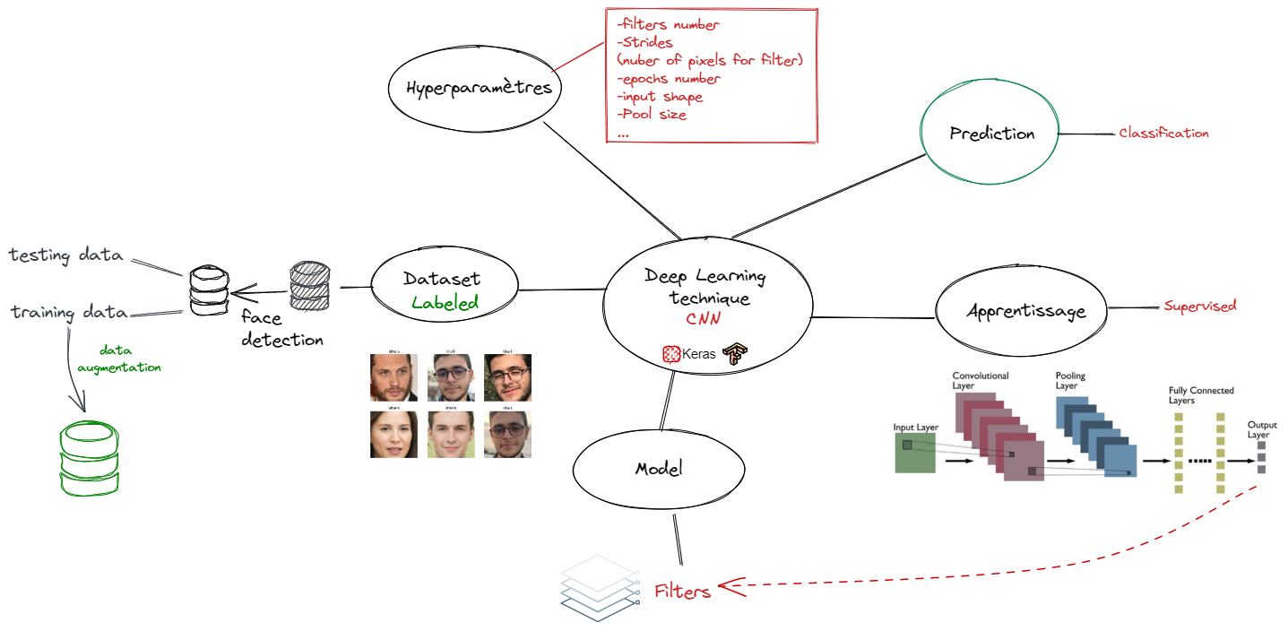
Overview

Slide 6
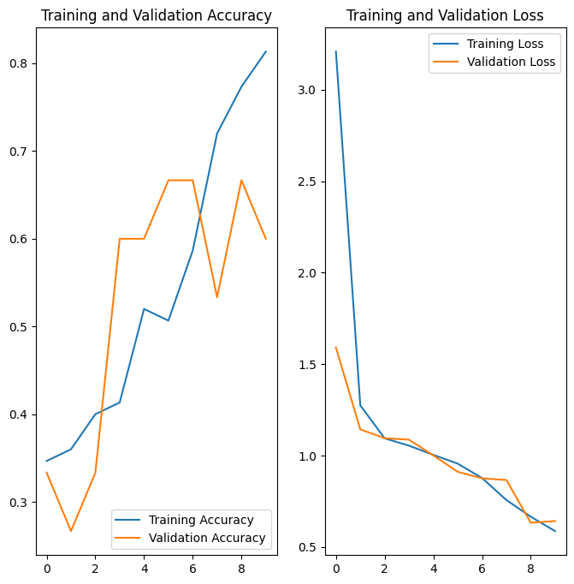
Model Evaluation
Good training accuracy.
Validation accuracy can be better.
In this case there is no overfit.

Slide 7


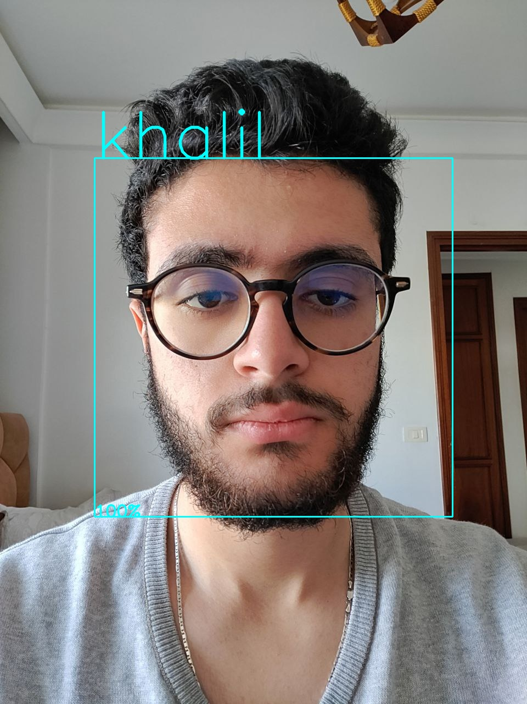
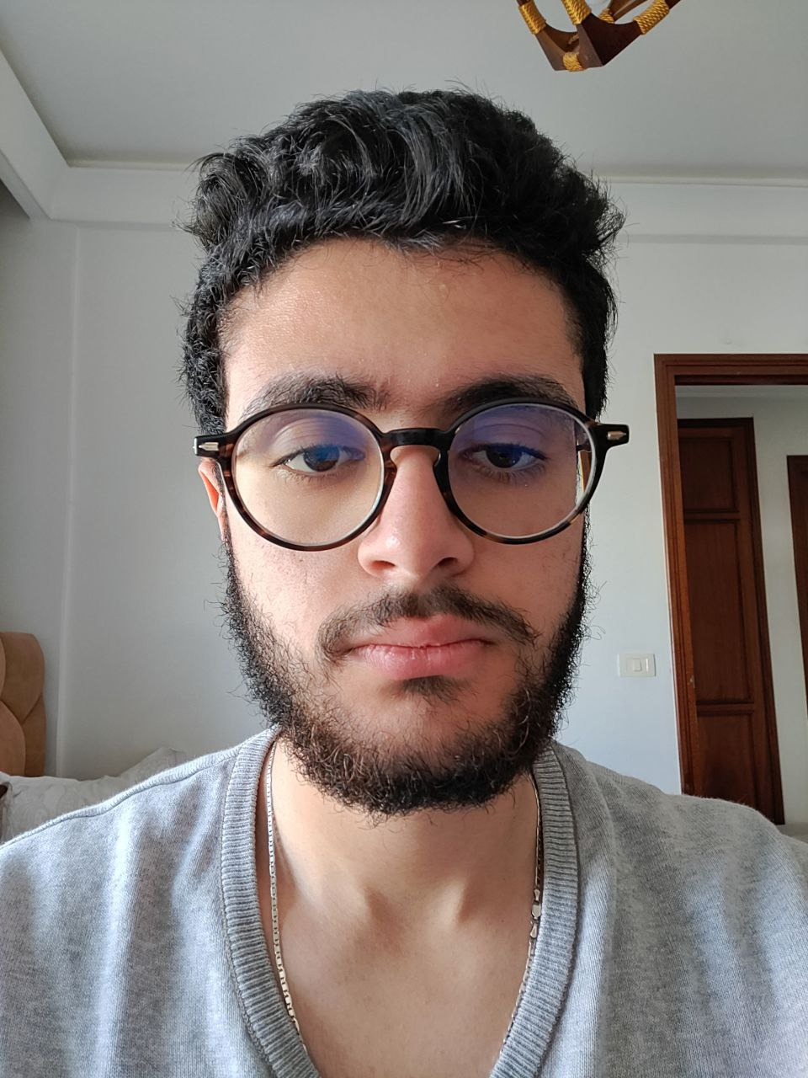
Web Application
Images
Backend
Frontend
Use case:
Selfie
Prediction

Slide 8



Next Step
Fine tune hyper parameters
Regularization
Improve face detection

Slide 9
Thank You! Any questions?

