Slide 1
CLAIMS & DEDUCTIBLE SYSTEM PRESENTATION - I
Prepared & Presented by:
Jagadeesh
20/12/2013

Slide 2
Legal Slide

Slide 3
Contents
  Overview of claim
  Introduction to Deductible
  Commercial Plans
  Medicare Part–D plans
  Deductible in old and Legacy

Slide 4
Overview of claim
What is Claim ?
  A statement from a patient(Member) of a health care provider Presented to an Insurance company or HMO for payment
Member really interested in
  Claim is successful/ Not
  How much money member needs to pay

Slide 5
Different types of claims
POS – Point Of Sale
Submitted at the Pharmacy by Pharmacist by looking at the Prescription Prescribed by the Prescriber to the Member.
ECT – Electronic Claims Transmission
PAPER CLAIMS
DMR Claims

Slide 6
What is Co pay ?
What is Coinsurance ?

Slide 7
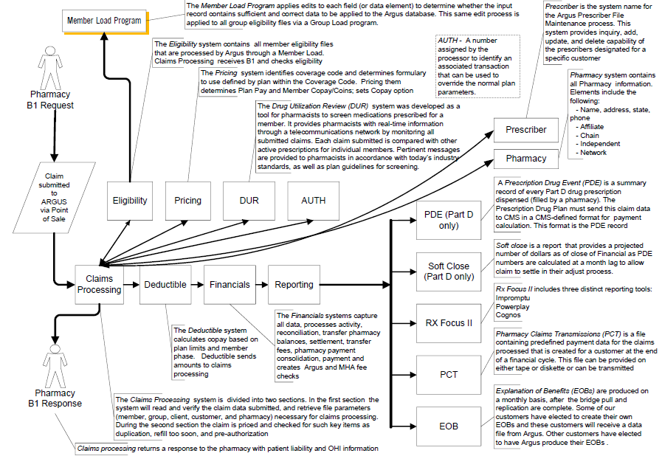

Slide 8
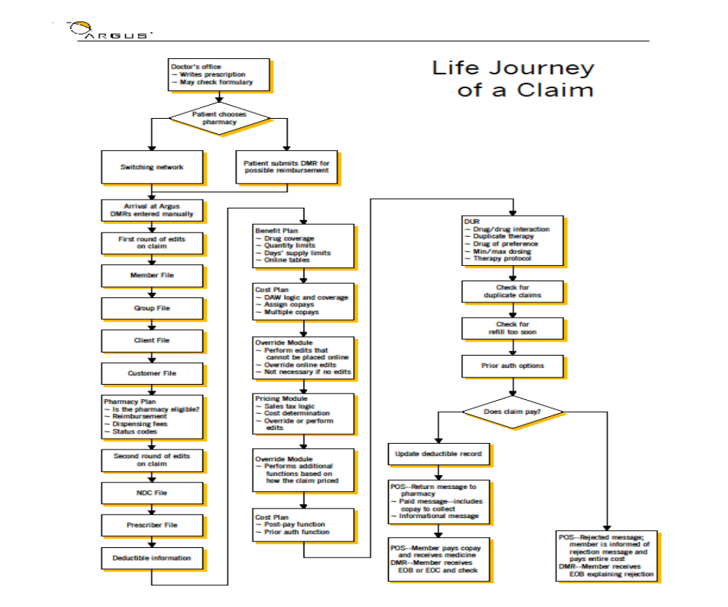

:
Claim Life Cycle:

Slide 9
Components
Benefit Plans
Cost Plans
Override Modules
Pricing Modules
Authorization.

Slide 10
Deductible Plan
What is Deductible Plan
A plan which actually determines the coverage of the health insurance ( We can say the layer above the coverage)
Before Deductible
After Deductible
What is “deductible” in health insurance
  A fixed dollar amount you must pay out-of-pocket before your plan begins covering your care

Slide 11
Deductible Plan Types
Commercial Deduct Plans
Plans designed by the insurance companies
Part – D deductible Plans.
Plans Designed by the CMS.
Is a federal program to subsidize the costs of prescription drugs for Medicare beneficiaries in the US.
Medicare:
Medicare is the federal health insurance program for people who are 65 or older, certain younger people with disabilities, and people with End-Stage Renal Disease(Like kidney ….)

Slide 12
Queries ????

Slide 13
Thank You!

