Slide 1
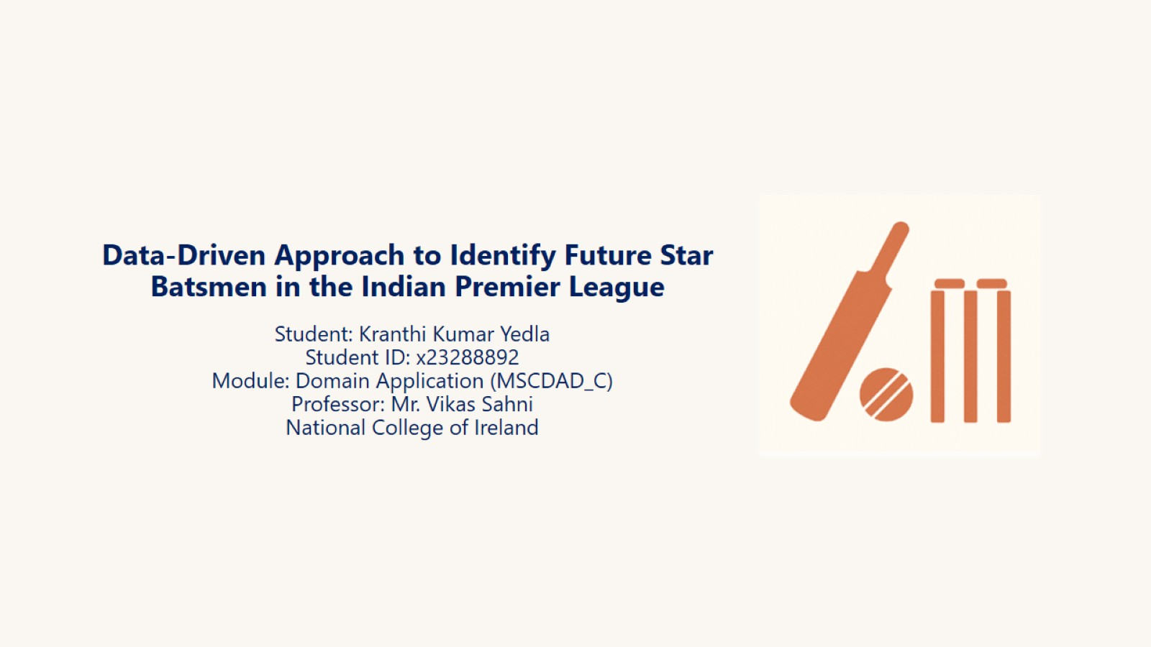
Data-Driven Approach to Identify Future Star Batsmen in the Indian Premier League

Slide 2
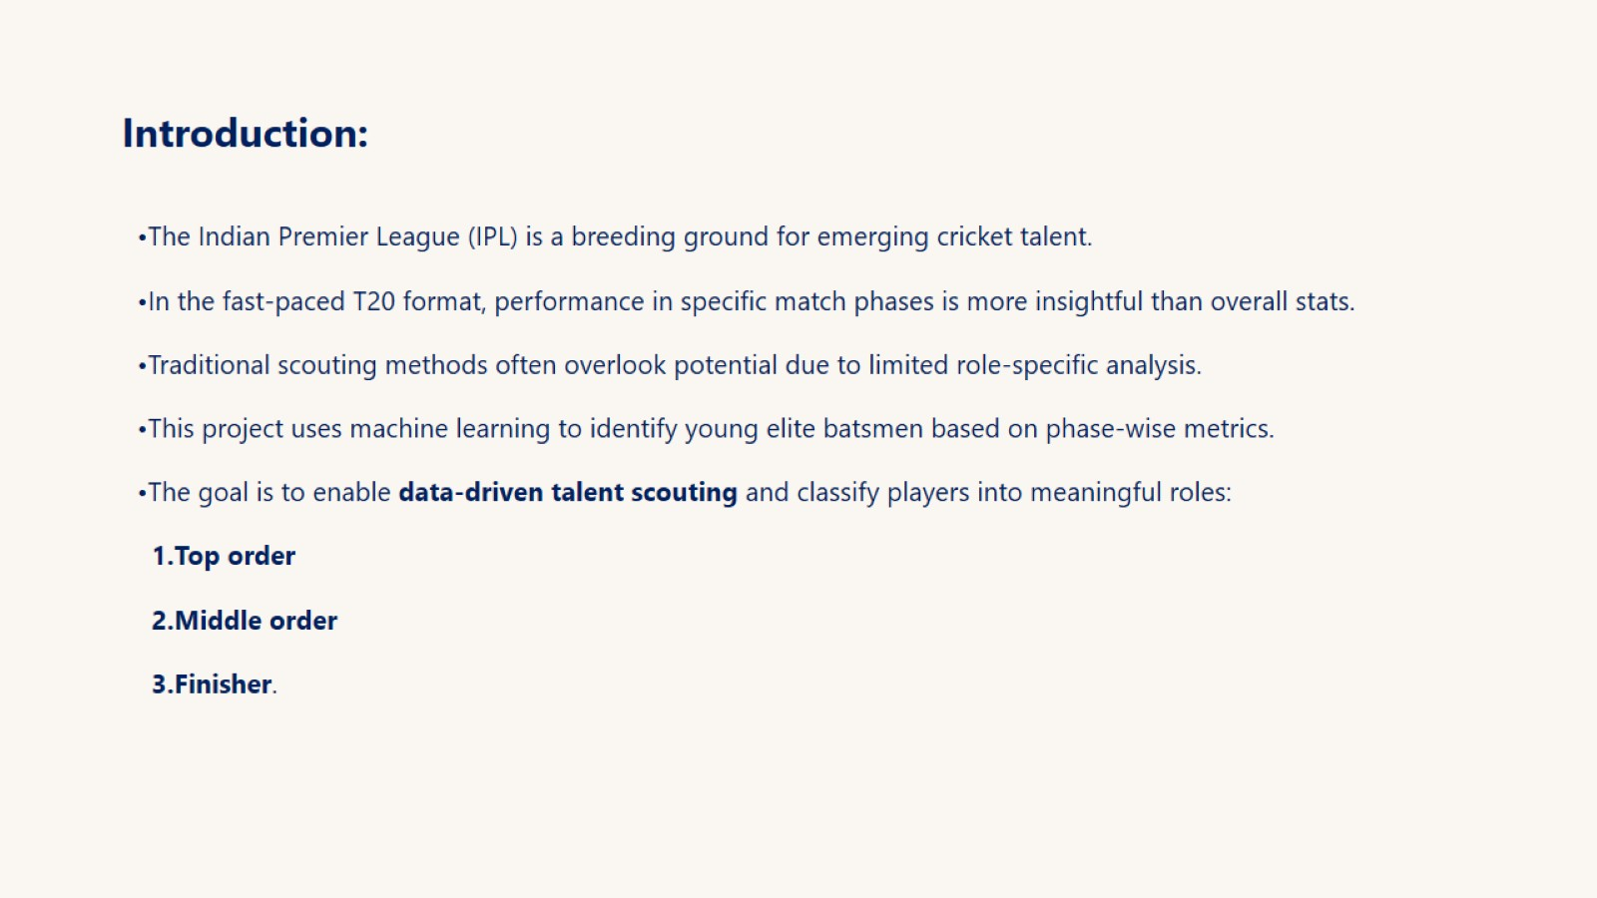
Introduction:

Slide 3
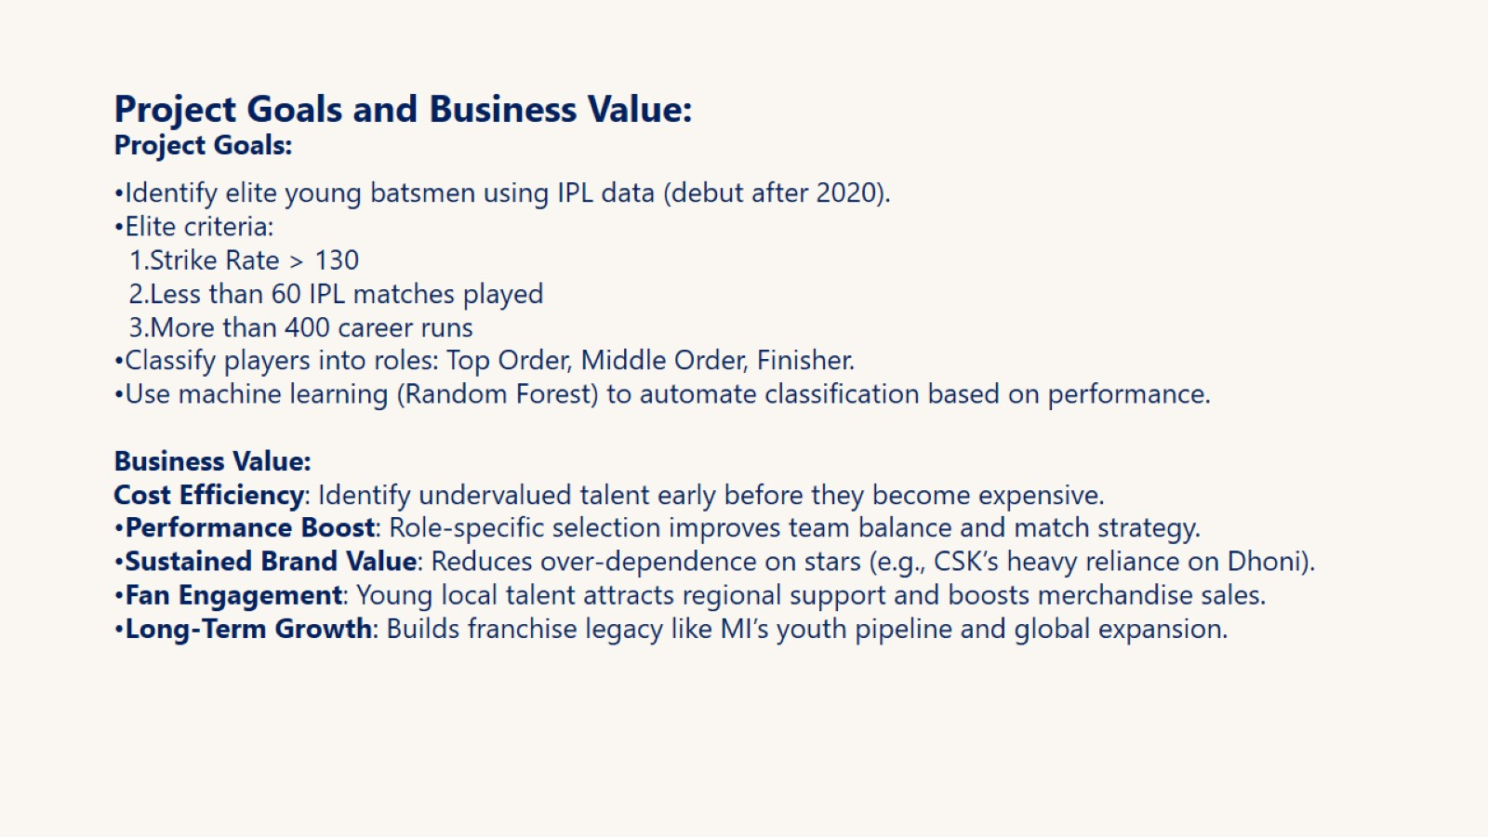
Project Goals and Business Value: Project Goals:

Slide 4
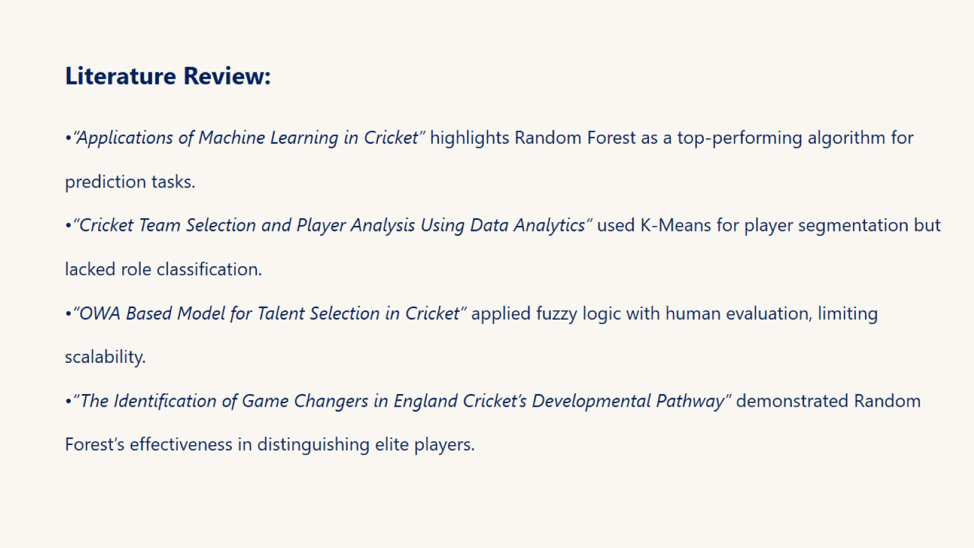
Literature Review:

Slide 5
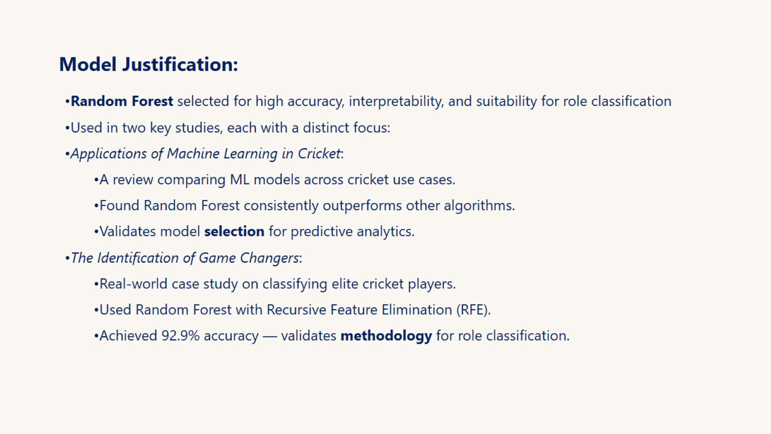
Model Justification:

Slide 6
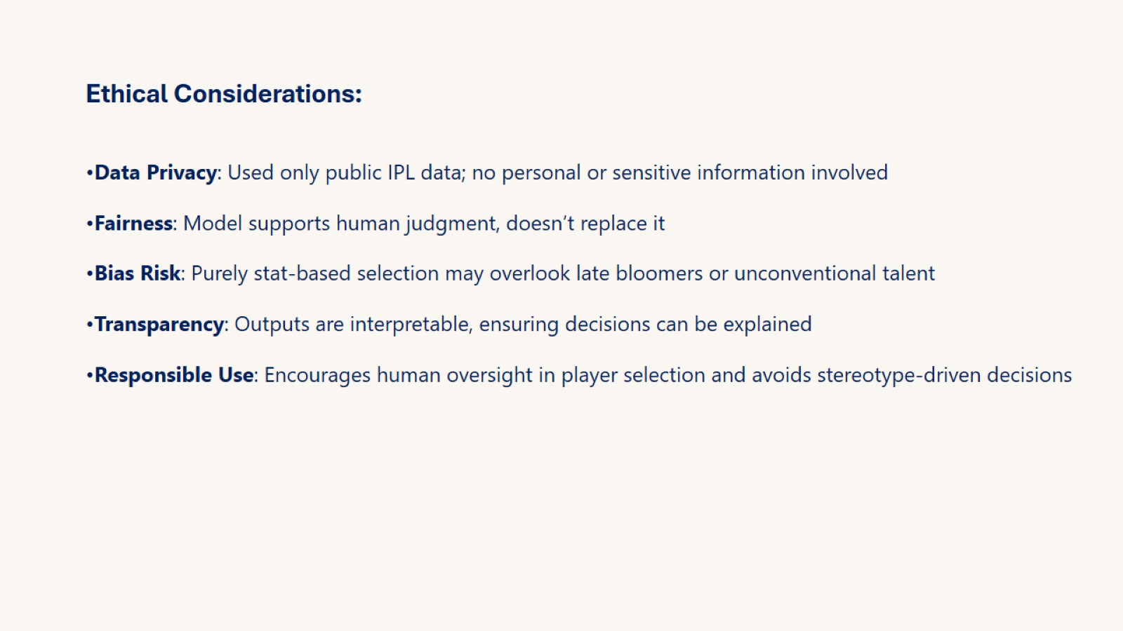
Ethical Considerations:

Slide 7
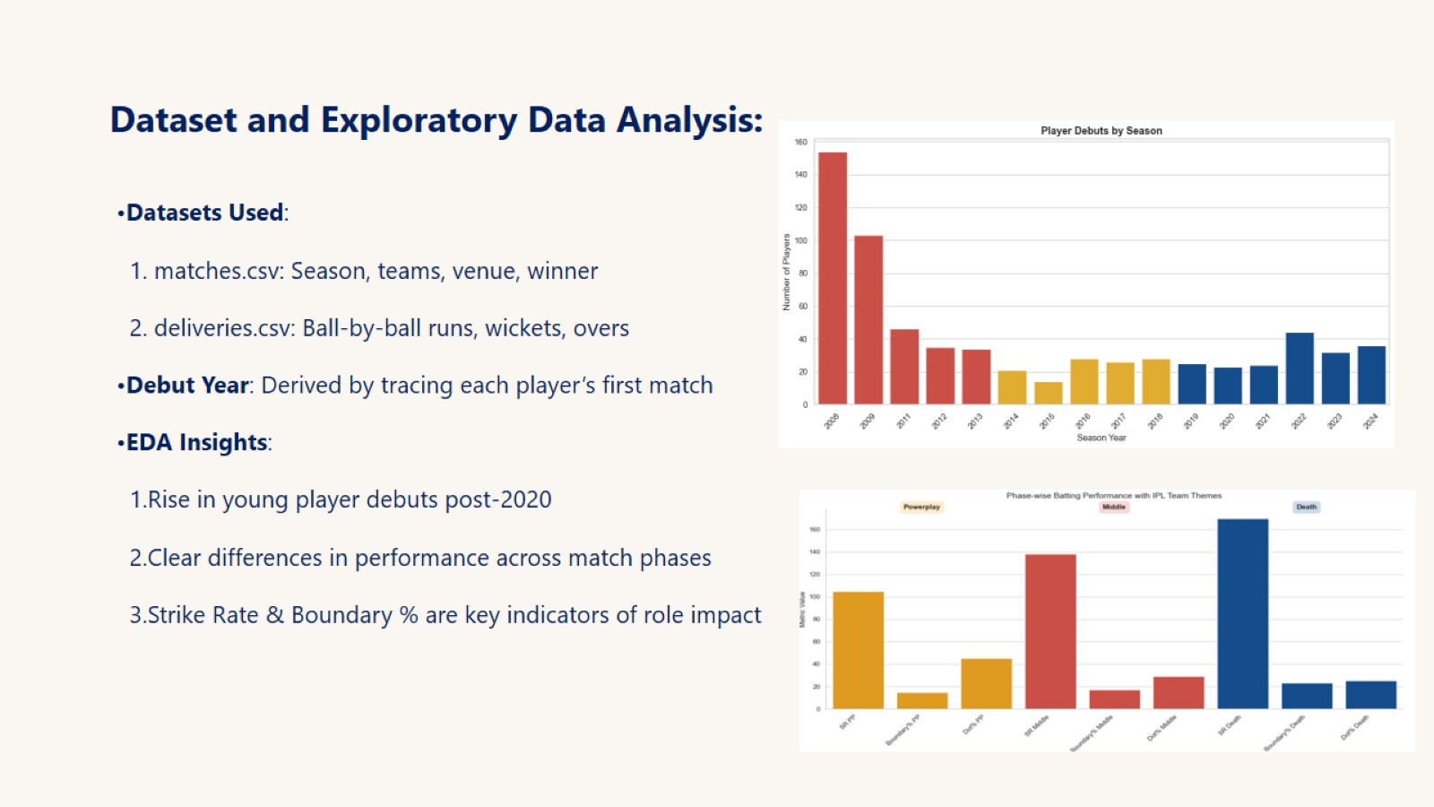
Dataset and Exploratory Data Analysis:

Slide 8
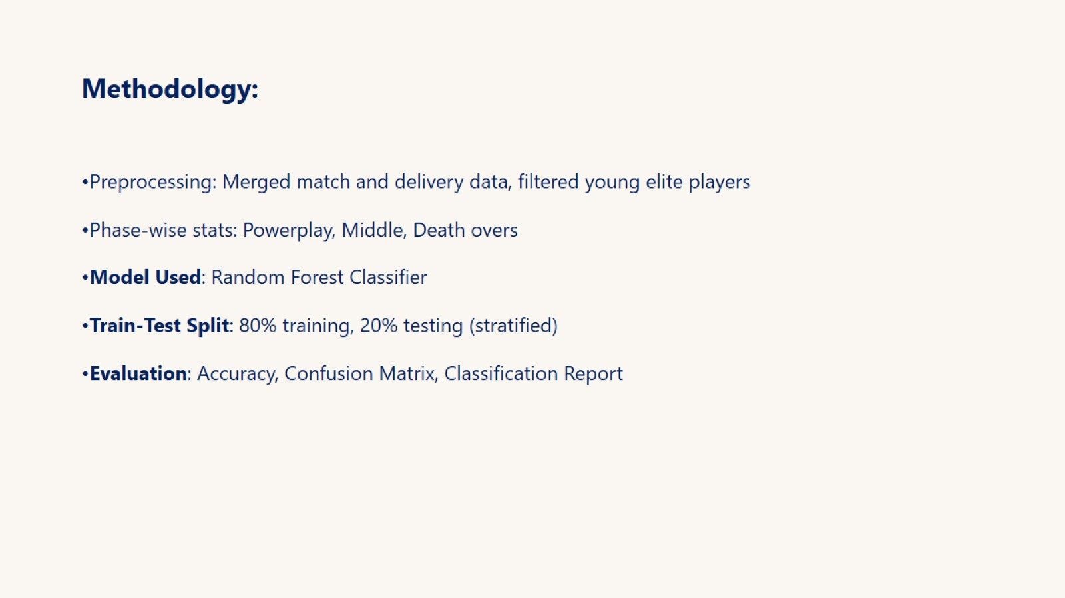
Methodology:

Slide 9
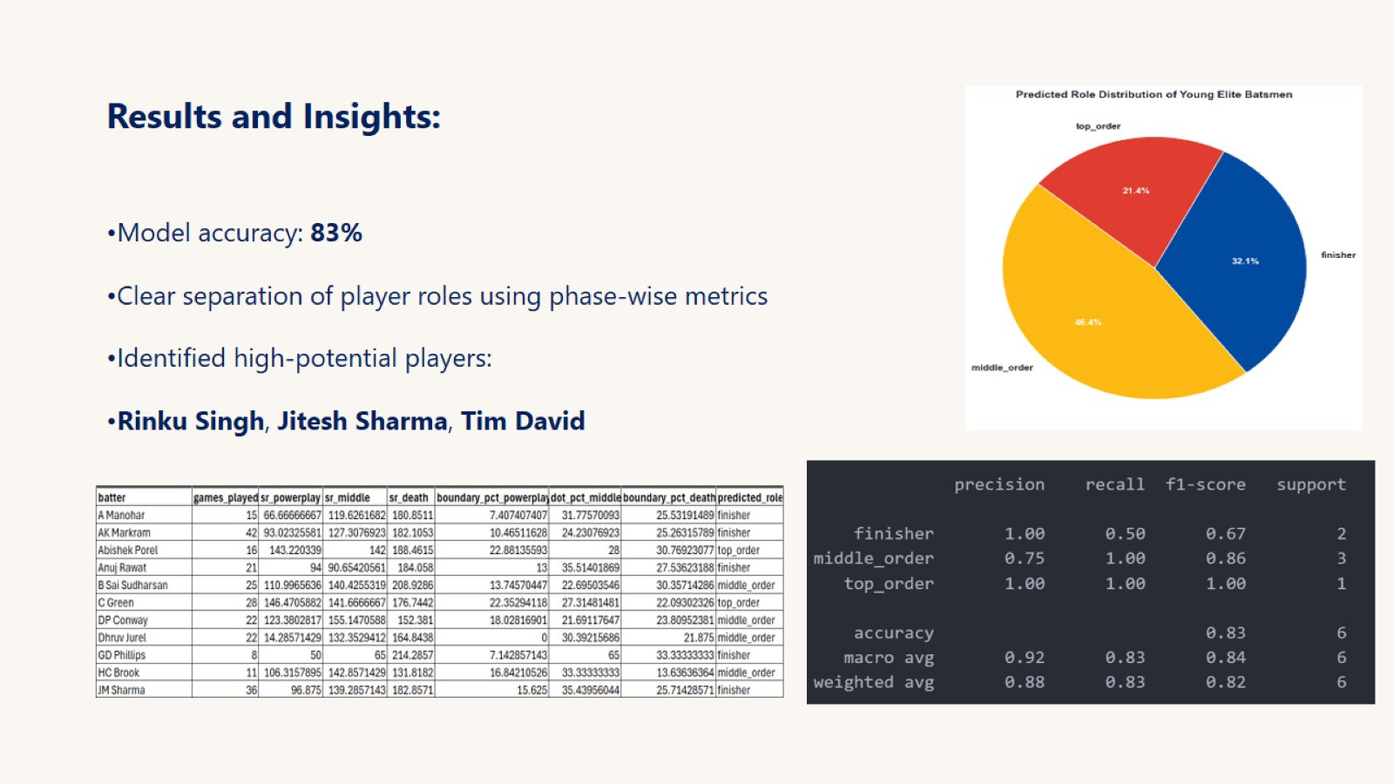
Results and Insights:

Slide 10
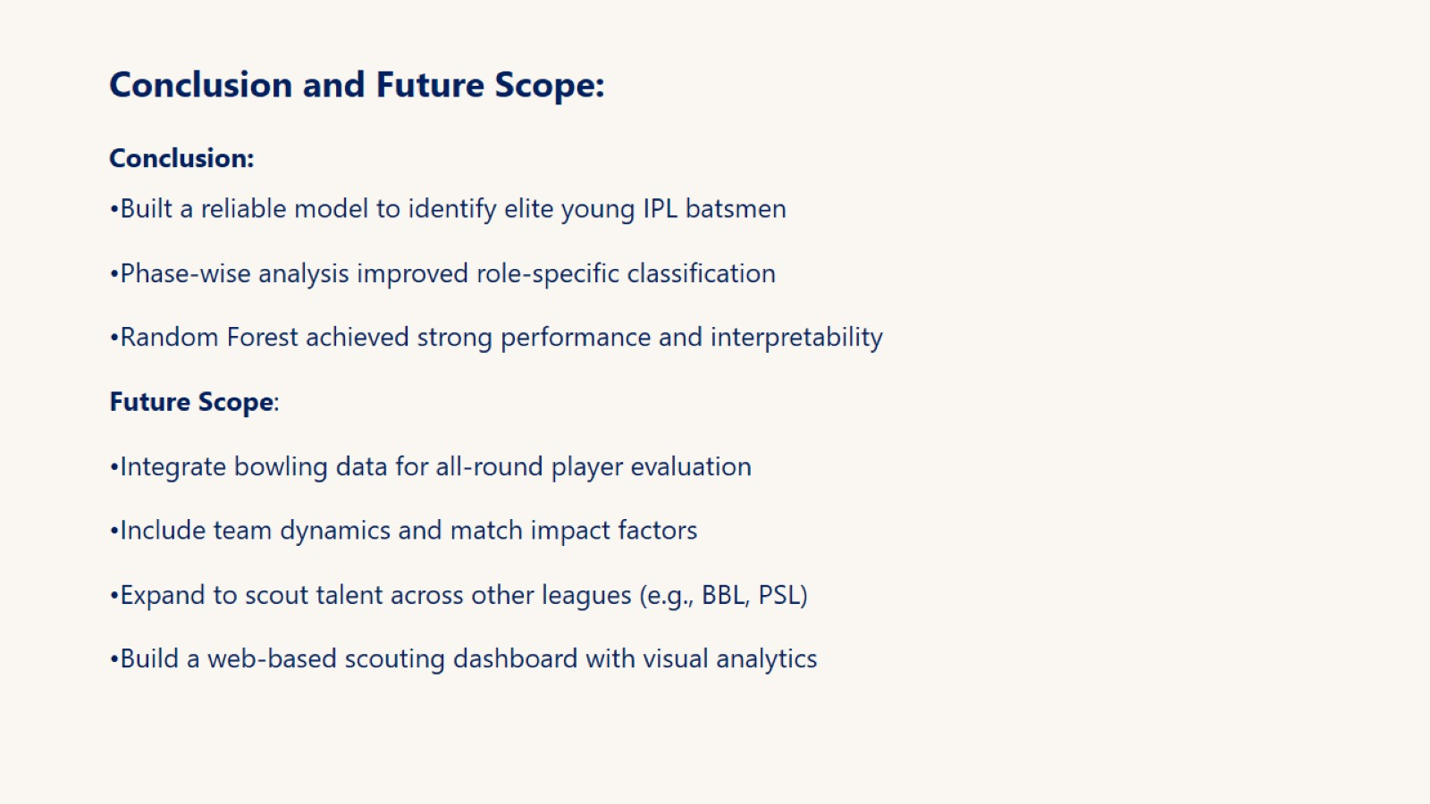
Conclusion and Future Scope: Conclusion:

Slide 11

Thank You

