Slide 1
MongoDB Training
NoSQL Database | Document-Oriented | Scalable
Vishnu Chaturvedi

Slide 2
Agenda
01. What is MongoDB
02. Key concepts
03. Document structure
04. CRUD Operations
05. Common query operators
06. Indexing
07. Aggregation framework
08. Best Practices
09. Tools and resources

Slide 3
Trainer – Vishnu Chaturvedi
10 Years of Experience in Backend Development.
Currently working as a Lead Engineer – Product Domain at Ferguson.
Joined Ferguson in April 2025, part of TIF-Middleware.
Core Expertise: Java, Spring Boot, MongoDB, Elasticsearch and Backend Systems.
Passionate about technology, problem solving & knowledge sharing.
Hobbies: Chess & exploring new technologies.

Slide 4

What is MongoDB?
Popular NoSQL database system
Document-oriented - stores data in JSON-like documents
Flexible schema - no predefined structure required
Horizontally scalable - supports sharding for large datasets
High availability - replica sets for redundancy and fault tolerance
Aggregation framework for complex data processing and analytics

Slide 5
Key Concepts
Core MongoDB Terminology
Database | Container for collections
Collection | Group of documents (similar to tables in SQL)
Document | Individual record in JSON/BSON format
Field | Key-value pair within a document
Index | Data structure for fast query lookups
_id | Unique Identifier (automatically created)
5
9/3/2026

Slide 6
Document Structure
Example JSON Document:
{
"_id": ObjectId("..."),
"name": "Laptop",
"category": "Electronics",
"price": 50000,
"inStock": true,
"tags": ["gadget", "tech"],
"specs": {
"processor": "Intel i7",
"ram": "16GB"
}
}
6
9/3/2026

Slide 7
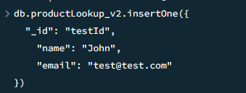
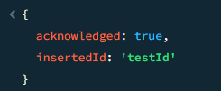
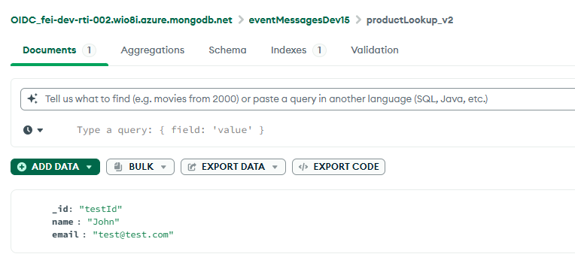
CRUD Operations - CREATE
Insert a single document – insertOne()
💡 Result: Automatically generates _id for each document • insertOne() - adds single document
• insertMany() - adds multiple documents in one operation
• Both return InsertedIds for the new documents

Slide 8
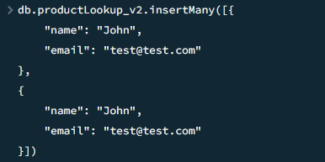
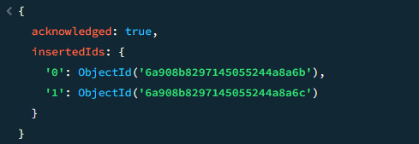
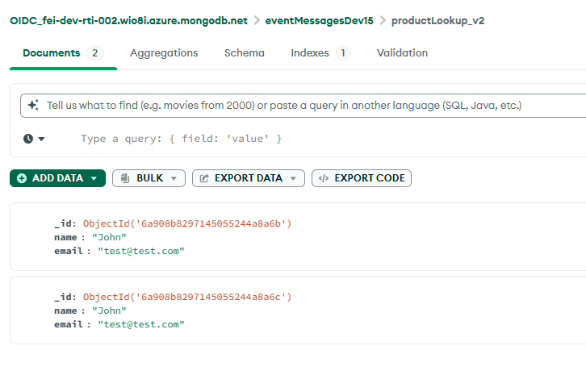
CRUD Operations - CREATE ……….
Persisting multiple documents – insertMany()

Slide 9
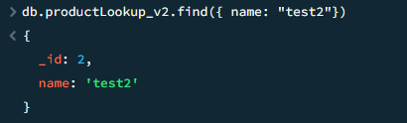
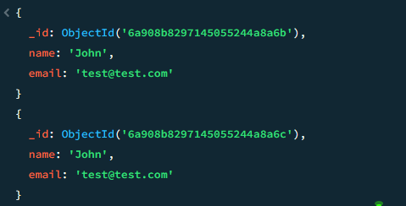
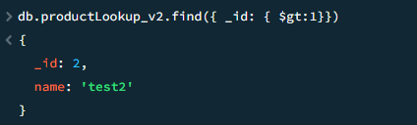
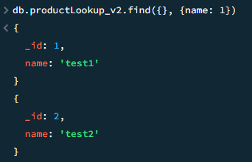
CRUD Operations - READ
Find all documents – find()
Find one document
Find with filter condition
Find with projection (Select specific fields)

Slide 10
CRUD Operations - READ
Projection Syntax: { fieldName: 1 } to include, 0 to exclude
Example: { name: 1, email: 1, _id: 0 } returns only name and email

Slide 11
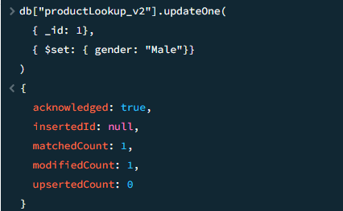
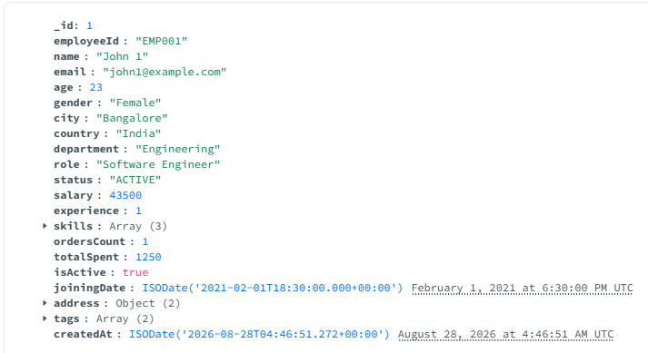
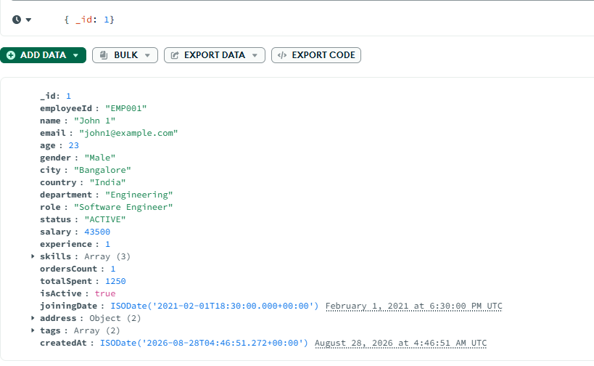
CRUD Operations - UPDATE
Updating a single document – updateOne()

Slide 12
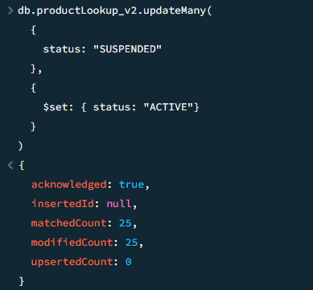
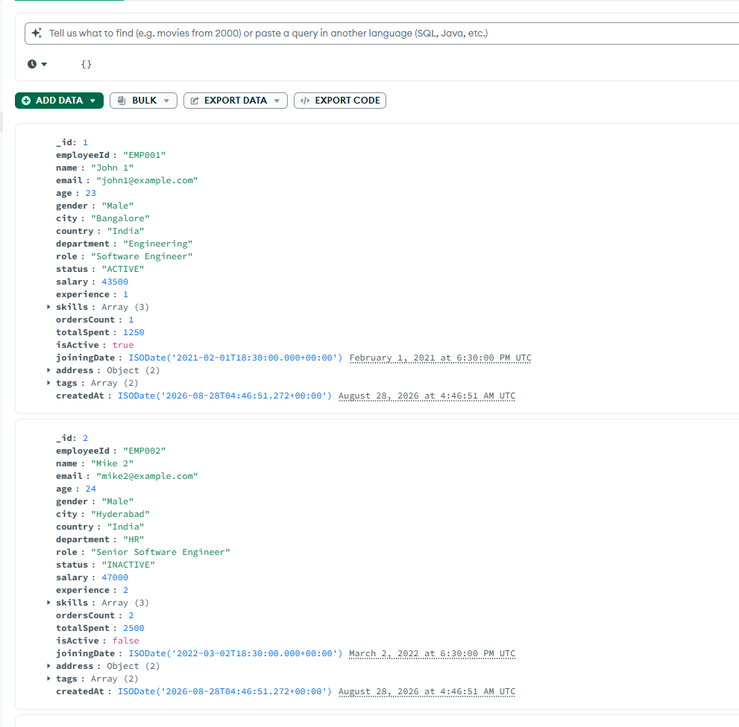
CRUD Operations - UPDATE……
Updating multiple documents– updateMany()

Slide 13
CRUD Operations – UPDATE……
⚠️ IMPORTANT: Always use $set operator • Correct: { $set: { field: value } }
• Wrong: { field: value } (replaces entire document!)

Slide 14
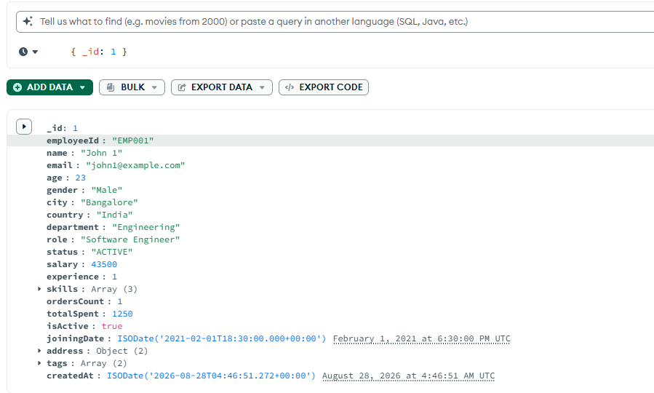
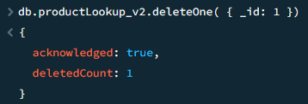
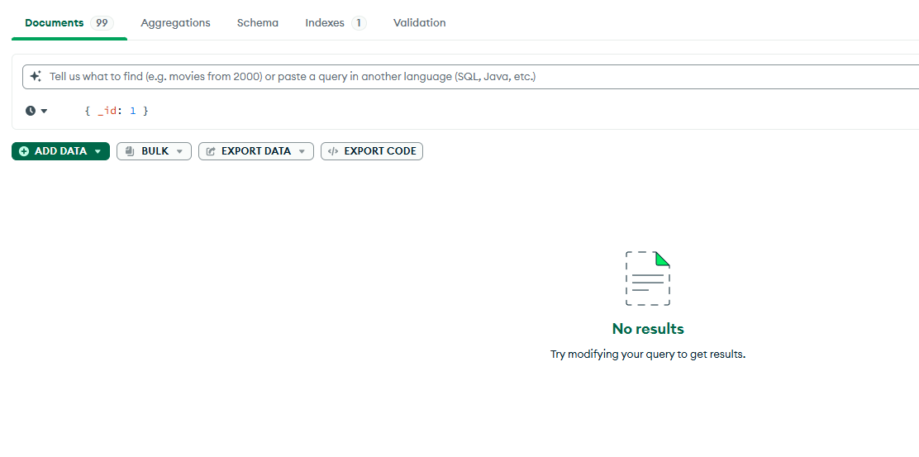
CRUD Operations – DELETE
Delete a single document – deleteOne()
Existing document

Slide 15
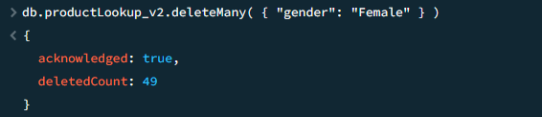
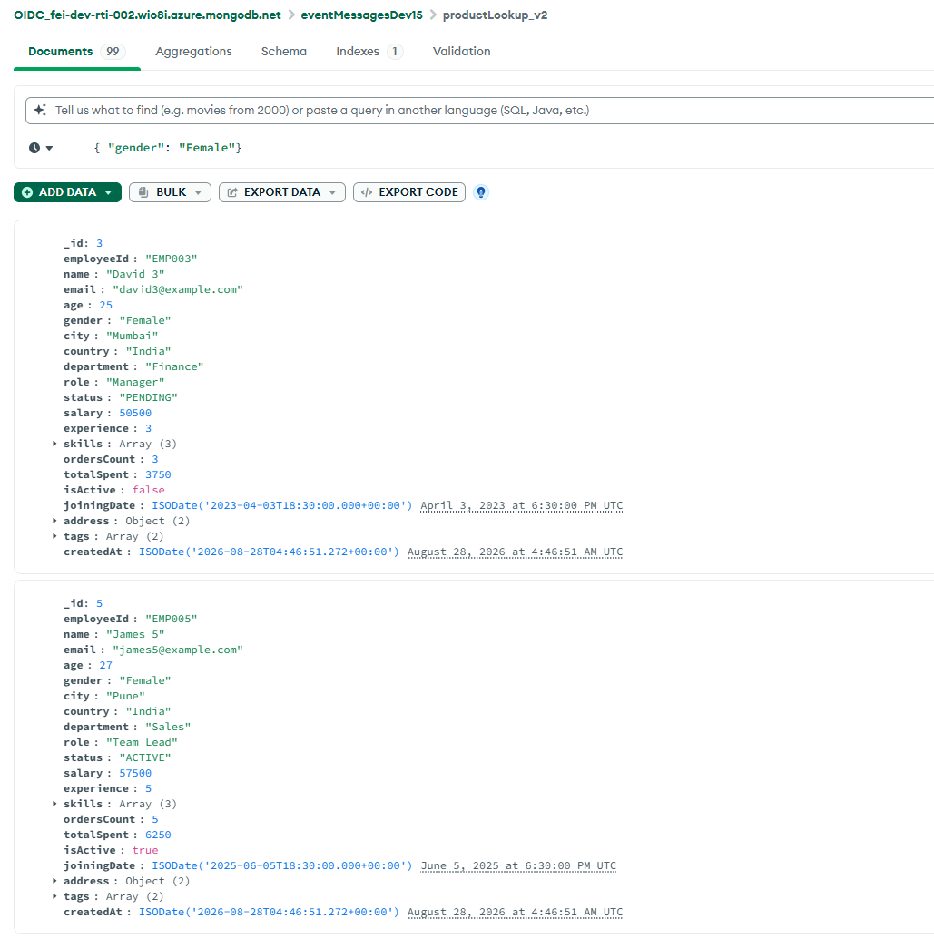
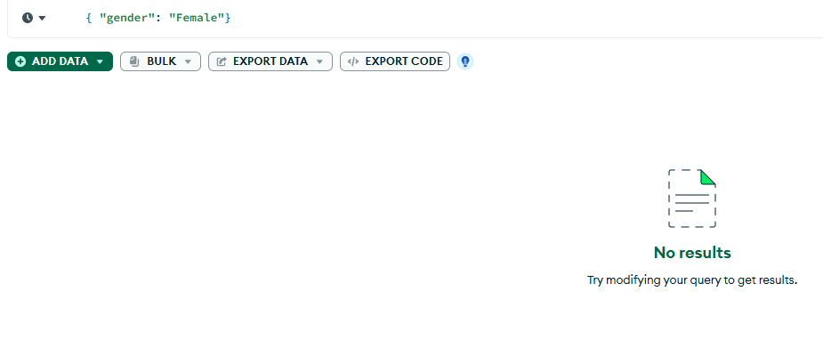
CRUD Operations – DELETE………
Delete multiple document – deleteMany()

Slide 16
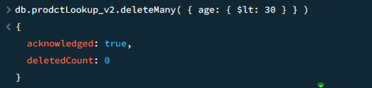
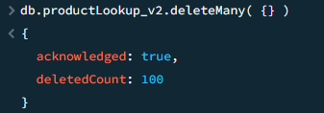
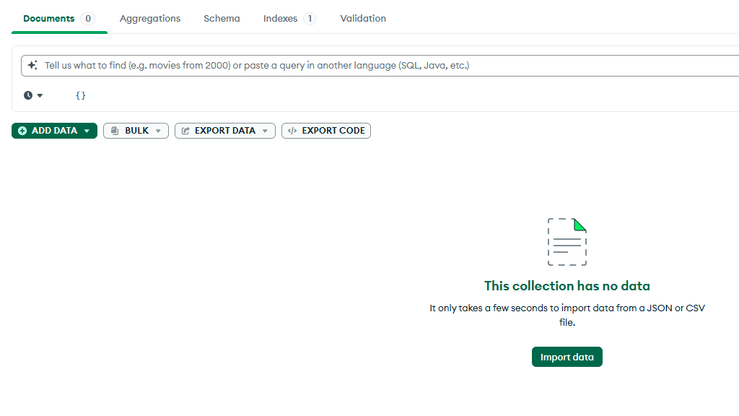
CRUD Operations – DELETE………
Delete with Condition
Delete all documents – ( Use with caution ⚠️)

Slide 17
CRUD Operations – DELETE………
⚠️ WARNING: Test with find() before deleting!
Always run db.collection.find(filter) FIRST to verify which documents will be deleted

Slide 18
Common Query Operators
Essential Operators for Queries
$eq – Equal to db.users.find({ status: { $eq: "active" } })
$gt, $gte – Greater than / Greater than or equal db.orders.find({ amount: { $gt: 10000 } })
$lt, $lte – Less than / Less than or equal db.cities.find({ city: { $in: ["Mumbai", "Delhi"] } })
$in – Match any value in the array db.users.find({ city: { $in: ["Mumbai", "Delhi", "Bangalore"] } })
$and, $or - Logical AND / OR operations db.products.find({ $and: [ { category: "Electronics" }, { price: { $gt: 20000 } } ] }) db.products.find({ $or: [ { inStock: false }, { rating: { $lt: 4.0 } } ] })
$ne – Not equal to db.users.find({ status: { $ne: "active" } })

Slide 19
Common Query Operators
Essential Operators for Queries
$eq – Equal to db.users.find({ status: { $eq: "active" } })
$gt, $gte – Greater than / Greater than or equal db.orders.find({ amount: { $gt: 10000 } })
$lt, $lte – Less than / Less than or equal db.cities.find({ city: { $in: ["Mumbai", "Delhi"] } })
$in – Match any value in the array db.users.find({ city: { $in: ["Mumbai", "Delhi", "Bangalore"] } })
$and, $or - Logical AND / OR operations db.products.find({ $and: [ { category: "Electronics" }, { price: { $gt: 20000 } } ] }) db.products.find({ $or: [ { inStock: false }, { rating: { $lt: 4.0 } } ] })
$ne – Not equal to db.users.find({ status: { $ne: "active" } })

Slide 20
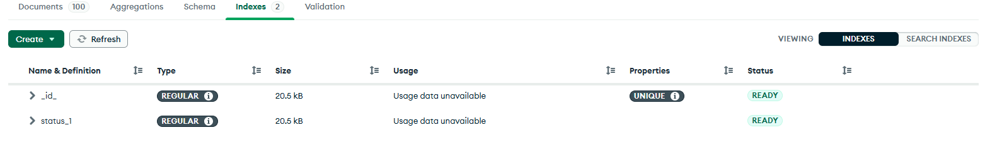
Indexing for Performance
Improve Query Speed with Indexes
Improves query performance by reducing scan time.
Uses B-tree data structure for efficient lookups.
Create Single Field Index

Slide 21
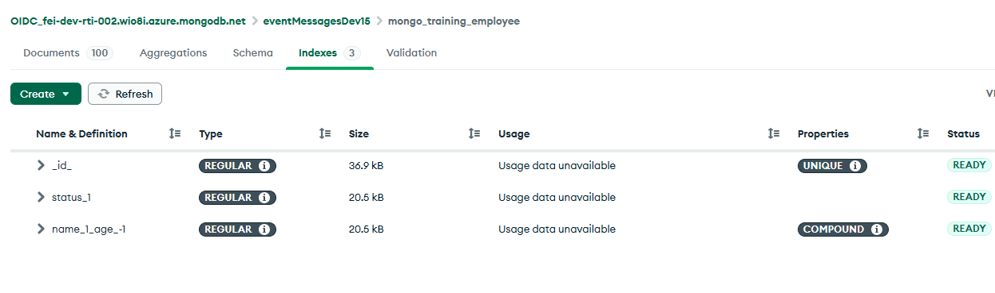
Indexing for Performance…….
Compound Index A compound index is an index that contains two or more fields from a document, allowing MongoDB to efficiently execute queries that use those fields together.
Creating a compound index

Slide 22
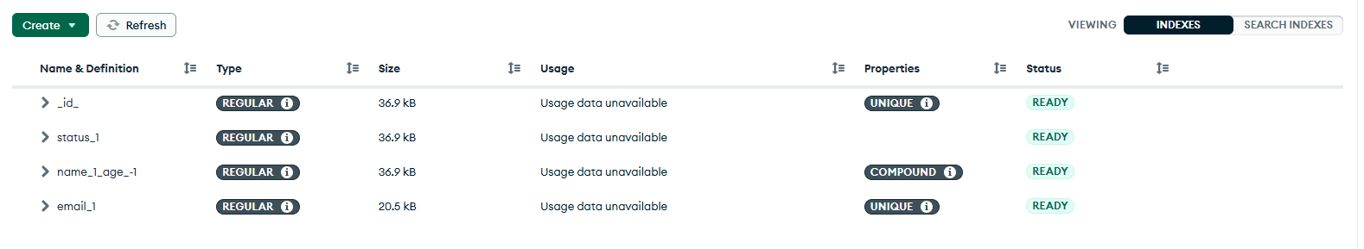
Indexing for Performance…….
Unique Index A unique index ensures that a particular field (or combination of fields) cannot contain duplicate values in a MongoDB collection.
Creating a unique index

Slide 23
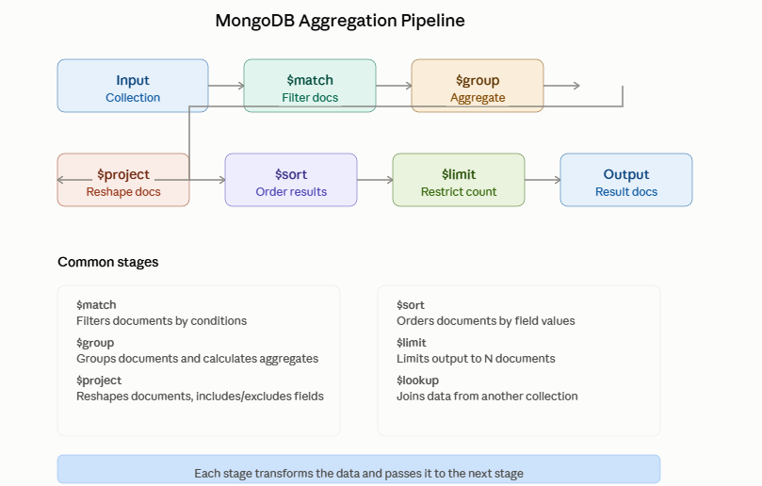
Aggregation Framework
Aggregation framework is a MongoDB feature used to process, transform, filter, group, and analyze data through a sequence of stages called a pipeline.
$match – Filter documents based on conditions
$group – Group by a field and aggregate values
$sort – Sort documents by specified fields
$project – Select and reshape specific fields
$lookup – Perform joins with other collections.

Slide 24
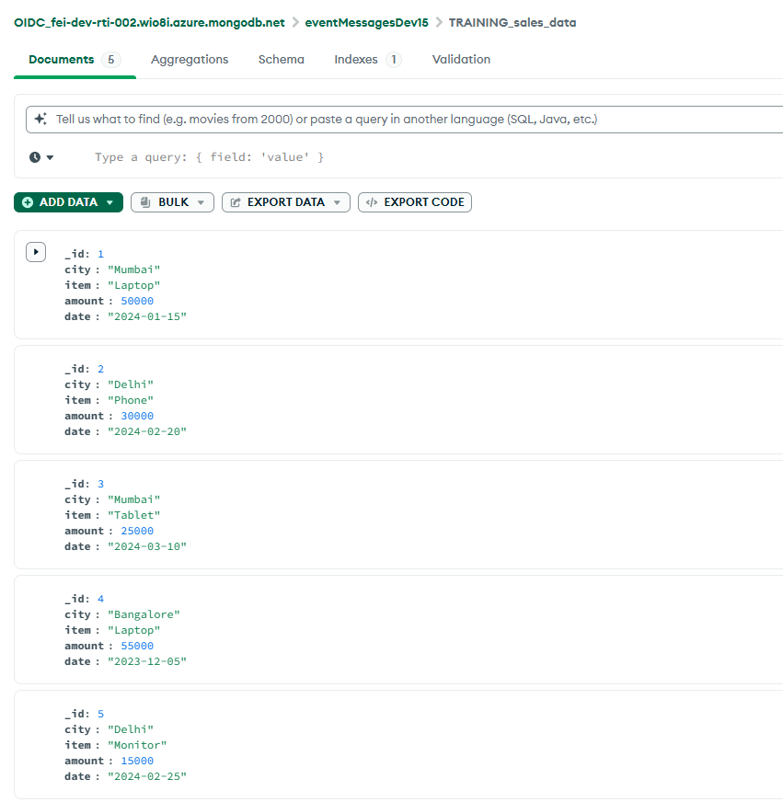
Sales Data Aggregation Pipeline example
Input collection: TRAINING_sales_data

Slide 25
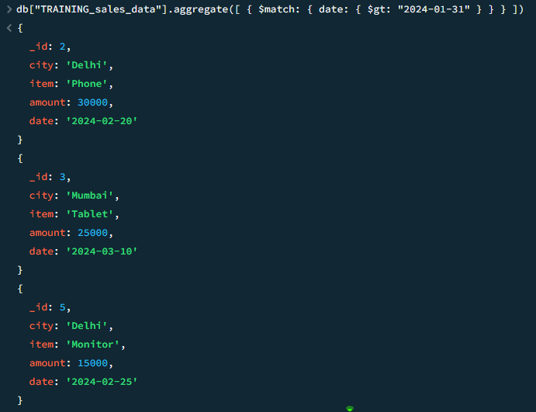
Continued….
$match – Filter by condition Only sales after January 2024:

Slide 26
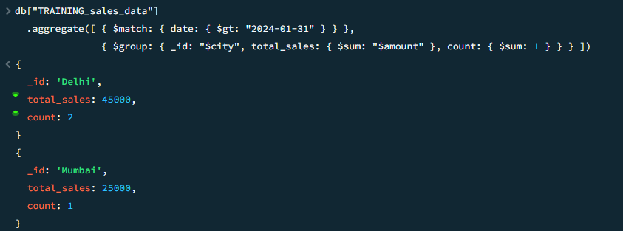
Continued….
$group – Aggregate by city Group by city and calculate totals

Slide 27
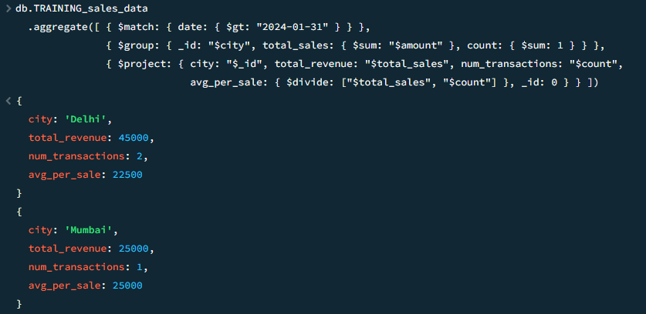
Continued….
$project – Reshape and rename fields Make fields names friendly and add calculations
Tip: _id: 0 removes the ID field; $divide creates new fields
Key concepts to remember
$match early: Filter first to reduce data processed by later stages.
$group combines: Use $sum, $avg, $min, $max, $count to aggregate
$project reshapes: Pick, rename or compute fields for final output.
Each stage transforms: Output of once stage becomes input of next.

Slide 28
Best practices
Always use indexes on frequently queried fields.
Avoid deeply nested structures - keep schema flat
Use meaningful field names for clarity
Validate data before insertion
Use transaction for multi-document consistency
Monitor slow queries and optimize them
Plan sharding strategy for scalabilty
Regular backups and disaster recovery plan

Slide 29
Tools and resouces
MongoDB Shell (mongosh)
Command-line interface for MongoDB
MongoDB Compass
GUI for querying and data visualization
MongoDB Atlas
Cloud-hosted MongoDB service (free tier available)
Official Drivers
Node.js, Python, Java, Go, C#, Ruby, etc.
MongoDB University
Free online courses and certifications
Documentation
docs.mongodb.com - comprehensive reference

Slide 30
Quick Quiz - CRUD Operations
Question 1: What does _id in MongoDB represent?
A) User ID
B) Unique Identifier (automatically created)
C) Collection ID
D) Database ID
Question 2: Which is correct comparison?
A) Database ≈ Table
B) Collection ≈ Table ✓
C) Document ≈ Column
D) Field ≈ Row

Slide 31
Quick Quiz - CRUD Operations
Question 1: What does _id in MongoDB represent?
A) User ID
B) Unique Identifier (automatically created) ✓
C) Collection ID
D) Database ID
Question 2: Which is correct comparison?
A) Database ≈ Table
B) Collection ≈ Table ✓
C) Document ≈ Column
D) Field ≈ Row

Slide 32
Quick Quiz - CRUD Operations
Question 1: Which command inserts multiple documents?
A) insert()
B) insertOne()
C) insertMany()
D) addMany()
Question 2: What's WRONG with this update?
A) Syntax is correct
db.users.updateOne(
{ _id: 1 },
{ name: "John" }
)
B) Missing $set operator
C) _id cannot be used
D) updateOne doesn't exist

Slide 33
Quick Quiz - CRUD Operations
Question 1: Which command inserts multiple documents?
A) insert()
B) insertOne()
C) insertMany() ✓
D) addMany()
Question 2: What's WRONG with this update?
A) Syntax is correct
db.users.updateOne(
{ _id: 1 },
{ name: "John" }
)
B) Missing $set operator ✓ ⚠️
C) _id cannot be used
D) updateOne doesn't exist

Slide 34
Quick Quiz - Query Operators
Question 1: What does $and operator do?
A) Matches if ANY condition is true
B) Matches if ALL conditions are true
C) Counts total conditions
D) Combines results from two queries
Question 2: Which is cleaner & faster?
For finding users from Mumbai, Delhi, or Bangalore?
A) Using $or with 3 conditions
B) Using $in: ["Mumbai", "Delhi", "Bangalore"]

Slide 35
Quick Quiz - Query Operators
Question 1: What does $and operator do?
A) Matches if ANY condition is true
B) Matches if ALL conditions are true ✓
C) Counts total conditions
D) Combines results from two queries
Question 2: Which is cleaner & faster?
For finding users from Mumbai, Delhi, or Bangalore?
A) Using $or with 3 conditions
B) Using $in: ["Mumbai", "Delhi", "Bangalore"] ✓

Slide 36
Quick Quiz - Aggregation Pipeline
Question 1: Best pipeline stage order?
A) $group → $match → $sort
B) $match → $group → $sort
C) $sort → $match → $group
D) Any order works
Question 2: Which stage reshapes documents?
A) $match
B) $group
C) $project
D) $sort

Slide 37
Quick Quiz - Aggregation Pipeline
Question 1: Best pipeline stage order?
A) $group → $match → $sort
B) $match → $group → $sort ✓
C) $sort → $match → $group
D) Any order works
Question 2: Which stage reshapes documents?
A) $match
B) $group
C) $project ✓
D) $sort

Slide 38
Final Quiz - Apply Your Knowledge
Scenario:
E-commerce system: Find all "active" orders from Mumbai and Delhi. Calculate total amount per customer. Show only customer name and total. Sort by highest total first.
Challenge: Write the aggregation pipeline!

Slide 39
Final Quiz - Apply Your Knowledge
Scenario:
E-commerce system: Find all "active" orders from Mumbai and Delhi. Calculate total amount per customer. Show only customer name and total. Sort by highest total first.
Challenge: Write the aggregation pipeline!
💡 ANSWER
db.orders.aggregate([
{ $match: { status: "active", city: { $in: ["Mumbai", "Delhi"] } } },
{ $group: { _id: "$customer_name", total: { $sum: "$amount" } } },
{ $project: { customer: "$_id", total: 1, _id: 0 } },
{ $sort: { total: -1 } }
])

Slide 40
Thank you!
+91-7395902450
Vishnu.Chaturvedi@ferguson.com
FERGUSON.COM

