Slide 1
Image Recognition Based on Deep Learning
Presenting By: Group-5
Kranthi Swapna Garapati
Harika Lakshmi Kareti
Venkata Sai Aditya Nischal Dasari
Akshitha Chalamala

Slide 2
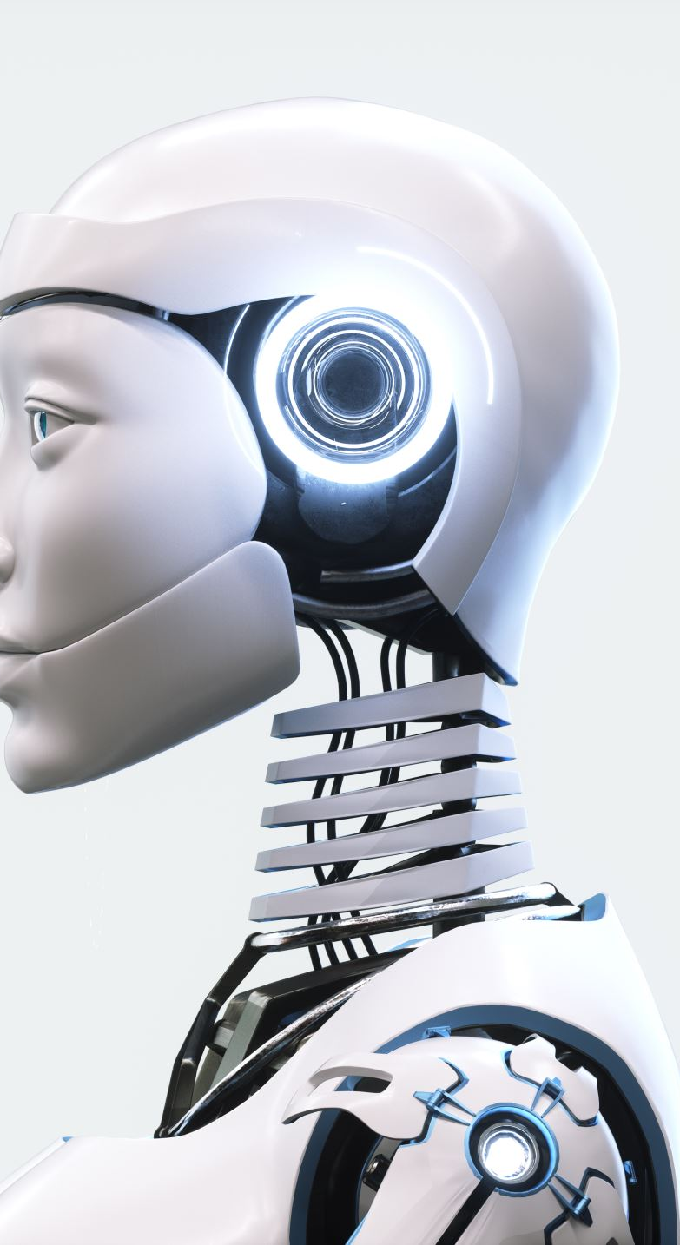
Introduction
Image Recognition: Image recognition is the process where a machine interprets and understands visual data, such as objects, faces, and handwritten text.
Importance: Image recognition is crucial in industries like healthcare (disease diagnosis), autonomous vehicles (pedestrian and vehicle detection), and security (face recognition).
Traditional Methods: Before deep learning, computer vision relied on manual feature extraction, which was limited and domain-specific.
Deep Learning Advantage: Deep learning models, especially CNNs, automatically learn features from raw image data, eliminating manual intervention.

Slide 3

Overview of Deep Learning
What is Deep Learning?: A machine learning subset using multi-layer neural networks to learn data representations at different abstraction levels.
Key Characteristics:
Self-Learning: Deep learning improves by adjusting weights, without manual feature engineering.
Representation Learning: Deep learning extracts features directly from raw data, like image pixels.
Comparison with Traditional Methods: Traditional machine learning relies on predefined features, while deep learning learns hierarchical features from data.
Successful Applications:
Face Detection: Used in social media platforms for auto-tagging.
Medical Image Analysis: Helps in detecting tumors in MRI scans.
Autonomous Vehicles: Vehicle systems use deep learning to recognize road signs, pedestrians, and obstacles.

Slide 4

Convolutional Neural Network (CNN)
Key Components of CNN:
Convolution Layer: Applies filters to detect features like edges and textures.
Pooling Layer: Reduces data size by taking the maximum or average, improving efficiency.
Fully Connected Layer: Classifies the extracted features into output classes.
Architecture & Working:
A CNN consists of input, convolution, pooling, and fully connected layers. As images pass through, it extracts features from basic edges to complex objects.
Advantages:
CNNs excel in image recognition by capturing spatial hierarchies, making them translation-invariant.
Example:
A CNN trained on MNIST recognizes digits by learning features like curves and lines.

Slide 5
Deep Belief Network (DBN)
What is a DBN?
A Deep Belief Network (DBN) is a probabilistic generative model made of stacked Restricted Boltzmann Machines (RBMs), used for unsupervised learning and feature extraction.
Structure
DBNs consist of multiple RBMs, each learning features from input data. Stacking them provides rich data representations.
Training
Unsupervised Pre-Training: RBMs extract features layer by layer.
Fine-Tuning: The network is refined using supervised methods like backpropagation.
Use in Image Recognition
DBNs are effective for tasks like dimensionality reduction, generative modeling, and feature extraction, especially in complex datasets.

Slide 6

Experiment Setup
Datasets:
MNIST: A dataset of 28x28 grayscale images of handwritten digits (0-9), consisting of 60,000 training images and 10,000 testing images. It's commonly used for training image recognition models.
Real-World Handwritten Characters: This dataset includes 67 characters (10 digits, 26 uppercase and lowercase English letters, and 5 Chinese characters), written by 500 people. It is more challenging due to variations in handwriting.
Data Preprocessing: Images are resized (28x28) and normalized before being fed into the neural network to improve performance.

Slide 7
Results of CNN
Training Setup
Learning Rate: Controls how much the model adjusts weights during training.
Kernel Numbers: More filters improve performance but increase computational load.
Accuracy Results
MNIST: 99.28% accuracy, demonstrating CNN's effectiveness in digit recognition.
Real-World Data: 92.91% accuracy, showing strong performance on complex datasets.
Challenges
Overfitting: Too many kernels can lead to overfitting, reducing performance on new data.
Learning Rate: Too small slows convergence; too large overshoots optimal weights.

Slide 8
Results of DBN
Accuracy Results:
On MNIST: 98.12% accuracy, slightly lower than CNN, but still good for unsupervised learning models.
On Real-World Handwritten Characters: 91.66% accuracy, slightly lower due to the challenge of using unsupervised models for highly variable handwritten characters.
Impact of Hidden Layer Structure:
Too Few Neurons: Results in poor feature extraction and low accuracy.
Too Many Neurons: Leads to overfitting, reducing generalization ability.
Training Method: The greedy unsupervised algorithm helps in learning the features layer by layer, but it might not perform as well as CNNs for classification tasks.

Slide 9
Comparison: CNN vs. DBN
CNN:
Supervised Learning: Requires labeled data for training.
Better for 2D Data: CNNs are highly effective for image data, where spatial relationships are important.
Disadvantage: Requires a large amount of labeled data for training.
DBN:
Unsupervised Learning: DBNs are good at feature extraction from unlabeled data and work well for tasks like dimensionality reduction.
Better for 1D Data: DBNs excel in tasks like speech recognition where temporal dependencies matter.
Disadvantage: Might require more fine-tuning for practical applications like image classification.

Slide 10

Conclusion
Deep Learning’s Potential
Deep learning, especially CNNs, has revolutionized image recognition with high accuracy and no manual feature extraction.
Future Directions
Transfer Learning: Adapting pre-trained models for new tasks.
Real-Time Recognition: Optimizing for applications like security and autonomous driving.
Challenges
Data Requirements: Needs large labeled datasets.
Interpretability: Understanding model decisions remains a challenge.

Slide 11
Thank You

