Slide 1
Predictive Analytics For Agricultural Investments: Enhancing ROI And Mitigating Financial Risks For Farmers
Presented By:
Harsha Keladi Ganapathi
Kranthi Swapna Garapati
Sharath Chandra Kamuni

Slide 2
Problem statement
Investment and financial management challenges
Importance of Financial Planning
Lack of Investment Awareness
Uncertainty in ROI
Risk Assessment

Slide 3
Introduction:
Objective: This project aims to provide actionable insights regarding investment, ROI, and financial risk to farmers through a data-driven approach.
Target Audience
New Farmers: Individuals starting their agricultural journey without prior cultivation experience.
Experienced Farmers: Those with historical data from previous harvests, seeking to optimize their investment strategies.

Slide 4
CRISP-DM with Agile Framework Flowchart
Project Initiation
(Define Objectives & Team)
Business Understanding
(Identify Farmer Needs & Risks)
Data Understanding
(Gather Data Sources, Exploratory)
Data Preparation
(Clean, Transform, & Integrate)
Model Evaluation & Validation (Assess) Performance & Risk)
Evaluation & Validation (Assess) Performance & Risk)
Insights & Reporting
(Deliver Actionable Insights to Farmers)

Slide 5
Data Ingestion
Data Cleaning
Data Transformation
Predictive Modelling
Insights And Recommendations
Output Visualization
Feedback Loop
Methodolgy

Slide 6
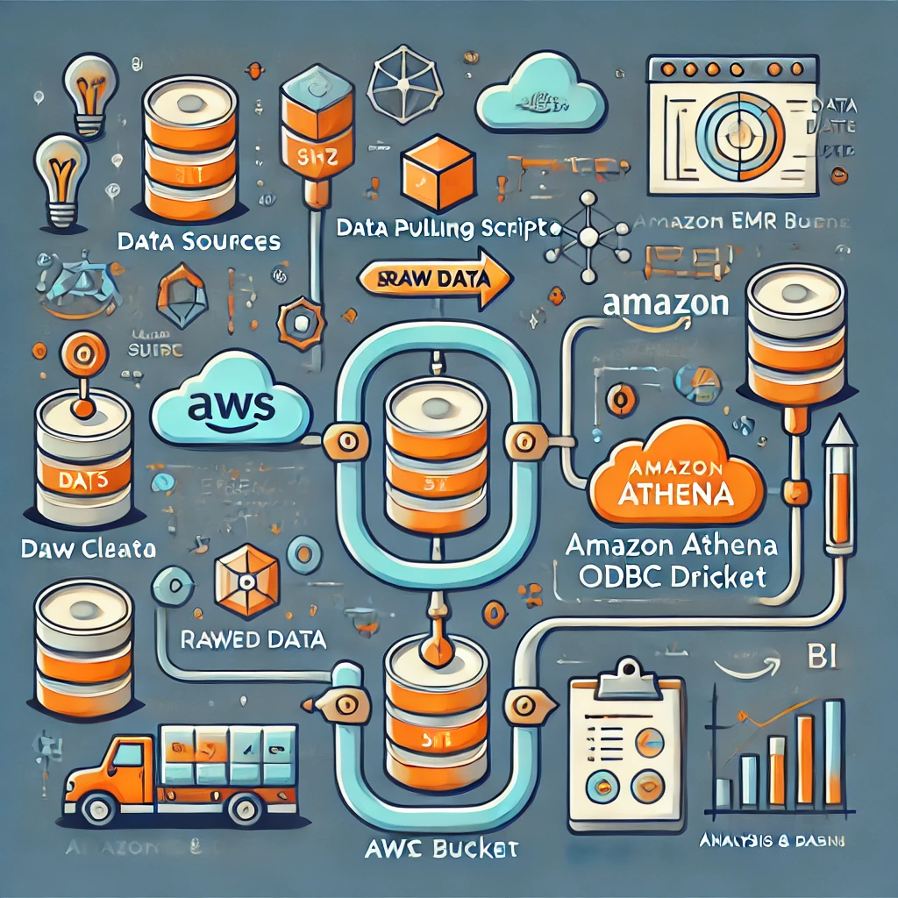
Architecture

Slide 7
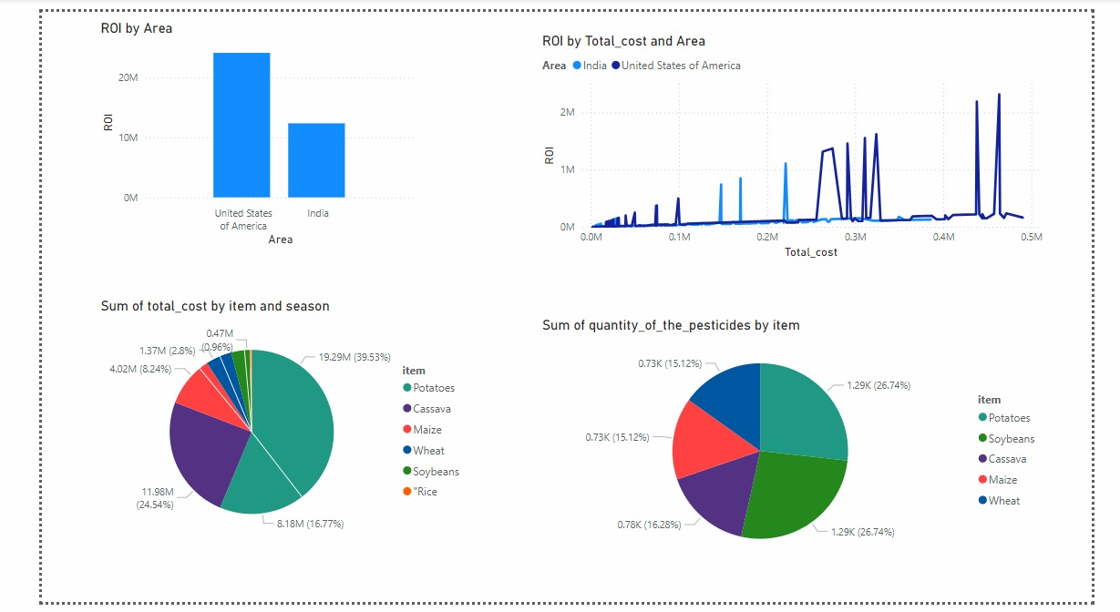

Slide 8


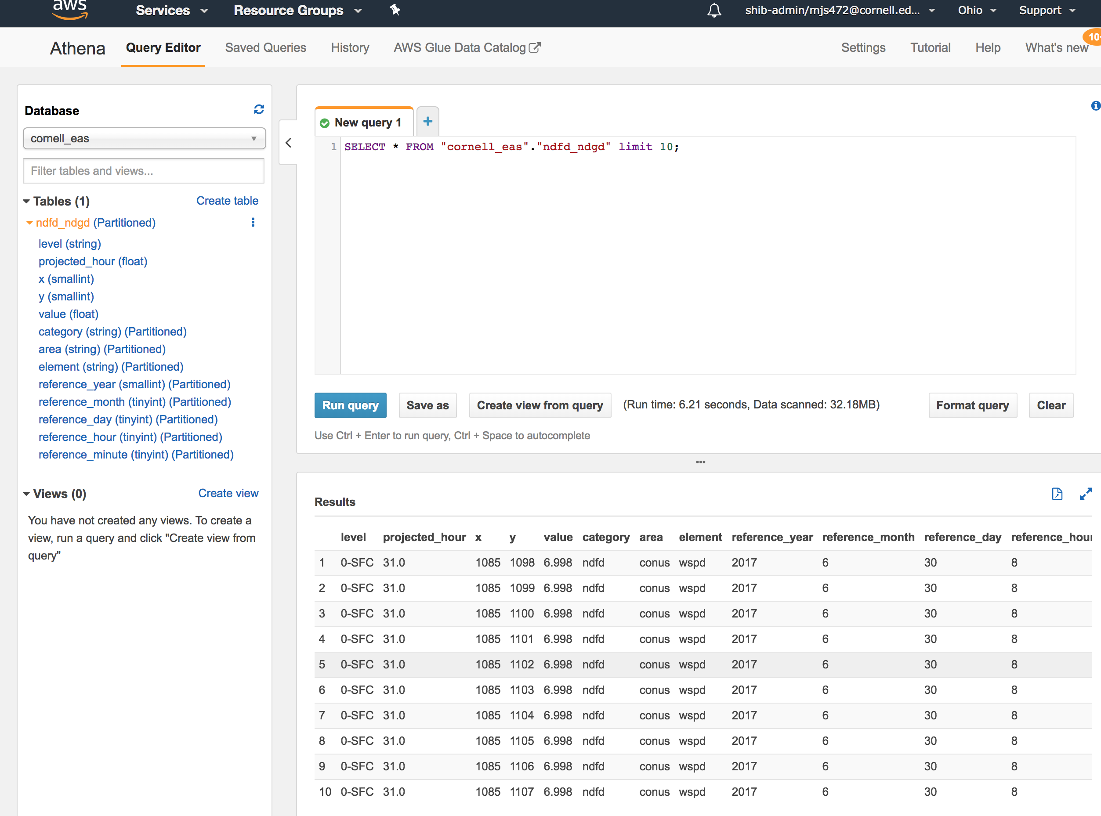

Tools and Technologies planning
Data Collection
Data Storage
Data Cleaning & Transformation
Data Visualization

Slide 9

Thank you
Any Questions

