Slide 1
Virtual Private Network

Slide 2
Outline
Why VPN is needed
IP Tunneling
How VPN works
TUN/TAP interface
Layer-2 and Layer-3 VPNs

Slide 3
Introduction
Networks primarily intended for internal use are called private network.
If we grant access from outside to the private network, the attack surface will significantly broaden.
If the internal resources still use IP address as the basis for authorization, it is not difficult for attackers to access the protected resources

Slide 4
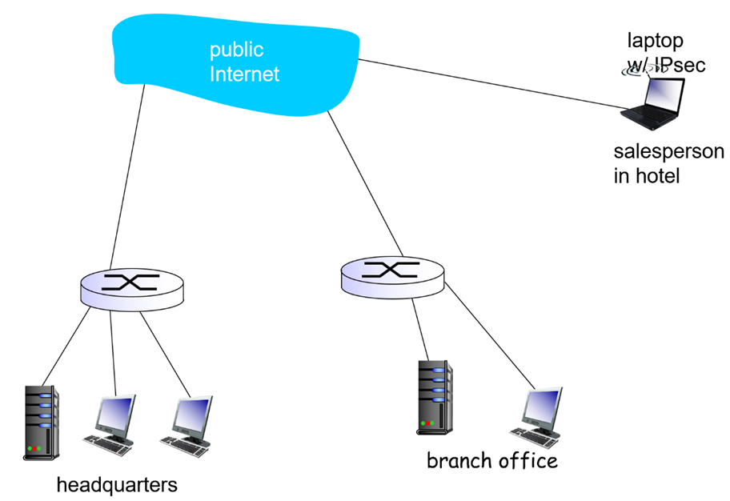
Motivation: Why VPN?
Organizations often want private networks for security
costly: separate routers, links, DNS infrastructure
VPN: institution’s inter-office traffic is sent over public Internet instead
encrypted before entering public Internet
logically separate from other traffic

Slide 5
Virtual Private Network
VPN allows users to create a secure, private network over a public network such as the Internet. This is achieved by:
Having a designated host (VPN server) on the network
Outside computers have to go through the VPN server to reach the hosts inside a private network via authentication.
VPN server is exposed to the outside and the internal computers are still protected, via firewalls or reserved IP addresses.

Slide 6
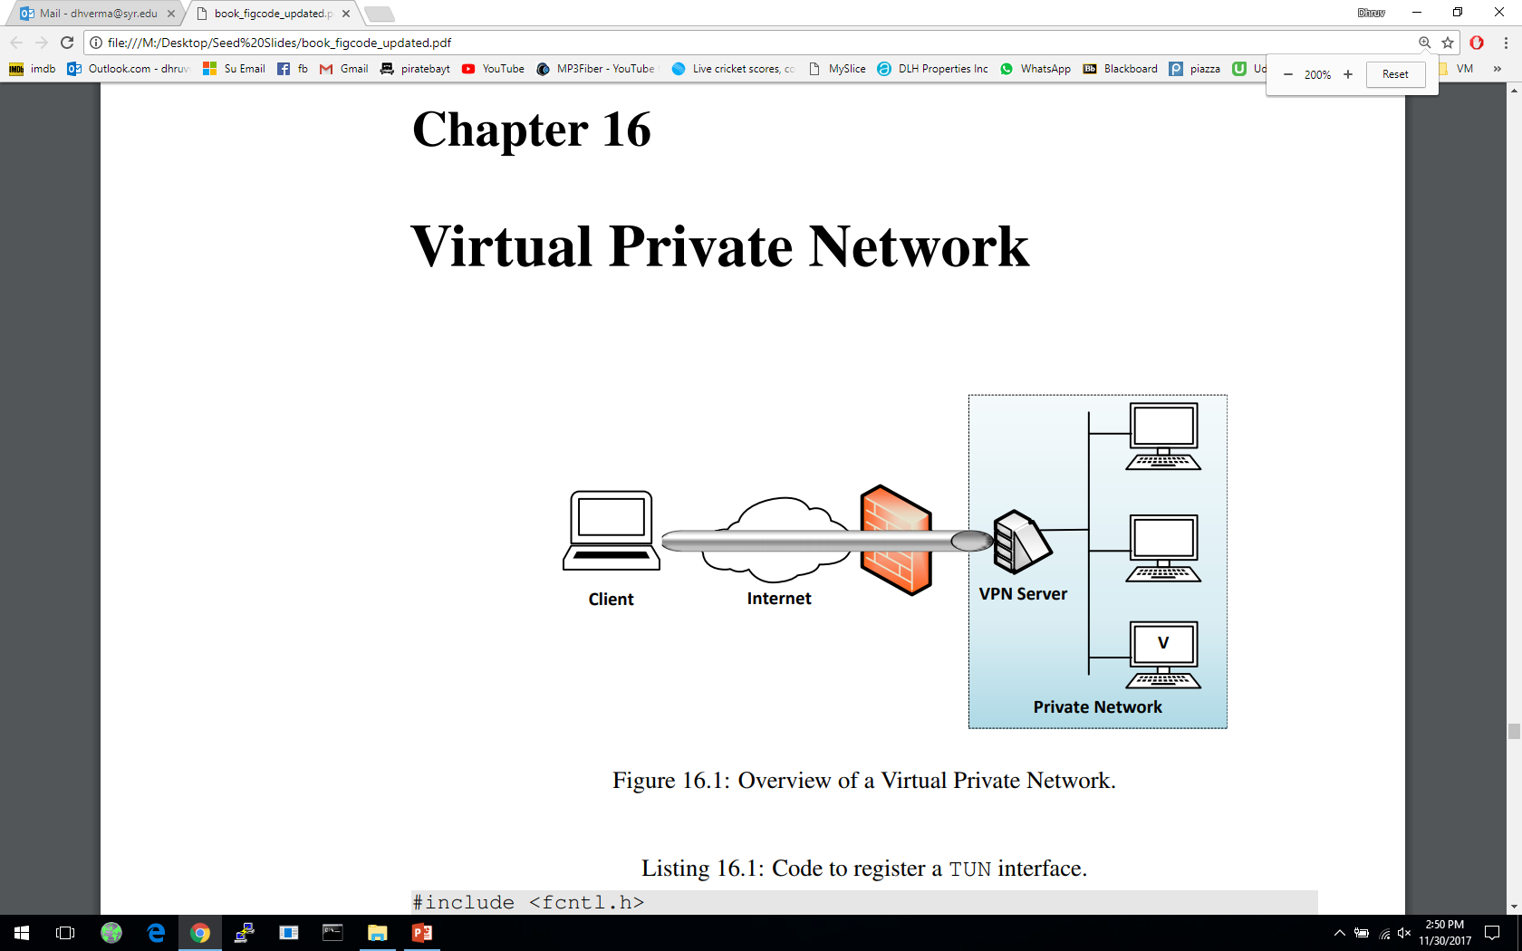
A Typical Setup
This is a typical VPN setup where the “Client” machine wants to connect with machine “V” on a private network. “Client” uses the “VPN Server” to get authenticated to the private network
IP Tunneling

Slide 7



IP Tunneling
Traffics inside the tunnel are protected
Tunnel End A
Tunnel End B
The tunnel goes through a public network, such as the Internet.
The actual packet between the two ends of the tunnel
The payload carries another IP packet, which is the packet that needs to be protected, such as packets to/from a private network

Slide 8
Two Types of IP Tunneling
IPSec Tunneling:
Utilizes the Internet Protocol Security protocol
IPSec has a mode called Tunneling mode, where the original IP packet is encapsulated and placed into a new IP packet
TLS/SSL Tunneling:
Tunneling done outside the kernel, at the application level
Idea is to put each VPN-bound IP packet inside a TCP or UDP packet as a payload
The other end of the tunnel will extract the IP packet from the TCP/UDP payload
To secure the packets, both ends will use TLS/SSL protocol on top of TCP/UDP

Slide 9
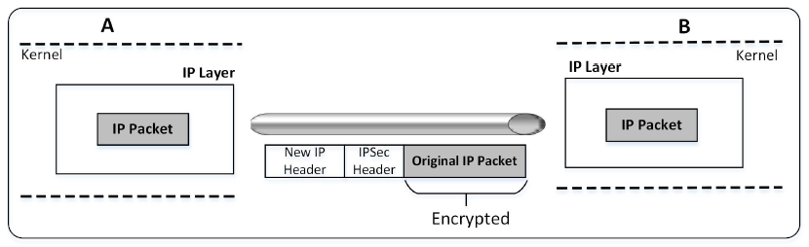
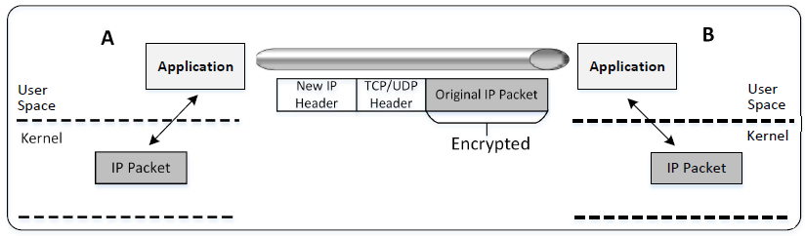
Two Types of IP Tunneling
IPSec Tunneling
TLS/SSL Tunneling
(we will focus on this type)

Slide 10
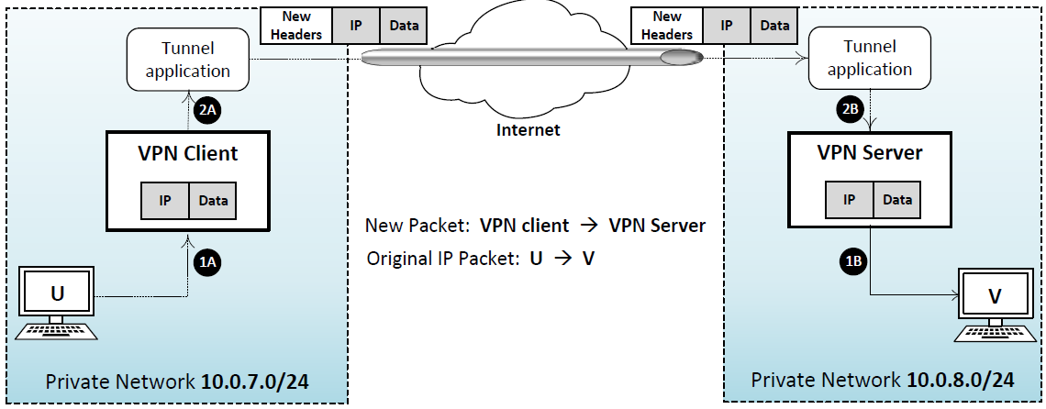
An Overview of How TLS/SSL VPN Works
Question: How can the Tunnel application get an IP packet?
This is just a normal TCP or UDP based SSL connection
Notes:
VPN Client and Server must :
Establish a secure tunnel between them
Forward IP packets that need to go to the other private network
After receiving an IP packet, release it into the private network

Slide 11
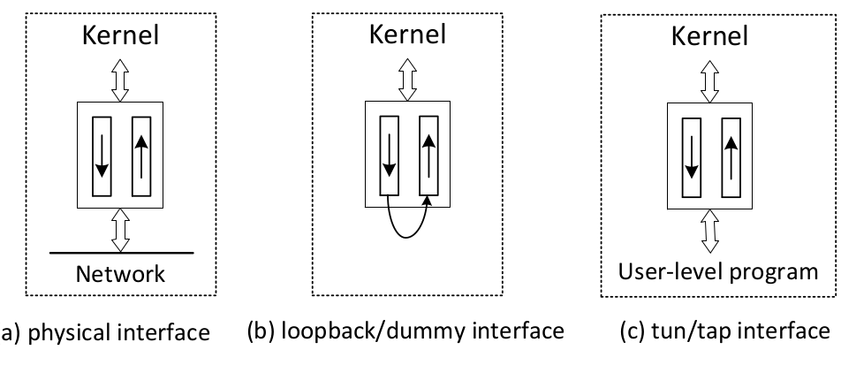
Physical and Virtual NIC
One end of a NIC is the OS kernel (protocol stack). The other end can vary, especially for virtual NIC, which is implemented using software

Slide 12
TUN/TAP Interface
Most operating systems have two types of network interfaces:
Physical: Corresponds to the physical Network Interface Card (NIC)
Virtual: It is a virtualized representation of computer network interfaces that may or may not correspond directly to the NIC card. Example: loopback device
TUN Virtual Interface
Work at OSI layer 3 or IP layer
For Layer-3 VPN
Sending any packet to TUN will result in the packet being delivered to user space program
TAP Virtual Interface
Work at OSI layer 2 or Ethernet layer
For Layer-2 VPN
Used for providing virtual network adapters for multiple guest machines connecting to a physical device of the host machine
Notes:
The primary task for the tunnel application is to establish a TLS/SSL channel, get IP packets from the system and send them over the channel
Establishing the SSL channel will be talked about in Chapter 19
We will focus on how the tunnel application gets the IP packets from the system
TUN/TAP interfaces can be seen as a point-to-point network device, which connects two computers

Slide 13
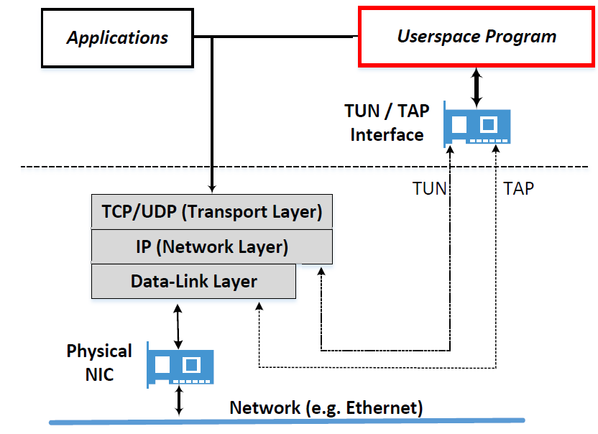
TUN/TAP Interface
Question: How can the Tunnel application get an IP packet?
Typically, applications interact with kernel using socket
Using socket, kernel only gives the data part of a packet to applications
Applications need to use a different way to interact with kernel
Socket Interface

Slide 14
Python OS Module
Python os module provides a portable way of using operating system dependent functionality
os.open(path, flags)
Open the file path and set various flags according to flags and possibly its mode according to mode
os.system(command)
Execute the command (a string) in a subshell

Slide 15
os.read() and os.write()
os.read(fd, n)
Read at most n bytes from file descriptor fd. Return a bytestring containing the bytes read
os.write(fd, str)
Write the bytestring in str to file descriptor fd. Return the number of bytes actually written

Slide 16
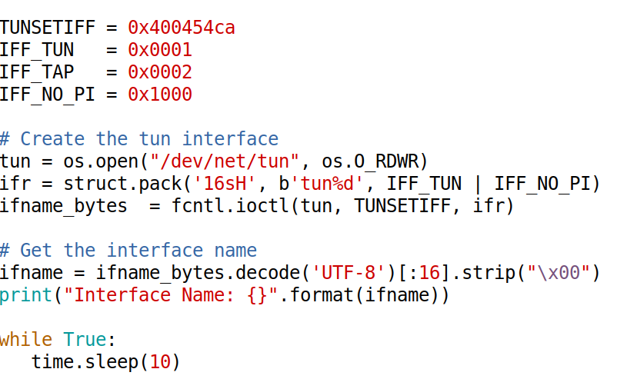
Creating TUN Interface in Python

Slide 17
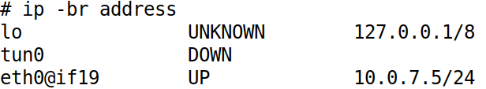
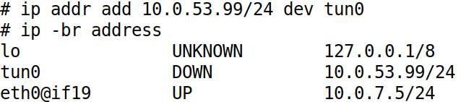
Configure TUN Interface (1)
Show the TUN Interface
Set the IP Address for the TUN Interface

Slide 18
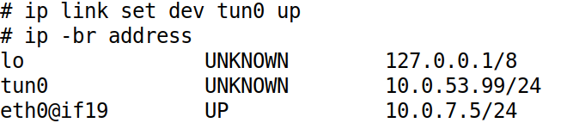
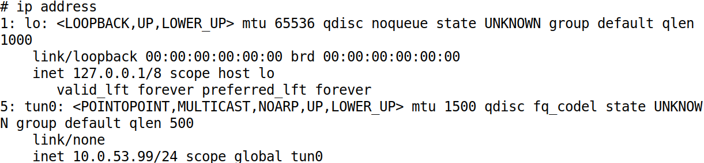
Configure TUN Interface (2)
Bring Up the TUN Interface

Slide 19

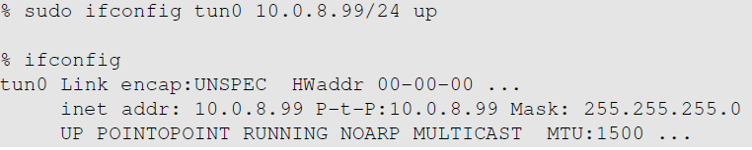
Configure the TUN Interface – Another Way
Find the TUN interface
Assign an IP address to the TUN interface and bring it up

Slide 20
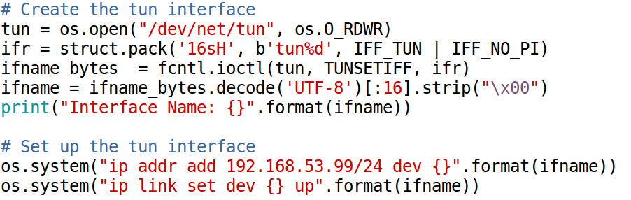
Add the Configuration to Python Code

Slide 21
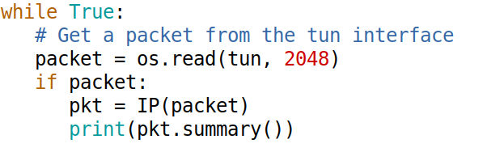
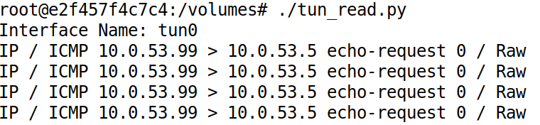
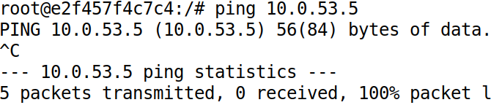
Reading From the TUN Interface
The Code
Testing

Slide 22
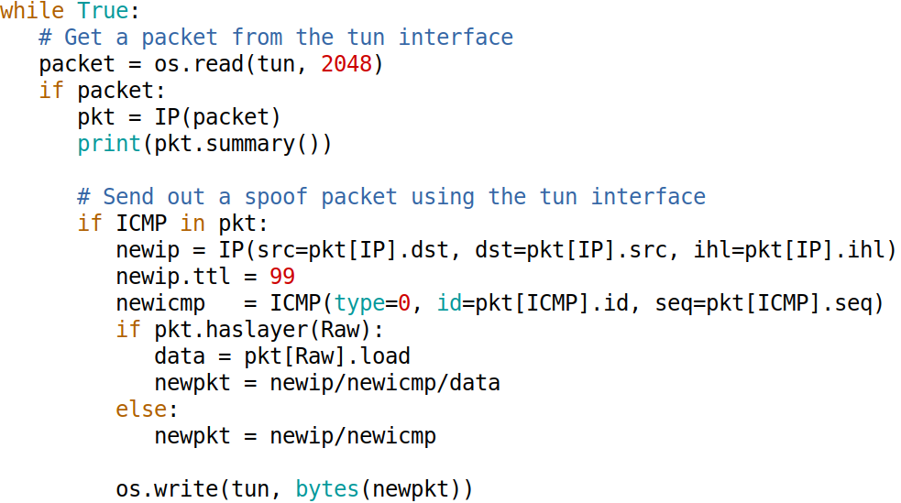
Writing to the TUN Interface (1)

Slide 23

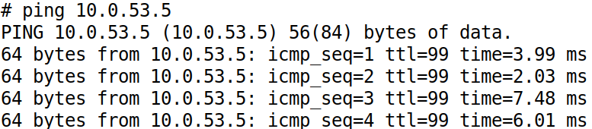
Writing to the TUN Interface (2)
Testing

Slide 24
Creating IP Tunnel

Slide 25
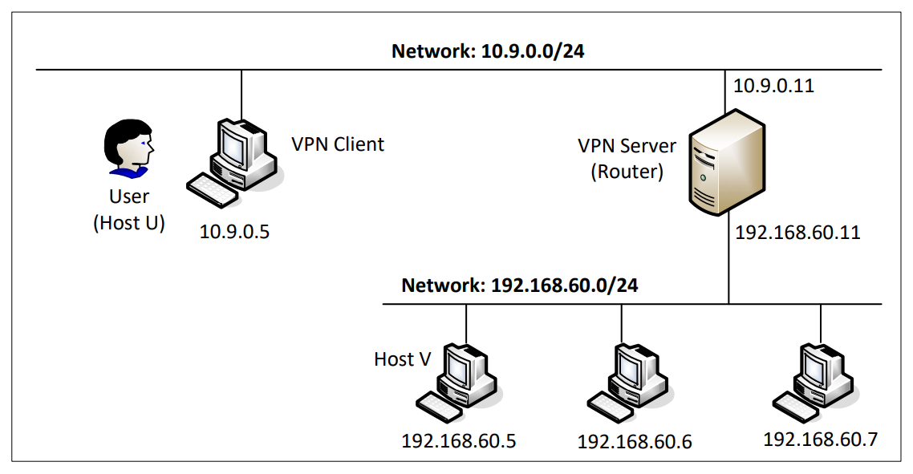
Network Configuration
Notes:
Client tun interface IP 192.168.53.99
VPN server tun interface IP 192.168.53.1

Slide 26
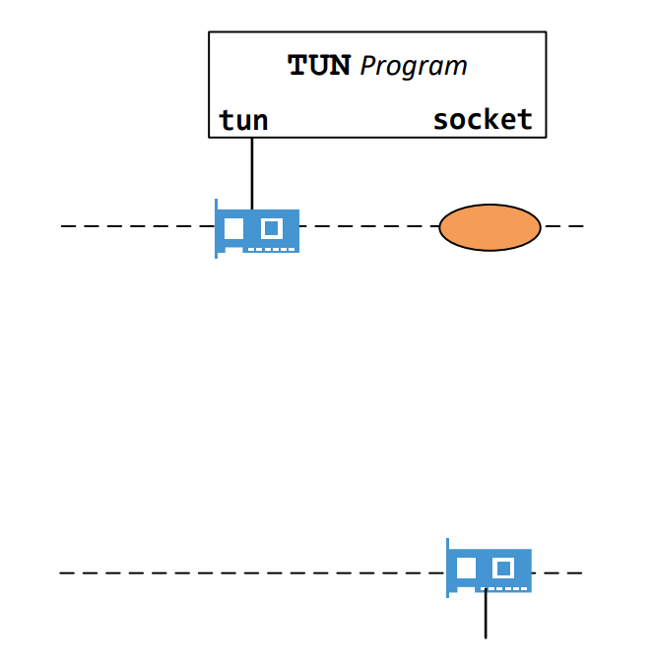
Client: Put IP Packet Inside Tunnel

Slide 27
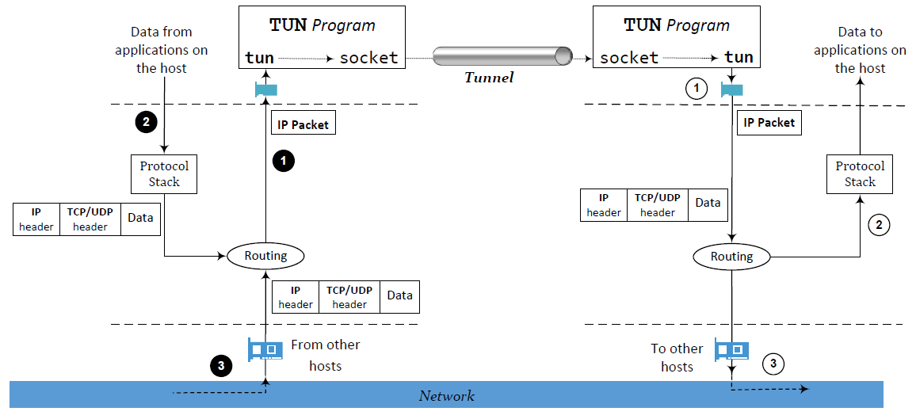
Set UP the Routing
Routing packets to the tunnel

Slide 28
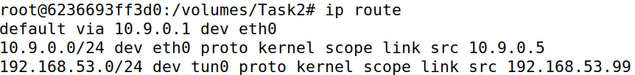
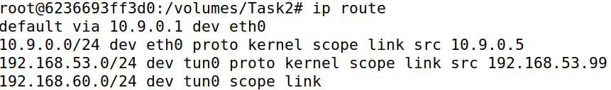
Route to TUN Interface
Packets to this destination should be routed to the tun0 interface, i.e., they should go through the tunnel.
Routing Table
Route Traffic to the TUN Interface
# ip route add 192.168.60.0/24 dev tun0

Slide 29
Establish a Transport-Layer Tunnel
A tunnel is just a TLS/SSL connection.
Two applications (VPN client and server applications) just establish a TLS/SSL connection between themselves.
Traffics inside are protected by TLS/SSL
What makes this TLS/SSL connection a tunnel?
The payloads inside are IP packets
That is why it is called IP tunnel

Slide 30
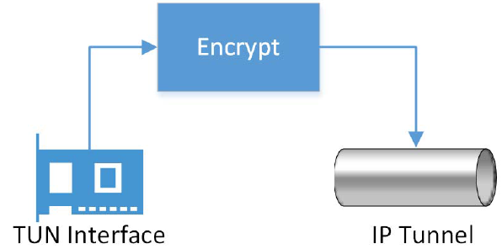
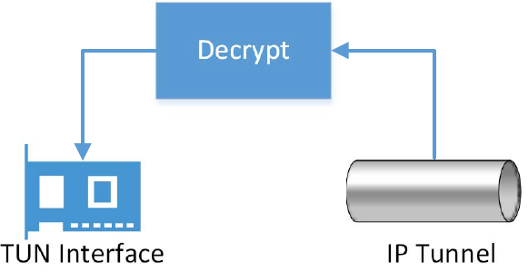
How to Send/Receive Packets via Tunnel
Sending a packet via the tunnel
Get an IP packet from the TUN interface
Encrypt it (also add MAC)
Send it as a payload to the other end of the tunnel
Receiving a packet from the tunnel
Get a payload from the tunnel
Decrypt it and verify its integrity
We get the actual packet
Write the packet to the TUN interface

Slide 31
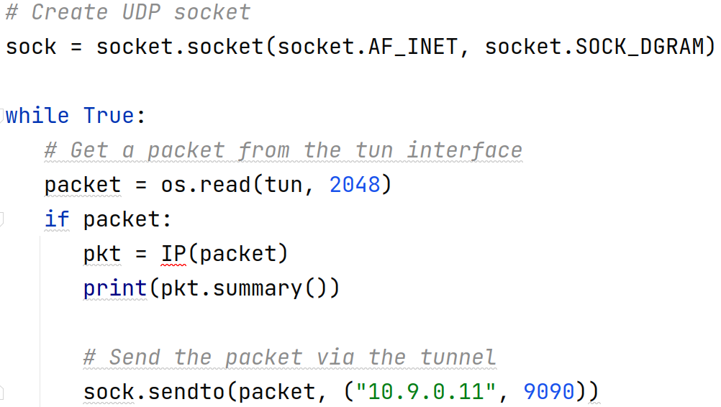
Client Code
… set up and configure the TUN interface …

Slide 32
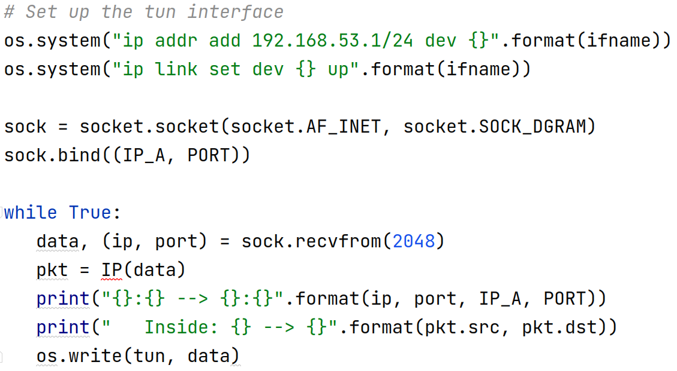
VPN Server Code
… Create and TUN interface …

Slide 33
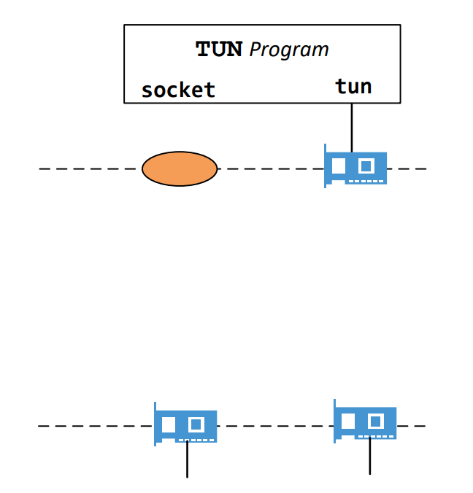
Server: Forward IP Packet

Slide 34
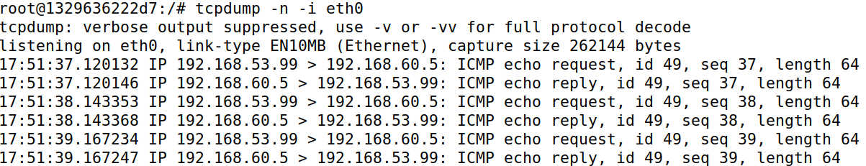
Testing
// From VPN Client
# ping 192.168.60.5
// Observe from 192.168.60.5
# tcpdump -n -i eth0

Slide 35
Returning From Private Network

Slide 36
Routing Back to VPN Server

Slide 37
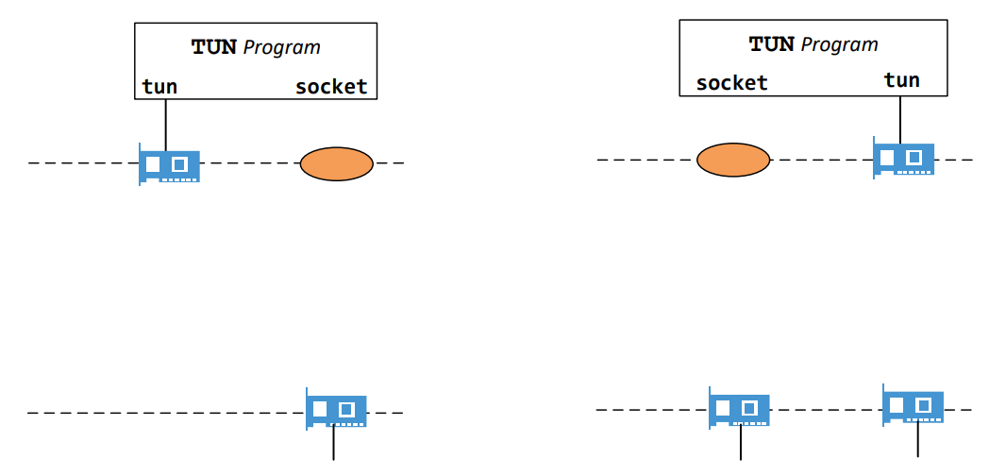
Tunneling Packet To Client

Slide 38
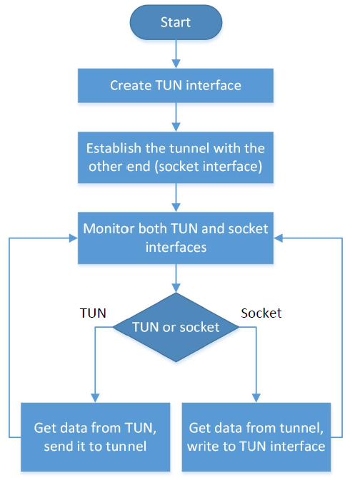
Monitoring Both Interfaces
Each tunnel application has two interfaces: socket and TUN
Need to monitor both
Forward packets between these two interfaces

Slide 39
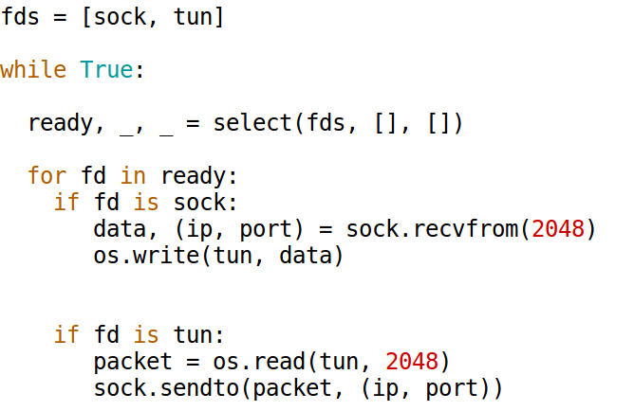
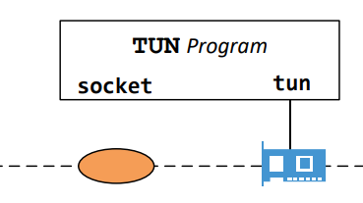
Monitoring Multiple Interfaces
select() will be blocked until one of the interfaces has data.

Slide 40
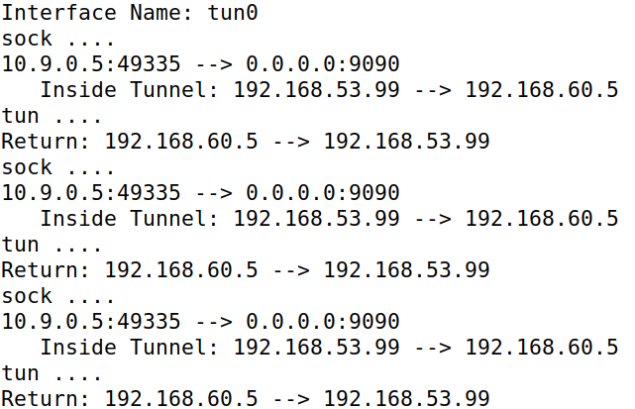
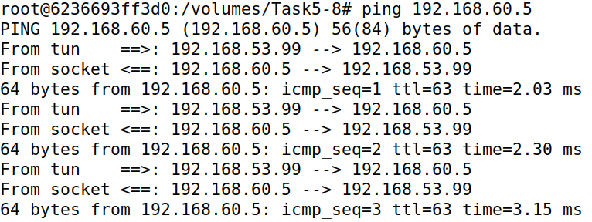
Complete the Tunnel
VPN Client
Run ping 192.168.60.5
VPN Server

Slide 41
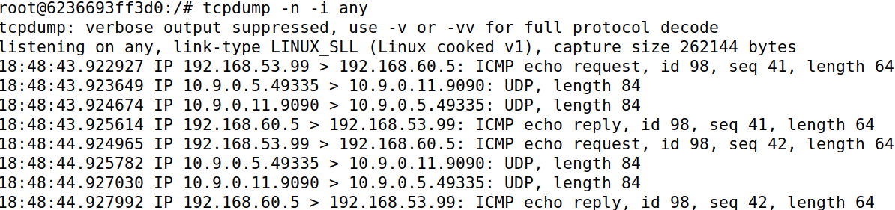
Network Traffic: From VPN Client

Slide 42
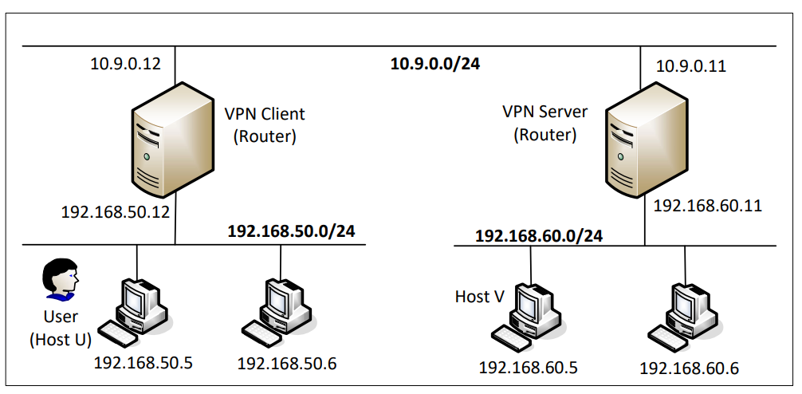
Network To Network

Slide 43
Routing Tables
On 192.168.50.5
On 192.168.60.5

Slide 44
Set Up Routing on VPN Client and Server
On VPN client: Packets to 192.168.60.0/24 should go to the tunnel
# ip route add 192.168.60.0/24 dev tun0
os.system("ip route add 192.168.60.0/24 dev {}".format(ifname))
On VPN server: Packets to 192.168.50.0/24 should go to the tunnel
# ip route add 192.168.50.0/24 dev tun0

Slide 45
Layer 2 VPN

Slide 46
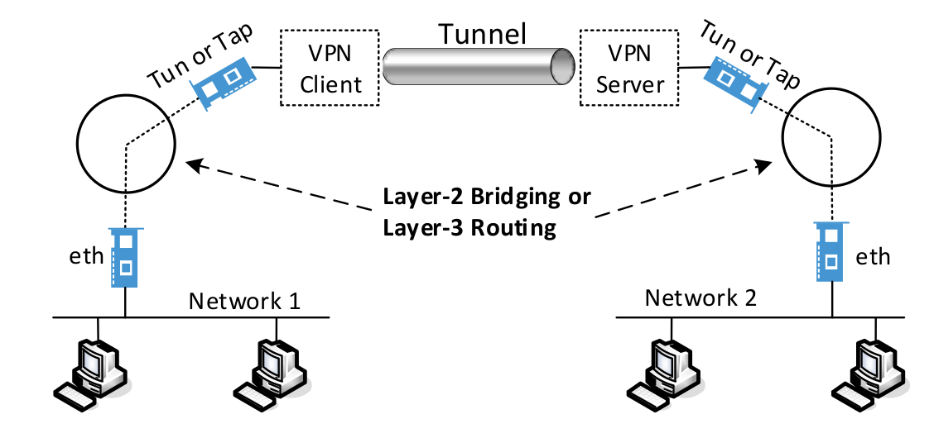
Layer 2 versus Layer 3 VPN

Slide 47
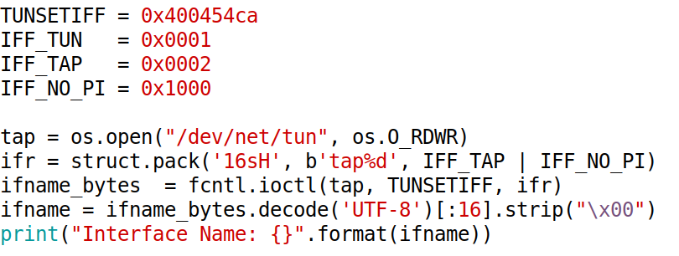
Create TAP Interface

Slide 48
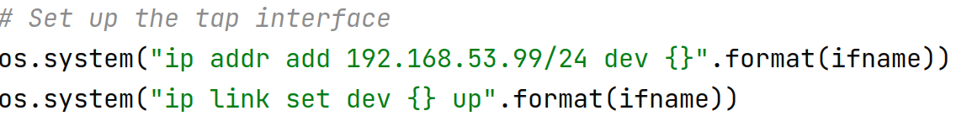
Set Up the TAP Interface

Slide 49
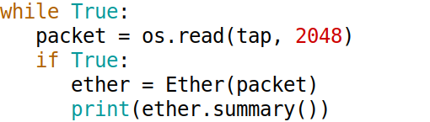
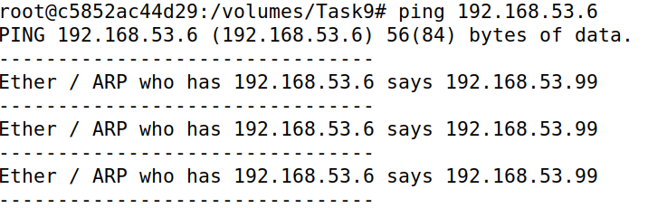
Test the TAP Interface
Ping 192.168.53.6
Notes:
From 10.0.32.5 (Host A), we ping a non-existing host within the same network, such as 10.0.32.100. Because Host A does not know the MAC address of the destination, it sends out ARP request messages. These broadcast messages reach the eth1 interface on the VPN client. This interface is connected to the bridge br0, which forwards the ARP message to the tap0 interface. That is why our TAP program gets the message. See the following:

Slide 50
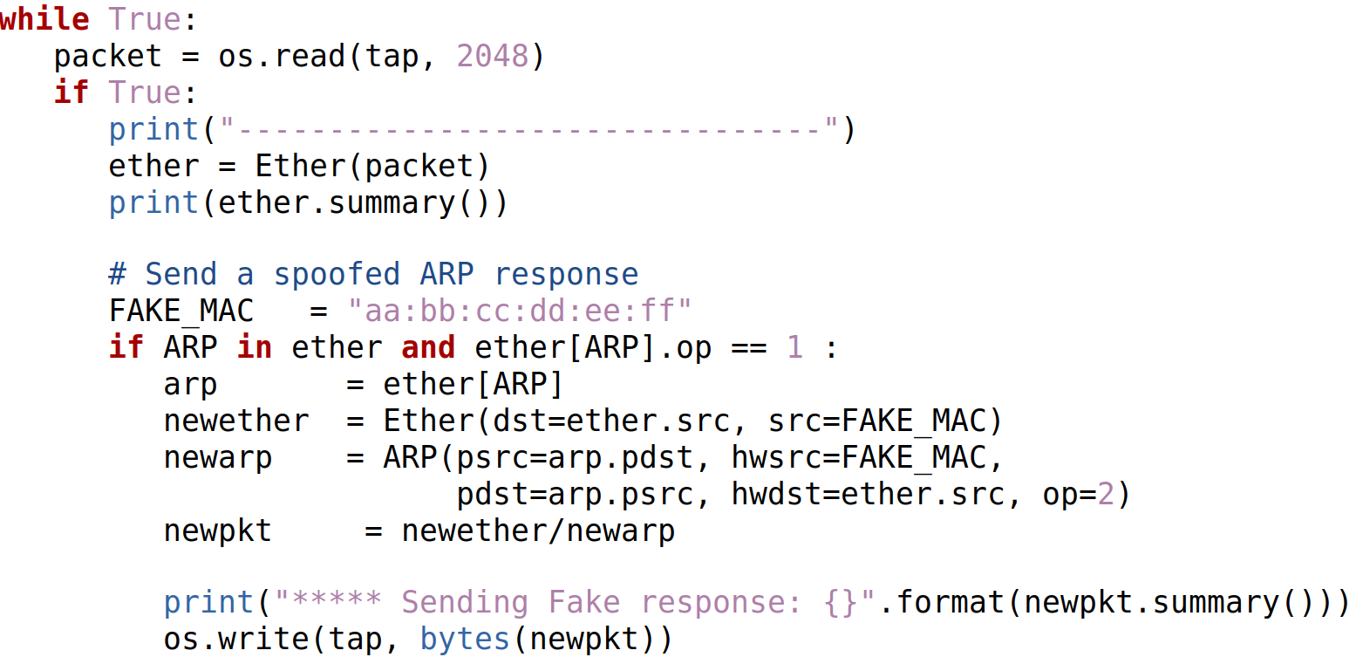
Spoof an ARP Reply via TAP Interface

Slide 51
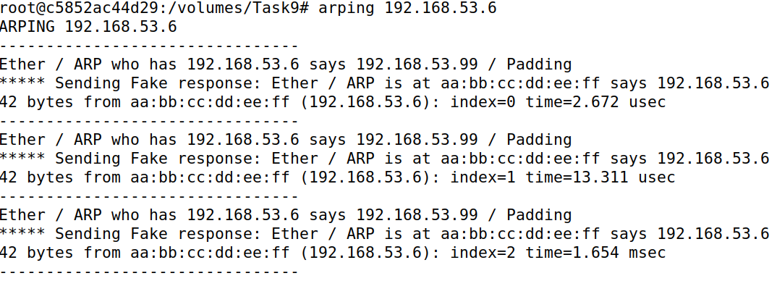
Test the TAP Interface

Slide 52
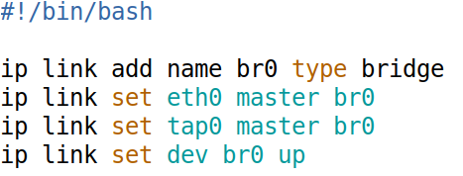
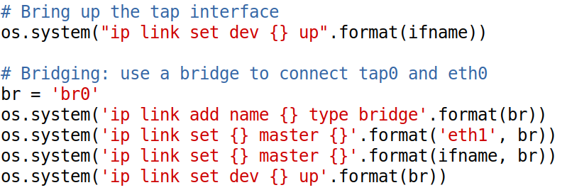
Bridging TAP and Ethernet Interfaces
Using commands
In Python program
Notes:
In the kernel, eth1 will be automatically turned into the promiscuous mode

Slide 53
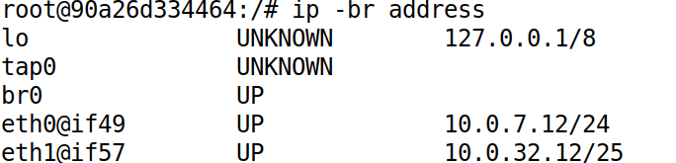
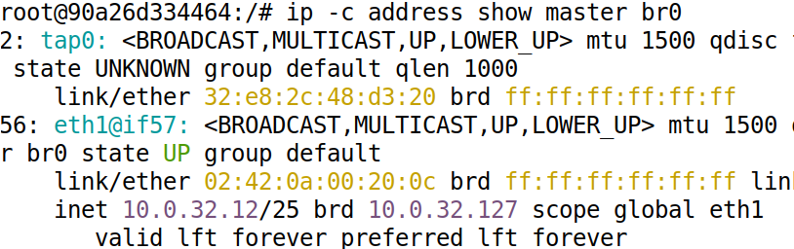
List the Bridge and Interfaces
List the bridges
List the interfaces

Slide 54
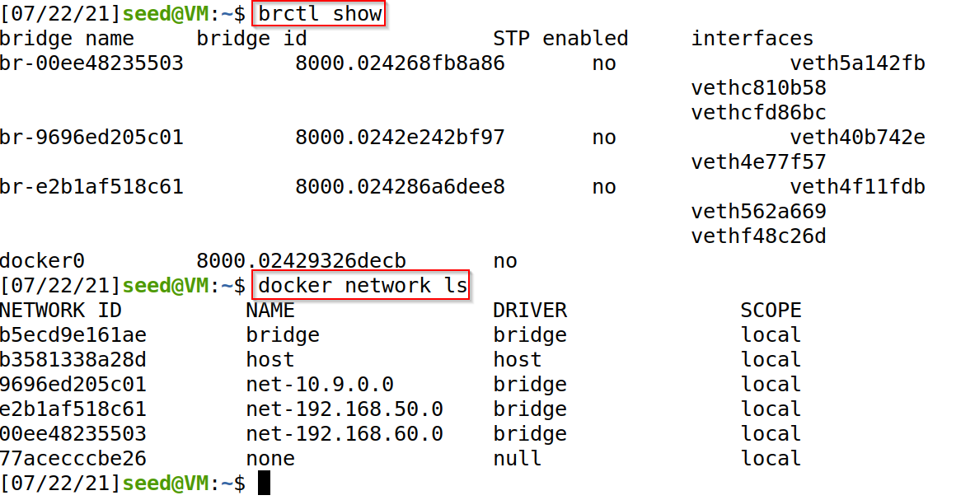
Bridges Created In the Lab Environment

Slide 55


Bridging Two Networks: Setup
Notes:
Typically, the goal of bridging is to connect two segments of the same network, i.e., both segments have the same network prefix. However, in Docker, we cannot directly create two network segments with the same network prefix. We use a trick to achieve that. We first create two different networks: 10.0.32.0/25 and 10.0.32.128/25 (see the figure). Once all the containers have started, on Hosts A, B, C, and D, we delete the original addresses on their eth0 interfaces, and replace them with another address, which is the same address, but with a different netmask (24 bits, instead of 25 bits). Now all these hosts are on the “same” network, 10.0.32.0/24. The changes are made in the Compose file. See the command entry for Host A:

Slide 56

TAP Client/Server Program
Write the TAP interface
Write the tunnel

Slide 57


Testing the Layer 2 Tunnel

Slide 58

A Case Study
C:\> ipconfig

Slide 59

Checking Routing Table
C:\> route print

Slide 60


IP Addresses After Running VPN

Slide 61

Routing Table After Running VPN
Notes:
Tun interface IP 153.91.92.244
VPN server IP 153.91.3.203
Computer real interface IP 192.168.1.70

Slide 62
Summary
What is VPN?
IP tunneling
IP tunneling using TLS/SSL
TUN/TAP interface
Building a VPN using TUN/TAP interface

