Slide 1
Chapter 19 Generics

Slide 2
Objectives
To know the benefits of generics (§19.1).
To use generic classes and interfaces (§19.2).
To declare generic classes and interfaces (§19.3).
To understand why generic types can improve reliability and readability (§19.3).
To declare and use generic methods and bounded generic types (§19.4).
To use raw types for backward compatibility (§19.5).
To know wildcard types and understand why they are necessary (§19.6).
To convert legacy code using JDK 1.5 generics (§19.7).
To understand that generic type information is erased by the compiler and all instances of a generic class share the same runtime class file (§19.8).
To know certain restrictions on generic types caused by type erasure (§19.8).
To design and implement generic matrix classes (§19.9).

Slide 3
Don’t Repeat Yourself (DRY)
DRY is a software design principle
Want to avoid writing the same, or similar code multiple times?
Why?

Slide 4
Some reasons:
Makes code base larger
-More burden on maintenance
Takes more time to make more versions
-Costs more money

Slide 5
Generality
What we’re looking for is generality
We would like to be able to write a data structure or algorithm once, but have it work with different data types.
We don’t want to have to write a different version for every data type

Slide 6
Examples:
Data Structures: Stack for Double, Char, BigInteger, Date, etc.
Algorithms: binarySearch() for String, Integer, Double, Date, etc.
Interfaces: Comparable for defining how differenct types should be compared

Slide 7
Downside to Generality
Engineering is about trade offs
Desirable qualities often compete with each other
Generality is definitely desirable, but it competes with efficiency

Slide 8
More general means more reusable, less efficient
More specific means more efficient, less reusable
Which to favor depends on the goal and context of our project
Can be good to favor generality unless we know efficiency will be an issue.

Slide 9
Generics
Generics are a feature that facilitates generality and reusability
To some extent, generality we’ve described is accomplished using polymorphism
…but this can be dangerous

Slide 10
Comparable c = new Date();
System.out.println(c.compareTo(“red”));

Slide 11
Compiles, but has a runtime error
Comparing a Date object to a string causes a crash.
Using generics, we can shift these type of runtime errors into compilation errors.
Compilation errors are preferable to runtime errors.

Slide 12
Comparable<Date> c = new Date();
System.out.println(c.compareTo(“red”));

Slide 13
So, generics allow us to:
Make software more reusable
Detect errors at compilation

Slide 14
Using Generics
Many classes and methods in Java support generics
ArrayList:https://docs.oracle.com/javase/8/docs/api/java/util/ArrayList.html
The <E> notation indicates the class or method supports generics
Sometimes <T> is used too

Slide 15
Why Do You Get a Warning?
public class ShowUncheckedWarning {
public static void main(String[] args) {
java.util.ArrayList list =
new java.util.ArrayList();
list.add("Java Programming");
}
}
To understand the compile warning on this line, you need to learn JDK 1.6 generics.

Slide 16
Fix the Warning
public class ShowUncheckedWarning {
public static void main(String[] args) {
java.util.ArrayList<String> list =
new java.util.ArrayList<String>();
list.add("Java Programming");
}
}
`
No compile warning on this line.

Slide 17
With <String>
Can’t mix and match!
Can only add Strings to the list
Adding objects of other types gives and error
    list.add(new Employee());

Slide 18
What is Generics?
Generics is the capability to parameterize types. With this capability, you can define a class or a method with generic types that can be substituted using concrete types by the compiler. For example, you may define a generic stack class that stores the elements of a generic type. From this generic class, you may create a stack object for holding strings and a stack object for holding numbers. Here, strings and numbers are concrete types that replace the generic type.

Slide 19
Why Generics?
The key benefit of generics is to enable errors to be detected at compile time rather than at runtime. A generic class or method permits you to specify allowable types of objects that the class or method may work with. If you attempt to use the class or method with an incompatible object, a compile error occurs.

Slide 20
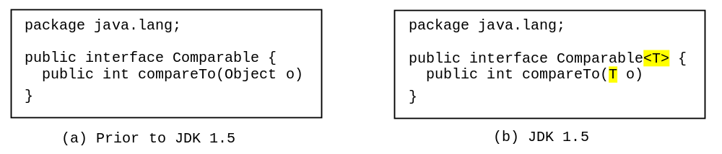
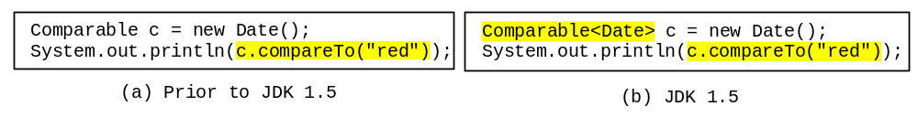
Generic Type
Generic Instantiation
Runtime error
Improves reliability
Compile error

Slide 21
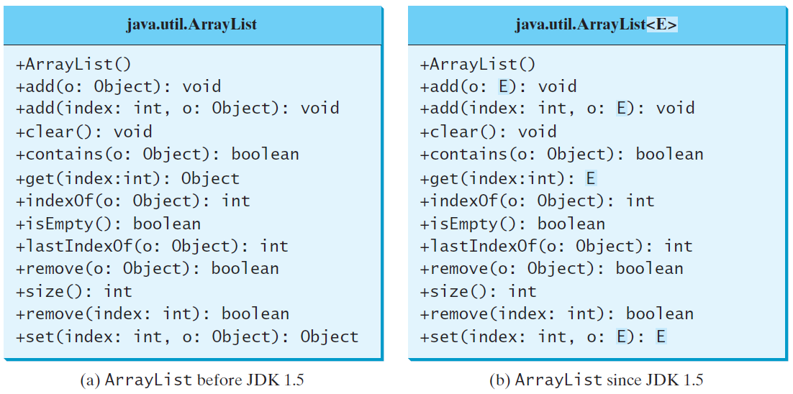
Generic ArrayList in JDK 1.5

Slide 22
No Casting Needed
ArrayList<Double> list = new ArrayList<>();
list.add(5.5); // 5.5 is automatically converted to new Double(5.5)
list.add(3.0); // 3.0 is automatically converted to new Double(3.0)
Double doubleObject = list.get(0); // No casting is needed
double d = list.get(1); // Automatically converted to double

Slide 23
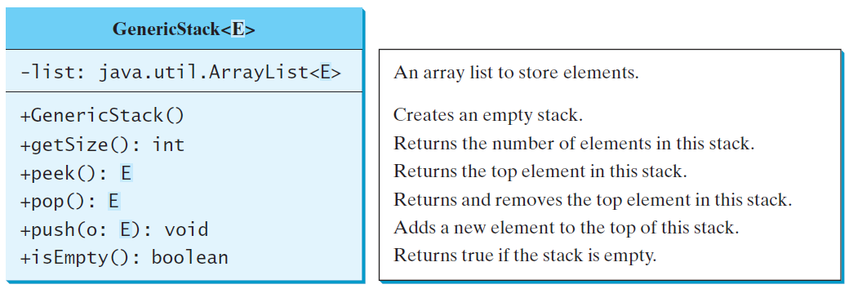
Declaring Generic Classes and Interfaces
GenericStack

Slide 24
Generic Methods
public static <E> void print(E[] list) {
for (int i = 0; i < list.length; i++)
System.out.print(list[i] + " ");
System.out.println();
}
public static void print(Object[] list) {
for (int i = 0; i < list.length; i++)
System.out.print(list[i] + " ");
System.out.println();
}

Slide 25
Bounded Generic Type
public static void main(String[] args ) {
Rectangle rectangle = new Rectangle(2, 2);
Circle circle = new Circle (2);
System.out.println("Same area? " + equalArea(rectangle, circle));
}
public static <E extends GeometricObject> boolean
equalArea(E object1, E object2) {
return object1.getArea() == object2.getArea();
}

Slide 26
Raw Type and Backward Compatibility
// raw type
ArrayList list = new ArrayList();
This is roughly equivalent to
ArrayList<Object> list = new ArrayList<Object>();

Slide 27
Raw Type is Unsafe
// Max.java: Find a maximum object
public class Max {
/** Return the maximum between two objects */
public static Comparable max(Comparable o1, Comparable o2) {
if (o1.compareTo(o2) > 0)
return o1;
else
return o2;
}
}
Runtime Error:
Max.max("Welcome", 23);

Slide 28
Make it Safe
// Max1.java: Find a maximum object
public class Max1 {
/** Return the maximum between two objects */
public static <E extends Comparable<E>> E max(E o1, E o2) {
if (o1.compareTo(o2) > 0)
return o1;
else
return o2;
}
}
Max.max("Welcome", 23);

Slide 29
Wildcards
Why wildcards are necessary? See this example.
WildCardNeedDemo
? unbounded wildcard
? extends T bounded wildcard
? super T lower bound wildcard
AnyWildCardDemo
SuperWildCardDemo

Slide 30
Example
Listing 19.7 – WildCardDemo.java
Compile time error
Integer is a subclass of Number
However, GenericStack<Integer> is not a subclass of GenericStack<Number>
Would like to be able to say, "Accept any GenericStack whose generic parameter is a subtype of Number"

Slide 31
Three Generic Wildcards
There's three different generic wildcards (where T is generic type):
Unbounded Wildcard: <?>
Bounded Wildcard: <? extends T>
Lower-Bound Wildcard: <? super T>

Slide 32
Unbounded Wildcard
Unbounded wildcard <?> accepts any type
for the generic parameter
  public static void print(GenericStack<?> stack)
  This could accept GenericStack<Integer>, GenericStack<Number>, etc.
<?> is equivalent to <? extends Object>
Listing 19.8 – AnyWildCardDemo.java
Method's stack parameter can be a GenericStack set to any type

Slide 33
Bounded Wildcard
Bounded wildcard <? extends T> accepts T and any type that is a subtype of T
? must be a subclass of T or a class that implements T
public static void print(GenericStack<? extends Number> stack)
Could accept argument of type GenericStack<Integer>,
GenericStack<Double>, etc.
GenericStack<? extends Number> probably what was intended in WildCardDemo.java

Slide 34
Lower-Bound Wildcard
Lower-bound wildcard <? super T> accepts T and superclasses of T

Slide 35
Example
Listing 19.9 – SuperWildCardDemo.java
Would also work if we said stack1 is set to a type that is a subtype of the type stack2 is set to
public static <T> add(GenericStack<? extends T>
stack1, GenericStack<T> stack2)

Slide 36
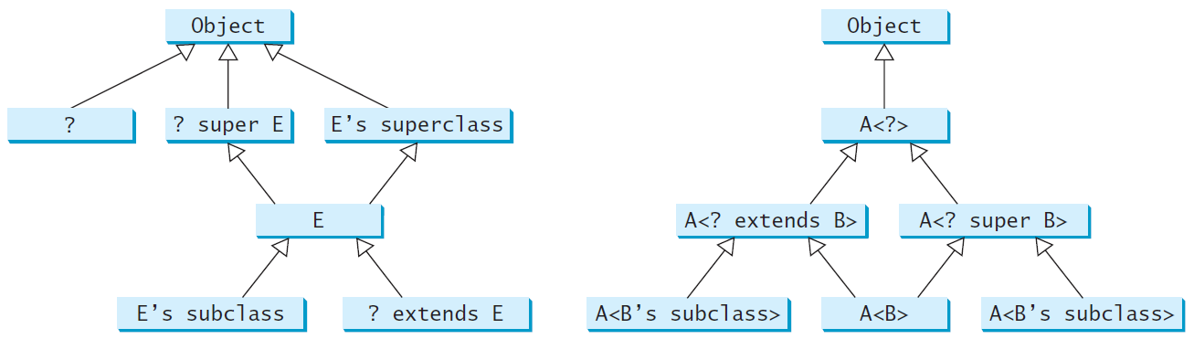
Generic Types and Wildcard Types

Slide 37
Avoiding Unsafe Raw Types
Use
new ArrayList<ConcreteType>()
Instead of
new ArrayList();
TestArrayListNew
Run

Slide 38
Erasure and Restrictions on Generics
Generics are implemented using an approach called type erasure. The compiler uses the generic type information to compile the code, but erases it afterwards. So the generic information is not available at run time. This approach enables the generic code to be backward-compatible with the legacy code that uses raw types.

Slide 39
Once the compiler verifies that generic types are used safely, they’re converted to raw types
This is known as type erasure
  Generic type information is erased
Generic type actually replaced with Object type and appropriate casting added in

Slide 40
Before Type Erasure
  ArrayList<String> list = new ArrayList<>();
  list.add("Hello");
  String s = list.get(0);

Slide 41
After Type Erasure
  ArrayList list = new ArrayList();
  list.add("Hello");
  String s = (String)(list.get(0));

Slide 42
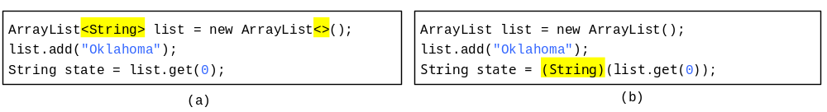
Compile Time Checking
For example, the compiler checks whether generics is used correctly for the following code in (a) and translates it into the equivalent code in (b) for runtime use. The code in (b) uses the raw type.

Slide 43
Bounded Type Erasure
If the generic type was bounded, the compiler replaces it with the bounding type
With <E extends SomeClass>, E gets replaced with SomeClass

Slide 44
Before Type Erasure
static <E extends GeometricObject> Boolean equalArea(E pbject1, E object2)
{
  return object1.getArea() == object2.getArea();
}

Slide 45
After Type Erasure
public static Boolean equalArea(GeometricObject object1, GeometricObject object2)
{
return object1.getArea() == object2.getArea();
}

Slide 46
Important Facts
It is important to note that a generic class is shared by all its instances regardless of its actual generic type.
  GenericStack<String> stack1 = new GenericStack<>();
  GenericStack<Integer> stack2 = new GenericStack<>();
Although GenericStack<String> and GenericStack<Integer> are two types, but there is only one class GenericStack loaded into the JVM.

Slide 47
Restrictions on Generics
Restriction 1: Cannot Create an Instance of a Generic Type. (i.e., new E()). But E as a variable type is fine.
        E varName;
Restriction 2: Generic Array Creation is Not Allowed. (i.e., new E[100]).
Restriction 3: A Generic Type Parameter of a Class Is Not Allowed in a Static Context.
Restriction 4: Exception Classes Cannot be Generic.

Slide 48
Restriction 3 Example
public class Test<E>{
public static E x1; //illegal
public E x2;
public static void m(E x) //illegal
{
}
public void m2(E x)
{
}
}

Slide 49
Designing Generic Matrix Classes
Objective: This example gives a generic class for matrix arithmetic. This class implements matrix addition and multiplication common for all types of matrices.
GenericMatrix

Slide 50
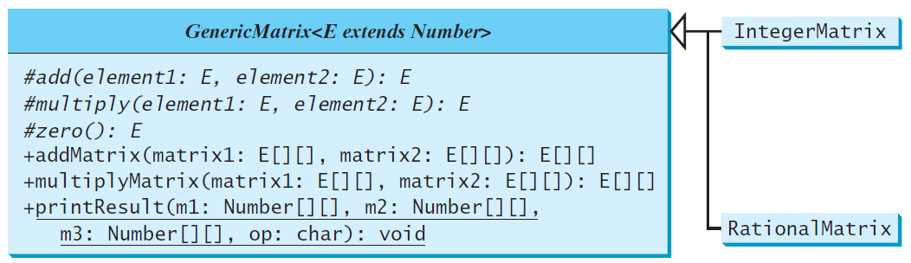
UML Diagram

Slide 51
Source Code
Objective: This example gives two programs that utilize the GenericMatrix class for integer matrix arithmetic and rational matrix arithmetic.
IntegerMatrix
TestIntegerMatrix
Run
RationalMatrix
TestRationalMatrix
Run

